Slide 1
Tableau Overview and Publicly Available Data Sources
Sagar Samtani and Hsinchun Chen
with updates from Hongyi Zhu and Steven Ullman
MIS 464
Spring 2023

Slide 2

Tableau Background
Tableau is a powerful data visualization software.
Capable of creating various interactive visualizations from a multitude of data sources.
Tableau is a commercial software but is available to students for free.
Download from (http://www.tableau.com/academic/students)
Tableau is primarily a drag-and-drop software.

Slide 3
Data Sources and Types of Visualizations
Tableau can connect to variety of data sources, including:
Local files – Excel, text, Access
Traditional databases – SQL Server, MySQL, Oracle, PostgreSQL, DB2
Cloud technologies – Amazon Aurora, EMR, Redshift, BigQuery
Big Data Technologies – Hadoop, Hive, Spark SQL
Tableau can create a variety of visualizations including:
Basic bar and line charts (e.g., temporal, box plots, etc.)
Geospatial analysis
Word clouds
Treemaps
Network analysis, although there are better tools for this (e.g., Gephi)!
These visualizations can be combined into interactive dashboards.
Can later be published online or shared easily.

Slide 4
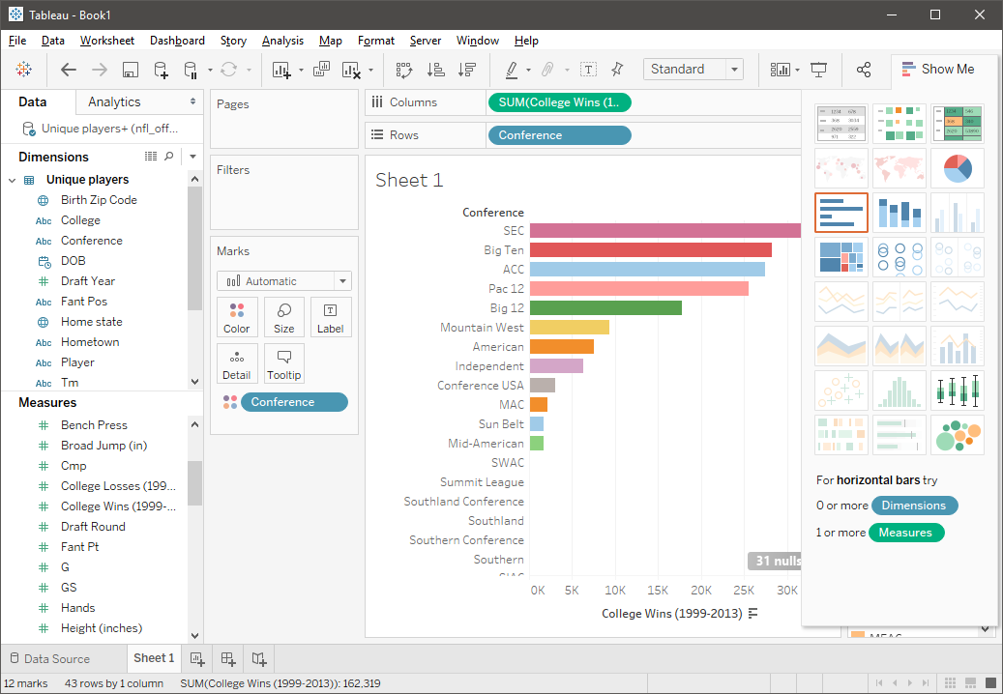
Tableau Interface
Blue: discrete data
Green: continuous data
Dimensions
Data fields that cannot be aggregated
Qualitative values (such as names, dates, or geographical data)
Measures
Data fields that can be measured, aggregated, or used for math operations
Numeric, quantitative values
Drag-n-drop
Data
Worksheet
Format/Encode
Plot types
Tabs
https://onlinehelp.tableau.com/current/pro/desktop/en-us/datafields_typesandroles.htm

Slide 5
Walkthrough Example
The following example will teach you how to load data into Tableau, make three basic visualizations, and put them into a dashboard.
Bar chart, Word Cloud, and Geospatial visualization.
The data used in this example is an Excel spreadsheet about NFL Offensive players from 1999-2013. It contains:
~40,000 rows of data
Player information (physically measurable traits, birthplace, college attended)
Positions played
Wins achieved in career
Dataset source: https://public.tableau.com/app/resources/sample-data

Slide 6
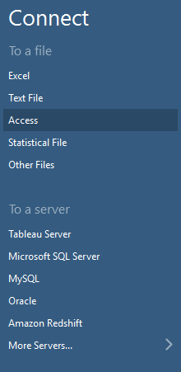
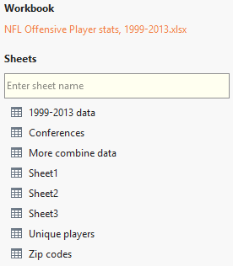
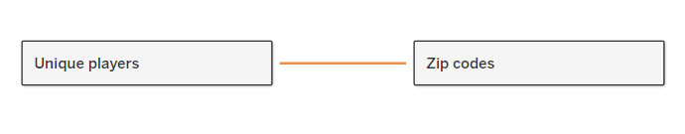
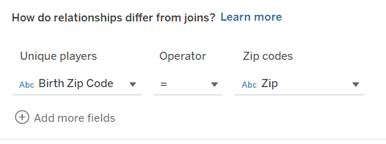
Connecting to a Data Source
1
2
2
3
We will have to connect to a data source to start making visualizations.
Since our data is in an Excel workbook, we will select that.
Second, we will join two of the sheets in the workbook such that we can get access to a larger set of data. Drag the “Unique players” and “Zip codes” sheets to the right. Select the “Inner” join option.
We will join the sheets based on zip code.

Slide 7
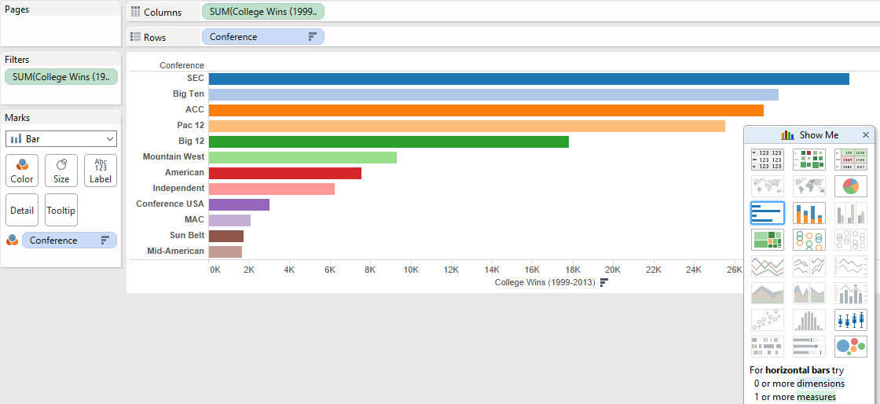
Creating a Bar Chart
1
3
2
Suppose we want to know which major college conferences have most combined wins since 1999.
First, drag the “Conference” dimension into the “Rows” bar, and the “College Wins” into the columns. Hit the drop down on the “College Wins” and select “Sum.”
Second, select bar chart on the right-hand side.
To add a little bit of color, drag the “Conference” into the “Color” mark.

Slide 8
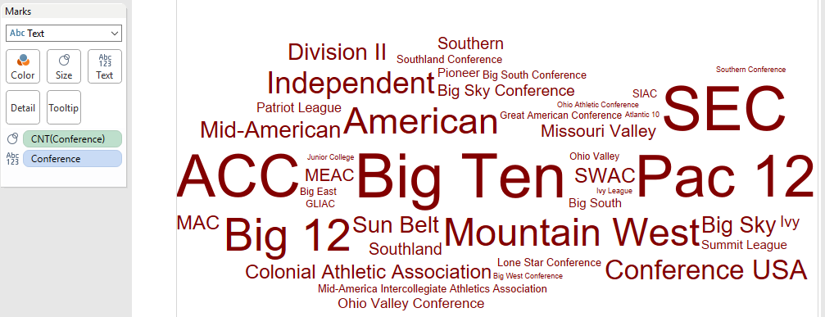
Creating a Word Cloud
1
2
Suppose now we want to get a general sense of the most popular conferences in terms of player enrollment is concerned. A word cloud is a great way to visually represent this.
First, switch the “Marks” option to “Text”.
Second, drag the “Conference” dimension into the “Text” marks box.
Then drag the “Conference” dimension into the “Size” marks box.
Adjust the measurement on this by hitting the drop down and selecting “Measure (Count)”

Slide 9
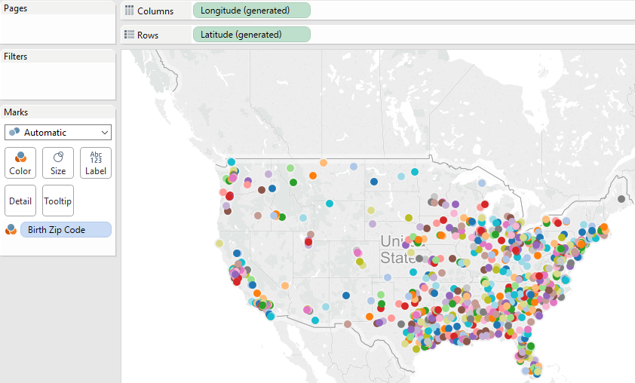
Creating a Geospatial Visualization
Consider now that we are interested in the birthplaces of all of the NFL players.
We can easily create a map representation.
Drag the “Longitude” dimension to columns, and “Latitude” dimension to the rows. Select the map visualization.
Add in some color by dragging the “Birth Zip Code” into the “Color” Marks.
1
2

Slide 10
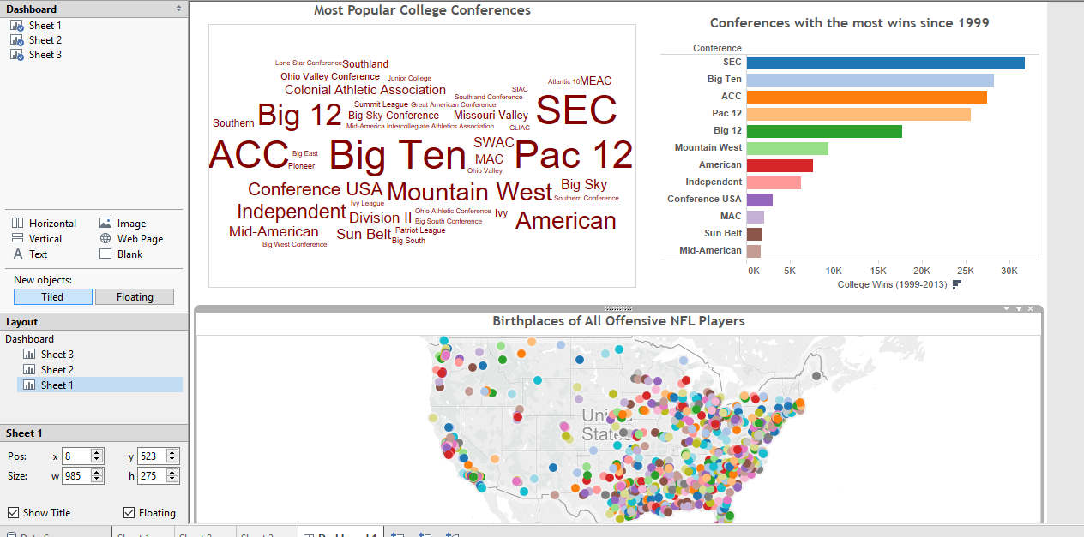
Combining Visualizations into a Dashboard
To tell a more comprehensive story, we can create a dashboard combining all of the visualizations.
Simply open a dashboard view and start dragging sheets into the dashboard.
You can format and add filters into the dashboard as you wish.

Slide 11
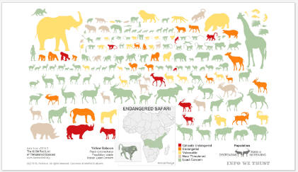
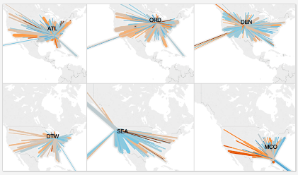
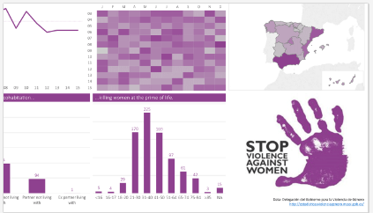
Further Examples
It is useful to explore other Tableau visualizations to get ideas.
https://public.tableau.com/s/gallery contains many great visualizations.
Endangered Safari
US Flights Delayed by Precipitation
Domestic Violence in Spain

Slide 12
Tableau Resources
Gallery of Tableau visualizations:
https://public.tableau.com/s/gallery
Tableau training videos:
http://www.tableau.com/learn/training
Sample Tableau data sources:
https://public.tableau.com/s/resources
Reference book:
Tableau Your Data!: Fast and Easy Visual Analysis with Tableau Software. Daniel Murray, 2nd edition, 2015.
Available online through UA Library
Companion materials: http://tableauyourdata.com/downloads/

Slide 13
Publicly Available Data Sources
Name of Data Source | # Entries | Description | Data Formats | URL
US Data.gov EU OpenData | > 300,000 > 15,000 | Agriculture, Business, climate, consumer, ecosystem, education, energy, finance, health, local government manufacturing, public safety, science and research | HTML, XML, XLSX, CSV, PDF, shapefile, txt, zip | http://www.data.gov/ http://data.europa.eu/euodp/data/dataset
Kaggle | 14,072 | Product, insurance, forum comments, twitter data, images | CSV, XLSX, SQL | https://www.kaggle.com/datasets
UC Irvine Machine Learning Repository | 468 | Research datasets used in past machine learning publications | HTML, XML, XLSX, CSV, PDF, txt, zip | https://archive.ics.uci.edu/ml
Amazon Opendata on AWS | 90 | Public transportation, satellite images, web pages, genome, ecosystem, etc. | Data API (CSV, JSON) | https://registry.opendata.aws/
Microsoft Research Open Data | 53 | Biology, engineering, healthcare, physics, math, science and research | CSV, TXT, TSV, PDF | https://msropendata.com/

Slide 14
Publicly Available Data Sources
Name of Data Source | # Entries | Description | Data Formats | URL
Awesome Public Datasets (Github Repo) | > 600 | Agriculture, Biology, Climate, Data Challenges, Economics, Education, Finance, Government, Healthcare, Machine Learning, NLP, Search Engines, Sports, Transportation | XLSX, JSON, XML, Zip, CSV, PDF | https://github.com/awesomedata/awesome-public-datasets
Figshare | > 50 | Data from: Various sciences (Astronomy, biological, environmental, information, etc.), engineering, commerce, management, tourism | XLSX, Zip, XML, CSV, PDF | https://figshare.com/
KD Nuggets | > 50 | Data sets designed specifically for data mining tasks | JSON, CSV, SQL, XLSX | http://www.kdnuggets.com/datasets/index.html
VisualData | 247 | Computer Vision datasets | JPG, PNG, … | https://www.visualdata.io/
ML Vis | 48 | Repository of scientific datasets for visualization | CSV | http://www.mlvis.com/
Google Dataset Search | Search engine for publicly available datasets | https://toolbox.google.com/datasetsearch
Enigma | Search engine for publicly available datasets | https://public.enigma.com/

Slide 15
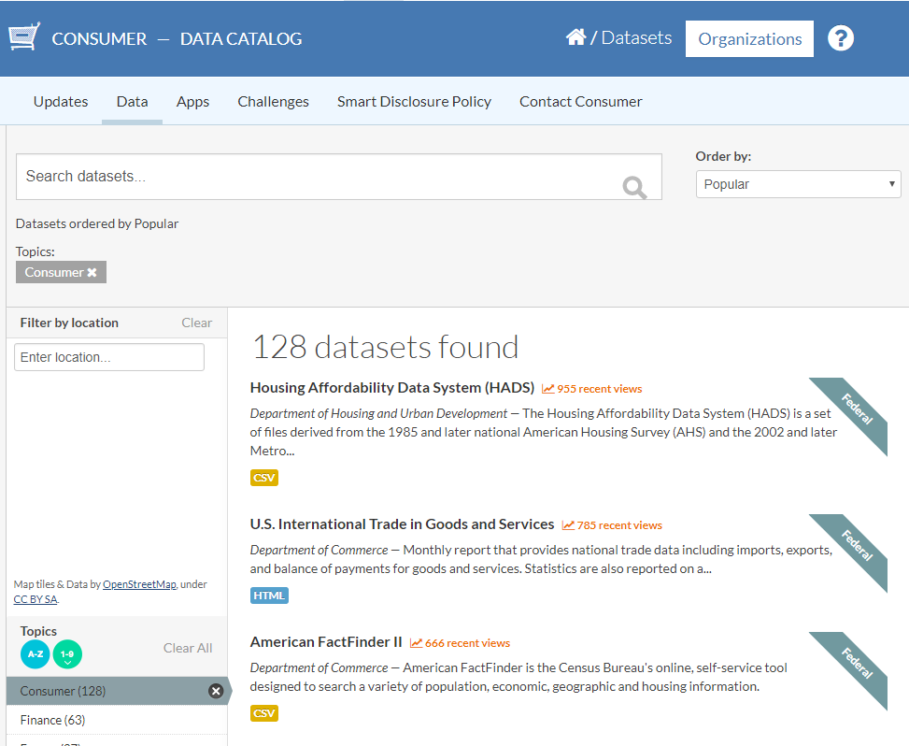
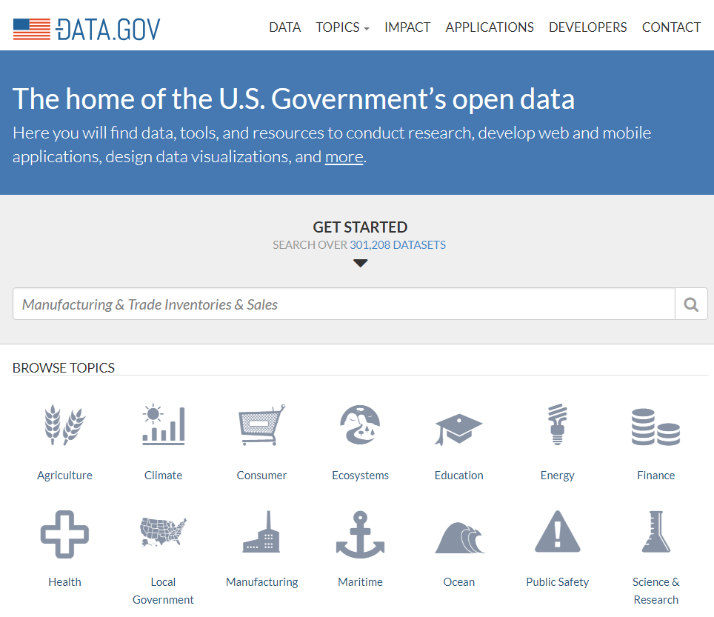
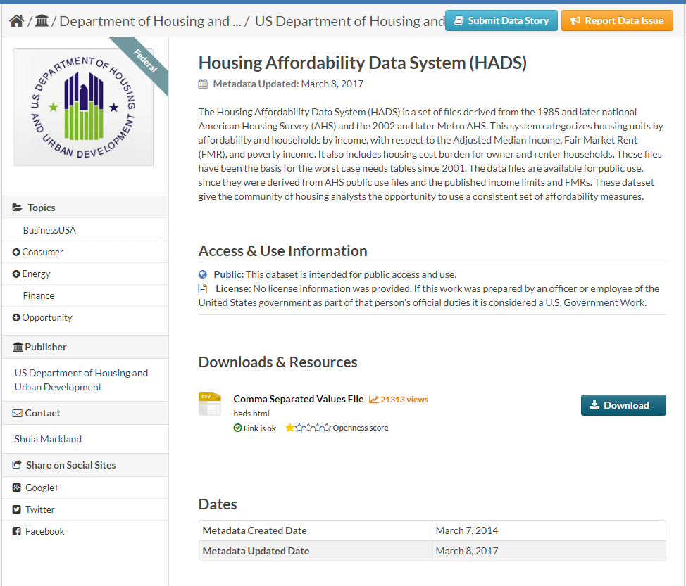
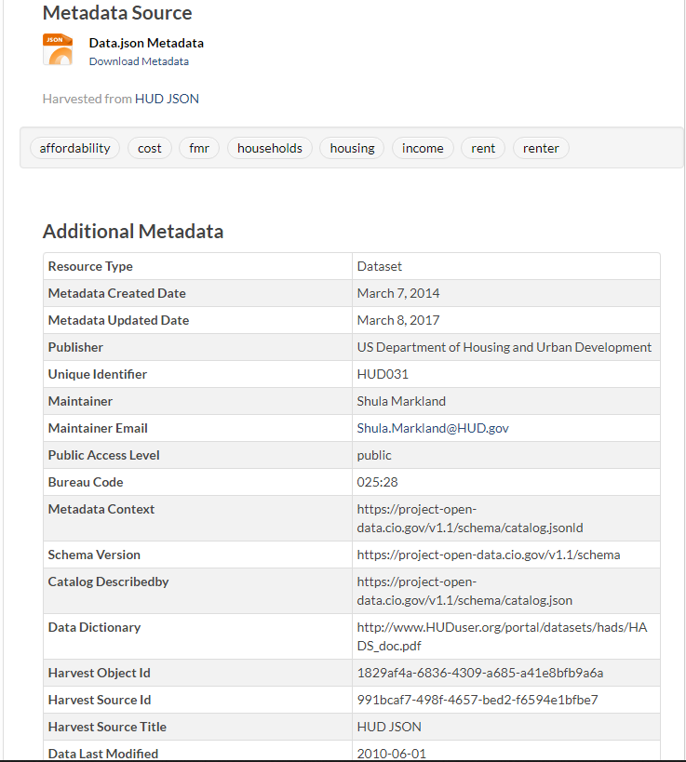
US Data.gov
Dataset Search
Metadata and Additional Info
Introduction
Data Download
Browse by Category

Slide 16
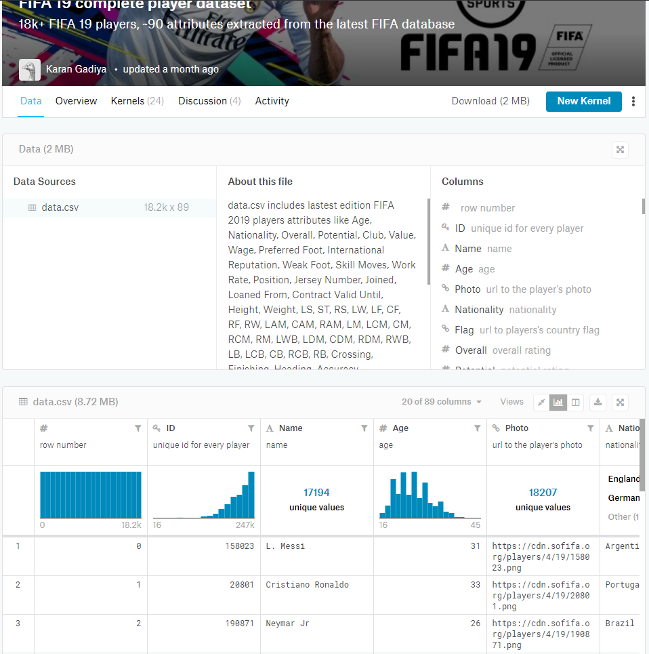
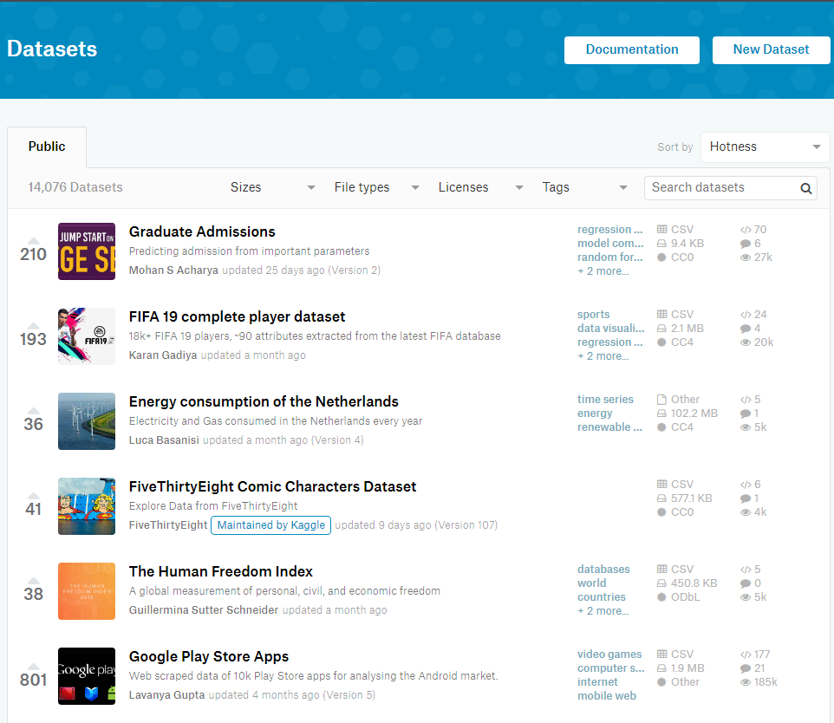
Kaggle
Other users’ projects using this dataset
Metadata and Description
Dataset Search
Browse with Filters
Data Demo and Explore Panel

Slide 17
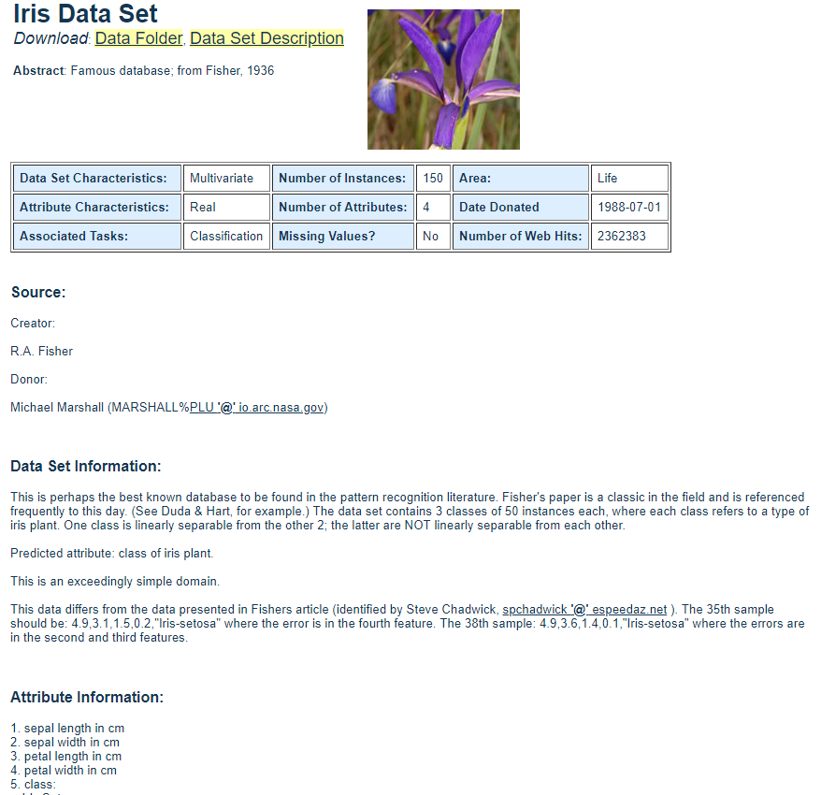
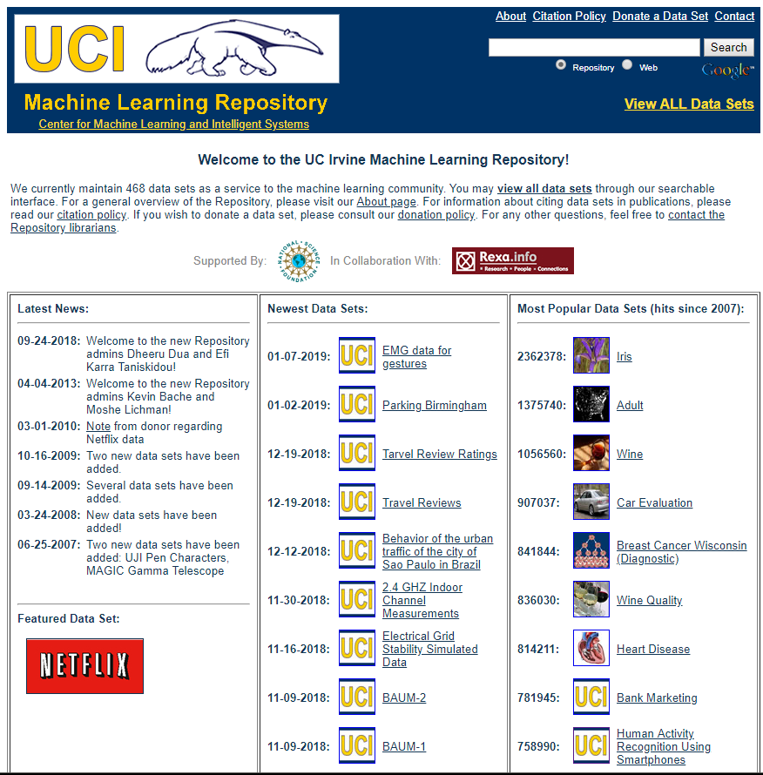
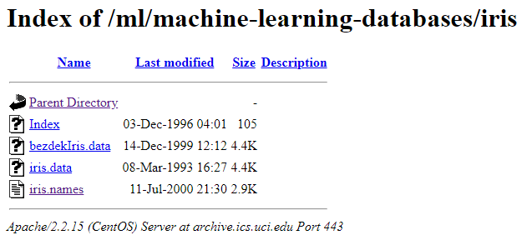
UCI Repository
Search and Browse
Metadata and Description

Slide 18
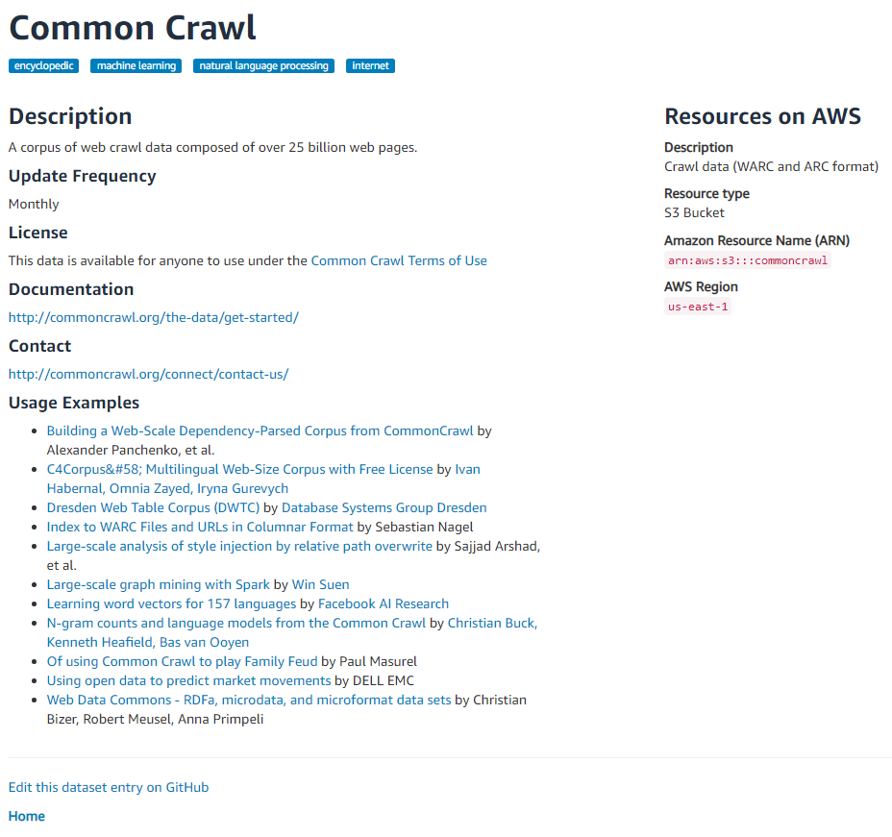
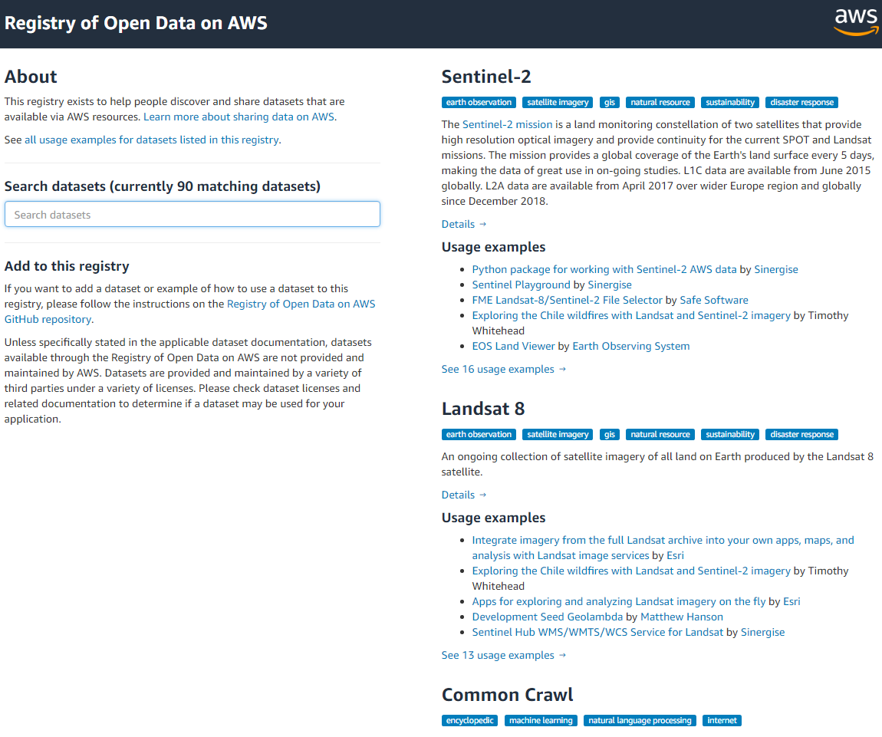
Amazon OpenData
Dataset Search
User Project Examples with This Dataset
Browsing

