Slide 1
Introduction to Hadoop and Apache Spark
Concepts and Tools
Shan Jiang, with updates from Sagar Samtani and Shuo Yu
Spring 2019
Acknowledgements: The Apache Software Foundation and Data Bricks
Reza Zadeh – Institute for Computational and Mathematical Engineering at Stanford University

Slide 2
Outline
Overview
MapReduce Framework
HDFS Framework
Hadoop Mechanisms
Relevant Technologies
Apache Spark
Tutorial on Amazon Elastic MapReduce
What and Why?
} How?

Slide 3
Overview of Hadoop

Slide 4
Why Hadoop?
Hadoop addresses “big data” challenges.
“Big data” creates large business values today.
$34.9 billion worldwide revenue from big data analytics in 2017*.
Various industries face “big data” challenges. Without an efficient data processing approach, the data cannot create business values.
Many firms end up creating large amounts of data that they are unable to gain any insight from.
*https://wikibon.com/wikibons-2018-big-data-analytics-market-share-report/

Slide 5
Big Data Facts
KB MB GB TB PB EB ZB YB
[100 TB] of data uploaded daily to Facebook.
[235 TB] of data has been collected by the U.S. Library of Congress in April 2011.
Walmart handles more than 1 million customer transactions every hour, which is more than [2.5 PB] of data.
Google processes [20 PB] of data per day.
[2.7 ZB] of data exist in the digital universe today.
100 TB
235 TB
2.5 PB
20 PB
2.7 ZB

Slide 6

Why Hadoop?
Hadoop is a platform for storage and processing huge datasets distributed on clusters of commodity machines.
Two core components of Hadoop:
MapReduce
HDFS (Hadoop Distributed File Systems)

Slide 7
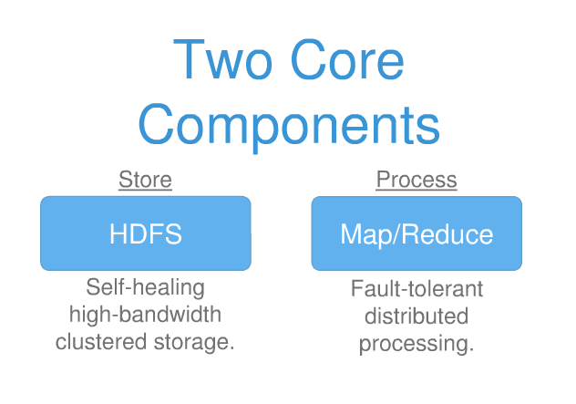
Core Components of Hadoop

Slide 8
Core Components of Hadoop
MapReduce
An efficient programming framework for processing parallelizable problems across huge datasets using a large number of commodity machines.
HDFS
A distributed file system designed to efficiently allocate data across multiple commodity machines, and provide self-healing functions when some of them go down.
 | Commodity machine | Super computer
Performance | Low | High
Cost | Low | High
Availability | Readily available | Hard to obtain

Slide 9
Hadoop vs. MapReduce
They are not the same thing!
Hadoop = MapReduce + HDFS
Hadoop is an open source implementation based on Google MapReduce and Google File System (GFS).

Slide 10
Hadoop vs. RDBMS
Many businesses are turning from RDBMS to Hadoop-based systems for data management.
In a word, if businesses need to process and analyze large-scale, real-time data, choose Hadoop. Otherwise staying with RDBMS is still a wise choice.
 | Hadoop-based | RDBMS
Data format | Structured & Unstructured | Mostly structured
Scalability | Very high | Limited
Speed | Fast for large-scale data | Very fast for small-medium size data.
Analytics | Powerful analytical tools for big data. | Some limited built-in analytics.

Slide 11
Hadoop vs. Other Distributed Systems
Common Challenges in Distributed Systems
Component Failure
Individual computer nodes may overheat, crash, experience hard drive failures, or run out of memory or disk space.
Network Congestion
Data may not arrive at a particular point in time.
Communication Failure
Multiple implementations or versions of client software may speak slightly different protocols from one another.
Security
Data may be corrupted, or maliciously or improperly transmitted.
Synchronization Problem
….

Slide 12
Hadoop vs. Other Distributed Systems
Hadoop
Uses efficient programming model.
Efficient, automatic distribution of data and work across machines.
Good in component failure and network congestion problems.
Weak for security issues.

Slide 13
HDFS

Slide 14
HDFS Framework
Hadoop Distributed File System (HDFS) is a highly fault-tolerant distributed file system for Hadoop.
Infrastructure of Hadoop Cluster
Hadoop = MapReduce + HDFS
Specifically designed to work with MapReduce.
Major assumptions:
Large data sets
Hardware failure
Streaming data access

Slide 15
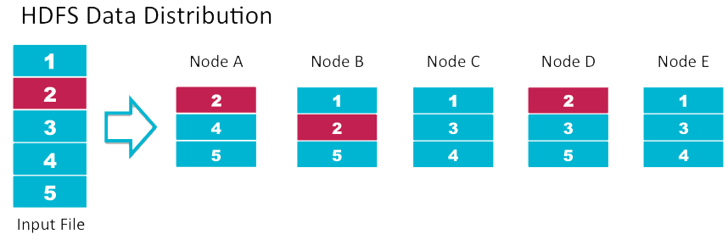
HDFS Framework
Key features of HDFS:
Fault Tolerance - Automatically and seamlessly recover from failures
Data Replication - to provide redundancy.
Load Balancing - Place data intelligently for maximum efficiency and utilization
Scalability - Add servers to increase capacity
“Moving computations is cheaper than moving data.”
Notes:
Why is block 2 in red?

Slide 16
HDFS Framework
Components of HDFS:
DataNodes
Store the data with optimized redundancy
NameNode
Manage the DataNodes

Slide 17
MapReduce Framework

Slide 18
MapReduce Framework
Map:
Extract something of interest from each chunk of record.
Reduce:
Aggregate the intermediate outputs from the Map process.
The Map and Reduce have different instantiations in different problems.
General framework

Slide 19
MapReduce Framework
Outputs of Mappers and inputs/outputs of Reducers are key-value pairs <k,v>.
Programmers must do the coding according to the MapReduce Model
Specify Map method
Specify Reduce method
Define the intermediate outputs in <k,v> format.

Slide 20
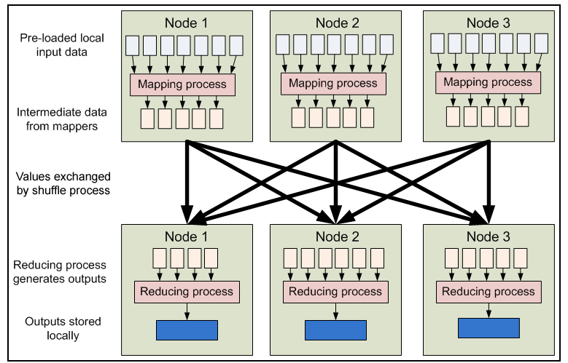
MapReduce Framework

Slide 21
Example: WordCount
A “HelloWorld” problem for MapReduce.
Input: 1,000,000 documents (text data).
Job: Count the frequency of each word.
Too slow to do on one machine.
Each Map function produces <word,1> pairs for its assigned task (say, 1,000 documents)
<a,1>
<dog,1>
<ran,1>
<into,1>
<a,1>
<cat,1>
… …
document 1: a dog ran into a cat.
document 2: ….. ……
Map

Slide 22
Example: WordCount
Each Reduce function aggregates <word,1> pairs for its assigned task. The task is assigned after map outputs are sorted and shuffled.
<a,1>
<dog,1>
<into,1>
<a,1>
<a,1>
<a,1>
<dog, 1>
<cat,1>
<dog, 1>
… …
<a,4>
<cat,1>
<dog,3>
<into,1>
… …
Reduce
All Reduce outputs are finally aggregated and merged.

Slide 23
Hadoop Mechanisms

Slide 24
Hadoop Architecture
Hadoop has a master/slave architecture.
Typically one machine in the cluster is designated as the NameNode and another machine as the JobTracker, exclusively.
These are the masters.
The rest of the machines in the cluster act as both DataNode and TaskTracker.
These are the slaves.

Slide 25
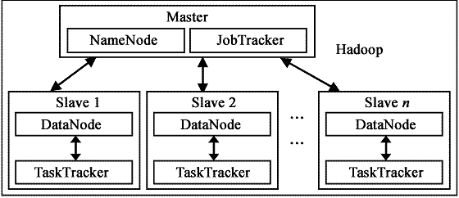
Hadoop Architecture
Example 1
Masters
Job Tracker
NameNode

Slide 26
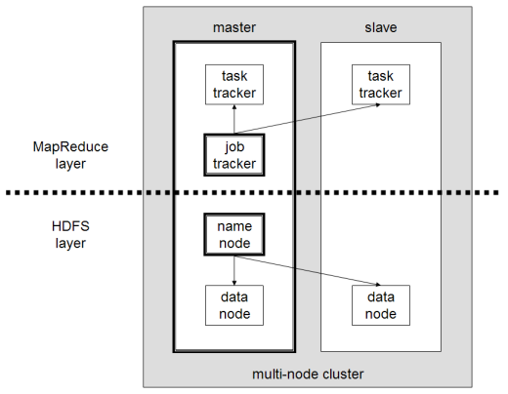
Hadoop Architecture
Example 2 (for small problems)

Slide 27
Hadoop Architecture
NameNode (master)
Manages the file system namespace.
Executes file system namespace operations like opening, closing, and renaming files and directories.
It also determines the mapping of data chunks to DataNodes.
Monitor DataNodes by receiving heartbeats.
DataNodes (slaves)
Manage storage attached to the nodes that they run on.
Serve read and write requests from the file system’s clients.
Perform block creation, deletion, and replication upon instruction from the NameNode.

Slide 28
Hadoop Architecture
JobTracker (master)
Receive jobs from client.
Talks to the NameNode to determine the location of the data
Manage and schedule the entire job.
Split and assign tasks to slaves (TaskTrackers).
Monitor the slave nodes by receiving heartbeats.
TaskTrackers (slaves)
Manage individual tasks assigned by the JobTracker, including Map operations and Reduce operations.
Every TaskTracker is configured with a set of slots, these indicate the number of tasks that it can accept.
Send out heartbeat messages to the JobTracker to tell that it is still alive.
Notify the JobTracker when succeeds or fails.

Slide 29
Hadoop program (Java)
Hadoop programs must be written to conform to MapReduce model. It must contain:
Mapper Class
Define a map method
map(KEY key, VALUE value, OutputCollector output) or map(KEY key, VALUE value, Context context)
Reducer Class
Define a reduce method
reduce(KEY key, VALUE value, OutputCollector output) or reduce(KEY key, VALUE value, Context context)
Main function with job configurations.
Define input and output paths.
Define input and output formats.
Specify Mapper and Reducer Classes

Slide 30
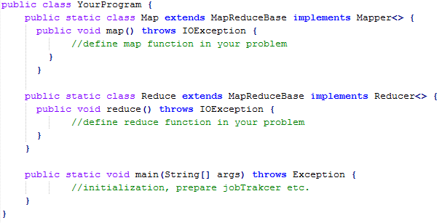
Hadoop program (Java)

Slide 31
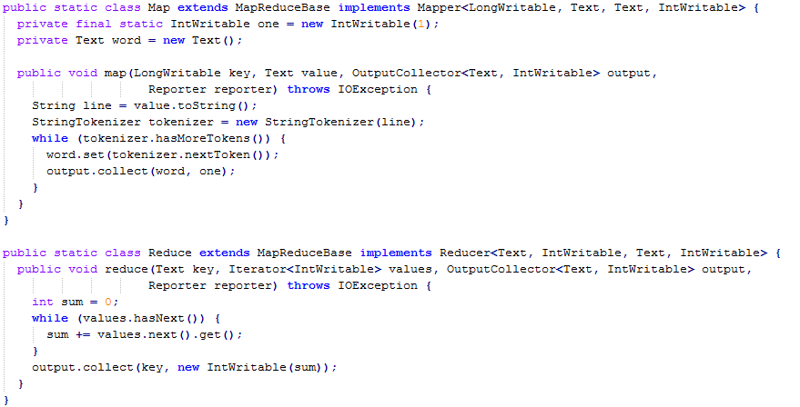
Example: WordCount
WordCount.java

Slide 32
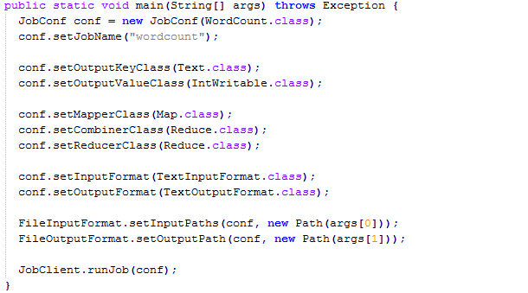
Example: WordCount (cont’d)
WordCount.java

Slide 33
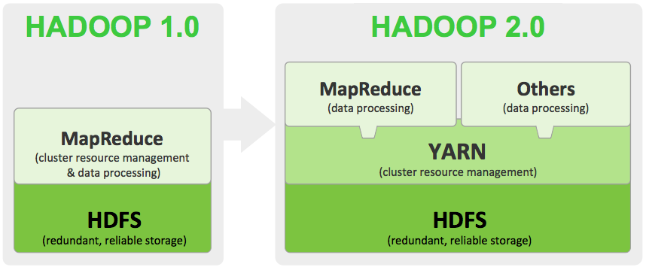
Where is Hadoop going?
Hadoop 3.0 has been released in December 2017.
HDFS supports erasure code, saving a half of storage space.
MapReduce performance improvement by 30%
Less stable
Notes:
YARN: yet another resource negotiator
CPU, memory

Slide 34
Relevant Technologies

Slide 35









Technologies relevant to Hadoop
Zookeeper
Pig

Slide 36
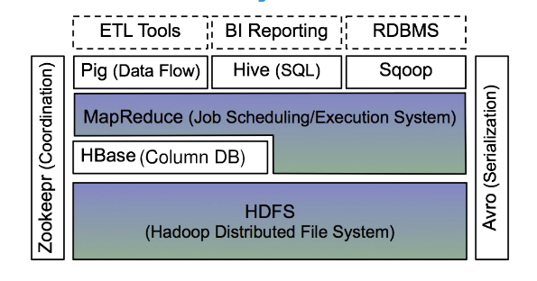
Hadoop Ecosystem

Slide 37
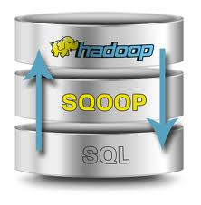
Sqoop
Provides simple interface for importing data straight from relational DB to Hadoop.

Slide 38
NoSQL
HDFS: Append-only file system
A file once created, written, and closed need not be changed.
To modify any portion of a file that is already written, one must rewrite the entire file and replace the old file.
Not efficient for random read/write.
Use relational database? Not scalable.
Solution: NoSQL
Stands for Not Only SQL.
Class of non-relational data storage systems.
Usually do not require a pre-defined table schema in advance.

Slide 39
NoSQL
Motivations of NoSQL
Simplicity of design
Simpler “horizontal” scaling
Finer control over availability
Compromise consistency in favor of availability, partition tolerance, and speed.
Many NoSQL databases do not fully support ACID
Atomicity, consistency, isolation, durability

Slide 40
NoSQL
NoSQL data store models:
Key-Value store
Document store
Wide-column store
Graph store
NoSQL Examples:
MongoDB
HBase
Cassandra
Its suitability depends on the problem.
Good for big data and real-time web applications
{“id”: “2019000001”,
“name”: “iPhone”,
“model”: “XR”,
“saleDate”: “01-JAN-2019”,
...
}

Slide 41
HBase
HBase
Hadoop Database.
Good integration with Hadoop.
A datastore on HDFS that supports random read and write.
A distributed database modeled after Google BigTable.
Best fit for very large Hadoop projects.

Slide 42
Comparison between NoSQLs
The following articles and websites provide a comparison on pros and cons of different NoSQLs
Articles
http://blog.markedup.com/2013/02/cassandra-hive-and-hadoop-how-we-picked-our-analytics-stack/
http://kkovacs.eu/cassandra-vs-mongodb-vs-couchdb-vs-redis/
DB Engine Comparison
http://db-engines.com/en/systems/MongoDB%3BHBase

Slide 43
Need for High-Level Languages
Hadoop is great for large data processing!
But writing Mappers and Reducers for everything is verbose and slow.
Solution: develop higher-level data processing languages.
Hive: HiveQL is like SQL.
Pig: Pig Latin is similar to Perl.

Slide 44
Hive
Hive: data warehousing application based on Hadoop.
Query language is HiveQL, which looks similar to SQL.
Translate HiveQL into MapReduce jobs.
Store & manage data on HDFS.
Can be used as an interface for HBase, MongoDB etc.

Slide 45
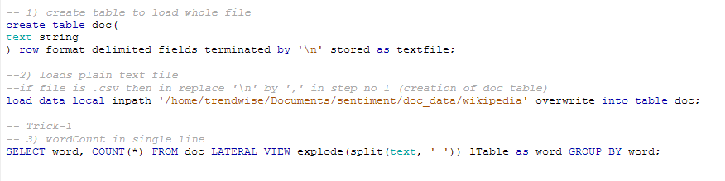
Hive WordCount.hql

Slide 46
Pig
A high-level platform for creating MapReduce programs used in Hadoop.
Translate into efficient sequences of one or more MapReduce jobs.
Execute the MapReduce jobs.

Slide 47
Pig WordCount.hql
A = load './input/'; B = foreach A generate flatten(TOKENIZE((chararray)$0)) as word; C = group B by word; D = foreach C generate COUNT(B), group; store D into './wordcount';

Slide 48
Mahout
A scalable data mining engine on Hadoop (and other clusters).
“Weka on Hadoop Cluster”.
Steps:
1) Prepare the input data on HDFS.
2) Run a data mining algorithm using Mahout on the master node.

Slide 49
Mahout
Mahout currently has
Collaborative Filtering.
User and Item based recommenders.
K-Means, Fuzzy K-Means clustering.
Mean Shift clustering.
Dirichlet process clustering.
Latent Dirichlet Allocation.
Singular value decomposition.
Parallel Frequent Pattern mining.
Complementary Naive Bayes classifier.
Random forest decision tree based classifier.
High performance java collections (previously colt collections).
A vibrant community.
and many more cool stuff to come by this summer thanks to Google summer of code.
….

Slide 50
Zookeeper
Zookeeper: A cluster management tool that supports coordination between nodes in a distributed system.
When designing a Hadoop-based application, a lot of coordination works need to be considered. Writing these functionalities is difficult.
Zookeeper provides services that can be used to develop distributed applications.
Zookeeper provide services such as :
Configuration management
Synchronization
Group services
Leader election
….
Who use it?
Hbase
Cloudera
…

Slide 51
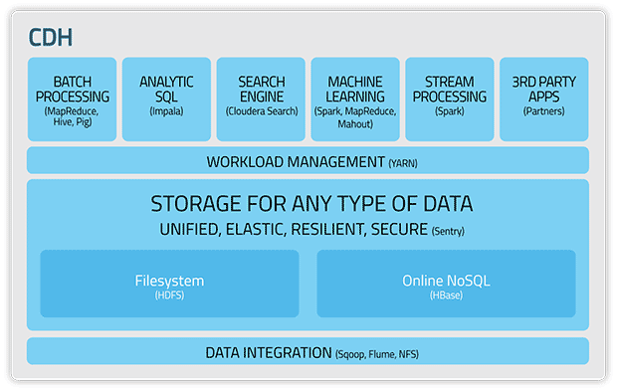
Cloudera
A platform that integrates many Hadoop-based products and services.

Slide 52
Hadoop is powerful. But where do we find so many commodity machines?

Slide 53
Amazon Elastic MapReduce
Setting up Hadoop clusters on the cloud.
Amazon Elastic MapReduce (AEM).
Powered by Hadoop.
Uses EC2 instances as virtual servers for the master and slave nodes.
Key Features:
No need to do server maintenance.
Resizable clusters.
Hadoop application support including HBase, Pig, Hive etc.
Easy to use, monitor, and manage.

Slide 54
References
These articles are good for learning Hadoop.
http://developer.yahoo.com/hadoop/tutorial/
https://hadoop.apache.org/docs/r1.2.1/mapred_tutorial.html
http://www.michael-noll.com/tutorials/
http://www.slideshare.net/cloudera/tokyo-nosqlslidesonly
http://www.fromdev.com/2010/12/interview-questions-hadoop-mapreduce.html

Slide 55
Apache Spark

Slide 56
Apache Spark Background
Many of the aforementioned Big Data technologies (Hbase, Hive, Pig, Mahout, etc.) are not integrated with each other.
This can lead to reduced performance and integration difficulties.
However, Apache Spark (current stable version: 2.4.0, November 2018) is a state-of-the-art Big Data technology that integrates many of the core functions from each of these technologies under one framework.

Slide 57
Apache Spark Background
Apache Spark is a fast and general engine for large-scale data processing built upon distributed file systems.
Most common one is Hadoop Distributed File System (HDFS).
Benefit from in-memory operations, Spark is 10 times faster than Hadoop and supports Java, Python, and Scala API’s.
Hadoop operations are mainly on disk
Spark is good for distributed computing tasks, and can handle batch, interactive, and real-time data within a single framework.

Slide 58
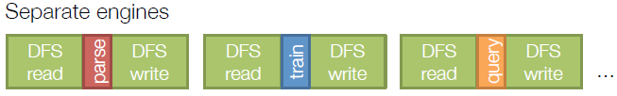
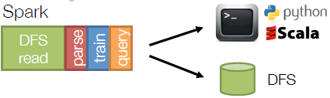
Apache Spark Background
Previous Big Data processing techniques involved leveraging several engines.
In contrast, Apache Spark allows users to leverage a single engine via Python, Scala, and other languages for multiple tasks.

Slide 59


Apache Spark Background
Traditional data processing on Hadoop involved heavy disk I/O.
Apache Spark is built around the concept of Resilient Distributed Datasets
(RDD’s) where the data processing occurs primarily in memory.
Notes:
http://www.thecloudavenue.com/2014/01/resilient-distributed-datasets-rdd.html

Slide 60
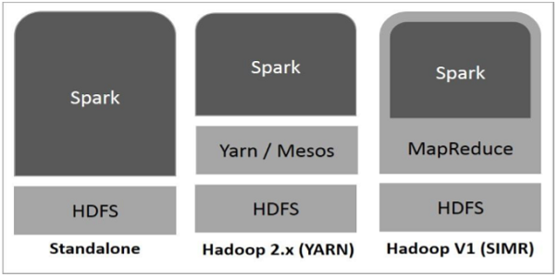
Spark Deployment Options
Standalone − Spark occupies the place on top of HDFS. Spark and MapReduce run side-by-side for all jobs.
Hadoop Yarn − Spark runs on Yarn without any pre-installation or root access required. It helps to integrate Spark into Hadoop ecosystem or Hadoop stack. It allows other components to run on top of the stack.
Spark in MapReduce (SIMR) − Spark in MapReduce is used to launch spark job in addition to standalone deployment. With SIMR, user can start Spark and uses its shell without any administrative access.

Slide 61
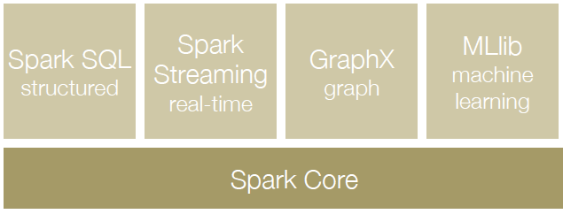
Spark Components
Regardless of deployment, Spark provides four standard libraries.
Spark SQL – allows for SQL-like queries of data
Spark Streaming – allows real-time processing of data
GraphX – allows graph analytics
MLlib – provides Machine Learning tools.

Slide 62
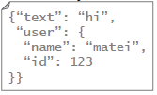
Spark Components – Spark SQL
Spark SQL introduces a new data abstraction called SchemaRDD, which provides support for structured and semi-structured data. Consider the examples below.
From Hive:
c = HiveContext(sc)
rows = c.sql(“select text, year from hivetable”)
rows.filter(lambda r: r.year > 2013).collect()
From JSON:
c.jsonFile(“tweets.json”).registerAsTable(“tweets”)
c.sql(“select text, user.name from tweets”)

Slide 63
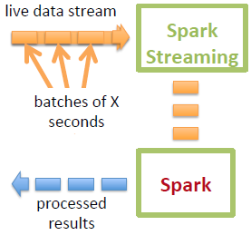
Spark Components – Spark Streaming
Spark Streaming leverages Spark’s fast scheduling ability to perform streaming analytics.
Chops up the live stream into batches of X seconds
Spark treats each data batch as Resilient Distributed Datasets (RDDs) and processes them using RDD operations
The processed results of the RDD operations are returned in batches

Slide 64
Spark Components - GraphX
GraphX is a distributed graph-processing framework on top of Spark.
Users can build graphs using RDDs of nodes and edges.
Provides a large library of graph algorithms with decomposable steps.

Slide 65
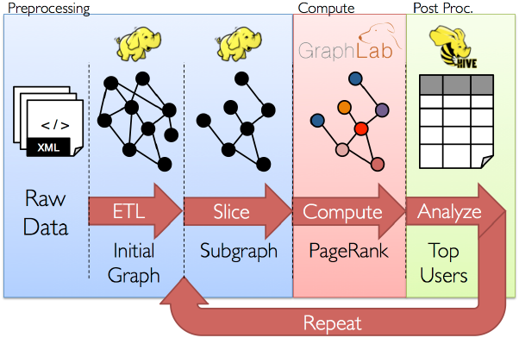
Spark Components - GraphX

Slide 66
Spark Components – GraphX Algorithms
Collaborative Filtering
Alternating Least Squares
Stochastic Gradient Descent
Tensor Factorization
Structured Prediction
Loopy Belief Propagation
Max-Product Linear Programs
Gibbs Sampling
Semi-supervised ML
Graph SSL
CoEM
Community Detection
Triangle Counting
K-core Decomposition
K-Truss
Graph Analytics
PageRank
Personalized PageRank
Shortest Path
Graph Coloring
Classification
Neural Networks

Slide 67
Spark Components – MLlib
MLlib (Machine Learning Library) is a distributed machine learning framework above Spark.
Spark MLlib is nine times as fast as the Hadoop disk-based version of Apache Mahout (before Mahout gained a Spark interface).
Spark MLlib provides a variety of classic machine learning algorithms.

Slide 68
Spark Components – MLlib Algorithms
Classification – logistic regression, linear SVM, Naïve Bayes, classification tree
Regression – Generalized Linear Models (GLMs), Regression tree
Collaborative filtering – Alternating Least Squares (ALS), Non-negative Matrix Factorization (NMF)
Clustering – k-means
Decomposition – SVD, PCA
Optimization – stochastic gradient descent, L-BFGS

Slide 69
Resources for Apache Spark
Spark has a variety of free resources you can learn from.
Big Data University - http://bigdatauniversity.com/courses/spark-fundamentals/
Founders of Spark, Databricks - https://databricks.com/
Apache Spark download - http://spark.apache.org/
Apache Spark set up tutorial - http://www.tutorialspoint.com/apache_spark/

Slide 70
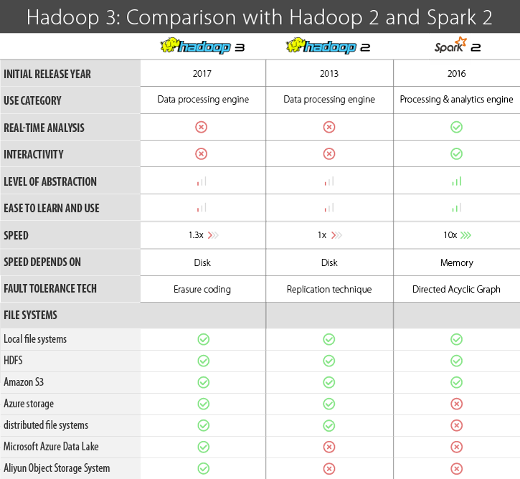

Slide 71
Tutorial on Hadoop Cluster and Spark Setup

Slide 72
Prerequisites
Familiarize with Linux Platform:
Preliminary Unix/Linux understandings.
If you use Windows OS, download VirtualBox and install a Linux distribution on it.
VirtualBox:
https://www.virtualbox.org/
The latest Ubuntu Distribution:
http://www.ubuntu.com/download/desktop
Do the following in the terminal:
Install JAVA 7:
$ sudo apt-get install openjdk-7-jdk
Install SSH:
$ sudo apt-get install ssh

Slide 73
Install and Setup Hadoop on a Single Node
Install Hadoop:
$ wget http://http://mirror.cc.columbia.edu/pub/software/apache/hadoop/common/hadoop-1.2.1/hadoop-1.2.1.tar.gz
Unpack the downloaded hadoop distribution:
$ tar xzf hadoop-1.2.1.tar.gz
Set environment variables (assume you unpacked the hadoop distribution under home directory):
$ export HADOOP_HOME=/home/hadoop-1.2.1
Open with a text editor “conf/hadoop-env.sh”, and set the JAVA_HOME variable as the path where you installed JDK.
e.g. “export JAVA_HOME=/usr/lib/java-7-openjdk”

Slide 74
Test Single Node Hadoop
Go to the directory defined by HADOOP_HOME:
$ cd hadoop-1.2.1
Use Hadoop to calculate pi:
$ bin/hadoop jar hadoop-examples-*.jar pi 3 10000
If Hadoop and Java are installed correctly, you will see an approximate value of pi.

Slide 75

Setup a multi-node Hadoop cluster
1. Install and Setup Hadoop (as well as Java & ssh) in every node in your cluster.
In this tutorial, we will set up a Hadoop cluster with 3 nodes.
The diagram below shows the assumed IP addresses for three nodes. Ensure the network connection between three nodes.
Hadoop cluster
Slave node 1
128.196.0.2
Master node
128.196.0.1
Slave node 2
128.196.0.3

Slide 76
Setup a multi-node Hadoop cluster
2. Shutdown each single-node Hadoop before continuing if you haven’t done so already.
$ bin/stop-all.sh

Slide 77
Setup a multi-node Hadoop cluster
3. Configure the SSH access.
1) Generate an SSH key for the master node.
$ ssh-keygen -t rsa -P '' -f ~/.ssh/id_rsa
2) Copy the master’s public key to all nodes.
$ cat ~/.ssh/id_rsa.pub >> ~/.ssh/authorized_keys
$ ssh-copy-id -i ~/.ssh/id_rsa.pub yourusername@128.196.0.2
$ ssh-copy-id -i ~/.ssh/id_rsa.pub yourusername@128.196.0.3
3) Test the SSH access.
$ ssh 128.196.0.1
$ ssh 128.196.0.2
$ ssh 128.196.0.3
All of these must be done on the master node.

Slide 78
Setup a multi-node Hadoop cluster
4. Determine the Hadoop architecture.
In this tutorial, we are going to put NameNode and JobTracker on the same master node, and assign DataNode and TaskTracker to each of the rest nodes.
Hadoop cluster
DataNode_1
TaskTracker_2
NameNode
JobTracker
DataNode_2
TaskTracker_2

Slide 79

Setup a multi-node Hadoop cluster
5. Define the secondary NameNode (Optional).
We need to do this step only on the master node.
This node works as the substitute when the primary NameNode fails.
HADOOP_HOME/conf/master is the file which defines the secondary NameNode.
e.g. We set the slave node 3 as the secondary NameNode. To do this, open conf/master and write 128.196.0.3 in the file.

Slide 80

Setup a multi-node Hadoop cluster
5. Define the slave nodes.
We need to do this step only on the master node.
The slave nodes are where DataNodes and TaskTrackers will be run.
HADOOP_HOME/conf/slaves is the file which defines the slave nodes.
e.g. We use the slave nodes 2 & 3. To do this, open conf/slaves and write 128.196.0.2 and 128.196.0.3 in the file.

Slide 81
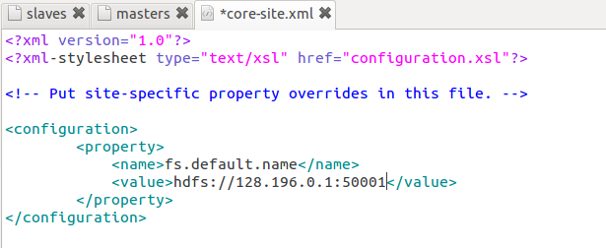
Setup a multi-node Hadoop cluster
6. Modify the configuration files on each node.
There are three configuration files: conf/core-site.xml, conf/mapred-site.xml, and conf/hdfs-site.xml
conf/core-site.xml
This file specifies the NameNode host and port.

Slide 82
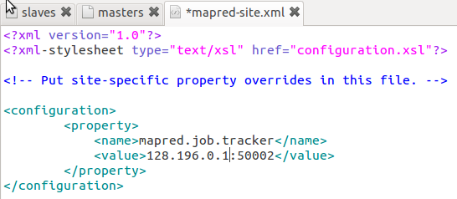
Setup a multi-node Hadoop cluster
conf/mapred-site.xml
This file specifies the JobTracker host and port.

Slide 83
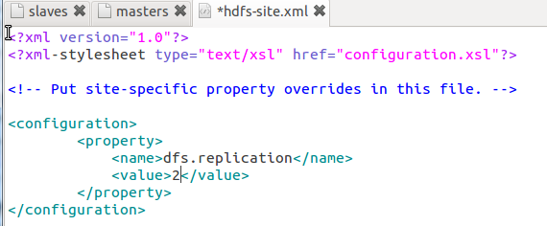
Setup a multi-node Hadoop cluster
conf/hdfs-site.xml
This file specifies how many machines a single file should be replicated to before it becomes available.
The higher this value is, the more robust the Hadoop cluster becomes, but slower for starting.

Slide 84
Setup a multi-node Hadoop cluster
7. Format the Hadoop Cluster.
We need to do this only once for setting up the Hadoop cluster.
Never do this when Hadoop is running.
Run the following command on the node where NameNode is defined.
$ bin/hadoop namenode -format

Slide 85
Setup a multi-node Hadoop cluster
8. Start the Hadoop cluster.
First start the HDFS daemon on the node where NameNode is defined.
$ bin/start-dfs.sh
Then start the MapReduce daemon on the node where JobTracker is defined (in our tutorial, the same master node).
$ bin/start-mapred.sh

Slide 86
Setup a multi-node Hadoop cluster
9. Run some Hadoop Program.
Now you can use your Hadoop cluster to run a program written for Hadoop. The larger data your program processes, the faster you will feel for using Hadoop.
bin/hadoop jar {yourprogram}.jar [argument_1], [argument_2] …

Slide 87
Setup a multi-node Hadoop cluster
10. Stop the Hadoop cluster.
First stop the MapReduce daemon on the node where JobTracker is defined.
$ bin/stop-dfs.sh
Then stop the HDFS daemon on the node where NameNode is defined (in our tutorial, the same master node).
$ bin/stop-mapred.sh

Slide 88
Hadoop Web Interfaces
http://localhost:50070/
Web UI of the NameNode daemon
http://localhost:50030/
Web UI of the JobTracker daemon
http://localhost:50060/
Web UI of the TaskTracker daemon

Slide 89
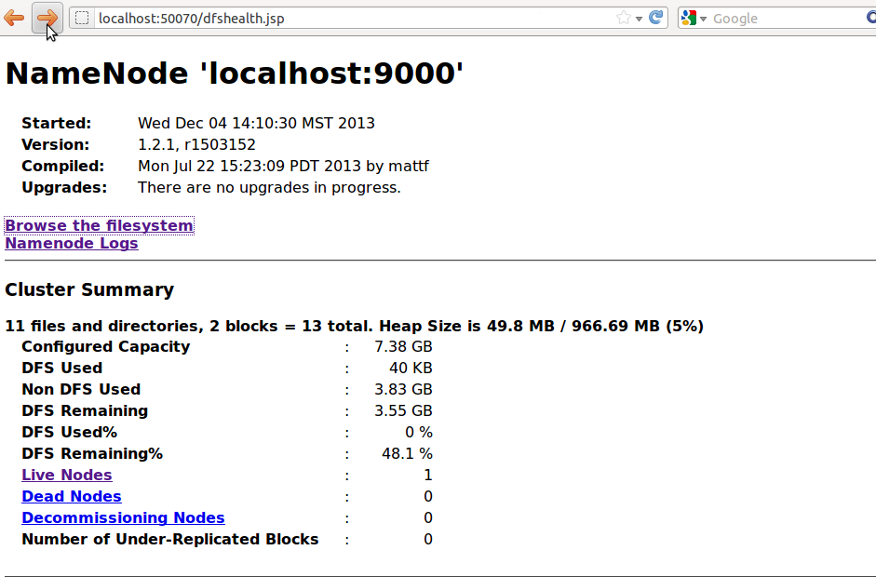
NameNode Interface

Slide 90
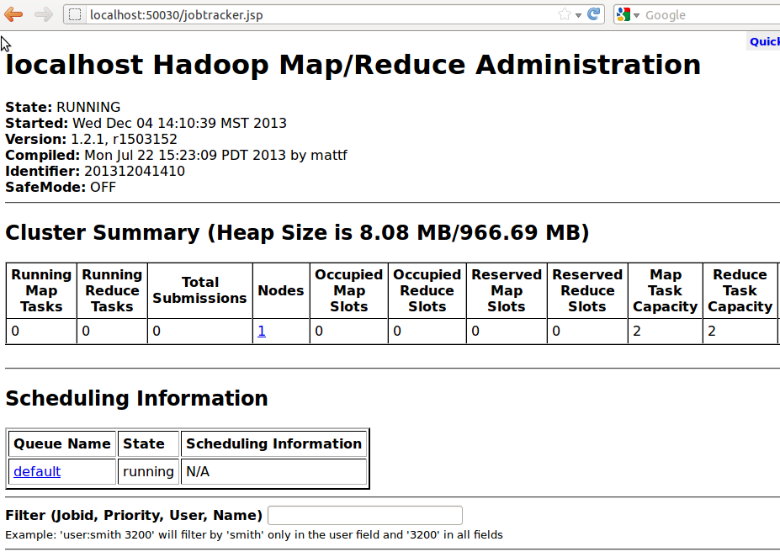
JobTracker Interface

Slide 91
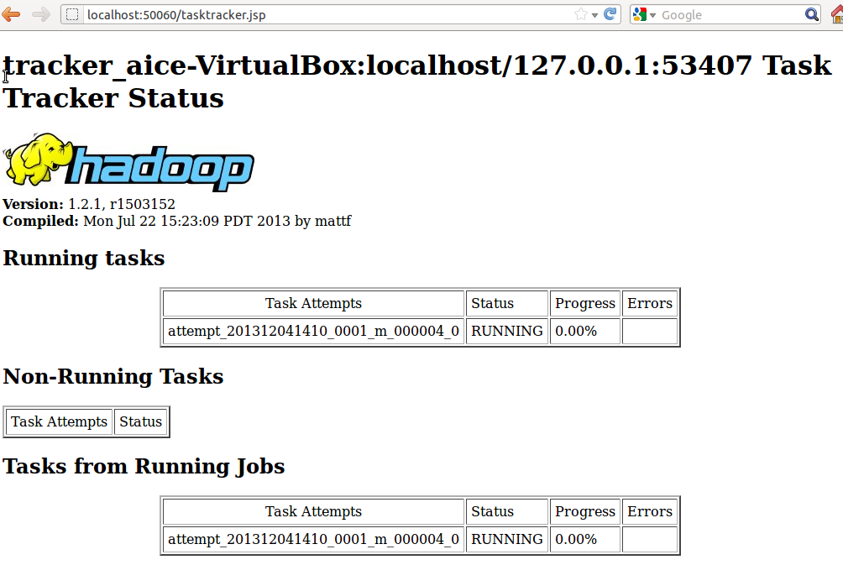
TaskTracker Interface

Slide 92
Amazon Elastic MapReduce
Cloud-based Hadoop System

Slide 93
Cloud Implementation of Hadoop
Amazon Elastic MapReduce (AEM) Key Features:
Resizable clusters.
Hadoop application support including HBase, Pig, Hive etc.
Easy to use, monitor, and manage.

Slide 94
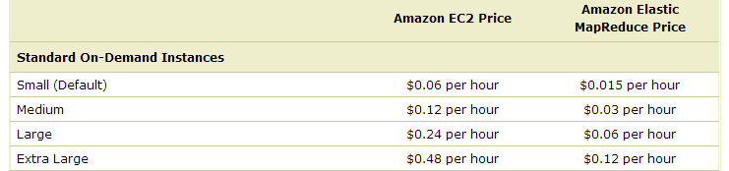
AEM Pricing
Unfortunately, it’s not free.
Pay for AEM service.
Since AEM uses EC2 instances, also pay for EC2.
Typical Costs:
You pay for what you use.
Automatically terminates the clusters when no job is running. Only charges for the resources used during running time.
Adjust the size of clusters.

Slide 95
1. Login to Amazon AWS account.
If not, sign up for Amazon Web Services (http://aws.amazon.com/).

Slide 96
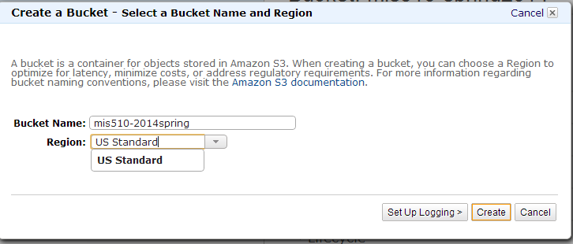
2. Create an Amazon S3 bucket
Go to https://console.aws.amazon.com/s3/
The bucket is used to store the application files and input/output of Hadoop program running on the cluster.
To avoid cross-region bandwidth charges, create the bucket in the same region as the cluster you'll launch. For this tutorial, select the region US Standard.

Slide 97
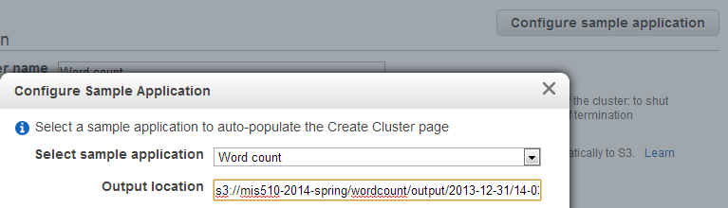
3. Create a cluster
1) Go to https://console.aws.amazon.com/elasticmapreduce/vnext and select “Create a cluster.”
2) (optional) Select “Configure sample application”:
Choose “Word count” as sample application.
Specify the output location, using your S3 bucket name.
*If you use your own Hadoop program, you will specify the input/output in later steps.

Slide 98
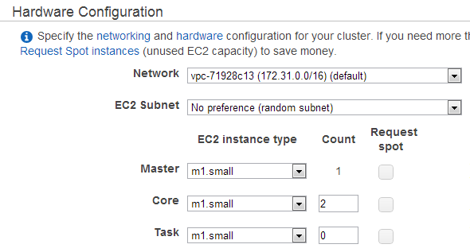
3. Create a cluster
3) Configure hardware.
In Hardware Configuration section, determine the number of nodes in the cluster.
In this tutorial, we use minimum numbers to reduce cost.

Slide 99
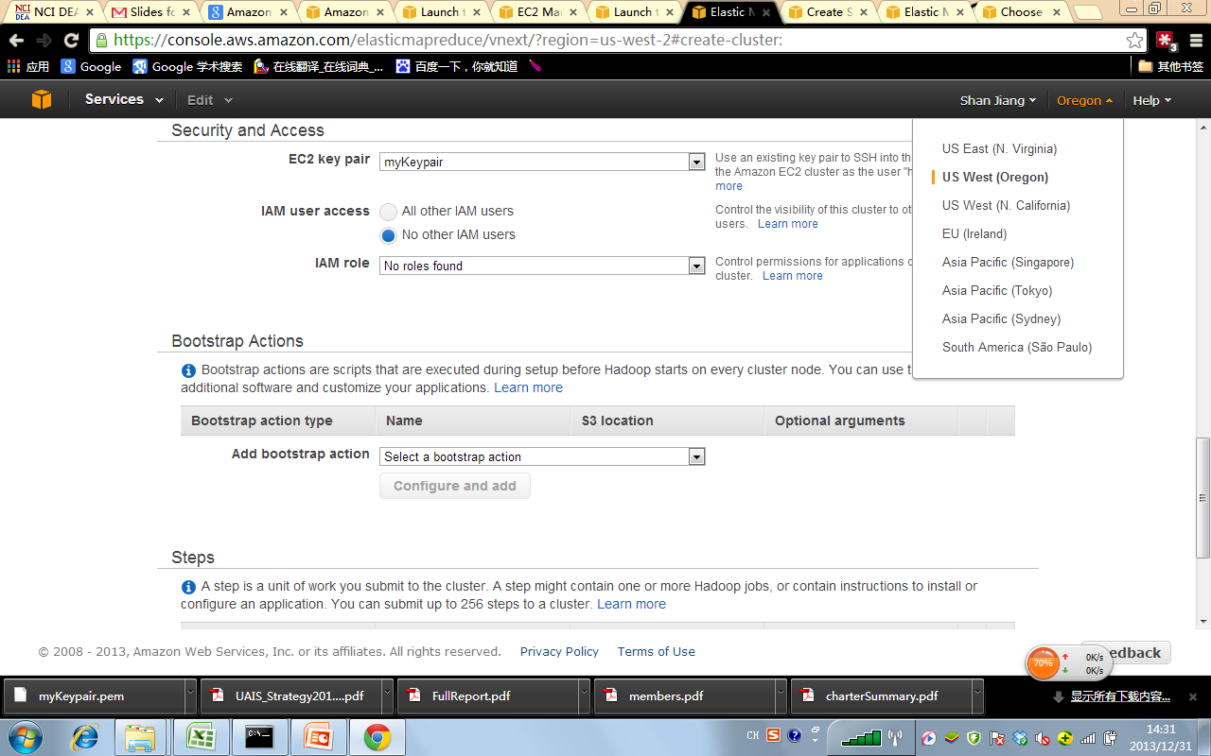
3. Create a cluster
4) Configure the key pair.
This is used to SSH the master nodes.
Choose the Region where you locate the Hadoop Cluster, and select a key pair.
If no key pairs have been created, go to https://console.aws.amazon.com/ec2, choose “Key Pair”, and create one.
Also, you may need to go to https://console.aws.amazon.com/iam/home?#security_credential to create security access keys.

Slide 100
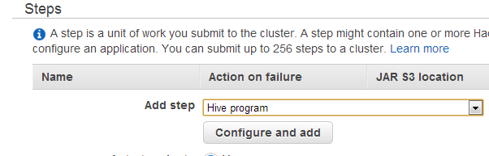
3. Create a cluster
5) Select the Hadoop programs you already coded under “Steps” section.
AEM accepts four types of program files:
Hadoop streaming scripts
Hive program
Pig program
JAR files
In any case, you need to first upload the program and datasets to Amazon S3 bucket, and specify the S3 locations for program file(s), program arguments, input and output paths in the configuration window (see next slide).

Slide 101
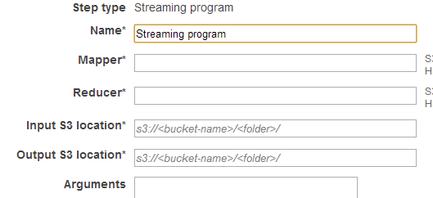
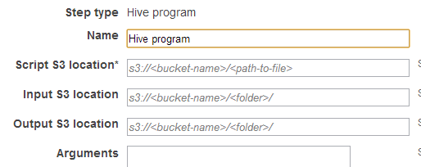
Examples of Hadoop program configurations

Slide 102
4. Launch the cluster
After finishing all the steps, click “Create Cluster at the bottom”, then you will be guided to Hadoop Cluster console where you can monitor the running progress.
The AEM will automatically run all the steps (jobs) you specified, terminate the cluster upon finish, and delete the cluster after two months.
Charges only occur when the cluster is running. No charges after termination.

Slide 103
For more information
Follow a more complete tutorial of using AEM at http://docs.aws.amazon.com/ElasticMapReduce/latest/DeveloperGuide

