Slide 1
Publicly Available Data Sources (Free)
Spring 2019
MIS 464
Sagar Samtani and Hsinchun Chen
with updates from Hongyi Zhu

Slide 2
Publicly Available Data Sources
Name of Data Source | # Entries | Description | Data Formats | URL
US Data.gov EU OpenData | > 300,000 > 15,000 | Agriculture, Business, climate, consumer, ecosystem, education, energy, finance, health, local government manufacturing, public safety, science and research | HTML, XML, XLSX, CSV, PDF, shapefile, txt, zip | http://www.data.gov/ http://data.europa.eu/euodp/data/dataset
Kaggle | 14,072 | Product, insurance, forum comments, twitter data, images | CSV, XLSX, SQL | https://www.kaggle.com/datasets
UC Irvine Machine Learning Repository | 468 | Research datasets used in past machine learning publications | HTML, XML, XLSX, CSV, PDF, txt, zip | https://archive.ics.uci.edu/ml
Amazon Opendata on AWS | 90 | Public transportation, satellite images, web pages, genome, ecosystem, etc. | Data API (CSV, JSON) | https://registry.opendata.aws/
Microsoft Research Open Data | 53 | Biology, engineering, healthcare, physics, math, science and research | CSV, TXT, TSV, PDF | https://msropendata.com/

Slide 3
Publicly Available Data Sources
Name of Data Source | # Entries | Description | Data Formats | URL
Awesome Public Datasets (Github Repo) | > 600 | Agriculture, Biology, Climate, Data Challenges, Economics, Education, Finance, Government, Healthcare, Machine Learning, NLP, Search Engines, Sports, Transportation | XLSX, JSON, XML, Zip, CSV, PDF | https://github.com/awesomedata/awesome-public-datasets
Figshare | > 50 | Data from: Various sciences (Astronomy, biological, environmental, information, etc.), engineering, commerce, management, tourism | XLSX, Zip, XML, CSV, PDF | https://figshare.com/
KD Nuggets | > 50 | Data sets designed specifically for data mining tasks | JSON, CSV, SQL, XLSX | http://www.kdnuggets.com/datasets/index.html
VisualData | 247 | Computer Vision datasets | JPG, PNG, … | https://www.visualdata.io/
ML Vis | 48 | Repository of scientific datasets for visualization | CSV | http://www.mlvis.com/
Google Dataset Search | Search engine for publicly available datasets | https://toolbox.google.com/datasetsearch
Enigma | Search engine for publicly available datasets | https://public.enigma.com/

Slide 4
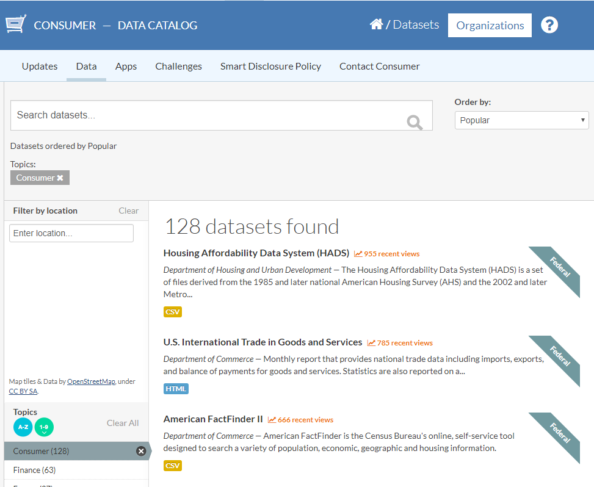
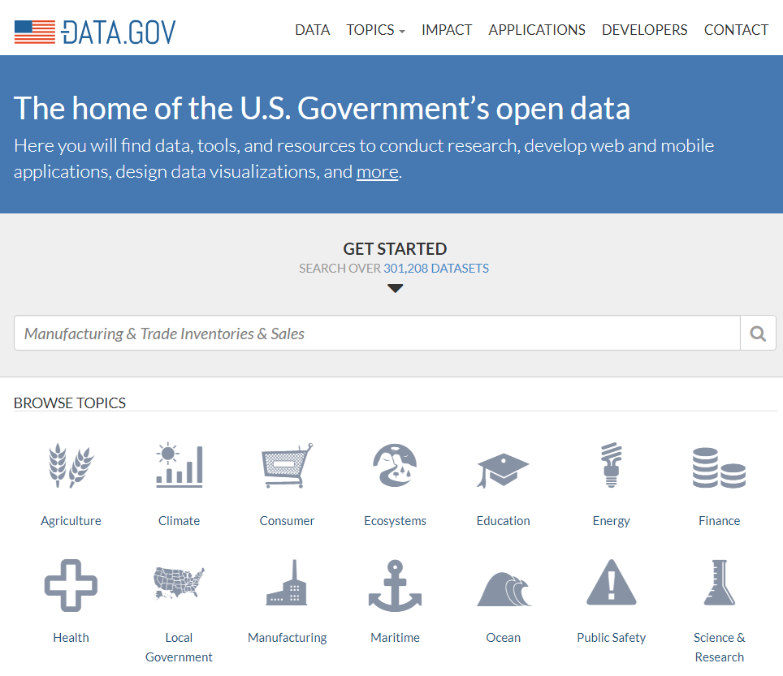
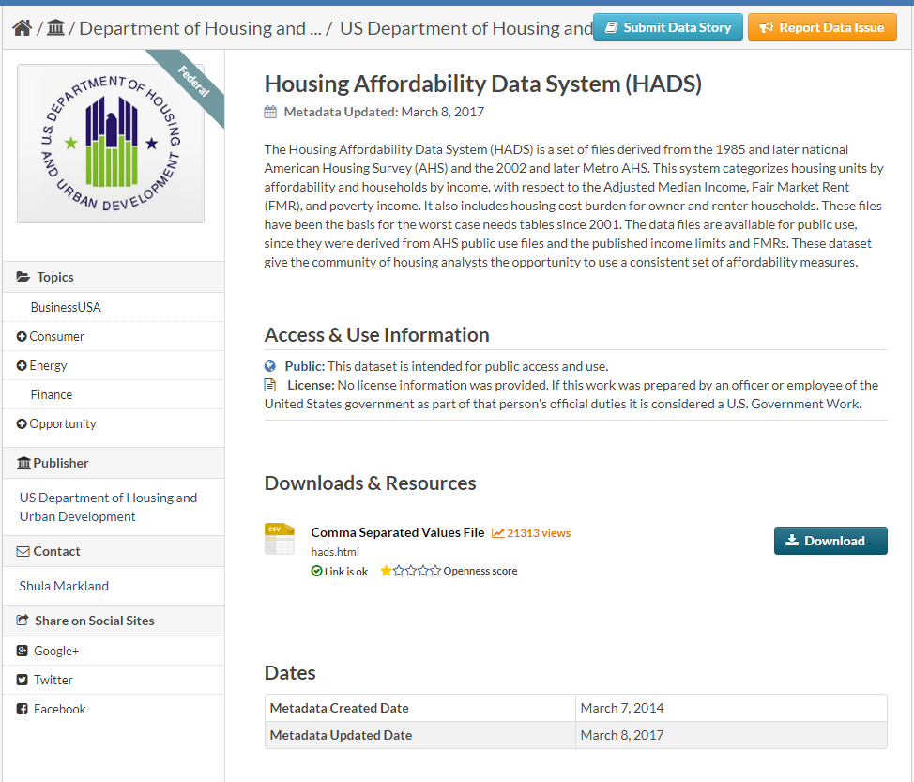
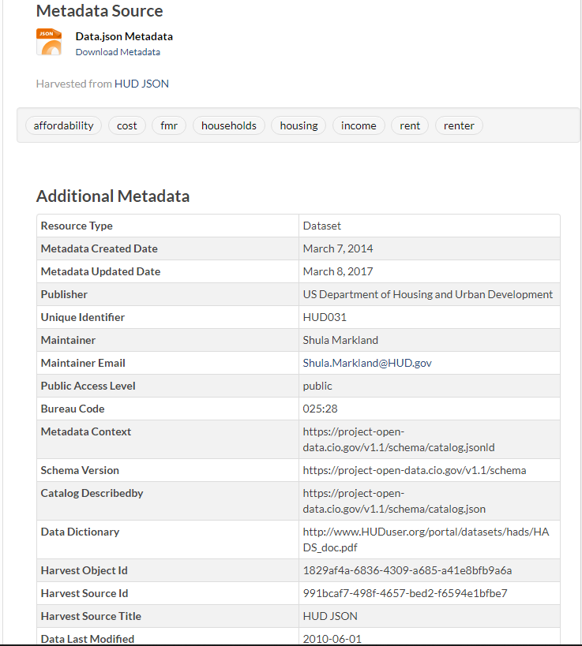
US Data.gov
Dataset Search
Metadata and Additional Info
Introduction
Data Download
Browse by Category

Slide 5
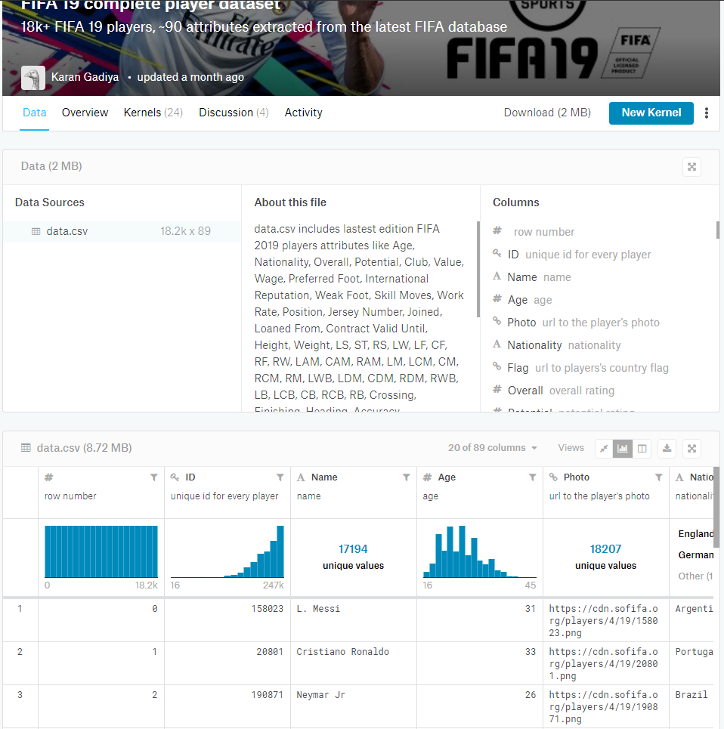
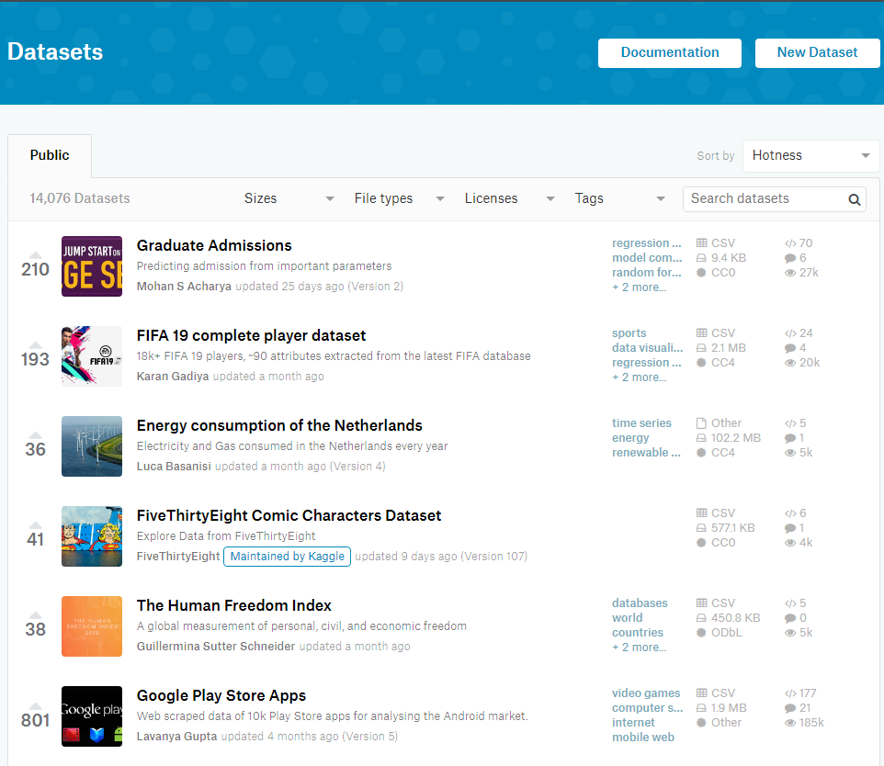
Kaggle
Other users’ projects using this dataset
Metadata and Description
Dataset Search
Browse with Filters
Data Demo and Explore Panel

Slide 6
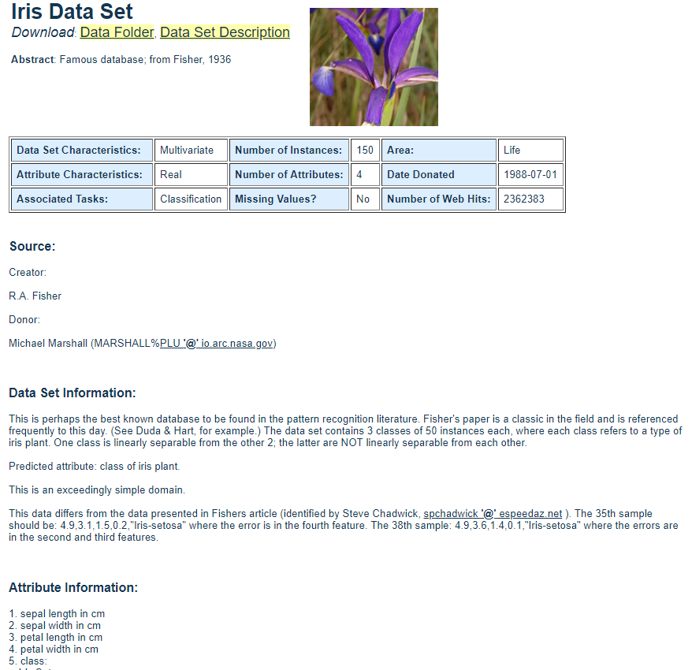
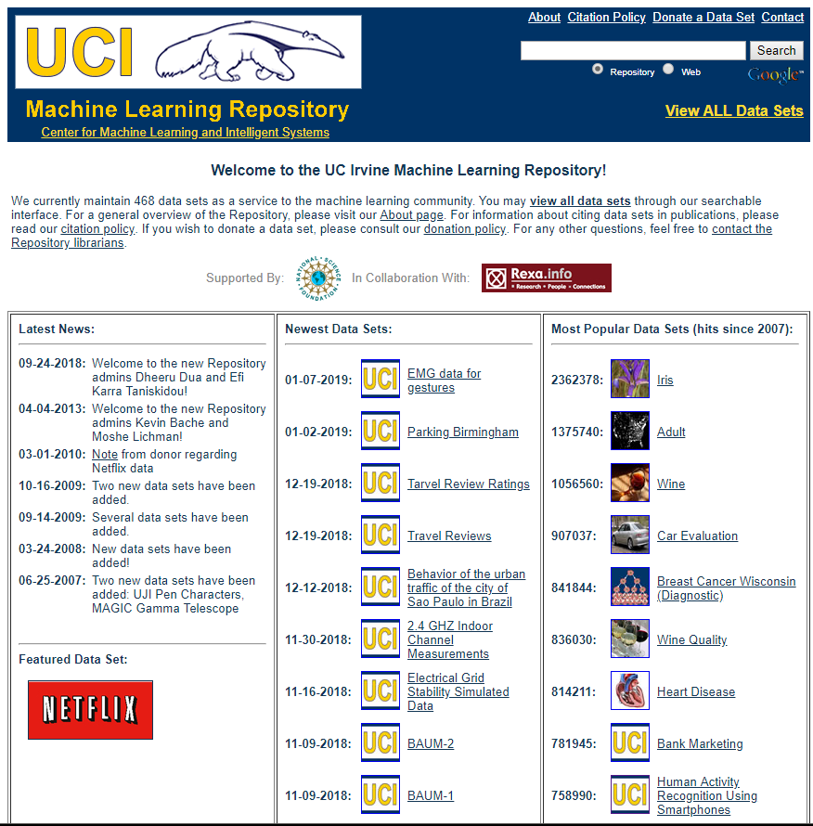
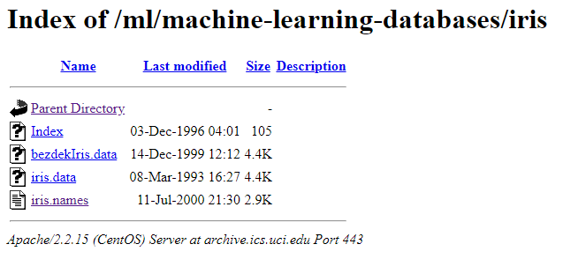
UCI Repository
Search and Browse
Metadata and Description

Slide 7
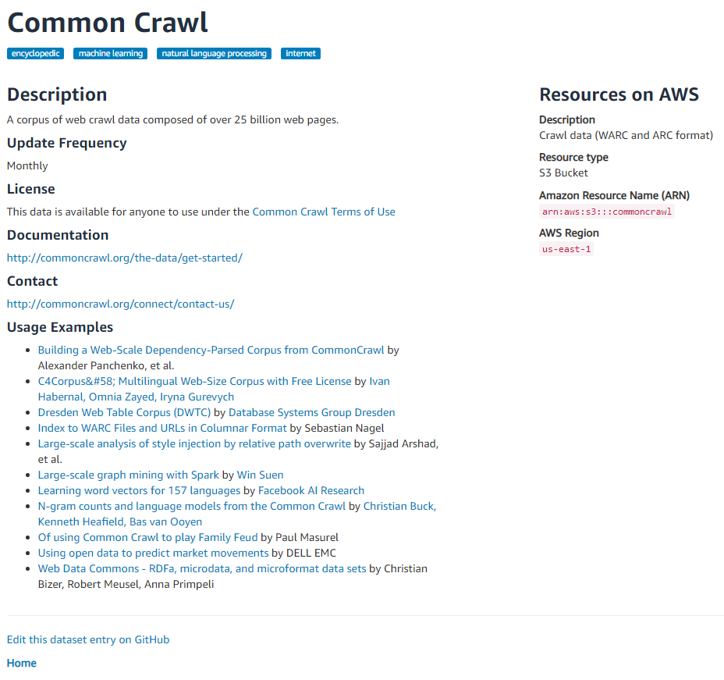
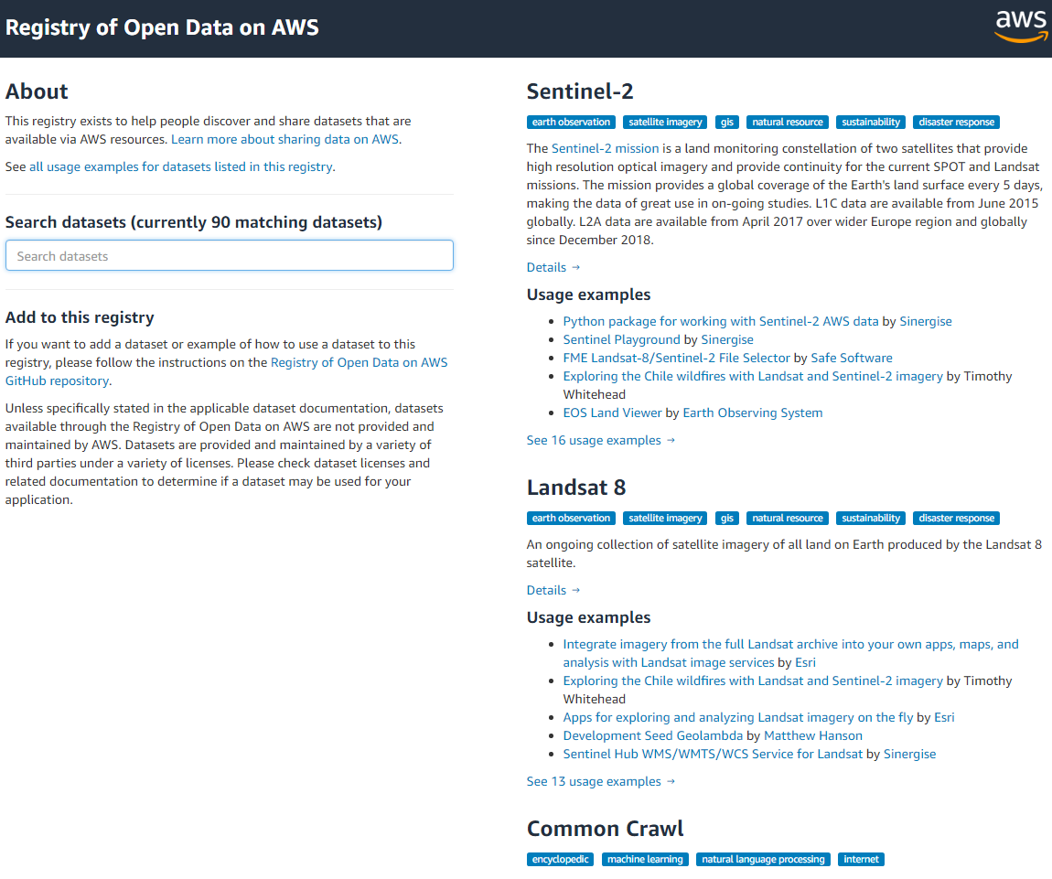
Amazon OpenData
Dataset Search
User Project Examples with This Dataset
Browsing

