Slide 1
Text Mining: Techniques, Tools, ontologies and Shared tasks
Xiao Liu, with updates from Shuo Yu
Spring 2019

Slide 2
Introduction
Text mining, also referred to as text data mining, refers to the process of deriving high quality information from text.
Text mining is an interdisciplinary field that draws on information retrieval, data mining, machine learning, statistics and computational linguistics.
Text mining techniques have been applied in a large number of areas, such as business intelligence, national security, scientific discovery (especially life science), social media monitoring and etc..

Slide 3
Introduction
In this set of slides, we are going to cover:
the most commonly used text mining techniques
Ontologies that are often used in text mining
Open source text mining tools
Shared tasks in text mining which reflect the hot topics in this area
A research case which applies text mining techniques to solve a healthcare related problem with social media data.

Slide 4
Text mining techniques
Text Classification
Sentiment Analysis
Topic Modeling
Named Entity Recognition
Entity Relation Extraction

Slide 5
Text Classification
Text Classification or text categorization is a problem in library science, information science, and computer science. Text classification is the task of choosing correct class label for a given input.
Some examples of text classification tasks are
Deciding whether an email is a spam or not (spam detection) .
Deciding whether the topic of a news article is from a fixed list of topic areas such as “sports”, “technology”, and “politics” (document classification).
Deciding whether a given occurrence of the word bank is used to refer to a river bank, a financial institution, the act of tilting to the side, or the act of depositing something in a financial institution (word sense disambiguation).

Slide 6
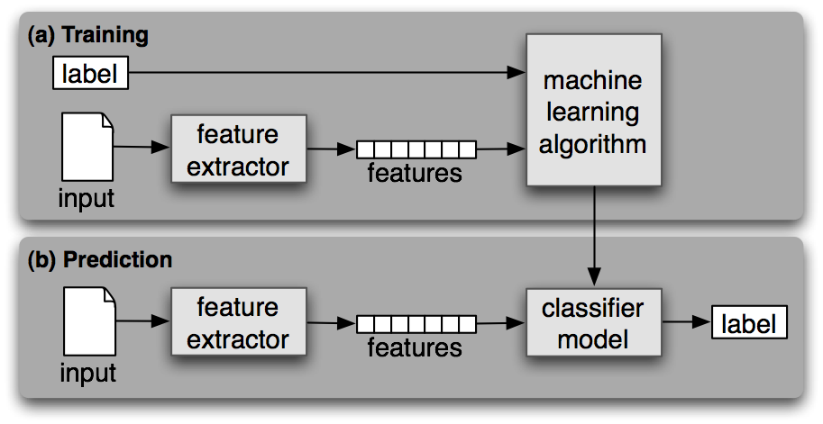
Text Classification
Text classification is a supervised machine learning task as it is built based on training corpora containing the correct label for each input. The framework for classification is shown in figure below.
(a) During training, a feature extractor is used to convert each input value to a feature set. These feature sets, which capture the basic information about each input that should be used to classify it, are discussed in the next section. Pairs of feature sets and labels are fed into the machine learning algorithm to generate a model.
(b) During prediction, the same feature extractor is used to convert unseen inputs to feature sets. These feature sets are then fed into the model, which generates predicted labels.

Slide 7
Text Classification
Common features for text classification include: bag-of words (BOW), bigrams, tri-grams and part-of-speech (POS) tags for each word in the document.
The most commonly adopted machine learning algorithms for text classifications are naïve Bayes, support vector machines, and maximum entropy classifications.
Algorithm | Language | Tools
Naïve Bayes | Java | Weka, Mahout, Mallet
 | Python | NLTK
Support Vector Machines | C++ | SVM-light, mySVM, LibSVM
 | MatLab | SVM Toolbox
 | Java | Weka
Maximum entropy | Java | Mallet
 | Python | NLTK

Slide 8
Sentiment Analysis
Sentiment analysis (also known as opinion mining) refers to the use of natural language processing, text analysis and computational linguistics to identify and extract subjective information in source material.
The rise of social media such as forums, micro blogging and blogs has fueled interest in sentiment analysis.
Online reviews, ratings and recommendations in social media sites have turned into a kind of virtual currency for businesses looking to market their products, identifying new opportunities and manage their reputations.
As businesses look to automate the process of filtering out the noise, identifying relevant content and understanding reviewers’ opinions, sentiment analysis is the right technique.

Slide 9
Sentiment Analysis
The main tasks, their descriptions and approaches are summarized in the table below:
Task | description | Approaches | lexicons/ algorithms
Polarity Classification | classifying a given text at the document, sentence, or feature/aspect level into positive, negative or neutral | lexicon based scoring | SentiWordNet, LIWC
 |  | machine learning classification | SVM
Affect Analysis | Classifying a given text into affect states such as "angry", "sad", and "happy" | lexicon based scoring | WordNet-Affect
 |  | machine learning classification | SVM
Subjectivity Analysis | Classifying a given text into two classes: objective and subjective | lexicon based scoring | SentiWordNet, LIWC
 |  | machine learning classification | SVM
Feature/Aspect Based Analysis | Determining the opinions or sentiment expressed on different features or aspects of entities (e.g., the screen[feature] of a cell phone [entity]) | Named entity recognition + entity relation detection | SentiWordNet, LIWC, WordNet
 |  |  | SVM
Opinion Holder /Target Analysis | Detecting the holder of a sentiment (i.e. the person who maintains that affective state) and the target (i.e. the entity about which the affect is felt) | Named entity recognition + entity relation detection | SentiWordNet, LIWC, WordNet
 |  |  | SVM

Slide 10
Topic Modeling
Topic models are a suite of algorithms for discovering the main themes that pervade a large and otherwise unstructured collection of documents.
Topic Modeling algorithms include Latent Semantic Analysis (LSA), Probability Latent Semantic Indexing (PLSI), and Latent Dirichlet Allocation (LDA).
Among them, Latent Dirichlet Allocation (LDA) is the most commonly used nowadays.
Topic modeling algorithms can be applied to massive collections of documents.
Recent advances in this field allow us to analyze streaming collections, like you might find from a Web API.
Topic modeling algorithms can be adapted to many kinds of data.
They have been used to find patterns in genetic data, images, and social networks.

Slide 11
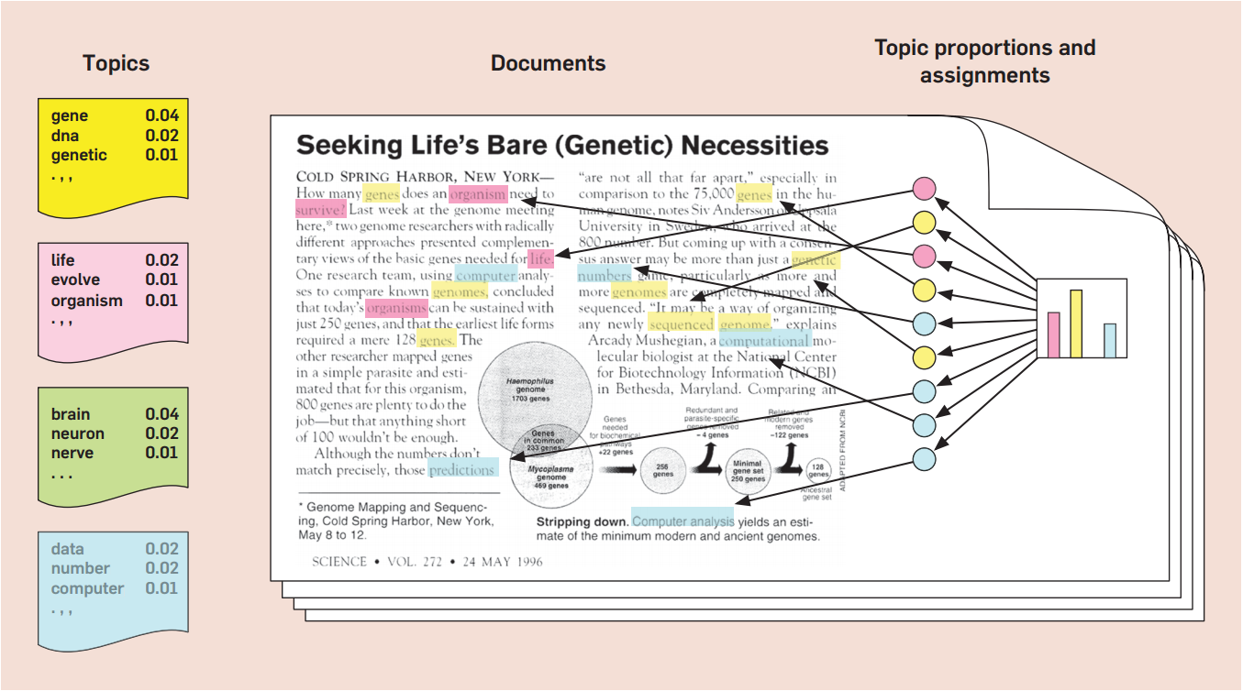
Topic Modeling - LDA
The figure below shows the intuitions behind latent Dirichlet allocation. We assume that some number of “topics”, which are distributions over words, exist for the whole collection (far left). Each document is assumed to be generated as follows. First choose a distribution over the topics (the histogram at right); then, for each word, choose a topic assignment (the colored coins) and choose the word from the corresponding topic .

Slide 12
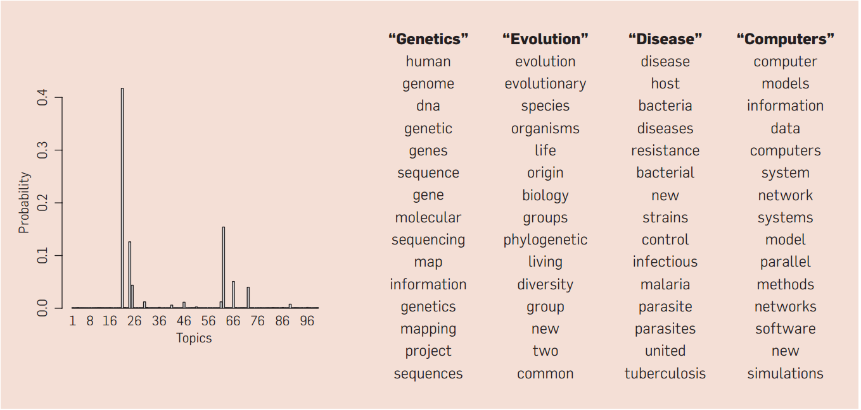
Topic Modeling - LDA
The figure below show real inference with LDA. 100-topic LDA model is fitted to 17,000 articles from journal Science. At left are the inferred topic proportions for the example article in previous figure. At right are the top 15 most frequent words from the most frequent topics found in this article.

Slide 13
Topic Modeling - Tools
Name | Model/Algorithm | Language | Author | Notes
lda-c | Latent Dirichlet allocation | C | D. Blei | This implements variational inference for LDA.
class-slda | Supervised topic models for classification | C++ | C. Wang | Implements supervised topic models with a categorical response.
lda | R package for Gibbs sampling in many models | R | J. Chang | Implements many models and is fast . Supports LDA, RTMs (for networked documents), MMSB (for network data), and sLDA (with a continuous response).
tmve | Topic Model Visualization Engine | Python | A. Chaney | A package for creating corpus browsers.
dtm | Dynamic topic models and the influence model | C++ | S. Gerrish | This implements topics that change over time and a model of how individual documents predict that change.
ctm-c | Correlated topic models | C | D. Blei | This implements variational inference for the CTM.
Mallet | LDA, Hierarchical LDA | Java | A. McCallum | Implements LDA and Hierarchical LDA
Stanford topic modeling toolbox | LDA, Labeled LDA, Partially Labeled LDA | Java | Stanford NLP Group | Implements LDA, Labeled LDA, and PLDA

Slide 14
Named Entity Recognition
Named entity refers to anything that can be referred to with a proper name.
Named entity recognition aims to
Find spans of text that constitute proper names
Classify the entities being referred to according to their type
Type | Sample Categories | Example
People | Individuals, fictional Characters | Turing is often considered to be the father of modern computer science.
Organization | Companies, parties | Amazon plans to use drone copters for deliveries.
Location | Mountains, lakes, seas | The highest point in the Catalinas is Mount Lemmon at an elevation of 9,157 feet above sea level.
Geo-Political | Countries, states, provinces | The Catalinas, are located north, and northeast of Tucson, Arizona, United States.
Facility | Bridges, airports | In the late 1940s, Chicago Midway was the busiest airport in the United States by total aircraft operations.
Vehicles | Planes, trains, cars | The updated Mini Cooper retains its charm and agility.
In practice, named entity recognition can be extended to types that are not in the table above, such as temporal expressions (time and dates), genes, proteins, medical related concepts (disease, treatment and medical events) and etc..

Slide 15
Named Entity Recognition
Named entity recognition techniques can be categorized into knowledge-based approaches and machine learning based approaches.
Category | Advantage | Disadvantage | Tools /Ontology
Knowledge-based approach | Require little training data | Creating lexicon manually is time-consuming and expensive; encoded knowledge might be importable across domains. | General Entity Types
 |  |  | WordNet
 |  |  | Lexicons created by experts
 |  |  | Medical domain:
 |  |  | GATE (University of Sherfield)
 |  |  | UMLS (National library of Medicine)
 |  |  | MedLEE (Originally from Columbia University, commericalized now)
Machine learning approach - Conditional Random Field (CRF) - Hidden Markov Model (HMM) | Reduced human effort in maintaining rules and dictionaries | Prepared a set of annotated training data | Conditional Random Field tools
 |  |  | Stanford NER
 |  |  | CRF++
 |  |  | Mallet
 |  |  | Hidden Markov Model tools
 |  |  | Mallet
 |  |  | Natural Language Toolkit(NLTK)

Slide 16
Entity Relation Extraction
Entity relation extraction discerns the relationships that exist among the entities detected in a text. Entity relation extraction techniques are applied in a variety of areas.
Question Answering
Extracting entities and relational patterns for answering factoid question
Feature/Aspect based Sentiment Analysis
Extract relational patterns among entity, features and sentiments in text R(entity, feature, sentiment).
Mining bio-medical texts
Protein binding relations useful for drug discovery
Detection of gene-disease relations from biomedical literature
Finding drug-side effect relations in health social media

Slide 17
Entity Relation Extraction
Entity relation extraction approaches can be categorized into three types
Category | Method | Advantage | Disadvantage | Tools
Co-occurrence Analysis | If two entities co-occur within certain distance, they are considered to have a relation | Simplicity and flexibility; high recall | Low precision; cant decide relation types
Rule-based approaches | Create rules for relation extraction based on syntactic and semantic information in the sentences | General, flexible; | Lower portability across different domains Manual encoding of syntactic and semantic rules | Syntactic information: Stanford Parser; OpenNLP; Semantic information: Domain Knowledge bases
Supervised Learning | Feature-based methods: feature representation Kernel-based methods: Kernel function | Little or no manual development of rules and templates | Annotated corpora is required. | Dan Bikel’s parser; MST parser; Stanford parser; SVM classifier: SVM-light LibSVM

Slide 18
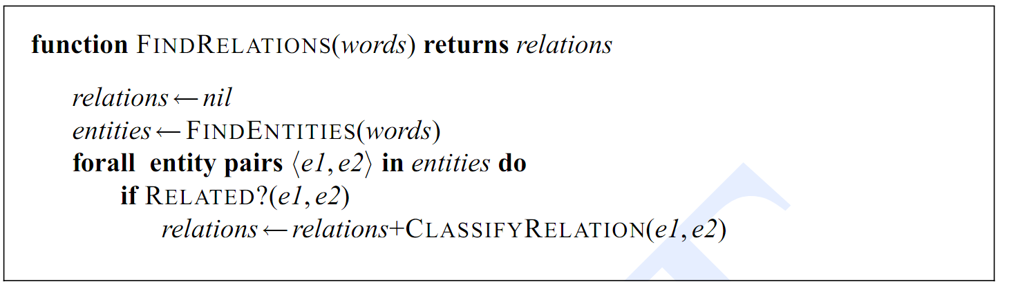
Supervised Learning Approaches for Entity Relation Extraction
Supervised learning approach breaks relation extraction into two subtasks (relation detection and relation classification). Each task is a text classification problem.
Supervised learning approach can be categorized by feature based methods and kernel based methods.
Classifier 1: Detect when a relation is present between two entities
Classifier 2: Classify the relation types
Feature based methods
Feature Extraction
Sentences
Text Analysis
(POS, Parse Trees)
Classifier
Kernel Function
Kernel based methods

Slide 19
Supervised Learning Approach to Entity Relation Extraction
Feature based methods rely on features to represent instances for classification. The features for relation extraction can be categorized into:
Entity-based features | Word-based features | Syntactic features
Entity types of the two candidate arguments | Bag-of-words and bag-of-bigrams between entities | Presence of particular constructions in a constituent structure
Concatenation of the two entity types | Stemmed version of Bag-of-words and bag-of-bigrams between entities | Chunk based-phrase paths
Headwords | Words and stems immediately preceding and following the entities | Bags of chunk heads
Bag-of-words from the arguments | Distance in words between the arguments | Dependency-tree paths
 | Number of entities between the arguments | Constituent-tree paths
 |  | Tree distance between the arguments

Slide 20
Supervised Learning Approach to Entity Relation Extraction
Kernel-based methods are an effective alternative to explicit feature extraction.
They retain the original representation of objects and use the object only via computing a kernel function between a pair of objects.
Kernel K(x,y) defines similarity between objects x and y implicitly in a higher dimensional space. Commonly used kernel functions for relation extractions are:
Author | Kernels | Description | Node attributes
Zelenko et al. 2003 | Shallow Parse Tree Kernel | Use shallow parse trees | entity type,word, POS tag
Culotta et al. 2004 | Dependency tree kernel | Use dependency parse trees | Word, POS, Generalized POS, Chunk tag, Entity Type, Entity level
Bunescu et al. 2005 | Shortest dependency path kernel | shortest path between entities in a dependency tree | Word, POS, Generalized POS, Entity Type

Slide 21
Ontology
Ontology represents knowledge as a set of concepts with a domain, using a shared vocabulary to denote types, properties, and interrelationships of those concepts.
In text mining, ontology is often used to extract named entities, detect entity relations and conduct sentiment analysis. Commonly used ontologies are listed in the table below:
Name | Creator | Description | Application
WordNet | Princeton University | A large lexical database of English. | Word sense disambiguation
 |  |  | Text summarization
 |  |  | Text similarity analysis
SentiWordNet | Andrea Esuli, Fabrizio Sebastian | A lexical resource for opinion mining. | Sentiment analysis
Linguistic Inquiry and Word Count (LIWC) | James W. Pennebaker, Roger J. Booth, Martha E. Francis | LIWC is a lexical resource for sentiment analysis. | Sentiment analysis
 |  |  | Affect analysis
 |  |  | Deception detection
Unified Medical Language System (UMLS) | US National Library of Medicine | The Unified Medical Language System (UMLS) is a compendium of many controlled vocabularies in the biomedical sciences. | Medical entity recognition
MedEffect | Canadian Adverse Drug Reaction Monitoring Program(CADRMP) | A knowledge base about drug and side effect in Canada | Medical entity recognition
 |  |  | Drug safety surveillance
Consumer Health Vocabulary (CHV) | University of Utah | Mapping consumer health vocabulary to standard medical terms in UMLS. | Medical entity recognition, Health social media analytics
FDA’s Adverse Event Reporting System (FAERS) | United States Food and Drug Administration | Documenting adverse drug event reports and drug indications of all the medical products in US market. | Medical entity recognition

Slide 22
WordNet
WordNet is an online lexical database in which English nouns, verbs, adjectives and adverbs are organized into sets of synonyms.
Each word represents a lexicalized concept. Semantic relations link the synonym sets (synsets).
WordNet contains more than 118,000 different word forms and more than 90,000 senses.
Approximately 17% of the words in WordNet are polysemous (have more than on sense); 40% have one or more synonyms (share at lease one sense in common with other words).

Slide 23
WordNet
Six semantic relations are presented in WordNet because they apply broadly throughout English and because a user need not have advanced training in linguistics to understand them. The table below shows the included semantic relations.
WordNet has been used for a number of different purposes in information systems, including word sense disambiguation, information retrieval, text classification, text summarization, machine translation and semantic textual similarity analysis .
Semantic Relation | Syntactic Category | Examples
Synonymy (similar) | Noun, Verb, Adjective, Adverb | Pipe, tube Rise, ascent Sad, happy Rapidly, speedily
Antonymy (opposite) | Adjective, Adverb | Wet, dry Powerful, powerless Rapidly, slowly
Hyponymy (subordinate) | Noun | Maple, tree Tree, plant
Meronymy (part) | Noun | Brim, hat Ship, fleet
Troponomy (manner) | Verb | March, walk Whisper, speak
Entailment | Verb | Drive, ride Divorce, marry

Slide 24
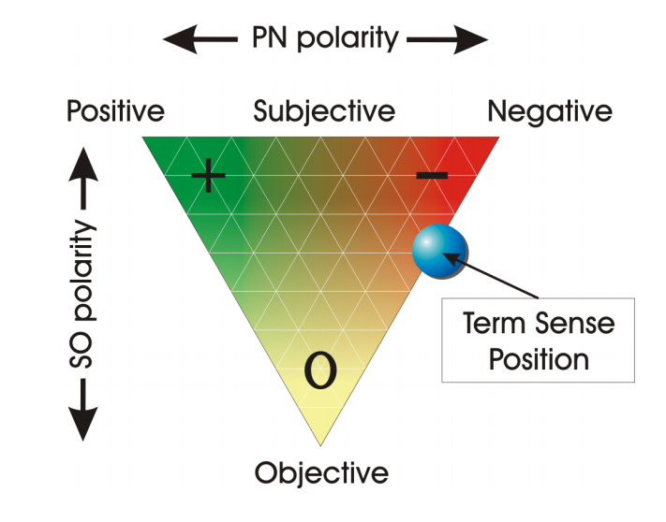
SentiWordNet
SentiWordNet is a lexical resource explicitly devised for supporting sentiment analysis and opinion mining applications.
SentiWordNet is the result of the automatic annotation of all the synsets of WordNet according to the notions of “positivity”, “negativity” and “objectivity”.
Each of the “positivity”, “negativity” and “objectivity” scores ranges in the interval [0.0,1.0], and their sum is 1.0 for each synset.
The figure above shows the graphical representation adopted by SentiWordNet for representing the opinion-related properties of a term sense.

Slide 25
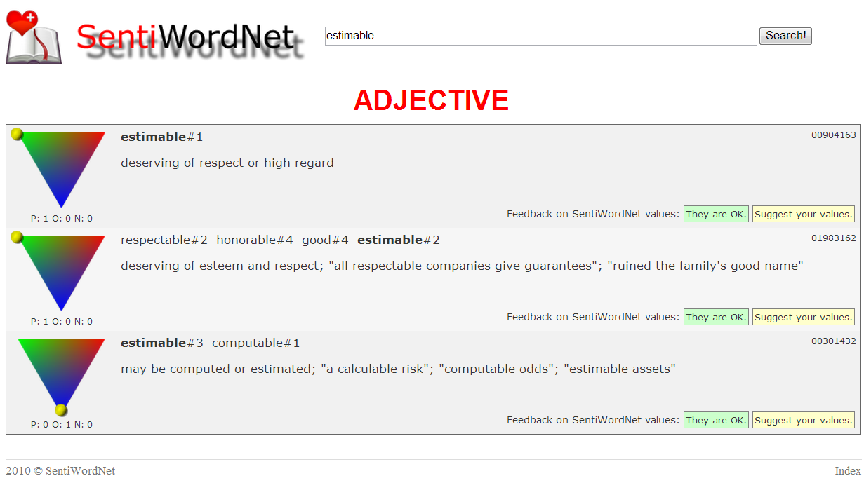
SentiWordNet
In SentiWordNet, different senses of the same term may have different opinion-related properties.
Search term
Sense 1
Positivity, objectivity and negativity score
Sense 2
Sense 3
Synonym of estimable in this sense
The figure above shows the visualization of opinion related properties of the term estimable in SentiWordNet (http://sentiwordnet.isti.cnr.it/search.php?q=estimable).

Slide 26
Linguistic Inquiry and Word Count (LIWC)
Linguistic Inquiry and Word Count (LIWC) is a text analysis program that looks for and counts word in psychology-relevant categories across text files.
Empirical results using LIWC demonstrate its ability to detect meaning in a wide variety of experimental settings, including to show attentional focus, emotionality, social relationships, thinking styles, and individual differences.
LIWC is often adopted in NLP applications for sentiment analysis, affect analysis, deception detection and etc..

Slide 27
Linguistic Inquiry and Word Count (LIWC)
The LIWC program has two major components: the processing component and the dictionaries.
Processing
Opens a series of text files (posts, blogs, essays, novels, and so on)
Each word in a given text is compared with the dictionary file.
Dictionaries: the collection of words that define a particular category
English dictionary: over 100,000 words across over 80 categories examined by human experts.
Major categories: functional words, social processes, affective processes, positive emotion, negative emotion, cognitive processes, biological processes, relativity and etc..
Multilingual: Arabic, Chinese, Dutch, French, German, Italian, Portuguese, Russian, Serbian, Spanish and Turkish.

Slide 28
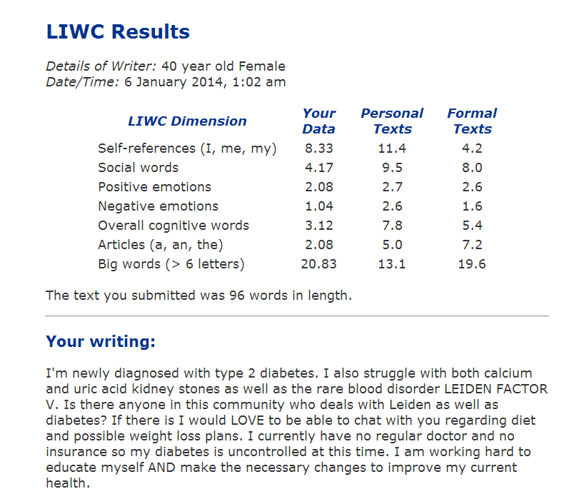
Linguistic Inquiry and Word Count (LIWC)
LIWC results from input text
LIWC results from personal text and formal writing for comparison
LIWC categories
Input text: A post from a 40 year old female member in American Diabetes Association online community
LIWC online demo: http://www.liwc.net/tryonlineresults.php

Slide 29
Unified Medical Language System (UMLS)
The Unified Medical Language System (UMLS) is a repository of biomedical vocabularies developed by the US National Library of Medicine.
UMLS integrates over 2.5 million names for 900,551 concepts from more than 60 families of biomedical vocabularies, as well as 12 million relations among these concepts.
Ontologies integrated in the UMLS Metathesaurus include the NCBI taxonomy, Gene Ontology (GO), the Medical Subject Headings (MeSH), Online Mendelian Inheritance in Man (OMIM), University of Washington Digital Anatomist symbolic knowledge base (UWDA) and Systematized Nomenclature of Medicine—Clinical Terms(SNOMED CT).

Slide 30
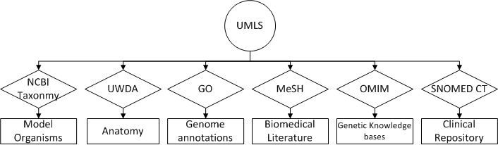
Unified Medical Language System (UMLS)
Major Ontologies integrated in UMLS
Name | Creator | Description | Application
National Center for Biotechnology Information (NCBI) Taxonomy | National Library of Medicine | All of the organisms in public sequence database | Identify organisms
University of Washington Digital Anatomist Source Information (UWDA) | University of Washington Structural Informatics Group | Symbolic models of the structures and relationships that constitute the human body. | Identify terms in anatomy
Gene Ontology (GO) | Gene Ontology Consortium | Gene product characteristics and gene product annotation data | Gene product annotation
Medical Subject Headings (MeSH) | National Library of Medicine | Vocabulary thesaurus used for indexing articles for PubMed | Cover terms in biomedical literature
Online Mendelian Inheritance in Man (OMIM) | McKusick-Nathans Institute of Genetic Medicine Johns Hopkins University | human genes and genetic phenotypes | Annotate human genes
Systematized Nomenclature of Medicine--Clinical Terms (SNOMED CT) | College of American Pathologists | Comprehensive, multilingual clinical healthcare terminology in the world | Identify clinical terms

Slide 31
Unified Medical Language System (UMLS)
Accessing UMLS data
No fee associated, license agreement required
Available for research purposes, restrictions apply for other kinds of applications
UMLS related tools
MetamorphoSys (command line program)
UMLS installation wizard and customization tool
Selecting concepts from a given sub-domain
Selecting the preferred name of concepts
MetaMap (Java)
Extracts UMLS concepts from text
Variable length of input text
Outputs a ranked listed of UMLS concepts associated with input text

Slide 32
MedEffect
MedEffect is the Canada Vigilance Adverse Reaction Online Database, which contains information about suspected adverse reactions to health products.
Report submitted by consumers and health professionals
Containing a complete list of medications, adverse reactions and drug indications (medical conditions for legit use of medication)
MedEffect is often used in healthcare research for annotating medications and adverse reactions from text (Leaman et al. 2010; Chee et al. 2011).

Slide 33
Consumer Health Vocabulary (CHV)
Consumer Health Vocabulary (CHV) is a lexicon linking UMLS standard medical terms to health consumer vocabulary.
Laypeople have different vocabulary from healthcare professionals to describe medical problems.
CHV helps to bridge the communication gap between consumers and healthcare professionals by mapping the UMLS standard medical terms to consumer health language.
It has been applied in prior studies to better understand and match user expressions for medical entity extraction in social media (Yang et al. 2012; Benton et al. 2011).

Slide 34
FDA’s Adverse Event Reporting System (FAERS)
FDA’s Adverse Event Reporting System(FAERS) documents adverse drug event reports and drug indications of all the medical products in US market.
Reports submitted by consumers, health professionals, pharmaceutical companies and researchers.
Containing complete list of medical products in United States and their suspected adverse reactions
FAERS has been applied in healthcare research for medical named entity recognitions and adverse drug event extractions (Bian et al. 2012, Liu et al. 2013).

Slide 35
MedEffect
MedEffect is the Canada Vigilance Adverse Reaction Online Database, which contains information about suspected adverse reactions to health products.
Report submitted by consumers and health professionals
Containing a complete list of medications, adverse reactions and drug indications (medical conditions for legit use of medication)
MedEffect is often used in healthcare research for annotating medications and adverse reactions from text (Leaman et al. 2010; Chee et al. 2011).

Slide 36
Consumer Health Vocabulary (CHV)
Consumer Health Vocabulary (CHV) is a lexicon linking UMLS standard medical terms to health consumer vocabulary.
Laypeople have different vocabulary from healthcare professionals to describe medical problems.
CHV helps to bridge the communication gap between consumers and healthcare professionals by mapping the UMLS standard medical terms to consumer health language.
It has been applied in prior studies to better understand and match user expressions for medical entity extraction in social media (Yang et al. 2012; Benton et al. 2011).

Slide 37
Word Embedding

Slide 38
Word Embedding
Word embedding is one of the most popular language models.
Representation of document vocabulary
It is capable of capturing context of a word in a document, semantic and syntactic similarity, relation with other words, etc.
Loosely speaking, word embeddings are vector representations of particular words.

Slide 39
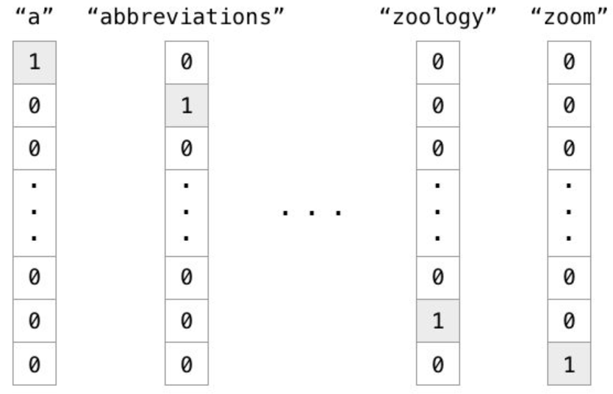
Why Do We Need It?
In the traditional Vector Space Model (VSM), each word is represented in a separate dimension.
The dimensionality of VSM equals the vocabulary size.
Each word is independent.

Slide 40
Why Do We Need It?
However, this one-hot representation does not capture the relationships between words.
E.g., “Berlin” <-> “Germany”, “Beijing” <-> “China”
The high dimensionality often leads to very sparse representations.
Word2Vec, one of the most popular technique to learn word embeddings, aims to learn a more compact (low-dimensionality) representation of words, with their relationships preserved.

Slide 41
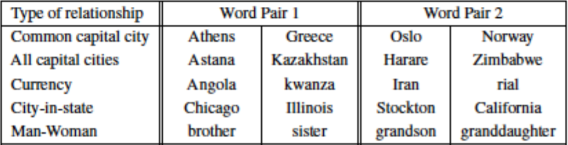
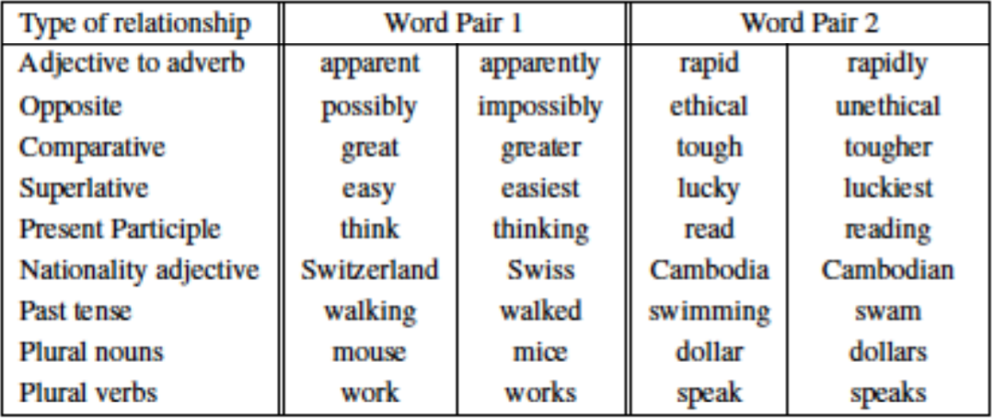
Word Relationships
Semantic
Syntactic

Slide 42
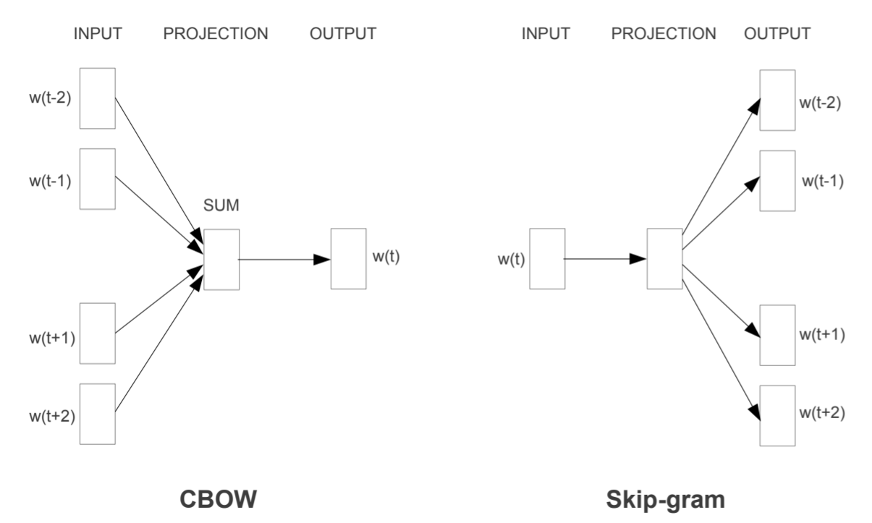
Word2Vec
Two methods (Mikolov et al. 2013a; 2013b):
Continuous Bag-of-Words (CBOW)
Skip-gram

Slide 43
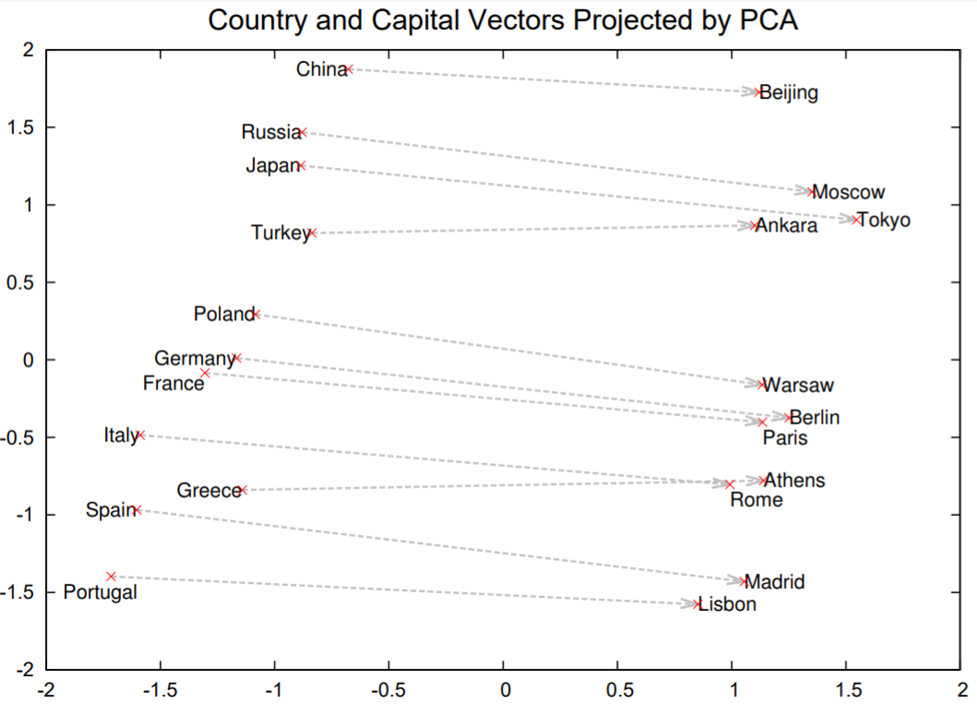
Word2Vec Visualization
Embeddings of sample word pairs trained with 1000-dimensional Skip-gram

Slide 44
Implementation
Self-trained embeddings
Keras has a specific layer, Embedding, that can turn positive integers (indexes) into dense vectors of fixed size. (https://keras.io/layers/embeddings)
Google pre-trained embeddings
Link; Tutorial
1.5GB; 3 million words and phrases
Trained on ~100 billion words from a Google News dataset
Vector dimensionality: 300

Slide 45
A-Z list of Open Source NLP toolkits

Slide 46
Name | Main Features | Language | Creators | Website
Antelope framework | Part-of-speech tagging, dependency parsing, WordNet lexicon | C#, VB.net | Proxem | [1]
Apertium | Machine translation for language pairs from Spanish, English, French, Portuguese, Catalan and Occitan | C++, Java | (various) | [2]
ClearTK | Wrappers for machine learning libraries (SVMlight, LibSVM, OpenNLP MaxEnt) and NLP tools (Snowball Stemmer, OpenNLP, Stanford CoreNLP) | Java | The Center for Computational Language and Education Research at the University of Colorado Boulder | [3]
cTakes | Sentence boundary detection, tokenization, normalization, POS tagging, chunking, context (family history, symptoms, disease, disorders, procedures) annotator, negation detection, dependency parsing, drug mention annotator | Java | Children's Hospital Boston, Mayo Clinic | [4]
DELPH-IN | Deep linguistic analysis: head-driven phrase structure grammar (HPSG) and minimal recursion semantic parsing | LISP, C++ | Deep Linguistic Processing with HPSG Initiative | [5]
Factorie | scalable NLP toolkit for named entity recognition, relation extraction, parsing, pattern matching, and topic modeling(LDA) | Java | University of Massachusetts Amherst | [6]
FreeLing | Tokenization, sentence splitting, contradiction splitting, morphological analysis, named entity recognition, POS tagging, dependency parsing, co -reference resolution | C++ | Universitat Politècnica de Catalunya | [7]
General Architecture for Text Engineering (GATE) | Information extraction (tokenization, sentence splitter, POS tagger, named entity recognition, coreference resolution), machine learning library wrapper (Weka, MaxEnt, SVMLight, RASP, LibSVM), Ontology (WordNet) | Java | GATE open source community | [8]
Graph Expression | Information extraction (named entity recognition, relation and fact extraction, parsing and search problem solving) | Java | Startup huti.ru | [9]

Slide 47
Name | Main Features | Language | Creators | Website
Learning Based Java | POS tagger, Chunking, coreference resolution, named entity recognition | Java | Cognitive Computation Group at UIUC | [10]
LingPipe | Topic classification, named entity recognition, clustering, POS tagging, spelling correction, sentiment analysis, logistic regression, word sense disambiguation | Java | Alias-i | [11]
Mahout | Scalable machine learning libraries (logistic regression, Naïve Bayes, Random Forest, HMM, SVM, Neural Network, Boosting, K-means, Fuzzy K-means, LDA, Expectation Maximization, PCA ) | Java | Online community | [12]
Mallet | Document classification(Naïve Bayes, Maximum Entropy, decision trees), sequence tagging (HMM, MEMM, CRF), topic modeling (LDA, Hierarchical LDA) | Java | University of Massachusetts Amherst | [13]
MetaMap | Map biomedical text to the UMLS Metathesaurus and discover Metathesaurus concepts referred to in text. | Java | National Library of Medicine | [14]
MII nlp toolkit | de-identification tools for free-text medical reports | Java | UCLA Medical Imaging Informatics (MII) Group | [15]
MontyLingua | Tokenization, POS tagging, chunking, extractors for phrases and subject/verb/object tuples from sentences, morphological analysis, text summarization | Python, Java | MIT | [16]
Natural Language Toolkit (NLTK) | Interface to over 50 open access corpora, lexicon resource such as WordNet, text processing libraries for classification, tokenization, stemming, POS tagging, parsing and semantic reasoning. | Python | Online community | [17]
NooJ (based onINTEX) | Morphological analysis, syntactic parsing, named entity recogntion | .NET Framework-based | University of Franche-Comté, France | [18]

Slide 48
Name | Main Features | Language | Creators | Website
OpenNLP | Tokenization, sentence segmentation, POS tagging, named entity extraction, chunking, parsing, coreference resolution | Java | Online community | [19]
Pattern | Wrapper for Google, Twitter and Wikipedia API, web crawler, HTML DOM parsing, POS tagging, n-gram search, sentiment analysis, WordNet, machine learning algorithms for clustering and classification, network analysis and visualization | Python | Tom De Smedt, CLiPS,University of Antwerp | [20]
PSI-Toolkit | Text preprocessing, sentence splitting, tokenization, lexical and morphological analysis, syntactic/ semantic parsing, machine translation | C++ | Adam Mickiewicz University in Poznań | [21]
ScalaNLP | Tokenization, POS tagging, sentence segmentation, sequence tagging (CRF, HMM), machine learning algorithms (linear regression, Naïve Bayes, SVM, K-Means, LDA, Neural Network ) | Scala | David Hall and Daniel Ramage | [22]
Stanford NLP | Tokenization, POS tagging, named entity recognition, parsing, coreference, topic modeling, classification (Naïve Bayes, logistic regression, maximum entropy), sequence tagging(CRF) | Java | The Stanford Natural Language Processing Group | [23]
Rasp | Tokenization, POS tagging, lemmatization, parsing | C++ | University of Cambridge, University of Sussex | [24]
Natural | Tokenization, stemming, classification (Naïve Bayes, logistic regression),morphological analysis, WordNet | JavaScript, NodeJs | Chris Umbel | [25]
Text Engineering Software Laboratory (Tesla) | Tokenization, POS tagging, sequence alignment | Java | University of Cologne | [26]
Treex | Machine translation | Perl | Charles University in Prague | [27]

Slide 49
Name | Main Features | Language | Creators | Website
UIMA | Industry standard for content analytics, contains a set of rule based and machine learning annotators and tools | Java / C++ | Apache | [28]
VisualText | Tokenization, POS tagging, named entity recognition, classification, text summarization | NLP++ / compiles to C++ | Text Analysis International, Inc | [29]
WebLab-project | Language identification, named entity recognition, semantic analysis, relation extraction, text classification and clustering, text summarization | Java / C++ | OW2 | [30]
UniteX | Tokenization, sentence boundary detection, parsing, morphological analysis, rule-based named entity recognition, text alignment, word sense disambiguation | Java & C++ | Laboratoire d'Automatique Documentaire et Linguistique | [31]
The Dragon Toolkit | tools for accessing PubMed, TREC collection, NewsGroup articles, Reuters Articles, and Google Search Engine, ontologies (UMLS, WordNet, MeSH), tokenization, stemming, POS tagging, named entity recognition, classification (Naïve Bayes, SVM-light, LibSVM, logistic regression), clustering (K-Means, hierarchical clustering), topic modeling(LDA), text summarization, | Java | Drexel University | [32]
Text Extraction, Annotation and Retrieval Toolkit | Tokenization, chunking, sentence segmenting, parsing, ontology(WordNet), topic modeling (LDA), named entity recognition, stemming, machine learning algorithms (decision tree, SVM, neural network) | Ruby | Louis Mullie | [33]
Zhihuita NLP API | Chinese text segmentation, spelling checking, pattern matching, | C | Zhihuita.org | [34]

Slide 50
Shared Tasks (Competitions) in Healthcare and Nature Language Processing Domains

Slide 51
Introduction
Shared task series in Nature Language Processing often represent a community-wide trend and hot topics which are not fully explored in the past.
To keep up with the state-of-the-art techniques and new research topics in NLP community, we explore major conferences, workshops, special interest groups belonging to Association for Computational Linguistics (ACL).
We organize our findings into two categories: ongoing shared tasks and watch list.
Ongoing list contains competitions that have already made task descriptions, data and schedules for 2014 publicly available.
International Workshop on Semantic Evaluation (SemEval)
CLEF eHealth Evaluation Lab
Watch list contains competitions that haven’t made content available but are relevant to our interests.
Conference on Nature Language Learning (CoNLL) Shared Tasks
Joint Conference on Lexical and Computational Semantics (*SEM) Shared Tasks
BioNLP
i2b2 Challenge

Slide 52
SemEval
Overview
SemEval, International Workshop on Semantic Evaluation, is an ongoing series with evaluation of computational semantic analysis systems. It evolved from the SensEval (word sense evaluation) series.
SIGLEX, a Special Interest Group on Lexicon of the Association for Computational Linguistics, is the umbrella organization for the SemEval.
SemEval- 2014 will be the 8th workshop on semantic evaluation. The workshop will be co-located with the 25th International Conference on Computational Linguistics (COLING) in Dublin, Ireland.

Slide 53
SemEval
Past workshops
Workshop | No. of Tasks | Areas of study | Languages of Data Evaluated
Senseval-1(1998) | 3 | Word Sense Disambiguation (WSD) - Lexical Sample WSD tasks | English, French, Italian
Senseval-2(2001) | 12 | Word Sense Disambiguation (WSD) - Lexical Sample, All Words, Translation WSD tasks | Czech, Dutch, English, Estonian, Basque, Chinese, Danish, English, Italian, Japanese, Korean, Spanish, Swedish
Senseval-3(2004) | 16 | Logic Form Transformation, Machine Translation (MT) Evaluation, Semantic Role Labeling, WSD | Basque, Catalan, Chinese, English, Italian, Romanian, Spanish
SemEval-2007 | 19 | Cross-lingual, Frame Extraction, Information Extraction, Lexical Substitution, Lexical Sample, Metonymy, Semantic Annotation, Semantic Relations, Semantic Role Labeling, Sentiment Analysis, Time Expression, WSD | Arabic, Catalan, Chinese, English, Spanish, Turkish
SemEval-2010 | 18 | Co-reference, Cross-lingual, Ellipsis, Information Extraction, Lexical Substitution, Metonymy, Noun Compounds, Parsing, Semantic Relations, Semantic Role Labeling, Sentiment Analysis, Textual Entailment, Time Expressions, WSD | Catalan, Chinese, Dutch, English, French, German, Italian, Japanese, Spanish
SemEval-2012 | 8 | Common Sense Reasoning, Lexical Simplification, Relational Similarity, Spatial Role Labeling, Semantic Dependency Parsing, Semantic and Textual Similarity | Chinese, English
SemEval-2013 | 14 | Temporal Annotation, Sentiment Analysis, Spatial Role Labeling, Noun Compounds, Phrasal Semantics, Textual Similarity, Response Analysis, Cross-lingual Textual Entailment, BioMedical Texts, Cross and Multi-lingual WSD, Word Sense Induction, and Lexical Sample | Catalan, French, German, English, Italian, Spanish

Slide 54
SemEval-2014
Task ID | Task Name | Description | Data
1 | Evaluation of compositional distributional semantic models (CDSMs) on full sentences | Subtask A: predicting the degree of relatedness between two sentences Subtask B: detecting the entailment relation holding between them | 10,000 English sentence pairs, each annotated for relatedness score in meaning and the entailment relation (entail, contradiction, and neutral) between the two sentences.
2 | Grammar Induction for Spoken Dialogue Systems | Creating clusters consisting of semantically similar fragments. For example, the following two fragments: “depart from <City>” and “fly out of <City>” are in the same cluster as they refer to the concept of departure city. | Training data will cover two domains: air travel and tourism. The data will be available in two languages: Greek and English.
3 | Cross-level semantic similarity | Evaluating similarity across different sizes of text: paragraph to sentence, sentence to phrase, phrase to word and word to sense. | Information about data hasn't been released yet.
4 | Aspect Based Sentiment Analysis | Subtask 1: Aspect term extraction Subtask 2: Aspect term polarity Subtask 3: Aspect category detection Subtask 4: Aspect category polarity | Two domain-specific datasets (restaurant reviews and laptop reviews), consisting of over 6,500 sentences with fine-grained aspect-level human-authored annotations will be provided.
5 | L2 writing assistant | Build a translation assistance system that concerns the translation of fragments of one language (L1), i.e. words or phrases in a second language (L2) context. For example, input (L1=French,L2=English): “I rentre à la maison because I am tired” Desired output: “I return home because I am tired”. | The data set covers the following L1 and L2 pairs : English-German, English-Spanish, French-English and Dutch-English. The trial data contains 500 sentences for each language pair. Information about training data hasn't been released yet.

Slide 55
SemEval-2014
Task ID | Task Name | Description | Data
6 | Spatial Robot Commands | Parse spatial robot commands using data from an annotated corpus, collected from a simplified ‘blocks world’ game (http://www.trainrobot.com) | In trial data, each natural language command is annotated into robot command. "Move the blue block on top of the grey block." is labeled as (event: (action: move) (entity: (color: blue) (type: cube)) (destination: (spatial-relation: (relation: above) (entity: (color: gray) (type: cube)))))
7 | Analysis of Clinical Text | Combine supervised methods for entity/acronym/abbreviation recognition and mapping to UMLS CUIs (Concept Unique Identifiers) with unsupervised discovery and sense induction of the entities/acronyms/abbreviations. | Information about data hasn't been released yet.
8 | Broad-Coverage and Cross-Framework Semantic Dependency Parsing | This task seeks to stimulate more generalized semantic dependency parsing and give a more direct analysis of ‘who did what to whom’ from sentences. | In trial data, 198 sentences from WSJ are annotated with the desired semantic representation.
9 | Sentiment Analysis for Twitter | Subtask A - Contextual Polarity Disambiguation: Given a message containing a marked instance of a word or a phrase, determine whether that instance is positive, negative or neutral in that context. Subtask B - Message Polarity Classification: Given a message, decide whether the message is of positive, negative, or neutral sentiment. | training: 9,728 Twitter messages development: 1,654 Twitter messages (can be used for training as well) development-test A: 3,814 Twitter messages (CANNOT be used for training) development-test B: 2,094 SMS messages (CANNOT be used for training)
10 | Semantic Textual Similarity in Spanish | Develop and evaluate the semantic textual similarity systems for Spanish | The annotations and systems will use a scale from 0 (no relation) to 4 (semantic equivalence), indicating the similarity between two sentences. A development dataset of 65 annotated sentence pairs is provided. The test data will consist of 300 sentence pairs.

Slide 56
SemEval-2014
Important Dates
Trial data ready Oct. 30, 2013
Training data ready Dec. 15, 2013
Test data ready Mar. 10, 2014
Evaluation end Mar. 30, 2014
Paper submission due Apr. 30, 2014
Paper reviews due May. 30, 2014
Camera ready due Jun. 30, 2014
Workshop Aug. 23-30, 2014, Dublin, Ireland

Slide 57
CLEF eHealth Evaluation Lab
Overview
The CLEF Initiative (Conference and Labs of the Evaluation Forum,) is a self-organized body whose main mission is to promote research, innovation, and development of information access systems with an emphasis on multilingual and multimodal information with various levels of structure.
Started from 2000, the CLEF aims to stimulate investigation and research in a wide range of key areas in the information retrieval domain, becoming well-known in the international IR community. The results were traditionally presented and discussed at annual workshops in conjunction with the European Conference for Digital Libraries (ECDL), now called Theory and Practice on Digital Libraries (TPDL).

Slide 58
CLEF eHealth Evaluation Lab
Overview
In Year 2013, CLEF started eHealth Evaluation Lab, a shared task focused on natural language processing(NLP) and information retrieval (IR) for clinical care.
The CLEF eHealth Evaluation Lab 2013 has three tasks:
Annotation of disorder mentions spans from clinical reports
Annotation of acronym/abbreviation mention spans from clinical reports
Information retrieval on medical related web documents

Slide 59
CLEF eHealth 2014
Task ID | Task | Description | Data
1 | Visual-Interactive Search and Exploration of eHealth Data | Subtask A: visualize discharge summary together with the disorder standardization and shorthand expansion data in an effective and understandable way for laypeople Subtask B:design a visual exploration approach that will provide an effective overview over a larger set of possibly relevant documents to meet the patient’s information need. | 6 de-identified discharge summaries and 50 real patient search queries genereated from the discharge summary
2 | Information extraction from clinical text | Develop annotated data, resources, methods that make clinical documents easier to understand from nurses and patients’ perspective. 10 different attributes: Negation Indicator, Subject Class, Uncertainty Indicator, Course Class, Severity Class, Conditional Class, Generic Class, Body Location, DocTime Class, and Temporal Expression, should be captured from clinical text and classified into certain value slot. | A set of de-identified clinical reports are provided by the MIMIC II database. A training set of 300 reports and their disease/disorder mention templates with filled attribute: value slots will be provided. A test set of 200 reports and their disease/disorder mention templates with default-filled attribute: value slots will be provided will be provided for the Task 2 challenge one week before the run submission deadline.
3 | User-centered health information retrieval | Subtask A: monolingual information retrieval task- retrieve the relevant medical documents for the user queries Subtask B: multilingual information retrieval task - German, French and Czech. | A set of medical-related documents in four languages (English, German, French and Czech) are provided by the Khresmoi project (approximately 1 million medical documents for each language). 5 training queries and 50 test queries are provided.

Slide 60
CLEF eHealth 2014
Important Dates
CLEF2014 Lab registration opens Nov 2013
Task data release begins Nov. 15 2013
Participant submission deadline: final submission to be evaluated May 01 2014
Results released Jun. 01 2014
Participant working notes (i.e., extended abstracts and reports) submission deadline Jun. 15 2014
CLEF eHealth lab session at CLEF 2014 in Sheffield, UK Sept. 15 - 18 2014

Slide 61
CoNLL
Overview
CoNLL, the Conference on Natural Language Learning is a yearly meeting of Special Interest Group on Nature Language Learning (SIGNLL) of the Association for Computational Linguistics (started from 1997).
Since 1999, CoNLL has included a shared task in which training and test data is provided by the organizers which allows participating systems to be evaluated and compared in a systematic way. Description of the systems and evaluation of their performances are presented both at the conference and in the proceedings.
The last CoNLL was held in August 2013, in Sofia, Bulgaria, Europe. Information about CoNLL 2014 and its shared task will be released in next month.

Slide 62
CoNLL
Recent shared tasks from CoNLL
Year | Task | Data | Language
2013 | Grammatical Error Correction | National University of Singapore Corpus of Learner English (NUSCLE) | English
2012 | Modeling Multilingual Unrestricted Coreference in OntoNotes | OntoNotes dataset from Linguistic Data Consortium | Arabic, Chinese, English
2011 | Modeling Unrestricted Coreference in OntoNotes | OntoNotes dataset from Linguistic Data Consortium | English
2010 | Subtask A: Learning to detect sentences containing uncertainty Subtask B: Learning to resolve the in-sentence scope of hedge cues | A: biological abstracts and full articles from the BioScope (biomedical domain) corpus B: paragraphs from Wikipedia possibly containing weasel information | English
2009 | Syntactic and Semantic Dependencies in Multiple Languages | Data with gold standard annotation of syntactic dependency, type of dependency, frame, role set and sense in multiple languages | English, Catalan, Chinese, Czech, German, Japanese and Spanish

Slide 63
*SEM
Overview
Joint Conference on Lexical and Computational Semantics (*SEM), started from 2012, is organized by Association for Computational Linguistics (ACL) Special Interest Group on Lexicon (SIGLEX) and Special Interest Group on Computational Semantics (SIGSEM).
The main goal of *SEM is to provide a stable forum for researchers working on different aspects of semantic processing.
Every *SEM conference includes a shared task in which training and test data are provided by the organizers, allowing participating systems to be evaluated and compared in a systematic way. *SEM 2014 will release information about shared task in Dec. or early Jan. 2014.

Slide 64
*SEM
*SEM 2012 shared task:
Description: Resolving the scope and the focus of negation
Data: Stories by Conan Doyle, and WSJ PropBank Data (about 8,000 sentences in total). All occurrences of negation, their scope and focus are annotated.
*SEM 2013 shared task:
Description: Create a unified framework for the evaluation of semantic textual similarity modules and characterize their impact on NLP applications.
The data covers 5 areas: paraphrase sentence pairs (MSRpar), sentence pairs from video descriptions (MSRvid), MT evaluation sentence pairs (MTnews and MTeuroparl) and gloss pairs (OnWN).

Slide 65
BioNLP
Overview
BioNLP shared tasks are organized by the ACL’s special Interest Group for biomedical natural language processing.
BioNLP 2013 was the twelfth workshop on biomedical natural language processing and held in conjunction with the annual ACL or NAACL meeting.
BioNLP shared tasks are bi-annual event held with the BioNLP workshop started from 2009. The next event will be held in 2015.

Slide 66
BioNLP Past Shared Tasks
Year | Task | Data | Released Date | End Date
2013 | 1. Genia Event Extraction from NFkB Knowledge base construction | NFKB Knowledge base | Oct. 2012 | Apr. 2013
 | 2. Cancer Genetics | PubMed Literature
 | 3. Pathway Curation | PubMed abstracts
 | 4. Corpus Annotation with Gene Regulation Ontology | PubMed Literature
 | 5. Bacteria Biotopes | Webpage documents with general information about bacteria species
 | 7. Gene Regulation Network in Bacteria | PubMed Abstracts
2011 | 1. GENIA | PubMed abstracts | Dec. 2010 | Apr. 2011
 | 2. Epigenetics and Post-translational Modifications | PubMed abstracts
 | 3. Infectious Diseases | PubMed abstracts
 | 4. Bacteria Biotopes | PubMed abstracts
 | 5. Bacteria Interactions | PubMed abstracts
 | 6. Co-reference | PubMed abstracts
 | 7. Gene/Protein Entity Relations | PubMed abstracts
 | 8. Gene renaming | PubMed abstracts
2009 | 1. core event extraction(identify events concerningwith the given proteins ) | PubMed abstracts | Dec. 15 2008 | Mar. 30 2009
 | 2. Event enrichment | PubMed abstracts
 | 3. Negation and speculation | PubMed abstracts

Slide 67
i2b2 Challenges
Informatics for Integrating Biology and the Bedside (i2b2) is an NIH funded National Center for Biomedical Computing (NCBC).
I2b2 center organizes data challenges to motivate the development of scalable computational frameworks to address the bottleneck limiting the translation of genomic findings and hypotheses in model systems relevant to human health.
I2b2 challenge workshops are held in conjunction with Annual Meeting of American Medical Informatics Association.

Slide 68
Previous i2b2 Challenges
Year | Task | Data | Release Date | End Date
2012 | Temporal relation extraction | EHR | Jun. 2012 | Sept. 2012
2011 | Co-reference resolution | EHR | Jun. 2011 | Sept. 2011
2010 | Relation extraction on medical problems | Discharge summaries | Apr. 2010 | Sept. 2010
2009 | Medication extraction | Narrative patient records | Jun. 2009 | Sept. 2009
2008 | Recognizing Obesity and co-morbidities | Discharge summaries | Mar. 2008 | Sept. 2008
2006 | De-identified discharge summaries | Discharge summaries | Jun. 2006 | Sept. 2006

Slide 69
Applying Text Mining In Health Social Media Research: An example

Slide 70
Extracting Adverse Drug Events from Health Social Forums
Online patient forums can provide valuable supplementary information on drug effectiveness and side effects.
Those forums cover large and diverse population and contain data directly from patients.
Patient forum ADE reports can serve as an economical alternative to expensive and time-consuming patient-oriented drug safety data collection projects.
It can help to generate new clinical hypothesis, cross-validate the adverse drug events detected from other data sources, and conduct comparison studies.
Post ID | Post Content | Contain ADE? | Report source
9043 | I had horrible chest pain [Event] under Actos [Treatment]. | ADE | Patient
12200 | From what you have said, it seems that Lantus [Treatment] has had some negative side effects related to depression [Event] and mood swings [Event]. | ADE | Hearsay
25139 | I never experienced fatigue [Event] when using Zocor [Treatment]. | Negated ADE | Patient
34188 | When taking Zocor [Treatment], I had headaches [Event] and bruising [Event]. | ADE | Patient
63828 | Another study of people with multiple risk factors for stroke [Event] found that Lipitor [Treatment] reduced the risk of stroke [Event] by 26% compared to those taking a placebo, the company said. | Drug Indication | Diabetes research

Slide 71


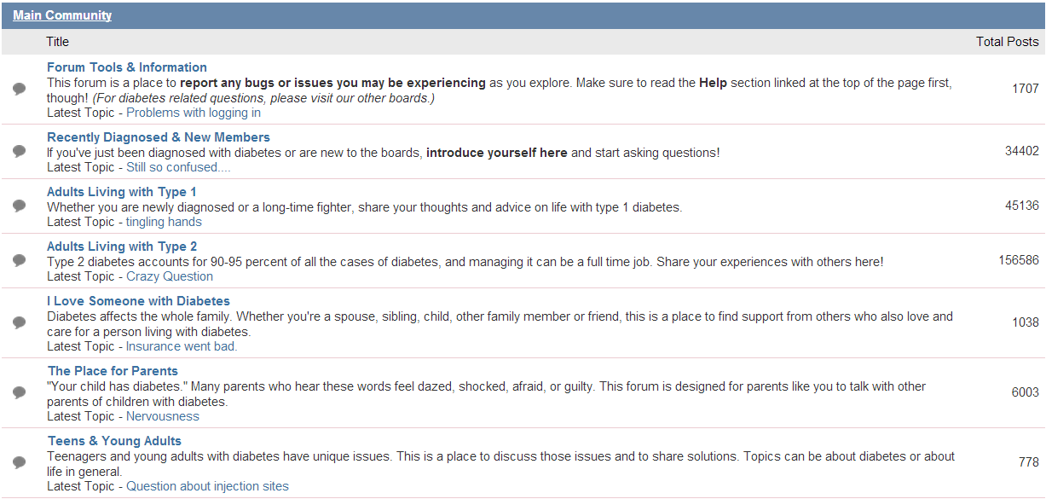
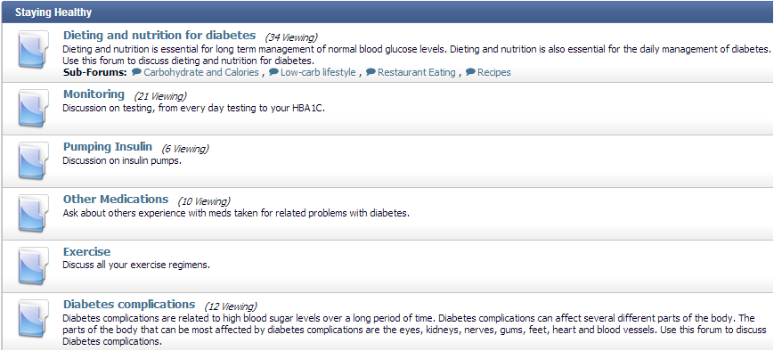
Test Bed
Discussion about disease monitoring and medical products
Discussion about disease and medical problems
Forum Name | Number of Posts | Number of Topics | Number of Member Profiles | Time Span | Total Number of Sentences
American Diabetes Association | 184,874 | 26,084 | 6,544 | 2009.2-2012.11 | 1,348,364
Diabetes Forums | 568,684 | 45,830 | 12,075 | 2002.2-2012.11 | 3,303,804
Diabetes Forum | 67,444 | 6,474 | 3,007 | 2007.2-2012.11 | 422,355

Slide 72
Extracting Adverse Drug Events from Health Social Forums
Challenges
Topics in patient social media cover various sources, including news and research, hearsay (stories of other people) and patient’s experience. Redundant and noisy information often masks patient-experienced ADEs.
Currently, extracting adverse event and drug relation in patient comments results in low precision due to confounding with drug indications (Legitimate medical conditions a drug is used for ) and negated ADE (contradiction or denial of experiencing ADEs) in sentences.
Solutions
Develop relation extractor for recognizing and extracting adverse drug event relations.
Develop a text classifier to extract adverse drug event reports based on patient experience.

Slide 73
Extracting Adverse Drug Event from Health Social Forums
Patient Forum Data Collection: collect patient forum data through a web crawler
Data Preprocessing: remove noisy text including URL, duplicated punctuation, etc, separate post to individual sentences.
Medical entity extraction: identify treatments and adverse events discussed in forum
Adverse drug event extraction: identify drug-event pairs indicating an adverse drug event based on results of medical entity extraction
Report source classification: classify the source of reported events either from patient experience or hearsay

Slide 74
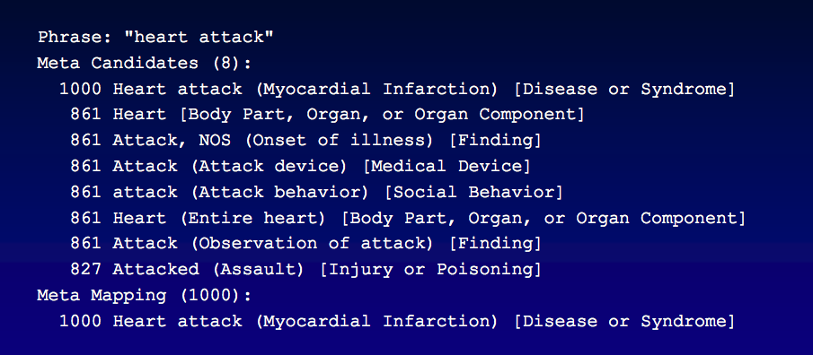
Medical Entity Extraction
Initialize the medical entity extraction with MetaMap to match terms related to drugs and ADEs in forum discussion.
Filter the terms extracted by MetaMap that never appear in FAERS reports.
Query Consumer Health Vocabulary for consumer preferred terms of the entities extracted by MetaMap and look up those consumer vocabularies in the discussions.
MetaMap is a Java API that extract medical terms in UMLS. The figure below shows sample output of MetaMap.
FAERS is FDA’s knowledge base which contains adverse drug event reports filed by consumers, doctors and drug companies.
ConsumerHealthVocabulary is a lexicon for mapping consumer preferred terms to terms in standard biomedical ontology such as UMLS.

Slide 75
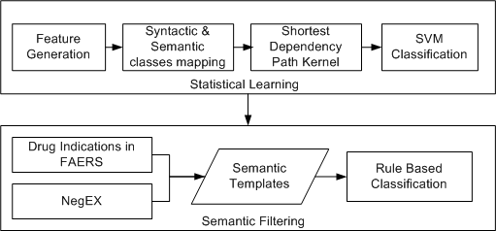
Adverse Drug Event Extraction
Kernel based statistical learning
Feature generation
Generate representations of the relation instances
Syntactic and semantic classes mapping
Categorize lexical features into syntactic and semantic classes to reduce the feature sparsity
Shortest dependency path kernel
Compute the similarity score between two relation instances
SVM Classification
Determine the hyperplane between instances with a relation and instances without a relation
Semantic filtering
Drug indications from FAERS
Incorporate medical domain knowledge for differentiating drug indication from adverse events
NegEX
Incorporate linguistic knowledge to identify negated adverse drug events.
Semantic templates
Form filtering templates using the knowledge from FAERS and NegEX.
Rule based classification
Classify relation instance based on the templates.

Slide 76
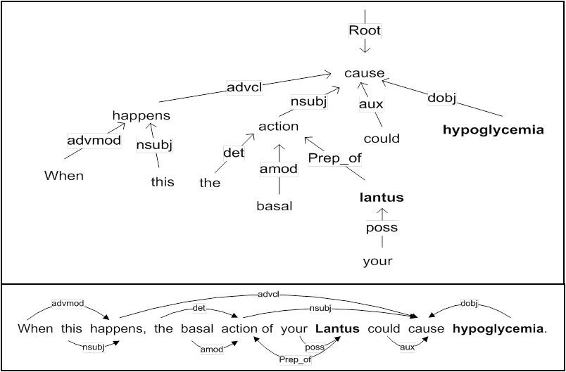
Adverse Drug Event Extraction
Feature generation
We utilized the Stanford Parser (http://nlp.stanford.edu/software/stanford-dependencies.shtml) for dependency parsing.
The figure above shows the dependency tree of a sentence. In this sentence, hypoglycemia is an adverse event and Lantus is a diabetes treatment. Grammatical relations between words are illustrated in the figure. For instance, ‘cause’ and ‘hypoglycemia’ have a relation ‘dobj’ as ‘hypoglycemia’ is the direct object of ‘cause’. In this relation, ‘cause’ is the governor and ‘hypoglycemia’ is the dependent.

Slide 77
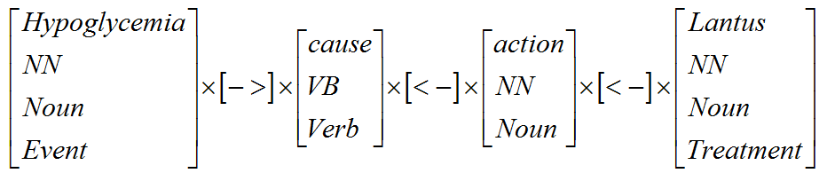
Adverse Drug Event Extraction
Syntactic and Semantic Classes Mapping
To reduce the data sparsity and increase the robustness of our method, we expand shortest dependency path by categorizing words on the path into syntactic and semantic classes with varying degrees of generality.
Word classes include part-of-speech (POS) tags and generalized POS tags. POS tags are extracted with Stanford CoreNLP packages. We generalized the POS tags with Penn Tree Bank guidelines for the POS tags. Semantic types (Event and Treatments) are also used for the two ends of the shortest path.
Syntactic and Semantic Classes Mapping from dependency graph
The relation instance in the figure above is represented as a sequence of features X=[x1,x2,x3,x4,x5,x6,x7],
where x1={Hypoglycemia, NN, Noun, Event}, x2={->}, x3={cause, VB, Verb}, x4 ={<-}, x5={action, NN, Noun}, x6={<-}, x7={Lantus, NN, Noun, Treatment}.

Slide 78
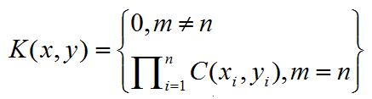
Adverse Drug Event Extraction
Shortest Dependency Path Kernel function
If x=x1x2…xm and y=y1y2..yn are two relation examples, where xi denotes the set of word classes corresponding to position i, the kernel function is computed as in equation below (Bunescu et al. 2005).
is the number of common word classes between x_{i} and y_{i}.
Relation instance X=[{Hypoglycemia, NN, Noun, Event}, {->}, {cause, VB, Verb}, {<-}, {action, NN, Noun}, {<-}, {Lantus, NN, Noun, Treatment}].
Relation instance y=[{depression, NN, Noun, Event}, {->}, {indicate, VBP, Verb}, {<-}, {effect, NN, Noun}, {<-}, {Lantus, NNP, Noun, Treatment}].
K(x,y) can be computed as the product of the number of common features x_{i} and y_{i} in position i.
K(x,y)=3*1*1*1*2*1*3=18.

Slide 79
Adverse Drug Event Extraction
SVM Classification
There are a lot of SVM software/tools have been developed and commercialized.
Among them, SVM-light package and LIBSVM are two of the most widely used tools. Both are free of charge and can be downloaded from the Internet.
SVM-light is available at http://svmlight.joachims.org/
LIBSVM can be found at http://www.csie.ntu.edu.tw/~cjlin/libsvm/

Slide 80
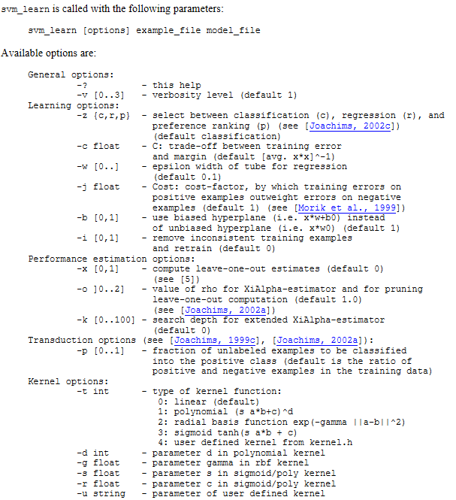
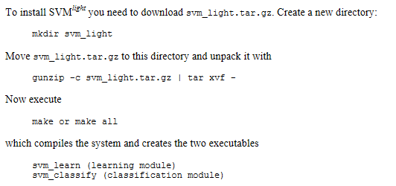
Adverse Drug Event Extraction
SVM-light

Slide 81
Adverse Drug Event Extraction
Algorithm . Statistical Learning for Adverse Drug Event Extraction
Input: all the relation instances with a pair of related drug and medical events, R(drug, event).
Output: whether the instances have a pair of related drug and event
Procedure:
1. For each relation instance R(drug,event) :
Generate Dependency tree T of R(drug,event)
Features = Shortest Dependency Path Extraction (T, R)
Features = Syntactic and Semantic Classes Mapping (Features)
2. Separate relation instances into training set and test set
3. Train a SVM classifier C with shortest dependency kernel function based on the training set
4. Use the SVM classifier C to classify instances in the test set into two classes R(drug, event) = True and R(drug, event) = False.

Slide 82
Adverse Drug Event Extraction
Algorithm . Semantic Filtering Algorithm
Input: a relation instance i with a pair of related drug and medical events, R(drug, event).
Output: The relation type.
If drug exists in FAERS:
Get indication list for drug;
For indication in indication list:
If event= indication:
Return R(drug, event) = ‘Drug Indication’;
For rule in NegEX:
If relation instance i matches rule:
Return R(drug, event) = ‘Negated Adverse Drug Event’;
Return R(drug, event) = ‘Adverse Drug Event’;

Slide 83
Report Source Classification
In order to classify the report source of adverse drug events, we developed a feature-based classification model to distinguish patient reports from hearsay based on the prior studies.
We adopted BOW features and Transductive Support Vector Machines in SVM-light for classification.

Slide 84
Evaluation on Medical Entity Extraction
The performance of our system (F-measure) surpasses the best performance in prior studies ( F-measure73.9% ), which is achieved by applying UMLS and MedEffect to extract adverse events from DailyStrength (Leaman et al., 2010). There may be several causes for our approach to outperform prior work.
Combination of multiple lexicons improves precision.
DailyStrength is a general health social website where users may have more diverse health vocabulary and develop more linguistic creativity. Extracting medical named entities could be more difficult than our data source.

Slide 85
Evaluation on Adverse Drug Event Extraction
Compared to co-occurrence based approach (CO), statistical learning (SL) contributed to the increase of precision from around 40% to above 60% while the recall dropped from 100% to around 60%. F-measure of SL is better than CO method.
Semantic filtering (SF) further improved the precision in extraction from 60% to about 80% by filtering drug indications and negated ADEs.

Slide 86
Evaluation on Report Source Classification
Without report source classification (RSC), the performance of extraction is heavily affected by noise in the discussion.
The precision ranged from 51% to 62% without RSC.
Overall performance (F-measure) ranged from 68% to 76%
After report source classification, the precision and F-measure significantly improved.
The precision increased from 51% up to 84%
The overall performance (F-measure ) increased from 68% to above 80%.

Slide 87
Contrast of Our Proposed Framework to Co-occurrence based approach
2972
1069
652
3652
1387
721
1072
421
194
There are a large number of false adverse drug events which couldn’t be filtered out by co-occurrence based approach.
Based on our approach , only 35% to 40% of all the relation instances contain adverse drug events.
Among them, about 50% comes from patient reports.

Slide 88
References
*SEM: http://ixa2.si.ehu.es/starsem/
CoNLL: http://ifarm.nl/signll/conll/
SemEval: http://alt.qcri.org/semeval2014/
CLEF eHealth: http://clefehealth2014.dcu.ie/home
BioNLP: http://2013.bionlp-st.org/
I2b2:https://www.i2b2.org/
Benton A., Ungar L., Hill S., Hennessy S., Mao J., Chung A., & Holmes J. H. (2011). Identifying potential adverse effects using the web: A new approach to medical hypothesis generation. Journal of biomedical informatics, 44(6), pp. 989-996.
Bian, J., Topaloglu, U., & Yu, F. (2012). Towards large-scale twitter mining for drug-related adverse events. In Proceedings of the 2012 ACM International Workshop on Smart health and wellbeing, pp. 25-32.
Bunescu R.C., Mooney R.J. (2005). A Shortest Path Dependency Kernel for Relation Extraction. In: Proceedings of the conference on Human Language Technology and Empirical Methods in Natural Language Processing, pp. 724-731.
Chee B. W., Berlin R., & Schatz B. (2011). Predicting adverse drug events from personal health messages. In: AMIA Annual Symposium Proceedings Vol. 2011, pp. 217-226
Culotta, A., & Sorensen, J. (2004, July). Dependency tree kernels for relation extraction. In Proceedings of the 42nd Annual Meeting on Association for Computational Linguistics Association for Computational Linguistics, pp. 423-429.
Leaman R., Wojtulewicz L, Sullivan R, Skariah A., Yang J, Gonzalez G. (2010) Towards Internet- Age Pharmacovigilance: Extracting Adverse Drug Reactions from User Posts to Health-Related Social Networks, In: Proceedings of the 2010 Workshop on Biomedical Natural Language Processing, ACL, pp.117-125.
Liu, X., & Chen, H. (2013). AZDrugMiner: an information extraction system for mining patient-reported adverse drug events in online patient forums. In Smart Health. Springer Berlin Heidelberg, pp. 134-150.
Yang C. C., Yang H., Jiang L., & Zhang M. (2012). Social media mining for drug safety signal detection. In: Proceedings of the 2012 international workshop on Smart health and wellbeing ACM, pp. 33-40.
Zelenko D., Aone C. and Richardella A(2003): Kernel methods for relation extraction. Journal of Machine Learning Research, 3, pp.1083-1106.

Slide 89
References
Mikolov, T., Chen, K., Corrado, G., & Dean, J. (2013). Efficient estimation of word representations in vector space. arXiv preprint arXiv:1301.3781; ICLR Workshop.
Mikolov, T., Sutskever, I., Chen, K., Corrado, G. S., & Dean, J. (2013). Distributed representations of words and phrases and their compositionality. In Advances in Neural Information Processing Systems (pp. 3111-3119).

