Slide 1
What Can Ontology and Natural Language Do for Each Other?
Julia M. Taylor
Purdue University

Slide 2
This is What this Talk attempts to cover
“Understanding” explicit information from text (using ontology)
Determining (guessing?) implicit information from text (using ontology)
Enriching ontology from text information (present and absent)
Testing ontology by determining what unknown words can mean
What happens when there are multiple interpretations of text?
Notes:
Not necessarily in this order

Slide 3
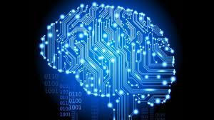
What is ontology
Specification of conceptualization
vs.
Study of nature of being, existence, reality
Image: http://www.gizmag.com/ibm-supercomputer-simulates-a-human-sized-brain/25093/
Notes:
Reasoning?

Slide 4
Beware of false knowledge; it is more dangerous than ignorance.
George Bernard Shaw

Slide 5
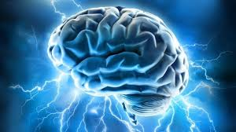
What is natural language
Language that humans(?) use to communicate with each other naturally
Image: http://www.iflscience.com/brain/direct-brain-brain-communication-used-humans
Notes:
Cognitively normal human beings are able to learn

Slide 6
The single biggest problem in communication is the illusion that it has taken place
George Bernard Shaw

Slide 7
Is there any overlap?

Slide 8
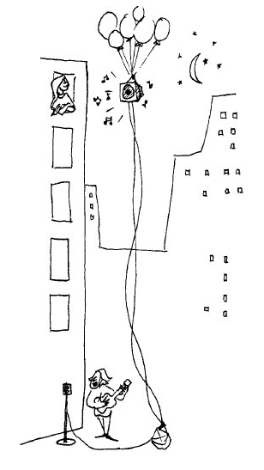
If the balloons popped, the sound wouldn’t be able to carry since everything would be too far away from the correct floor. A closed window would also prevent the sound from carrying, since most buildings tend to be well insulated. Since the whole operation depends on a steady flow of electricity, a break in the middle of the wire would also cause problems. Of course, the fellow could shout, but the human voice is not loud enough to carry that far. An additional problem is that a string could break on the instrument. Then there could be no accompaniment to the message. It is clear that the best situation would involve less distance. Then there would be fewer potential problems. With face to face contact, the least number of things could go wrong.
Bransford, J.D., & Johnson, M.K. (1972). Contextual prerequisites for understanding: Some investigations of comprehension and recall. Journal of Verbal Learning and Verbal Behavior, 11, 717-726.
Notes:
Robustness, grain size, etc

Slide 9
What Can computer ‘see’?
If the balloons popped, the sound wouldn’t be able to carry since everything would be too far away from the correct floor.
A closed window would also prevent the sound from carrying, since most buildings tend to be well insulated.

Slide 10







Ontological Semantic Technology
POST (Processor for OST Modules)
Unattested input
InfoBase Know-ge
… Adv. Modules…
Syntax
Phonology
Morpholog
Onto restr
Com sense
Input (Texts, Data, etc.)
TMRs (Text Meaning Representations)
NL e.g. English
Phon
Morph
InfoBase
Shorthand and Common-Sense Rules
Syntax
Lexicon/Onomasticon
Ontology
J.M. Taylor, V. Raskin, C.F. Hempelmann, "From Disambiguation Failures to Common-Sense Knowledge Acquisition: A Day in the Life of an Ontological Semantic System," Web Iintelligence Conference, Lyon, France, August 2011
JM. Taylor, V. Raskin, and LM. Stuart “Machine Human Understanding: Syntax and Semantics Revisited,” IEEE-SMC Conference, Seoul, South Korea, October 2012

Slide 11
1 onto, N natural languages
Hong, JH (2013) Ontology-based robotics communication using natural language processing in the firefighting domain, MS thesis, unpublished, Purdue University, 2013

Slide 12
If the balloons popped, the sound wouldn’t be able to carry since since everything would be too far away from the correct floor
A closed window would also prevent the sound from carrying, since most buildings tend to be well insulated

Slide 13
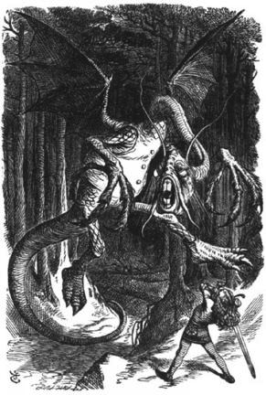
"Beware the Jabberwock, my son! The jaws that bite, the claws that catch! Beware the Jubjub bird, and shun The frumious Bandersnatch!"
He took his vorpal sword in hand: Long time the manxome foe he sought -- So rested he by the Tumtum tree, And stood awhile in thought.
And, as in uffish thought he stood, The Jabberwock, with eyes of flame, Came whiffling through the tulgey wood, And burbled as it came!
One, two! One, two! And through and through The vorpal blade went snicker-snack! He left it dead, and with its head He went galumphing back.
"And, has thou slain the Jabberwock? Come to my arms, my beamish boy! O frabjous day! Callooh! Callay!’ He chortled in his joy.
Lewis Carrol, Through the Looking-Glass and What Alice Found There, 1872
http://www.jabberwocky.com/carroll/jabber/jabberwocky.html

Slide 14


How can it work?
1
0
Taylor, JM & Raskin, V. (2011). Understanding the unknown: Unattested input processing in natural language. Proceedings of Fuzz-IEEE, 2011.
Notes:
There are two ways of checking the ontology: 1) from explicit text; 2) by defaults (3: this)

Slide 15
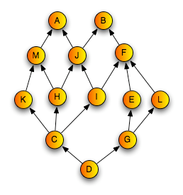
Guessing the Unknown
A man opened the door to his house with xyz
A man opened the door to his house with his girlfriend in his arms
A man opened the door to his house with the pretty view (not his other house that doesn’t have it)
A man opened the door to his house with a new keyless remote combination
Notes:
This is where we are getting into defaults

Slide 16
unattested input testing
Randomly selected from 4469 transitive verbs, until 100 was reached
189 senses (59 with no examples, 30 unacceptable interpretation)
Replaced direct objects in examples with zzz
She decided she would rethink the new curtains before buying them for the whole house →She decided she would rethink zzz before buying them for the whole house.
zzz could take place of any object or events in the ontology, but not a property
34.4% unacceptable
13% no worse that what a human would do
Taylor, JM, Raskin, V, & Hempelmann, CF. (2011). Towards computational guessing of unknown word meanings: The Ontological Semantics Approach. Proceedings of Cognitive Science Conference, 2011.
Notes:
The constantly barking dog infuriated the neighbors -> wide receiver.
the engine emitted steam -> shampoo, beer, yogurt

Slide 17
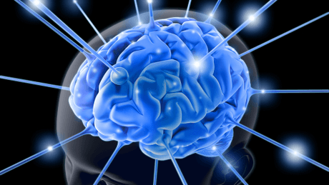
Defaults: How useful are they for ontology?
Sam opened the door to his house with xyz
?Sam opened the door to his house with a key
Sam opened the door to his house with a broken key
Sam opened the door to his house and …
Image: http://www.nimh.nih.gov/health/educational-resources/brain-basics/brain-basics.shtml
Notes:
Anonymization, medical databases, annotations, etc

Slide 18
WD-inference
Facebook update:
A white dude was hitting on me all night
Taylor, JM, Raskin, V., Hempelmann, CF & Attardo, S (2010) An unintended inference and ontological property defaults. Proceedings of IEEE SMC 2010.

Slide 19
Jokes, Defaults, Stereotypes

Slide 20
Computer’s Interpretation is not always… good
The pope had become very ill and was taken to many doctors, all of whom could not figure out how to cure him. Finally he was brought to an old physician, who stated that he could figure it out. After about an hour's examination he came out and told the cardinals that he knew what was wrong. He said that the bad news was that it was a rare disorder of the testicles. He said that the goods news was that all the pope had to do to be cured was to have sex. Well, this was not good news to the cardinals, who argued about it at length. Finally they went to the pope with the doctor and explained the situation. After some thought, the pope stated, "I agree, but under four conditions.” The cardinals were amazed and there arose quite an uproar. Over all of the noise there arose a single voice that asked, "And what are the four conditions?” The room stilled. There was a long pause. The pope replied, "First the girl must be blind, so that she cannot see with whom she is having sex. "Second, she must be deaf, so that she cannot hear with whom she is having sex. "And third she must be dumb so that if somehow she figures out with who she is having sex, she can tell no one". After another long pause a voice arose and asked, "And the fourth condition"? The pope smiled and replied, "Big Boobs".
→ concept of erectile-dysfunction is activated

Slide 21
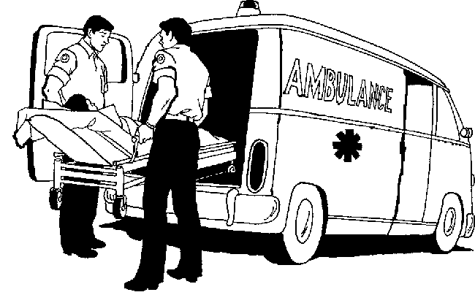
The Serious Business of Humor
Andy didn't want to go on the blind date that Tom had arranged for him. "What if she's really ugly and I hate her?" he complained. "Then just clutch your chest and fake a heart attack," Tom replied. Andy thought this was a good idea, so he agreed to go through with it. He went to the address Tom had given him, and a beautiful woman answered the door. "Hi, I'm your blind date!" Andy said. The woman clutched her chest and fell to the ground.
One of many internet version

Slide 22
Blind Date joke: Simplified structure
worry: experiencer: Andy
reason
Blind date:
partic-nt: Andy
partic-nt: woman
Anticipating the date
during
advice:
agent: friend
Benefic: Andy
topic
scream:
agent: Andy
before
Heart-attack:
agent: Andy
epistemic: no
condition
appearance:
patient: woman
beauty: low
appearance:
patient: girl
beauty: high
sexiness: high
descript
scream:
agent: woman
expected: no
Heart-attack:
agent: woman
epistemic: no
before
clutch:
agent: woman
theme: chest
before
fall:
agent: woman
location: ground
Actual date

Slide 23
3 manipulated versions of the same joke
1c
Andy is going on a blind date but is worried that she may turn out to be ugly. A friend advises him to fake a heart attack then. The date turns out to be beautiful and sexy, but she suddenly clutches her chest and falls to the ground.
1d
Andy is going on a blind date. He asks a friend, “What do I do if she’s ugly?” The friend advises him, “If you don’t like what you see, just clutch your chest and fake a heart attack.” The date turns out to be beautiful and sexy, but she suddenly clutches her chest and falls to the ground.
1e
Andy is going on a blind date but is worried that she may turn out to be ugly. A friend of both advises him to scream and fake a heart attack if he doesn’t want to stay for a long time. When Andy comes to the provided address, the date turns out to be beautiful and sexy, but she suddenly screams “aaauuuhhh,” clutches her chest and falls to the ground.

Slide 24
5 versions, summarized?
Anticipating the date
Dialog:
worry: experiencer: M2
reason
Blind date:
partic-nt: M2
partic-nt: F1
theme
setup:
agent: M1 (friend of M2; friend of F1)
during
Expository text:
advice:
agent: M1
benefic: M2
topic
scream:
agent: M2
before
clutch:
agent: M2
theme: chest
Version 1
Version 2
Version 3
Version 4
Version 5
condition
before
appearance:
patient: F1
beauty: low
meet:
partic-nt: M2
partic-nt: F1
Motion_event:
agent: M2
towards: door
Heart-attack:
agent: M2
epistemic: no
before
fall:
agent: M2
location: ground
Dialog:
appearance:
patient: F1
beauty: high
sexiness: high
descript
scream:
agent: F1
expected: no
Heart-attack:
agent: F1
epistemic: no
before
Motion_event:
agent: M2
towards: door
meet:
partic-nt: M2
partic-nt: F!
clutch:
agent: F1
theme: chest
fall:
agent: F1
location: ground
before
Actual date
Notes:
Not a single version of the joke provides all the links.

Slide 25
So… What Can they do for each other?
NL for ontology
Perfect tool for verification
Can be used for enrichment
Ontology for NL
Shows multiple possible interpretations, even when unintended by human
Competing views
Unintended inference

Slide 26
Thank you!
Questions?

