Slide 1
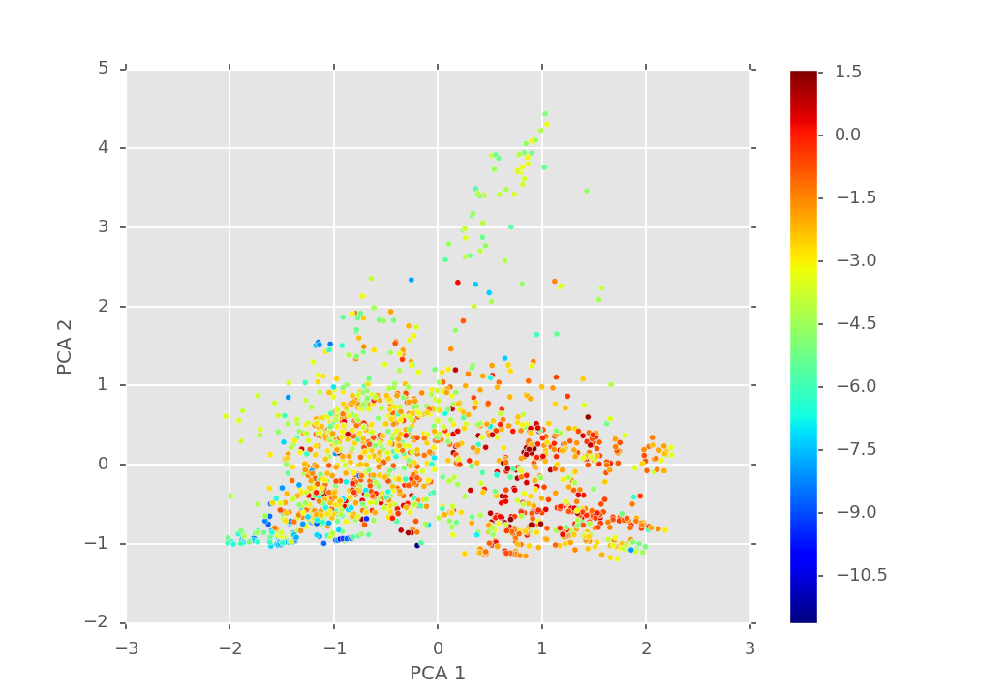
Principle component analysis of Morgan fingerprints to visually inspect properties in chemical space.
Some general clustering trends can be seen about the different fingerprint regions that contributed to solubility.

Slide 2
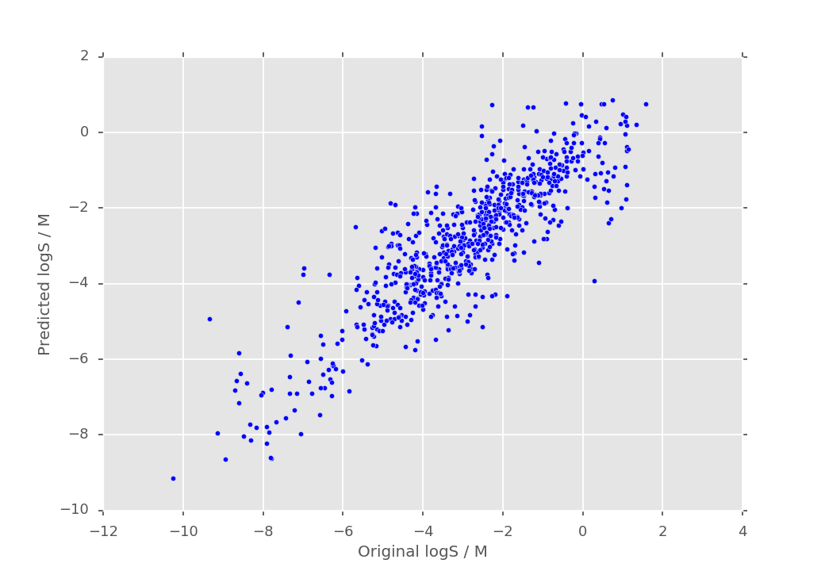
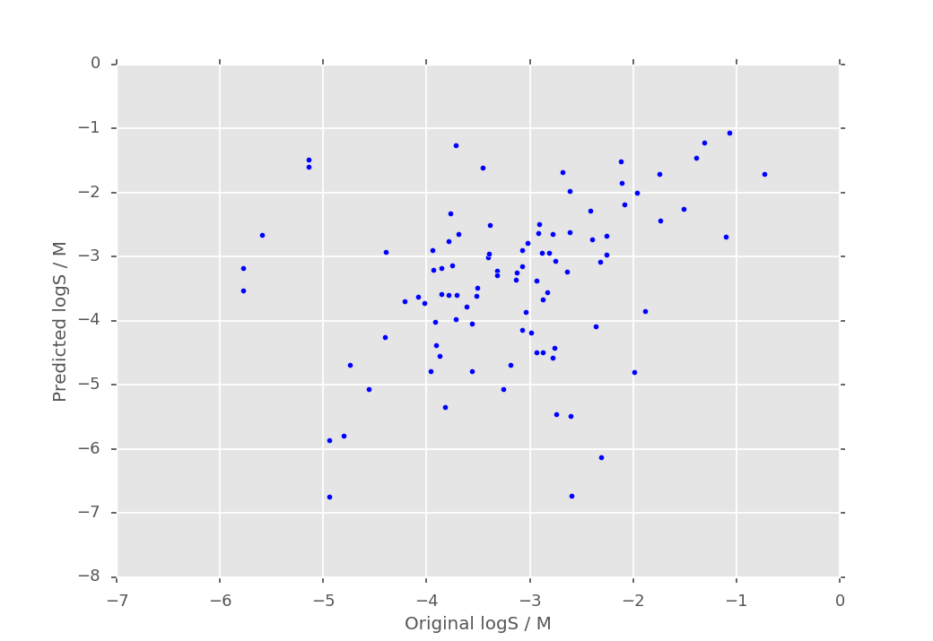
Used kernel ride regression on molecular fingerprints on larger database (without PubChem data) to predict logS values.
Tested linear and radial basis function kernel and obtained similar accuracies, suggesting linear relationships
Grid search approach to identify best hyperparameters for the model.
R^2 = -2.2
RMSE = 0.96
R^2 = 0.77
RMSE = 1.36

Slide 3
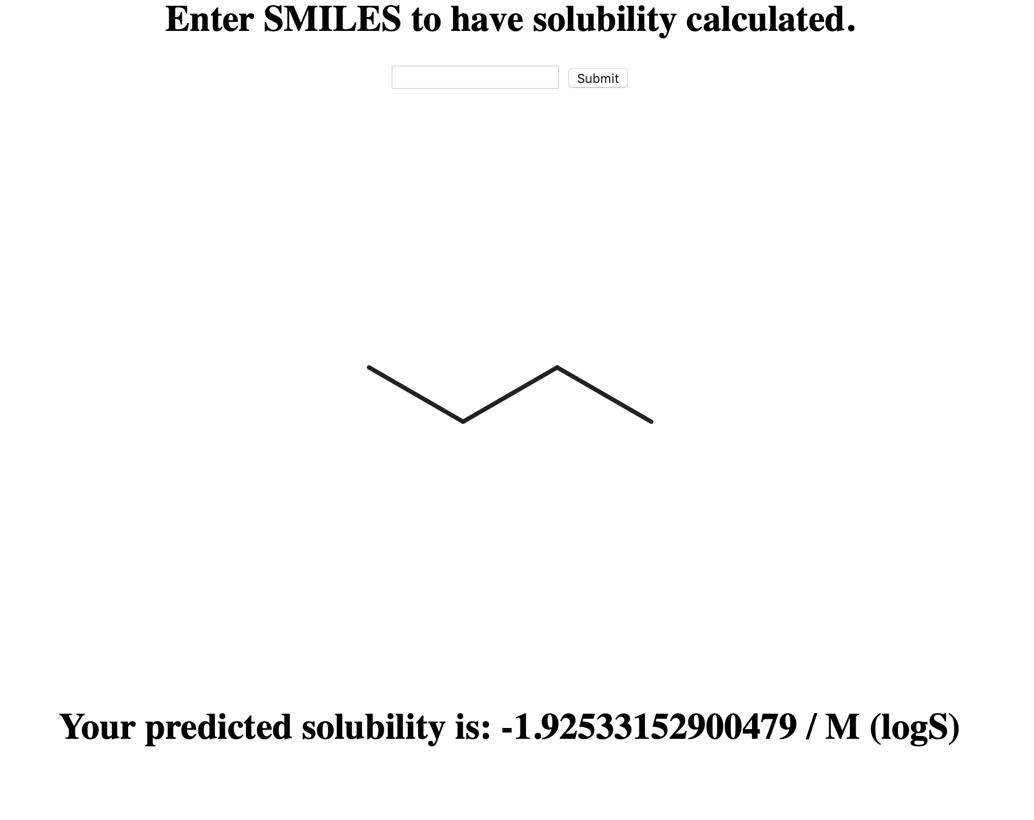
Website for predicting solubility values.
solubility.serveo.net

