Slide 1
Greedy Job Sequencing
with Deadlines and Profits
Design and Analysis of Algorithms — DAA-538
October 2026

Slide 2
Introduction
• Job Sequencing is a classic optimization problem in computer science and operations research.
• We are given n jobs, each with a deadline and a profit. The goal is to maximize total profit.
• Each job takes exactly one unit of time, and only one job can run at a time.
• A job earns its profit only if it completes on or before its deadline.
• The Greedy approach sorts jobs by profit (descending) and assigns each to the latest available slot.
• This greedy choice is provably optimal — it always yields the maximum possible profit.

Slide 3
Problem Statement
Given: A set of n jobs, where each job Jᵢ has:
• A unique Job ID (e.g., J1, J2, …)
• A Deadline dᵢ (positive integer) — the latest time unit by which the job must finish
• A Profit pᵢ (non-negative) — the reward earned if the job is completed on time
Constraints:
• Each job takes exactly 1 unit of time to execute
• Only one job can be processed in each time slot
• Time slots are numbered 1, 2, …, max(dᵢ)
Objective: Find a schedule S ⊆ {J1, …, Jn} that maximizes Σ pᵢ for all Jᵢ ∈ S,
such that each scheduled job finishes within its deadline and no two jobs share a slot.

Slide 4
Greedy Algorithm — Logic & Pseudocode
• Sort all jobs by profit in descending order.
• Determine max deadline → number of time slots.
• For each job (highest profit first):
• Find the latest empty slot ≤ its deadline.
• If found → schedule the job there.
• If not → reject the job.
• Sum profits of all scheduled jobs.
GREEDY-JOB-SEQUENCING(Jobs)
Sort Jobs by profit (descending)
max_d ← max deadline
Slots[1..max_d] ← EMPTY
FOR each job J in sorted Jobs:
FOR s ← min(J.deadline, max_d) DOWNTO 1:
IF Slots[s] == EMPTY:
Slots[s] ← J
scheduled ← scheduled ∪ {J}
BREAK
IF J not placed:
rejected ← rejected ∪ {J}
profit ← Σ p for all J in scheduled
RETURN scheduled, rejected, profit

Slide 5
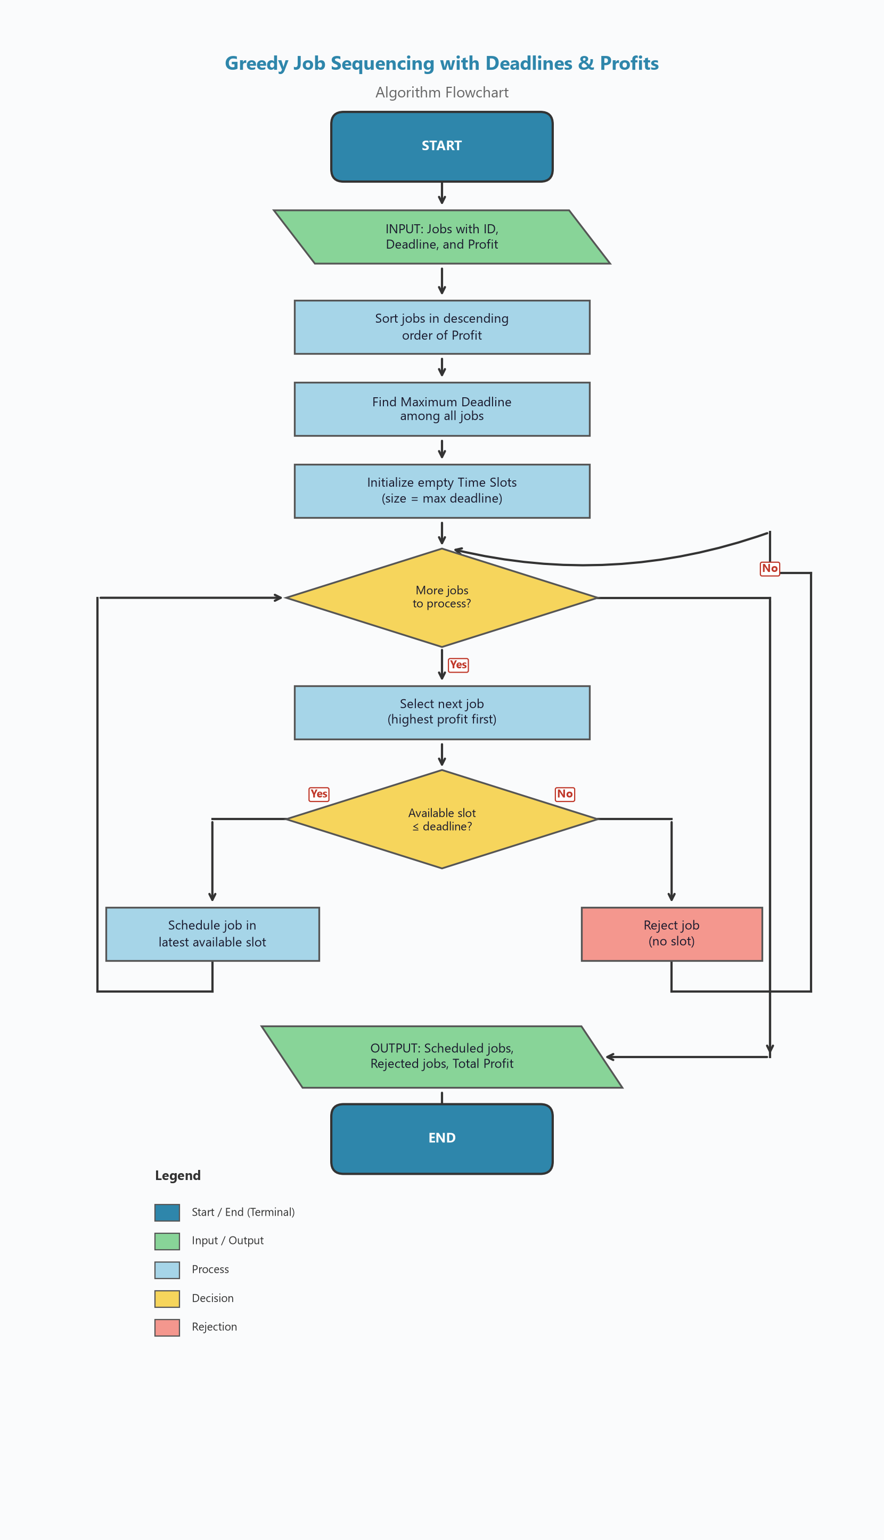
Flowchart

Slide 6
Sample Dataset
Five jobs with their deadlines and profits:
Job ID | Deadline | Profit
J1 | 2 | 100
J2 | 1 | 19
J3 | 2 | 27
J4 | 1 | 25
J5 | 3 | 15
• Step 1: J1 → Slot 2 ✓
• Step 2: J3 → Slot 1 ✓
• Step 3: J4 → Rejected ✗
• Step 4: J2 → Rejected ✗
• Step 5: J5 → Slot 3 ✓
After sorting by profit (descending): J1 (100) → J3 (27) → J4 (25) → J2 (19) → J5 (15)

Slide 7
Results & Complexity Analysis
Optimal Schedule
Time & Space Complexity
Slot | Job | Profit
1 | J3 | 27
2 | J1 | 100
3 | J5 | 15
Aspect | Complexity
Sorting | O(n log n)
Scheduling | O(n × d)
Overall Time | O(n × d)
Space | O(n + d)
★ Maximum Total Profit: 142
n = number of jobs, d = maximum deadline.
Can be optimized to O(n log n) using Union-Find.
Rejected Jobs: J4, J2

Slide 8
Conclusion & Learning Outcomes
• Greedy Strategy — Learned that choosing the highest-profit job first and assigning it to the latest available slot yields a provably optimal solution.
• Scheduling Fundamentals — Understood how to model real-world scheduling constraints (deadlines, limited time slots) as an algorithmic problem.
• Slot-Based Assignment — Practiced assigning tasks to the latest feasible slot, preserving flexibility for subsequent jobs.
• Complexity Awareness — Analyzed O(n × d) time and O(d) space, and learned about Union-Find optimization to achieve near-linear time.
• Input Validation — Implemented robust checks for invalid data (negative deadlines, non-numeric profits, empty inputs).
• Verified Correctness — Confirmed the algorithm produces the expected optimal profit of 142 for the given five-job dataset.
Design and Analysis of Algorithms — DAA-538

