Slide 1
DESIGN AND ANALYSIS OF ALGORITHMS
DAA MACRO PROJECT
GROUP — 12
B.Tech Computer Science & Engineering — Comprehensive Unit Portfolio
UNIT 1
Asymptotic Analysis
Big-O, Ω, Θ Notations
Growth Rate Curves
Semi-Log Scale Graph
UNIT 2
Greedy Job Sequencing
Deadlines & Profits
Greedy Optimal Strategy
Decision Flowchart
UNIT 3
0/1 Knapsack Problem
Dynamic Programming
Optimal Substructure
Table State Visualization
UNIT 4
Sum of Subsets Problem
Backtracking Technique
State Space Search Tree
Early Branch Pruning

Slide 2
Asymptotic Analysis
Growth Rates & Notation Comparison (Unit 1)
Design and Analysis of Algorithms (DAA)
B.Tech CSE — Group 12 | Mini Project Presentation
1/10

Slide 3
What is Asymptotic Analysis?
Asymptotic analysis is the mathematical evaluation of an algorithm's resource consumption (time or memory) as the input size n becomes arbitrarily large.
• Hardware Independence: Execution speed varies across processors, operating systems, and compilers. Asymptotic analysis measures efficiency independently of machine specifications.
• Focus on Scalability: How does the execution time scale when input n grows from 10 to 1,000,000?
• Ignoring Low-Order Terms: As n approaches infinity, higher-order terms dominate, rendering smaller terms and constant multipliers negligible.
• Core Objective: Compare an algorithm's complexity against standard reference families (logarithmic, linear, polynomial, exponential).
Key Idea: As n → ∞, the highest-order term dictates computational resource growth.
2/10

Slide 4
The Three Fundamental Notations
Big-O Notation — O(g(n))
Asymptotic Upper Bound
• Represents the worst-case ceiling.
• Guarantees the algorithm will NEVER take more time than c·g(n) for large n.
• Mnemonic: The Ceiling.
Big-Omega — Ω(g(n))
Asymptotic Lower Bound
• Represents the best-case floor.
• Guarantees the algorithm will take AT LEAST c·g(n) steps in the limit.
• Mnemonic: The Floor.
Big-Theta — Θ(g(n))
Asymptotically Tight Bound
• Sandwiches the function from both above and below.
• Pinpoints the EXACT growth rate when upper and lower bounds match.
• Mnemonic: The Exact Corridor.
3/10

Slide 5
Mathematical Definitions & Equivalence Theorem
Formal Mathematical Definitions:
• Big-O Definition: 0 ≤ f(n) ≤ c · g(n) for all n ≥ n₀, where c > 0 and n₀ ≥ 1.
• Big-Omega Definition: 0 ≤ c · g(n) ≤ f(n) for all n ≥ n₀, where c > 0 and n₀ ≥ 1.
• Big-Theta Definition: 0 ≤ c₁ · g(n) ≤ f(n) ≤ c₂ · g(n) for all n ≥ n₀, where c₁, c₂ > 0 and n₀ ≥ 1.
THE ASYMPTOTIC EQUIVALENCE THEOREM
f(n) = Θ(g(n)) ⟺ f(n) = O(g(n)) AND f(n) = Ω(g(n))
Significance: An algorithm has a tight bound Θ(g(n)) if and only if its upper ceiling and lower floor match the exact same rate of growth.
4/10

Slide 6
Mathematical Dry Run: f(n) = 3n² + 2n + 1
► Step 1: Identify Dominant Candidate Term
The given polynomial is f(n) = 3n² + 2n + 1. The highest exponent is 2, so our reference function is g(n) = n².
► Step 2: Proving Big-O (Upper Bound)
We must find c > 0, n₀ ≥ 1 such that 3n² + 2n + 1 ≤ c · n².
For n ≥ 1, we know 2n ≤ 2n² and 1 ≤ 1n².
Thus: 3n² + 2n + 1 ≤ 3n² + 2n² + 1n² = 6n².
Choosing c = 6 and n₀ = 1 confirms: f(n) ∈ O(n²).
► Step 3: Proving Big-Omega (Lower Bound)
We must find c > 0, n₀ ≥ 1 such that 3n² + 2n + 1 ≥ c · n².
Since 2n + 1 > 0 for all n ≥ 1, it is immediate that:
3n² + 2n + 1 ≥ 3n² for all n ≥ 1.
Choosing c = 3 and n₀ = 1 confirms: f(n) ∈ Ω(n²).
► Step 4: Establishing Big-Theta (Tight Bound)
Combining Steps 2 and 3: for all n ≥ 1, 3n² ≤ 3n² + 2n + 1 ≤ 6n².
With c₁ = 3, c₂ = 6, and n₀ = 1, f(n) is formally proven to be Θ(n²).
5/10

Slide 7
Algorithm Case Studies
Linear Search Analysis
Algorithm: Sequentially compares target key with each element in an array of size n.
Best Case: Ω(1) Target element is located at index 0 on the very first comparison.
Worst Case: O(n) Target element is at index n-1 or absent entirely (requires n comparisons).
Average Case: Θ(n) On average, finds target after n/2 comparisons.
Key Takeaway: Because best-case and worst-case bounds diverge (1 vs n), Linear Search is NOT Θ(n) across all cases.
Merge Sort Analysis
Algorithm: Divide-and-conquer strategy: recursively splits array in half and merges sorted halves.
Recurrence Relation: T(n) = 2T(n/2) + Θ(n)
Consistent Behavior: Merge Sort always splits down to single elements and merges in linear time, regardless of initial input order.
Tight Bound: Θ(n log n) Best, Average, and Worst cases are all identically Θ(n log n).
Key Takeaway: Since upper and lower bounds match in all scenarios, Merge Sort possesses a universally tight bound.
6/10

Slide 8
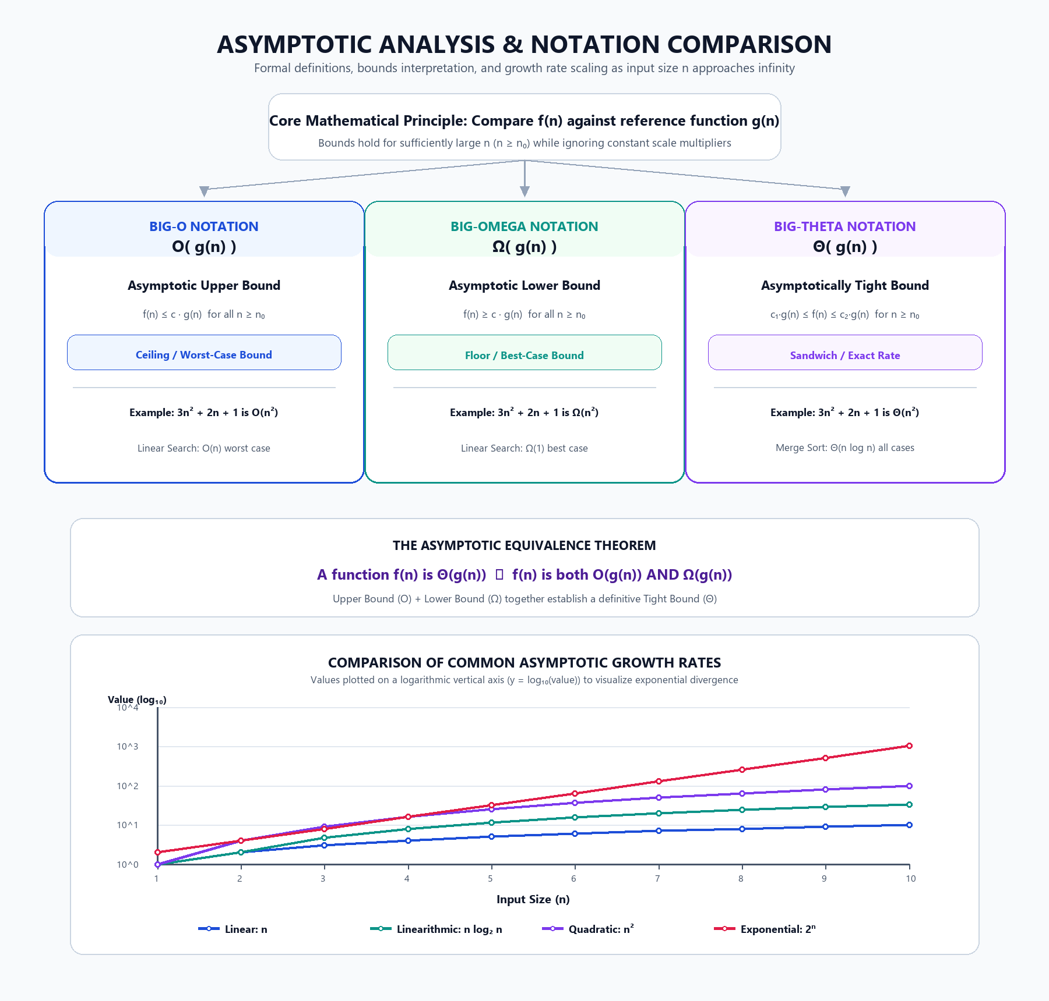
Visualization & Asymptotic Graph
7/10

Slide 9
Understanding Growth Rates & Semi-Log Plot
Quantitative Comparison of Tested Growth Rates (for n = 1 to 10):
• Linear Function — n: Scales steadily: f(1)=1, f(5)=5, f(10)=10. Growth factor remains constant.
• Linearithmic Function — n log₂ n: Common in divide-and-conquer: f(1)=0, f(5)≈11.6, f(10)≈33.2.
• Quadratic Function — n²: Common in nested loops: f(1)=1, f(5)=25, f(10)=100. Accelerates quickly.
• Exponential Function — 2ⁿ: Intractable combinatorial search: f(1)=2, f(5)=32, f(10)=1024! Explodes.
Why Use a Logarithmic Vertical Axis (y = log₁₀(value))?
At n = 10, the exponential value (1024) is over 100 times larger than the linear value (10). On a standard linear chart, the linear and linearithmic lines would be squashed flat against the bottom axis. Using log₁₀ scales decades (1, 10, 100, 1000) evenly, ensuring all four curves remain distinct, visible, and directly comparable.
8/10

Slide 10
Complexity Hierarchy & Key Viva Points
Growth Rate Hierarchy: O(1) < O(log n) < O(n) < O(n log n) < O(n²) < O(2ⁿ) < O(n!)
Frequently Asked Viva Questions & Answers:
Q: If an algorithm is O(n²), is it also O(n³)?
A: YES. Big-O is an upper bound ceiling. Any function bounded by n² is certainly bounded by n³. However, it is NOT Θ(n³).
Q: Why are constants ignored in asymptotic notation?
A: Constants depend on hardware specs and runtime environments. Asymptotic analysis measures purely algorithmic scalability as n grows.
Q: What distinguishes Big-O from worst-case running time?
A: 'Worst-case' describes the worst possible input scenario; Big-O is a mathematical upper bound that can be applied to worst-case, best-case, or average-case functions.
Q: What is the significance of the threshold n₀?
A: It guarantees that the bounding inequality holds for all sufficiently large inputs, even if smaller inputs behave irregularly.
9/10

Slide 11
Learning Outcomes & Conclusion
Learning Outcomes:
1. Mastered the formal mathematical definitions and inequalities for O, Ω, and Θ notations.
2. Demonstrated that an asymptotically tight bound requires satisfying both upper and lower bounds simultaneously.
3. Solved polynomial asymptotic growth proofs by identifying suitable constants c and threshold n₀.
4. Analyzed algorithm case studies, distinguishing algorithms with variable bounds (Linear Search) from uniform bounds (Merge Sort).
5. Learned how to visualize widely divergent growth curves using logarithmic scaling in Python.
CONCLUSION
Asymptotic analysis provides a robust, machine-independent foundation for evaluating algorithmic efficiency. By abstracting away low-level machine dependencies and focusing on asymptotic growth rates, developers and researchers can accurately predict scalability and design optimal software architectures.
10/10

Slide 12
Greedy Job Sequencing
with Deadlines and Profits
Design and Analysis of Algorithms — Group 12
October 2026

Slide 13
Introduction
• Job Sequencing is a classic optimization problem in computer science and operations research.
• We are given n jobs, each with a deadline and a profit. The goal is to maximize total profit.
• Each job takes exactly one unit of time, and only one job can run at a time.
• A job earns its profit only if it completes on or before its deadline.
• The Greedy approach sorts jobs by profit (descending) and assigns each to the latest available slot.
• This greedy choice is provably optimal — it always yields the maximum possible profit.

Slide 14
Problem Statement
Given: A set of n jobs, where each job Jᵢ has:
• A unique Job ID (e.g., J1, J2, …)
• A Deadline dᵢ (positive integer) — the latest time unit by which the job must finish
• A Profit pᵢ (non-negative) — the reward earned if the job is completed on time
Constraints:
• Each job takes exactly 1 unit of time to execute
• Only one job can be processed in each time slot
• Time slots are numbered 1, 2, …, max(dᵢ)
Objective: Find a schedule S ⊆ {J1, …, Jn} that maximizes Σ pᵢ for all Jᵢ ∈ S,
such that each scheduled job finishes within its deadline and no two jobs share a slot.

Slide 15
Greedy Algorithm — Logic & Pseudocode
• Sort all jobs by profit in descending order.
• Determine max deadline → number of time slots.
• For each job (highest profit first):
• Find the latest empty slot ≤ its deadline.
• If found → schedule the job there.
• If not → reject the job.
• Sum profits of all scheduled jobs.
GREEDY-JOB-SEQUENCING(Jobs)
Sort Jobs by profit (descending)
max_d ← max deadline
Slots[1..max_d] ← EMPTY
FOR each job J in sorted Jobs:
FOR s ← min(J.deadline, max_d) DOWNTO 1:
IF Slots[s] == EMPTY:
Slots[s] ← J
scheduled ← scheduled ∪ {J}
BREAK
IF J not placed:
rejected ← rejected ∪ {J}
profit ← Σ p for all J in scheduled
RETURN scheduled, rejected, profit

Slide 16
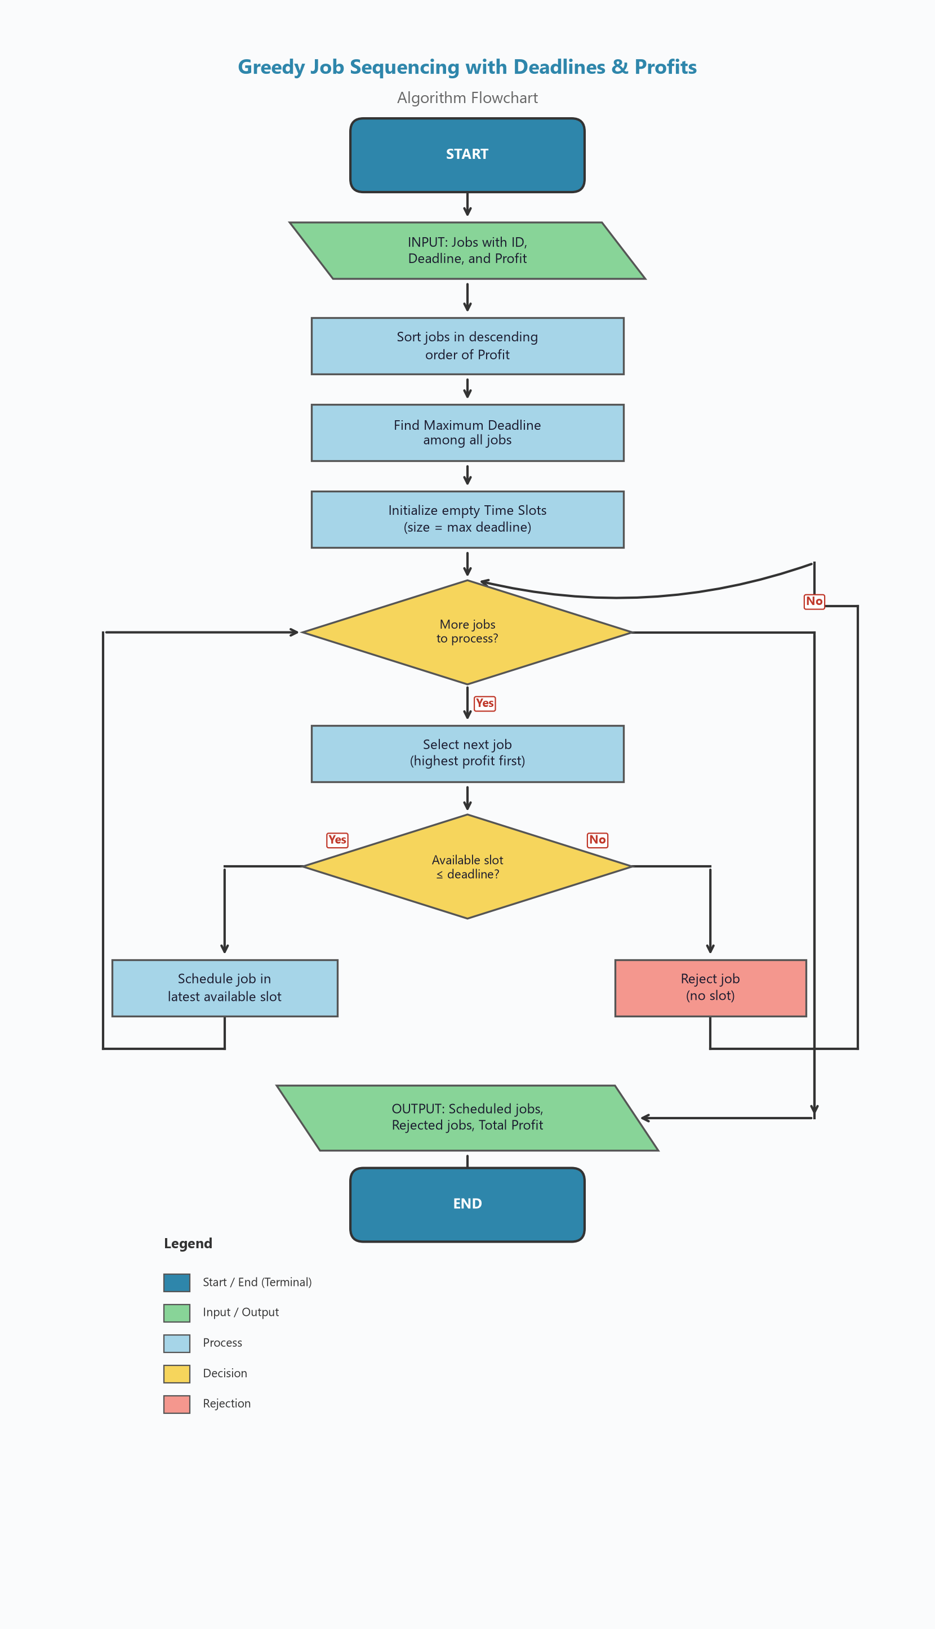
Flowchart

Slide 17
Sample Dataset
Five jobs with their deadlines and profits:
Job ID | Deadline | Profit
J1 | 2 | 100
J2 | 1 | 19
J3 | 2 | 27
J4 | 1 | 25
J5 | 3 | 15
• Step 1: J1 → Slot 2 ✓
• Step 2: J3 → Slot 1 ✓
• Step 3: J4 → Rejected ✗
• Step 4: J2 → Rejected ✗
• Step 5: J5 → Slot 3 ✓
After sorting by profit (descending): J1 (100) → J3 (27) → J4 (25) → J2 (19) → J5 (15)

Slide 18
Results & Complexity Analysis
Optimal Schedule
Time & Space Complexity
Slot | Job | Profit
1 | J3 | 27
2 | J1 | 100
3 | J5 | 15
Aspect | Complexity
Sorting | O(n log n)
Scheduling | O(n × d)
Overall Time | O(n × d)
Space | O(n + d)
★ Maximum Total Profit: 142
n = number of jobs, d = maximum deadline.
Can be optimized to O(n log n) using Union-Find.
Rejected Jobs: J4, J2

Slide 19
Conclusion & Learning Outcomes
• Greedy Strategy — Learned that choosing the highest-profit job first and assigning it to the latest available slot yields a provably optimal solution.
• Scheduling Fundamentals — Understood how to model real-world scheduling constraints (deadlines, limited time slots) as an algorithmic problem.
• Slot-Based Assignment — Practiced assigning tasks to the latest feasible slot, preserving flexibility for subsequent jobs.
• Complexity Awareness — Analyzed O(n × d) time and O(d) space, and learned about Union-Find optimization to achieve near-linear time.
• Input Validation — Implemented robust checks for invalid data (negative deadlines, non-numeric profits, empty inputs).
• Verified Correctness — Confirmed the algorithm produces the expected optimal profit of 142 for the given five-job dataset.
Design and Analysis of Algorithms — DAA-538

Slide 20
0/1 Knapsack using Dynamic Programming
DAA Macro Project — Group 12

Slide 21
Problem Statement
Maximize the aggregate profit by selecting an optimal subset of items.
Each item can be selected at most once (0/1 decision variable).
Maximum Knapsack capacity W = 10.
The project uses 4 distinct items with specified weights and profits.

Slide 22
Input and Objective
Item 1: Weight = 1, Profit = 10
Item 2: Weight = 2, Profit = 20
Item 3: Weight = 4, Profit = 35
Item 4: Weight = 5, Profit = 45
Objective: Find the subset maximizing profit without exceeding capacity W = 10.

Slide 23
Dynamic Programming Approach
Construct table dp[i][w] storing optimal profit for first i items and capacity w.
For each item, evaluate choice between excluding or including the item.
Recurrence: dp[i][w] = max(dp[i-1][w], profit[i-1] + dp[i-1][w - weight[i-1]]).
Backtrack from dp[n][W] through the table to identify the selected items.

Slide 24
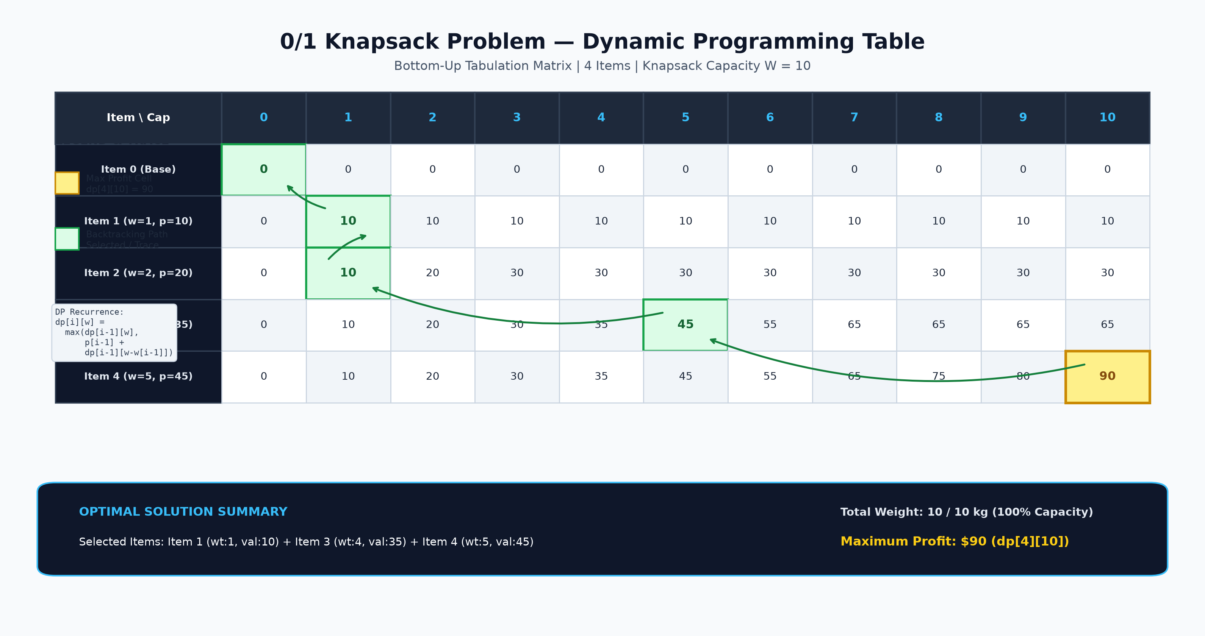
DP Table Visualization

Slide 25
Result and Complexity
Maximum Profit = 90
Selected Items = 1, 3, 4
Total Weight = 10 / 10
Time Complexity: O(n * W) = O(4 * 10) = 40 operations
Space Complexity: O(n * W) auxiliary table space

Slide 26
Learning Outcome
Understood bottom-up tabular Dynamic Programming for 0/1 Knapsack.
Learned how subproblems are formulated and stored in a DP matrix.
Understood item inclusion/exclusion state transitions and backtracking.
Completed implementation, prompt engineering, and visual verification.

Slide 27
Sum of Subsets
Using Backtracking
Design and Analysis of Algorithms (DAA) — Group 12
1/10

Slide 28
What is the Sum of Subsets Problem?
Given a set of positive integers and a target sum,
find ALL subsets whose elements add up exactly to the target.
Example:
Set S = { 5, 10, 12 }
Target Sum M = 15
Question: Which subsets of S sum to exactly 15?
This is a classic combinatorial search problem.
It appears in cryptography, resource allocation, and scheduling.
Answer: { 5, 10 } → 5 + 10 = 15 ✓
2/10

Slide 29
What is Backtracking?
Backtracking is a systematic trial-and-error technique.
• Build a solution step by step (depth-first).
• At each step, make a CHOICE (include or exclude an element).
• If the choice leads to a dead end → UNDO it (backtrack).
• If the partial sum already exceeds the target → PRUNE that branch.
Why use it here?
– A brute-force approach checks all 2ⁿ subsets.
– Backtracking PRUNES branches early, reducing work.
Key idea: Don't explore paths that can never lead to a solution.
3/10

Slide 30
Algorithm — Step by Step
1. Initialize the set S = {5, 10, 12} and target sum M = 15.
2. Start with an empty subset { } and current sum = 0.
3. Pick the next element from S.
4. Branch into two choices:
a) Include the element → add its value to current sum.
b) Exclude the element → keep current sum unchanged.
5. If current sum == M → record subset as a VALID SOLUTION.
6. If current sum > M → PRUNE the branch (stop exploring).
7. Recurse for the remaining elements.
8. After exploring "Include", backtrack (remove the element)
and explore "Exclude".
9. Stop when all elements have been considered.
4/10

Slide 31
Pseudocode
FUNCTION findSubsets(index, currentSubset, currentSum, targetSum, S):
IF currentSum == targetSum THEN
PRINT currentSubset ← Solution found!
RETURN
IF currentSum > targetSum THEN
RETURN ← Prune (bounding function)
IF index >= LENGTH(S) THEN
RETURN ← All elements considered
// Choice 1: INCLUDE S[index]
ADD S[index] to currentSubset
findSubsets(index + 1, currentSubset, currentSum + S[index], targetSum, S)
// Backtrack: UNDO inclusion
REMOVE last element from currentSubset
// Choice 2: EXCLUDE S[index]
findSubsets(index + 1, currentSubset, currentSum, targetSum, S)
CALL findSubsets(0, { }, 0, 15, {5, 10, 12})
5/10

Slide 32
Dry Run — Tracing the Algorithm
Call findSubsets(0, { }, 0) — start with empty subset
► Include 5 → findSubsets(1, {5}, 5)
► Include 10 → findSubsets(2, {5,10}, 15)
currentSum == 15 → ✅ SOLUTION FOUND: {5, 10}
► Exclude 10 → findSubsets(2, {5}, 5)
► Include 12 → findSubsets(3, {5,12}, 17)
17 > 15 → ❌ PRUNED
► Exclude 12 → findSubsets(3, {5}, 5)
End of set, 5 ≠ 15 → Unsuccessful
► Exclude 5 → findSubsets(1, { }, 0)
► Include 10 → {10}, sum=10 → Include 12 → {10,12}, sum=22 → ❌ PRUNED
→ Exclude 12 → {10}, sum=10 → Unsuccessful
► Exclude 10 → { }, sum=0 → Include 12 → {12}, sum=12 → Unsuccessful
→ Exclude 12 → { }, sum=0 → Unsuccessful
6/10

Slide 33
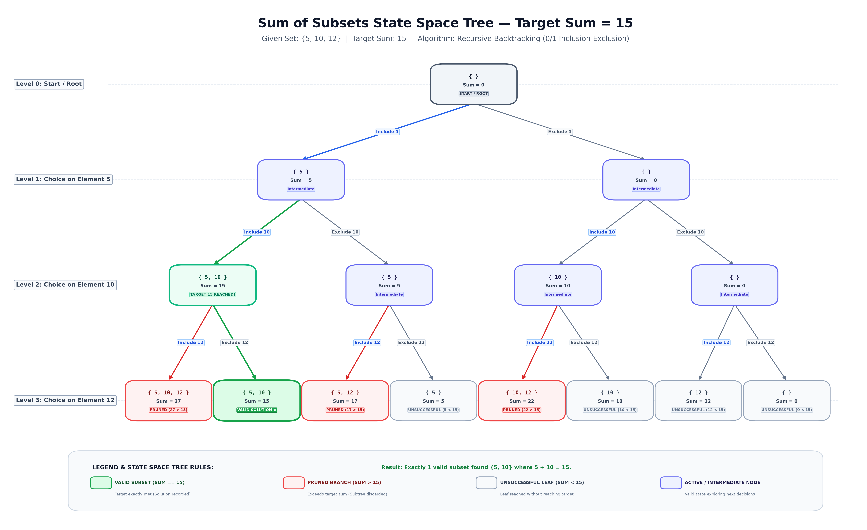
State Space Tree — Visualization
7/10

Slide 34
Understanding the State Space Tree
Root Node (Level 0): { }, Sum = 0 — starting point.
Level 1 — Decision on element 5:
Include 5 → {5}, Sum = 5 | Exclude 5 → { }, Sum = 0
Level 2 — Decision on element 10:
{5} + Include 10 → {5,10}, Sum = 15 ✅ TARGET REACHED!
Level 3 — Decision on element 12 (leaf nodes):
🟢 GREEN nodes → Valid solution (sum == 15):
{5, 10} with sum = 15
🔴 RED nodes → Pruned branches (sum > 15):
{5,10,12}=27 {5,12}=17 {10,12}=22
⬜ GRAY nodes → Unsuccessful leaves (sum < 15):
{5}=5 {10}=10 {12}=12 { }=0
8/10

Slide 35
Result & Complexity Analysis
Result
Valid subset found: { 5, 10 }
Sum: 5 + 10 = 15 ✓
Total valid subsets: 1
Why is {12} not a solution?
12 ≠ 15 → does not meet target.
Why prune branches > 15?
All elements are positive — adding more
can only increase the sum further.
Time Complexity
Worst case: O(2ⁿ) — every subset is explored.
With pruning: significantly fewer nodes are visited.
For n = 3: total possible subsets = 2³ = 8; pruned branches = 3 → only 5 leaf evaluations needed.
Space Complexity: O(n) — recursion stack depth equals number of elements.
9/10

Slide 36
Learning Outcomes & Conclusion
Learning Outcomes
1. Understood the concept of backtracking and recursion.
2. Learned how to construct and interpret a state space tree.
3. Understood how include/exclude decisions generate all subsets.
4. Learned how pruning (bounding functions) improve efficiency.
5. Practiced documenting a project with README and visualizations.
Conclusion: Backtracking is a powerful technique for solving combinatorial problems like Sum of Subsets. By systematically exploring include/exclude decisions and pruning branches that exceed the target, it finds all valid solutions efficiently without exhaustively checking every possibility.
10/10

