Slide 1
Sum of Subsets
Using Backtracking
Design and Analysis of Algorithms (DAA)
B.Tech CSE — Mini Project Presentation
1/10

Slide 2
What is the Sum of Subsets Problem?
Given a set of positive integers and a target sum,
find ALL subsets whose elements add up exactly to the target.
Example:
Set S = { 5, 10, 12 }
Target Sum M = 15
Question: Which subsets of S sum to exactly 15?
This is a classic combinatorial search problem.
It appears in cryptography, resource allocation, and scheduling.
Answer: { 5, 10 } → 5 + 10 = 15 ✓
2/10

Slide 3
What is Backtracking?
Backtracking is a systematic trial-and-error technique.
• Build a solution step by step (depth-first).
• At each step, make a CHOICE (include or exclude an element).
• If the choice leads to a dead end → UNDO it (backtrack).
• If the partial sum already exceeds the target → PRUNE that branch.
Why use it here?
– A brute-force approach checks all 2ⁿ subsets.
– Backtracking PRUNES branches early, reducing work.
Key idea: Don't explore paths that can never lead to a solution.
3/10

Slide 4
Algorithm — Step by Step
1. Initialize the set S = {5, 10, 12} and target sum M = 15.
2. Start with an empty subset { } and current sum = 0.
3. Pick the next element from S.
4. Branch into two choices:
a) Include the element → add its value to current sum.
b) Exclude the element → keep current sum unchanged.
5. If current sum == M → record subset as a VALID SOLUTION.
6. If current sum > M → PRUNE the branch (stop exploring).
7. Recurse for the remaining elements.
8. After exploring "Include", backtrack (remove the element)
and explore "Exclude".
9. Stop when all elements have been considered.
4/10

Slide 5
Pseudocode
FUNCTION findSubsets(index, currentSubset, currentSum, targetSum, S):
IF currentSum == targetSum THEN
PRINT currentSubset ← Solution found!
RETURN
IF currentSum > targetSum THEN
RETURN ← Prune (bounding function)
IF index >= LENGTH(S) THEN
RETURN ← All elements considered
// Choice 1: INCLUDE S[index]
ADD S[index] to currentSubset
findSubsets(index + 1, currentSubset, currentSum + S[index], targetSum, S)
// Backtrack: UNDO inclusion
REMOVE last element from currentSubset
// Choice 2: EXCLUDE S[index]
findSubsets(index + 1, currentSubset, currentSum, targetSum, S)
CALL findSubsets(0, { }, 0, 15, {5, 10, 12})
5/10

Slide 6
Dry Run — Tracing the Algorithm
Call findSubsets(0, { }, 0) — start with empty subset
► Include 5 → findSubsets(1, {5}, 5)
► Include 10 → findSubsets(2, {5,10}, 15)
currentSum == 15 → ✅ SOLUTION FOUND: {5, 10}
► Exclude 10 → findSubsets(2, {5}, 5)
► Include 12 → findSubsets(3, {5,12}, 17)
17 > 15 → ❌ PRUNED
► Exclude 12 → findSubsets(3, {5}, 5)
End of set, 5 ≠ 15 → Unsuccessful
► Exclude 5 → findSubsets(1, { }, 0)
► Include 10 → {10}, sum=10 → Include 12 → {10,12}, sum=22 → ❌ PRUNED
→ Exclude 12 → {10}, sum=10 → Unsuccessful
► Exclude 10 → { }, sum=0 → Include 12 → {12}, sum=12 → Unsuccessful
→ Exclude 12 → { }, sum=0 → Unsuccessful
6/10

Slide 7
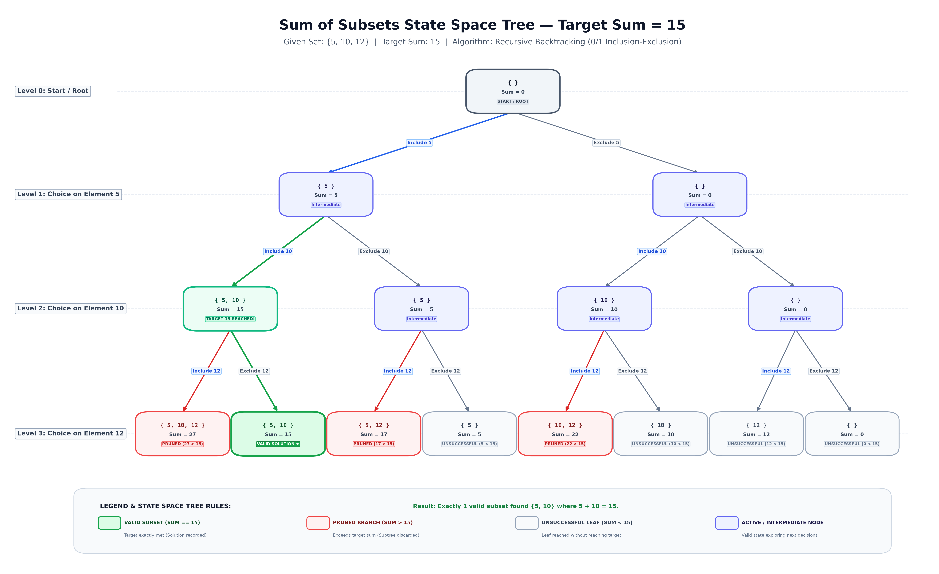
State Space Tree — Visualization
7/10

Slide 8
Understanding the State Space Tree
Root Node (Level 0): { }, Sum = 0 — starting point.
Level 1 — Decision on element 5:
Include 5 → {5}, Sum = 5 | Exclude 5 → { }, Sum = 0
Level 2 — Decision on element 10:
{5} + Include 10 → {5,10}, Sum = 15 ✅ TARGET REACHED!
Level 3 — Decision on element 12 (leaf nodes):
🟢 GREEN nodes → Valid solution (sum == 15):
{5, 10} with sum = 15
🔴 RED nodes → Pruned branches (sum > 15):
{5,10,12}=27 {5,12}=17 {10,12}=22
⬜ GRAY nodes → Unsuccessful leaves (sum < 15):
{5}=5 {10}=10 {12}=12 { }=0
8/10

Slide 9
Result & Complexity Analysis
Result
Valid subset found: { 5, 10 }
Sum: 5 + 10 = 15 ✓
Total valid subsets: 1
Why is {12} not a solution?
12 ≠ 15 → does not meet target.
Why prune branches > 15?
All elements are positive — adding more
can only increase the sum further.
Time Complexity
Worst case: O(2ⁿ) — every subset is explored.
With pruning: significantly fewer nodes are visited.
For n = 3: total possible subsets = 2³ = 8; pruned branches = 3 → only 5 leaf evaluations needed.
Space Complexity: O(n) — recursion stack depth equals number of elements.
9/10

Slide 10
Learning Outcomes & Conclusion
Learning Outcomes
1. Understood the concept of backtracking and recursion.
2. Learned how to construct and interpret a state space tree.
3. Understood how include/exclude decisions generate all subsets.
4. Learned how pruning (bounding functions) improve efficiency.
5. Practiced documenting a project with README and visualizations.
Conclusion: Backtracking is a powerful technique for solving combinatorial problems like Sum of Subsets. By systematically exploring include/exclude decisions and pruning branches that exceed the target, it finds all valid solutions efficiently without exhaustively checking every possibility.
10/10

