Slide 1
RNN(2)
Presentator: Kyu Hun Sim

Slide 2
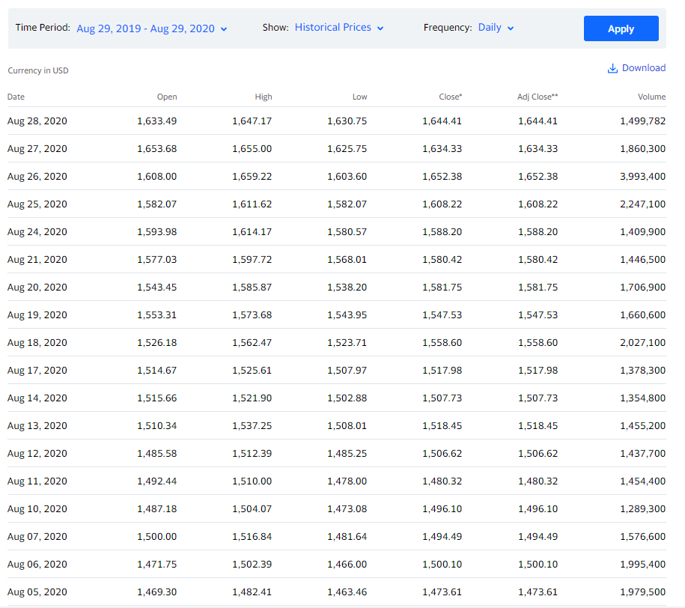
RNN Time Series
Time Series Data: Data arranged at regular time intervals

Slide 3
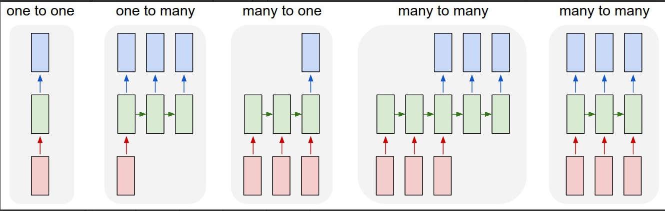
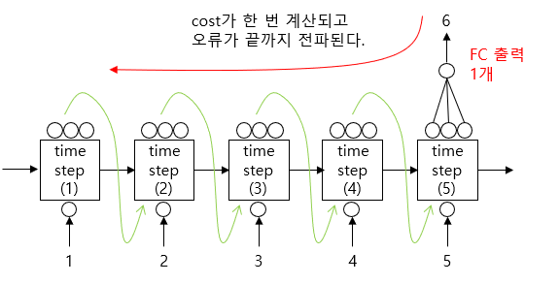
RNN Time series
Many to one: time series, text classification
Many to many: text generation

Slide 4
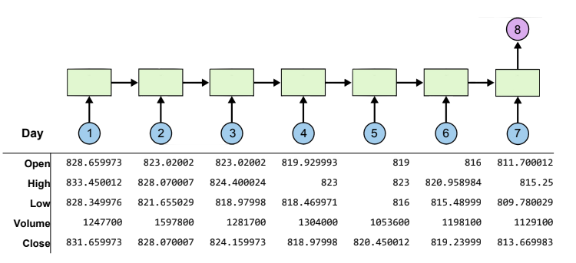
RNN Time series
Vector with 5 different dimensions
Print with 10 hidden state dimension
Connect Fully connected Layer
Output is to predict the Close of the 8th day

Slide 5
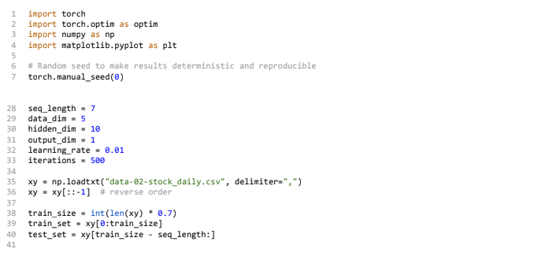
Apply RNN

Slide 6
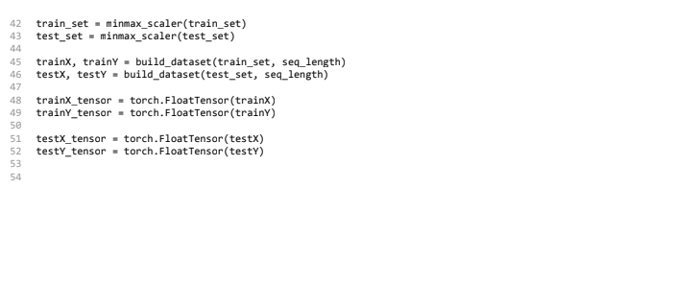
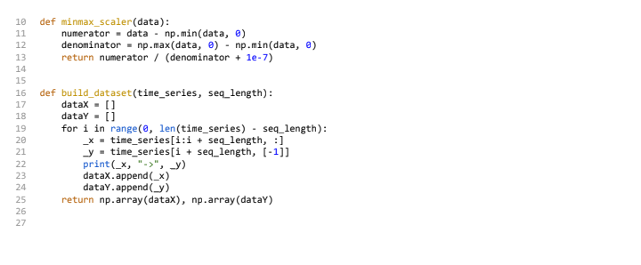
Apply RNN

Slide 7
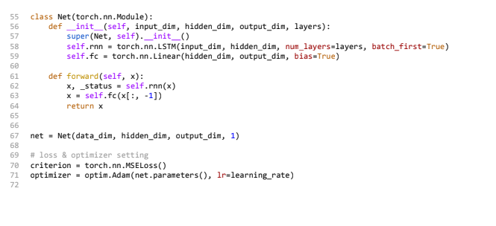
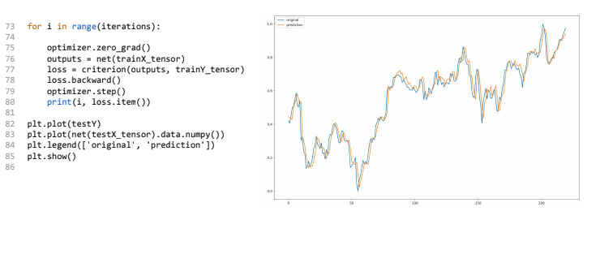
Apply RNN

Slide 8
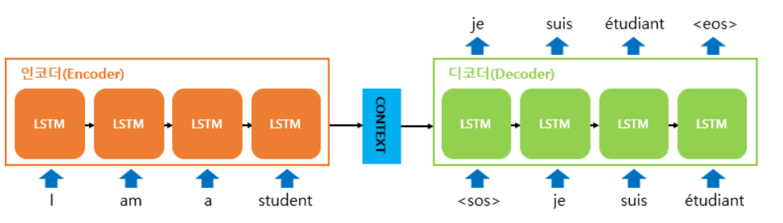
Seq2Seq
Example: Chat bot, machine translation

Slide 9
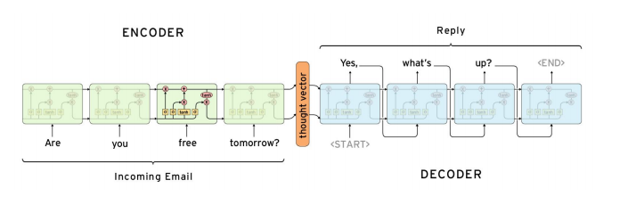
Seq2Seq
Encoder: delivers the vector compressed in the input order to the decoder
Decoder: Put first cell’s hidden state,
The output of first cell is the first word of sentence
Enter the second cell with hidden state to predict next word

Slide 10
Context Vector
https://jalammar.github.io/visualizing-neural-machine-translation-mechanics-of-seq2seq-models-with-attention/

Slide 11
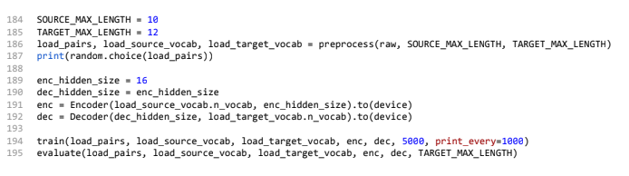
Code
Translate English sentence to Hanguel sentence

Slide 12
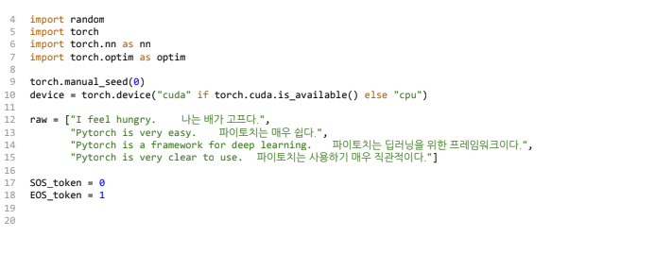
Code(2)

Slide 13
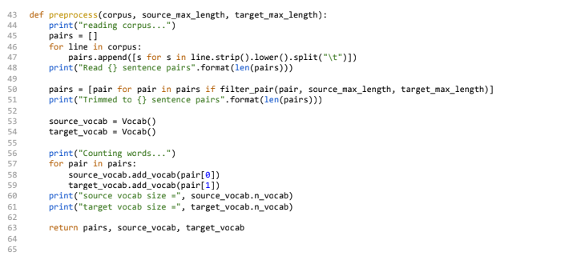
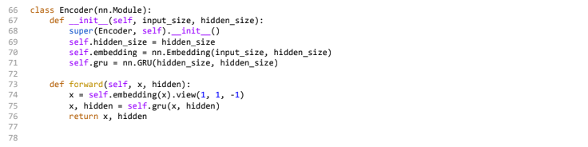
Code(3)

Slide 14
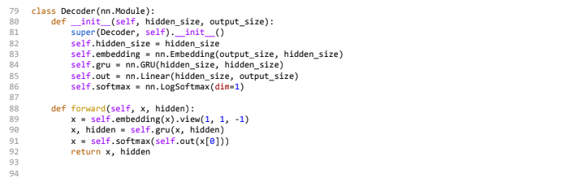
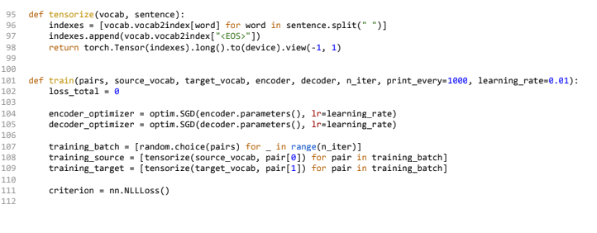
Code(4)

Slide 15
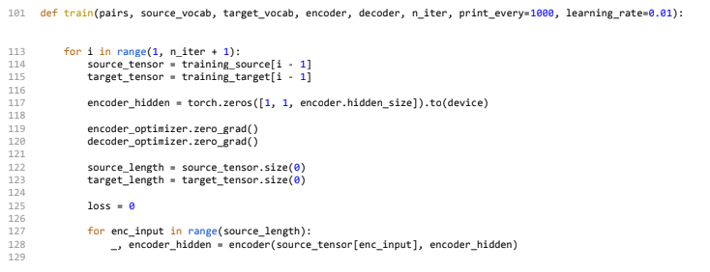
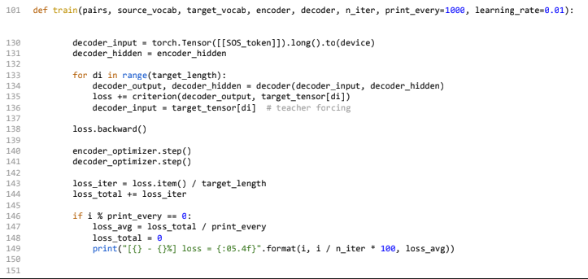
Code(5)

Slide 16
Seq2Seq attention
Disadvantage of Seq2Seq
1)Because of fixed size vector which is compressed all info, information loss occurs
2) Vanishing gradient problem occurs
Attention: At each time step when the decoder predicts an output word, the entire input sentence from the encoder is referenced.

