Slide 1
Kafka Tuning Guide in Spring Cloud Stream
CLoudera

Slide 2
Table of contents
Producer Tuning
Parameter setting for reliability message deliver
Partitioning strategy configuration for order-guarantee
Advanced Kafka producer Parameter tuning
Producer client Monitoring
Consumer Tuning
Parameters settings for reliable message consumer
Rebalance Handling
Dead Letter Topic processing
Consumer group monitoring
Benchmark Tests
Further Improvements

Slide 3
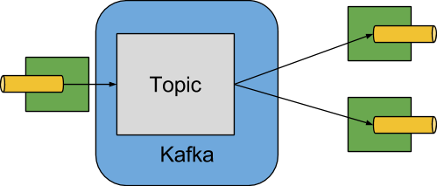
Spring Cloud Kafka

Slide 4
Producer Tuning – Current & Recommend Settings
Kafka Parameters | Current Settings | Recommend Settings
replicationFactor | 1 or 3 | 3
ack | 1 or all | all
min.insync.replica | Not set | 2

Slide 5
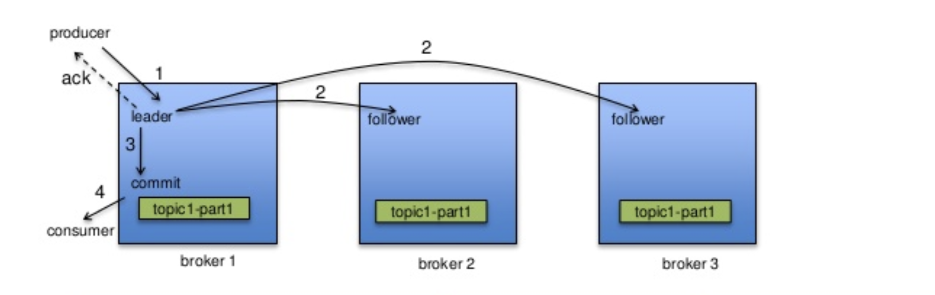
Producer Tuning – How Producer write data to topic

Slide 6
Producer Tuning -- Parameter setting for reliability message deliver
Replication Factor = 1
Spring cloud default value is 1.
With the default value set in producer agent, if a Kafka broker server is down, it will lead to producer agents can’t write data to the topic on the broker.
For example, if broker1 is down. The agent can’t write data to topic A, which will cause pipeline stop.
Broker1 (down)
Broker2
Broker3
Topic A
Topic B
Topic C
Fail
agent

Slide 7
Producer Tuning -- Parameter setting for reliability message deliver
We recommend replication factor set to 3
In Spring Cloud Stream, when Kafka topic auto-creation is enabled, we should set topic replication factor to 3.
With the setting in agent, a Kafka broker failure will not affect agent writing data to the topic on that broker, because Kafka cluster will auto-elect a new leader on other Kafka broker to allow agent to write data to the topic.
Broker1 (down)
Broker2
Broker3
Topic A
Topic A Replica 1
Topic A Replica 2
Success
agent

Slide 8
Producer Tuning -- Parameter setting for reliability message deliver
How to set replication factor set to 3 in Spring Cloud
Set spring.cloud.stream.kafka.binder.autoCreateTopics to true
Set spring.cloud.stream.kafka.binder.replicationFactor to 3

Slide 9
Producer Tuning -- Parameter setting for reliability message deliver

Slide 10
Producer Tuning -- Advanced Kafka producer Parameter tuning

Slide 11
Consumer Tuning
Consumer

Slide 12
Topic design review and suggestions
Topic design need to make the following decision
Name
Schema (Json, Avro)
Contents
Key/ordering
Number of partitions
Number of replicas

Slide 13
Topic design review and suggestions
Since performance and order guarantee are two key important requirements in MSE 3.0 project, we reviewed current topic design, considering the followings factors that relate the performance and order guarantee
Key/ordering
# of partitions
# of replicas (this factor is discussed in producer setting)

Slide 14
Key/Order – Review Conclusion and Risk
This discussed earlier in producer setting. There are two ways to guarantee order
Single-partition topic
Key-based method for partition-level order guarantee
Currently, 90% topics using the single-partition topic solutions
Conclusion and suggestions for single-partition topic solution
Order can always be guaranteed from the perspective of topic.
However, there are some risks for single agent performance, order-guarantee and global Kafka cluster performance
Single agent performance risk
Event architecture is powerful if you can partition data into smaller subsets. But single-partition lost this advantage
Single-partition topic can only support single consumer instance in an agent. If the consumer instance process event slowly (i.e. writing data slowly to database). The performance is limited to the throughput of the database

Slide 15
Key/Order -- Single agent performance risk
Topic
Agent
Database
Partition 0
1 read data
1 Kafka Consumer Client
2 update database
The agent performance is affected by three parts:
Topic read throughput
database write throughput
topic write throughput
3 Write data
Topics

Slide 16
Key/order -- Single agent performance risk
Benchmark test for Kafka read/write have been done
Kafka Read
Kafka Write
If database process take long time, the throughput will drop significantly.
What about if throughput can’t meet requirement?
Single partition topic is designed for strong data consistency for distributed micro-services. So, a big picture is how to achieve strong data consistency in event-based microservices architecture. Advanced Micro-services techniques (i.e. distributed transaction) for achieve and Spring components for achieve strong data consistency need to be explored.
From Kafka side, Kafka stream support maintain micro-services states for data consistency using Kafka stream’s internal database to replace traditional DB. But the feedback is that this project is not suitable for using Kafka Stream.

Slide 17
Key/order – Order Guarantee Risk
For single partition topic design for message order guarantee, How Kafka producer, consumer and Spring Cloud Stream containers work together to operate messages, might also affect order guarantee. Because Kafka producer/consumer client read/write message in batch, and Spring container side provide multiple choices for processing the batch message processing.
Topic
read batch data
Kafka Producer Client
Data process
Spring Cloud Containers
Agent
Topic
write batch/single data
Kafka Consumer Client
Data process
Spring Cloud Containers
Agent

Slide 18
Key/order – Order Guarantee Risk
Suggestion
Check the parameters for Kafka that might affect order guarantee (i.e. max.in.flight.requests.per.connection, enable.idempotence). This parameters are not predefined in Spring Cloud Stream, so the default value are used. For example, max.in.flight.requests.per.connection=5. This value can lead to message out-of-order. So you need to check producer client work in Spring Cloud Stream container with the default settings.
Check how ListernerContainer in Spring Cloud support batch message process polled by consumer for order guarantee

Slide 19
Key/order – too many partitions that might affect broker performance
Single partition topic and for message type might cause there are many partitions. If the partitions # become huge, this might affect broker performance, such as
If one Broker down for some reasons, the more partitions on a broker, the longer time will take to elect new partitions. For example, it might take up to 5 seconds to elect the new leader for all 1000 partitions. For more partitions, it take longer time. Before finding a new leader for the topic, the affected topic can not be used.
Suggestion
the partitions # for one broker < 1000 (this is to considering using VM instance, for physical server the number can be larger)
If partitions # for one broker > 1000, add more broker is the first choice
If partitions # for one broker > 1000, you can consider merge topics. The topic merges relate with business logic and Spring Cloud implementation.

