Slide 1
Kafka Tuning Guide in Spring Cloud Stream
CLoudera

Slide 2
Table of contents
Producer Tuning
Parameter setting for reliability message deliver
Partitioning strategy configuration for order-guarantee
Advanced Kafka producer Parameter tuning
Producer client Monitoring
Consumer Tuning
Parameters settings for reliable message consumer
Rebalance Handling
Dead Letter Topic processing
Consumer group monitoring
Benchmark Tests
Further Improvements

Slide 3
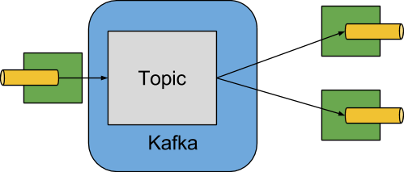
Spring Cloud Kafka

Slide 4
Producer Tuning – Current & Recommend Settings
Kafka Parameters | Current Settings | Recommend Settings
replicationFactor | 1 or 3 | 3
ack | 1 or all | all
min.insync.replica | Not set | 2

Slide 5
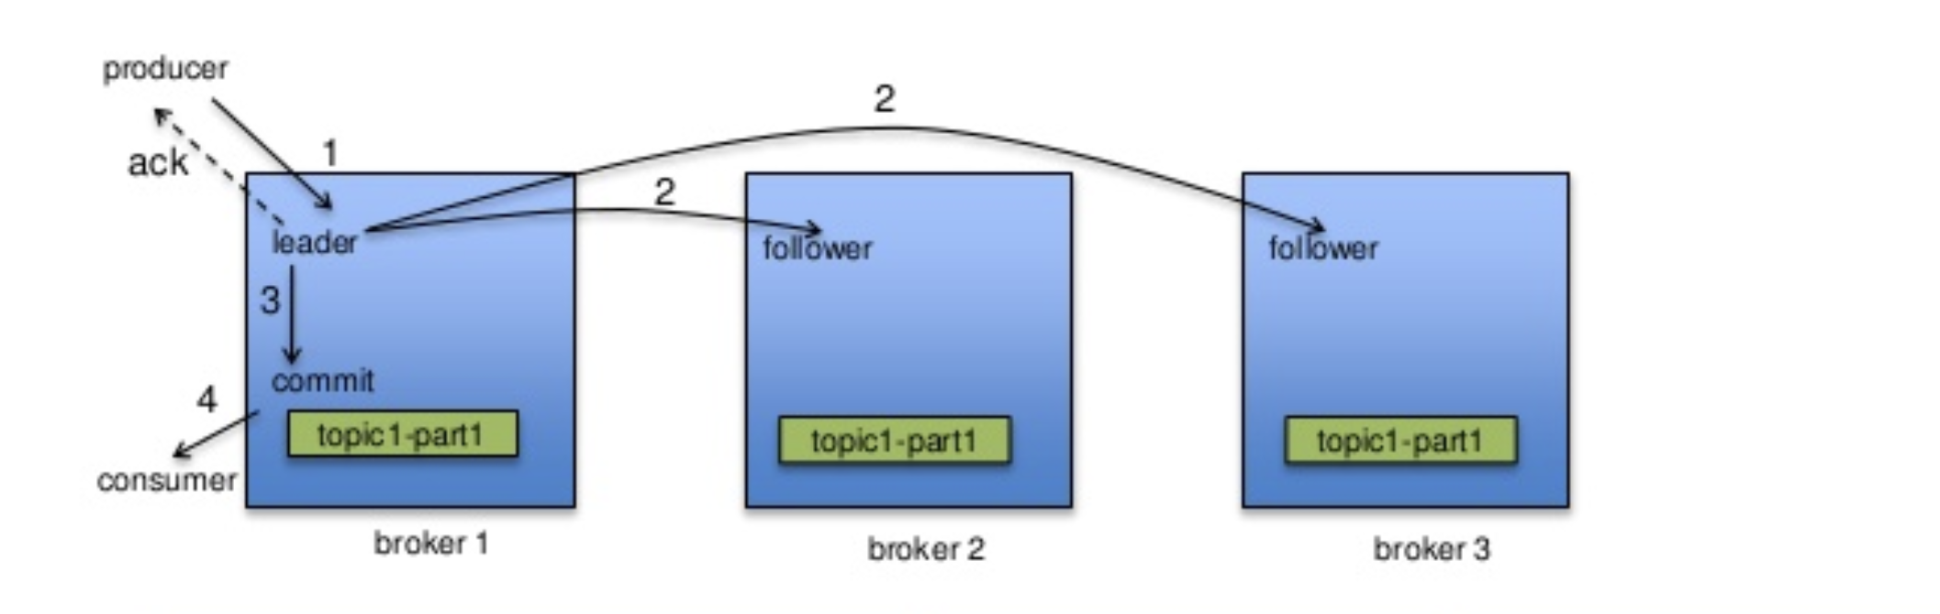
Producer Tuning – How Producer write data to topic

Slide 6
Producer Tuning -- Parameter setting for reliability message deliver
Replication Factor = 1
Spring cloud default value is 1.
With the default value set in producer agent, if a Kafka broker server is down, it will lead to producer agents can’t write data to the topic on the broker.
For example, if broker1 is down. The agent can’t write data to topic A, which will cause pipeline stop.
Broker1 (down)
Broker2
Broker3
Topic A
Topic B
Topic C
Fail
agent

Slide 7
Producer Tuning -- Parameter setting for reliability message deliver
We recommend replication factor set to 3
In Spring Cloud Stream, when Kafka topic auto-creation is enabled, we should set topic replication factor to 3.
With the setting in agent, a Kafka broker failure will not affect agent writing data to the topic on that broker, because Kafka cluster will auto-elect a new leader on other Kafka broker to allow agent to write data to the topic.
Broker1 (down)
Broker2
Broker3
Topic A
Topic A Replica 1
Topic A Replica 2
Success
agent

Slide 8
Producer Tuning -- Parameter setting for reliability message deliver
How to set replication factor set to 3 in Spring Cloud
Set spring.cloud.stream.kafka.binder.autoCreateTopics to true
Set spring.cloud.stream.kafka.binder.replicationFactor to 3

Slide 9
Producer Tuning -- Parameter setting for reliability message deliver

Slide 10
Producer Tuning -- Advanced Kafka producer Parameter tuning

