Slide 1

USA Renewable Energy
Group 5: Artem Iliushin, Bhumi Bhusal, Rafael Tem Pahs, Ryan Callaghan, Ryan Cheng

Slide 2
Project Description
Objectives
Analysis of Technical potential for clean energy for different states in US.
Solar power Energy
Geothermal Energy
Wind power Energy
Bio power Energy
Hydro power Energy
To analyze total clean energy potential vs current total energy consumption to see if the states have enough potential to fulfill their energy demand by going all renewable.
Tools
Python-Pandas for Data processing and cleaning.
Postgress-SQL for database.
Plotly-JS, ApexCharts-JS, Leaflet, Flask, Html, CSS, Bootstrap for visualization and Deployment.

Slide 3
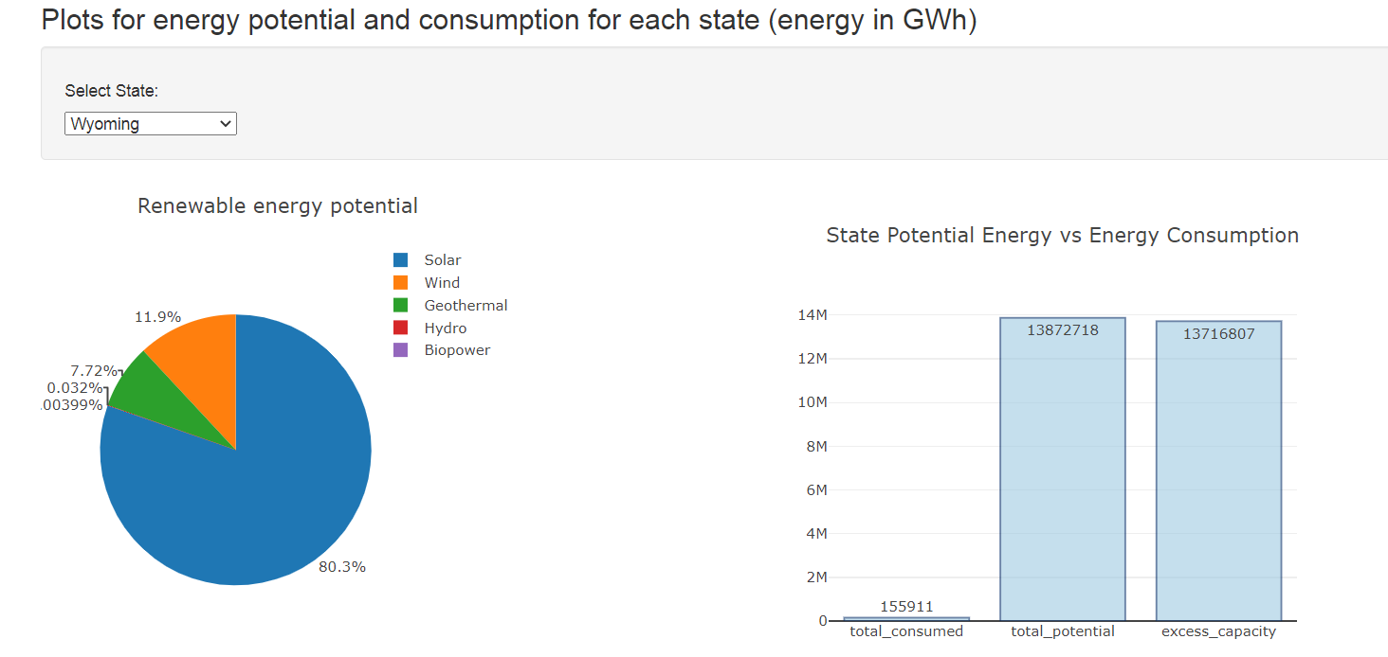
Visualization Methods:
We used Plotly-JavaScript to create Pie chart and Bar chart plot for
each state with dropdown selection option.
Pie chart represents the different renewable energy types potential.
Bar chart represents the total potential for renewable energy along with
current total consumption and excess energy capacity .

Slide 4
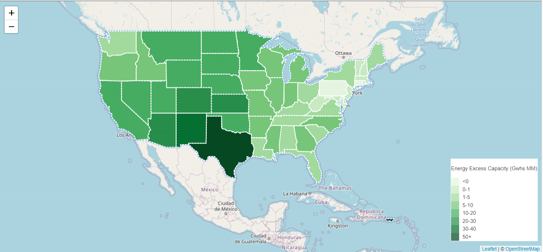
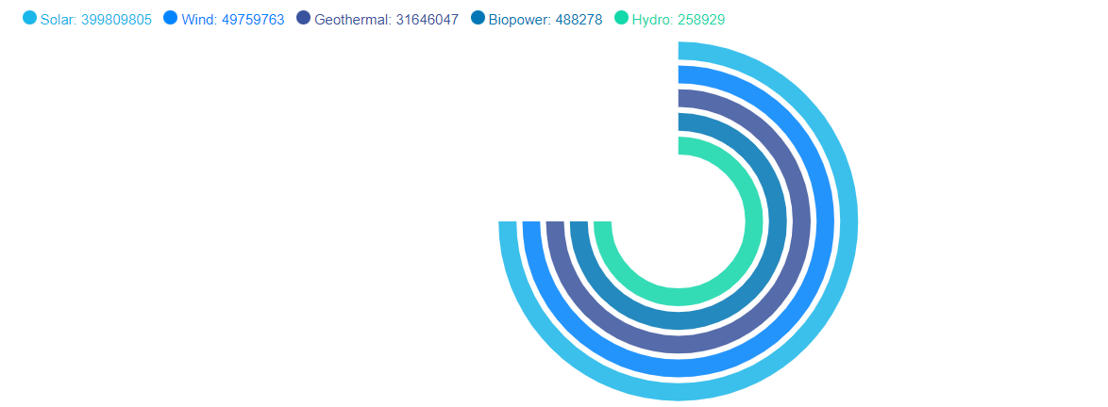

Visualization Methods:
We used leaflet choropleth to show heat map excess capacity for each State.
We used ApexCharts library to map total renewable energy capacity for US by types.

Slide 5
Troubleshooting
Data cleaning
Relatively smooth. Different energy units in raw data (GWh, BTU) and needed a conversion.
Database creation
We created dataframe with all small letter column names, and did same in creating table in postgres database. So we had no problem in in sending data from dataframe like in ETL project.
Jsonify the data from database.
Order of data in results pulled from Database should be same as the order in sending it in dictionary while using Jsonify.
Problem with Index file for main landing page to work.

Slide 6
Findings:
Texas was the state with largest renewable energy excess capacity.
Pennsylvania was the state with negative renewable energy excess capacity.
Solar power was the renewable energy with maximum potential in US.
Hydro power was the renewable energy with minimum potential in US.

Slide 7
Web Deployment:
Website hyperlink here

