Slide 1

Chicago Crimes: Facts and Trends From Last 3 Years!
Project 1: Summary
From group
Chi-BearsPy
Contributors:
Ryan Callaghan
Bhumi Bhusal
Artem Iliushin
Rafael Tem Pahs

Slide 2
Agenda:
Project overview
Summarize project goals
Findings analysis
Section I – Ryan Callaghan (crime types and overall trend)
Section II – Bhumi Bhusal (Trend of crimes with arrests, domestic vs non-domestic )
Section III – Artem Iliushin (crime distribution by time of day and g-map analysis )
Section IV – Rafael Tem Pahs (crime distribution by district)
Project Conclusion

Slide 3
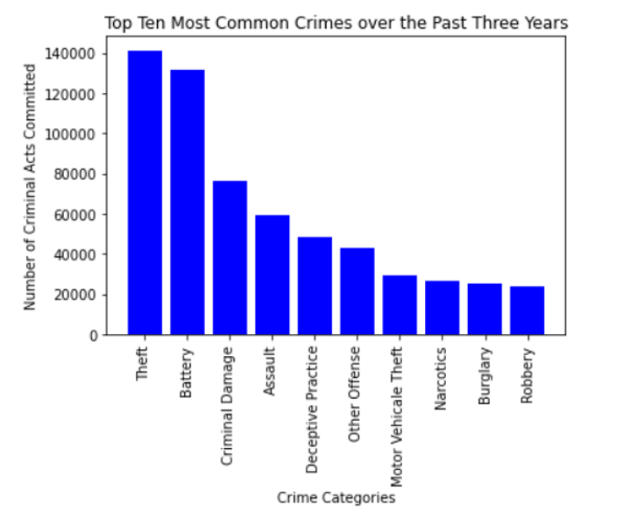
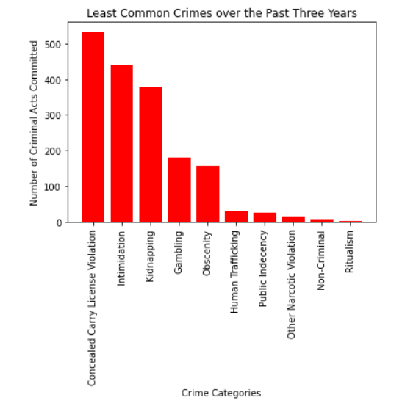
Section I : Crime distribution by types

Slide 4
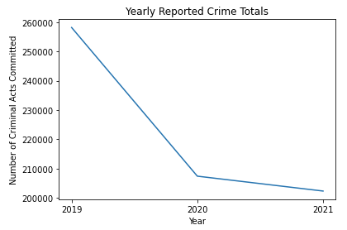
Section I : Overall crime trend for last three years

Slide 5
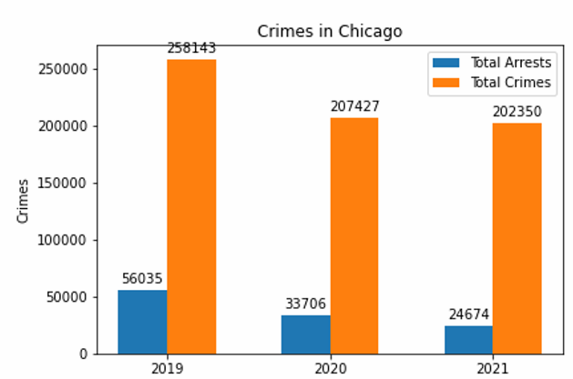
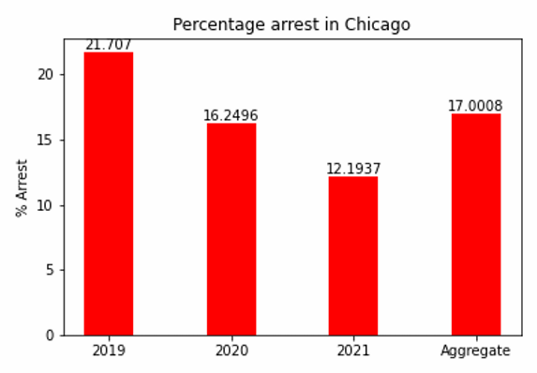
Section II : overall trends - crimes and arrests
Total Crimes: chi-square >8000, critical value = 6
Total Arrests: chi-square >13000, critical value = 6

Slide 6
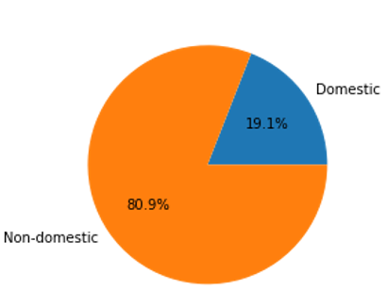
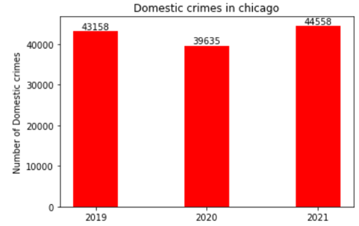
Section ii : domestic vs non-domestic crimes
Total crimes by domestic or non-domestic
Domestic crimes year over year

Slide 7
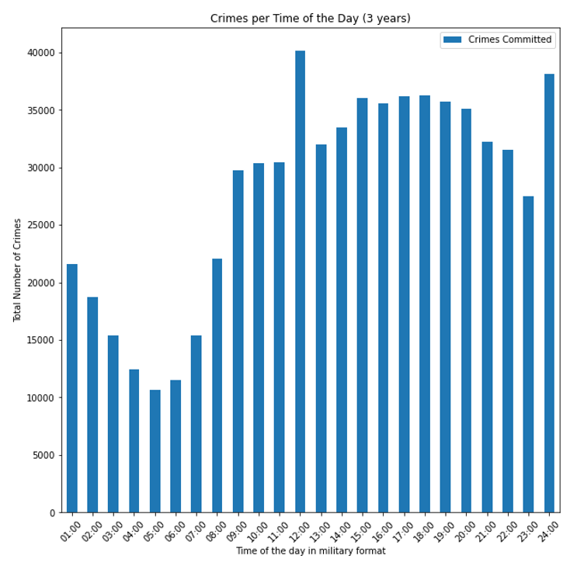
Section IIi : crime distribution by time of day

Slide 8
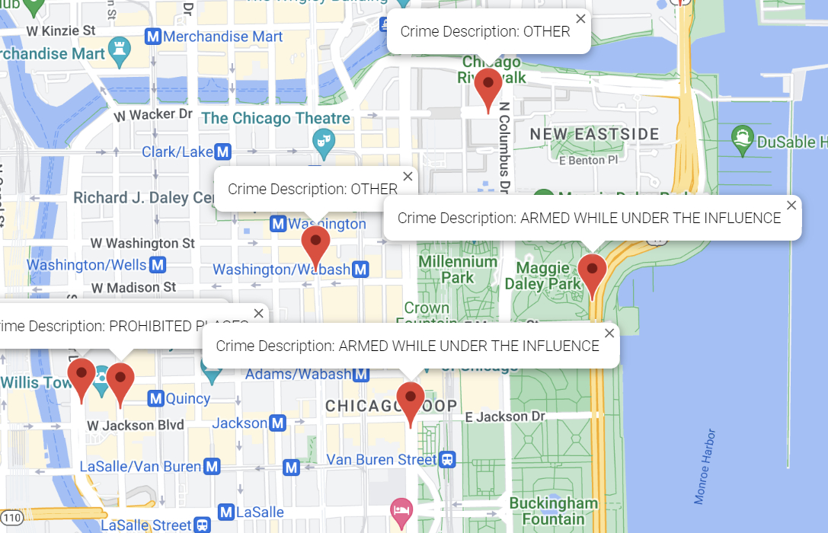
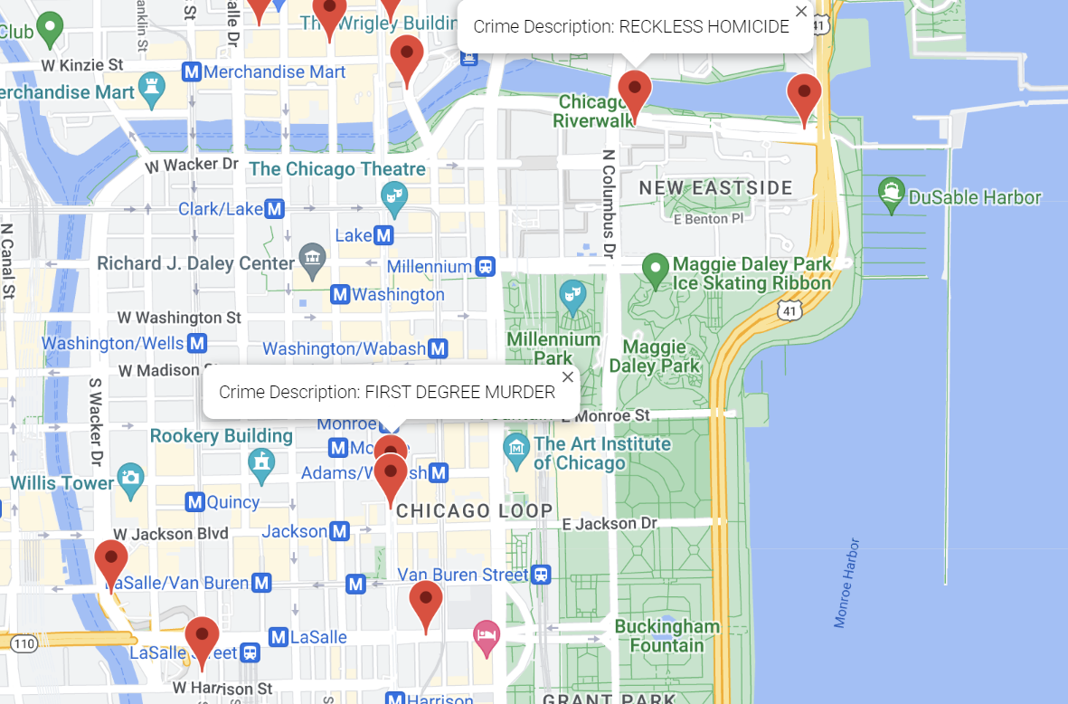
Section IIi : Homicides vs concealed carry g-map analysis of loop area & millennium park
Concealed carry violation
Homicide

Slide 9
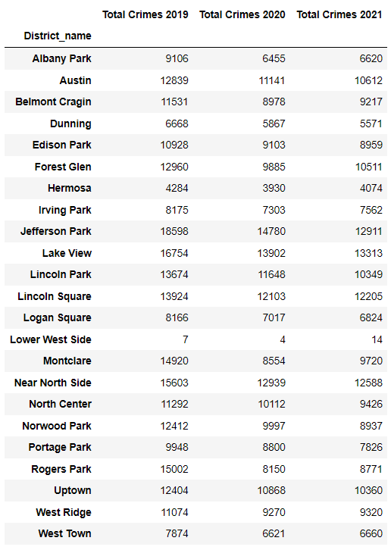
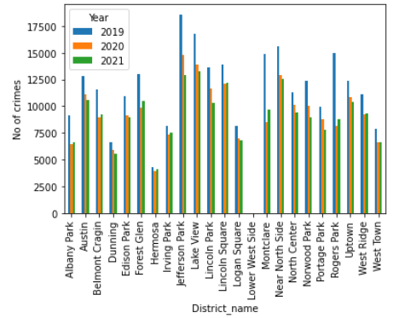
Section Iv : crime distribution by district
Total number of crimes per district by year

Slide 10
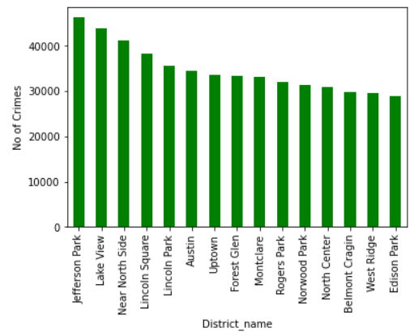
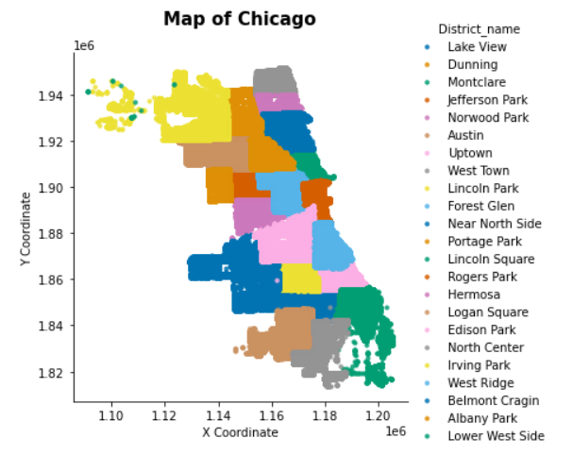
Section Iv : crime distribution by district
Total number of crimes per district

Slide 11
Conclusions
Theft and Battery were most common crimes.
Both total number of crimes and number of arrests decreased.
More crimes reported in the evening than on morning.
limitations
More crimes reported in north than in south.
The analysis are generalized to overall crimes reported.
The crime distribution may be different for crimes with different level of violence.

