Slide 1

E-Commerce Tech
CUI solo Project
Presentation
Ailiu WU

Slide 2
Agenda
Project Overview
Project Design
Implementation
SOLID Principle

Slide 3




1
Project Overview
Train a NLP service and build a shell application to perform 1. add grocery products to cart 2. check out
Train the NLP service to recognize actions using natural language
Prepare the dataset to fit entities
Give customers instructions to prevent getting stuck

Slide 4
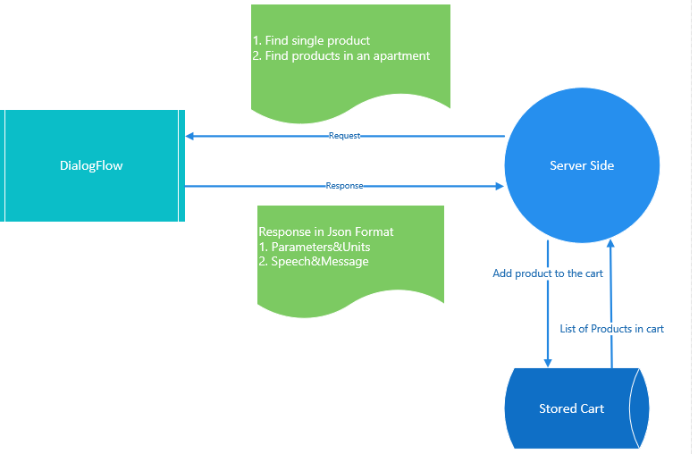
2
Project Design

Slide 5
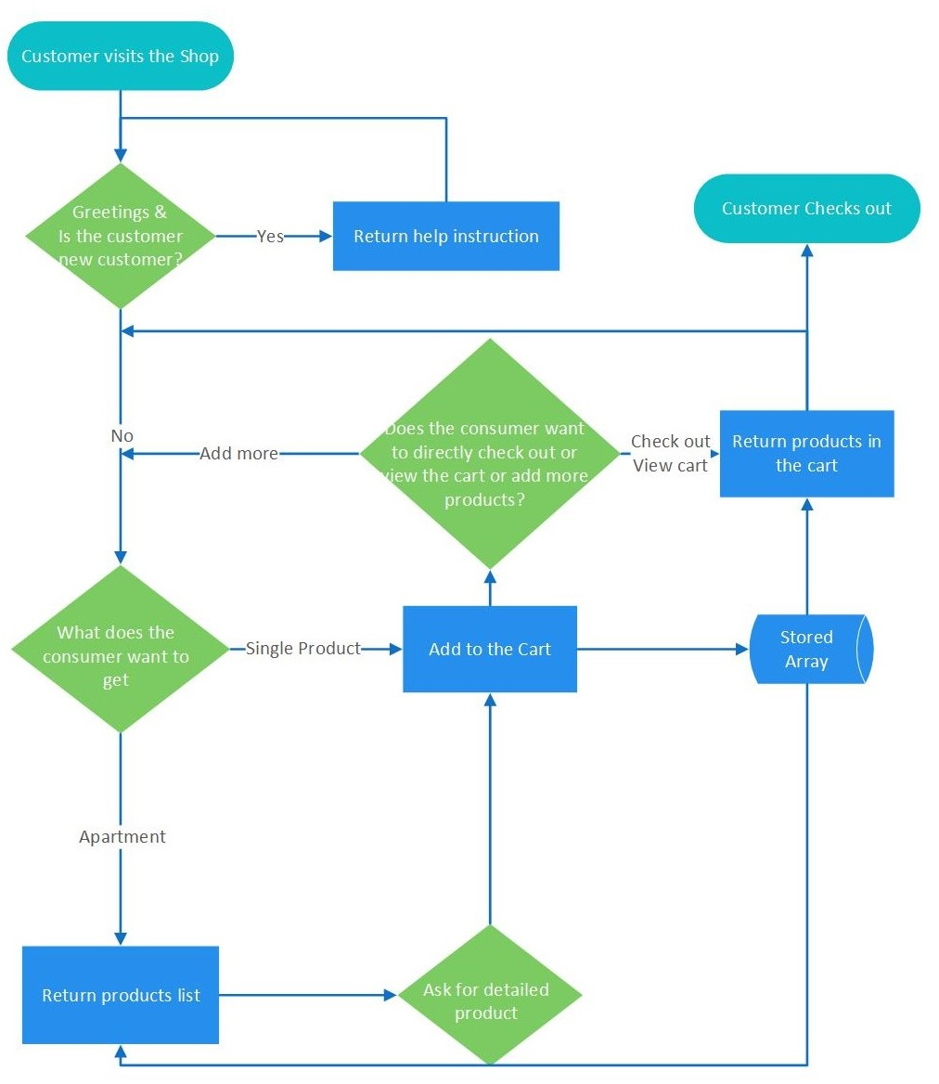
2
Project Design
This is a waterflow chart which shows a happy path of the program.

Slide 6
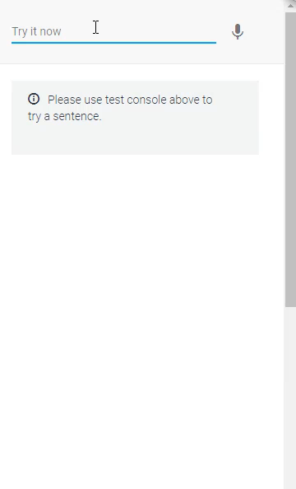
3
Implementation
This is a very simplified demo of the DialogFlow agent.
The implementation is through an api in NodeJS.

Slide 7
3
Implementation
Api.ai SDK
Connect to the DialogFlow agent with Client Access Token & Unique Session Id
Send Request/Response

Slide 8
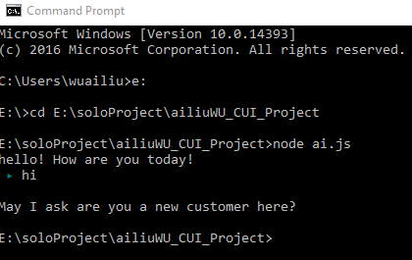
3
Implementation
Basically, the JS program would extract information from the response of DialogFlow agent.
Speech: show
Product&Unit: store in a cart array
Currently I am able to get the greeting response from the DialogFlow agent. Next, I will
Send multiple request in synchronous order
Modify the dataset and upload to the entities
Notes:
Stuck with programming. Asynchronous. GetResponse is the last program to execute.

Slide 9
4
SOLID
SRP
Request and response module would only handle the connection with DialogFlow
DIP
module.exports = function Bot (apiai) {……}
There is no require(library) in the Bot module
I sent the apiai from an outside function
const apiai = require('apiai’);
const Bot = require('./Bot’)
new Bot(apiai)
OCP
I wouldn’t change the request and response module
If there are other more complicated requests like requests with contexts and parameters, I would only extend this module rather than change it

Slide 10
THANKS
2017.Dec.07

