Slide 1
VAIDANATH GARDEN
(USES OF MEDICINAL PLANT FOR HOUSEHOLD)
Guided By:
Dr. S. Milton Ganesh, M.E, Ph.D.
Assistant Professor /IT
Team Members:
Manikandan J (422419205021)
Revathi A (422419205031)

Slide 2
DOMAIN: DATA MINING
Data mining is the process of discovering actionable information from large sets of data. Data mining uses mathematical analysis to derive patterns and trends that exist in data.
AREA: HERBAL MEDICINE
Herbal medicine has its origins in ancient cultures. It involves the medicinal use of plants to treat disease and enhance general health and wellbeing. Some herbs have powerful ingredients and should be taken with the same level of caution as pharmaceutical medications.

Slide 3
Problem :
Suggestion of Herbal Plants based upon profiling family Members
Input: Getting a Family Profile.
Output: Suggestion for Cropping and Preparation of Herbal Plants
Algorithm: Classification Algorithm

Slide 4
Software Required:
Apache Tomcat Server 12.5
MySQL 15.0
Java / python
HTML & CSS
OS Required:
Windows 10
Hardware Required:
Pc with 4 GB Ram

Slide 5

FLOW DIAGRAM:
FEATURE SELECTION
REGISTER / LOGIN
CLUSTERING
Select Features
Register
New user
K- Means Clustering
Check Status
Data Analysis
Output
Login
Data pre-processing
Old user
Personal DB
Herbal DB

Slide 6
MODULES
REGISTER / LOGIN:
The user can login into website/app that based on official database(personal DB) , whereas register can help to upload the present officially in the system.
FEARTURE SELECTION:
After login is valid, feature selection can sort out the specific data at base on
conditions. The sorted data’s are use to search the herbal plants data for the user’s problem.
CLUSTERING:
The Clustering Module, that consist algorithm to find the specific data of herbal plant and it suggested to user.

Slide 7
ALGORITHM:
Login
If( id = “valid mail_id” && pass=“Pass”)
Login successful
Else
Login Un successful
Register:
Get the data of user and stored in Database_hb.
Program verified
if( age ==“valid subset” && problem ==“id of problem” && symptoms=“sub id”)
print the List out Medicinal plants form database.

Slide 8
Project DEMO:
localhost/php/web/

Slide 9
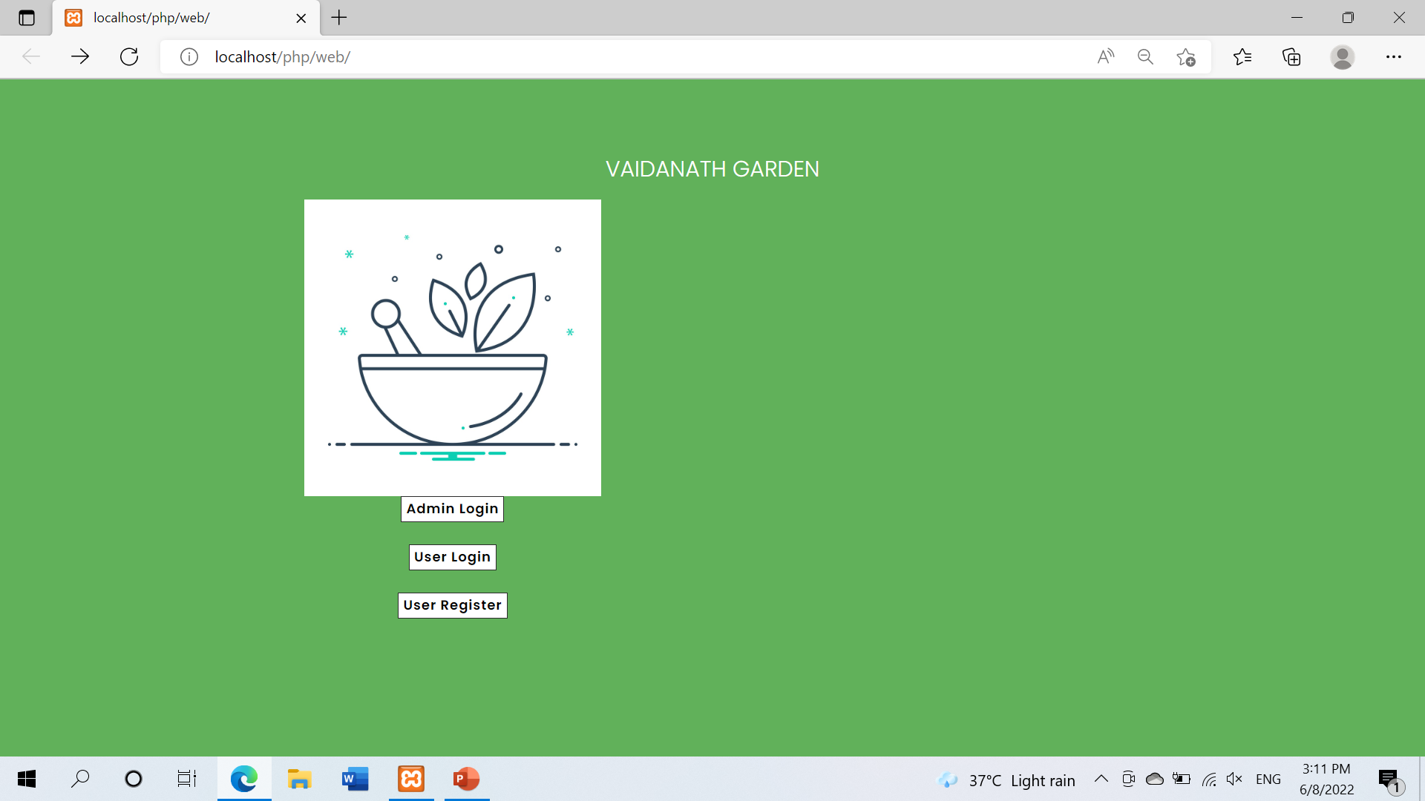

Slide 10
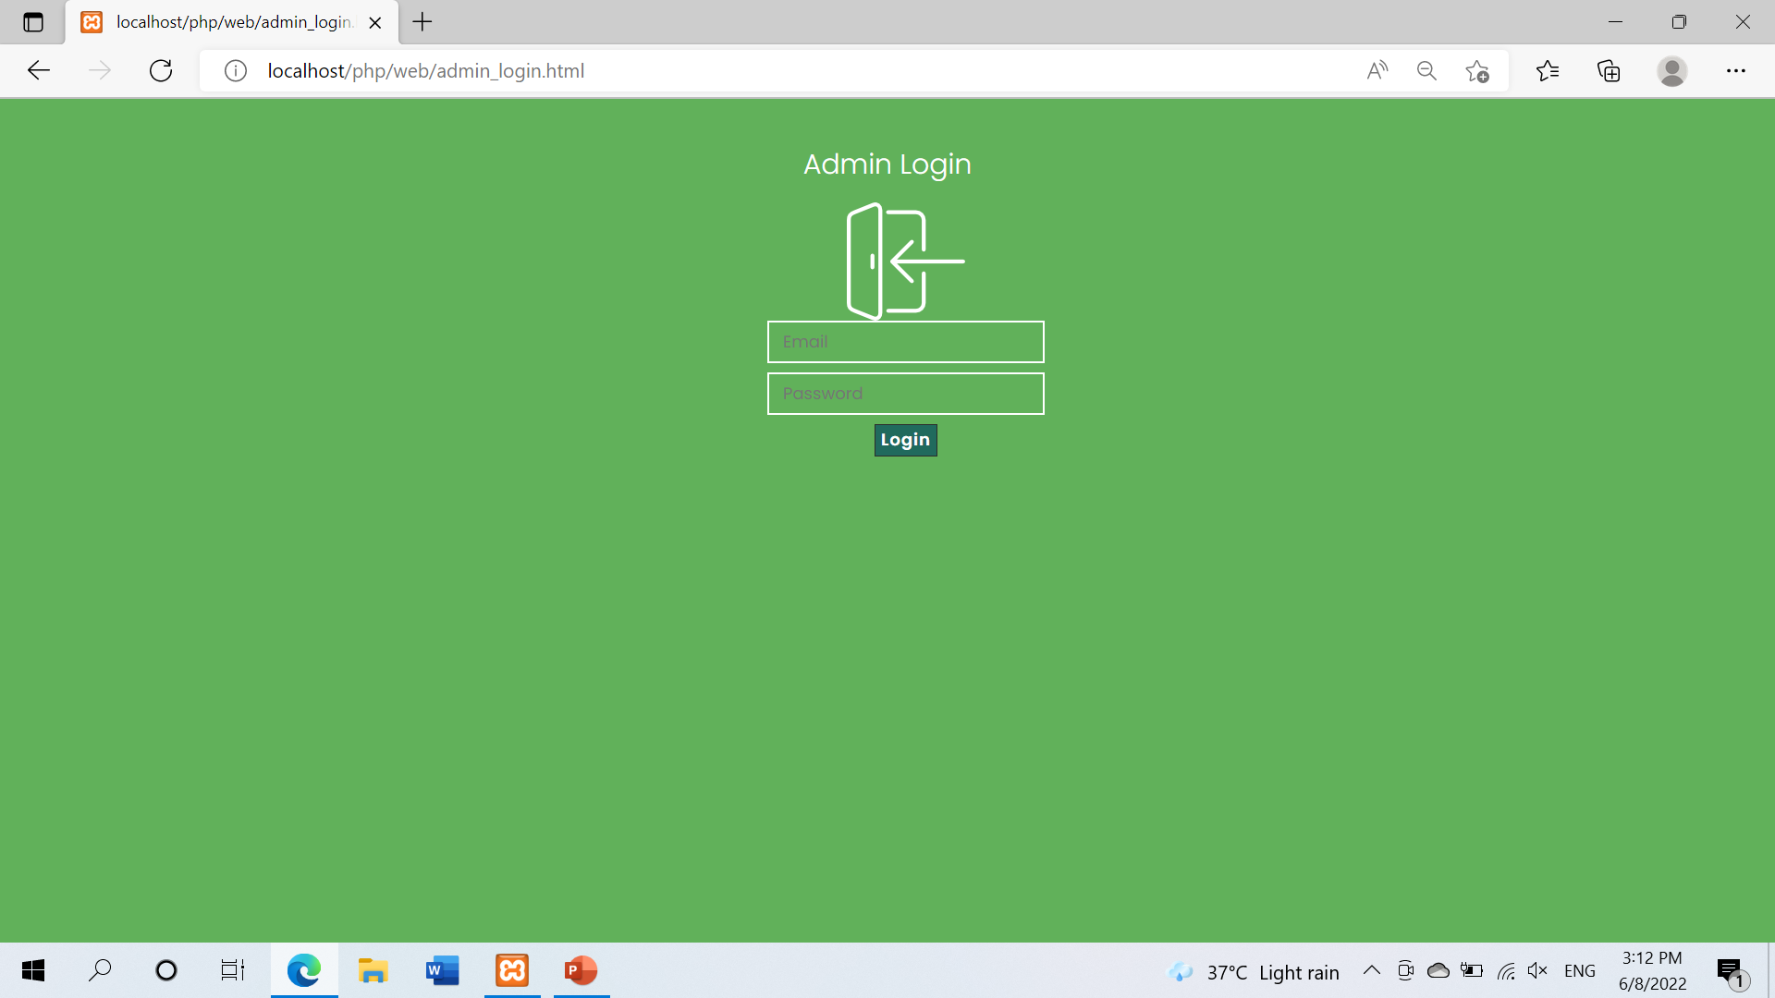
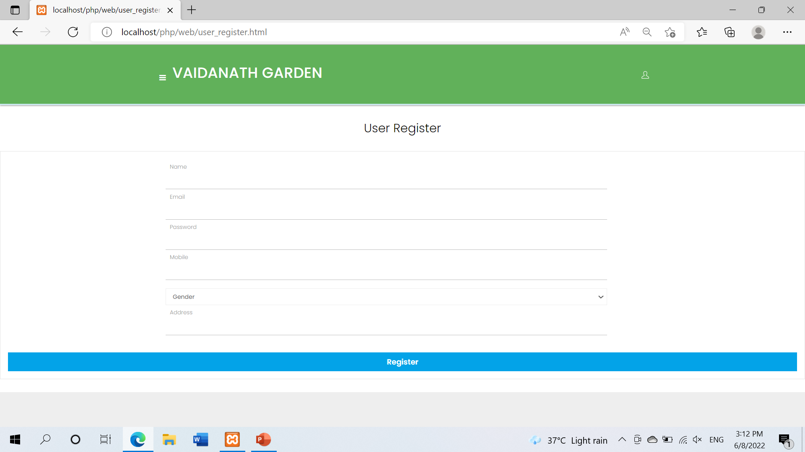

Slide 11
