Slide 1
IST – DBM2: DATA MINING
Ana Isabel Lopez and David Pardo

Slide 2
TABLE OF CONTENTS
01
02
03
Overview of the database
Preprocessing I
Clustering
04
05
06
Preprocessing II
Classification
Conclusions
A panoramic insight into the database structure and contents
Initial preprocessing to align with the clustering procedure
Cluster analysis and the comparison of the results
Second preprocessing to align with the classification procedure
Classification analysis and somo methods used to compare
Opinion of the results and possibles improvements

Slide 3
01
OVERVIEW OF THE DATABASE

Slide 4

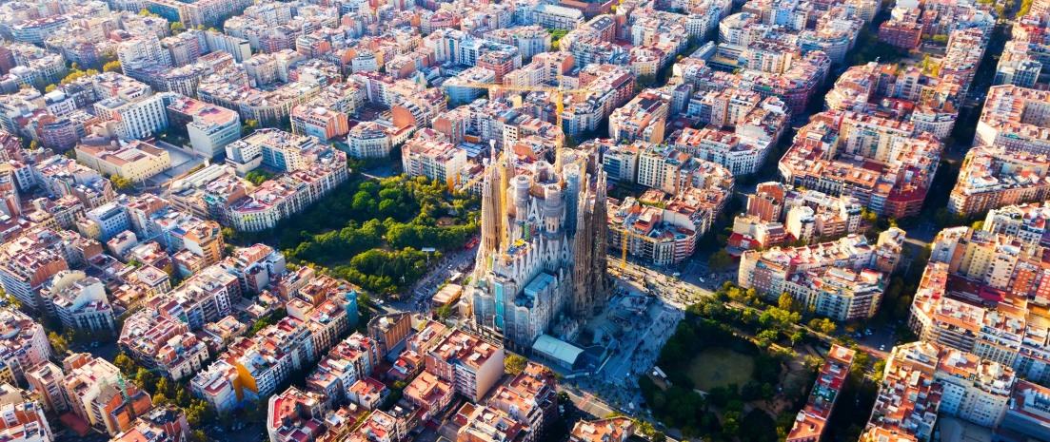
WEATHER DATABASE
Database
Dimensions
Database of meteorology at specific hours of each day for the five largest cities in Spain, from 2015 to 2018.
Because of the store of data hourly over 3 years, the amount of it is 178.396 rows.
17 columns of parameters related to the meteorology (rain, temperature, humidity…)

Slide 5
02
PREPROCESSING I

Slide 6
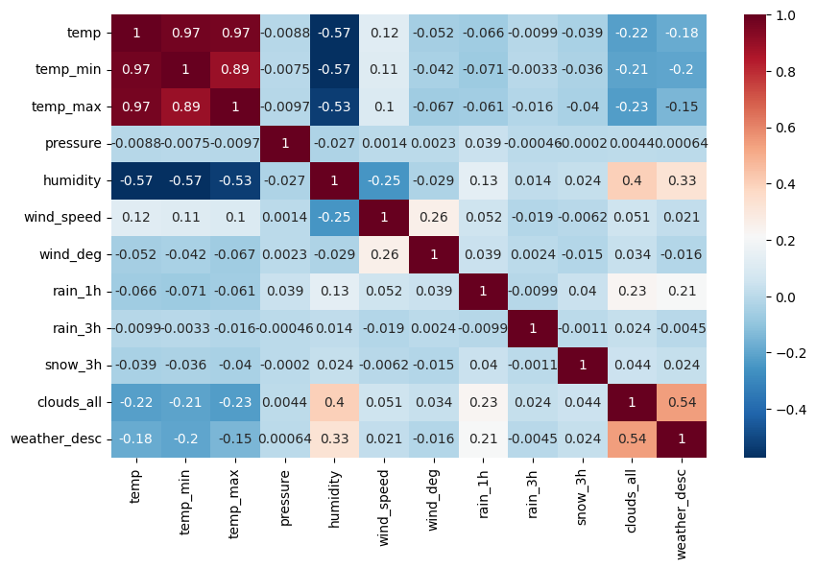
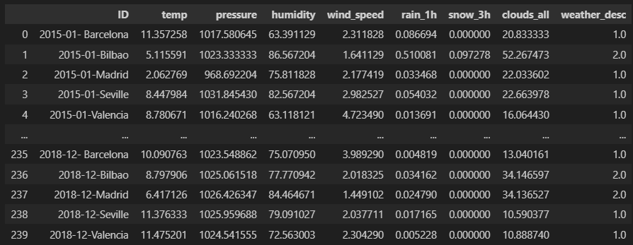
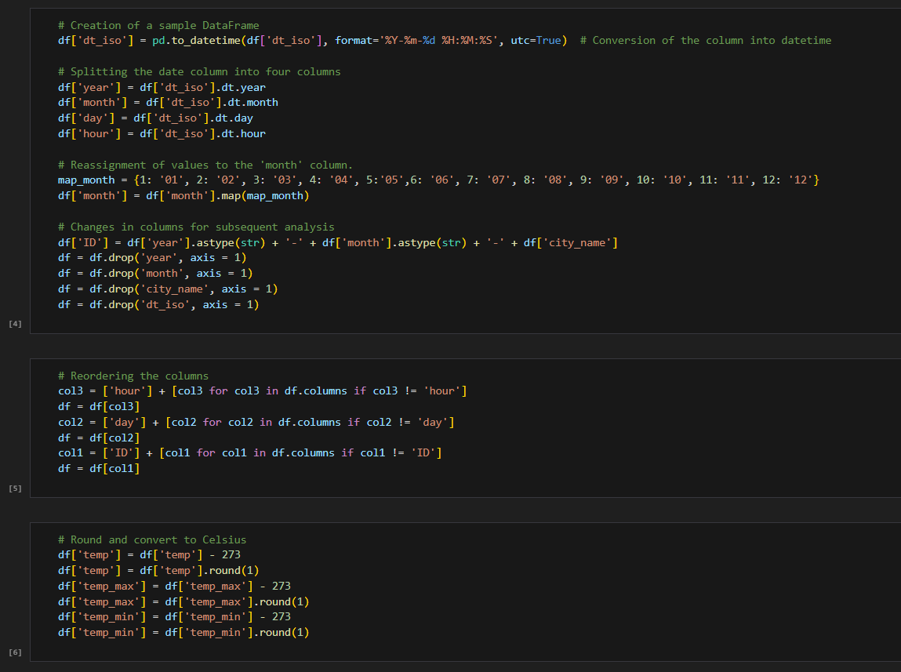
OUR PROCESS
Remove innecesary data
Unit conversion
Grouping values
Changes in formats
Assignation of numeric values
Reorder columns

Slide 7
OUR PROCESS
Remove innecesary data
Unit conversion
Grouping values
Changes in formats
Assignation of numeric values
Reorder columns

Slide 8
OUR PROCESS
Remove innecesary data
Unit conversion
Grouping values
Changes in formats
Assignation of numeric values
Reorder columns

Slide 9
OUR PROCESS
Remove innecesary data
Unit conversion
Grouping values
Changes in formats
Assignation of numeric values
Reorder columns

Slide 10
OUR PROCESS
Remove innecesary data
Unit conversion
Grouping values
Changes in formats
Assignation of numeric values
Reorder columns

Slide 11
OUR PROCESS
Remove innecesary data
Unit conversion
Grouping values
Changes in formats
Assignation of numeric values
Reorder columns

Slide 12
03
CLUSTERING

Slide 13
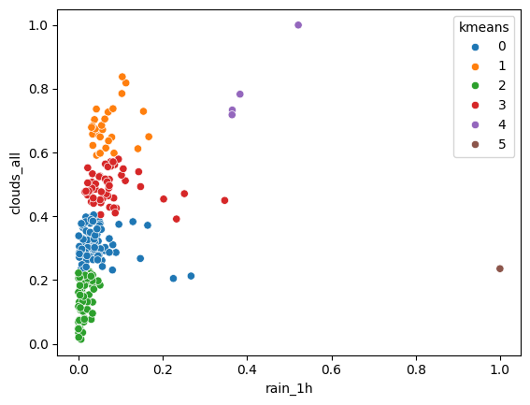
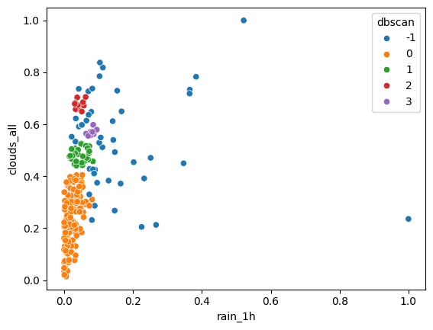
KMEANS VS. DBSCAN
K-MEANS
DBSCAN
Assumes spherical clusters, requires predefined cluster count, computationally efficient.
Flexible, handles arbitrary-shaped clusters and outliers, no need for predefining cluster count.

Slide 14
04
PREPROCESSING II

Slide 15
OUR NEW PROCESS
Same steps as before clustering
Creating intervals to numeric values
Not grouping values

Slide 16
05
CLASSIFICATION

Slide 17
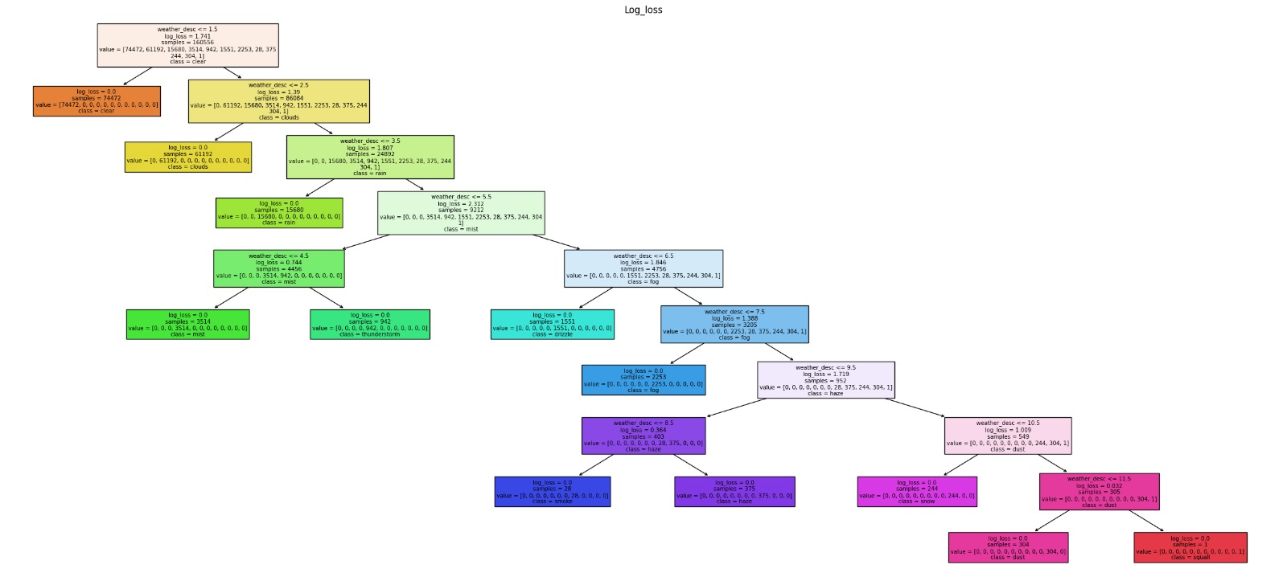
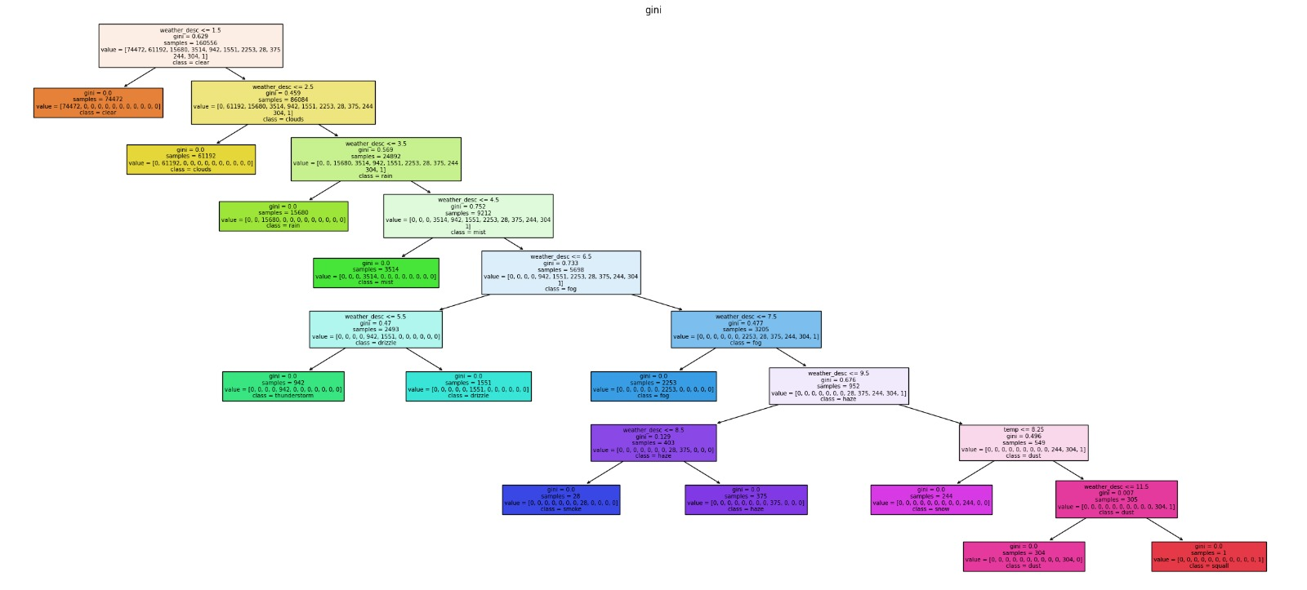

DECISION TREE CLASSIFIER
ENTROPY
Measures the uncertainty or lack of homogeneity in a node.
GINI
Impurity measures how mixed the classes are in a node
LOG LOSS
Optimization to minize the difference between predicted and actual probability distributions
Notes:
PONER ESQUEMAS DE LOS ARBOLES

Slide 18
DECISION TREE CLASSIFIER
ENTROPY
Measures the uncertainty or lack of homogeneity in a node.
GINI
Impurity measures how mixed the classes are in a node
LOG LOSS
Optimization to minize the difference between predicted and actual probability distributions
Notes:
PONER ESQUEMAS DE LOS ARBOLES

Slide 19
DECISION TREE CLASSIFIER
ENTROPY
Measures the uncertainty or lack of homogeneity in a node.
GINI
Impurity measures how mixed the classes are in a node
LOG LOSS
Optimization to minize the difference between predicted and actual probability distributions
Notes:
PONER ESQUEMAS DE LOS ARBOLES

Slide 20
DECISION TREE CLASSIFIER
ENTROPY
Measures the uncertainty or lack of homogeneity in a node.
GINI
Impurity measures how mixed the classes are in a node
LOG LOSS
Optimization to minize the difference between predicted and actual probability distributions
Notes:
PONER ESQUEMAS DE LOS ARBOLES

Slide 21
DECISION TREE CLASSIFIER
ENTROPY
Measures the uncertainty or lack of homogeneity in a node.
GINI
Impurity measures how mixed the classes are in a node
LOG LOSS
Optimization to minize the difference between predicted and actual probability distributions
Notes:
PONER ESQUEMAS DE LOS ARBOLES

Slide 22
DECISION TREE CLASSIFIER
ENTROPY
Measures the uncertainty or lack of homogeneity in a node.
GINI
Impurity measures how mixed the classes are in a node
LOG LOSS
Optimization to minize the difference between predicted and actual probability distributions
Notes:
PONER ESQUEMAS DE LOS ARBOLES

Slide 23
DECISION TREE CLASSIFIER
ENTROPY
Measures the uncertainty or lack of homogeneity in a node.
GINI
Impurity measures how mixed the classes are in a node
LOG LOSS
Optimization to minize the difference between predicted and actual probability distributions
Notes:
PONER ESQUEMAS DE LOS ARBOLES

Slide 24
BAGGING VS. RANDOM FOREST
BAGGING
RANDOM FOREST
Enhances the accuracy and stability by averaging multiple models trained on different subsets of data
Employs multiple trees to enhance accuracy and reduce overfitting
DIFFERENCES
Random Forest uses Bagging as a key component but adds more variability by restricting the features considered at each tree split

Slide 25
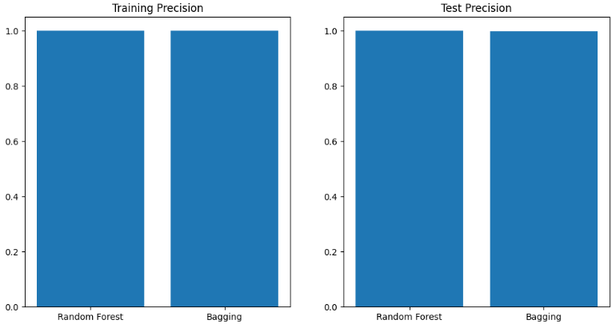
COMPARATION
Simple dataset without complexity, models generated by Bagging and Random Forest produce similar results

Slide 26
06
CONCLUSIONS

