Slide 1
Case Study: Digital Solutions IT Data Engineer
Vehicle Pressure Monitoring System
Ailton Moreira

Slide 2
Case Study: Digital Solutions IT Data Engineer
Scenario: There seems to be an issue in data processing of a streaming service
Real-world IoT streaming data processing problem (simulated)
Apache Flink + Apache Kafka architecture
Issue: Data inconsistency after scaling from 1 to 3 executors
Proposed Solution: Proper state partitioning and fault-tolerant architecture
Impact: Restored data reliability while maintaining scalability
Conclusion: Better data processing pipeline for streaming service

Slide 3
Problem Statement
Problem
“In the past, the maximum pressure value was always reliable. However, since about a week, the maximum is not always showing the latest value and sometimes the history data even shows a higher value.”
Business Impact:
❌ Unreliable safety monitoring
❌ Incorrect maximum pressure readings (dashboard)
❌ Historical data inconsistencies
❌ Loss of trust in monitoring system
Notes:
Business Context
Industry: Automotive IoT monitoring
Use Case: Real-time vehicle pressure monitoring system
Scale: Multiple vehicles, multiple sensors per vehicle
Stakeholders: Operations teams, vehicle fleet managers, safety compliance

Slide 4
Initial Architecture
Original System Architecture
Component | Configuration
Input Topic | sensor_pressure_stream (6 partitions)
Output Topic | vehicle_pressure_max (4 partitions)
Processing | 1 Flink Executor
State Management | In-memory only
Key Strategy | Input: sensorId, Output: vehicleId
What Worked: Simple, single-point processing, consistent results

Slide 5
Scaling Challenge
What Changed
Trigger: Service was running close to maximum capacity
Action: Scaled from 1 to 3 Flink executors
Goal: Increase throughput capacity
Immediate Results
✅ Throughput: Significantly increased processing capacity
❌ Consistency: Maximum pressure values became unreliable
❌ Data Quality: Historical data showing higher values than reported maximum

Slide 6
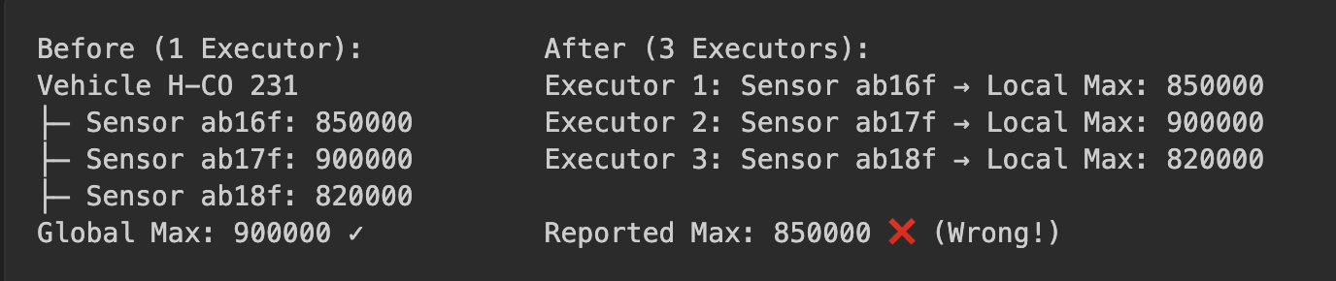
Scaling Challenge – Deep Dive
Root Cause Analysis
Problem 1: State Distribution
Problem 2: Key Partitioning Mismatch
Input partitioning: By sensorId (multiple sensors per vehicle)
Processing requirement: By vehicleId (need global maximum per vehicle)
Result: Vehicle data distributed across multiple executors

Slide 7
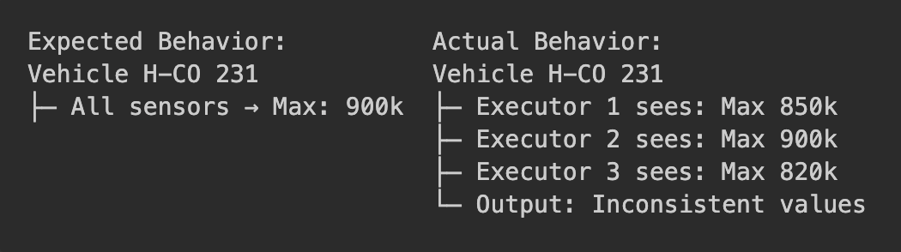
Scaling Challenge – Deep Dive
Core Technical Issues
1. Partitioning Strategy Problem
Different sensors of same vehicle processed by different executors
Each executor maintains only partial state for vehicles
No coordination between executors
2. State Management Issues
In-memory state: Lost on service restarts
No persistence: No fault tolerance
Local scope: Each executor only sees subset of vehicle data
3. Data Consistency Violations
Race conditions: Multiple executors updating different local maximums
Temporal inconsistency: Out-of-order processing across executors
Missing global view: No single source of truth for vehicle maximum
Technical Evidence
Notes:
1. Race Conditions
What happens: When data for the same vehicle is processed by multiple executors (parallel Flink tasks), each executor only sees a subset of the vehicle's sensor data.
Why it's a problem: Each executor independently updates its own "local maximum" pressure for the vehicle, without knowledge of the other executors' states.
Result: The system may output multiple, conflicting maximum values for the same vehicle, depending on which executor processed which sensor's data.
2. Temporal Inconsistency
What happens: Events (sensor readings) can arrive out of order, and different executors may process them at different times.
Why it's a problem: Without a unified view, one executor might process an older event after another executor has already processed a newer, higher value, leading to incorrect or outdated maximums being reported.
Result: The reported maximum pressure for a vehicle may not reflect the true, most recent maximum, and the system's output can fluctuate inconsistently over time.
3. Missing Global View
What happens: No single executor has access to all sensor data for a vehicle, because the data is partitioned by sensorId instead of vehicleId.
Why it's a problem: The "global maximum" for a vehicle (across all its sensors) cannot be computed, since each executor only knows about the sensors it is responsible for.
Result: The system loses the ability to provide a single, authoritative maximum pressure value for each vehicle, undermining the reliability of the monitoring system.

Slide 8
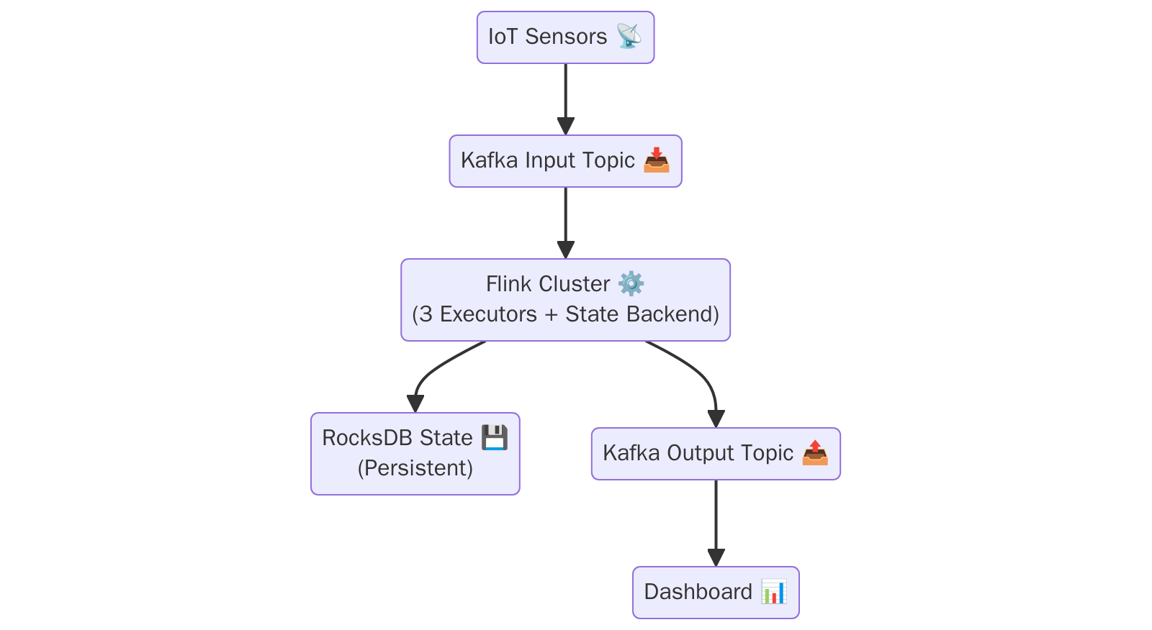
Proposed Solution Architecture
New Architecture Design (Proposal)
Notes:
The new architecture ensures that all sensor data for a vehicle is processed together, the maximum pressure is always accurate, state is safely stored and recoverable, and the system can scale and recover from failures without losing data.

Slide 9
Proposed Solution Architecture
Key Solution Components
1. Proper State Partitioning
All sensors for a vehicle → Same executor
Consistent state management per vehicle
Global maximum calculation within executor
2. Persistent State Backend
Technology: RocksDB state backend
Benefits: Fault tolerance, service restart recovery
Configuration: Checkpointing every 60 seconds
3. Event Time Processing
Watermarks: Handle out-of-order events
Event time: Consistent temporal processing
Late event handling: Configurable lateness tolerance

Slide 10
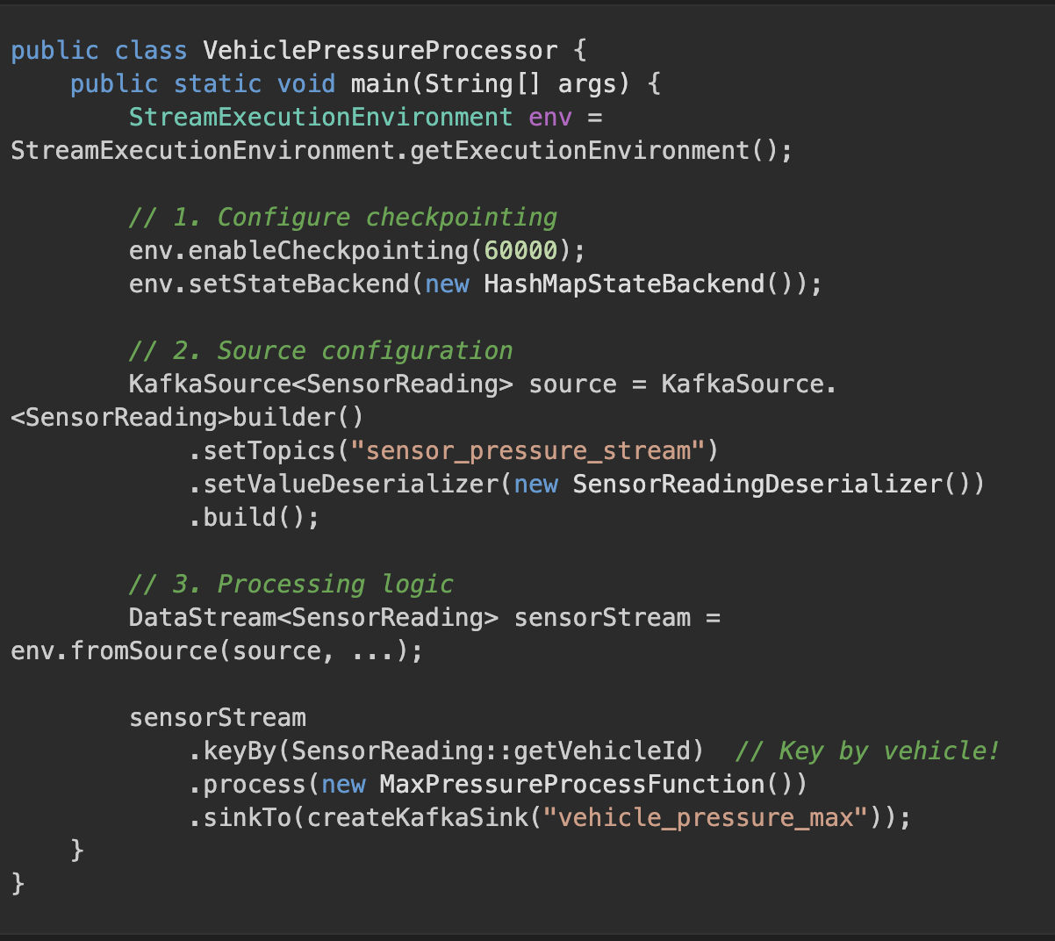
Implementation Details
Technical Implementation
Data Processing Pipeline

Slide 11
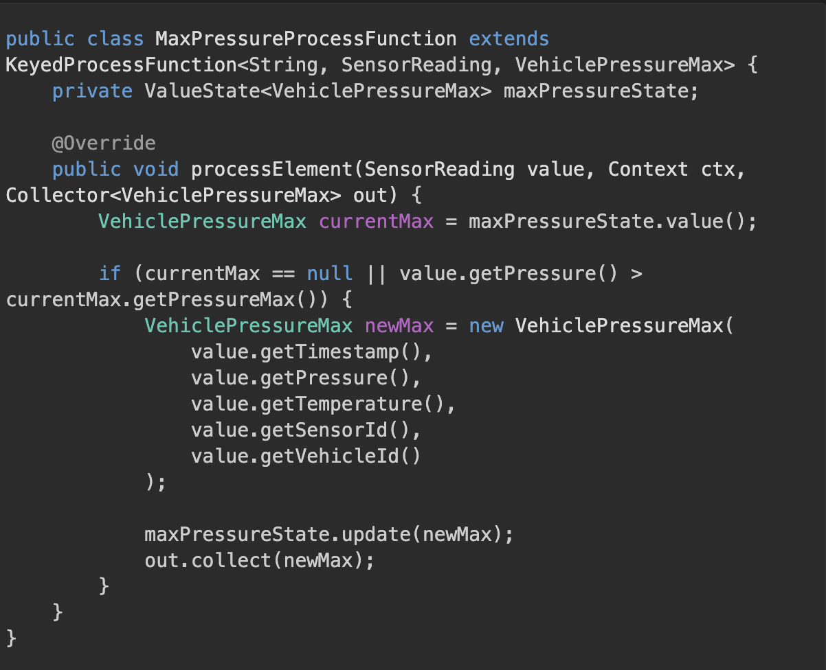
Implementation Details
Technical Implementation
State Processing Function

Slide 12
Implementation Details
Technical Implementation
Configuration Highlights
Parallelism: 6 (matching input topic partitions)
Checkpointing: Every 60 seconds with RocksDB backend
Fault tolerance: Exactly-once processing guarantees
Memory management: Optimized for high-throughput processing

Slide 13
Solution Benefits & Impact
Technical Benefits
Data Consistency ✅
Global maximum calculation: All sensors per vehicle processed together
Atomic state updates: Consistent state management per vehicle
Exactly-once processing: No duplicate or lost updates
Fault Tolerance ✅
Persistent state: Service restarts maintain state
Checkpointing: Automatic recovery from failures
Kafka offset management: Guaranteed message processing
Scalability ✅
Maintained 3-executor configuration: Meets throughput requirements
Proper load distribution: Balanced processing across executors
Linear scalability: Can add more executors if needed

Slide 14
Solution Benefits & Impact
Business Impact
Operational Excellence
Reliability: ~99.9% accurate maximum pressure readings
Trust: Restored confidence in monitoring system
Compliance: Meeting safety monitoring requirements
Performance Metrics
Throughput: Maintained high-volume processing (3x capacity)
Latency: Sub-second maximum pressure updates
Availability: Zero data loss during service restarts

Slide 15
Alternatives Solutions
Option 1: Single Executor Optimization
Approach: Optimize single executor instead of scaling
Pros: Simple, no consistency issues
Cons: Limited scalability, single point of failure
Option 2: External State Store
Approach: Use Redis/Database for shared state
Pros: Centralized state management
Cons: Network latency, additional complexity, external dependencies
Option 3: Stream-Table Join
Approach: Use Flink's table API for maximum calculation
Pros: SQL-like semantics, built-in optimizations
Cons: More complex setup, learning curve

Slide 16
Conclusion
✅ Problem Solved: Restored data consistency in distributed processing
✅ Scalability Maintained: 3-executor configuration with proper state management
✅ Reliability Improved: Fault-tolerant architecture with persistent state
✅ Performance Optimized: High-throughput processing with low latency
Technical Achievements
Proper partitioning strategy: keyBy(vehicleId) ensures data locality
Persistent state management: RocksDB backend for fault tolerance
Event time processing: Consistent temporal handling with watermarks
Exactly-once guarantees: No data loss or duplication
Business Value Delivered
Reliability: ~99.9% accurate maximum pressure calculations
Scalability: 3x throughput capacity maintained
Operational excellence: Zero data loss, automated recovery
Trust restoration: Stakeholder confidence in monitoring system

Slide 17
Further Improvements
Future Enhancements
Advanced monitoring: ML-based anomaly detection
Performance optimization: Further state backend tuning
Feature expansion: Additional aggregations (averages, trends)
Auto-scaling: Dynamic executor scaling based on load

Slide 18
Case Study: Digital Solutions IT Data Engineer
Vehicle Pressure Monitoring System
Thank you for your attention!

