Slide 1
Serverless | Cosmos DB
Running and publish Azure Functions project with Cosmos DB
Notes:
NOTE TO PRESENTERS
This deck contains a library of slides you can use to build a customized introduction to Avanade for external audiences, including clients, partners and recruits.
The deck is not meant to be used in its entirety, but rather to provide options for how you introduce Avanade, allowing you to match your content to your audience and their interests. The slides at the front of the deck provide an overview of how Avanade sees the marketplace changing and how we’re helping clients respond to those changes. Your introduction can be extended with slides from the appendices, depending on your purposes, to provide additional information of specific relevance to your presentation audience.

Slide 2
Prerequisites and more!
An Azure subscription (free account).
Main supported languages:
Language | Extension
C# | C# for VS Code
Java | Debugger for Java * + Maven 3+
Typescript | .Net Core 2.2 (preview)
Javascript | Node 8.0+

Slide 3
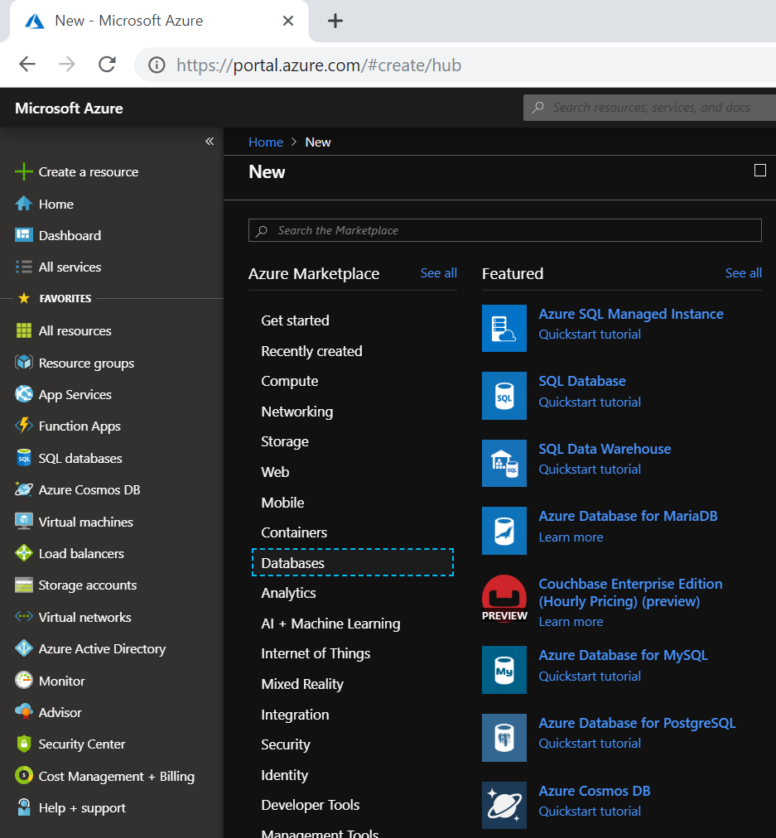
Create an Azure Cosmos DB
You must have an Azure Cosmos DB account that uses the SQL API before you create the output binding.
Sign in to the Azure portal.
Select:
> Create a resource
> Databases
> Azure Cosmos DB

Slide 4
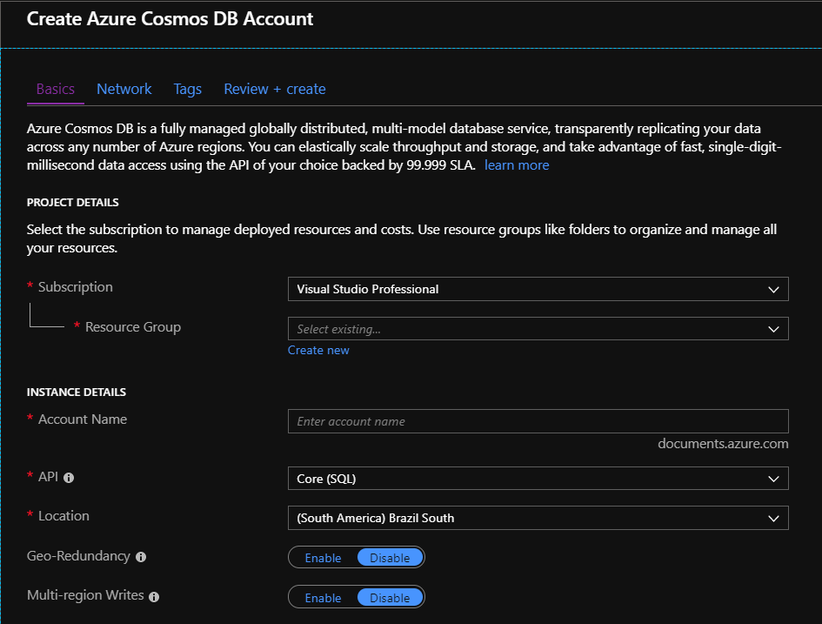
Create an Azure Cosmos DB
On the create Azure Cosmos DB page, enter the basic settings for the new Azure Cosmos account.

Slide 5
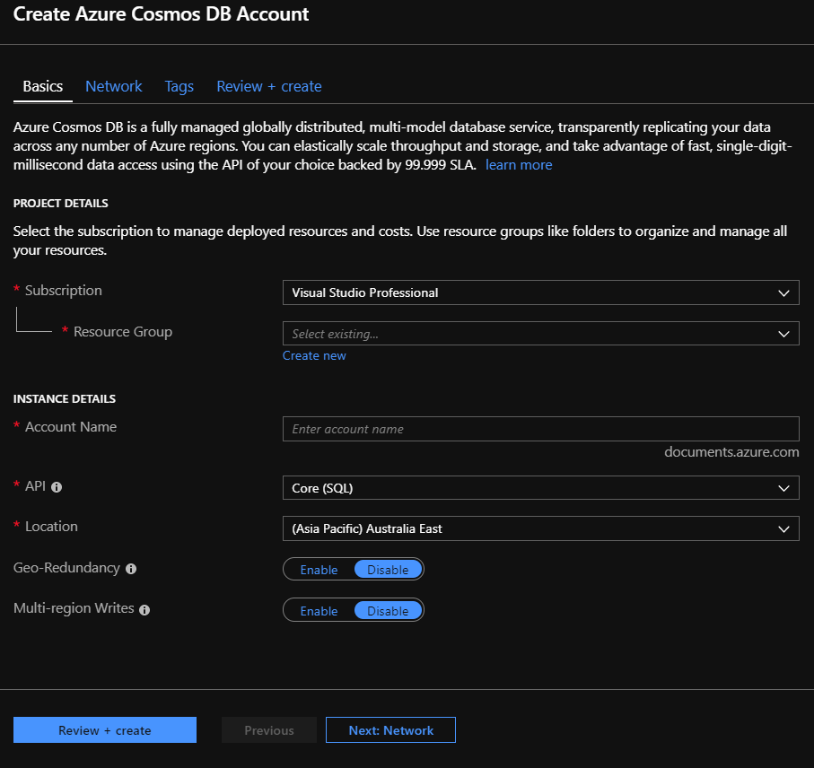
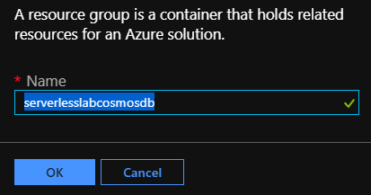
Create an Azure Cosmos DB
Select a resource group, or select Create new, then enter a unique name for the new resource group.
Fill using: “serverlesslabcosmodb”

Slide 6
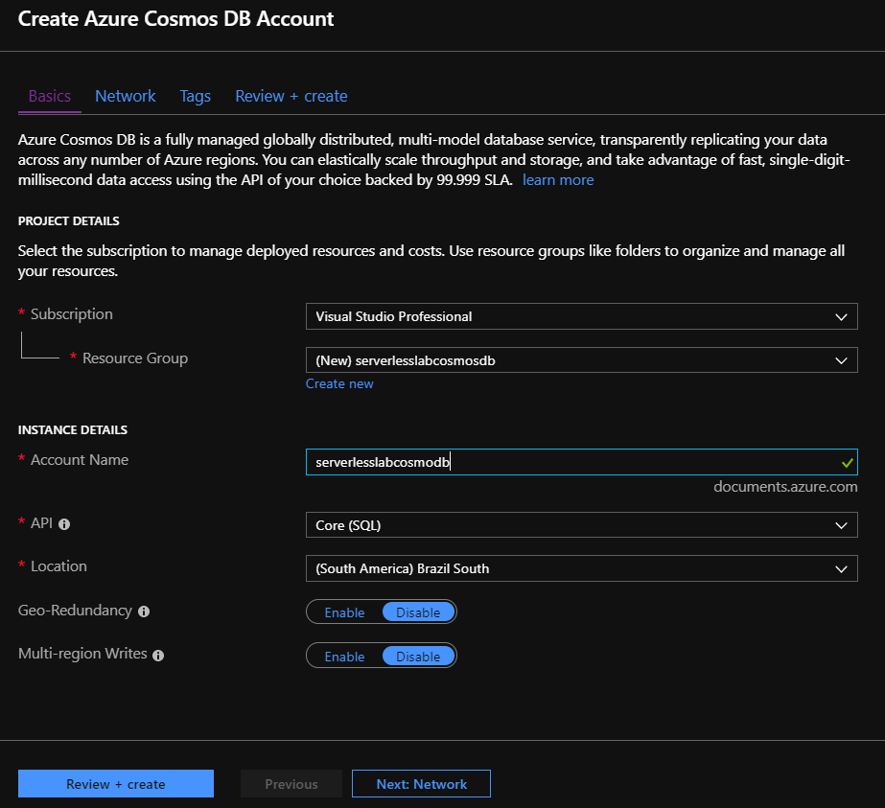
Create an Azure Cosmos DB
Enter a name to identify your Azure Cosmos account. (Because documents.azure.com is appended to the ID that you provide to create your URI, use a unique ID.)
Fill using: “serverlesslabcosmodb”
Select Review + create.
You can skip the Network and Tags sections.

Slide 7
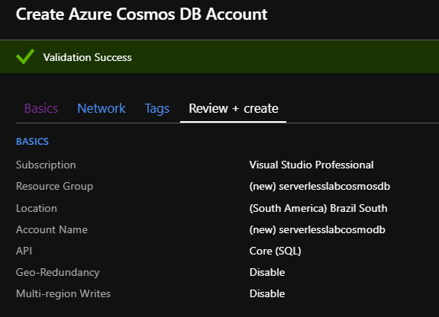

Create an Azure Cosmos DB
Review the account settings, and then click Create button. It takes a few minutes to create the account.

Slide 8
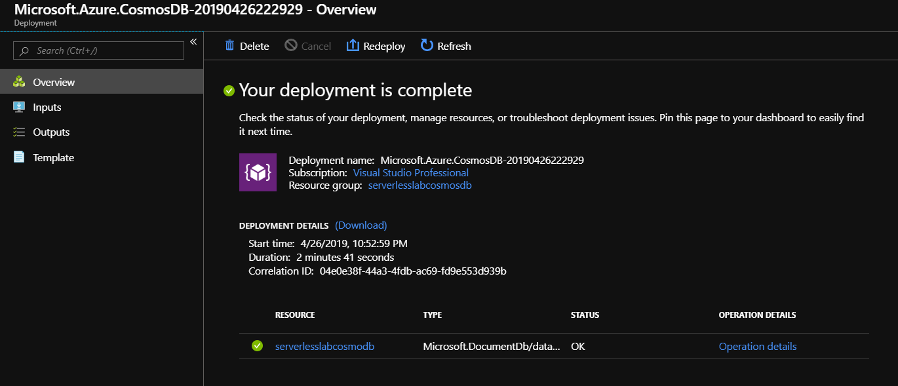
Create an Azure Cosmos DB
Wait for the portal page to display your deployment is complete. Check the resource’s name.

Slide 9
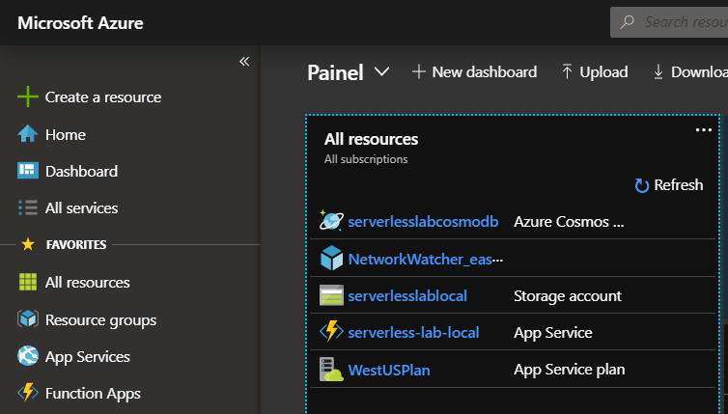
Access an Azure Cosmos DB resource
You must have to access Dashboard and find your Azure Cosmos DB resource.
Select:
> Dashboard
> serverlesslabcosmodb

Slide 10
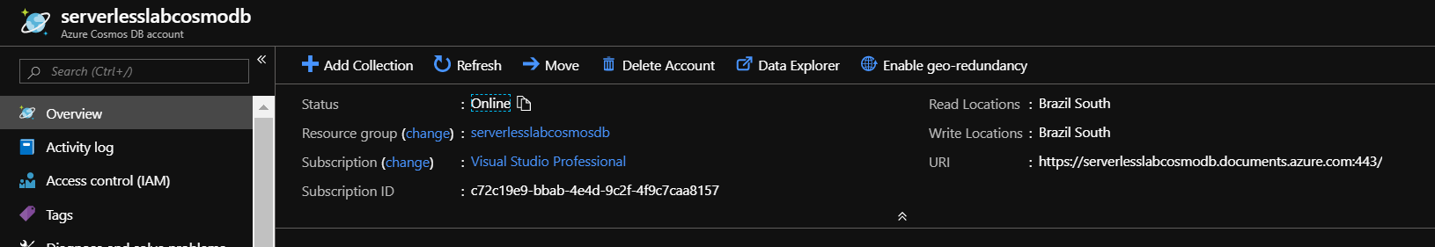
Access an Azure Cosmos DB resource
Some important informations to have external access (application, AFs and etc.) to your Azure Cosmos DB.

Slide 11
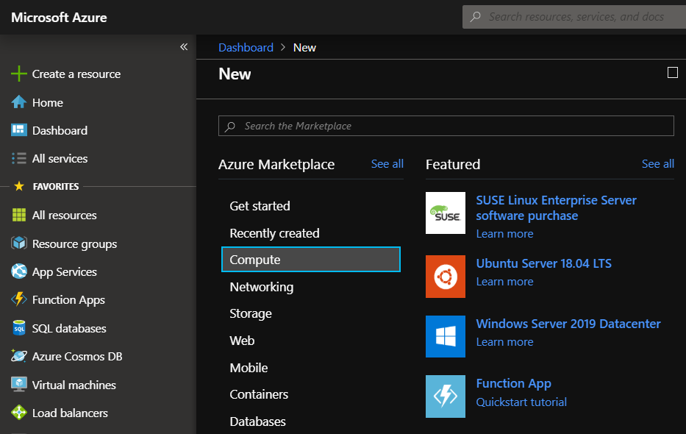
Create an Azure Function | App
Select the Create a resource button found on the upper left-hand corner of the Azure portal.
Select:
> Create a resource
> Compute
> Function App

Slide 12
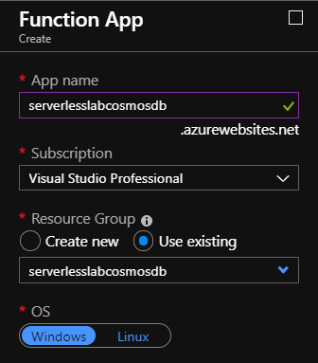
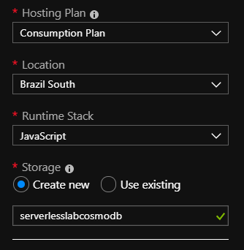
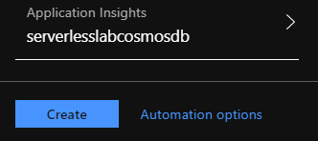
Create an Azure Function | App
Fill and review the Azure Function settings, and then click Create button.

Slide 13
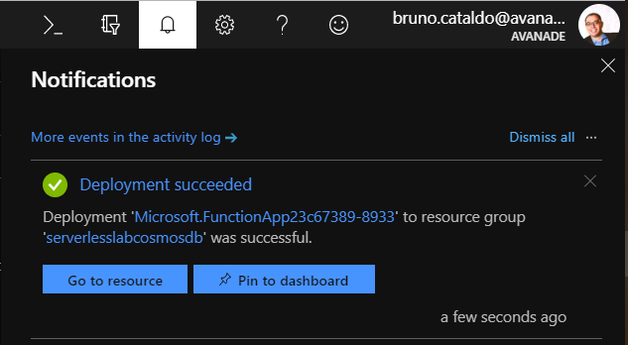
Create an Azure Function | App
Wait for the portal page notification to display Deployment succeeded. Click the Go to resource button.

Slide 14
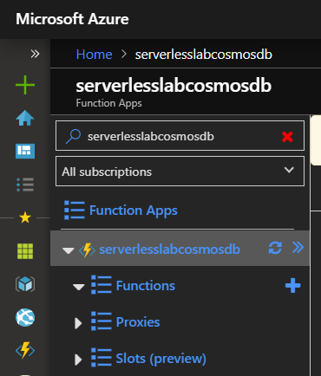
Create an Azure Function | Integrate
In the portal, navigate to the function app you created previously and expand both your function app and your function. After that click on the “+” button.

Slide 15
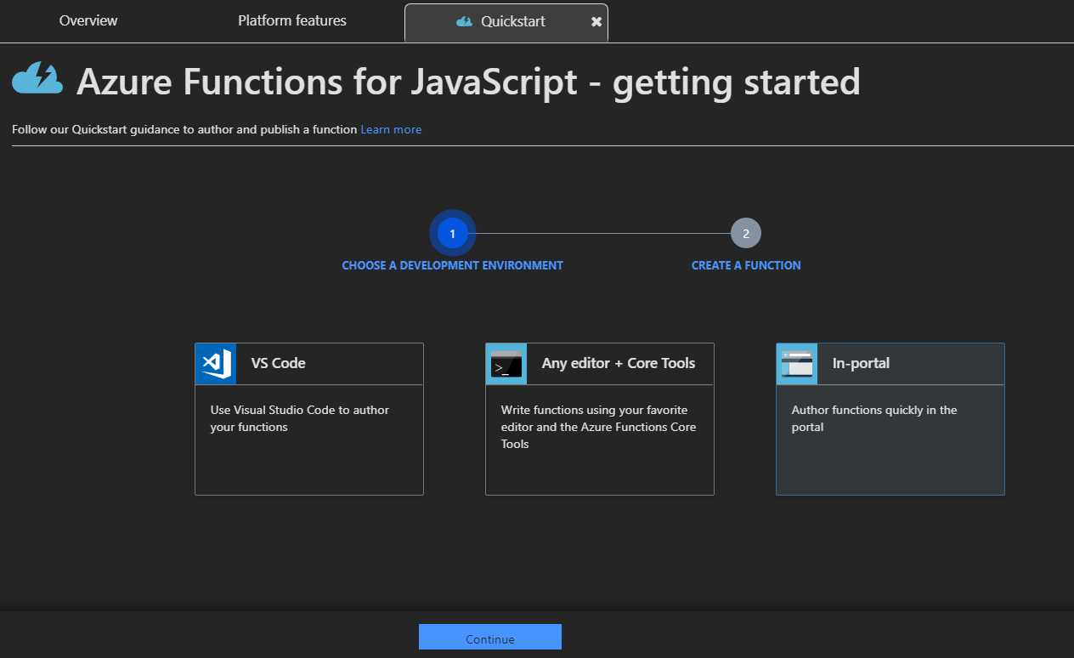
Create an Azure Function | Integrate
Click the Quickstart button, select the In-portal option and click Continue button.

Slide 16
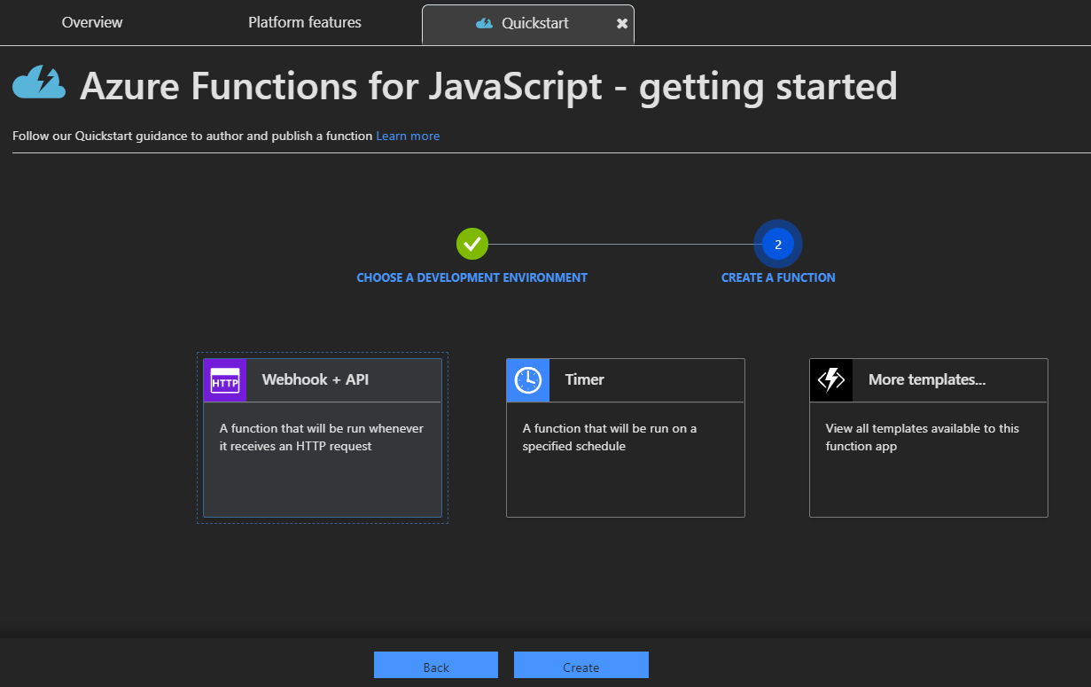
Create an Azure Function | Integrate
Select the Webhook + API option, click Create button and refresh the page.

Slide 17
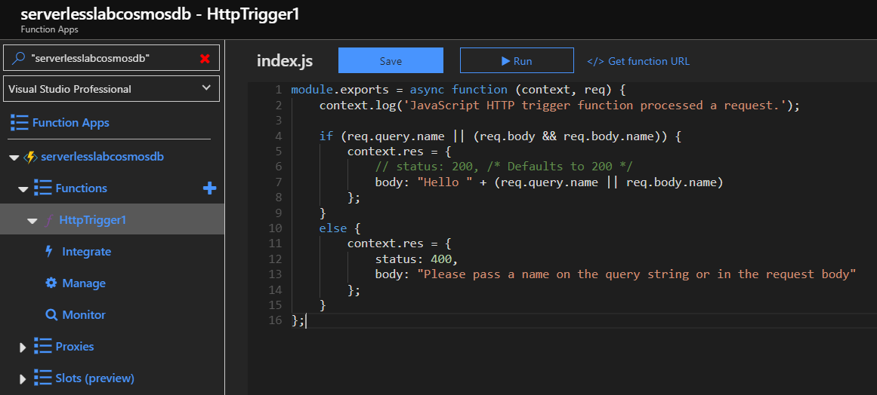
Create an Azure Function | Integrate
After page refresh select the Function option in the list and HttpTrigger1 to view your Azure Function script.

Slide 18
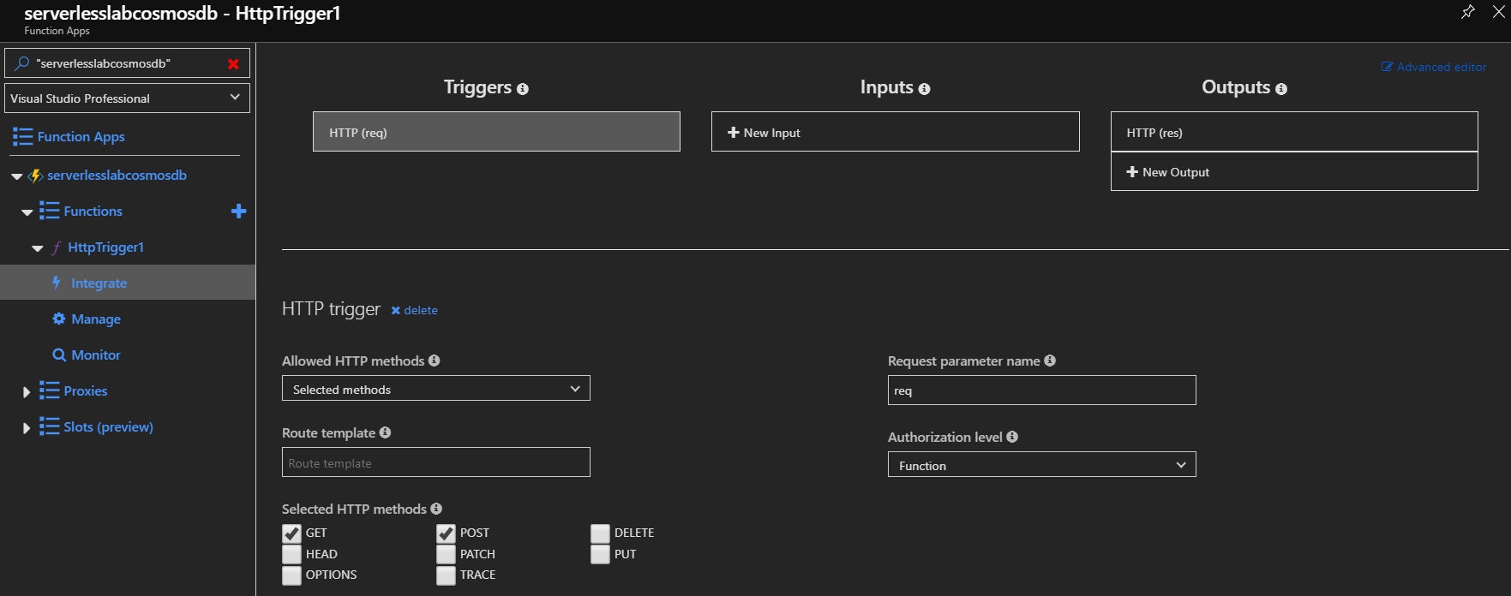
Create an Azure Function | Integrate
Select the Integrate item in the list to navigate to the next page. Click + New Output button.

Slide 19
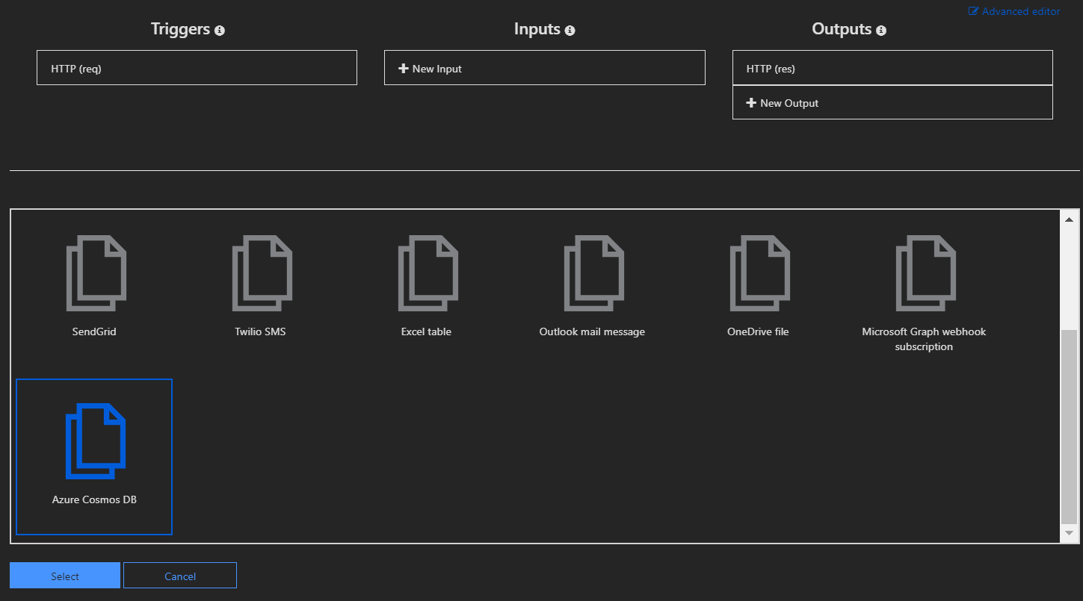
Create an Azure Function | Integrate
Select the Azure Cosmo DB item in the list and click Select button.

Slide 20
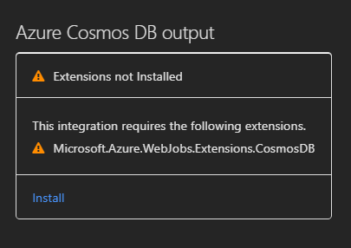
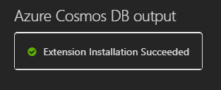
Create an Azure Function | Integrate
After reload page, scroll down page.
If you get an Extensions not installed message, choose Install to install the Azure Cosmos DB bindings extension in the function app. Installation may take a minute or two.

Slide 21
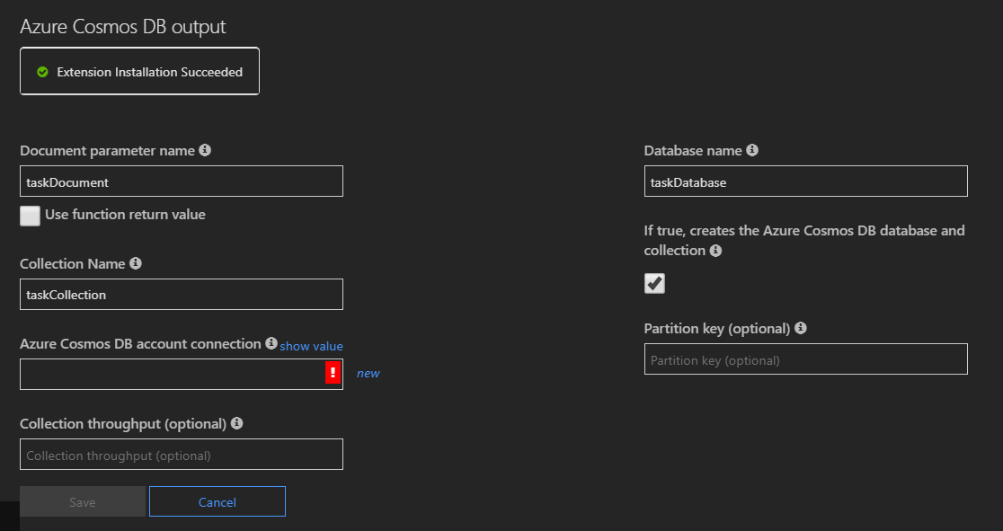
Create an Azure Function | Integrate
Use the Azure Cosmos DB output settings as specified in the table

Slide 22
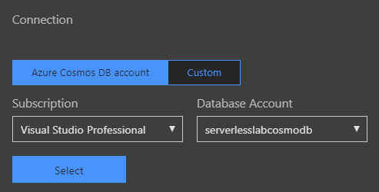
Create an Azure Function | Integrate
Select New to create an application setting for your account connection. Click Select button.

Slide 23
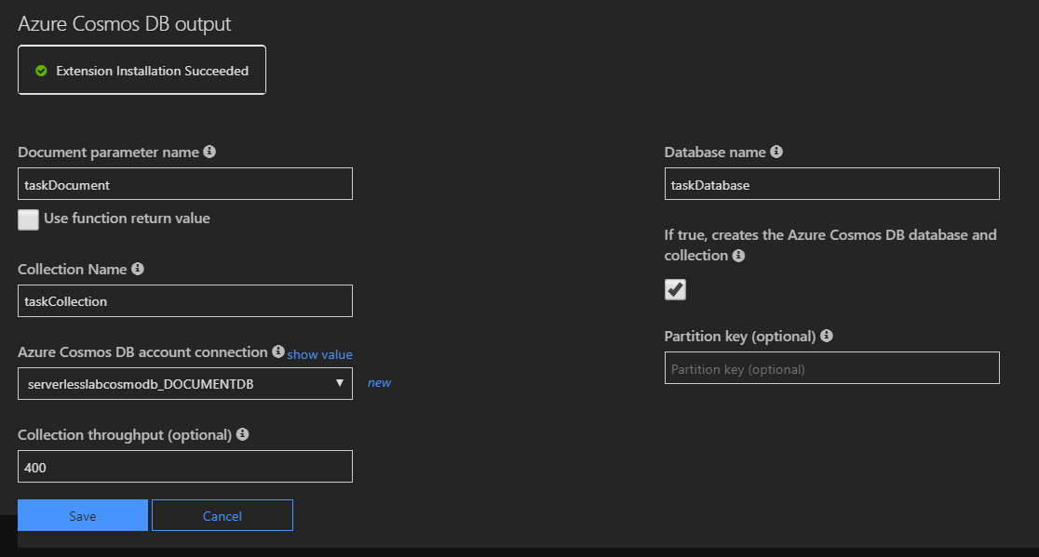
Create an Azure Function | Integrate
After all the configuration has been completed, click the Save button.

Slide 24
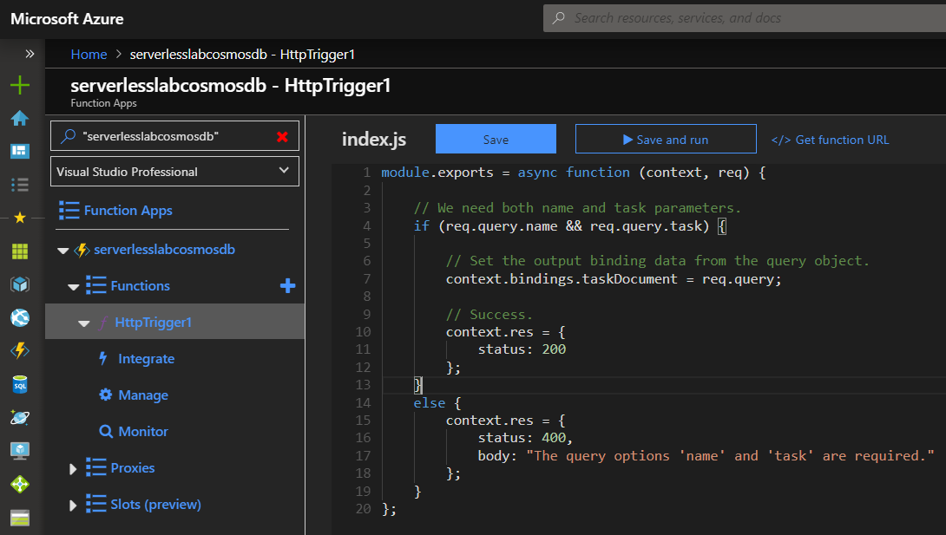
Create an Azure Function | Integrate
Click HttpTrigger1 link and replace the existing JavaScript function with the following code:

Slide 25
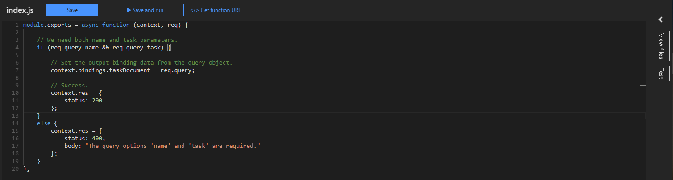
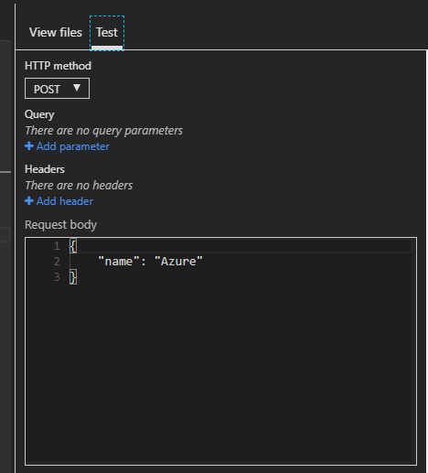
Test an Azure Function | Integrate
Click on the right button to open the panel and click the Test tab to open the test panel:

Slide 26
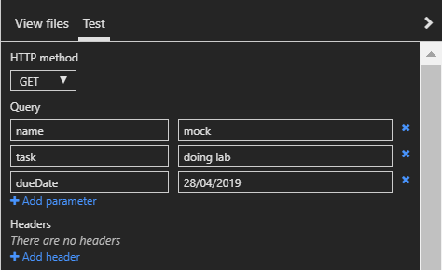

Test an Azure Function | Integrate
Select HTTP method with GET option.
Use the Query fields to fill the json request that going to be used to add an item and test.
Add 3 fields like image beside.
Click Save and run button.
* You can use a Request body to fill writing too.

Slide 27
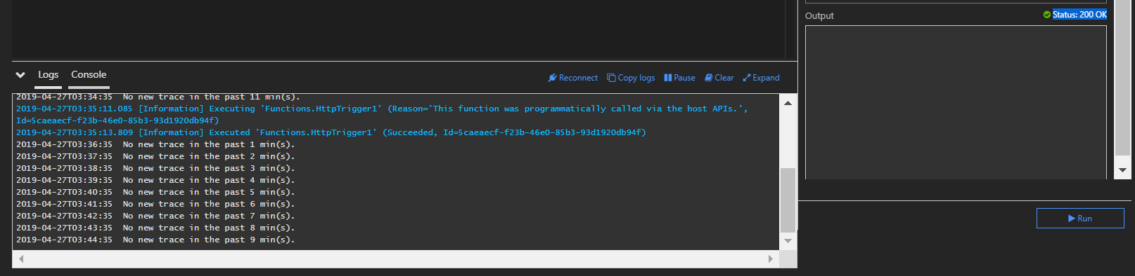
Test an Azure Function | Integrate
Wait for the test page to display Status: 200 OK in the output console (right side). For more details check the Logs and Console panel.

Slide 28
Check data on Azure Cosmos DB | Integrate
You must have to access Dashboard and find your Azure Cosmos DB resource.
Select:
> Dashboard
> serverlesslabcosmodb

Slide 29
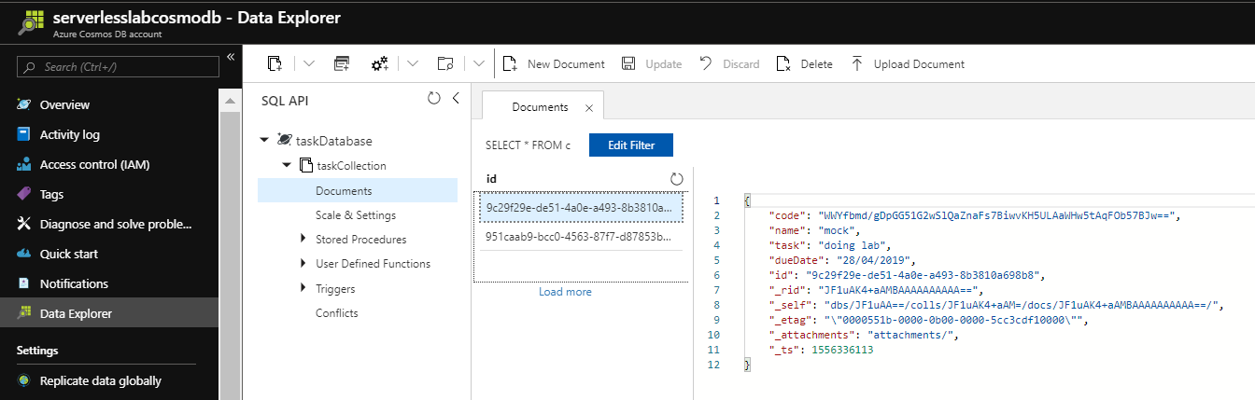
Check data on Azure Cosmos DB | Integrate
Select Data Explorer item, expand taskDatabase, expand taskCollection, click on Documents and hash indetificator like image. Check the data.

Slide 30
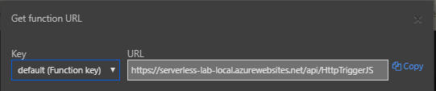
Test an Azure Function | Integrate + Browser
Click the "</> Get function URL“ link like the image below.
Using the button to copy the URL.

Slide 31
Test an Azure Function | Integrate + Browser
Paste the URL for the HTTP request into your browser's address bar. Append the query string in the end and execute the request.
&name=<yourname>
&task=<yourname>
&dueDate=<yourname>

Slide 32
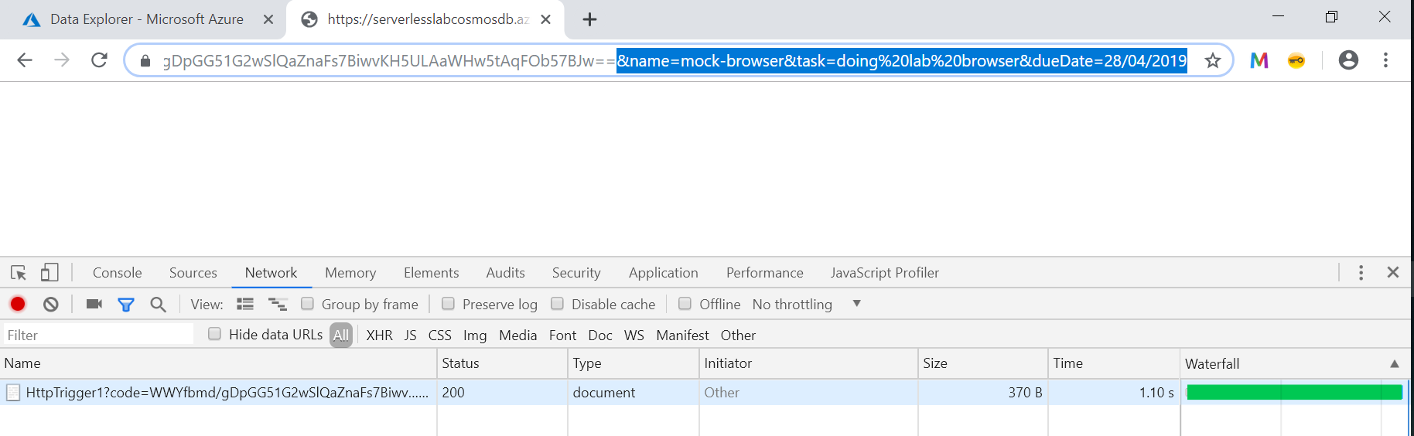
Test an Azure Function | Integrate + Browser
The following shows the response status 200 in the browser to the GET request using F12 or Network console of your browser.

Slide 33
Check data on Azure Cosmos DB | Integrate
You must have to access Dashboard and find your Azure Cosmos DB resource.
Select:
> Dashboard
> serverlesslabcosmodb

Slide 34
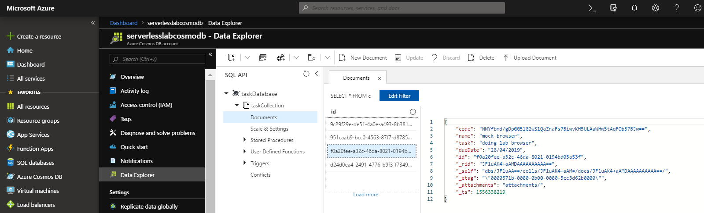
Check data on Azure Cosmos DB | Integrate
Select Data Explorer item, expand taskDatabase, expand taskCollection, click on Documents and hash indetificator like image. Check the data.

