Slide 1
Serverless | AFs
Running and publish your first Azure Functions project
Notes:
NOTE TO PRESENTERS
This deck contains a library of slides you can use to build a customized introduction to Avanade for external audiences, including clients, partners and recruits.
The deck is not meant to be used in its entirety, but rather to provide options for how you introduce Avanade, allowing you to match your content to your audience and their interests. The slides at the front of the deck provide an overview of how Avanade sees the marketplace changing and how we’re helping clients respond to those changes. Your introduction can be extended with slides from the appendices, depending on your purposes, to provide additional information of specific relevance to your presentation audience.

Slide 2
Prerequisites and more!
Install Visual Studio Code.
Install Git, NodeJS8+ and NPM.
Install Azure Functions Core Tools.
Install Azure Functions extension for VS Code.
An Azure subscription (free account).
Main supported languages:
Language | Extension
C# | C# for VS Code
Java | Debugger for Java * + Maven 3+
Typescript | .Net Core 2.2 (preview)
Javascript | Node 8.0+

Slide 3
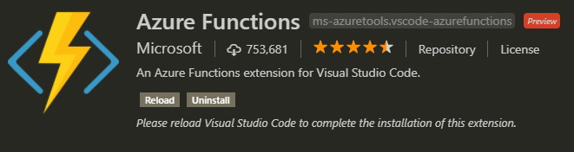
Prerequisites and more!
The following steps use download SDK and npm to install Core Tools on Windows. You can also use Chocolatey.
Create path “serverless-lab-local”.
Install npm –g azure-functions-core-tools

Slide 4
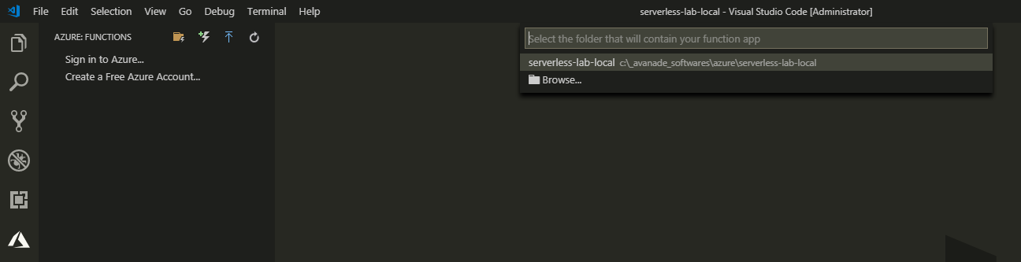
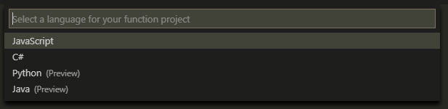
Create an Azure Function Project
The Azure Functions project template in Visual Studio Code creates a project that can be published to a function app in Azure. A function app lets you group functions as a logical unit for management, deployment, and sharing of resources.

Slide 5
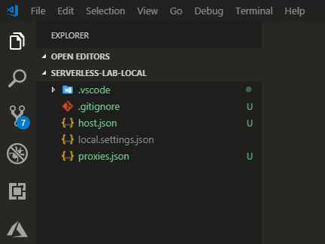
Create an Azure Function Project
The result can be viewed like image by clicking the Explorer icon.

Slide 6
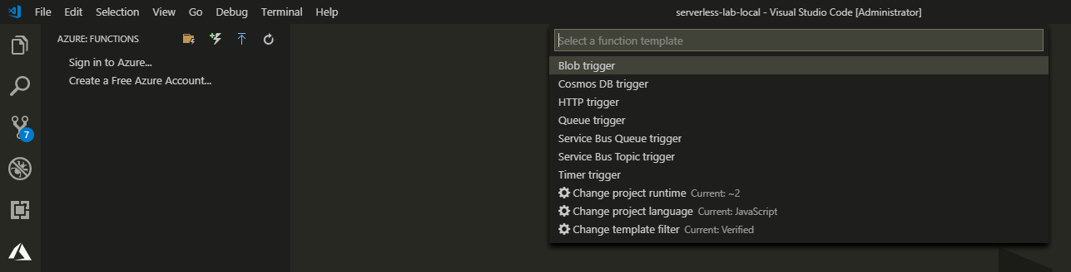

Create an Azure Function Project
From Azure: Functions view, choose the Create Function icon.
Select the folder with your function app project and select the HTTP trigger function template.
Type HTTPTriggerJS for the function name and press Enter.

Slide 7
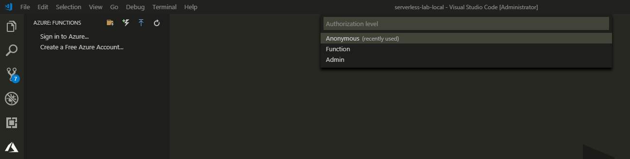
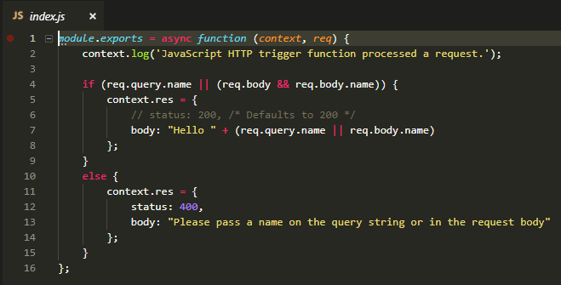
Create an Azure Function Project
In the list, select Anonymous authentication.
A function is created in your chosen language using the template for an HTTP-triggered function.

Slide 8
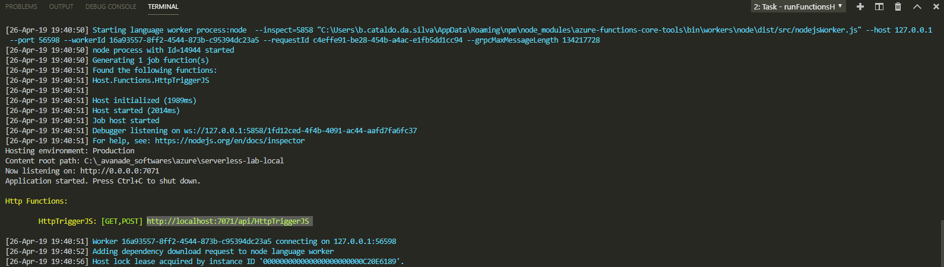
Let’s ride!
Let’s you run an Azure Functions project on your local development computer.
To test your function, set a breakpoint in the function code and press F5 to start the function app project.
Output from Core Tools is displayed in the Terminal panel or Prompt Command.

Slide 9
Let’s ride!
In the Terminal panel, copy the URL endpoint of your HTTP-triggered function.
Paste the URL for the HTTP request into your browser's address bar. Append the query string ?name=<yourname> to this URL and execute the request.

Slide 10
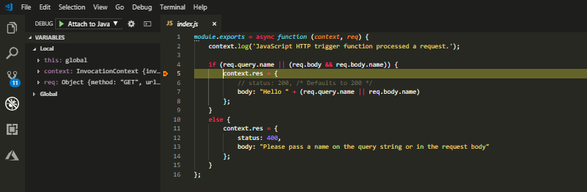
Let’s ride!
In the Terminal panel, copy the URL endpoint of your HTTP-triggered function.
Paste the URL for the HTTP request into your browser's address bar. Append the query string ?name=<yourname> to this URL and execute the request.

Slide 11
Let’s ride!
When you continue the execution, the following shows the response in the browser to the GET request.
After you've verified that the function runs correctly on your local computer, it's time to publish the project to Azure.

Slide 12
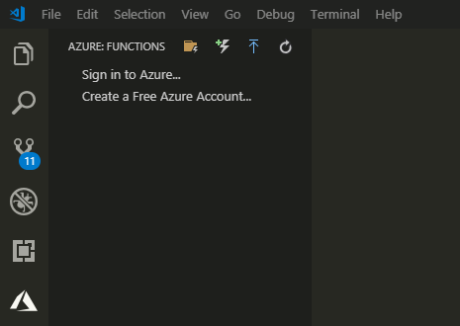
Sign in to Azure
Before you can publish your app, you must sign in to Azure.
In the Azure: Functions View, choose Sign in to Azure.... If you don't already have one, you can Create a free Azure account.

Slide 13
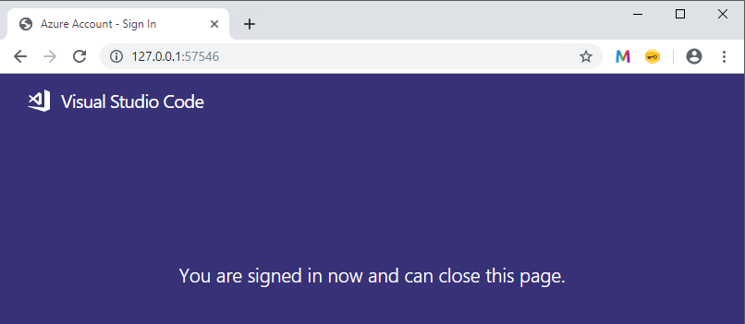
Sign in to Azure
When prompted, select Copy&Open, or copy the displayed code and open https://aka.ms/devicelogin in your browser.
Paste the copied code in the Device Login page, verify the sign in for Visual Studio Code, then select Continue.
Complete the sign in using your Azure account credentials. After you have successfully signed in, you can close the browser.

Slide 14
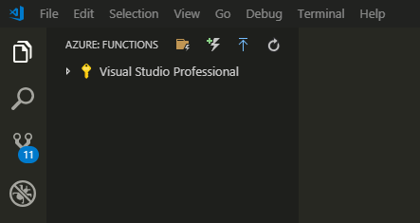
Sign in to Azure
When prompted, select Copy&Open, or copy the displayed code and open https://aka.ms/devicelogin in your browser.
Paste the copied code in the Device Login page, verify the sign in for Visual Studio Code, then select Continue.
Complete the sign in using your Azure account credentials. After you have successfully signed in, you can close the browser.

Slide 15
Publish the project to Azure | VS Code
If not signed-in, you are prompted to Sign in to Azure.
You can also Create a free Azure account.
After successful sign in from the browser, go back to Visual Studio Code.

Slide 16

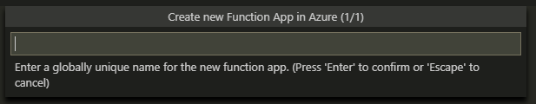
Publish the project to Azure | VS Code
In the Azure: Functions View, select the Deploy to Function App icon.
Type a globally unique name that identifies your function app and press Enter. Valid characters for a function app name are a-z, 0-9, and -.

Slide 17
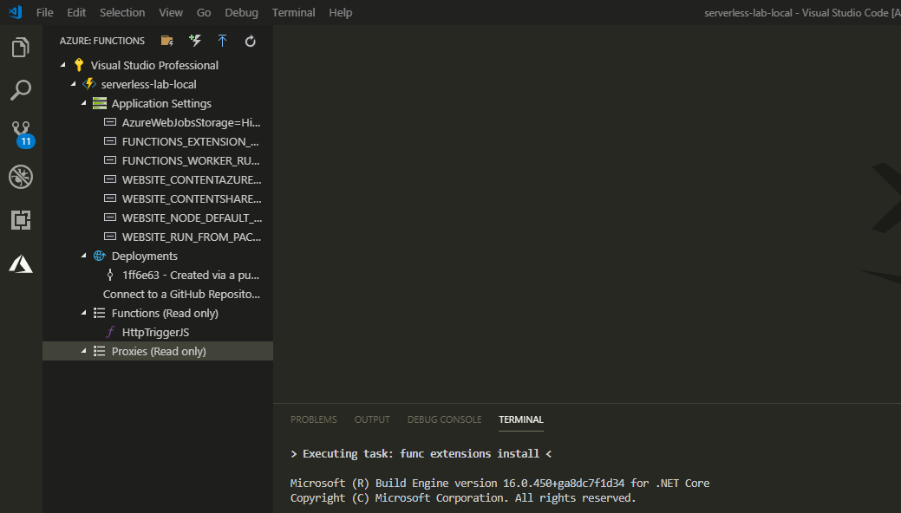
Publish the project to Azure | VS Code
The result can be viewed like image by clicking the Azure: Function View.

Slide 18
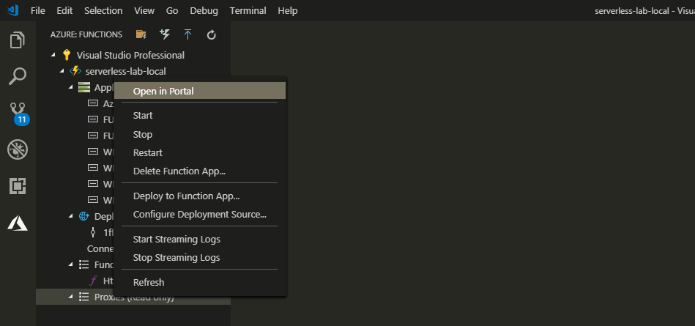
Publish the project to Azure | VS Code
Right-click mouse button in “serverless-lab-local” to open the Azure Function menu.
In the list, select Open in Portal option.

Slide 19
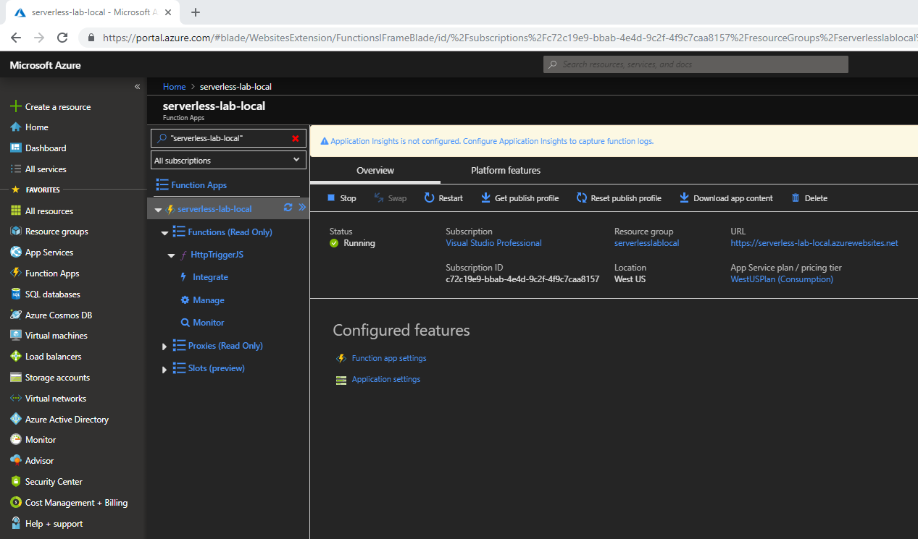
Publish the project to Azure | VS Code
When the site loads, you can view your Azure Function publication on the Azure Platform.
Select the Functions options and after the HttpTriggerJS item in the list to view the image below.

Slide 20
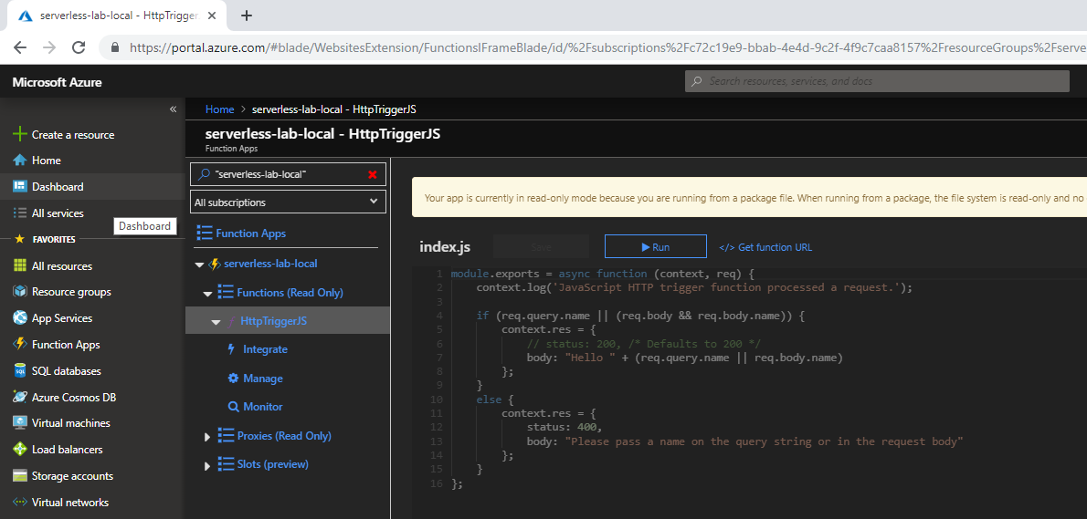
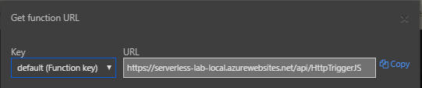
Publish the project to Azure | VS Code
Click the "</> Get function URL“ link like the image below.
Using the button to copy the URL.

Slide 21
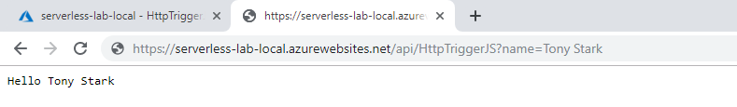
Publish the project to Azure | VS Code
Paste the URL for the HTTP request into your browser's address bar. Append the query string ?name=<yourname> to this URL and execute the request.
The following shows the response in the browser to the GET request.

