Slide 1
Foundations of Programming Languages – Course Overview
Acknowledgments: some slides taken or adapted from lecture notes of Stanford CS242
https://courseware.stanford.edu/pg/courses/317431/

Slide 2
What are programming languages for
Communication between programmers and HW
Model the real world
Model computation & communication
One of the most fundamental area of computer science
Examples
assembly, imperative (e.g., C), functional, OO, logical, web (e.g., JavaScript), domain-specific languages
Still a very active field, both in academia and industry
New languages: F#, Go, Scala, …

Slide 3
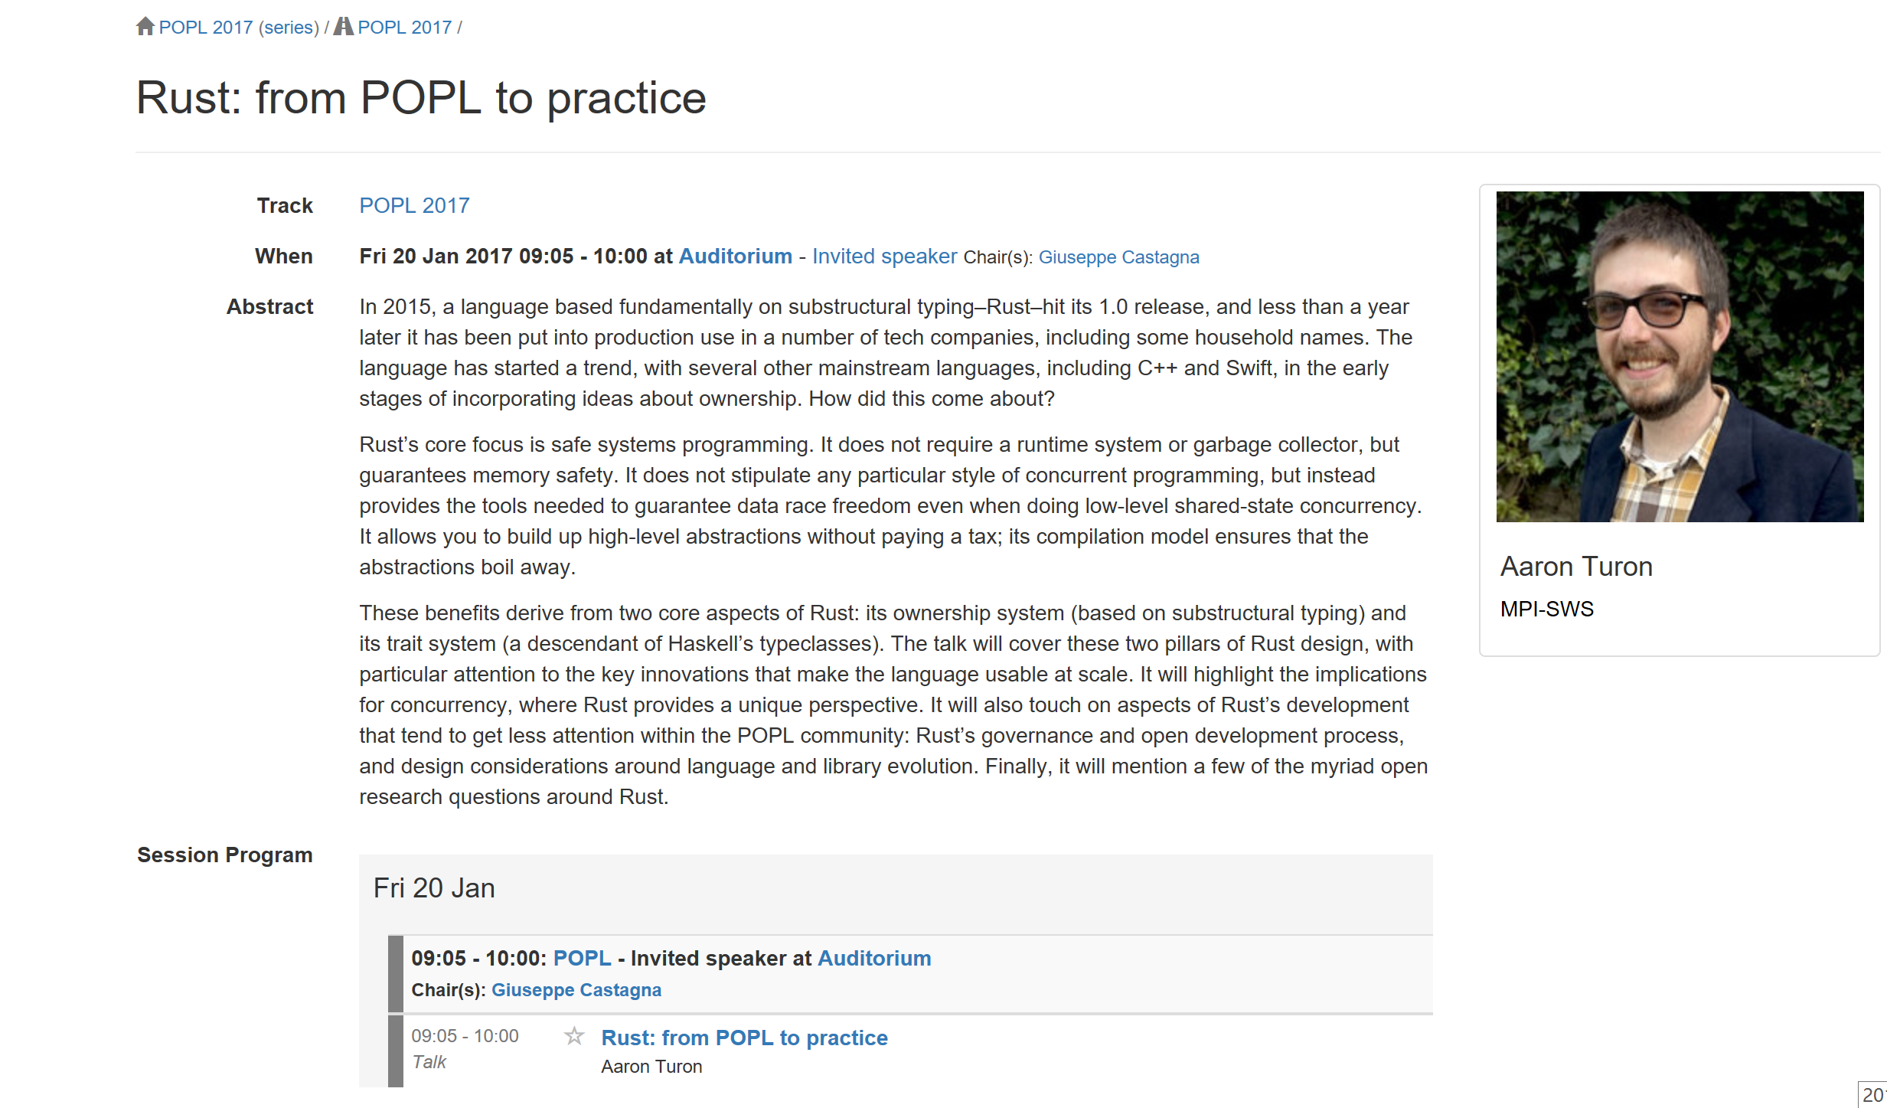
POPL 2017 Invited Talk on Rust

Slide 4
What do we care
Easy to use
Language design: good syntax, clear semantics, high-abstraction level
Enhance software productivity
e.g., domain specific languages (DSL)
Better performance
Language implementations: compilers, runtime (GC), parallelization
Better software quality (reliability and security)
Type safety, static/dynamic checking, verification
Theoretical foundations
Semantics, verification, etc.
Connections with other related fields: logic, computation theory, etc.

Slide 5
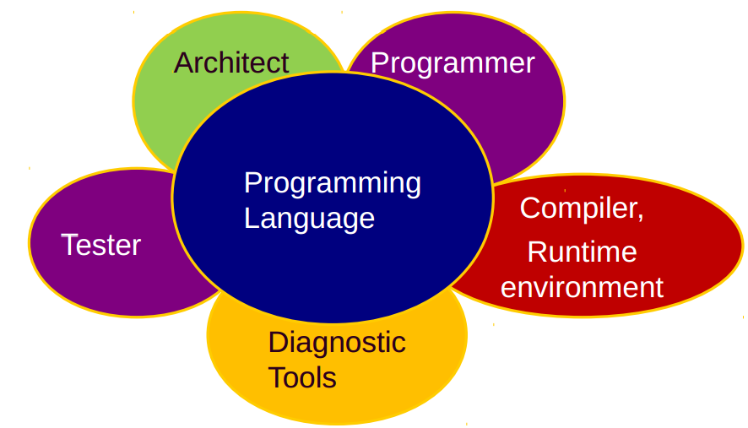
Language goals and trade-offs

Slide 6
Why should you take this course
Programming language concepts
A language is a “conceptual universe” (Perlis)
OO vs. Functional, for instance
Distinguish key properties from superficial details
Better programming skills
Write more efficient and reliable code
Be prepared for new PL methods, paradigms, tools
Learn to design your own languages
Domain-specific languages (e.g., big data, machine learning, networking, robotics)

Slide 7
Some PL Research Goals
Design and Implementation
Easy to use (design), efficient executable code (impl)
Multicore/Parallel/Distributed programming
Flaw detection: static, dynamic, etc.
Related fields: OS, architecture, domain specific fields
Principles and Theories
Semantics and Properties (e.g. expressiveness) of Programming Languages
Principles and theories for safety/security/correctness
Program analysis and verification
Related fields: logic and algebra, computation theory

Slide 8
Major Conferences
Principles of Programming Languages (POPL)
Programming Language Design and Implementation (PLDI)
Object-Oriented Programming, Systems, Languages & Applications (OOPSLA)
Principles and Practice of Parallel Programming (PPoPP)
International Conferences on Functional Programming (ICFP)
Architectural Support for Programming Languages and Operating Systems (ASPLOS)
Languages, Compilers and Tools for Embedded Systems (LCTES)

Slide 9
Major Conferences (2)
Related:
Logic in Computer Science (LICS)
Computer Aided Verification (CAV)

Slide 10
1-slide overview of research@KYHCS
KYHCS: USTC-Yale Joint Research Center for High-Confidence Software (founded in 2008)
Location: Suzhou and Hefei
Goal: building high-confidence SW systems
System software verification (e.g. OS kernels, compilers)
Verification of concurrent algorithms (e.g. multicore programs)
Automated analysis and verification of programs
Other: new language design and impl., semantics, …

Slide 11
Course Infomation
Instructors
Feng Xinyu
Course webpage
http://staff.ustc.edu.cn/~xyfeng/teaching/FOPL/
TA, office hours, news and assignments, lecture notes, reading materials and resources
Follow the courseware of Stanford CS242
https://courseware.stanford.edu/pg/courses/317431/

Slide 12
Temporary Syllabus
Introduction
Haskell
Foundations: lambda calculus, opr. semantics
Scope and stack storage allocation
Types and type checking/inference
Parametric polymorphism, type classes (ad-hoc polymorphism)
Monads
Exceptions and continuations

Slide 13
Temporary Syllabus (2)
Modularity
Objects
Prototypes, classes, inheritance
Object types and subtyping
Implementation structures
Templates and generics
Concurrency & Atomicity
Advanced topics

Slide 14
Grading
Attendance: 15%
Class attendance is highly recommended
Homework: 55%
Problem sets and programming assignments
Final paper: 30%

