Slide 1
Parallelism in Haskell
cs242
Kathleen Fisher
Reading: A Tutorial on Parallel and Concurrent Programming in Haskell
Skip Section 5 on STM
Thanks to Simon Peyton Jones, Satnam Singh, and Don Stewart for these slides.

Slide 2
The Grand Challenge
Making effective use of multi-core hardware is the challenge for programming languages now.
Hardware is getting increasingly complicated:
Nested memory hierarchies
Hybrid processors: GPU + CPU, Cell, FPGA...
Massive compute power sitting mostly idle.
We need new programming models to program new commodity machines effectively.

Slide 3
Candidate models in Haskell
Explicit threads
Non-deterministic by design
Monadic: forkIO and STM
Semi-implicit parallelism
Deterministic
Pure: par and pseq
Data parallelism
Deterministic
Pure: parallel arrays
Shared memory initially; distributed memory eventually; possibly even GPUs…
main :: IO ()
= do { ch <- newChan
; forkIO (ioManager ch)
; forkIO (worker 1 ch)
... etc ... }
Notes:
We talked about STM in the last lecture. Haskell also has support for standard concurrency primitives.
These are all active topics of research.

Slide 4
Parallelism vs Concurrency
A parallel program exploits real parallel computing resources to run faster while computing the same answer.
Expectation of genuinely simultaneous execution
Deterministic
A concurrent program models independent agents that can communicate and synchronize.
Meaningful on a machine with one processor
Non-deterministic

Slide 5
Haskell Execution Model
“Thunk” for fib 10
Pointer to the implementation
1
1
Values for free variables
3
8
6
8
10
8
5
5
Storage slot for the result
9
fib 0 = 0
fib 1 = 1
fib n = fib (n-1) + fib (n-2)

Slide 6
Functional Programming to the Rescue?
No side effects makes parallelism easy, right?
It is always safe to speculate on pure code.
Execute each sub-expression in its own thread?
Alas, the 80s dream does not work.
Far too many parallel tasks, many of which are too small to be worth the overhead of forking them.
Difficult/impossible for compiler to guess which are worth forking.
Idea: Give the user control over which expressions might run in parallel.

Slide 7
The par combinator
par :: a -> b -> b
x `par` y
Value (ie, thunk) bound to x is sparked for speculative evaluation.
Runtime may instantiate a spark on a thread running in parallel with the parent thread.
Operationally, x `par` y = y
Typically, x is used inside y:
All parallelism built up from the par combinator.
blurRows `par` (mix blurCols blurRows)

Slide 8
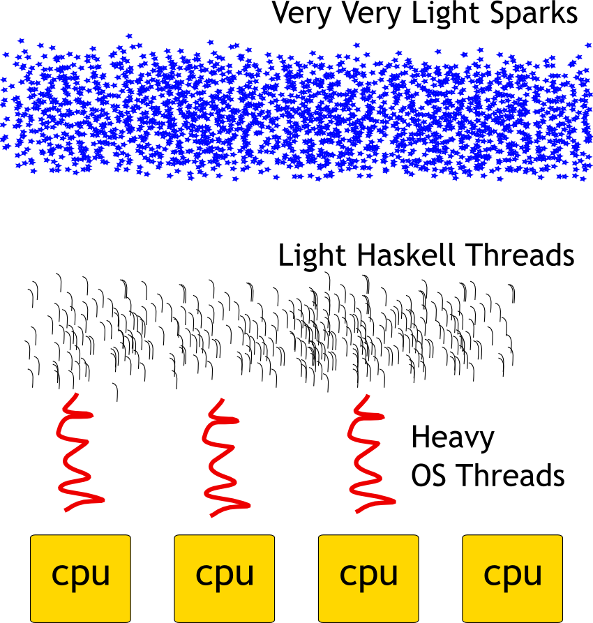
Concurrency Hierarchy

Slide 9
The GHC Runtime
Multiple virtual CPUs
Each virtual CPU has a pool of OS threads.
CPU-local spark pools for additional work.
Work-stealing queue to run sparks.
Lightweight Haskell threads map many-to-one onto OS threads.
Automatic thread migration and load balancing.
Parallel, generational garbage collection.

Slide 10
The meaning of par
par does not guarantee a new Haskell thread.
It hints that it would be good to evaluate the first argument in parallel.
The runtime decides whether to convert spark
Depending on current workload.
This allows par to be very cheap.
Programmers can use it almost anywhere.
Safely over-approximate program parallelism.

Slide 11
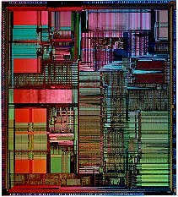
Example: One processor
x `par` (y + x)
y is evaluated
y
x is evaluated
x
x
x is sparked
x fizzles

Slide 12
Example: Two Processors
x `par` (y + x)
P1
P2
y is evaluated on P1
y
x is taken up for evaluation on P2
x
x
x is sparked on P1

Slide 13
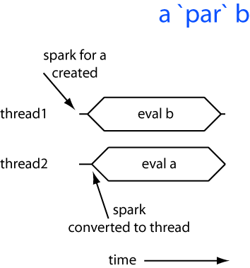
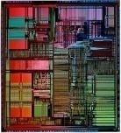
Model: Two Processors

Slide 14
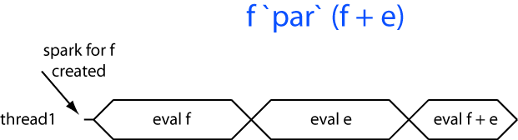

Model: One Processor
No extra resources, so spark for f fizzles.

Slide 15
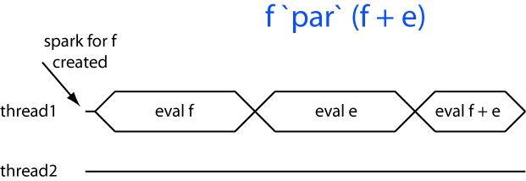
No parallelism?
Main thread demands f, so spark fizzles.

Slide 16
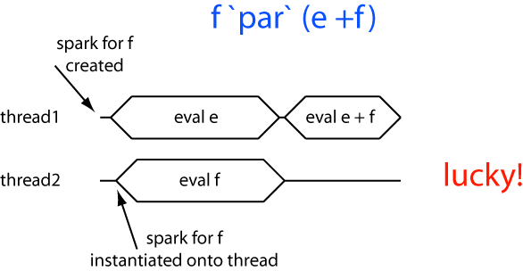

Lucky parallelism

Slide 17
A second combinator: pseq
pseq :: a -> b -> b
x `pseq` y
pseq: Evaluate x in the current thread, then return y.
Operationally,
With pseq, we can control evaluation order.
x `pseq` y = bottom if x -> bottom
= y otherwise.
e `par` f `pseq` (f + e)

Slide 18
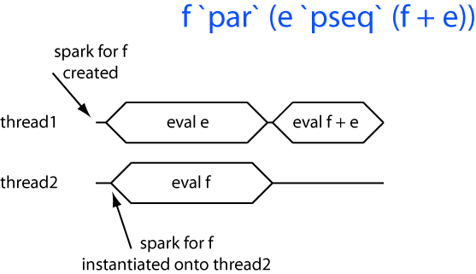
Using pseq

Slide 19
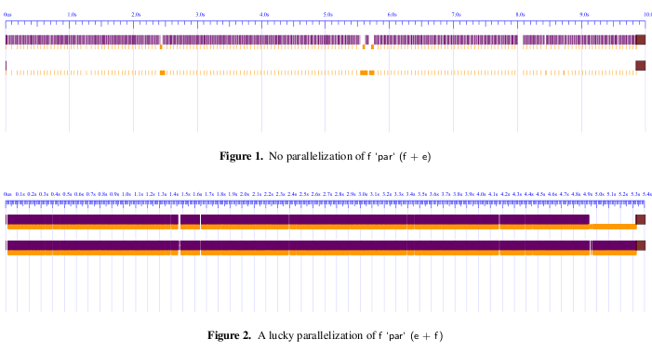
ThreadScope
ThreadScope (in Beta) displays event logs generated by GHC to track spark behavior:
Thread 1
Thread 2
(Idle)
f `par` (f + e)
Thread 1
Thread 2
(Busy)
f `par` (e + f)

Slide 20
Sample Program
fib :: Int -> Int
fib 0 = 0
fib 1 = 1
fib n = fib (n-1) + fib(n-2)
sumEuler :: Int -> Int
sumEuler n = … in ConcTutorial.hs …
parSumFibEulerGood :: Int -> Int -> Int
parSumFibEulerGood a b = f `par` (e `pseq` (f + e))
where
f = fib a
e = sumEuler b
The fib and sumEuler functions are unchanged.

Slide 21
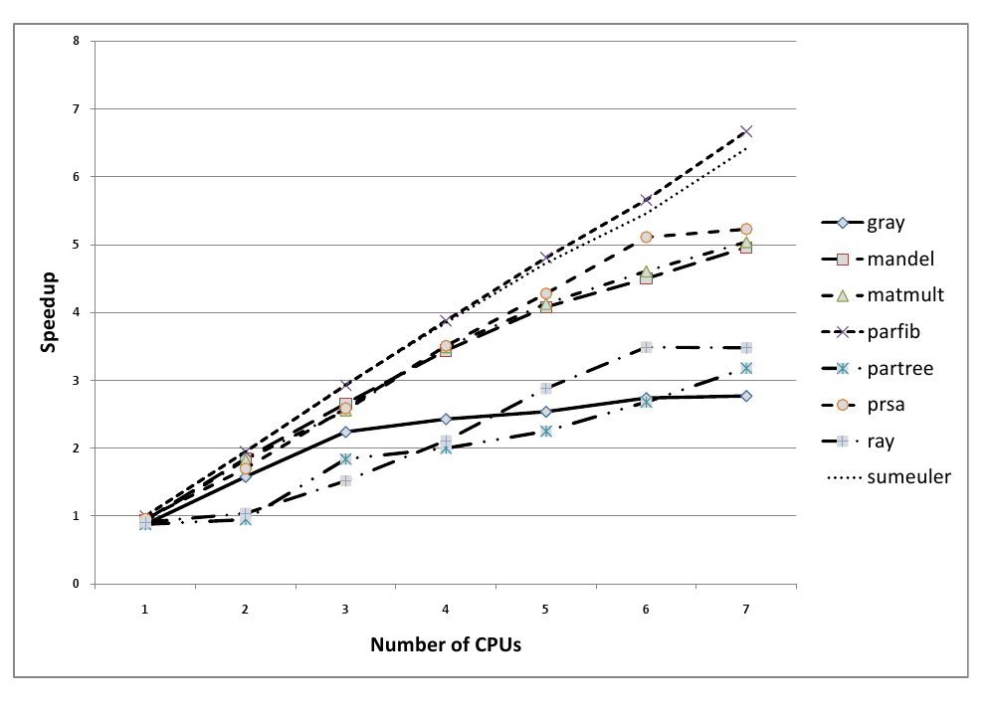
Strategies
Performance Numbers
Notes:
Numbers are published in “Runtime Support for Multicore Haskell” [ICFP 2009]
ray, gray: ray tracers
partree: parallel map and fold over a tree. badly written, but runs in parallel, so used as a benchmark.
Many changes in ghc 6.12 implementation (over 6.10) to support more efficient execution of par.

Slide 22
Summary: Semi-implicit parallelism
Deterministic:
Same results with parallel and sequential programs.
No races, no errors.
Good for reasoning: Erase the par combinator and get the original program.
Relies on purity.
Cheap: Sprinkle par as you like, then measure with ThreadScope and refine.
Takes practice to learn where to put par and pseq.
Often good speed-ups with little effort.

Slide 23
Candidate Models in Haskell
Explicit threads
Non-deterministic by design
Monadic: forkIO and STM
Semi-implicit
Deterministic
Pure: par and pseq
Data parallelism
Deterministic
Pure: parallel arrays
Shared memory initially; distributed memory eventually; possibly even GPUs…
main :: IO ()
= do { ch <- newChan
; forkIO (ioManager ch)
; forkIO (worker 1 ch)
... etc ... }
f :: Int -> Int
f x = a `par` b `pseq` a + b
where
a = f1 (x-1)
b = f2 (x-2)

Slide 24
Road map
Multicore
Parallel programming essential
Task parallelism
Each thread does something different.
Explicit: threads, MVars, STM
Implicit: par & pseq
Data parallelism
Operate simultaneously on bulk data
Massive parallelism
Easy to program
Single flow of control
Implicit synchronisation
Modest parallelism
Hard to program

Slide 25
Data parallelism
Flat data parallel
Apply sequential operation to bulk data
Nested data parallel
Apply parallel
operation to bulk data
The brand leader (Fortran, *C MPI, map/reduce)
Limited applicability (dense matrix, map/reduce)
Well developed
Limited new opportunities
Developed in 90’s
Much wider applicability (sparse matrix, graph algorithms, games etc)
Practically un-developed
Huge opportunity

Slide 26
Flat data parallel
foreach i in 1..N {
...do something to A[i]...
}
P1
P2
P3
1,000,000’s of (small) work items
Widely used, well understood, well supported
BUT: something is sequential.
Single point of concurrency
Easy to implement: use “chunking”
Good cost model

Slide 27
Nested data parallel
foreach i in 1..N {
...do something to A[i]...
}
Still 1,000,000’s of (small) work items
Main idea: Allow “something” to be parallel.
Now the parallelism structure is recursive, and un-balanced.
Still good cost model.
Hard to implement!

Slide 28
Nested DP is great for programmers
Fundamentally more modular.
Opens up a much wider range of applications:
Divide and conquer algorithms (e.g. sort)
Graph algorithms (e.g. shortest path, spanning trees)
Sparse arrays, variable grid adaptive methods (e.g. Barnes-Hut)
Physics engines for games, computational graphics (e.g. Delauny triangulation)
Machine learning, optimization, constraint solving
Notes:
Amount of parallelism is determined by dynamic properties of the data.

Slide 29
Nested DP is tough for compilers
Nested data parallel program
(the one we want to write)
Flat data parallel program
(the one we want to run)
Compiler
...because the concurrency tree is both irregular and fine-grained.
But it can be done! NESL (Blelloch 1995) is an existence proof.
Key idea: “Flattening” transformation:

Slide 30
Data Parallel Haskell
NESL (Blelloch) A mega-breakthrough but:
specialized, prototype
first order
few data types
no fusion
interpreted
Substantial improvement in
Expressiveness
Performance
Shared memory initially
Distributed memory eventually
GPUs anyone?
Haskell
broad-spectrum, widely used
higher order
very rich data types
aggressive fusion
compiled
Not a special purpose data-parallel compiler! Most support is either useful for other things, or is in the form of library code.

Slide 31
Array comprehensions
[:Float:] is the type of parallel arrays of Float
vecMul :: [:Float:] -> [:Float:] -> Float
vecMul v1 v2 = sumP [: f1*f2 | f1 <- v1 | f2 <- v2 :]
sumP :: [:Float:] -> Float
An array comprehension:
“the array of all f1*f2 where f1 is drawn from v1 and f2 from v2 in lockstep.”
Operations over parallel array are computed in parallel; that is the only way the programmer says “do parallel stuff.”
NB: no locks!

Slide 32
Sparse vector multiplication
A sparse vector is represented as a vector of (index, value) pairs:
[:(0,3),(2,10):] instead of [:3,0,10,0:].
sDotP :: [:(Int,Float):] -> [:Float:] -> Float
sDotP sv v = sumP [: f * (v!i) | (i,f) <- sv :]
v!i gets the ith element of v
sDotP [:(0,3),(2,10):][:2,1,1,4:]
= sumP [: 3 * 2, 10 * 1 :]
= 16
Parallelism is proportional to length of sparse vector.

Slide 33
Sparse matrix multiplication
A sparse matrix is a vector of sparse vectors:
[:[:(1,3),(4,10):],
[:(0,2),(1,12),(4,6):]:]
smMul :: [:[:(Int,Float):]:] -> [:Float:] -> Float
smMul sm v = sumP [: sDotP sv v | sv <- sm :]
Nested data parallelism here! We are calling a parallel operation, sDotP, on every element of a parallel array, sm.

Slide 34
Example: Data-parallel Quicksort
sort :: [:Float:] -> [:Float:]
sort a = if (lengthP a <= 1) then a
else sa!0 +:+ eq +:+ sa!1
where
p = a!0
lt = [: f | f<-a, f<p :]
eq = [: f | f<-a, f==p :]
gr = [: f | f<-a, f>p :]
sa = [: sort a | a <- [:lt,gr:] :]
Parallel filters
2-way nested data parallelism here.

Slide 35
How it works
Step 1
sort
Step 2
sort
sort
Step 3
sort
sort
sort
...etc...
All sub-sorts at the same level are done in parallel.
Segment vectors track which chunk belongs to which sub problem.
Instant insanity when done by hand.

Slide 36
Example: Parallel Search
type Doc = [: String :] -- Sequence of words
type Corpus = [: Doc :]
search :: Corpus -> String -> [: (Doc,[:Int:]):]
Find all Docs that mention the string, along with the places where it is mentioned (e.g. word 45 and 99)

Slide 37
Example: Parallel Search
type Doc = [: String :]
type Corpus = [: Doc :]
search :: Corpus -> String -> [: (Doc,[:Int:]):]
wordOccs :: Doc -> String -> [: Int :]
Find all the places where a string is mentioned in a document (e.g. word 45 and 99) .

Slide 38
Example: Parallel Search
type Doc = [: String :]
type Corpus = [: Doc :]
search :: Corpus -> String -> [: (Doc,[:Int:]):]
search ds s = [: (d,is) | d <- ds
, let is = wordOccs d s
, not (nullP is) :]
wordOccs :: Doc -> String -> [: Int :]
nullP :: [:a:] -> Bool

Slide 39
Example: Parallel Search
type Doc = [: String :]
type Corpus = [: Doc :]
search :: Corpus -> String -> [: (Doc,[:Int:]):]
wordOccs :: Doc -> String -> [: Int :]
wordOccs d s = [: i | (i,si) <- zipP positions d
, s == si :]
where
positions :: [: Int :]
positions = [: 1..lengthP d :]
zipP :: [:a:] -> [:b:] -> [:(a,b):]
lengthP :: [:a:] -> Int

Slide 40
Hard to implement well!
Evenly chunking at top level might be ill-balanced.
Top level alone might not be very parallel.
Corpus
Documents

Slide 41
The flattening transformation
Concatenate sub-arrays into one big, flat array.
Operate in parallel on the big array.
Segment vector tracks extent of sub-arrays.
etc…
Lots of tricksy book-keeping!
Possible to do by hand (and done in practice), but very hard to get right.
Blelloch showed it could be done systematically.

Slide 42
Fusion
Flattening enables load balancing, but it is not enough to ensure good performance. Consider:
Bad idea:
Generate [: f1*f2 | f1 <- v1 | f2 <-v2 :]
Add the elements of this big intermediate vector.
Good idea: Multiply and add in the same loop.
That is, fuse the multiply loop with the add loop.
Very general, aggressive fusion is required.
vecMul :: [:Float:] -> [:Float:] -> Float
vecMul v1 v2 = sumP [: f1*f2 | f1 <- v1 | f2 <- v2 :]

Slide 43
Implementation Techniques
Four key pieces of technology:
Vectorization
Specific to parallel arrays
Non-parametric data representations
A generically useful new feature in GHC
Distribution
Divide up the work evenly between processors
Aggressive fusion
Uses “rewrite rules,” an old feature of GHC
}
Flattening
Main advance: an optimizing data-parallel compiler implemented by modest enhancements to a full-scale functional language implementation.

Slide 44
Step 0: Desugaring
Rewrite Haskell source into simpler core, e.g, removing array comprehensions:
sDotP :: [:(Int,Float):] -> [:Float:] -> Float
sDotP sv v = sumP [: f * (v!i) | (i,f) <- sv :]
sDotP sv v = sumP (mapP (\(i,f) -> f * (v!i)) sv)
sumP :: Num a => [:a:] -> a
mapP :: (a -> b) -> [:a:] -> [:b:]

Slide 45
Step 1: Vectorization
Replace scalar function f by the lifted (vectorized) version, written f^.
svMul :: [:(Int,Float):] -> [:Float:] -> Float
svMul sv v = sumP (mapP (\(i,f) -> f * (v!i)) sv)
svMul sv v = sumP (snd^ sv *^ bpermuteP v (fst^ sv))
sumP :: Num a => [:a:] -> a
*^ :: Num a => [:a:] -> [:a:] -> [:a:]
fst^ :: [:(a,b):] -> [:a:]
snd^ :: [:(a,b):] -> [:b:]
bpermuteP :: [:a:] -> [:Int:] -> [:a:]

Slide 46
Vectorization: Basic idea
mapP f v
f^ v
f :: T1 -> T2
f^ :: [:T1:] -> [:T2:] -- f^ = mapP f
For every function f, generate its lifted version, named f^.
Result: A functional program, operating over flat arrays, with a fixed set of primitive operations *^, sumP, fst^, etc.
Lots of intermediate arrays!

Slide 47
Vectorization: Basic idea
f :: Int -> Int
f x = x + 1
f^ :: [:Int:] -> [:Int:]
f^ xs = xs +^ (replicateP (lengthP xs) 1)
Source | Transformed to…
Locals, xs | xs
Globals, g | g^
Constants, k | replicateP (lengthP xs) k
replicateP :: Int -> a -> [:a:]
lengthP :: [:a:] -> Int

Slide 48
Vectorization: Problem
How do we lift functions that have already been lifted?
f :: [:Int:] -> [:Int:]
f xs = mapP g xs = g^ xs
f^ :: [:[:Int:]:] -> [:[:Int:]:]
f^ xss = g^^ xss --???
Yet another version of g???

Slide 49
Vectorization: Key insight
First concatenate, then map, then re-split
f :: [:Int:] -> [:Int:]
f xs = mapP g xs = g^ xs
f^ :: [:[:Int:]:] -> [:[:Int:]:]
f^ xss = segmentP xss (g^ (concatP xss))
concatP :: [:[:a:]:] -> [:a:]
segmentP :: [:[:a:]:] -> [:b:] -> [:[:b:]:]
Shape
Flat data
Nested data
Payoff: f and f^ are enough. No f^^.

Slide 50
Step 2: Representing arrays
[:Double:] Arrays of pointers to boxed numbers are Much Too Slow.
[:(a,b):] Arrays of pointers to pairs are also Much Too Slow.
...
Idea!
Select representation of array based on its element type…

Slide 51
Step 2: Representing arrays
Extend Haskell with construct to specify families of data structures each with a different implementation.
data family [:a:]
data instance [:Double:] = AD Int ByteArray
data instance [:(a, b):] = AP [:a:] [:b:]
AP
[POPL05], [ICFP05], [TLDI07]
Notes:
These constructs are under development, so the syntax is subject to change.

Slide 52
Step 2: Representing arrays
data family [:a:]
data instance [:Double:] = AD Int ByteArray
data instance [:(a, b):] = AP [:a:] [:b:]
AP
Now *^ can be a fast loop because array elements are not boxed.
And fst^ is constant time!
fst^ :: [:(a,b):] -> [:a:]
fst^ (AP as bs) = as

Slide 53
Step 2: Nested arrays
Represent nested array as a pair of a shape descriptor and a flat array:
etc…
Shape
Flat data
data instance [:[:a:]:] = AN [:Int:] [:a:]

Slide 54
Step 2: Nested arrays
Representation supports operations needed for lifting efficiently:
Shape
Flat data
data instance [:[:a:]:] = AN [:Int:] [:a:]
concatP :: [:[:a:]:] -> [:a:]
concatP (AN shape data) = data
segmentP :: [:[:a:]:] -> [:b:] -> [:[:b:]:]
segmentP (AN shape _) data = AN shape data
Surprise: concatP, segmentP are constant time!

Slide 55
Higher order complications
f :: T1 -> T2 -> T3
f1^ :: [:T1:] -> [:T2:] -> [:T3:] -– f1^ = zipWithP f
f2^ :: [:T1:] -> [:(T2 -> T3):] -– f2^ = mapP f
f1^ is good for [: f a b | a <- as | b <- bs :]
But the type transformation is not uniform.
And sooner or later we want higher-order functions anyway.
f2^ forces us to find a representation for [:(T2->T3):]. Closure conversion [PAPP06]

Slide 56
Step 3: Distribution
sDotP :: [:(Int,Float):] -> [:Float:] -> Float
sDotP (AP is fs) v = sumP (fs *^ bpermuteP v is)
After steps 0-2, program consists of
Flat arrays
Vector operations over them (*^, sumP etc)
NESL directly executes this version.
Hand-coded assembly for primitive ops.
All the time is spent here anyway.
But, program has many intermediate arrays:
Increase memory traffic
Additional synchronisation points
Idea: distribution and fusion

Slide 57
Step 3: Distribution
sDotP :: [:(Int,Float):] -> [:Float:] -> Float
sDotP (AP is fs) v = sumP (fs *^ bpermuteP v is)
Distribution: Divide is, fs into chunks, one chunk per processor.
Fusion: Execute sumP (fs *^ bpermute v is) in a tight, sequential loop on each processor.
Combining: Add the results of each chunk.
Step 2 alone is not good on a parallel machine!

Slide 58
Expressing distribution
Introduce new type to mark distribution.
Type Dist a denotes collection of distributed a values.
(Selected) Operations:
splitD: Distribute data among processors.
joinD: Collect result data.
mapD: Run sequential function on each processor.
sumD: Sum numbers returned from each processor.
splitD :: [:a:] -> Dist [:a:]
joinD :: Dist [:a:] -> [:a:]
mapD :: (a->b) -> Dist a -> Dist b
sumD :: Dist Float -> Float

Slide 59
Distributing sumP
sumP is the composition of more primitive functions:
sumP :: [:Float:] -> Float
sumP xs = sumD (mapD sumS (splitD xs)
xs = [: 2,1,4,9,5 :]
Processor 1
splitD
Processor 2
xs₁ = [: 2,1,4 :]
t₁ = mapD sumS xs₁
= 7
xs₂ = [: 9,5 :]
t₂ = mapD sumS xs₂
= 14
mapD
sumD
result = 21
Notes:
sumS is a tight sequential loop.
mapD is the real source of parallelism: it allocates a gang of threads, one per processor, starts then running, and then waits for them to finish.

Slide 60
Example: Distribution
sumP is a composition of these functions:
sumS is a tight sequential loop.
mapD is true source of parallelism: It starts a “gang”, runs it, and waits for gang members to finish.
sumP :: [:Float:] -> Float
sumP xs = sumD (mapD sumS (splitD xs)
splitD :: [:a:] -> Dist [:a:]
mapD :: (a->b) -> Dist a -> Dist b
sumD :: Dist Float -> Float
sumS :: [:Float:] -> Float

Slide 61
Distributing Lifted Multiply
*^ :: [:Float:] -> [:Float:] -> [:Float:]
*^ xs ys = joinD (mapD mulS
(zipD (splitD xs) (splitD ys))
xs = [: 2,1,4,9,5 :]
ys = [: 3,2,2,1,1 :]
Processor 1
splitD
Processor 2
xs₁ = [: 2,1,4 :]
ys₁ = [: 3,2,2 :]
zs₁ = zipD …
t₁ = mapD mulS zs₁
= [: 6,2,8 :]
xs₂ = [: 9,5 :]
ys₂ = [: 1,1 :]
zs₂ = zipD …
t₂ = mapD sumS zs₂
= [: 9,5 :]
mapD
joinD
result = [: 6,2,8,9,5 :]
Notes:
mulS is a tight sequential loop.

Slide 62
Step 4: Fusion
Idea: Rewriting rules eliminate synchronizations.
sDotP :: [:(Int,Float):] -> [:Float:] -> Float
sDotP (AP is fs) v
= sumP (fs *^ bpermuteP v is)
= sumD . mapD sumS . splitD . joinD . mapD mulS $
zipD (splitD fs) (splitD (bpermuteP v is))
A joinD followed by a splitD
can be replaced by doing nothing.
joinD
splitD
{-# RULE
splitD (joinD x) = x #-}
Notes:
In Haskell, ‘.’ denotes function composition and ‘$’ denotes function application with low precedence, which is useful because it allows parentheses to be omitted.
If we expand the definitions of *^ and sumP from the previous slides, we get the definition of sDotP shown on this slide.

Slide 63
Step 4: Fusion
Idea: Rewriting rules eliminate synchronizations.
sDotP :: [:(Int,Float):] -> [:Float:] -> Float
sDotP (AP is fs) v
= sumP (fs *^ bpermuteP v is)
= sumD . mapD sumS . mapD mulS $
zipD (splitD fs) (splitD (bpermuteP v is))
A joinD followed by a splitD
can be replaced by doing nothing.
joinD
splitD
{-# RULE
splitD (joinD x) = x #-}
Notes:
In Haskell, ‘.’ denotes function composition and ‘$’ denotes function application with low precedence, which is useful because it allows parentheses to be omitted.

Slide 64
Step 4: Fusion
Idea: Rewriting rules eliminate synchronizations.
sDotP :: [:(Int,Float):] -> [:Float:] -> Float
sDotP (AP is fs) v
= sumP (fs *^ bpermuteP v is)
= sumD . mapD sumS . mapD mulS $
zipD (splitD fs) (splitD (bpermuteP v is))
Successive uses of mapD can
be coalesced, which removes a
synchronization point.
{-# RULE
mapD f (mapD g x)
= mapD (f.g) x
#-}
Notes:
In Haskell, ‘.’ denotes function composition and ‘$’ denotes function application with low precedence, which is useful because it allows parentheses to be omitted.

Slide 65
Step 4: Fusion
Idea: Rewriting rules eliminate synchronizations.
sDotP :: [:(Int,Float):] -> [:Float:] -> Float
sDotP (AP is fs) v
= sumP (fs *^ bpermuteP v is)
= sumD . mapD (sumS . mulS) $
zipD (splitD fs) (splitD (bpermuteP v is))
Successive uses of mapD can
be coalesced, which removes a
synchronization point.
{-# RULE
mapD f (mapD g x)
= mapD (f.g) x
#-}
Notes:
In Haskell, ‘.’ denotes function composition and ‘$’ denotes function application with low precedence, which is useful because it allows parentheses to be omitted.

Slide 66
Step 4: Sequential fusion
sDotP :: [:(Int,Float):] -> [:Float:] -> Float
sDotP (AP is fs) v = sumP (fs *^ bpermuteP v is)
= sumD . mapD (sumS . mulS) $
zipD (splitD fs) (splitD (bpermuteP v is))
Now we have a sequential fusion problem.
Problem:
Lots and lots of functions over arrays
Can’t have fusion rules for every pair
New idea: stream fusion.

Slide 67
Implementation Techniques
Four key pieces of technology:
Vectorization
Specific to parallel arrays
Non-parametric data representations
A generically useful new feature in GHC
Distribution
Divide up the work evenly between processors
Aggressive fusion
Uses “rewrite rules,” an old feature of GHC
}
Flattening
Main advance: an optimizing data-parallel compiler implemented by modest enhancements to a full-scale functional language implementation.

Slide 68
Purity pays off
Two key transformations:
Flattening
Fusion
Both rely on purely-functional semantics:
No assignments.
Every operation is pure.
Prediction: The data-parallel languages of the future will be functional languages

Slide 69
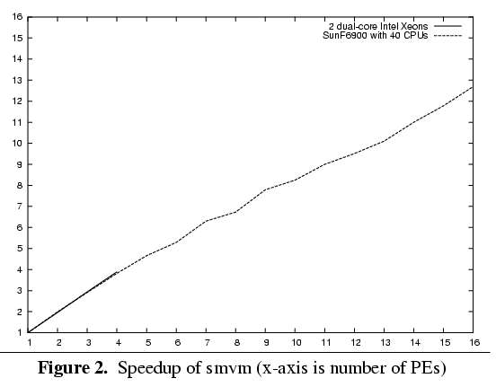
And it goes fast too...
1-processor version goes only 30% slower than C
Perf win with 2 processors
Pinch of salt

Slide 70
Data Parallel Summary
Data parallelism is the most promising way to harness 100’s of cores.
Nested DP is great for programmers: far, far more flexible than flat DP.
Nested DP is tough to implement, but we (think we) know how to do it.
Functional programming is a massive win in this space.
Work in progress: starting to be available in GHC 6.10 and 6.12.
http://haskell.org/haskellwiki/GHC/Data_Parallel_Haskell

Slide 71
Candidate Models in Haskell
Explicit threads
Non-deterministic by design
Monadic: forkIO and STM
Semi-implicit parallelism
Deterministic
Pure: par and pseq
Data parallelism
Deterministic
Pure: parallel arrays
Shared memory initially; distributed memory eventually; possibly even GPUs…
main :: IO ()
= do { ch <- newChan
; forkIO (ioManager ch)
; forkIO (worker 1 ch)
... etc ... }
f :: Int -> Int
f x = a `par` b `pseq` a + b
where
a = f1 (x-1)
b = f2 (x-2)

Slide 72
The Grand Challenge
Making effective use of multicore hardware is the challenge for programming languages now.
Hardware is getting increasingly complicated:
Nested memory hierarchies
Hybrid processors: GPU + CPU, Cell, FPGA...
Massive compute power sitting mostly idle.
We need new programming models to program new commodity machines effectively.
Language researchers are working hard to answer this challenge…

