Slide 1
编译原理(H) 讨论课

Slide 2
Introduction to modern C++
Key points:
Syntax changes nullptr, using, constexpr, lambda
Type inference auto, decltype
Smart pointers unique_ptr, shared_ptr
Rvalue reference motivation, move, forward
We will dicuss not only about what they are, but also how are they implemented.

Slide 3
Syntax changes
nullptr: typed null pointer constant
void f(int);
void f(void*);
f(0); // calls f(int)
f(nullptr); // calls f(void*)
Alias declaration
using UPtrMapSS = std::unique_ptr
<std::unordered_map<std::string, std::string>>;
using FP = void (*)(int, const std::string&);
template<typename T>
using MyAllocList = std::list<T, MyAlloc<T>>;
// more examples on dealing with templates

Slide 4
Syntax changes
constexpr: compile time constants
constexpr int base = 3;
constexpr int exp = base + 2;
constexpr int pow(int base, int exp) noexcept
{
auto result = 1;
for (int i = 0; i < exp; ++i) result *= base;
return result;
} // C++14
const std::array<int, pow(base, exp)> foo; // have 3^5 elements
// can’t be constexpr
What are the differences between constexpr and const?

Slide 5
Lambda expressions
// simple lambda expression
std::find_if(container.begin(), container.end(),
[](int val) { return 0 < val && val < 10; });
// lambda expression that captures the environment
int x;
auto add_x = [x](int y) { return x + y; }
auto add_to_x = [&x](int y) { x += y; }
Note: lifetimes of the captured references are NOT extended!

Slide 6
Type inference
Simple bottom-up type inference: similar to template type inference
On expression, function return type, function parameter type, lambdas:
auto pow(int base, int exp)
{
if (exp == 0) return 1;
else return base * pow(base, exp - 1);
} // C++14.
auto lambda = [](auto x, auto y) {return x + y;};
Why so simple? What happens on ptrs/refs?
Notes:
http://open-std.org/JTC1/SC22/WG21/docs/papers/2013/n3638.html

Slide 7
Smart pointers
unique_ptr: based on life-cycle, “owns” a pointer
shared_ptr: based on reference count, “shares” a pointer
weak_ptr: to break shared_ptr cycle (and more)
How to transfer ownership of an unique_ptr?
How to implement a tree? What about a graph?

Slide 8
Rvalue references: motivation
See the following example. Do you notice the efficiency problem?
class List { ... };
List a(10), b(20);
List c = a + b; // two steps: call op+ of a on b,
// call constructor on (a+b)
How do you write constructor for List?

Slide 9
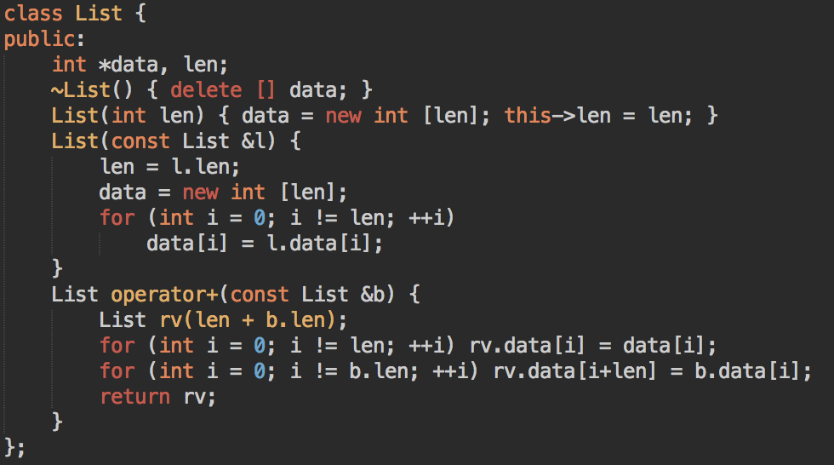
Using C++98 convention

Slide 10
What happens?
List c = a + b;
heap
heap
heap
a
a
a
b
b
b
a+b
a+b
c

Slide 11
Dilemma
operator+ have to return a temp value, which is abandoned later.
If we want to correctly perform copy between variables, we have to write a deep-copy constructor.
If we don’t want to deep-copy temp variables, we’ll have to modify the temp variable so that it wouldn’t perform delete.
heap
a
b
a+b
c

Slide 12
Approach
We want access to a temporary object (+1s), in a way that is more flexible than const lvalue references.
We want to distinguish temp values from regular values, so that we can treat them separately.
Therefore, we need to add a new form of type into the type system, which is rvalue reference, denoted as T&&.

Slide 13
Rvalue reference
Rvalue reference can only bind to rvalues, (non-const) lvalue reference can only bind to lvalues.
After binding, rvalue reference can be used as a regular reference, which leads to a fact that rvalue reference is an lvalue in expressions:
int &&r = 1+2;
r++; // valid!
Lifetime of that binded rvalue is extended to the lifetime of rvalue reference

Slide 14
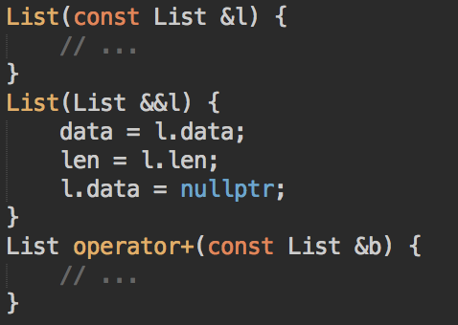
New solution
Treat lvalue reference normally: do deep-copy
Treat rvalues separately (in what we call a move constructor):
directly ‘steal’ data
prevent temp object from destroying them
The compiler will choose the correct overload for you
heap
a
b
l
a+b
c

Slide 15
std::move and std::forward
std::move simply performs a type cast, which makes other funtions treat an lvalue as rvalue
std::forward is a template function that pass arguments ‘as-is’ (in terms of type) to another function. Have a lot to do with templates.

Slide 16
Example: unique_ptr
unique_ptr is, as you imagine, unique, so we shouldn’t perform copy on it. Copy constructor is marked as deleted.
When a function returns an unique_ptr, which is later assigned to a new one, we can let the new one ‘steal’ the underlying raw pointer, and reset the old one, in the move constructor.
To explicitly do such ‘stealing’ on an lvalue (call the move constructor which accepts only rvalues), we do std::move.

Slide 17
Q&A

Slide 18
Clang Static Analyzer

Slide 19
静态分析
不需要执行, 直接分析代码

Slide 20
静态分析
不需要执行, 直接分析代码
可以用来
优化
变换, 重构
找 bug
验证程序正确性
可视化

Slide 21
静态分析
不需要执行, 直接分析代码
可以用来 找 bug
局限性
停机问题不可判定
int x = 0
If (program_halts_on_input(P, I))
x++
// x 的值?

Slide 22
静态分析
不需要执行, 直接分析代码
可以用来 找 bug
局限性
近似
False positive 漏报
False negtive 错报

Slide 23
静态分析
不需要执行, 直接分析代码
可以用来 找 bug
局限性
近似
方法

Slide 24
静态分析方法
Textual pattern matching

Slide 25
Textual pattern matching
直接进行字符串比配, 或进行一定的转换
#define M 0
int a = 5 / M;
int b = getValue();
if (b == 4) {
...
int c = 5 / (b – 4);
}
Token::Match(tok, “ / 0”);

Slide 26
静态分析方法
Textual pattern matching
Matching the Syntax Tree

Slide 27
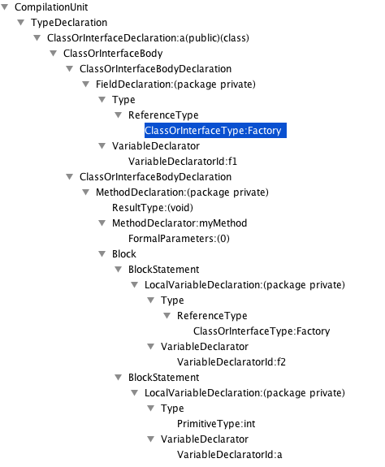
public class a {
Factory f1;
void myMethod() {
Factory f2;
int a;
}
}
//VariableDeclarator
[../Type/ReferenceType/ClassOrInterfaceType
[@Image = 'Factory'] and ..[@Final='false']]

Slide 28
静态分析方法
Textual pattern matching
Matching the Syntax Tree
Flow sensitive algorithms

Slide 29
静态分析方法
Textual pattern matching
Matching the Syntax Tree
Flow sensitive algorithms
Path sensitive algorithms – Clang Static Analyzer

Slide 30
符号执行
b: $b
switch(b)
default
void test(int b) {
int a,c;
switch (b){
case 1: a = b / 0; break;
case 4: c = b - 4;
a = b / c; break;
default:
}
}
b: $b
$b = [MIN_INT,0], [2,3], [5,MAX_INT]

Slide 31
符号执行
b: $b
switch(b)
default
case 1
void test(int b) {
int a,c;
switch (b){
case 1: a = b / 0; break;
case 4: c = b - 4;
a = b / c; break;
default:
}
}
b: $b
b: $b
$b=[MIN_INT,0],[2,3],[5,MAX_INT]
$b=[1,1]
a = b/0;
b: $b

Slide 32
符号执行
b: $b
switch(b)
default
case 4
case 1
void test(int b) {
int a,c;
switch (b){
case 1: a = b / 0; break;
case 4: c = b - 4;
a = b / c; break;
default:
}
}
b: $b
b: $b
b: $b
$b=[MIN_INT,0],[2,3],[5,MAX_INT]
$b=[1,1]
$b=[4,4]
c = b-4;
a = b/0;
b: $b
c: 0
b: $b
$b=[4,4]
a = b/c;
b: $b
c: 0
$b=[4,4]

Slide 33
Clang Static Analyzer
整体
FrontEnd
Core
Checkers
CSA
Clang
AST

Slide 34
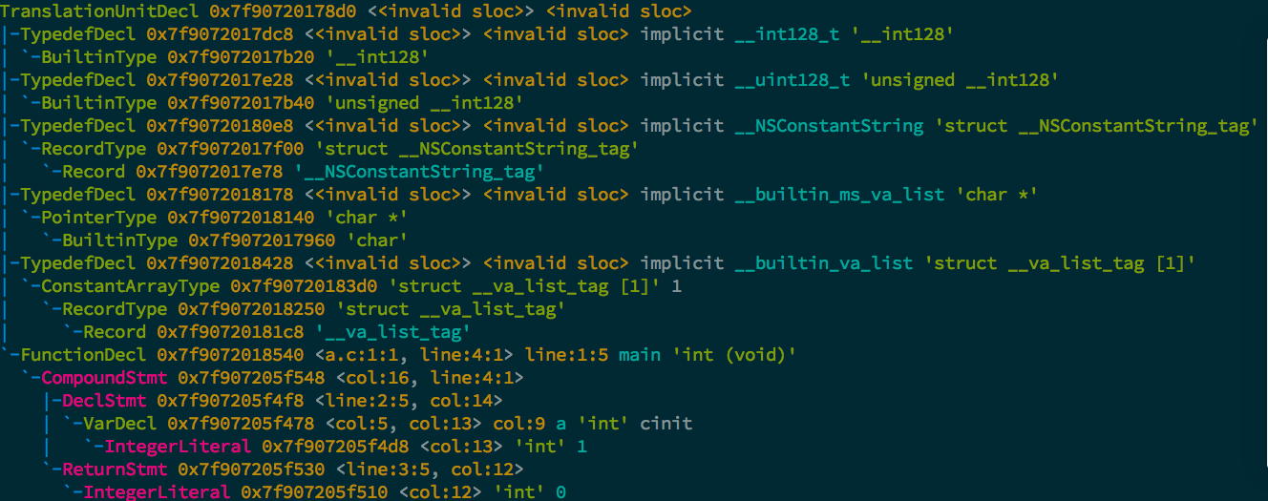
FrontEnd
Clang 产生 AST
int main(void) {
int a = 1;
return 0;
}

Slide 35
FrontEnd
Decl
Stmt
Type
Clang 产生 AST
int main(void) {
int a = 1;
return 0;
}
TranslationUnitDecl
ReturnStmt
PointerType

Slide 36
FrontEnd
Clang 产生 AST
AST 放在 ASTContext 里面

Slide 37
FrontEnd
Clang 产生 AST
AST 放在 ASTContext 里面
遍历 AST

Slide 38
遍历 AST
实现一个类 A, 继承 RecursiveASTVisitor<A> , 重载VisitXXX(XXX x)
class A : public RecursiveASTVisitor<A> {
public :
A(ASTContext *context)
:context(context) {}
bool VisitDecl(Decl *d) {
d->dump();
}
return true;
private :
ASTContext context;
}

Slide 39
遍历 AST
静态多态 Curiously Recurring Template Pattern
template <typename Child>
class Base {
void interface() {
static_cast<Child*>(this)->implementation();
}
void implementation() {
std::cout << “Base” << std::endl;
}
};
class Derived : Base<Derived> {
void implementation() {
std::cout << “Drived” << std::endl;
}
}

Slide 40
遍历 AST
静态多态 Curiously Recurring Template Pattern
对比动态多态
Base
Derived
vptr
vptr
void impl( )
void impl( )
Base *p;
p->vptr[0]()

Slide 41
遍历 AST
静态多态 Curiously Recurring Template Pattern
对比动态多态
省去 vtable, 指向 vtable 的指针
省去了动态多态的一次间接函数调用
可以 inline 优化

Slide 42
FrontEnd
Clang 产生 AST
AST 放在 ASTContext 里面
遍历 AST
Syntax 模式检查, 直接在 AST 上检查
Path 模式检查, 先构造 CFG, 在检查

Slide 43
FrontEnd
Clang 产生 AST
AST 放在 ASTContext 里面
遍历 AST
Syntax 模式检查, 直接在 AST 上检查
Path 模式检查, 先构造 CFG, 再检查
跨函数分析 (不支持跨translation unit)

Slide 44
跨函数分析
生成函数调用图 CallGraph
遍历函数体, 找到里面所有的函数调用
遍历 (顺序)
能够 inline 的函数(哪些?), 直接展开, 变成过程内分析

Slide 45
内存模型
<name, value> pairs
int i = 1;
int *p1 = &i;
int *p2 = &i;

Slide 46
内存模型
Var -> Loc -> Value
每个左值都有对应的一个 Region
VarRegion
SubRegion: ElementRegion, FieldRegion
MemSpaceRegion: stack, static, heap

Slide 47
内存模型
Var -> Loc -> Value
每个左值都有对应的一个 Region
VarRegion
SubRegion: ElementRegion, FieldRegion
MemSpaceRegion: stack, static, heap
RegionView
一块内存可以看做是 int* 也可以是 char*

Slide 48
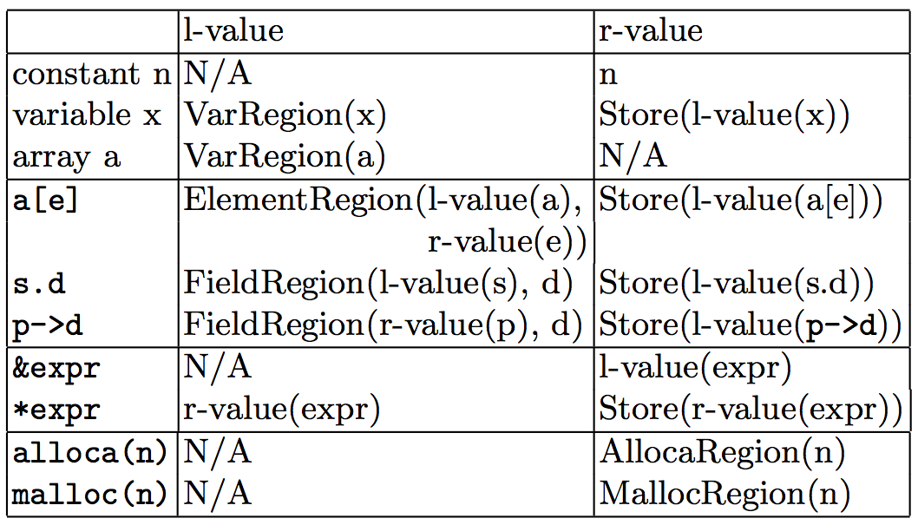
内存模型
Env : Expr -> SVal
Store : Region -> SVal

Slide 49
内存模型
struct s1 { int d; }
struct s2 { struct s1 * p; }
void foo() {
struct s1 data;
struct s2 *sp;
int a[2];
sp =
malloc(sizeof(struct s2))
sp->p = &data;
sp->p->d = 3;
a[1] = data.d;
}
Exp | Region | Value
data | region 1 | N/A
data.d | region 2 | undefined
sp | region 3 | undefined
a | region 4 | N/A
a[0] | region 5 | undefined
a[1] | region 6 | undefined

Slide 50
内存模型
struct s1 { int d; }
struct s2 { struct s1 * p; }
void foo() {
struct s1 data;
struct s2 *sp;
int a[2];
sp =
malloc(sizeof(struct s2))
sp->p = &data;
sp->p->d = 3;
a[1] = data.d;
}
Exp | Region | Value
data | region 1 | N/A
data.d | region 2 | undefined
sp | region 3 | undefined
a | region 4 | N/A
a[0] | region 5 | undefined
a[1] | region 6 | undefined
MallocReg0 | region 7 | N/A
MallocReg0.p | region 8 | undefined

Slide 51
内存模型
struct s1 { int d; }
struct s2 { struct s1 * p; }
void foo() {
struct s1 data;
struct s2 *sp;
int a[2];
sp =
malloc(sizeof(struct s2))
sp->p = &data;
sp->p->d = 3;
a[1] = data.d;
}
Exp | Region | Value
data | region 1 | N/A
data.d | region 2 | undefined
sp | region 3 | undefined
a | region 4 | N/A
a[0] | region 5 | undefined
a[1] | region 6 | undefined
MallocReg0 | region 7 | N/A
MallocReg0.p | region 8 | region 1

Slide 52
内存模型
struct s1 { int d; }
struct s2 { struct s1 * p; }
void foo() {
struct s1 data;
struct s2 *sp;
int a[2];
sp =
malloc(sizeof(struct s2))
sp->p = &data;
sp->p->d = 3;
a[1] = data.d;
}
Exp | Region | Value
data | region 1 | N/A
data.d | region 2 | 3
sp | region 3 | undefined
a | region 4 | N/A
a[0] | region 5 | undefined
a[1] | region 6 | undefined
MallocReg0 | region 7 | N/A
MallocReg0.p | region 8 | region 1

Slide 53
内存模型
struct s1 { int d; }
struct s2 { struct s1 * p; }
void foo() {
struct s1 data;
struct s2 *sp;
int a[2];
sp =
malloc(sizeof(struct s2))
sp->p = &data;
sp->p->d = 3;
a[1] = data.d;
}
Exp | Region | Value
data | region 1 | N/A
data.d | region 2 | 3
sp | region 3 | undefined
a | region 4 | N/A
a[0] | region 5 | undefined
a[1] | region 6 | 3
MallocReg0 | region 7 | N/A
MallocReg0.p | region 8 | region 1

Slide 54
Discussion

