Slide 2
How to Adopt Modern C++17 into Your C++ Code
Herb Sutter
BRK2146

Slide 3
Agenda
What’s new?
“Classic” vs. “Modern” C++
Move semantics; vocabulary types
“Top two” general issues/techniques
RAII + scopes
Error handling
“One more”
Pointers: Dumb and smart (and smart used correctly)

Slide 4
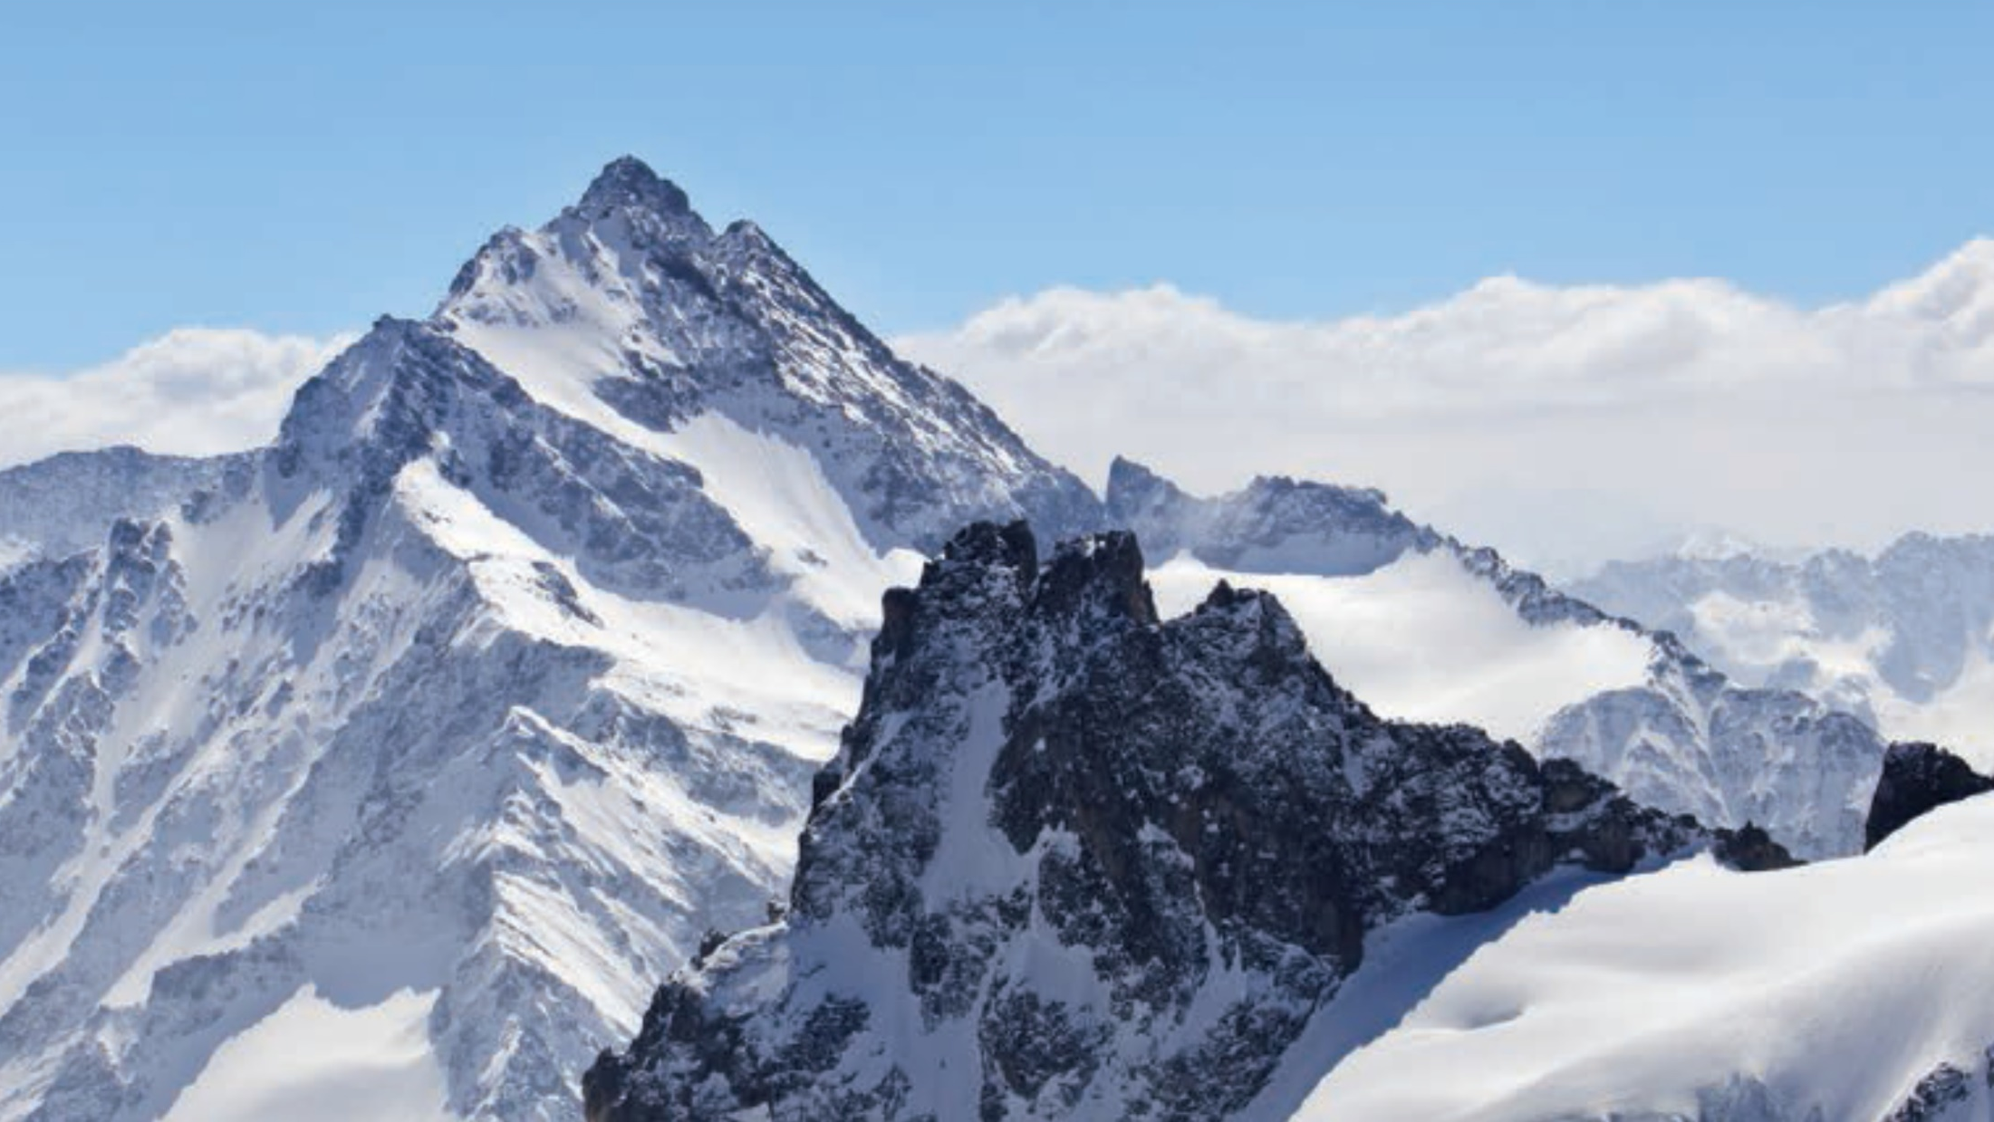

Coming in summer 2018
“What should every C++ programmer be expected to know?”
For years, there has not been a single source to point to.
Now there is. Readable on a long plane flight.
Recommend it heavily!
Also a demonstration that modern C++ is simpler to teach and explain.
Currently being updated for C++17, Second Edition ETA July 2018.

Slide 5
What’s different: At a glance
Then: C++98 code
circle* p = new circle( 42 );
vector<shape*> v = load_shapes();
for( vector<shape*>::iterator i = v.begin(); i != v.end(); ++i ) { if( *i && **i == *p ) cout << **i << “ is a match\n”; }
// … later, possibly elsewhere …
for( vector<shape*>::iterator i = v.begin(); i != v.end(); ++i ) { delete *i; }
delete p;
IMPORTANT: Still compiles and works!

Slide 6
What’s different: At a glance
auto type deduction
T* → shared_ptr<T>
new → make_unique or make_shared
Then: C++98 code
Now: Modern C++
circle* p = new circle( 42 );
vector<shape*> v = load_shapes();
for( vector<shape*>::iterator i = v.begin(); i != v.end(); ++i ) { if( *i && **i == *p ) cout << **i << “ is a match\n”; }
// … later, possibly elsewhere …
for( vector<shape*>::iterator i = v.begin(); i != v.end(); ++i ) { delete *i; }
delete p;
auto p = make_shared<circle>( 42 );
auto v = load_shapes();
for( auto& s : v ) { if( s && *s == *p ) cout << *s << “ is a match\n”; }
range-for
not exception-safe
missing try/catch, __try/__finally
no need for “delete” – automatic lifetime management
exception-safe

Slide 7
Example: Compute arithmetic mean
Python
Modern C++
using a concept (note: not yet VC++)
def mean(seq):
n = 0.0
for x in seq:
n += x
return n / len(seq)
auto mean(const Sequence& seq) {
auto n = 0.0;
for (auto x : seq)
n += x;
return n / seq.size();
}
automatic return type deduction

Slide 8
Example: Compute arithmetic mean
Python
Modern C++
def mean(seq):
return sum(seq) / len(seq)
mean = lambda seq: sum(seq) / len(seq)
auto mean(const Sequence& seq)
{ return reduce(begin(seq),end(seq)) / seq.size(); }
auto mean = [](const Sequence& seq)
{ return reduce(begin(seq),end(seq)) / seq.size(); }

Slide 9
Example: Compute arithmetic mean
Python
C++17 with parallel STL
def mean(seq):
return sum(seq) / len(seq)
mean = lambda seq: sum(seq) / len(seq)
auto mean(const Sequence& seq) {
return reduce(par_unseq,begin(seq),end(seq)) / seq.size();
}
auto mean = [](const Sequence& seq) {
return reduce(par_unseq,begin(seq),end(seq)) / seq.size();
}

Slide 10
Agenda
What’s new?
“Classic” vs. “Modern” C++
Move semantics; vocabulary types
“Top two” general issues/techniques
RAII + scopes
Error handling
“One more”
Pointers: Dumb and smart (and smart used correctly)

Slide 11
Value types & move efficiency
Then: C++98 code
Now: Modern C++
set<widget>* load_huge_data() { set<widget>* ret = new set<widget>(); // … load data and populate *ret … return ret; }
widgets = load_huge_data();
use(*widgets);
set<widget> load_huge_data() { set<widget> ret; // … load data and populate ret … return ret; }
widgets = load_huge_data();
use(widgets);
efficient, no deep copy
brittle
just asking for returned pointer to be leaked, dangled, etc.
extra indirection throughout code
clean semantics of value types
+ efficiency of reference types

Slide 12
Key new std:: vocabulary types in C++17
string_view
Non-owning const view of any contiguous sequence of characters.
Variations for different character types (e.g., wide).
optional<T>
Contains a T value or “empty.”
variant<Ts…>
Contains one value of a fixed set of types.
any
Contains one value of any type, fully dynamic type.

Slide 13
string_view (& variations, e.g., wstring_view)
Non-owning const view of a contiguous sequence of characters.
Note: NOT null-terminated.
All these callers, and all their types… … can be made to work with:
std::wstring s; f(s);
wchar_t* s, size_t len; f({s,len});
winrt::hstring s; f(s);
QString s; f(s.toWStringView());
CStringW s; f((LPCSTR)s); void f(wstring_view s);
CComBSTR s; f({s.m_str, s.Length()});
BSTR s; f({s,SysStringLen(s)});
_bstr_t s; f({s,s.length()});
UNICODE_STRING s; f({s.Buffer, s.Length});
/* … known incomplete sample … */

Slide 14
optional<T>
Contains a T value or “empty.”
std::optional<std::string> create() { if (something) return “xyzzy”; else return {}; // or std::nullopt }
int main() { auto result = create(); if (result) { std::cout << *result << ‘\n’; // ok }
try { cout << *result; } // can throw catch( const bad_optional_access& e) { /*...*/ }
cout << result.value_or(“empty”) << ‘\n’; // if empty, prints “empty” }

Slide 15
variant<Ts…>
Contains one value of a fixed set of types.
auto v = variant<int,double>(42); // v now holds an int
cout << get<int>(v); // ok, prints “42”
try { cout << get<double>(v); // error, throws } catch( const bad_variant_access& e) { cout << e.what(); }
v = 3.14159; // v now holds a double
cout << get<double>(v); // now ok, prints “3.14159”

Slide 16
any
Contains one value of any type, fully dynamic type.
auto a = any(42); // a now holds an int
cout << any_cast<int>(a); // ok, prints “42”
try { cout << any_cast<string>(a); // error, throws } catch( const bad_any_cast& e) { cout << e.what(); }
a = “xyzzy”s; // a now holds a std::string
cout << any_cast<string>(a); // now ok, prints “xyzzy”

Slide 17
Agenda
What’s new?
“Classic” vs. “Modern” C++
Move semantics; vocabulary types
“Top two” general issues/techniques
RAII + scopes
Error handling
“One more”
Pointers: Dumb and smart (and smart used correctly)

Slide 18
Objects own resources (RAII)
Make sure that objects own resources. Pass every “new” object to the constructor of an object that owns it (e.g., unique_ptr).
void f() { auto p = make_unique<widget>(…); my_class x( OpenFile() );
…
} // automatic destruction and deallocation, automatic exception safety
What if there isn’t already an RAII type?
Write one.
Rarely, consider gsl::finally. It is intended as a last resort.
Easy to abuse: In reviewed code, typically >50% of uses are abuses.

Slide 19
Scoped lifetime = efficient + exception-Safe
class widget {
private: gadget g;
public: void draw(); };
void f() { widget w; :::
w.draw();
:::
}
all types are destructible
lifetime automatically tied to enclosing object
no leak, exception safe
lifetime automatically tied to enclosing scope
constructs w, including the w.g gadget member
automatic destruction and deallocation for w and w.g
automatic propagation, as if “widget.dispose() { g.dispose(); }”
automatic exception safety, as if “finally { w.g.dispose(); w.dispose(); }”

Slide 20
Errors and exceptions: In one slide
Use exceptions/codes only to report errors, defined as the function can’t do what it advertised (achieve documented success postconditions).
Merriam-Webster: “an act that … fails to achieve what should be done”
Much clearer than “use exceptions for exceptional situations.”
Error codes vs. exceptions? No fundamental difference. Pick one (1).
Prefer exceptions wherever possible:
Error codes are ignored by default. (ouch)
Error codes have to be manually propagated by intermediate code.
Error codes don’t work well for errors in constructors and operators.
Error codes interleave “normal” and “error handling” code.
Use error codes on boundaries with non-C++ code (including C and DLL APIs).

Slide 21
Preconditions and postconditions
Precondition and postcondition violations should assert (or fail fast).
They are logic bugs in the function caller and function callee body, respectively, that should be reported at development time.
Also, throwing an exception loses debug stack context.
Postconditions should include or imply “!SUCCESS_EXIT ||”.
It’s only a postcondition violation (bug in function body) if we’re returning success.
It’s never a postcondition violation if we’re reporting an error (throwing an exception or returning a non-success code).
Corollary: If we’re throwing an exception, we never need to explicitly write “!SUCCESS_EXIT ||” on our postconditions because our success and failure paths are already explicitly distinct (return vs. throw).

Slide 22
Agenda
What’s new?
“Classic” vs. “Modern” C++
Move semantics; vocabulary types
“Top two” general issues/techniques
RAII + scopes
Error handling
“One more”
Pointers: Dumb and smart (and smart used correctly)

Slide 23
Don’t Use Owning *, new, or delete
C++98:
widget* factory();
void caller() { widget* w = factory(); gadget* g = new gadget(); use( *w, *g ); delete g; delete w; }
red ⇒ now “mostly wrong” ☺
Don’t use owning *, new, delete.
Except: Encapsulated inside impl of low-level data structures.
Modern C++:
unique_ptr<widget> factory();
void caller() { auto w = factory(); auto g = make_unique<gadget>(); use( *w, *g ); }
For “new”, use make_unique by default, make_shared if it will be shared.
For “delete”, write nothing.

Slide 24
NB: Non-Owning */& Are Still Great
C++98 “Classic”:
void f( widget& w ) { // if required use(w); }
void g( widget* w ) { // if optional if(w) use(*w); }
Modern C++ “Still Classic”:
void f( widget& w ) { // if required use(w); }
void g( widget* w ) { // if optional if(w) use(*w); }
auto upw = make_unique<widget>();
…
f( *upw );
auto spw = make_shared<widget>();
…
g( spw.get() );
✓
* and & FTW

Slide 25
Did You Know: Smart Pointers are Pretty Smart
Derived-to-base just works:
// void f(const shared_ptr<Base>&);
f( make_shared<Derived>() ); // ok
Non-const-to-const just works:
// void f(const shared_ptr<const Node>&);
f( make_shared<Node>() ); // ok
Bonus geek cred if you know the aliasing ctor:
struct Node { Data data; };
shared_ptr<Data> get_data(const shared_ptr<Node>& pn) { return { pn, &(pn->data) }; // ok }
Node
Data

Slide 26
Antipatterns Hurt Pain Pain
Antipattern #1: Parameters (Note: Any refcounted pointer type.)
void f( refcnt_ptr<widget>& w ) { use(*w); } // ?
void f( refcnt_ptr<widget> w ) { use(*w); } // ?!?!
Antipattern #2: Loops (Note: Any refcounted pointer type.)
refcnt_ptr<widget> w = …;
for( auto& e: baz ) {
auto w2 = w; use(w2, *w, *w2, whatever);
} // ?!?!?!?!
Example (HT: Andrei Alexandrescu): In late 2013, Facebook RocksDB changed pass-by-value shared_ptr to pass-*/&.
⇒ 4× QPS (100K to 400K) in one benchmark
Example: C++/WinRT factory cache was slow. “Obvious” suspect: cache’s mutex lock
Actual culprit: >50% time spent in extra AddRef/Release on returned object

Slide 27
Guideline: Dereference Unaliased+Local RC Ptrs
The reentrancy pitfall (simplified):
// global (static or heap), or aliased local … shared_ptr<widget> other_p …
void f( widget& w ) { g(); use(w); }
void g() { other_p = … ; }
void my_code() { f( *other_p ); // passing *nonlocal } // should not pass code review
“Pin” using unaliased local copy.
// global (static or heap), or aliased local … shared_ptr<widget> other_p …
void f( widget& w ) { g(); use(w); }
void g() { other_p = … ; }
void my_code() { auto pin = other_p; // 1 ++ for whole tree f( *pin ); // ok, *local }

Slide 28
Guideline: Dereference Unaliased+Local RC Ptrs
The reentrancy pitfall (simplified):
// global (static or heap), or aliased local … shared_ptr<widget> other_p …
void f( widget& w ) { g(); use(w); }
void g() { other_p = … ; }
void my_code() { f( *other_p ); // passing *nonlocal other_p->foo(); // (or nonlocal->) } // should not pass code review
“Pin” using unaliased local copy.
// global (static or heap), or aliased local … shared_ptr<widget> other_p …
void f( widget& w ) { g(); use(w); }
void g() { other_p = … ; }
void my_code() { auto pin = other_p; // 1 ++ for whole tree f( *pin ); // ok, *local pin->foo(); // ok, local-> }

Slide 29
Passing Smart Pointers
unique_ptr<widget> factory(); // source – produces widget
void sink( unique_ptr<widget> ); // sink – consumes widget
void reseat( unique_ptr<widget>& ); // “will” or “might” reseat ptr
void thinko( const unique_ptr<widget>& ); // usually not what you want
shared_ptr<widget> factory(); // source + shared ownership // when you know it will be shared, perhaps by factory itself
void share( shared_ptr<widget> ); // share – “will” retain refcount
void reseat( shared_ptr<widget>& ); // “might” reseat ptr
void may_share( const shared_ptr<widget>& ); // “might” retain refcount

Slide 30
Summary: “Doing it right”
Never pass smart pointers (by value or by reference) unless you actually want to manipulate the pointer ⇒ store, change, or let go of a reference.
Prefer passing objects by * or & as usual – just like always.
Remember: Take unaliased+local copy at the top of a call tree, don’t pass f(*other_p).
Else if you do want to manipulate lifetime, great, do it as on previous slide.
Express ownership using unique_ptr wherever possible, including when you don’t know whether the object will actually ever be shared.
It’s free = exactly the cost of a raw pointer, by design.
It’s safe = better than a raw pointer, including exception-safe.
It’s declarative = expresses intended uniqueness and source/sink semantics.
It removes many (often most) objects out of the ref counted population.
Else use make_shared up front wherever possible, if object will be shared.

Slide 31
Agenda
What’s new?
“Classic” vs. “Modern” C++
Move semantics; vocabulary types
“Top two” general issues/techniques
RAII + scopes
Error handling
“One more”
Pointers: Dumb and smart (and smart used correctly)

Slide 32



Daily Prizes
Xbox One X
DJI Spark Drone
Starbucks gift cards
Complete your evaluations to win prizes!
Be eligible to win! Make sure you are scanned into your session and complete your session eval to be eligible to win.
Seven winners each day! Winners will be notified via email.
Pick up your prize before leaving!
Prizes can be claimed at the info counter located on WSCC level 4, Galleria level.
Monday: pick up 2:15pm–6:30pm.
Tuesday: pick up 7:00am–6:00pm.
Wednesday: pick up 7:00am–5:30pm.
Please contact build@eventcore.com for more information

Slide 33
Bonus: C++ supports multiple return values
… and it turns out we’ve already been doing it.
Given a set<string> myset, consider:
// C++98
pair<set<string>::iterator,bool> result = myset.insert( “Hello” ); if (result.second) do_something_with( result.first ); // workaround
// C++11 – sweet backward compat
auto result = myset.insert( “Hello” ); // nicer syntax, and the if (result.second) do_something_with( result.first ); // workaround still works
// C++17
auto [ iter, success ] = myset.insert( “Hello” ); // normal return value if (success) do_something_with( iter );

Slide 34
How to Adopt Modern C++17 into Your C++ Code
Herb Sutter
BRK2146

