Slide 1

Midterm Review
For today’s review session, kindly clone the GitHub repository
https://github.com/aim-msds/msds-2025ft-ml3-review
Then follow the setup procedures.
Machine Learning 3
Session 12
MSDS FT 2025
09 May 2025

Slide 2
Midterms
General Instructions
Hands-on Coding
Two parts – CNN and RNN
3 hours
Starts at 9:00 AM (Friday, May 16, 2025)
Open everything but must be done INDIVIDUALLY
Cite usage of ChatGPT or any LLMs

Slide 3
Key Concepts

Slide 4
1 CNN
Key Concepts
Data loading and data preparation
Data augmentation
Defining the model architecture or loading a pretrained model
Model training and fine-tuning
Hyperparameter settings and loss functions
Model evaluation
Model deployment or inference

Slide 5
2 RNN
Key Concepts
Data loading and data preparation
Text vectorization and embedding
Time-series dataset preparation
Establishing baselines
Defining the model architecture or loading a pretrained model
Model training and fine-tuning
Hyperparameter settings and loss functions
Model evaluation
Model deployment or inference

Slide 6
3 Other
General Tips
Master one deep learning framework (tensorflow-keras or torch)
Create your own standard pipeline notebooks and utility functions module
Start small then scale up
Use ChatGPT and any other LLMs as a supplementary tool

Slide 7
References

Slide 8
References
Books
Deep Learning with Python by Chollet (2nd Edition)
Deep Learning with PyTorch by Stevens et al.
Tutorials
Keras - https://keras.io/examples/
TensorFlow - https://www.tensorflow.org/tutorials
PyTorch - https://docs.pytorch.org/tutorials/
Expert Guidelines
Deep Learning Tuning Playbook by Google Research
https://github.com/google-research/tuning_playbook

Slide 9
Supplementary Materials

Slide 10
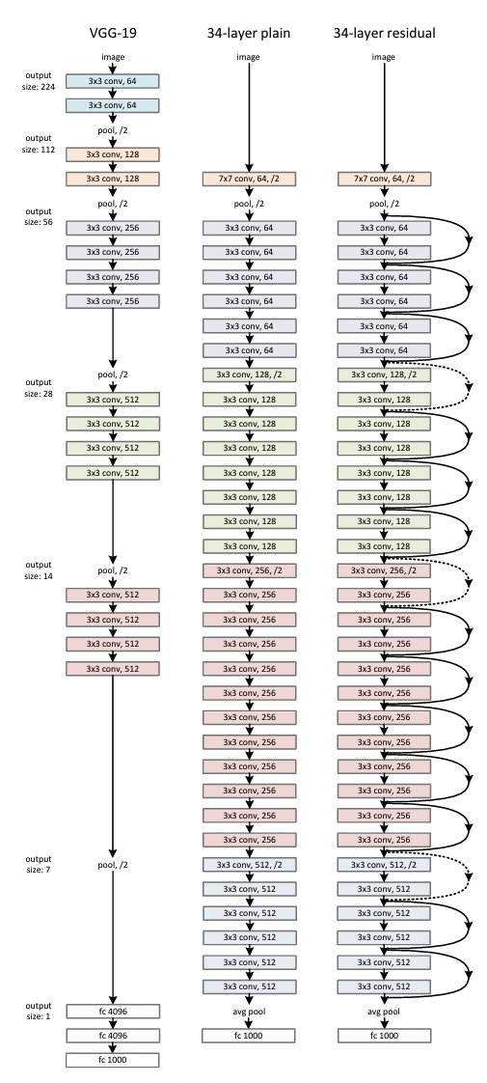
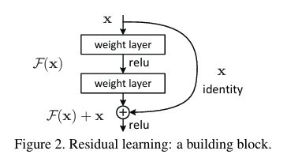
Residual Networks
Key idea: Residual connections
The function $ℱ$ represents the residual mapping to be learned.
Notes:
In this case F = W_2 sigma(W_1 x) where sigma = relu.

Slide 11
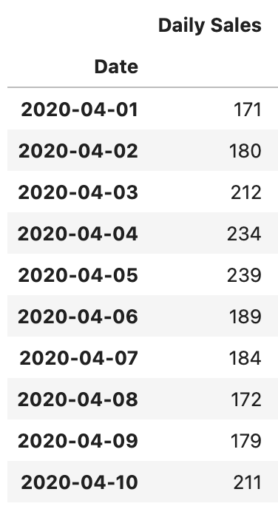






























Timeseries Dataset
Generating the sample-target pairs for timeseries
Timeseries Data
Sample
Target
$$t_{0}$$
$$t_{1}$$
$$t_{0}$$
$$t_{1}$$
$$t_{2}$$
$$t_{5}$$
$$t_{2}$$
$$t_{1}$$
$$t_{2}$$
$$t_{3}$$
$$t_{6}$$
$$t_{3}$$
$$t_{4}$$
$$t_{2}$$
$$t_{3}$$
$$t_{4}$$
$$t_{7}$$
$$t_{5}$$
$$t_{6}$$
$$t_{3}$$
$$t_{4}$$
$$t_{5}$$
$$t_{8}$$
$$t_{7}$$
$$t_{4}$$
$$t_{5}$$
$$t_{6}$$
$$t_{9}$$
$$t_{8}$$
$$t_{9}$$
Notes:
In this case F = W_2 sigma(W_1 x) where sigma = relu.

Slide 12















Timeseries Dataset
Timeseries Data Parameters
Step
Sample
Target
$$t_{0}$$
$$t_{1}$$
$$t_{2}$$
$$t_{3}$$
$$t_{4}$$
$$t_{5}$$
$$t_{6}$$
$$t_{7}$$
$$t_{8}$$
$$t_{9}$$
$$t_{10}$$
$$t_{11}$$
$$t_{12}$$
$$t_{13}$$
$$t_{14}$$
Lookback
Delay
Sample – Set of historical values used as predictors
Lookback – How far back in history we look to construct the sample
Delay – Time difference between target and sample
Step – Time step between values within the sample
Notes:
In this case F = W_2 sigma(W_1 x) where sigma = relu.

Slide 13
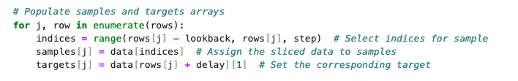
Timeseries Dataset
Timeseries Data Parameters
Step
Sample
Target
$$t_{0}$$
$$t_{1}$$
$$t_{2}$$
$$t_{3}$$
$$t_{4}$$
$$t_{5}$$
$$t_{6}$$
$$t_{7}$$
$$t_{8}$$
$$t_{9}$$
$$t_{10}$$
$$t_{11}$$
$$t_{12}$$
$$t_{13}$$
$$t_{14}$$
Lookback
Delay
Lookback = 7
Delay = 4
Step = 1
Snippet from the generator function
Notes:
In this case F = W_2 sigma(W_1 x) where sigma = relu.

Slide 14
Timeseries Dataset
Timeseries Data Parameters
$$t_{0}$$
$$t_{1}$$
$$t_{2}$$
$$t_{3}$$
$$t_{4}$$
$$t_{5}$$
$$t_{6}$$
$$t_{7}$$
$$t_{8}$$
$$t_{9}$$
$$t_{10}$$
$$t_{11}$$
$$t_{12}$$
$$t_{13}$$
$$t_{14}$$
Lookback = 6
Delay = 3
Step = 2
Snippet from the generator function
Notes:
In this case F = W_2 sigma(W_1 x) where sigma = relu.

Slide 15
Timeseries Dataset
Timeseries Data Parameters
Sample 1
$$t_{0}$$
$$t_{1}$$
$$t_{2}$$
$$t_{3}$$
$$t_{4}$$
$$t_{5}$$
$$t_{6}$$
$$t_{7}$$
$$t_{8}$$
$$t_{9}$$
$$t_{10}$$
$$t_{11}$$
$$t_{12}$$
$$t_{13}$$
$$t_{14}$$
Lookback = 6
Delay = 3
Step = 2
Snippet from the generator function
Notes:
In this case F = W_2 sigma(W_1 x) where sigma = relu.

Slide 16
Timeseries Dataset
Timeseries Data Parameters
Sample 2
$$t_{0}$$
$$t_{1}$$
$$t_{2}$$
$$t_{3}$$
$$t_{4}$$
$$t_{5}$$
$$t_{6}$$
$$t_{7}$$
$$t_{8}$$
$$t_{9}$$
$$t_{10}$$
$$t_{11}$$
$$t_{12}$$
$$t_{13}$$
$$t_{14}$$
Lookback = 6
Delay = 3
Step = 2
Snippet from the generator function
Notes:
In this case F = W_2 sigma(W_1 x) where sigma = relu.

Slide 17
Timeseries Dataset
Timeseries Data Parameters
Sample 3
$$t_{0}$$
$$t_{1}$$
$$t_{2}$$
$$t_{3}$$
$$t_{4}$$
$$t_{5}$$
$$t_{6}$$
$$t_{7}$$
$$t_{8}$$
$$t_{9}$$
$$t_{10}$$
$$t_{11}$$
$$t_{12}$$
$$t_{13}$$
$$t_{14}$$
Lookback = 6
Delay = 3
Step = 2
Snippet from the generator function
Notes:
In this case F = W_2 sigma(W_1 x) where sigma = relu.

Slide 18
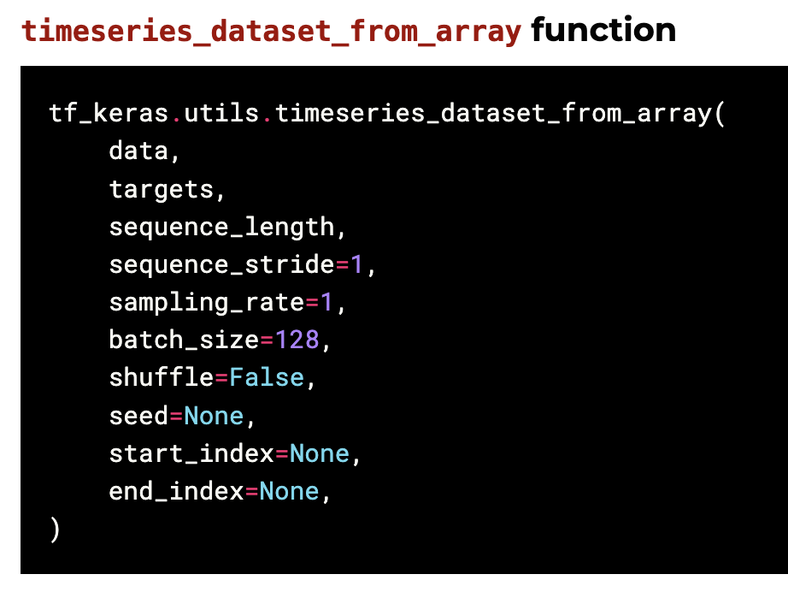
Timeseries Dataset
Timeseries Data Parameters
Sampling Rate
Sample
Target
$$t_{0}$$
$$t_{1}$$
$$t_{2}$$
$$t_{3}$$
$$t_{4}$$
$$t_{5}$$
$$t_{6}$$
$$t_{7}$$
$$t_{8}$$
$$t_{9}$$
$$t_{10}$$
$$t_{11}$$
$$t_{12}$$
$$t_{13}$$
$$t_{14}$$
Sequence Length
Ahead
Ahead – How far into the future the target is wrt sample
Sequence Length – Length of the sample used as predictor
Sampling Rate – Time step between values within the sample
Sequence Stride – Time difference between consecutive samples
Notes:
In this case F = W_2 sigma(W_1 x) where sigma = relu.

Slide 19
Timeseries Dataset
Timeseries Data Parameters
Sampling Rate
Sample
Target
$$t_{0}$$
$$t_{1}$$
$$t_{2}$$
$$t_{3}$$
$$t_{4}$$
$$t_{5}$$
$$t_{6}$$
$$t_{7}$$
$$t_{8}$$
$$t_{9}$$
$$t_{10}$$
$$t_{11}$$
$$t_{12}$$
$$t_{13}$$
$$t_{14}$$
Sequence Length
Ahead
Ahead = 5
Sequence Length = 7
Sampling Rate = 1
Sequence Stride = 1
Notes:
In this case F = W_2 sigma(W_1 x) where sigma = relu.

Slide 20
Timeseries Dataset
Timeseries Data Parameters
Sample 2
$$t_{0}$$
$$t_{1}$$
$$t_{2}$$
$$t_{3}$$
$$t_{4}$$
$$t_{5}$$
$$t_{6}$$
$$t_{7}$$
$$t_{8}$$
$$t_{9}$$
$$t_{10}$$
$$t_{11}$$
$$t_{12}$$
$$t_{13}$$
$$t_{14}$$
Ahead = 5
Sequence Length = 7
Sampling Rate = 1
Sequence Stride = 1
Notes:
In this case F = W_2 sigma(W_1 x) where sigma = relu.

Slide 21
Timeseries Dataset
Timeseries Data Parameters
Sample 3
$$t_{0}$$
$$t_{1}$$
$$t_{2}$$
$$t_{3}$$
$$t_{4}$$
$$t_{5}$$
$$t_{6}$$
$$t_{7}$$
$$t_{8}$$
$$t_{9}$$
$$t_{10}$$
$$t_{11}$$
$$t_{12}$$
$$t_{13}$$
$$t_{14}$$
Ahead = 5
Sequence Length = 7
Sampling Rate = 1
Sequence Stride = 1
Notes:
In this case F = W_2 sigma(W_1 x) where sigma = relu.

Slide 22
Timeseries Dataset
Timeseries Data Parameters
Sample 1
$$t_{0}$$
$$t_{1}$$
$$t_{2}$$
$$t_{3}$$
$$t_{4}$$
$$t_{5}$$
$$t_{6}$$
$$t_{7}$$
$$t_{8}$$
$$t_{9}$$
$$t_{10}$$
$$t_{11}$$
$$t_{12}$$
$$t_{13}$$
$$t_{14}$$
Ahead = 4
Sequence Length = 3
Sampling Rate = 2
Sequence Stride = 2
Notes:
In this case F = W_2 sigma(W_1 x) where sigma = relu.

Slide 23
Timeseries Dataset
Timeseries Data Parameters
Sample 1
$$t_{0}$$
$$t_{1}$$
$$t_{2}$$
$$t_{3}$$
$$t_{4}$$
$$t_{5}$$
$$t_{6}$$
$$t_{7}$$
$$t_{8}$$
$$t_{9}$$
$$t_{10}$$
$$t_{11}$$
$$t_{12}$$
$$t_{13}$$
$$t_{14}$$
Ahead = 4
Sequence Length = 3
Sampling Rate = 2
Sequence Stride = 2
Notes:
In this case F = W_2 sigma(W_1 x) where sigma = relu.

Slide 24
Timeseries Dataset
Timeseries Data Parameters
Sample 2
$$t_{0}$$
$$t_{1}$$
$$t_{2}$$
$$t_{3}$$
$$t_{4}$$
$$t_{5}$$
$$t_{6}$$
$$t_{7}$$
$$t_{8}$$
$$t_{9}$$
$$t_{10}$$
$$t_{11}$$
$$t_{12}$$
$$t_{13}$$
$$t_{14}$$
Ahead = 4
Sequence Length = 3
Sampling Rate = 2
Sequence Stride = 2
Notes:
In this case F = W_2 sigma(W_1 x) where sigma = relu.

Slide 25







Timeseries Dataset
Timeseries Data Parameters
Sampling Rate
Ahead = 4
Sequence Length = 3
Sampling Rate = 2
Sequence Stride = 2
$$t_{0}$$
$$t_{1}$$
$$t_{2}$$
$$t_{3}$$
$$t_{4}$$
$$t_{5}$$
$$t_{6}$$
$$t_{7}$$
$$t_{8}$$
$$t_{9}$$
$$t_{10}$$
$$t_{11}$$
$$t_{12}$$
$$t_{13}$$
$$t_{14}$$
Sampling Rate $×$ Sequence Length
Sampling Rate $×$ Ahead
Target’s first index = Sampling Rate $×$ (Sequence Length + Ahead – 1)
$$t_{0}$$
$$t_{1}$$
$$t_{2}$$
$$t_{3}$$
$$t_{4}$$
$$t_{5}$$
$$t_{6}$$
$$t_{7}$$
$$t_{8}$$
$$t_{9}$$
$$t_{10}$$
$$t_{11}$$
$$t_{12}$$
$$t_{13}$$
$$t_{14}$$
Sampling Rate $×$ Ahead
Last index of sample = Sampling Rate $×$ Ahead + 1
(negative index)
(negative index)
Upper bound index of sample = Sampling Rate $×$ Ahead

