Slide 1
Recurrent Neural Networks
COSCI 223 – Machine Learning 3 🧠
Sebastian C. Ibañez
sibanez@aim.edu
Asian Institute of Management

Slide 2
Outline
Sequence-to-Sequence
Attention

Slide 3
Sequence-to-Sequence
Sutskever et al. (2014). Sequence-to-Sequence Learning with Neural Networks.
Cho et al. (2014). Learning Phrase Representations using RNN Encoder-Decoder for Statistical Machine Translation.

Slide 4
Types of RNNs Based on Application
One-to-one ($T_{x}=T_{y}=1$)
Ex. Traditional neural network
One-to-many ($T_{x}=1,T_{y}>1$)
Ex. Music generation
$$y^{\left(1\right)}$$
$$y^{\left(1\right)}$$
$$y^{\left(2\right)}$$
$$y^{\left(T_{y}\right)}$$
$$h^{\left(0\right)}$$
$$h^{\left(0\right)}$$
$$…$$
$$x^{\left(1\right)}$$
$$x^{\left(1\right)}$$

Slide 5
Types of RNNs Based on Application
Many-to-one ($T_{x}>1,T_{y}=1$)
Ex. Sentiment analysis
Many-to-many ($T_{x}=T_{y}$)
Ex. Name entity recognition
$$y^{\left(1\right)}$$
$$y^{\left(1\right)}$$
$$y^{\left(2\right)}$$
$$y^{\left(T\right)}$$
$$h^{\left(0\right)}$$
$$…$$
$$h^{\left(0\right)}$$
$$…$$
$$x^{\left(1\right)}$$
$$x^{\left(2\right)}$$
$$x^{\left(T_{x}\right)}$$
$$x^{\left(1\right)}$$
$$x^{\left(2\right)}$$
$$x^{\left(T\right)}$$

Slide 6










Sequence-to-Sequence
Many-to-many* ($T_{x}≠T_{y}$)
Ex. Machine translation
$$y^{\left(1\right)}$$
$$y^{\left(2\right)}$$
$$y^{\left(T_{y}\right)}$$
$$h^{\left(0\right)}$$
$$…$$
$$…$$
$$x^{\left(1\right)}$$
$$x^{\left(2\right)}$$
$$x^{\left(T_{x}\right)}$$

Slide 7
Sequence-to-Sequence
Seq2Seq models can handle variable-length input and output sequences
Encoder maps the input sequence into a context vector that is then passed to the decoder as its initial hidden state

Slide 8
Sequence-to-Sequence
For time series data, seq2seq allows us to explicitly distinguish between historical information and known future information.

Slide 9












Seq2Seq with Autoregressive Decoder
$$y^{\left(1\right)}$$
$$y^{\left(2\right)}$$
$$y^{\left(3\right)}$$
$$y^{\left(h\right)}$$
$$h^{\left(0\right)}$$
$$…$$
$$…$$
$$x^{\left(1\right)}$$
$$x^{\left(2\right)}$$
$$x^{\left(w\right)}$$
- Input data of length $w$
- RNN Encoder
- RNN Decoder
- NN or activation, Output data of length $h$

Slide 10
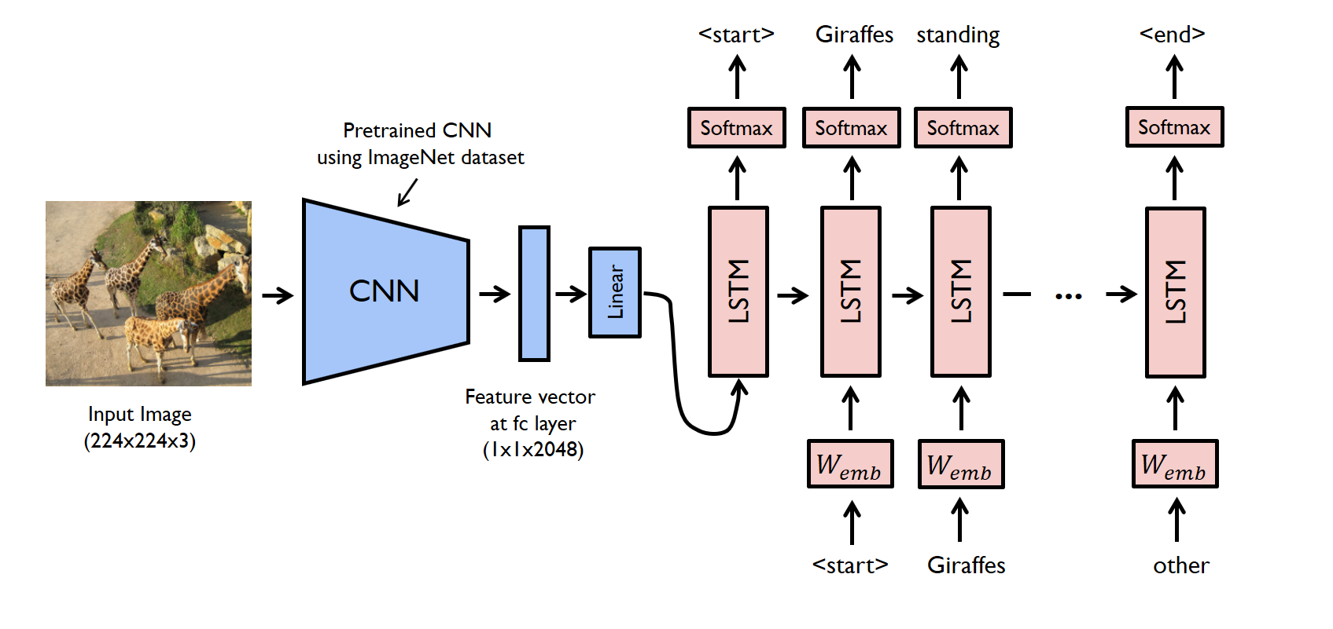
Image-to-Sequence

Slide 11
Limitations of Seq2Seq
RNN decoder only has access to the final state of the RNN encoder
E.g., human translator must “memorize” entire sentence before translating
Even with gating mechanisms, it is still difficult for RNNs to capture very long dependencies (100+ tokens)
E.g., suppose we let an RNN read a novel and answer questions about it

Slide 12
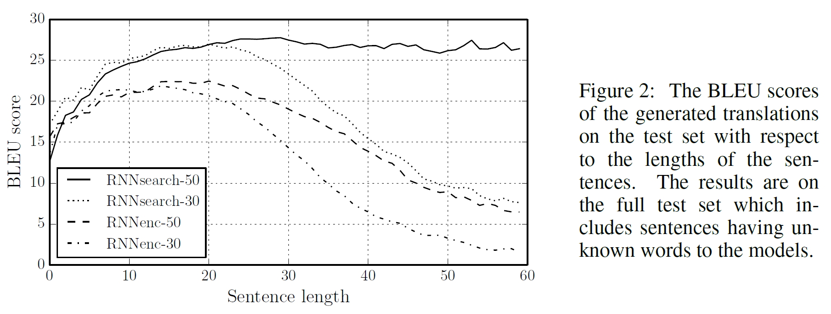
Limitations of Seq2Seq
Notes:
BLEU score measures the quality of translated text.

Slide 13
Attention
Bahdanau et al. (2014). Neural Machine Translation by Jointly Learning to Align and Translate.
Luong et al. (2015). Effective Approaches to Attention-based Neural Machine Translation.

Slide 14
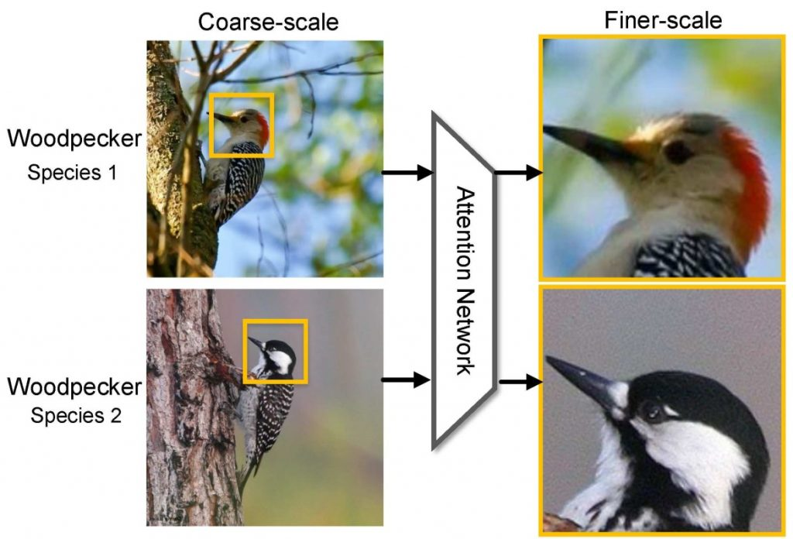
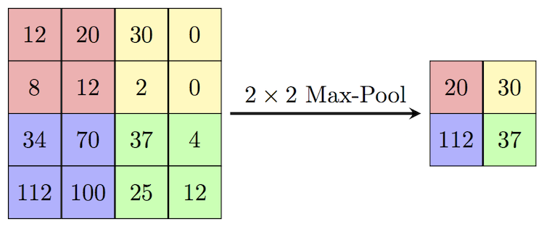
Attention
Notes:
Attention is about focus. Where in the data is the model paying attention to?

Slide 15
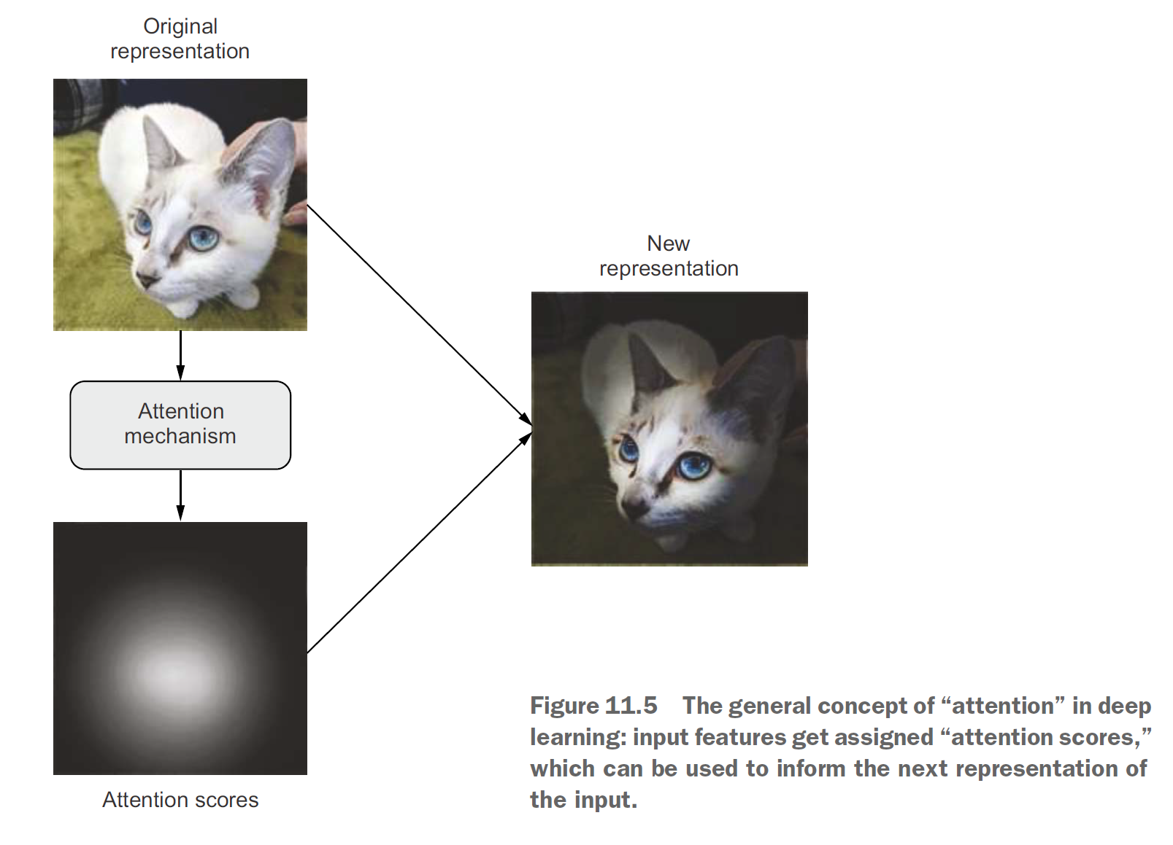
Attention

Slide 16



















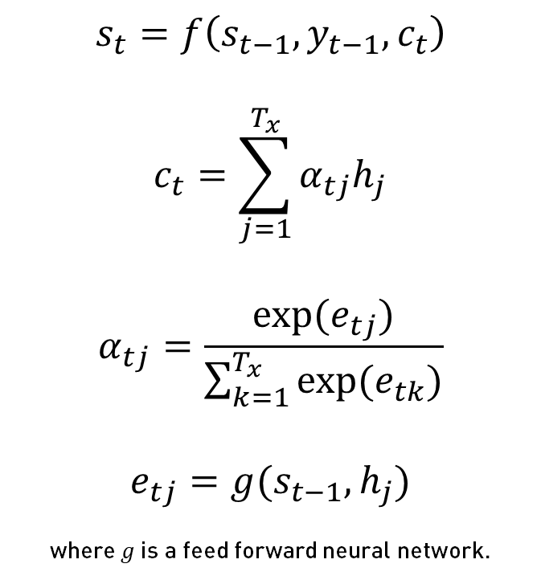
Seq2Seq with Attention
$$y^{\left(t−1\right)}$$
$$y^{\left(t\right)}$$
$$s_{t}=f\left(s_{t−1},y_{t−1},c_{t}\right)$$
$$c_{t}=\sum_{j=1}^{T_{x}}{α_{tj}h_{j}}$$
$$α_{tj}=\frac{\exp{(e_{tj})}}{\sum_{k=1}^{T_{x}}{\exp{(e_{tk})}}}$$
$$e_{tj}=g(s_{t−1},h_{j})$$
where $g$ is a feed forward neural network.
$$…$$
$$s^{\left(t−1\right)}$$
$$s^{\left(t\right)}$$
$$…$$
$$c^{\left(t\right)}$$
$$α_{1}^{(t)}$$
$$α_{T_{x}}^{(t)}$$
$$α_{2}^{(t)}$$
$$α_{… }^{(t)}$$
$$h^{\left(0\right)}$$
$$h^{\left(1\right)}$$
$$h^{\left(2\right)}$$
$$…$$
$$h^{\left(T_{x}\right)}$$
$$x^{\left(1\right)}$$
$$x^{\left(2\right)}$$
$$x^{\left(T_{x}\right)}$$
Notes:
In this attention model, the decoder hidden state $s_{t}$ is also a function of a context vector $c_{t}$ (yes, this term is overloaded).
The context vector $c_{t}$ is a ‘weighted sum’ of all the encoder’s hidden states $h_{j}$ (called annotations).
The weights are context dependent, it’s a function of the current decoder hidden state $s_{t}$ and the annotations $h_{j}$.

Slide 17
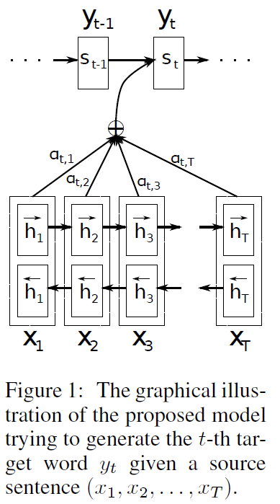
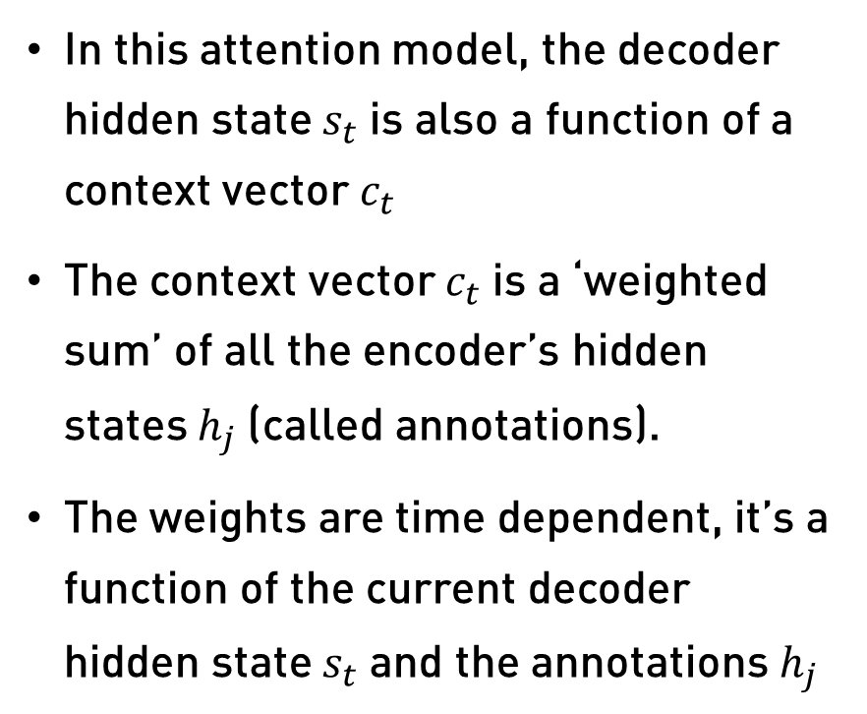
Seq2Seq with Attention
In this attention model, the decoder hidden state $s_{t}$is also a function of a context vector $c_{t}$
The context vector $c_{t}$is a ‘weighted sum’ of all the encoder’s hidden states $h_{j}$ (called annotations).
The weights are time dependent, it’s a function of the current decoder hidden state $s_{t}$and the annotations $h_{j}$
Notes:
In the Bahdanau paper, they use a bidirectional RNN encoder.

