Slide 1
Review Session
COSCI 223 – Machine Learning 3 🧠
Sebastian C. Ibañez
sibanez@aim.edu
Asian Institute of Management

Slide 2
Outline
Convolution Layers
Pooling Layers
Batch Normalization and Dropout
Autoencoders

Slide 3
Convolution Layers

Slide 4
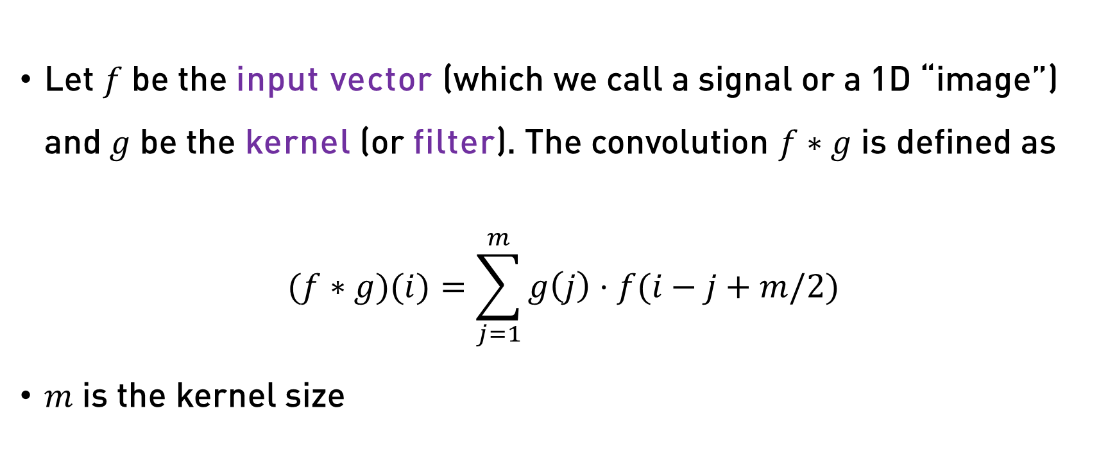
1D Convolution
Let $f$ be the input vector (which we call a signal or a 1D “image”) and $g$ be the kernel (or filter). The convolution $f∗g$ is defined as
$$(f∗g)(i)=\sum_{j=1}^{m}{g\left(j\right)⋅f(i−j+m/2)}$$
$m$ is the kernel size

Slide 5
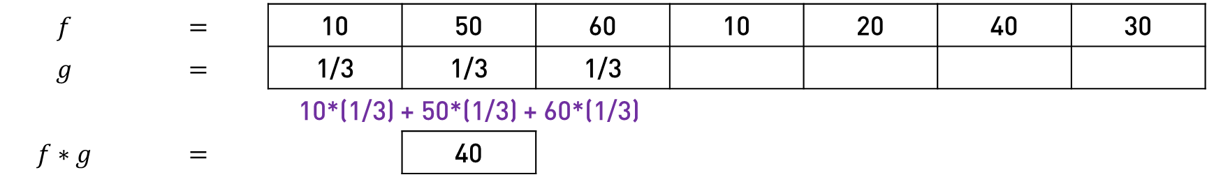
1D Convolution – Example
$$f$$ | $$=$$ | 10 | 50 | 60 | 10 | 20 | 40 | 30
$$g$$ | $$=$$ | 1/3 | 1/3 | 1/3
 |  | 10*(1/3) + 50*(1/3) + 60*(1/3)
$$f∗g$$ | $$=$$ |  | 40

Slide 6
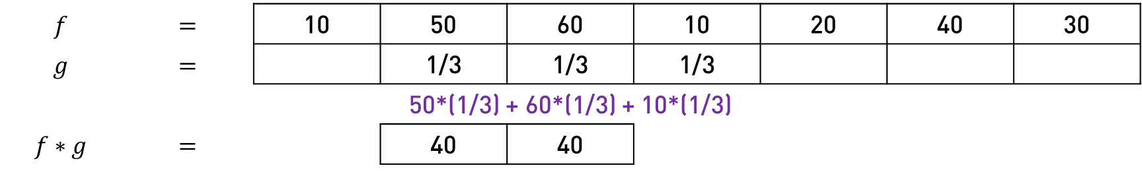
1D Convolution – Example
$$f$$ | $$=$$ | 10 | 50 | 60 | 10 | 20 | 40 | 30
$$g$$ | $$=$$ |  | 1/3 | 1/3 | 1/3
 |  |  | 50*(1/3) + 60*(1/3) + 10*(1/3)
$$f∗g$$ | $$=$$ |  | 40 | 40

Slide 7
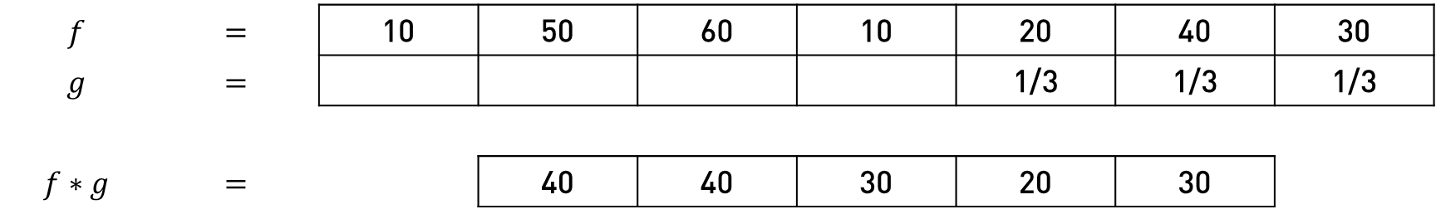
1D Convolution – Example
$$f$$ | $$=$$ | 10 | 50 | 60 | 10 | 20 | 40 | 30
$$g$$ | $$=$$ |  |  |  |  | 1/3 | 1/3 | 1/3
$$f∗g$$ | $$=$$ |  | 40 | 40 | 30 | 20 | 30
In this example, the 1D convolution was performed with a kernel size of 3, stride of 1, without padding, and dilation of 1.

Slide 8
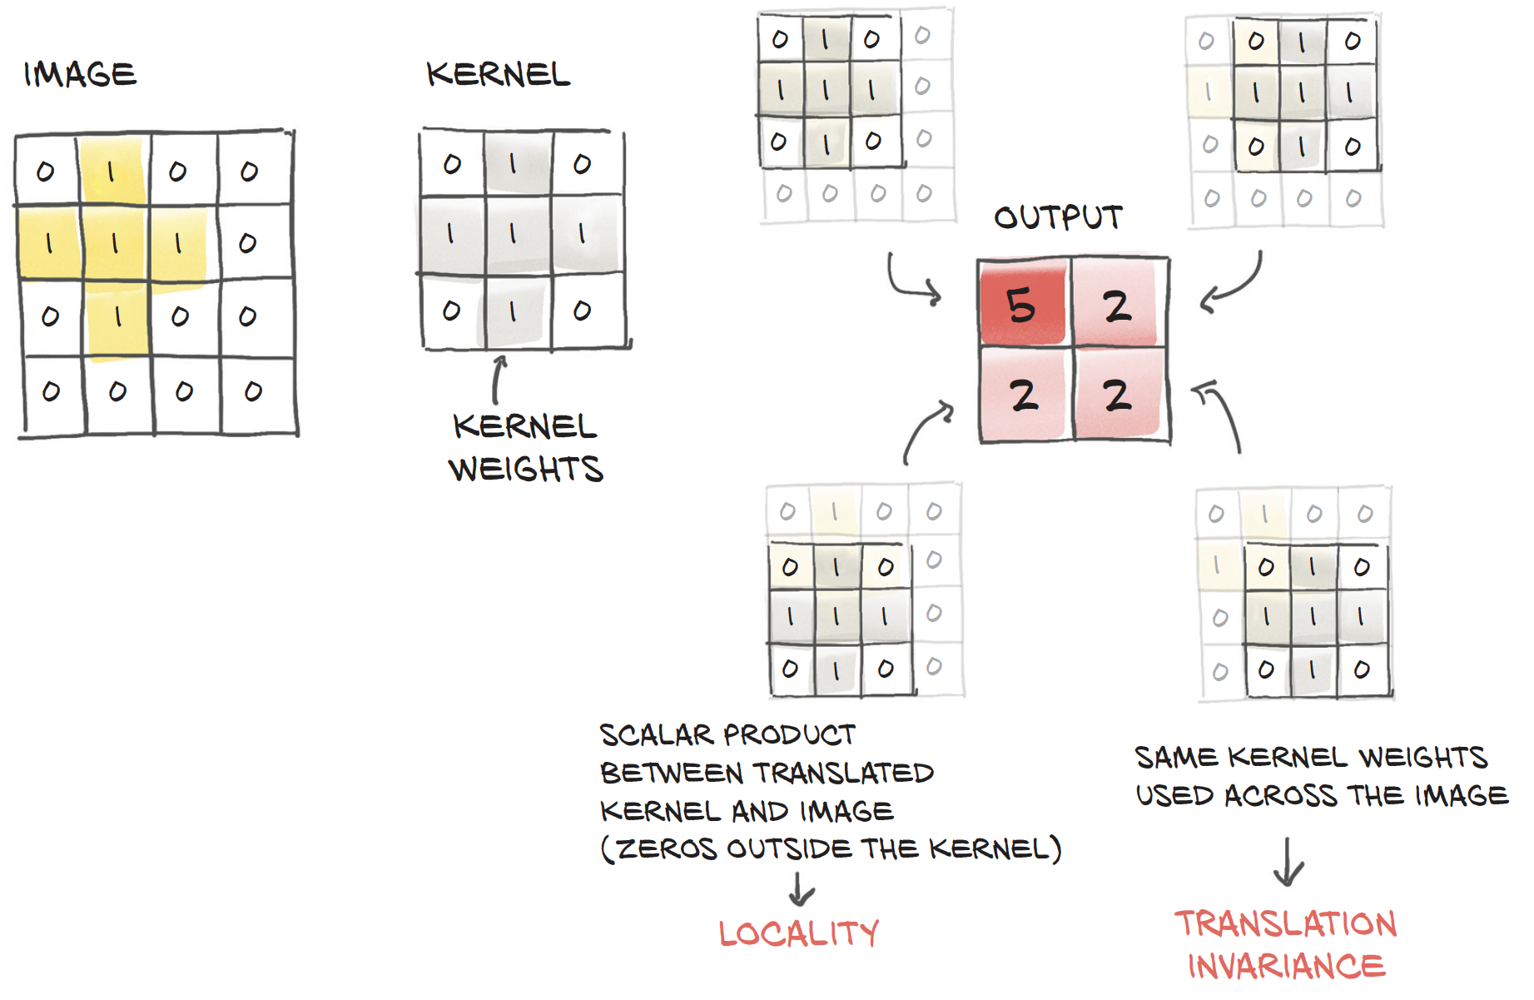
2D Convolution

Slide 9
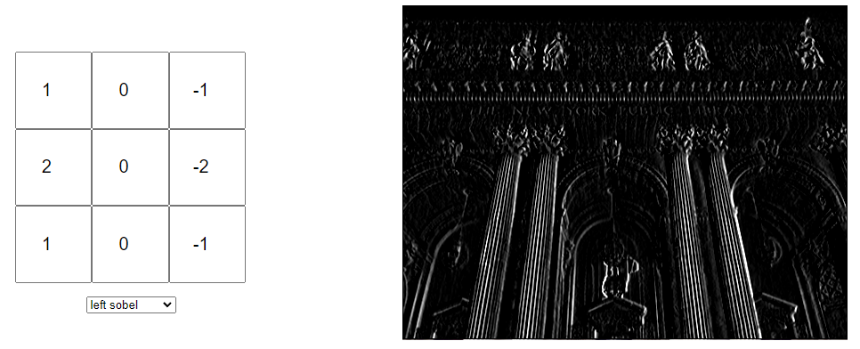
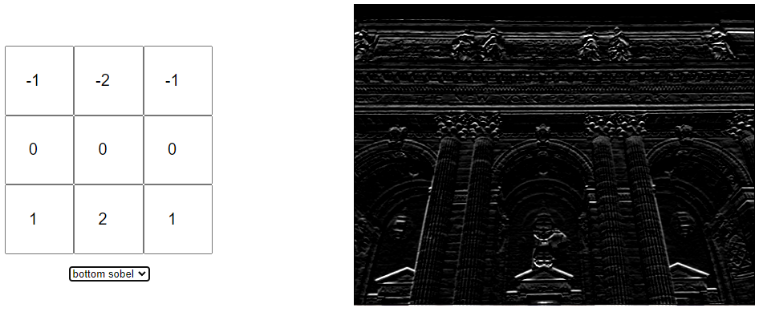
Kernels as Edge Detectors
Kernels allow us to extract meaningful features from raw pixel values.

Slide 10
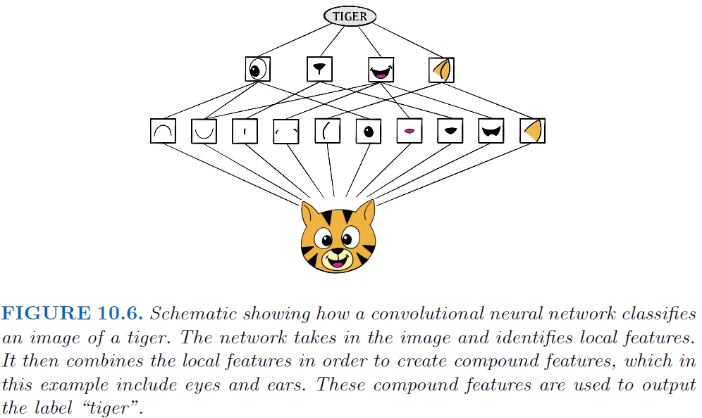
What do CNNs learn?

Slide 11
Why CNNs?
Parameter Sharing.
Learned kernels (which are “feature detectors”) that are useful in one part of the image is probably useful in other parts of the image
Sparse Connectivity.
More efficient.
In each layer, outputs are only dependent on local information

Slide 12
Pooling Layers

Slide 13
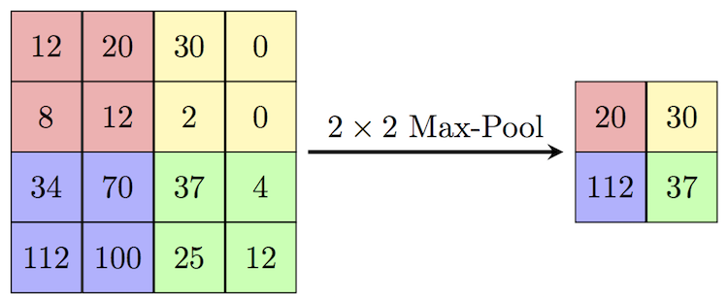
Max Pooling

Slide 14
Why Max Pooling?
Speed.
Reduce size of representation to speed up computation
No learnable parameters
Robustness.
Model can focus on the strongest feature or where most of the information is (i.e., attention)
Model can ignore “noise” that surrounds strong signals

Slide 15
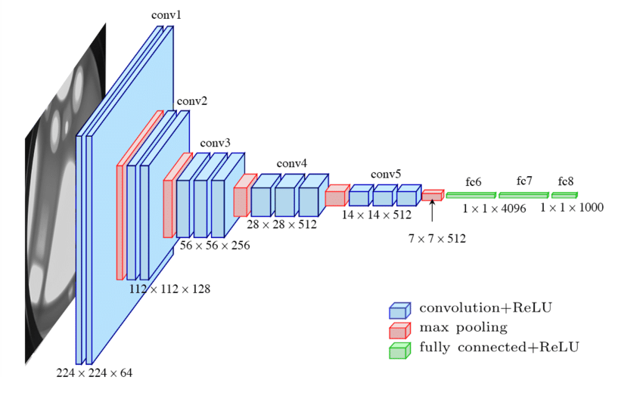
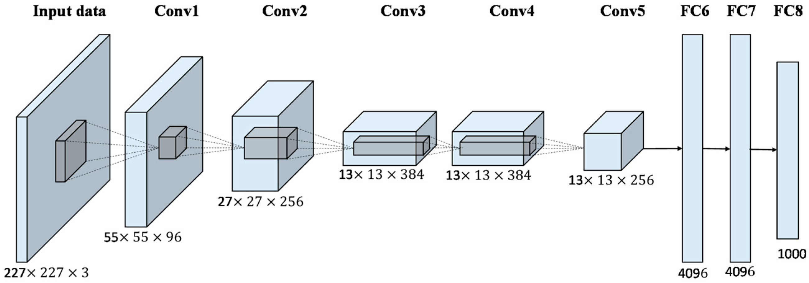
Classic CNN Architectures

Slide 16
Batch Normalization and Dropout

Slide 17
Batch Normalization
Batch normalization is a regularization method used to make the training of neural networks faster and more stable.
A batch normalization layer applies learnable scaling to the input.

Slide 18
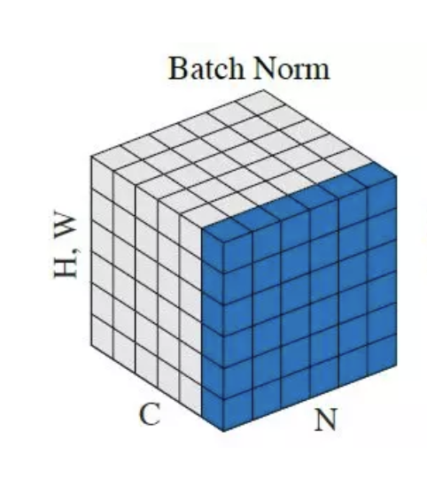

Batch Normalization
For a minibatch $B$:
$$μ_{B}=\frac{1}{m}\sum_{i=1}^{m}{x_{i}} \\ σ_{B}^{2}=\frac{1}{m}\sum_{i=1}^{m}{{\left(x_{i}−μ_{B}\right)}^{2} } \\ {\hat{x}}_{i}=\frac{x_{i}−μ_{B}}{\sqrt{σ_{B}^{2}+ε}} \\ y_{i}=γ{\hat{x}}_{i}+β$$
Where $γ,β$ are learnable parameters.

Slide 19
Dropout
Dropout is a regularization technique that drops a unit at training time with a specified probability.
The idea is to prevent “co-adaptation”, where a neural network becomes too reliant on certain connections (a symptom of overfitting).

Slide 20
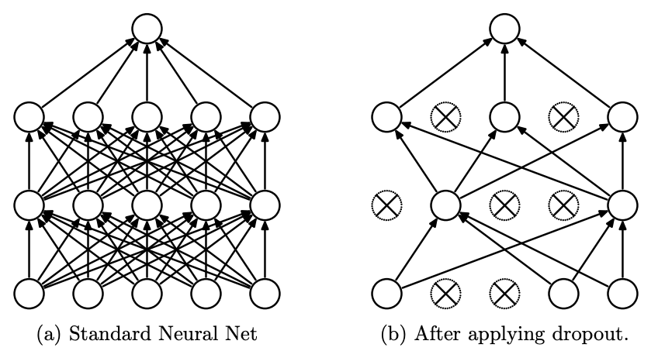
Dropout

Slide 21
Autoencoders

Slide 22
Autoencoder
Autoencoders are a type of bottleneck architecture that is trained to reconstruct its input.
The idea is to find a smaller, more compressed representation of your input.

Slide 23
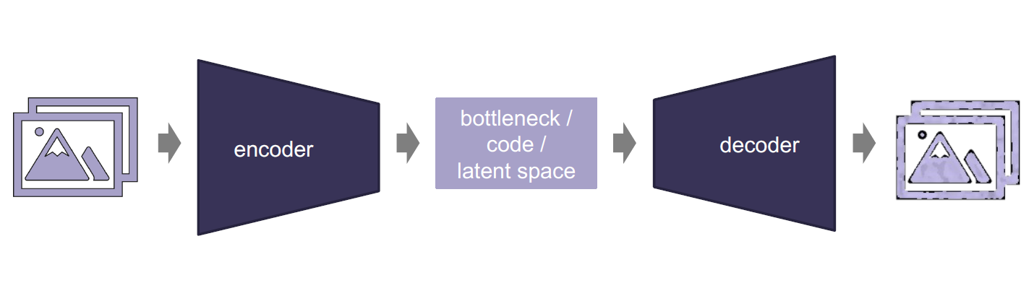
Autoencoder

