Slide 1
Recurrent Neural Networks
COSCI 223 – Machine Learning 3 🧠
Sebastian C. Ibañez
sibanez@aim.edu
Asian Institute of Management

Slide 2
Outline
Vanishing and Exploding Gradients
Gated Recurrent Unit
Long Short-Term Memory
Bidirectional RNNs and Deep RNNs

Slide 3
Vanishing and Exploding Gradients

Slide 4









Vanishing and Exploding Gradients
Because backpropagation requires the multiplication of many small or big numbers, very deep networks can suffer from vanishing or exploding gradients.
$$y^{\left(1\right)}$$
$$y^{\left(2\right)}$$
$$y^{\left(t\right)}$$
$$h^{\left(0\right)}$$
$$…$$
$$…$$
$$x^{\left(1\right)}$$
$$x^{\left(2\right)}$$
$$x^{\left(t\right)}$$
Notes:
Difficult for computations in later time steps to influence those that come much earlier.
The cat/cats, which already ate …, was/were full.

Slide 5
Vanishing and Exploding Gradients
To fix exploding gradients, we can apply gradient clipping, i.e. if the gradients exceed some threshold, then cap it.
Vanishing gradients are more challenging to deal with.
Solving the vanishing gradient problem essentially allows a model to better capture long-range dependencies.

Slide 6
Gated Recurrent Unit
Cho et al. (2014). Learning Phrase Representations using RNN Encoder-Decoder for Statistical Machine Translation.
Chung et al. (2014). Empirical Evaluation of Gated Recurrent Neural Networks on Sequence Modeling.

Slide 7

Recurrent Neural Network (Simple)
$$h_{t}=a(W_{xh}x_{t}+W_{hh}h_{t−1}+b_{h})$$
$$=a(W_{h}[h_{t−1},x_{t}]+b_{h})$$
Notes:
$h^{(t)}$ “summarizes” all the information prior to $t$

Slide 8
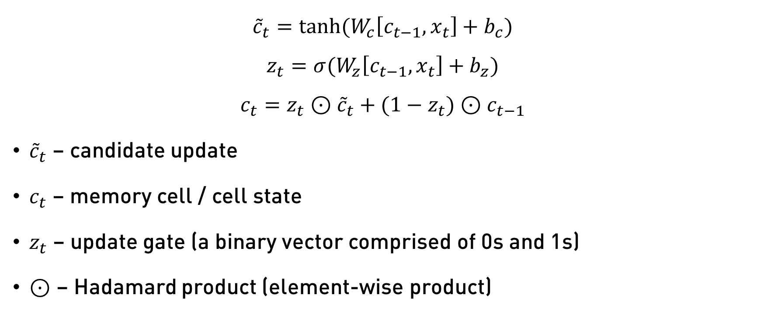
Gated Recurrent Unit (Simplified)
$${\tilde{c}}_{t}=tanh⁡(W_{c}\left[c_{t−1},x_{t}\right]+b_{c})$$
$$z_{t}=σ⁡(W_{z}\left[c_{t−1},x_{t}\right]+b_{z})$$
$$c_{t}=z_{t}⊙{\tilde{c}}_{t}+(1−z_{t})⊙c_{t−1}$$
${\tilde{c}}_{t}$ – candidate update
$c_{t}$ – memory cell / cell state
$z_{t}$ – update gate (a binary vector comprised of 0s and 1s)
$⊙$ – Hadamard product (element-wise product)
Notes:
- $c^{(t)}$and $z^{(t)}$are vectors. So the elements of $z^{(t)}$ is like a vector of bits (0 or 1) that tell you which of the states in $c^{(t)}$ to update. Keep some bits constant, update some bits.

Slide 9
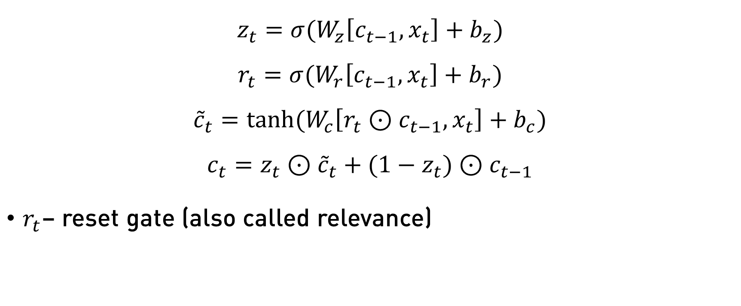
Gated Recurrent Unit (GRU)
$$z_{t}=σ⁡(W_{z}\left[c_{t−1},x_{t}\right]+b_{z})$$
$$r_{t}=σ⁡(W_{r}\left[c_{t−1},x_{t}\right]+b_{r})$$
$${\tilde{c}}_{t}=tanh⁡(W_{c}\left[r_{t}⊙c_{t−1},x_{t}\right]+b_{c})$$
$$c_{t}=z_{t}⊙{\tilde{c}}_{t}+(1−z_{t})⊙c_{t−1}$$
$r_{t}$– reset gate (also called relevance)
Notes:
Reset gate – may drop immediate information in order to recall something from the past (e.g. the cat/cats, which already ate …, was/were full.

Slide 10
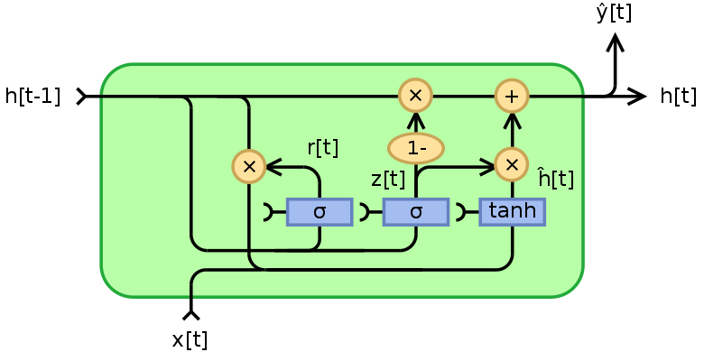
Gated Recurrent Unit (GRU)

Slide 11
Long Short-Term Memory
Hochreiter and Schmidhuber. (1997). Long Short-Term Memory.

Slide 12
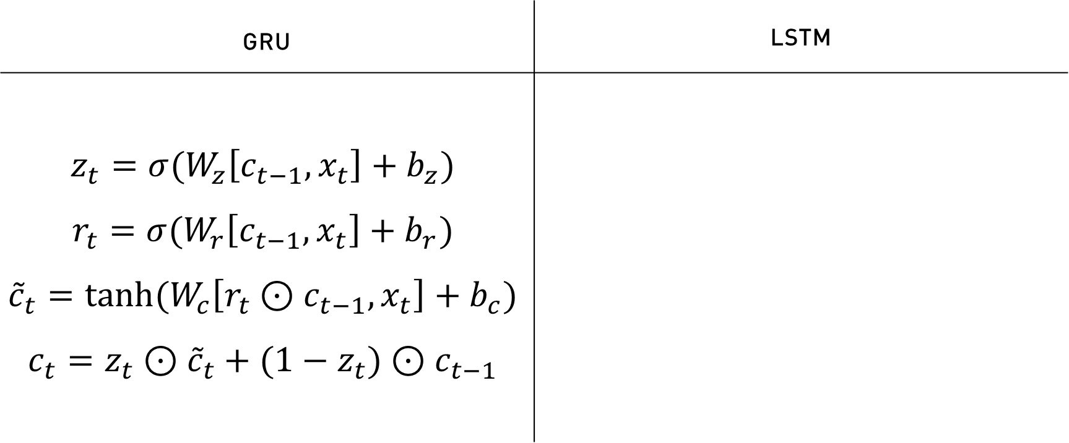

Long Short-Term Memory (LSTM)
GRU | LSTM
$$z_{t}=σ⁡(W_{z}\left[c_{t−1},x_{t}\right]+b_{z})$$ $$r_{t}=σ⁡(W_{r}\left[c_{t−1},x_{t}\right]+b_{r})$$ $${\tilde{c}}_{t}=tanh⁡(W_{c}\left[r_{t}⊙c_{t−1},x_{t}\right]+b_{c})$$ $$c_{t}=z_{t}⊙{\tilde{c}}_{t}+(1−z_{t})⊙c_{t−1}$$
$$i_{t}=σ⁡(W_{i}\left[h_{t−1},x_{t}\right]+b_{i})$$
$$f_{t}=σ⁡(W_{f}\left[h_{t−1},x_{t}\right]+b_{f})$$
$$o_{t}=σ⁡(W_{o}\left[h_{t−1},x_{t}\right]+b_{o})$$
$${\tilde{c}}_{t}=tanh⁡(W_{c}\left[h_{t−1},x_{t}\right]+b_{c})$$
$$c_{t}=i_{t}⊙{\tilde{c}}_{t}+f_{t}⊙c_{t−1}$$
$$h_{t}=o_{t}⊙c_{t}$$

Slide 13
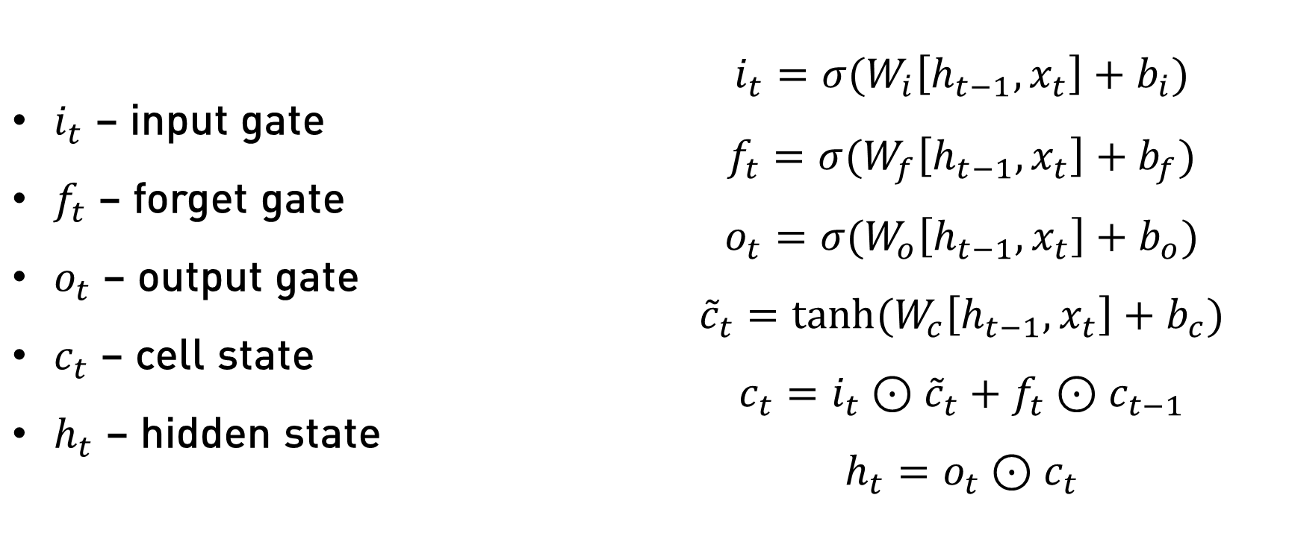
Long Short-Term Memory (LSTM)
$i_{t}$ – input gate $f_{t}$ – forget gate $o_{t}$ – output gate $c_{t}$ – cell state $h_{t}$ – hidden state | $$i_{t}=σ⁡(W_{i}\left[h_{t−1},x_{t}\right]+b_{i})$$ $$f_{t}=σ⁡(W_{f}\left[h_{t−1},x_{t}\right]+b_{f})$$ $$o_{t}=σ⁡(W_{o}\left[h_{t−1},x_{t}\right]+b_{o})$$ $${\tilde{c}}_{t}=tanh⁡(W_{c}\left[h_{t−1},x_{t}\right]+b_{c})$$ $$c_{t}=i_{t}⊙{\tilde{c}}_{t}+f_{t}⊙c_{t−1}$$ $$h_{t}=o_{t}⊙c_{t}$$

Slide 14
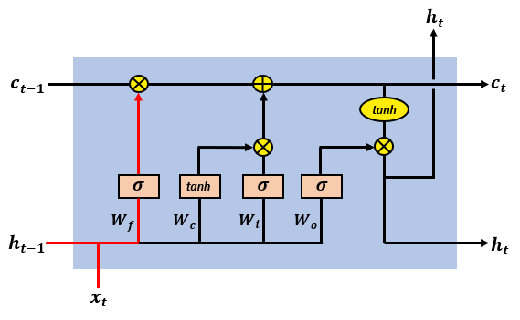
Long Short-Term Memory

Slide 15
LSTM vs GRU
Neither is necessarily better than the other
GRUs are simpler
Slightly faster to train
Scales better to bigger networks
LSTMs are more powerful, flexible
More popular choice

Slide 16
Bidirectional RNNs and Deep RNNs

Slide 17
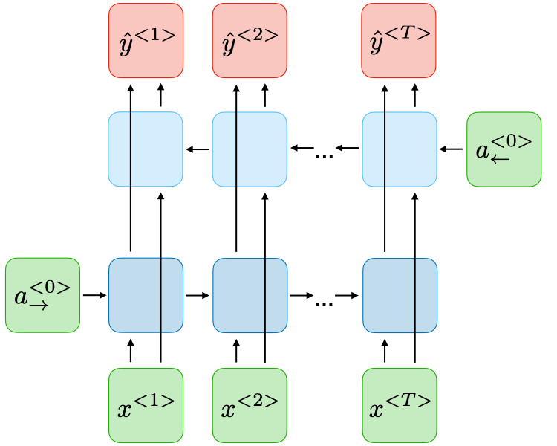
Bidirectional RNN

Slide 18
Example: Name Entity Recognition
I | like | teddy | bears
I | like | Teddy | Roosevelt

Slide 19
Example: Machine Translation
ang | batang | lalaki | ay | malusog
the | boy | is | healthy

Slide 20
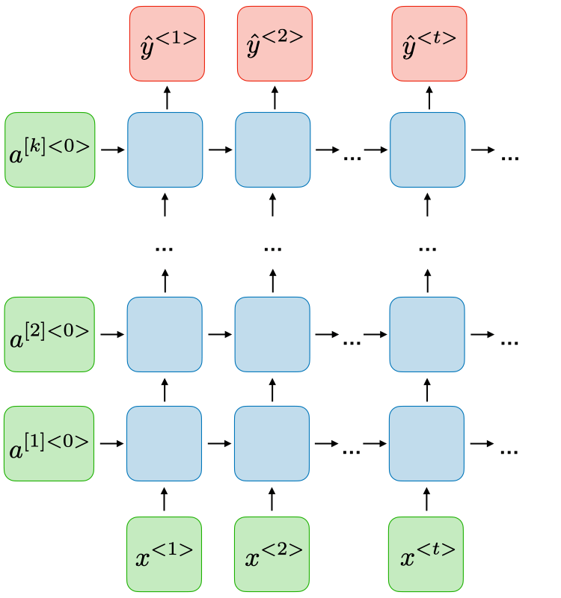
Deep RNN / Stacked RNN

