Slide 1
Transformers
COSCI 223 – Machine Learning 3 🧠
Sebastian C. Ibañez
sibanez@aim.edu
Asian Institute of Management

Slide 2
Outline
Robust Speech Recognition via Large-Scale Weak Supervision

Slide 3
Robust Speech Recognition via Large-Scale Weak Supervision
Radford, Kim, Xu, Brockman, McLeavy, and Sutskever (2022).
Open AI
Notes:
https://openai.com/research/whisper

Slide 4
Automatic Speech Recognition
Automatic speech recognition (ASR) is a machine learning application focused on the transcription of the spoken language into text.

Slide 5
Speech
Speech data (and audio signals in general) can be represented by a 1-D array of real numbers.
The value of the array at any time step is called the signal’s amplitude.

Slide 6
Speech
Since audio signals are continuous, we must sample values from the signal to represent them as finite arrays in computer memory.
The interval at which we sample is called the sampling rate and is measured in samples/sec or Hertz (Hz).

Slide 7
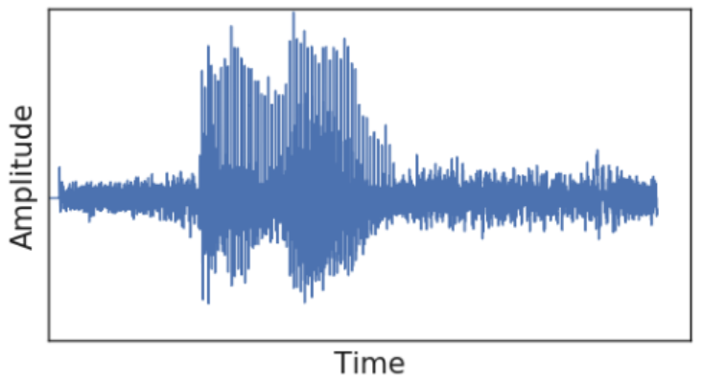
Speech

Slide 8
Sampling Rate vs Frequency
The sampling rate is the number of times per second that the audio signal is sampled.
The frequency is the number of times per second that the sound waves oscillate.
The sampling rate must be at least twice the frequency of the highest frequency component in the audio signal in order to avoid aliasing.

Slide 9
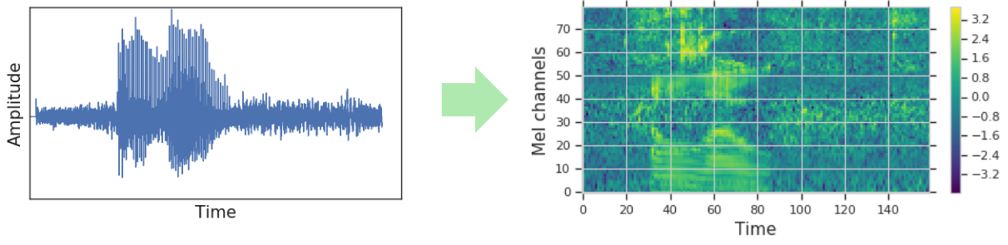
Log Mel Spectrogram
The audio waveform is typically encoded as a visual representation, such as a spectrogram, before training.

Slide 10
Log Mel Spectrogram
Spectogram representations are made by converting the signal into the frequency domain using a Fourier transform.
The mel scale is a nonlinear transformation of the frequency axis that is designed to better match the way that humans perceive pitch.
Notes:
The Fourier transform decomposes the signal into its constituent frequencies, and it can be thought of as a way of representing the sound as a collection of sine waves.

Slide 11
Whisper
“Whisper is an automatic speech recognition (ASR) system trained on 680,000 hours of multilingual and multitask supervised data collected from the web.”

Slide 12
Whisper
“We show that the use of such a large and diverse dataset leads to improved robustness to accents, background noise and technical language. Moreover, it enables transcription in multiple languages, as well as translation from those languages into English.”

Slide 13
Whisper
“We are open-sourcing models and inference code to serve as a foundation for building useful applications and for further research on robust speech processing.”

Slide 14
Whisper
“We are open-sourcing models and inference code to serve as a foundation for building useful applications and for further research on robust speech processing.”

Slide 15
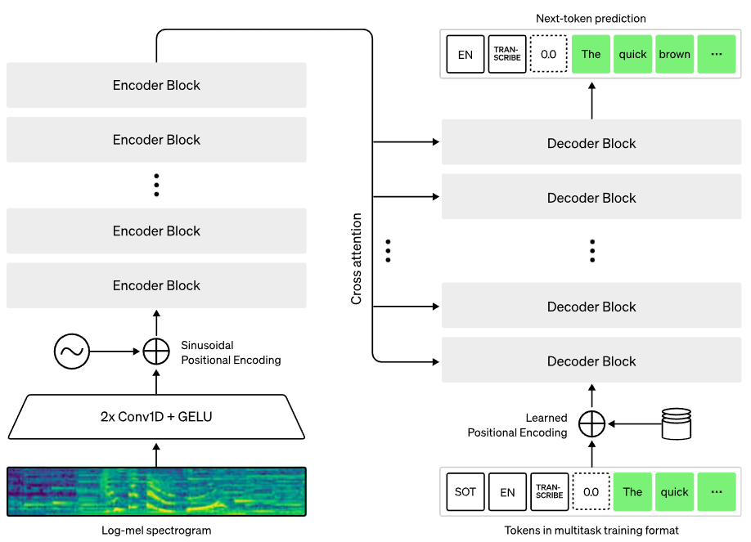
Whisper: Encoder-Decoder Transformer 🤖
30-second chunk
Text caption with special tokens
Notes:
Special tokens are used to direct the single model to perform tasks such as language identification, phrase-level timestamps, multilingual speech transcription, and to-English speech translation.

Slide 16
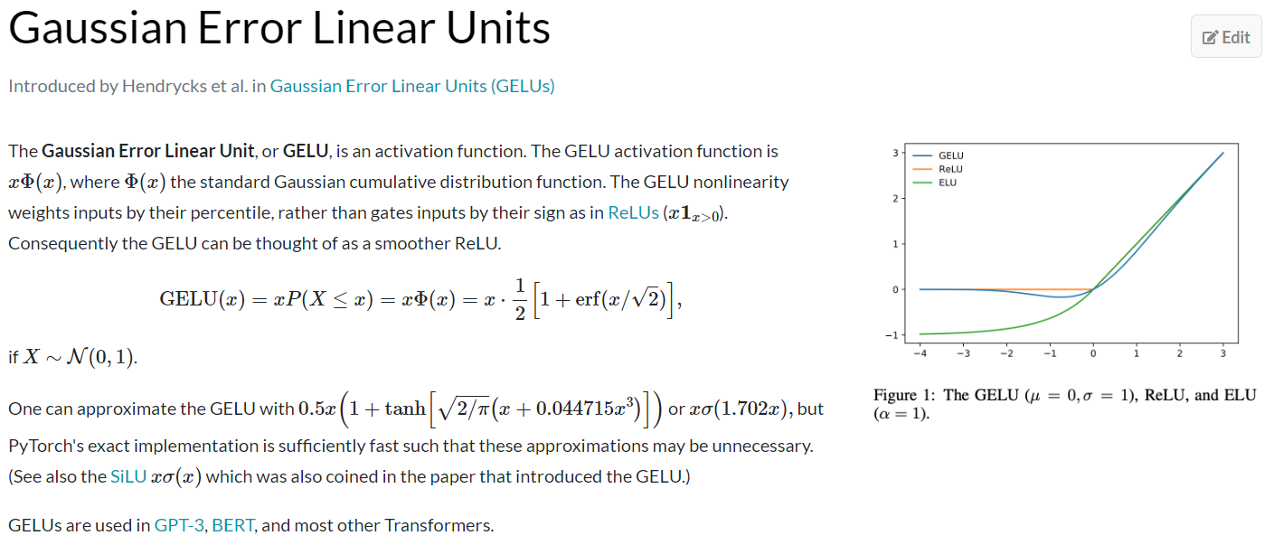
GELU Activation

Slide 17
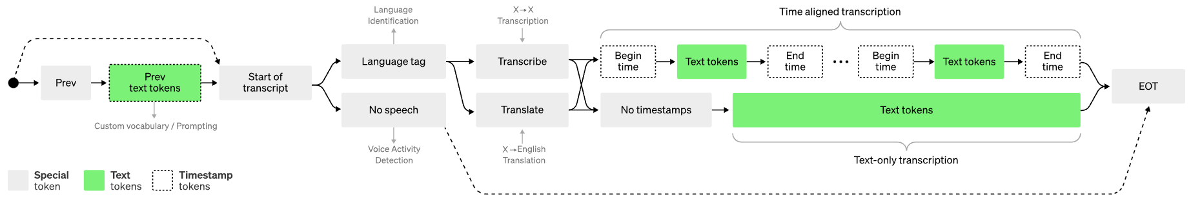
Whisper: Training Format
Notes:
Special tokens are used to direct the single model to perform tasks such as language identification, phrase-level timestamps, multilingual speech transcription, and to-English speech translation.

Slide 18
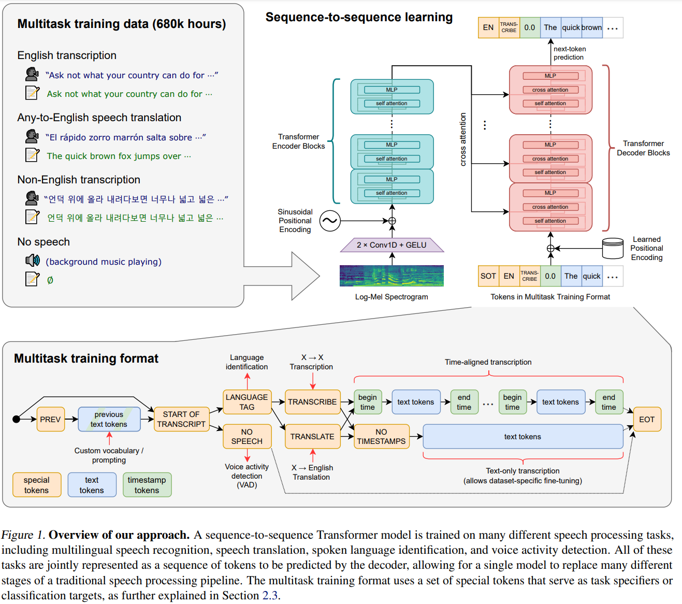

Slide 19
Whisper
“Other existing approaches frequently use smaller, more closely paired audio-text training datasets, or use broad but unsupervised audio pretraining. Because Whisper was trained on a large and diverse dataset and was not fine-tuned to any specific one, it does not beat models that specialize in LibriSpeech performance, a famously competitive benchmark in speech recognition.”

Slide 20
Whisper
“However, when we measure Whisper’s zero-shot performance across many diverse datasets we find it is much more robust and makes 50% fewer errors than those models.”

Slide 21
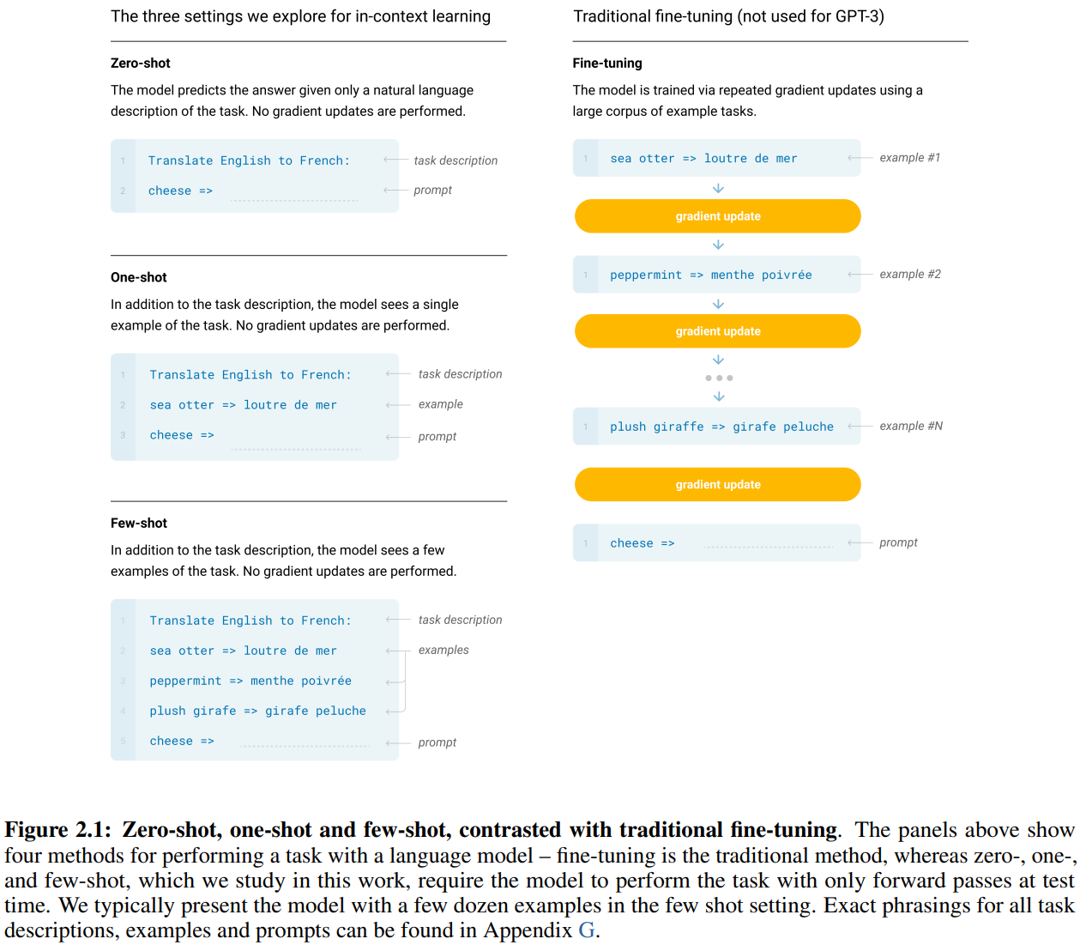

Slide 22
Whisper
“About a third of Whisper’s audio dataset is non-English, and it is alternately given the task of transcribing in the original language or translating to English. We find this approach is particularly effective at learning speech to text translation and outperforms the supervised SOTA on CoVoST2 to English translation zero-shot.”

