Slide 1
Transformers
COSCI 223 – Machine Learning 3 🧠
Sebastian C. Ibañez
sibanez@aim.edu
Asian Institute of Management

Slide 2
Outline
Self-Attention
Multi-Head Attention
Transformers

Slide 3
Self-Attention

Slide 4
Attention
Not all input information is equally important to the task at hand.
Models should “pay more attention” to some features and less to others.

Slide 5



















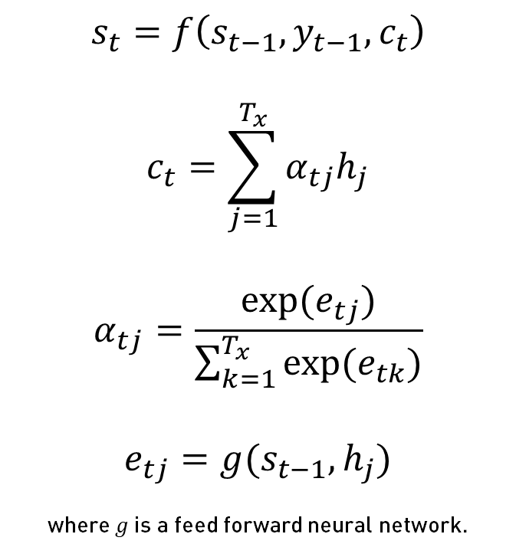
Seq2Seq with Attention
a
student
$$y_{t−1}$$
$$y_{t}$$
$$s_{t}=f\left(s_{t−1},y_{t−1},c_{t}\right)$$
$$c_{t}=\sum_{j=1}^{T_{x}}{α_{tj}h_{j}}$$
$$α_{tj}=\frac{\exp{(e_{tj})}}{\sum_{k=1}^{T_{x}}{\exp{(e_{tk})}}}$$
$$e_{tj}=g(s_{t−1},h_{j})$$
where $g$ is a feed forward neural network.
$$…$$
$$s_{t−1}$$
$$s_{t}$$
$$…$$
$$c_{t}$$
$$α_{t1}$$
$$α_{tT_{x}}$$
$$α_{t2}$$
$$α_{t…}$$
$$h_{0}$$
$$h_{1}$$
$$h_{2}$$
$$…$$
$$h_{T_{x}}$$
$$x_{1}$$
$$x_{2}$$
$$x_{T_{x}}$$
je
suis
étudiant

Slide 6
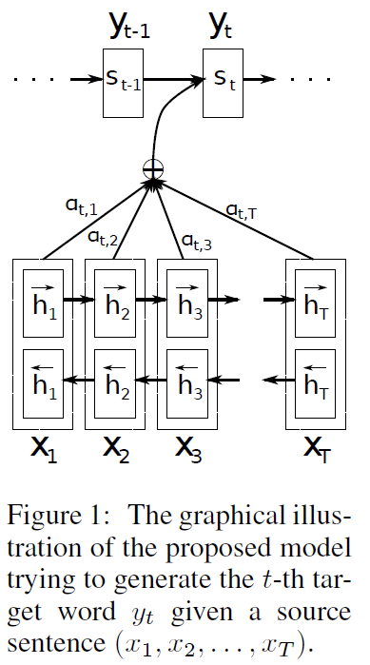
Seq2Seq with Attention
Bidirectional RNN

Slide 7
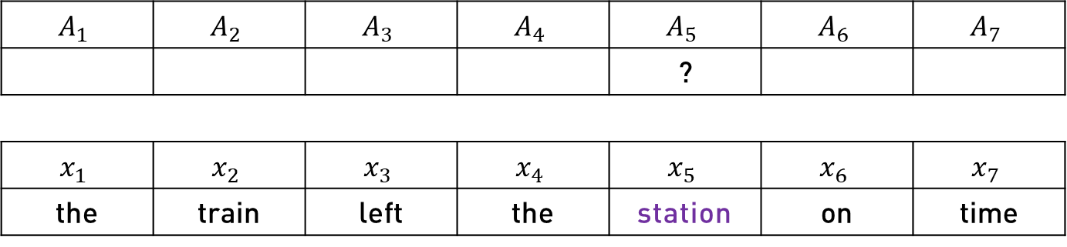
Self-Attention
Suppose we need an embedding for a word that captures its meaning based on the context.
What does the word “station” mean in this case?
$$A_{1}$$ | $$A_{2}$$ | $$A_{3}$$ | $$A_{4}$$ | $$A_{5}$$ | $$A_{6}$$ | $$A_{7}$$
 |  |  |  | ?
$$x_{1}$$ | $$x_{2}$$ | $$x_{3}$$ | $$x_{4}$$ | $$x_{5}$$ | $$x_{6}$$ | $$x_{7}$$
the | train | left | the | station | on | time

Slide 8

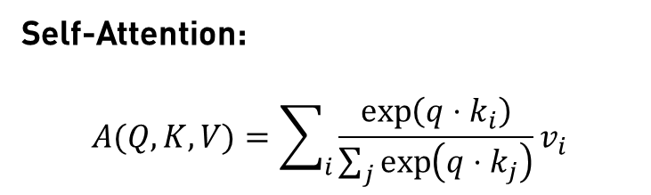
Self-Attention
RNN Attention:
$$α_{tj}=\frac{\exp{(e_{tj})}}{\sum_{k=1}^{T_{x}}{\exp{(e_{tk})}}}$$
Self-Attention:
$$A(Q,K,V)=\sum_{i}{\frac{\exp\left(q⋅k_{i}\right)}{\sum_{j}{\exp\left(q⋅k_{j}\right)}}}v_{i}$$
$$A_{1}$$ | $$A_{2}$$ | $$A_{3}$$ | $$A_{4}$$ | $$A_{5}$$ | $$A_{6}$$ | $$A_{7}$$
 |  |  |  | ?
$$x_{1}$$ | $$x_{2}$$ | $$x_{3}$$ | $$x_{4}$$ | $$x_{5}$$ | $$x_{6}$$ | $$x_{7}$$
the | train | left | the | station | on | time

Slide 9
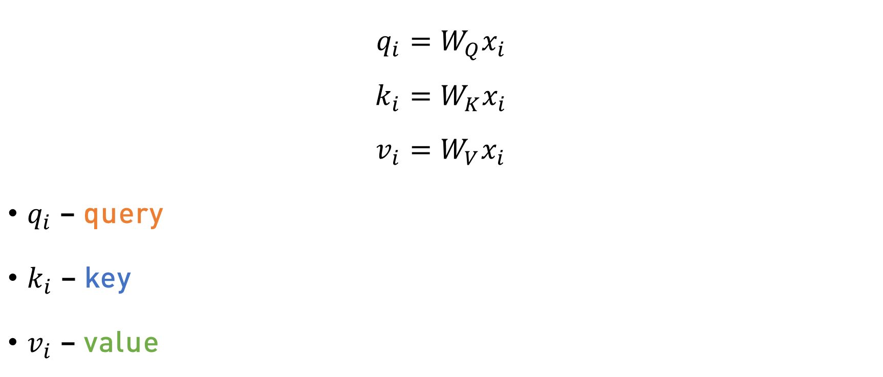
Self-Attention – Query, Key, Value
$$q_{i}=W_{Q}x_{i} \\ k_{i}=W_{K}x_{i} \\ v_{i}=W_{V}x_{i}$$
$q_{i}$ – query
$k_{i}$ – key
$v_{i}$ – value

Slide 10
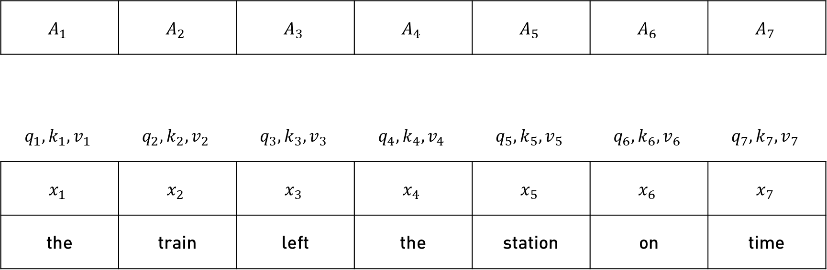
Self-Attention – Example
$$A_{1}$$ | $$A_{2}$$ | $$A_{3}$$ | $$A_{4}$$ | $$A_{5}$$ | $$A_{6}$$ | $$A_{7}$$
$$q_{1},k_{1},v_{1}$$ | $$q_{2},k_{2},v_{2}$$ | $$q_{3},k_{3},v_{3}$$ | $$q_{4},k_{4},v_{4}$$ | $$q_{5},k_{5},v_{5}$$ | $$q_{6},k_{6},v_{6}$$ | $$q_{7},k_{7},v_{7}$$
$$x_{1}$$ | $$x_{2}$$ | $$x_{3}$$ | $$x_{4}$$ | $$x_{5}$$ | $$x_{6}$$ | $$x_{7}$$
the | train | left | the | station | on | time

Slide 11
Self-Attention – Query, Key, Value
The query represents the model's current understanding of the input.
The key represents the importance of each part of the input sequence.
The value represents the information of each part of the input sequence.

Slide 12
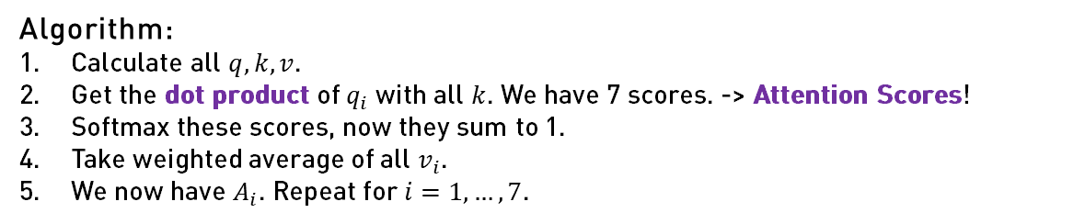
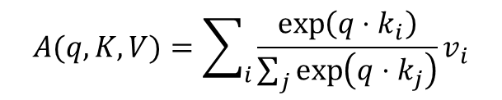
Self-Attention – Example
$$A_{1}$$ | $$A_{2}$$ | $$A_{3}$$ | $$A_{4}$$ | $$A_{5}$$ | $$A_{6}$$ | $$A_{7}$$
$$q_{1},k_{1},v_{1}$$ | $$q_{2},k_{2},v_{2}$$ | $$q_{3},k_{3},v_{3}$$ | $$q_{4},k_{4},v_{4}$$ | $$q_{5},k_{5},v_{5}$$ | $$q_{6},k_{6},v_{6}$$ | $$q_{7},k_{7},v_{7}$$
$$x_{1}$$ | $$x_{2}$$ | $$x_{3}$$ | $$x_{4}$$ | $$x_{5}$$ | $$x_{6}$$ | $$x_{7}$$
the | train | left | the | station | on | time
Algorithm:
Calculate all $q,k,v$.
Get the dot product of $q_{i}$ with all $k$. We have 7 scores. -> Attention Scores!
Softmax these scores, now they sum to 1.
Take weighted average of all $v_{i}$.
We now have $A_{i}$. Repeat for $i=1, …, 7$.
$$A(q,K,V)=\sum_{i}{\frac{\exp\left(q⋅k_{i}\right)}{\sum_{j}{\exp\left(q⋅k_{j}\right)}}}v_{i}$$

Slide 13
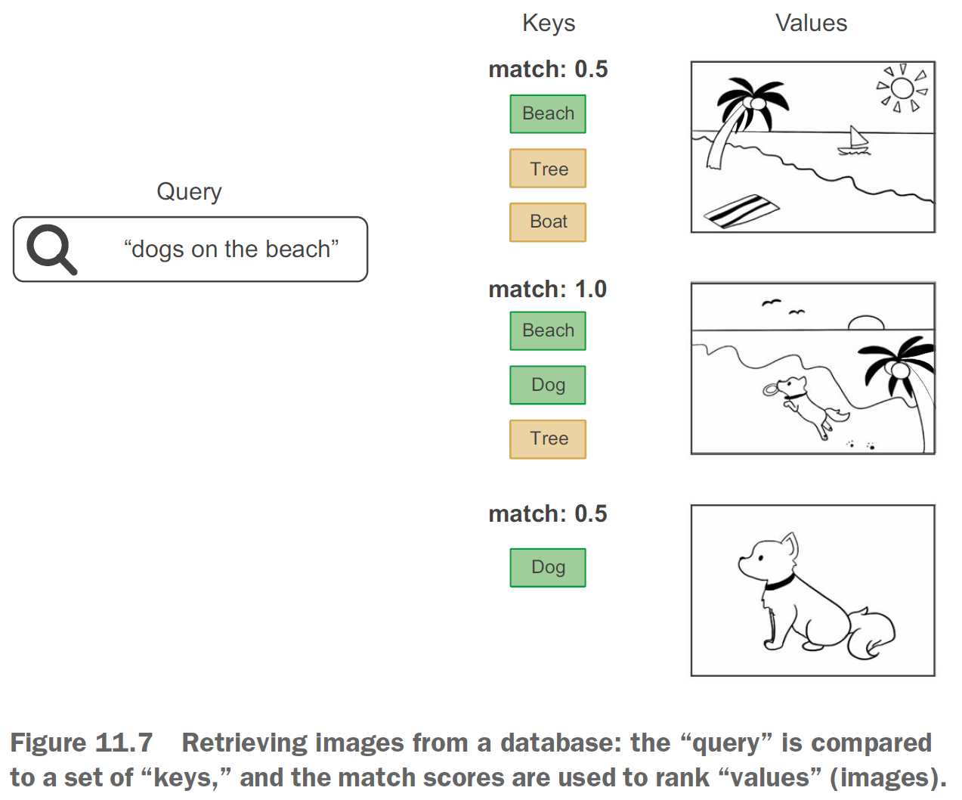
Self-Attention – Query, Key, Value

Slide 14
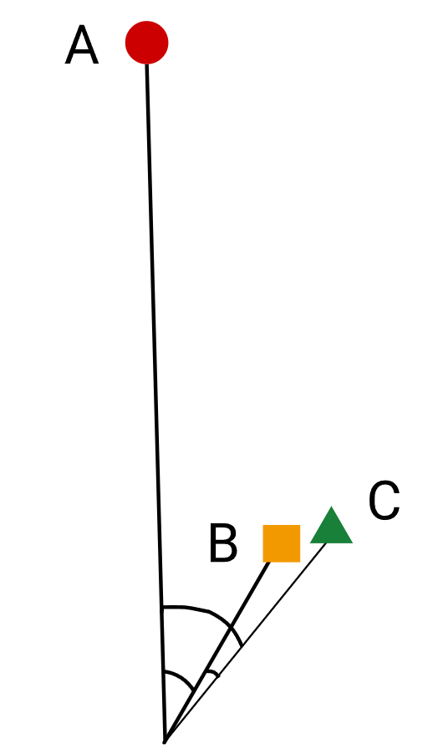
Dot Product
How do we interpret the dot product between two vectors?

Slide 15

Self-Attention
$$q_{i}=W_{Q}x_{i} \\ k_{i}=W_{K}x_{i} \\ v_{i}=W_{V}x_{i} \\ A(q,K,V)=\sum_{i}{\frac{\exp\left(q⋅k_{i}\right)}{\sum_{j}{\exp\left(q⋅k_{j}\right)}}}v_{i}$$

Slide 16
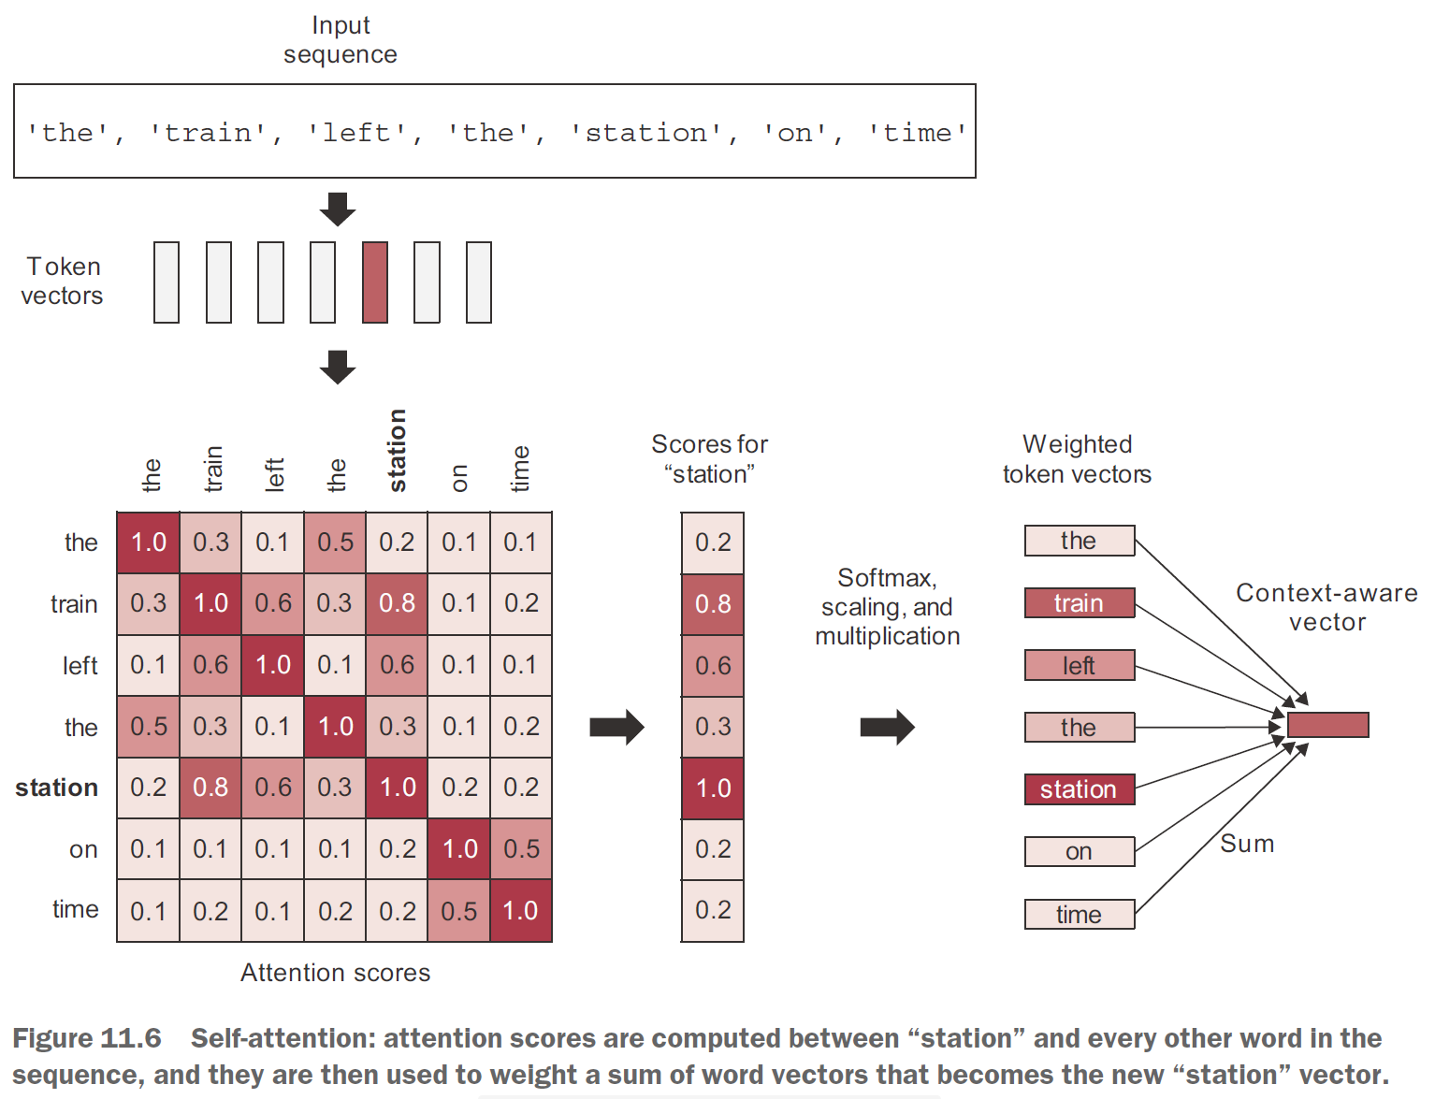

Slide 17

Scaled Dot-Product Attention
$$Q=W_{Q}x \\ K=W_{K}x \\ V=W_{V}x \\ A(Q,K,V)=softmax\left(\frac{QK^{T}}{\sqrt{d_{k}}}\right)V$$
Where $d_{k}$ is the dimensionality of the queries and keys.

Slide 18
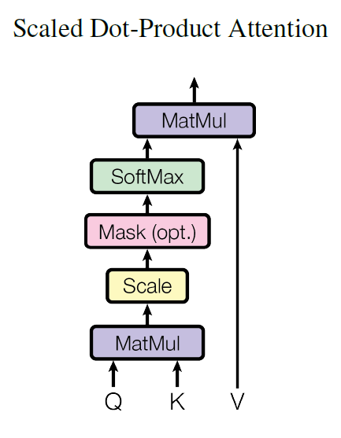
Scaled Dot-Product Attention

Slide 19
Self-Attention Intuitions from NLP
Machine translation – allows the model to learn to attend to different parts of the source and target sentences. This allows the model to learn to translate sentences that are not grammatically similar, but that have the same meaning.
Text summarization – allows the model to learn to attend to the most important parts of a text. This allows the model to generate summaries that are concise and informative.
Question answering – allows the model to learn to attend to the most relevant parts of a question and the answer. This allows the model to answer questions that are not explicitly stated in the text.

Slide 20
Multi-Head Attention

Slide 21
Multi-Head Attention
To increase complexity, we can stack multiple self-attention layers to parallelly compute many self-attention embeddings.
We call this Multi-Head Attention, where each self-attention block is referred to as a “head”.
Notes:
Increasing complexity allows us to learn “richer” representations of words.

Slide 22
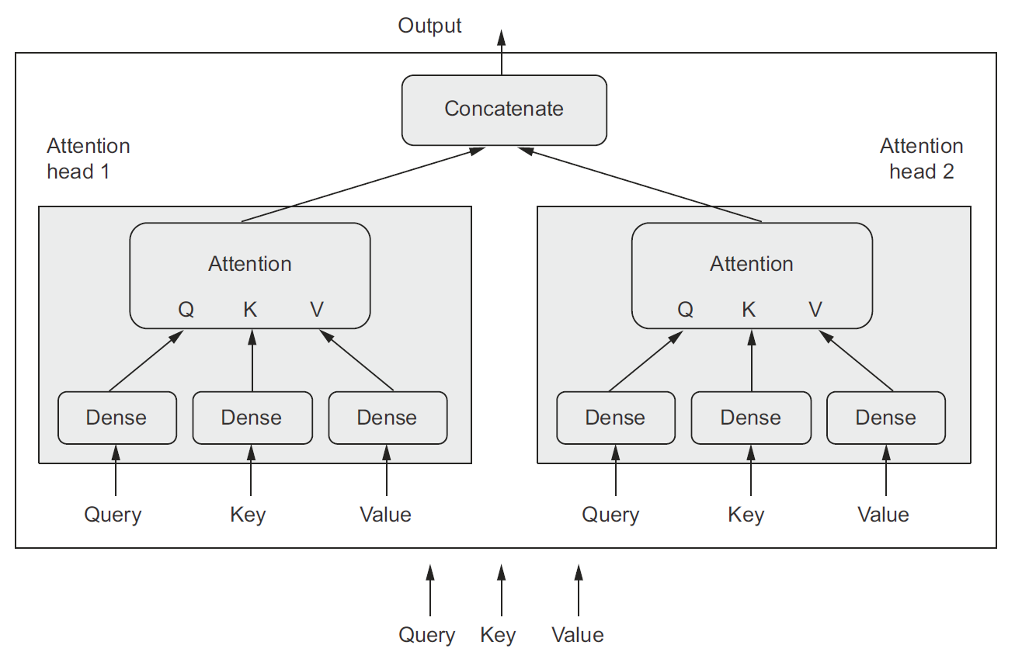
Multi-Head Attention
Dense

Slide 23

Multi-Head Attention
$$Q=W_{Q}^{h}(W_{Q}x) \\ K={W_{K}^{h}(W}_{K}x) \\ V={W_{V}^{h}(W}_{V}x) \\ {head}_{h}\left(Q,K,V\right)=softmax\left(\frac{QK^{T}}{\sqrt{d_{k}}}\right)V \\ MultiHead(Q,K,V)=Concat\left({head}_{1},{head}_{2},…,{head}_{h}\right)W_{O}$$
Where $h$ is the number of heads.
Notes:
Typical choice is $h=8$.

Slide 24
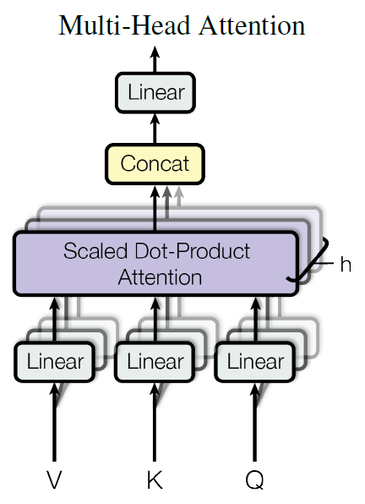
Multi-Head Attention

Slide 25
Multi-Head Attention
Multi-head attention allows the model to attend to different aspects of the input sequence and learn a more comprehensive representation of the input sequence.
For example, one attention head might attend to the temporal order of the words, while another attention head might attend to the semantic meaning of the words.

Slide 26
Example – Question Answering
Passage: The Eiffel Tower is one of the most famous landmarks in Paris, a beautiful city with a rich history and the capital of France.
Question: What is the capital of France?

Slide 27
Transformers

Slide 28
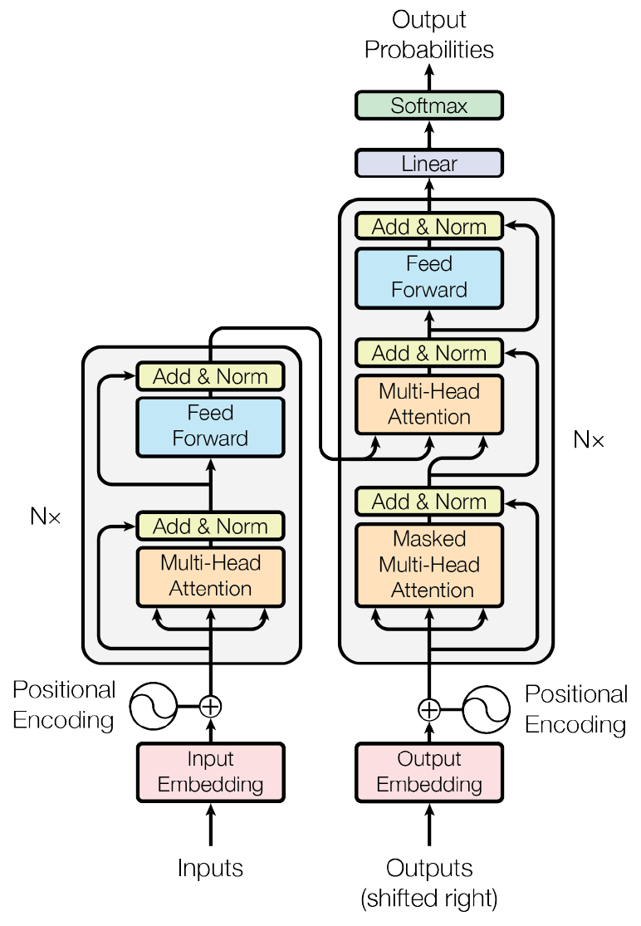
Notes:
Typical choice is $n=6$.

Slide 29
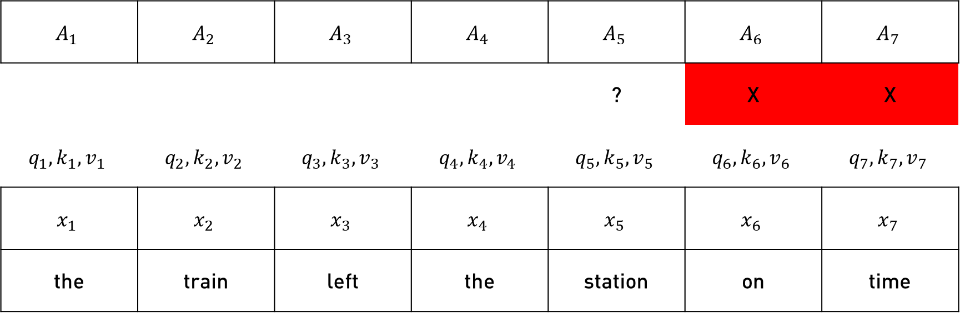
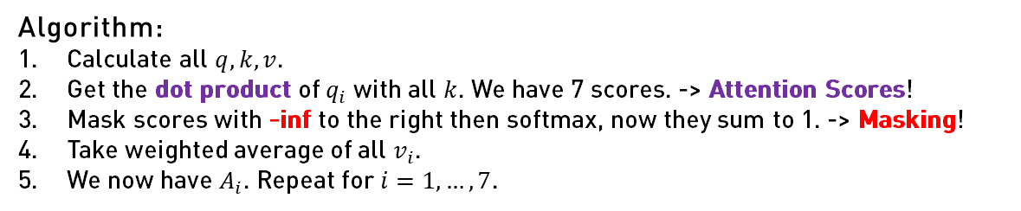
Masking
$$A_{1}$$ | $$A_{2}$$ | $$A_{3}$$ | $$A_{4}$$ | $$A_{5}$$ | $$A_{6}$$ | $$A_{7}$$
 |  |  |  | ? | X | X
$$q_{1},k_{1},v_{1}$$ | $$q_{2},k_{2},v_{2}$$ | $$q_{3},k_{3},v_{3}$$ | $$q_{4},k_{4},v_{4}$$ | $$q_{5},k_{5},v_{5}$$ | $$q_{6},k_{6},v_{6}$$ | $$q_{7},k_{7},v_{7}$$
$$x_{1}$$ | $$x_{2}$$ | $$x_{3}$$ | $$x_{4}$$ | $$x_{5}$$ | $$x_{6}$$ | $$x_{7}$$
the | train | left | the | station | on | time
Algorithm:
Calculate all $q,k,v$.
Get the dot product of $q_{i}$ with all $k$. We have 7 scores. -> Attention Scores!
Mask scores with -inf to the right then softmax, now they sum to 1. -> Masking!
Take weighted average of all $v_{i}$.
We now have $A_{i}$. Repeat for $i=1, …, 7$.
$$A(q,K,V)=\sum_{i}{\frac{\exp\left(q⋅k_{i}\right)}{\sum_{j}{\exp\left(q⋅k_{j}\right)}}}v_{i}$$
Notes:
When training, masking allows the network to mimic what happens during inference time.

Slide 30
Masking

Slide 31
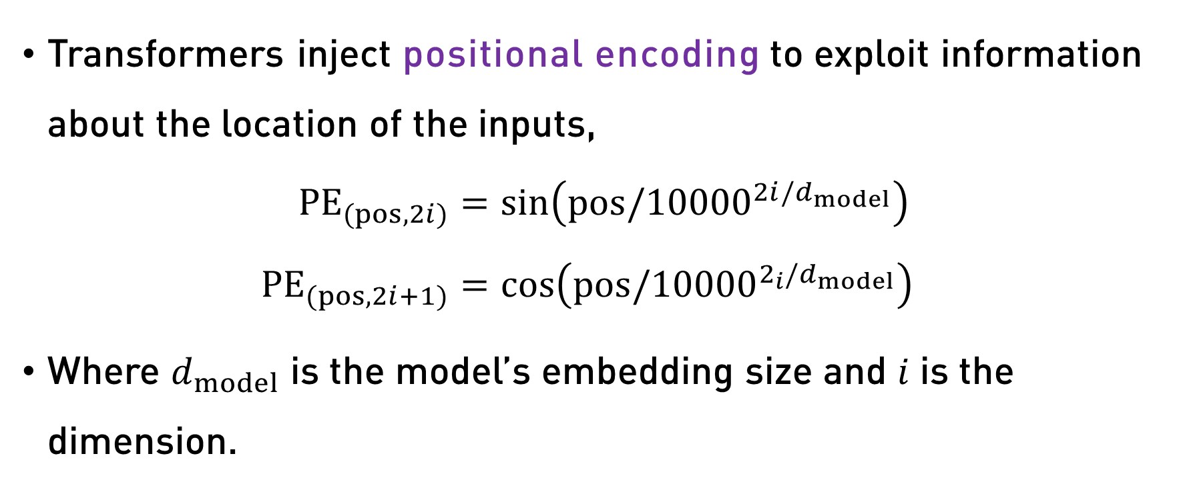
Positional Encoding
Transformers inject positional encoding to exploit information about the location of the inputs,
$${PE}_{(pos,2i)}=\sin\left(pos/{10000}^{2i/d_{model}}\right) \\ {PE}_{(pos,2i+1)}=\cos\left(pos/{10000}^{2_{i}/d_{model}}\right)$$
Where $d_{model}$ is the model’s embedding size and $i$ is the dimension.

Slide 32
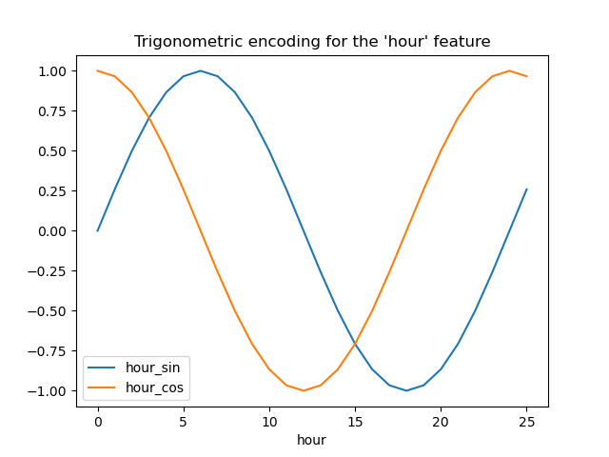
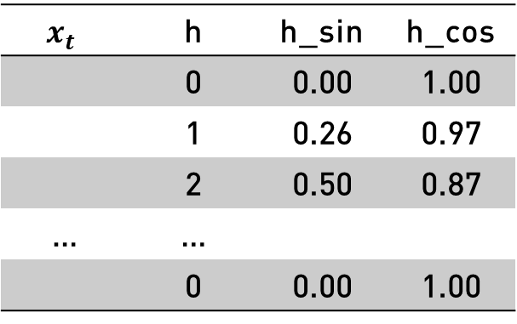
*Cyclical Encoding for Time Series
$$x_{t}$$ | h | h_sin | h_cos
 | 0 | 0.00 | 1.00
 | 1 | 0.26 | 0.97
 | 2 | 0.50 | 0.87
… | …
 | 0 | 0.00 | 1.00

Slide 33
Note: This encoder-decoder architecture
was designed for NMT.
(K, V)
(Q, K, V)
(Q, K, V)

Slide 34
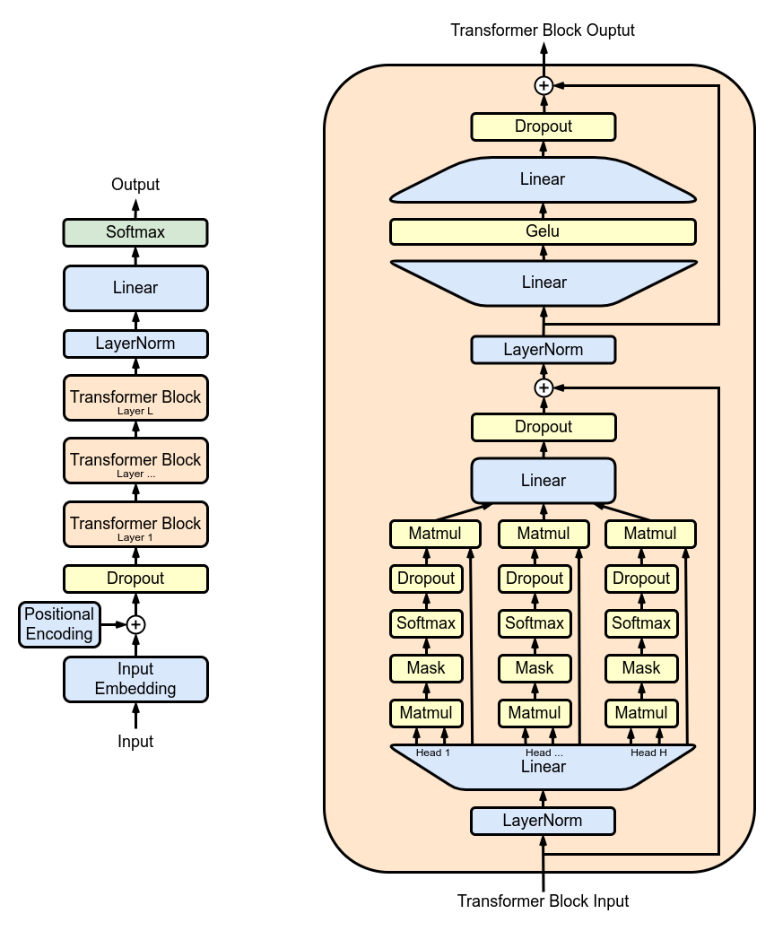
Generative Pre-Trained Transformer.
Notes:
Here $L=12$.

Slide 35
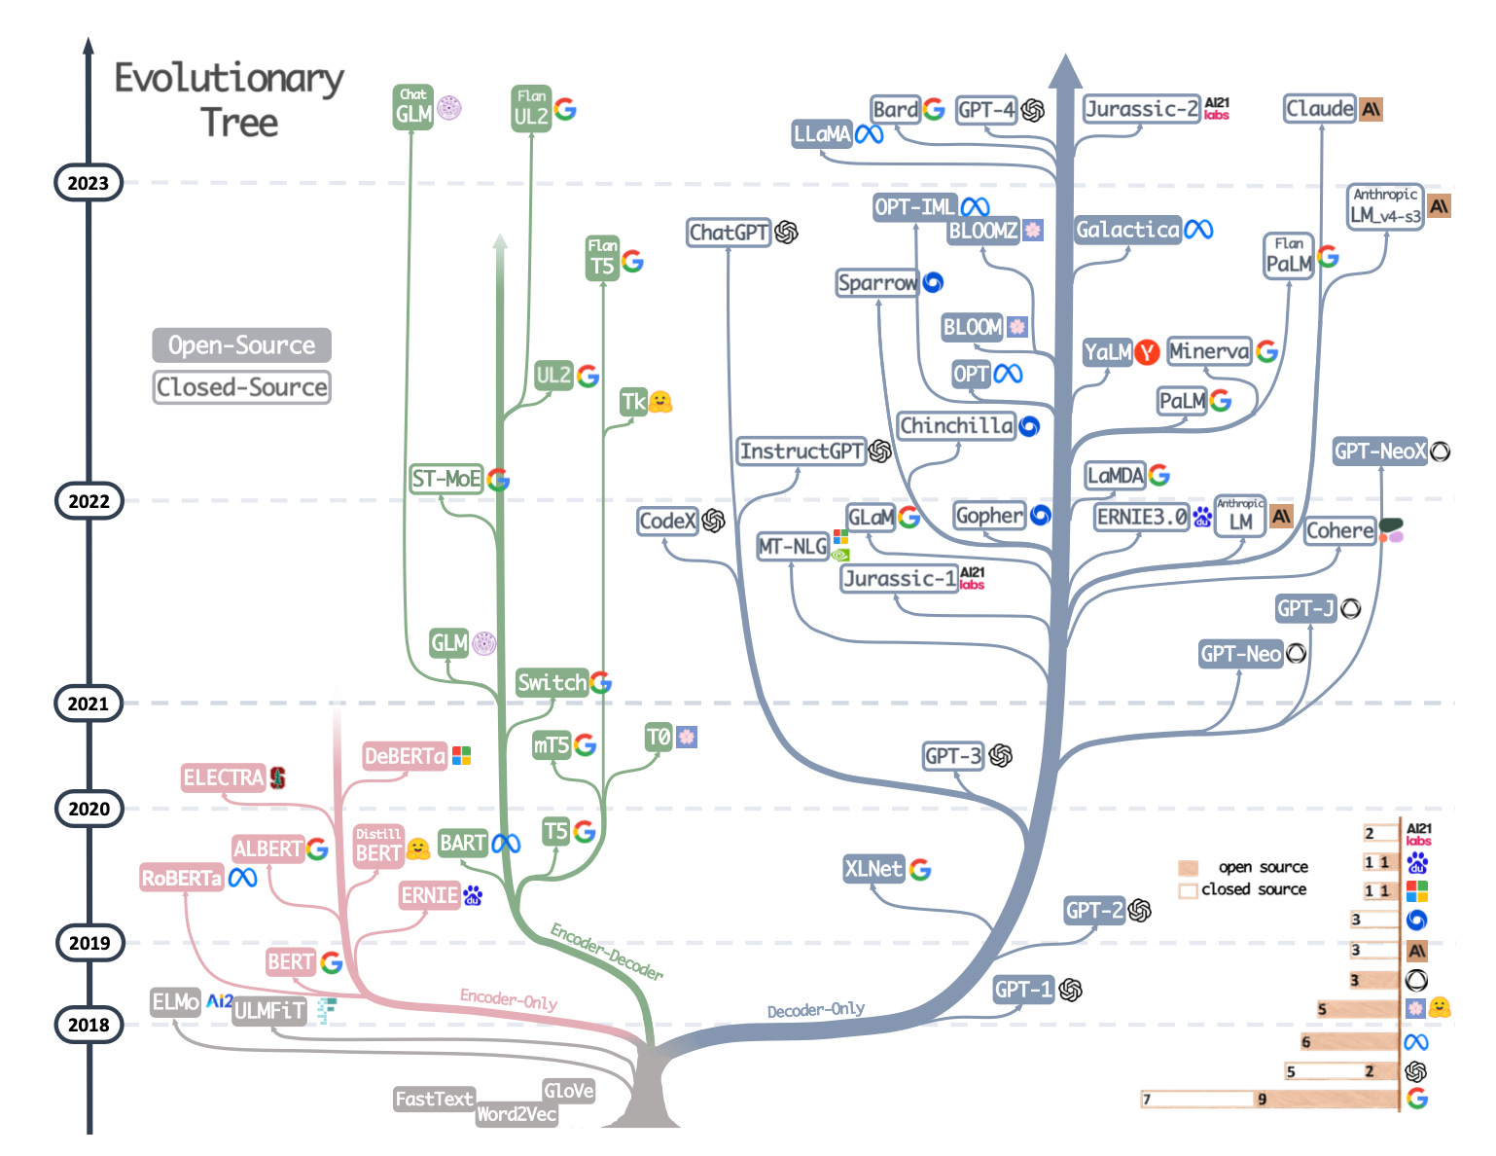
The Transformer Timeline.

Slide 36
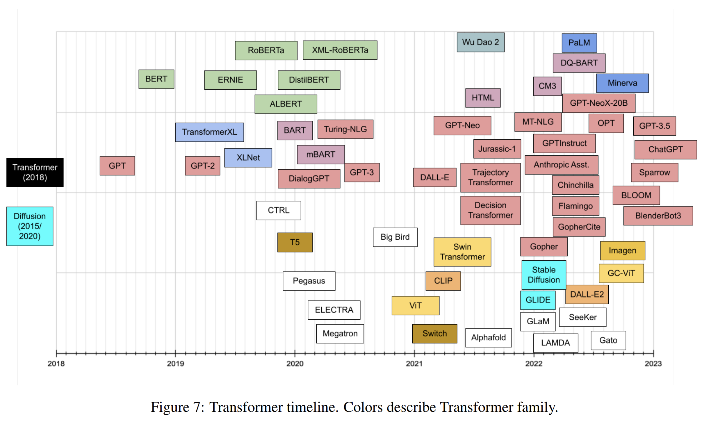
The Transformer Timeline.

Slide 37
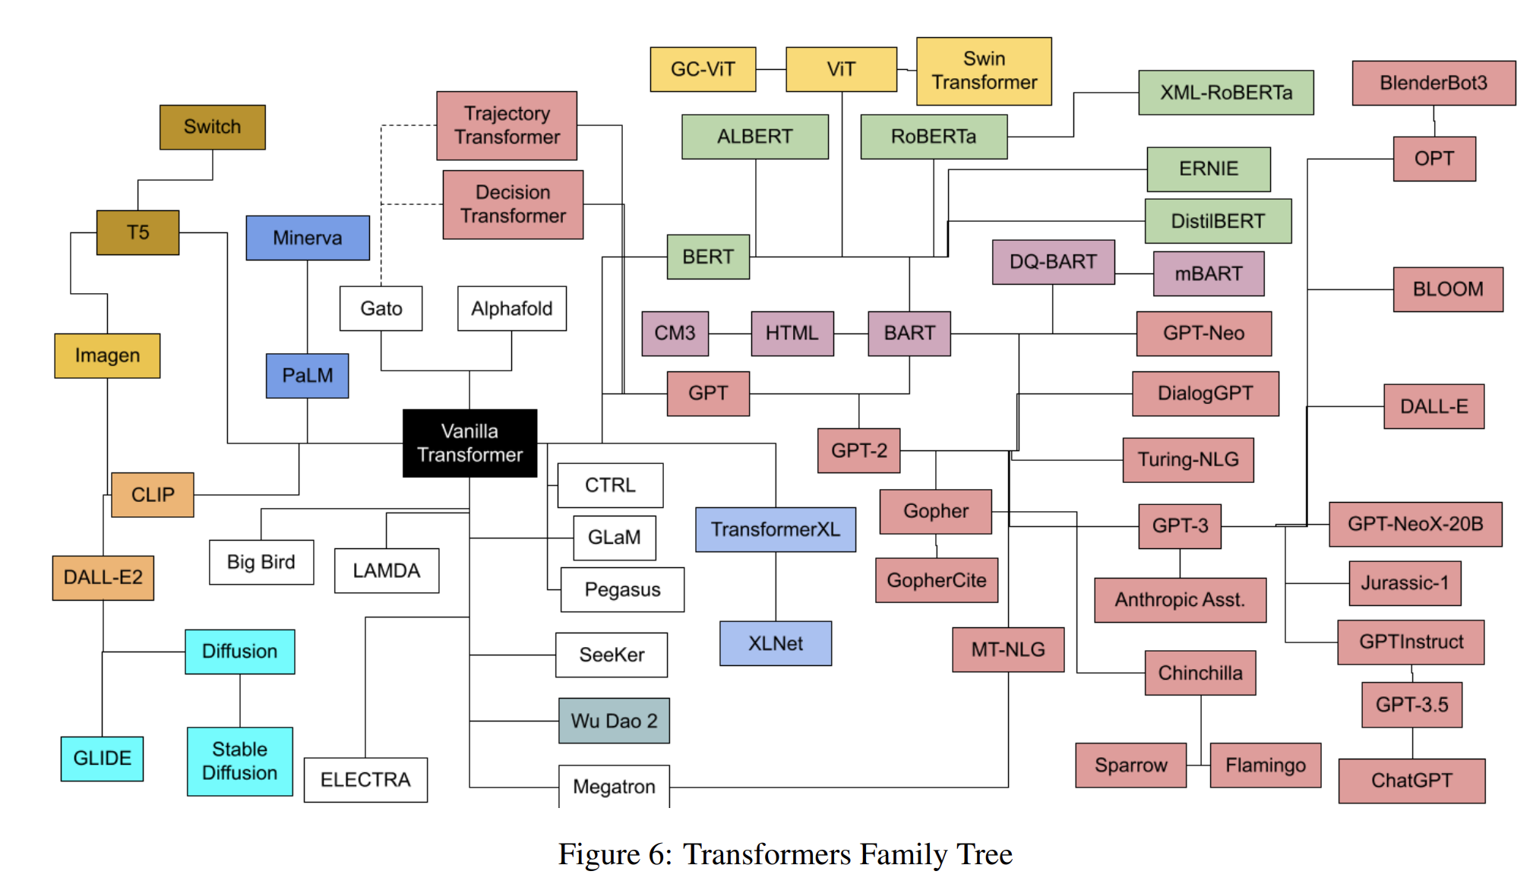
The Transformer Family Tree.

Slide 38
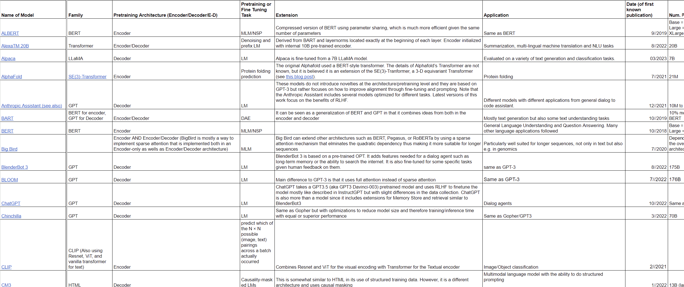
The Transformer Catalog Table.

