Slide 1

Study Session - RNNs
Machine Learning 3
MSDS FT 2024
08 May 2024

Slide 2
Goals for this Session
RNN fundamentals
Differences in architectures of Simple RNN, LSTM, and GRU
Code implementation

Slide 3
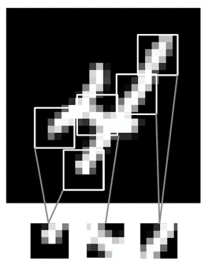
Review
Convolutional Neural Networks
Recognize local patterns
Translation invariant
Learn spatial hierarchies of patterns
Parameter sharing

Slide 4
Review
The case for sequential data
Examples: text data, time-series data, audio data
We need a representation that is capable of handling the order of the input samples and has a memory of the past seen examples

Slide 5

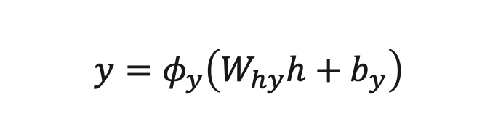


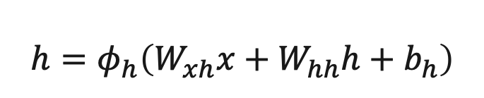






Recurrent Neural Networks
$$L$$
$$y_{pred}$$
$$y_{actual}$$
Simple RNN Architecture
RNN
$$W_{hh}$$
RNN
$$W_{hh}$$
RNN
$$W_{hh}$$
RNN
$$W_{hy}$$
Dense
$$W_{xh}$$
$$W_{xh}$$
$$W_{xh}$$
$$W_{xh}$$
$$h=φ_{h}\left(W_{xh}x+W_{hh}h+b_{h}\right)$$
$$y=φ_{y}\left(W_{hy}h+b_{y}\right)$$

Slide 6




Recurrent Neural Networks
LSTM Architecture
carry track
RNN
RNN
RNN
RNN
$$x^{(1)}$$
$$x^{(2)}$$
$$x^{(3)}$$
$$x^{(4)}$$

Slide 7
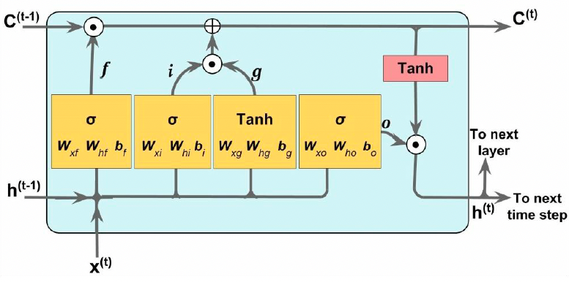
Recurrent Neural Networks
LSTM Architecture

Slide 8
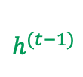

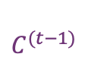







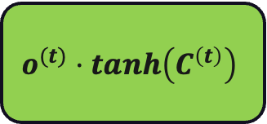












Recurrent Neural Networks
LSTM Architecture
update carry track
$$C^{(t−1)}$$
$$C^{(t)}$$
$$f⋅C^{\left(t−1\right)}+i⋅g$$
$$f$$
$$i$$
$$g$$
$$tanh$$
$$h^{(t−1)}$$
$$W_{hf}$$
$$W_{hi}$$
$$W_{hg}$$
$$W_{ho}$$
$$h^{(t)}$$
$$σ$$
$$σ$$
$$tanh$$
$$σ$$
$$o^{(t)}⋅tanh\left(C^{\left(t\right)}\right)$$
update hidden state
$$W_{xf}$$
$$W_{xi}$$
$$W_{xg}$$
$$W_{xo}$$
$$x^{(t)}$$

Slide 9
Recurrent Neural Networks
GRU Architecture
carry track
RNN
RNN
RNN
RNN
$$x^{(1)}$$
$$x^{(2)}$$
$$x^{(3)}$$
$$x^{(4)}$$

Slide 10
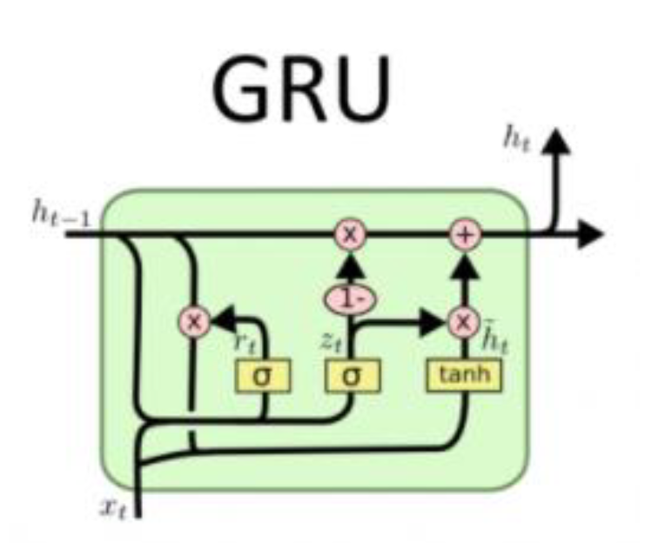
Recurrent Neural Networks
GRU Architecture
Zhou, Jiayu, et al. "On Building Real Time Intelligent Agricultural Commodity Trading Models." 2022 IEEE Eighth International Conference on Big Data Computing Service and Applications (BigDataService). IEEE, 2022.

Slide 11





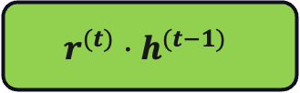




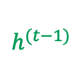





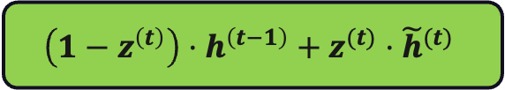
Recurrent Neural Networks
GRU Architecture (v3)
update hidden state
reset hidden state
$$h^{(t)}$$
$$\left(1−z^{\left(t\right)}\right)⋅h^{\left(t−1\right)}+z^{(t)}⋅{\tilde{h}}^{(t)}$$
$$r^{(t)}⋅h^{(t−1)}$$
$$r^{\left(t\right)}$$
$$z^{(t)}$$
$${\tilde{h}}^{\left(t\right)}$$
$$h^{(t−1)}$$
$$W_{hr}$$
$$W_{hz}$$
$$W_{ro}$$
$$σ$$
$$σ$$
$$tanh$$
$$W_{xr}$$
$$W_{xz}$$
$$W_{xo}$$
$$x^{(t)}$$

Slide 12
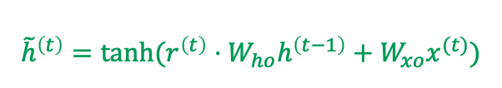

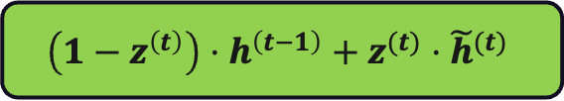



Recurrent Neural Networks
GRU Architecture (v1)
update hidden state
$$h^{(t)}$$
$$\left(1−z^{\left(t\right)}\right)⋅h^{\left(t−1\right)}+z^{(t)}⋅{\tilde{h}}^{(t)}$$
$$r^{\left(t\right)}$$
$$z^{\left(t\right)}$$
$${\tilde{h}}^{\left(t\right)}=tanh(r^{\left(t\right)}⋅W_{ho}h^{\left(t−1\right)}+W_{xo}x^{(t)})$$
$$h^{(t−1)}$$
$$W_{hr}$$
$$W_{hz}$$
$$σ$$
$$σ$$
$$W_{ho}$$
$$tanh$$
$$W_{xr}$$
$$W_{xz}$$
$$W_{xo}$$
$$x^{(t)}$$

