Slide 1
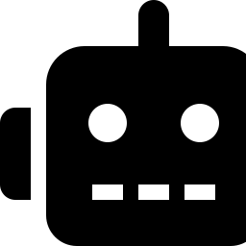
JD CORTEX
Perception, Reasoning, and Memory for an EZ-Robot JD Humanoid
Built on Synthiam ARC, Google Gemini, and YOLO vision
Tatheer Aima Naqvi
Vision pipeline · Gemini reasoning · Whitelisted actions · Surveillance & ambient modes
Bushra Ushaaq
Witness memory · ARC control panel · Gesture control · System launcher

Slide 2


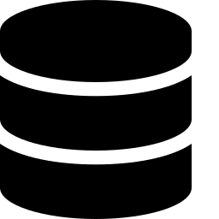

OVERVIEW
What JD Cortex Actually Does
Understands you
Watches the room
Remembers
Stays safe
Typed, spoken, or gestured commands are understood in plain language.
A camera pipeline notices who is present, their posture, and what they hold.
Arrivals, departures, and sightings are kept in a running diary.
Every action is checked against a fixed, pre-approved whitelist before it runs.
The core idea: sensing, remembering, deciding, and acting are handled by separate processes. Nothing is done by one giant program — which makes the whole system easier to reason about, and safer to run.
2

Slide 3



ARCHITECTURE
Five Cooperating Processes
Vision Pipeline
Witness Recorder
Brain (main.py)
ARC → JD
camera → scene_state.json
scene state → diary
Gemini + validation
speech + movement
ARC Panel (C#)
Gesture Control
status, diary, hold-to-talk
webcam → ARC directly
Why split it up? Only main.py ever opens the ARC connection that speaks — watchers queue messages through a shared file instead of talking to ARC directly. Gesture control gets its own, completely separate ARC connection, so it can never collide with conversation.
3

Slide 4
DATA FLOW
How One Command Reaches JD
1
Input arrives
2
Local match first
3
Gemini, if needed
Typed, spoken (local Parakeet), or via the ARC panel — all reach the same process_command().
The text is checked against the safe-action list before anything else runs.
Scene summary, witness diary, and chat history are attached to the prompt.
4
Reply is spoken
5
Action re-checked
6
JD moves
main.py sends the reply to ARC's SayWait — the only process that ever does.
Any suggested action is validated again against known_actions.py before ARC ever sees it.
A confirmed movement runs, then JD returns to Standing automatically.
4

Slide 5
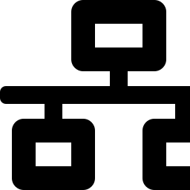


COMMAND & CONTROL
The Brain — jd_robot_system/main.py
One connection, one owner
arc_connection.py opens a single TCP socket to ARC — opened once, used for every command.
Three input paths, one brain
Console typing, local voice (Parakeet), and the ARC panel all funnel through process_command().
main.py
single ARC
connection
Validate, then act
known_actions.py holds the whitelist — movements, sounds, lights. Nothing runs without a match.
Background alert thread
Polls a file-backed speech queue so surveillance and ambient watchers can still speak safely.
5

Slide 6

REASONING
Gemini Integration — Three Distinct Uses
understand()
assess_alert()
ambient_comment()
Conversation & action match
Surveillance judgement
Companion remarks
Returns REPLY + MATCH. Only ever suggests an action — main.py must still validate it before it runs.
Fails SAFE: if Gemini is unreachable, it alerts anyway with a generic line rather than staying silent.
Fails SILENT: if Gemini is unreachable, it simply says nothing — a skipped remark costs nothing.
Quota resilience: each call walks a list of model names — skipping to the next on a 404 — and rotates through up to three API keys per model, since the free tier allows roughly 20 requests/day/key/model. A live usage counter is shown on the ARC panel.
6

Slide 7
PERCEPTION
Vision Pipeline — A Pure Sensor Process
Object detection
vision_pipeline/scene_state.json
YOLO identifies general objects in frame.
{
"timestamp": 1723222110.4,
"objects_visible": ["laptop", "cup"],
"people": {
"3": {
"name": "aima",
"posture": "sitting",
"holding": "cup",
"sitting_on": "chair"
}
}
}
Pose tracking
YOLO pose gives each person a tracker ID.
Face recognition
Matches against known_encodings.pkl to assign real names.
Written atomically: a temporary .tmp file is renamed into place with os.replace(...), so no reader — scene_context, the witness recorder, or the panel — ever sees a half-written file.
7

Slide 8
MEMORY
The Witness Diary — A Robot That Remembers
Identity by name, never tracker ID
The same person can burn through dozens of tracker IDs a minute — unrecognised sightings pool into one “unknown” bucket instead.
SQLite
(WAL mode)
Debounced arrivals & departures
A couple of seconds of continuous presence confirms an arrival; a longer solid gap confirms a departure — no flapping on a tracking hiccup.
Feeds the same Gemini prompt
memory_context.py adds a diary block alongside the live scene — so “who did you see today?” is answered by the same brain as any other question.
Retention: 14 days by default (JD_DIARY_KEEP_DAYS) — pruned automatically at every recorder startup.
8

Slide 9
INTERACTION
Hand-Gesture Control
Gesture → Action
Reads a stationary webcam — never JD's own camera
Fist
Forward
JD's own camera moves when JD moves — a FORWARD gesture would shake the view, lose the hand, and trip the very safety stop meant to protect it.
Open hand
Stop
Index left / right
Turn
Index down
Sit
Automatic safety stop
Peace sign
Wave
If the hand disappears mid-walk, JD is stopped automatically after a short number of hand-less frames — it can never be left walking indefinitely.
Three fingers
Stand
Index + pinky
Pushups
9

Slide 10
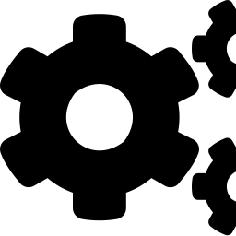
INTERFACE
The ARC Control Panel (“Memory” Skill)
A C# ARC Behavior Control skill giving one live window into everything JD Cortex is doing.
Connection light
Scene card
One input box
Live status of the link to the Python brain
What JD currently sees, updated live
Free text for both memory questions and commands
Hold-to-talk
Gesture toggle
Guarded shutdown
Push-to-record voice input from the panel
Starts/stops hand-gesture control with a plain-language legend
A confirmed stop button for the whole system
Protocol: 127.0.0.1:5005 — one line in, one line out (status, diary [n], alerts [n], gesture on|off, listen start|stop, stop, or free text).
10

Slide 11
SAFETY
Two Watchers, Two Failure Philosophies
Surveillance Watcher
Ambient Watcher
Fails SAFE
Fails SILENT
• Watches for unknown people and sensitive objects (knives, scissors)
• Watches for meaningful changes — arrivals, departures, posture, idle time
• A condition must persist across multiple polls before it fires
• Asks Gemini whether a short remark is genuinely natural right now
• Logs to activity_log.txt and requests a snapshot
• Deliberately conservative — silence is the common, expected case
• If Gemini is unreachable, it alerts anyway with generic wording — silence could hide a real event
• If Gemini is unreachable, it just says nothing — a skipped remark costs nothing
11

Slide 12
UNDER THE HOOD
Tech Stack & Running the System
Vision
Reasoning
Speech
YOLO (ultralytics) · OpenCV · face_recognition
Google Gemini — plain HTTP, no SDK
Local Parakeet (sherpa-onnx) — nothing leaves the machine
Gestures
Memory
Control
MediaPipe 0.10.21 (pinned)
SQLite, WAL mode
Synthiam ARC — TCP script server, port 6666
One launcher for the whole system
python run.py check
reports every library, model file, key, and port before a session
python run.py
starts vision, memory, brain, and watchers in dependency order
python run.py --minimal
brain + witness memory only, no vision
12

Slide 13
Thank You
JD Cortex keeps sensing, remembering, deciding, and acting as separate, cooperating processes — safe by construction, not by afterthought.
One whitelist, always checked — Gemini reasons, but never drives JD directly.
One ARC voice, one owner — every other process queues speech instead of speaking itself.
Memory by name, not tracker ID — durable, readable, and honest about what JD actually saw.
Tatheer Aima Naqvi · Bushra Ushaaq
Project: JD Cortex

