Slide 1
FYP PROPOSAL DEFENCE · FAST NUCES ISLAMABAD
KneeWS
Knee Weak Supervision
Noise-Aware Weak Supervision from Multilingual Radiology Reports for Multi-Label Knee MRI Analysis
The problem in one sentence
Only 58 of 4,407 knee MRI studies carry expert labels; the other 4,349 carry radiology reports that disagree with expert readings about one time in six, in ways nobody has measured — so the labels we must train on are wrong, and we do not know how.
[ Member 1 ] · [ Member 2 ] · [ Member 3 ]
Supervisor: [ Supervisor name ]
Declared stream: Research-derived (Stream A)
· Primary SDG: 3 — Good Health and Well-being
Notes:
Say the one-sentence problem out loud before anything else. 58 expert-labelled studies against 4,349 report-only ones, and the reports are wrong about one time in six. Everything in the next nineteen minutes follows from that sentence.

Slide 2
2
Problem and users
OF 10
Who faces it, how it is handled today, and why the failure matters
Who
What they face today
Why the current handling fails
Medical-imaging AI researchers & model developers
Expert annotation is the bottleneck. A study takes two radiologists plus an adjudicator; a dataset takes years. So teams train on labels scraped from reports instead.
The scraping step converts free text to a hard 1 or 0 and treats every finding the report does not mention as absent. That assumption is never measured, and it is silently wrong.
Radiologists in high-volume settings
A knee MRI is read once, by one reader, under time pressure. What gets written is what was clinically relevant to that referral.
Findings that were seen but not worth reporting vanish. They are not negatives — they are silences, and a model trained on them learns the wrong prevalence.
The notional client — the group operating the deployed model
Wants a system that reads a new study from images alone and returns probabilities it can act on.
A model trained on unmeasured noise produces confident numbers with no honest error bar, which is worse than no number at all.
THE FAILURE, IN ONE NUMBER
SDG 3 — GOOD HEALTH AND WELL-BEING
Synovitis is present in about 46.6% of expert-read studies in this dataset. It appears in about 3.3% of the reports. Train the standard way and the model learns that synovitis almost never happens — an error of roughly 43 percentage points, introduced entirely by the labelling step.
Connection: diagnostic support where expert annotation is scarce. Boundary: the SDG is context for the problem, not the claimed technical contribution and not part of the CCP.
The system is a research and decision-support tool. It is not, and will not be presented as, a clinically validated diagnostic system.
KneeWS · noise-aware weak supervision · proposal defence
2
Notes:
The synovitis number is the strongest single fact in the deck. 46.6 percent against 3.3 percent. If the panel remembers one thing, make it that. It proves the problem is real, it is specific to this dataset, and it is not something we invented.

Slide 3
3
Existing solutions and prior FYP comparison
OF 10
Structural comparison — problem, users, approach, evidenced limitation, and what it implies for us
Existing solution / prior FYP
Problem & target users
Core approach
Evidence-based limitation
Implication for us
CheXpert 2019 / CheXbert 2020
Chest X-ray researchers; report-to-label conversion
Four states: positive, negative, uncertain, unmentioned. Rule + BERT labeller.
English only. The four states are used as-is — their reliability is never estimated.
We estimate what each state is worth, across ~10 languages, on MRI.
MAPLEZ, MedIA 2025
Chest imaging; soft supervision from reports
LLM states a verbalised probability, used directly as a soft target.
Gain of only +0.4 AUROC. Depends on the LLM's own calibration, unmeasured for non-English.
Becomes our Arm 4. We estimate reliability from data, not from self-report.
RSNA public baseline (0.891)
Competition entrants
Multilingual rule extractor + DINOv2-small 2.5D image model.
Treats every unmentioned finding as absent — the assumption we believe is costly.
Becomes our Arm 1 baseline; we measure what that assumption costs.
Closest prior FYPs: EarlyRay (F25-064-D), RetinaScope (F25-045-D)
Radiology workflow; retinal disease screening
Images in, labels out. Both development-designated.
Both assume the training labels are correct. Neither treats label quality as a problem.
No departmental FYP has made supervision quality the research object.
Current manual workflow
Radiologists and referring clinicians
Radiologist reads the study and dictates free text for one reader.
No structured multi-label record exists; findings not written down are lost to any later use.
This is the source of the noise we model, not a competitor.
THE GAP, STATED STRUCTURALLY
Four-state report labels exist. Soft targets from reports exist. Quantified omission exists for chest and brain. What does not exist is a per-finding, per-state reliability model estimated for knee MRI, across ten languages, on a dataset where multiple sites share each language — which is the first dataset that lets language bias and institution bias be told apart. Changing the modality alone would not be a contribution; changing what is estimated, and proving it against held-out experts, is.
KneeWS · noise-aware weak supervision · proposal defence
3
Notes:
Handbook C.10 warns that changing platform, language or model name is not a difference. So lead with the structural difference: everyone else consumes report states, we estimate what they are worth. The prior-FYP row is from the Fall-2025 tab of the departmental repository; the full multi-year scan is still in progress and we should say so if asked.

Slide 4
4
R&D / recent technical work
OF 10
Every source below changed a decision — research used to decide, not to fill pages
Source / method
Main finding or method
Relevance & limitation
Decision it influenced
Planned evidence
CheXpert / CheXbert (2019–20)
Four-state representation of report findings.
Foundational, but English-only and single modality.
Adopt four states; build our own multilingual labeller.
Hand-audited labeller accuracy across languages.
VisualCheXbert 2021; Wood 2020 / Benger 2023; Fytas 2026
Unmentioned ≠ absent, measured. Report sensitivity 60–78% in brain MRI; 59% of confirmed chest findings absent from reports.
Proves the problem is real and general. Never measured for knee MRI.
Justifies the whole project; sets omission as a headline metric.
Per-finding, per-language omission estimates for knee MRI.
Gündel & Ghesu, MedIA 2021
Per-class report reliability estimated on a small expert re-read subset, injected into the loss.
Closest published method to ours. Single language, chest X-ray, two states.
Our primary estimator, extended to 4 states × 12 findings with hierarchical pooling.
Reliability table with credible intervals; ablation against this method.
Northcutt, JAIR 2021; Bernhardt, Nat Comms 2022
Confident learning — estimate a noise model from a model's own out-of-fold behaviour, no gold labels.
Mature and well-tested, but not applied to four-state report supervision or to MRI.
Becomes our secondary method and an ablation arm.
Estimated noise model validated against the untouched expert set.
RSNA data card + competition rules
58 gold / 4,349 report-only; hosted LLM APIs not permitted for report text; 9-hour offline notebook.
Hard constraints on what we may build.
Open-weight labeller running in-notebook; two-stage 2.5D to fit 8 GB.
Rules compliance check; runtime measured on target hardware.
TWO PAPERS STILL TO BE READ IN FULL BEFORE THE NOVELTY CLAIM IS WRITTEN DOWN
Ye et al., Expert Systems with Applications 2026 (label-wise reliability for chest radiography) and Xiao, IEEE TMI 2024 (multi-label positive-unlabelled learning). We name them now rather than discover them later.
KneeWS · noise-aware weak supervision · proposal defence
4
Notes:
The point of this slide is that the literature changed what we are building, not that we read a lot. Every row's fourth column is a decision. If a panel member asks which source we would drop, the answer is none — each one closed off an option.

Slide 5
5
Complex computing challenge
OF 10
What is technically hard, and why this is not a course project
#
Characteristic
Claim
Why
1
Conflicting requirements
Strong
4,349 noisy studies are needed for signal, yet each one may be wrong; uncertainty must be preserved and turned into a usable number; 569 GB of imaging inside 8 GB of VRAM.
2
No obvious solution / depth of analysis
Strong
There is no standard answer to what is the training target for a finding the report never mentions. It must be determined experimentally.
3
Depth of knowledge
Strong
MRI and DICOM, multi-label learning, noisy-label theory, multilingual clinical language, calibration, and leakage-safe design must all be combined.
4
Unfamiliar issues
Strong
Language is nearly a proxy for institution; reports and expert reads disagree systematically; 48 quantities must be estimated from 58 studies.
5
Beyond standard practice
Strong
Frameworks supply networks, DICOM readers and language models. None decides how noisy report supervision should be modelled.
6
Diverse stakeholders
Weak — declared
Users are imaging researchers, model developers and reviewers. We do not claim a broad conflicting stakeholder landscape.
7
Significant consequences
Moderate
Over-confident predictions matter in a domain that may inform clinical decisions, so uncertainty is evaluated explicitly. No validation is claimed.
8
Interdependence
Strong
Report interpretation determines reliability, which determines targets, which determines model behaviour. No part can be solved alone.
9
Ill-defined requirements or cause
Strong
Whether the noise is class-conditional or severity-dependent is unknown at the start. The POC reduces that uncertainty.
WHY THIS IS NOT A COURSE PROJECT
WE ARE NOT MANUFACTURING COMPLEXITY
A course project trains a classifier on labels it is given. Here the labels are the research object — what they are worth has to be estimated, and no documented procedure answers that.
Characteristic 6 is marked weak because it is weak. The complexity comes from the dataset and the problem, not from added technologies.
KneeWS · noise-aware weak supervision · proposal defence
5
Notes:
Do not read all nine rows. Lead with 2, 4 and 8, then point at row 6 and say we marked it weak deliberately. Panels notice honesty here — the handbook explicitly warns against inflating every row, so the weak mark is worth more than a ninth strong claim.

Slide 6
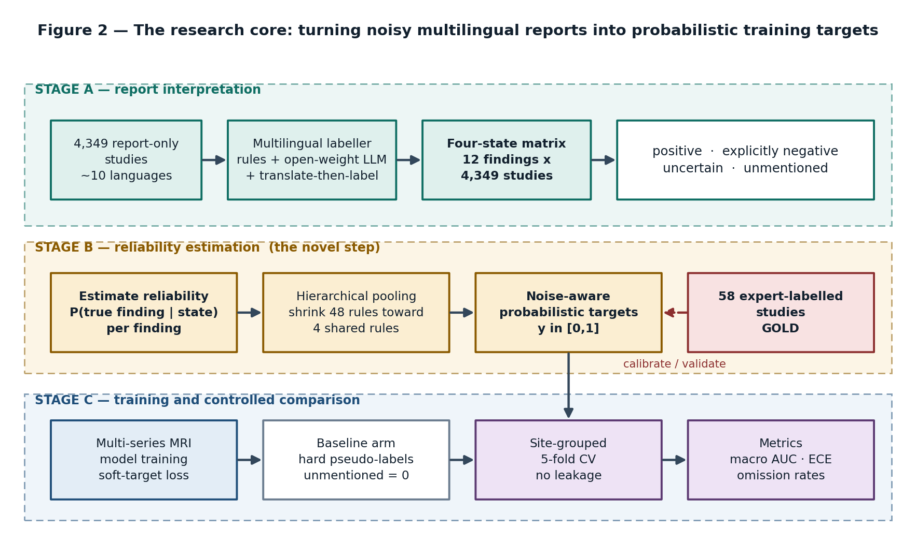
6
Proposed solution and contribution
OF 10
Architecture idea, main modules, and a clear contribution statement
Contribution statement
Existing approaches perform well when report-derived labels are treated as correct, but remain weak when a finding is present and simply unmentioned — worth about 43 percentage points for synovitis here. We will contribute a per-finding, per-state reliability model that turns four-state report evidence into calibrated probabilistic training targets, through hierarchical partial pooling on the expert-labelled subset, and evaluate it against hard pseudo-labelling under site-grouped cross-validation on macro AUC, worst-finding AUC, calibration error and per-finding omission rate.
CONTRIBUTION TYPES CLAIMED
Method — the reliability estimator.
Evaluation — the leakage-safe comparison and omission measurement.
Data — a four-state multilingual label set for 12 findings.
WHAT WE ARE NOT CLAIMING
Not a new network architecture. Not a leaderboard win. Not clinical validation. The image model is deliberately conventional so that any measured difference is attributable to the labels.
Figure 2 — turning noisy multilingual reports into probabilistic training targets
KneeWS · noise-aware weak supervision · proposal defence
6
Notes:
Read the contribution statement verbatim — it is written to the handbook's template on purpose, and the panel will recognise the shape. Then point at the diagram and say where the novelty sits: one box, the reliability estimation stage. Everything else is engineering around it.

Slide 7
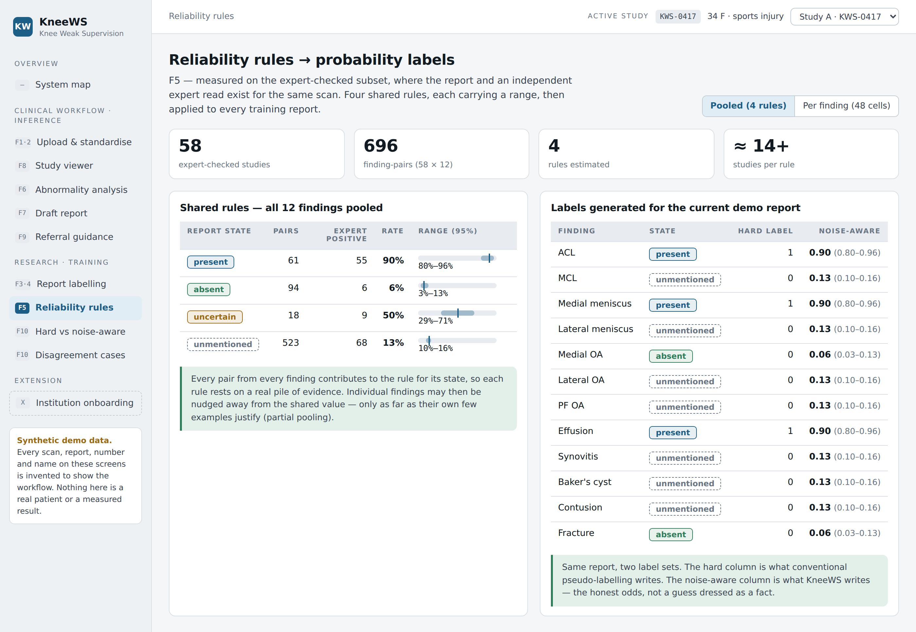
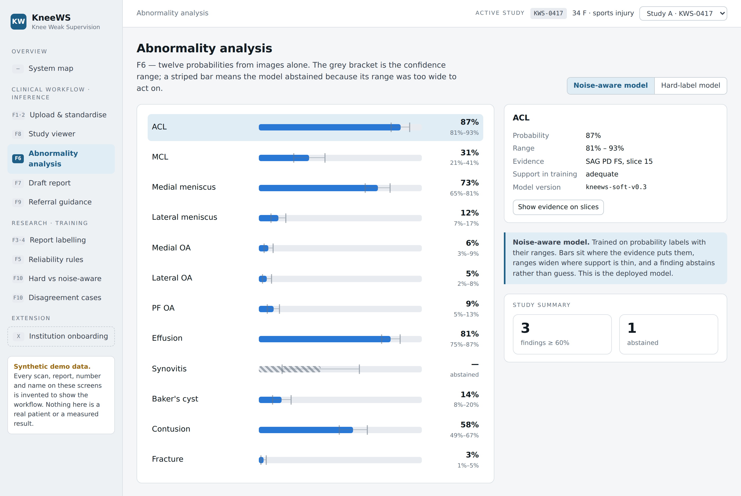
7
POC-lite / feasibility evidence
OF 10
The riskiest assumption, what we ran, what came back, and what it changed
POC 1 — can the estimator work at all?
POC 2 — does the workflow hold together?
POC 3 — do the constraints permit it?
Risky assumption
That 48 reliability quantities (12 findings × 4 states) can be estimated from 58 expert studies.
That report labelling, reliability and image analysis can be one coherent product rather than three scripts.
That 569 GB of DICOM can be processed on an 8 GB laptop GPU, within competition rules.
Input and setup
58 × 12 = 696 finding-pairs, pooled to state level; partial-pooling arithmetic with intervals.
Clickable high-fidelity prototype, 10 screens, synthetic demo data, hard vs noise-aware toggle.
Rules review; two-stage 2.5D design with a frozen encoder and cached features.
Result
Pooled state rules estimable with usable intervals. Per-finding cells not — median cell ~14 pairs.
End-to-end path runs: upload, analyse, draft report, refer, and research path: label, estimate, compare, inspect.
Hosted LLM APIs not permitted for report text. Feature caching moves head training to minutes on CPU.
What it changed
Partial pooling became the committed design. Per-finding estimation dropped from scope.
Confirmed the ten registered features are one system; institution onboarding moved to optional extension.
Open-weight in-notebook labeller became mandatory; 3D end-to-end training was ruled out.
Reliability rules → probability labels: pooled rules with intervals
Abnormality analysis: twelve probabilities, with abstention
STATED PLAINLY
Every number in the prototype is synthetic, no image model trained yet, dataset figures second-hand pending first-hand verification — this POC establishes feasibility and two design decisions, not results.
KneeWS · noise-aware weak supervision · proposal defence
7
Notes:
The handbook is explicit that a slide saying a POC was done is not a POC. Show the screens live if there is time, and state the POC 1 result plainly: the arithmetic told us we could not do what we originally planned, and we changed the design. A POC that disproved an assumption is worth more than one that confirmed it.

Slide 8
8
Evaluation plan and risks
OF 10
How success will be measured; risks, dependencies, and the tool / API / GenAI boundary
Evaluation question
Our answer
What is the baseline?
Hard pseudo-labelling with unmentioned treated as absent — the approach behind the public 0.891 baseline. Further arms: uncertainty heuristics, MAPLEZ-style verbalised probability, and gold-free confident learning.
What data and cases?
4,349 report-only studies for training; 58 expert-labelled studies held for validation; site-grouped 5-fold cross-validation, because random folds inflate AUC by about +0.053 here.
What metrics?
Macro AUC across the twelve findings (the competition metric); worst-finding AUC; calibration error on the expert set; per-finding omission estimate; per-language noise profile.
Measurable non-functional criterion
Inference on a new study within 60 seconds on an 8 GB GPU; the full offline pipeline inside the 9-hour notebook budget.
Which failure cases matter?
Rare findings with thin counts; synovitis, where the model may be blind to what it must detect; severity-dependent omission; any site leakage surviving fold construction.
What can the evidence support?
A narrow claim — that modelling report reliability improves calibration and yields the first per-finding omission estimates for knee MRI. We will not claim a large AUC gain; the closest comparator gained +0.4.
RISKS, DEPENDENCIES AND COMMITTED SCOPE
TOOL / API / GENAI BOUNDARY
• AUC gain too small to claim — lead with calibration and omission, not accuracy.
• Site leakage — site-grouped folds enforced in code from week six.
• Prior publication — Ye 2026 and Xiao 2024 read before the claim is written.
• 58 too few for stable estimates — partial pooling.
• Compute limits — two-stage 2.5D, one GPU pass; subset declared if reduced.
• The 58 figure is wrong — verified first-hand in week one.
• Committed scope excludes institution onboarding; formats beyond DICOM and NIfTI are optional.
Support: PyTorch, pydicom, scikit-learn, Git.
Core-assist: frozen pretrained encoder; open-weight in-notebook LLM for report labelling, hand-audited.
Core-replacement: none.
The swap test: replace either core-assist with a comparable alternative and the contribution survives — we claim the label model, not the backbone. An AI-usage log runs from week one, countersigned.
KneeWS · noise-aware weak supervision · proposal defence
8
Notes:
Ten marks sit on the tool boundary alone, so do not rush the right-hand box. The swap test is the sentence to say out loud: replace the encoder with any comparable model and our contribution is untouched. That is what separates core-assist from core-replacement in the handbook.

Slide 9
9
Work division and iteration plan
OF 10
Member-wise responsibilities and milestones
Member
Primary technical ownership
Decisions they own
FYP-1 evidence
Member 1
Data and imaging pipeline
DICOM and NIfTI ingestion, series reconstruction and protocol profiling, preprocessing, frozen-encoder feature caching, site-grouped fold construction.
Slice selection strategy; resampling and normalisation; how sites are identified and grouped; the caching format everything downstream reads.
Working ingestion on real studies; cached features; an automated leakage check on the folds.
Member 2
Labelling and reliability
Multilingual four-state labeller (rules, open-weight LLM, translate-then-label), the four-state matrix, and the reliability estimator with pooling.
How each language is handled; how the three labelling routes are combined; the pooling prior; which findings earn a deviation from the shared estimate.
Four-state matrix over 4,349 studies; hand-audited labeller error rate; reliability table with intervals.
Member 3
Model, evaluation and application
Training arms and the soft-target loss, the metrics and calibration harness, disagreement analysis, and the clinical-facing screens.
Loss formulation for probabilistic targets; which metrics are primary; abstention thresholds; what evidence the interface exposes.
Baseline run with out-of-fold predictions; the comparison harness; the working viewer and analysis screens.
SHARED RESPONSIBILITIES
THE SCOPE TEST APPLIED
Architecture and integration, quality assurance, the evaluation design itself, ethics and legal compliance, repository discipline, and the defence. Ownership is primary, not exclusive — every member can explain the whole idea.
Remove any one member and a genuinely difficult subsystem and its evidence disappear — the label pipeline, the estimator, or the evaluation. None of the three is interface work or documentation.
Phase
Milestones
FYP-1
W1–2 verify dataset facts first-hand and secure storage · W2–4 ingestion and protocol profiling · W4–7 multilingual four-state labeller · W6–8 feature cache and site-grouped folds · W8–10 baseline arm and out-of-fold predictions · W10–13 reliability estimation with intervals · W13–15 checkpoint and the primary-versus-secondary decision
FYP-2
W16–19 noise-aware training and the remaining arms · W19–22 disagreement and per-language analysis · W22–26 viewer, structured report and referral guidance · W26–28 calibration, evaluation harness and reproducibility packaging · W28–30 acceptance testing with a domain-expert proxy, write-up and defence
KneeWS · noise-aware weak supervision · proposal defence
9
Notes:
The scope test box is the answer to the question the handbook tells panels to ask. Say it directly: remove any one of us and a hard subsystem plus its evidence vanishes. Nobody here owns only slides or only testing.

Slide 10
10
DEI, Ethics and legal issues
OF 10
Statements we can be held to, not boilerplate
DIVERSITY, EQUITY AND INCLUSION
ETHICS
LEGAL AND PROFESSIONAL
• The core measurement of this project is an equity measurement.
• We report omission rates per language. If the system degrades for Turkish, Croatian or Greek reporting sites relative to English, our own headline metric exposes it rather than hiding it.
• Accessibility is built in, not retrofitted: colour-blind-safe palette, no meaning carried by colour alone, keyboard-navigable review screens, and readable type in the clinical views.
• Within the team, primary technical ownership is distributed across the three genuinely difficult subsystems, with a rotating reviewer so no member is confined to interface or documentation work.
• De-identified public research data. No patient recruitment, no new data collection, no identifiable records handled by the team.
• The system abstains rather than guesses.
• Where the confidence range is too wide to act on, it reports abstention instead of a number — the behaviour a decision-support tool should have.
• Every screen carries a standing non-diagnostic disclaimer. Referral guidance names a specialist category, never a named doctor, a diagnosis or a treatment.
• Failures, disagreements and the limits of the evidence are reported as results, not omitted from them.
• No real users can be reached inside two semesters for a clinical tool. Acceptance testing will use a domain-expert proxy, declared now at proposal stage rather than at the final defence.
• RSNA / Kaggle competition data licence and rules observed, including the prohibition on hosted LLM APIs for report text and the offline notebook constraint.
• Only open-weight models with permissive licences. All external code, models, datasets and prompts attributed in the dependency disclosure sheet.
• No redistribution of DICOM data. Derived features and trained weights only.
• An AI-usage log is maintained from week one and countersigned by the supervisor, covering ideation, code generation, debugging, test generation and documentation.
THE STANDING DISCLAIMER, CARRIED ON EVERY SCREEN OF THE SYSTEM
KneeWS is a medical-imaging research and decision-support system. It is not a clinically validated diagnostic system, it does not provide diagnosis or treatment advice, and its referral guidance names a specialist category only.
KneeWS · noise-aware weak supervision · proposal defence
10
Notes:
The DEI point is the one that is genuinely ours rather than generic: our headline metric is a per-language equity measurement. Most projects bolt DEI on; here it falls out of the research question, and that is worth saying plainly.

