Slide 1
FUUAST CMS - Complaint Management System
Final Year Project | Federal Urdu University | Aimal Khan Ahmed Khan | FCMS-2026-0001 | 48 Commits | Anonymous | 72h Escalation | Email

Slide 2
Problem Statement
• Manual system: Papers lost, no tracking, no transparency
• Students afraid to complain due to identity reveal
• No escalation if coordinator doesn't act for 72h
• No email notification on status change
• Solution: Digital CMS with FCMS-2026-0001, Anonymous Locked, 72h Auto-Escalation, Email

Slide 3
Key Features Week 5-8
• Week 5: FCMS-2026-0001 Auto ID Engine + Anonymous Complaint Locked Yes/No
• Week 6: My Complaints Page - List with FCMS code, Search by FCMS-2026-0001, Status Tracking
• Week 7: Admin Panel /admin/complaints + Status Update + 72h Auto-Escalation php artisan complaints:escalate -> 1 complaints escalated after 72h!
• Week 8: Email Notification - ComplaintStatusMail - FCMS Resolved email in log + Gmail Inbox
• Security: Role-based access student, coordinator, hod, admin

Slide 4
Tech Stack
• Backend: Laravel 11, PHP 8.2, SQLite (database.sqlite)
• Frontend: Blade, Tailwind CSS, HTML
• Features: Laravel Mail, Console Commands, Eloquent ORM
• Tools: VS Code, Git, GitHub, dbdiagram.io for ERD
• Security: Anonymous flag, Role-based, complaint_code UNIQUE

Slide 5
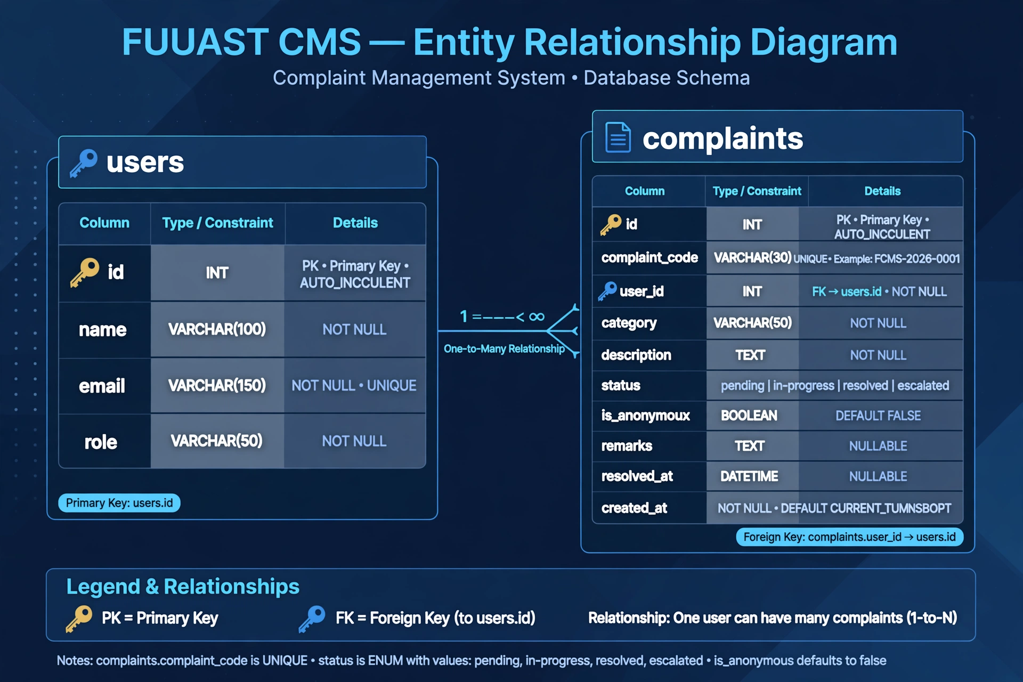
ERD Diagram
• Tables: users (id PK, name, email, role) and complaints (id PK, complaint_code UNIQUE FCMS-2026-0001, user_id FK->users.id, category, description, status, is_anonymous BOOLEAN, remarks, resolved_at, created_at)
• Relationship: One USER can have many COMPLAINTS (One-to-Many) complaints.user_id -> users.id FOREIGN KEY
• Constraints: complaint_code UNIQUE, status ENUM pending/in-progress/resolved/escalated, is_anonymous DEFAULT false
• Image: public/ERD.png saved in public folder, shown in README.md

Slide 6
Workflow Demo Flow
• Step 1: Student Register/Login -> Submit Complaint -> Category, Description, Anonymous Checkbox -> System generates FCMS-2026-0001
• Step 2: My Complaints -> See FCMS-2026-0001 pending with status badge
• Step 3: Coordinator Login coordinator@fuuast.edu.pk -> Admin Panel /admin/complaints -> Update Status to Resolved + Remarks
• Step 4: System sends Email: ComplaintStatusMail -> Subject FCMS-2026-0001 resolved -> Log in storage/logs/laravel.log + Gmail Inbox
• Step 5: If pending >72h: php artisan complaints:escalate -> Status auto escalated -> Remarks: Auto-escalated after 72h

Slide 7
72h Auto-Escalation - Technical
• Command: app/Console/Commands/EscalateComplaints.php
• Logic: Check where status=pending and created_at < now()->subHours(72) -> Update to escalated + remarks
• Cron: Can be scheduled daily via Laravel Scheduler
• Terminal Proof: 1 complaints escalated after 72h! - Screenshot with FCMS-2026-0001
• Test Route: /test-escalate sets FCMS-2026-0001 to 4 days old pending for testing
• Viva Point: What if coordinator doesn't act? Auto-escalation to HOD after 72h!

Slide 8
Email Notification - Week 8 Day 1
• File: app/Mail/ComplaintStatusMail.php - Mailable class with $complaint
• View: resources/views/emails/complaint_status.blade.php - HTML email with FCMS code, Status, Remarks
• Controller: Admin/ComplaintController.php - updateStatus sends Mail::to(user->email)->send(new ComplaintStatusMail)
• .env: MAIL_MAILER=log for testing (saves to storage/logs/laravel.log) + smtp for real Gmail
• Proof: laravel.log opened in Notepad shows From: fuuast@fuuast.edu.pk, Subject: FCMS-2026-0001 resolved + Gmail Inbox 2 emails

Slide 9
GitHub & Deployment - 48 Commits
• GitHub: https://github.com/aimalkhanbangash11111-design/fuuast-cms
• Commits: Week1-8 - Week5 ID Engine, Week6 My Complaints, Week7 Admin +72h, Week8 Email+ERD+README
• README.md: Features, Tech Stack, Setup, Admin Login, Viva Points FCMS-2026-0001
• public/ERD.png: ERD image saved in public folder
• Deployment: Ready for Render.com / Hostinger - composer install && php artisan migrate --force
• Stats: 48 commits, 10+ files, 2 tables, 1 command, 1 mail, 1 ERD

Slide 10
Live Demo & Conclusion - FYP DONE!
• Demo: Student Login -> Submit Complaint -> Get FCMS-2026-0001 -> My Complaints -> Search -> Admin Login -> /admin/complaints -> Update Resolved -> Email Sent! -> Check laravel.log + Gmail
• Viva Q&A: Q1: FCMS-2026-0001 generation? A: Complaint model boot creates FCMS-YEAR-XXXX auto increment
• Q2: Anonymous? A: is_anonymous boolean hides name Q3: 72h? A: EscalateComplaints checks created_at <72h Q4: Email? A: ComplaintStatusMail
• Future: SMS Notification, File Attachment, Department-wise routing, Dashboard analytics
• Thank You: FUUAST CMS v1.0 - Final Year Project - Aimal Khan Ahmed Khan - Degree Done!

