Slide 1
Deixiscript:
Exploring and Implementing a Common Sense Approach to Naturalistic Programming
Candidate: Aiman Al Masoud
Supervisor: Prof. Marco Porta
A/Y: 2022/2023

Slide 2
Naturalistic Programming
The attempt to write code using a subset of natural language.
Traditionally implemented as a special purpose programming language.
Today natural language is also relevant due to Large Language Models.
AI-Assisted coding & Prompt Engineering
Traditional programming languages could become obsolete in the medium to long term.

Slide 3

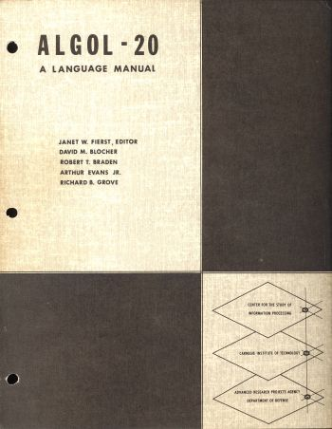
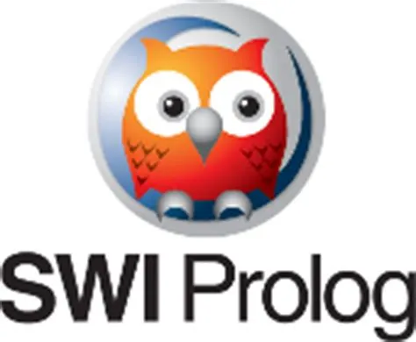

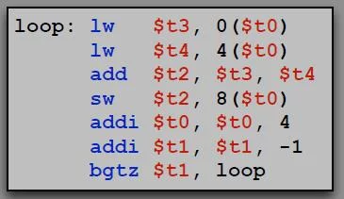
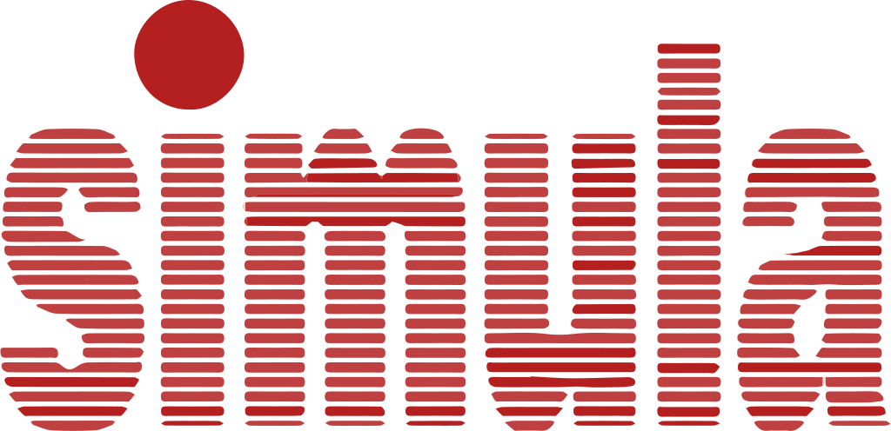
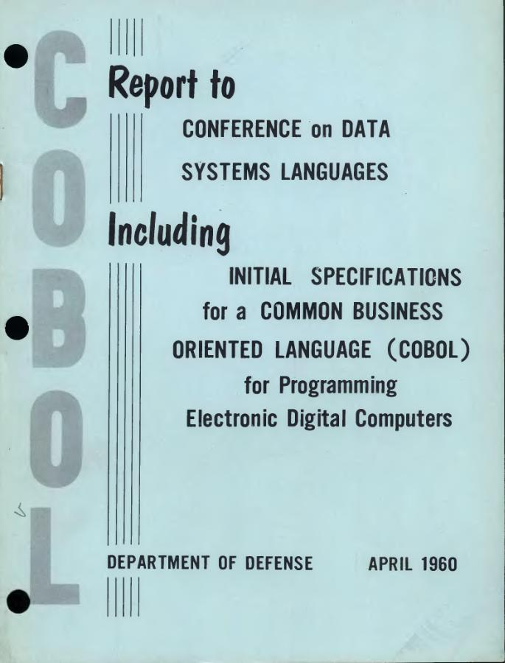

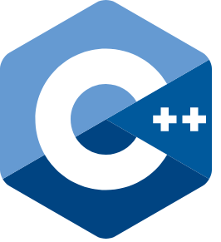
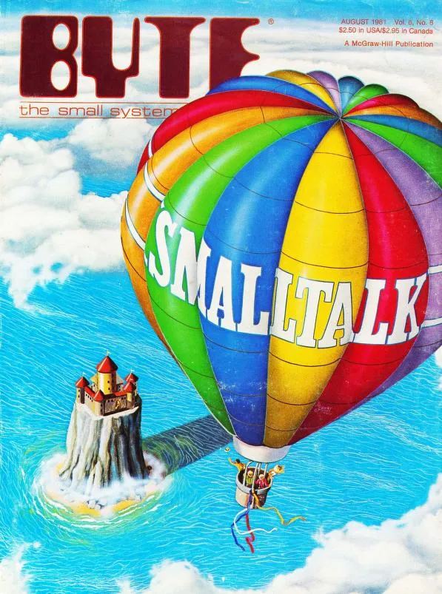
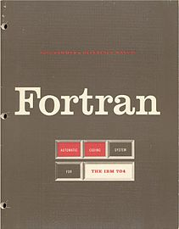
A Timeline of Programming Languages
Lisp and ALGOL 58 (1958)
Prolog (1970s)
Haskell (1990)
Assembly Languages
(late 1940s)
Simula
(early 1960s)
Machine Code
(mid 1940s)
COBOL (1959)
Smalltalk
(late 1960s)
C++
(early 1980s)
Fortran (1957)
Python, Java,
JavaScript, Scala,
Typescript, Kotlin, etc…
(> 1990)

Slide 5
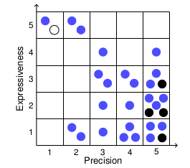
Why Naturalistic Programming
Precision/Expressiveness Trade-off
Semantic Gap
From: “A Survey and Classification of Controlled
Natural Languages”, Tobias Kuhn.
Notes:
White dots: natural languages.
Black dots: formal languages.
Blue dots: CNLs (Controlled Natural Languages).

