Slide 1
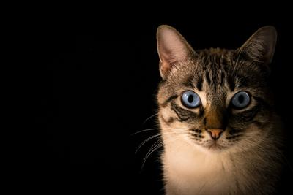
Image Quality Assessment Project

Slide 2
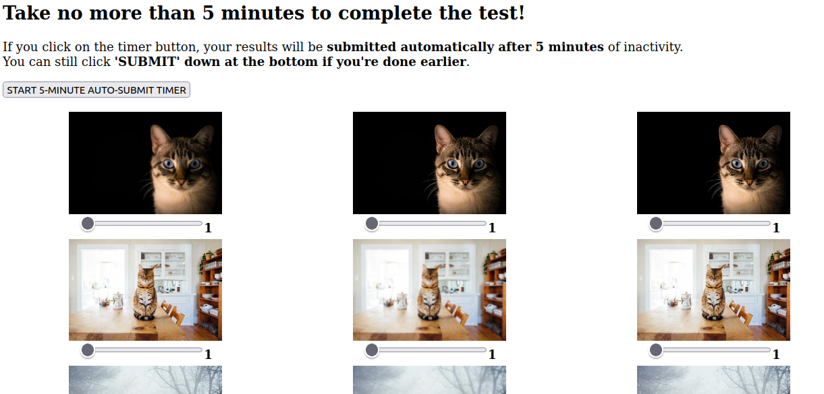
Data Collection Stage
The subjects of the experiment were directed to this website:
https://awesomehungrykitty.pythonanywhere.com/
(11 subjects partook to the experiment).

Slide 3
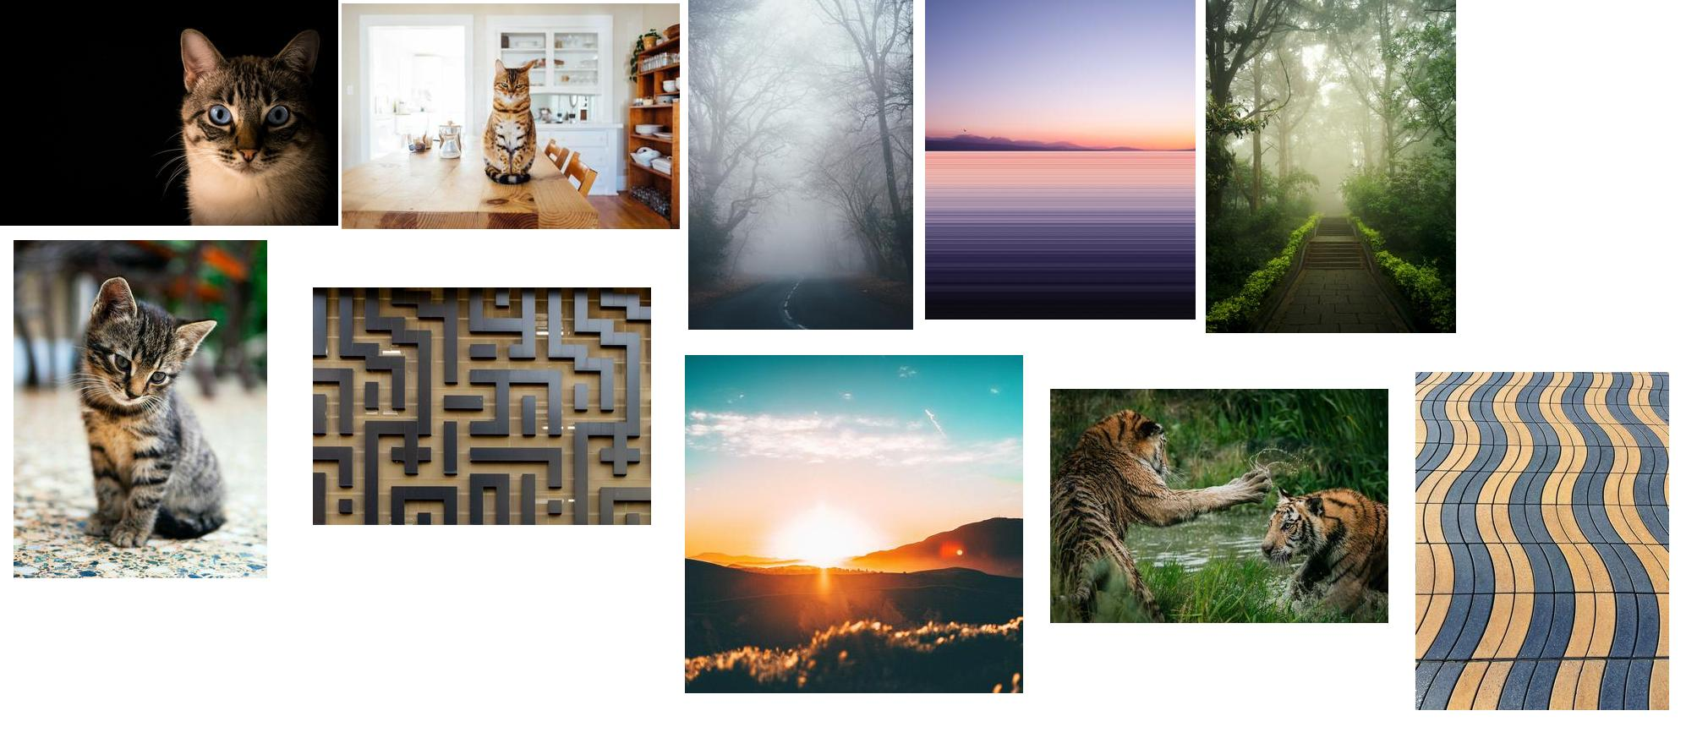
The images
cat_blue_eyes
cat_kitchen
fog
horizon
jungle
kitten
maze
tigers
sunrise
wavy_pavement
Source:
https://unsplash.com/

Slide 4
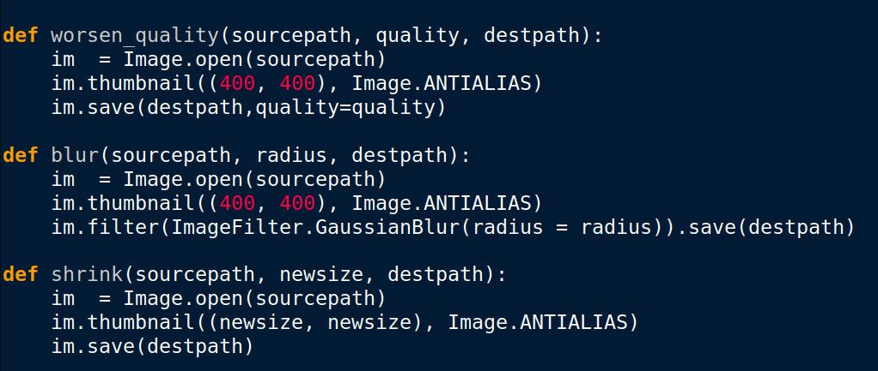
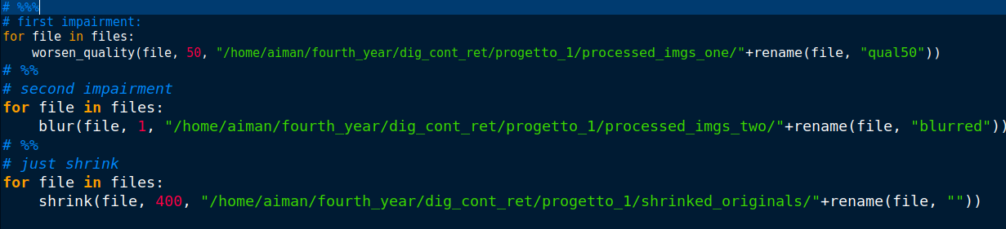
Applied Distortions:
→ Slight Distortion: JPG quality = 50
→ Significant Distortion: Gaussian blur with radius = 1

Slide 5
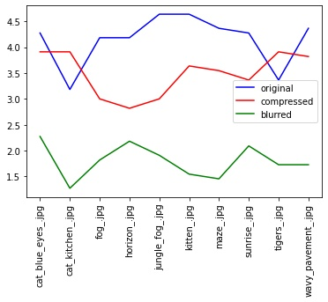
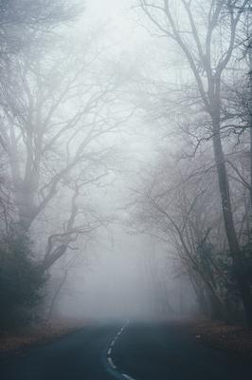
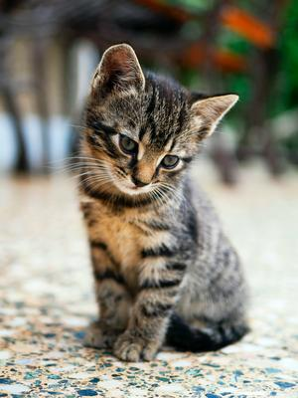
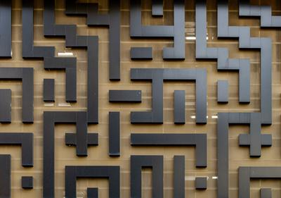
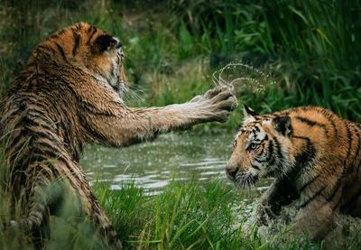
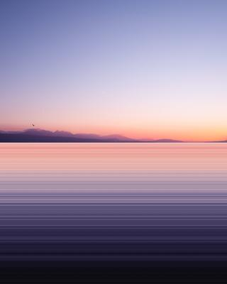
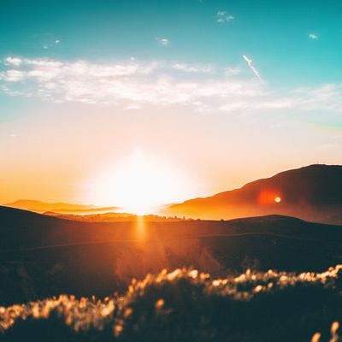
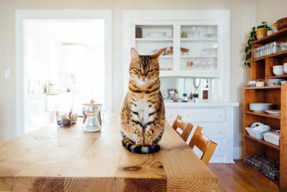
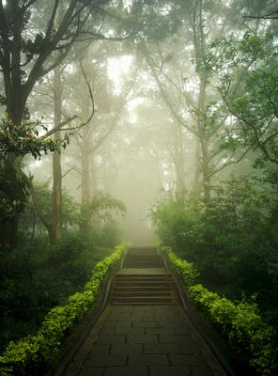
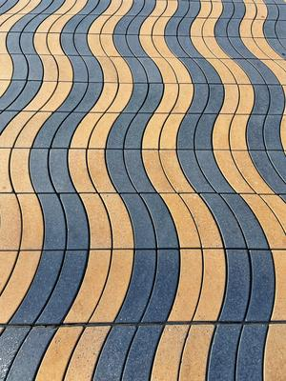
Mean Scores

Slide 6
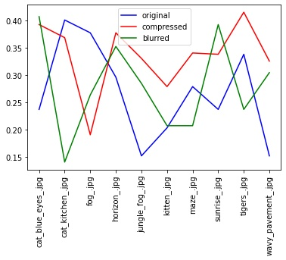
Variances of Mean Scores

Slide 7
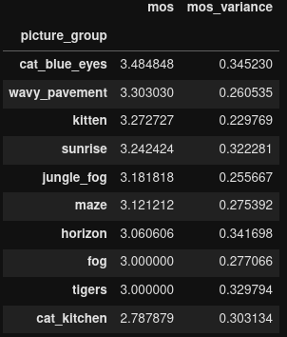
MOS and variance of each image
Sorted by mos:
Higher mos = higher appreciation of the image.

Slide 8
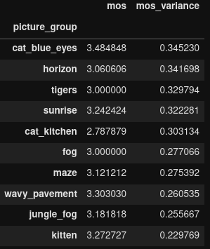
Sorted by mos_variance:
Higher mos_variance = the image is more “controversial”, people disagreed more on its rating.

Slide 9
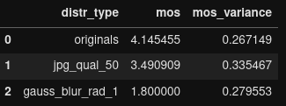
Distortion vs MOS & Variance
Disagreement higher for JPG quality = 50, which means it’s the more ambiguous and
confusing distortion of the two.

Slide 10
That’s all, thanks!

