Slide 1
Project #2 Pong
Spring 2025
0512-4494
AIMAN ABED
EDWARD KHOURY

Slide 2

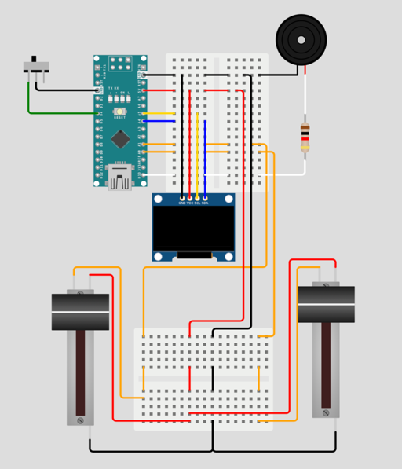
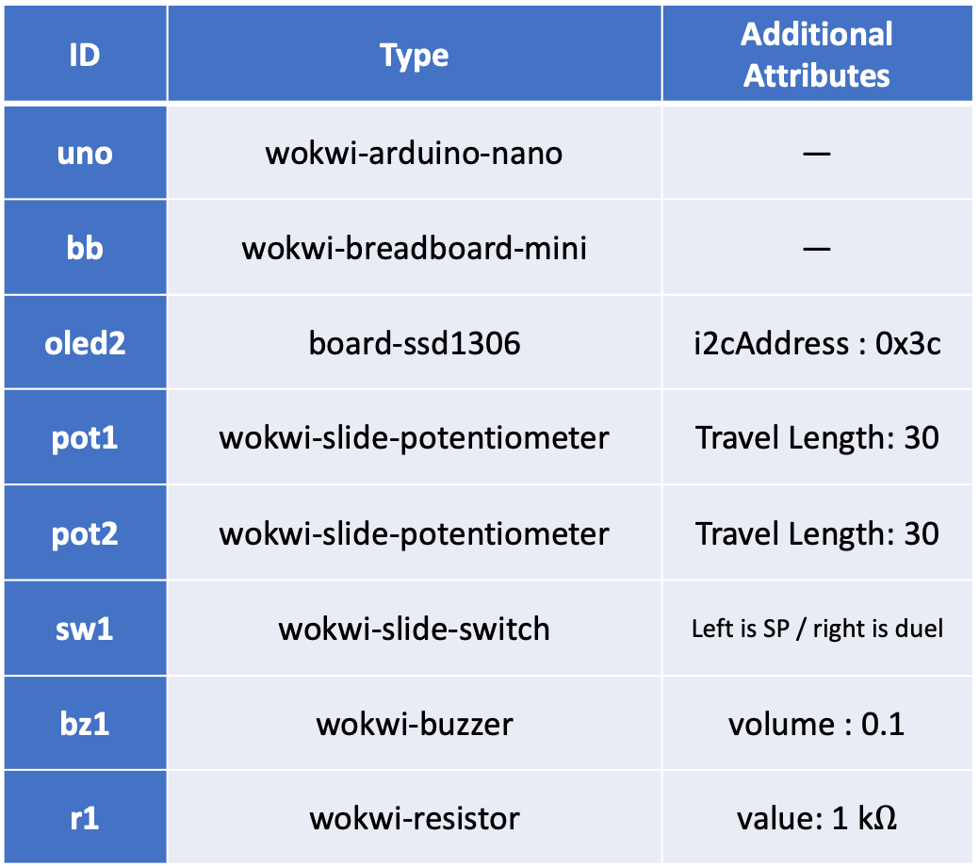
Hardware (Components) Diagram
ID | Type | Additional Attributes
uno | wokwi-arduino-nano | —
bb | wokwi-breadboard-mini | —
oled2 | board-ssd1306 | i2cAddress : 0x3c
pot1 | wokwi-slide-potentiometer | Travel Length: 30
pot2 | wokwi-slide-potentiometer | Travel Length: 30
sw1 | wokwi-slide-switch | Left is SP / right is duel
bz1 | wokwi-buzzer | volume : 0.1
r1 | wokwi-resistor | value: 1 k$Ω$

Slide 3

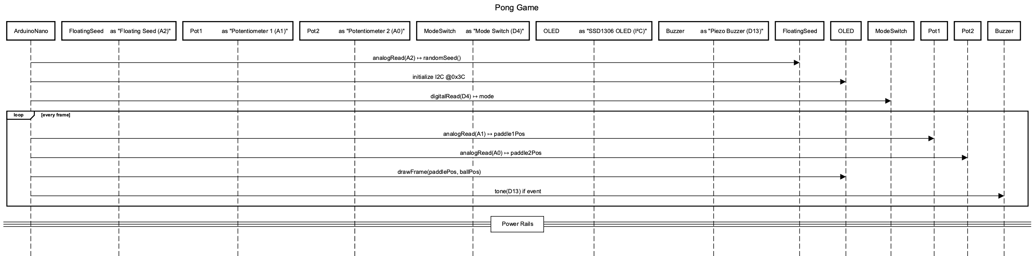
hardware Blocks Diagram

Slide 4
Software Blocks Diagram
ARDUINO
Setup
Time buffer
Game mode
game state
Slide switch
Potentiometer1
Potentiometer2
Time buffer

Slide 5
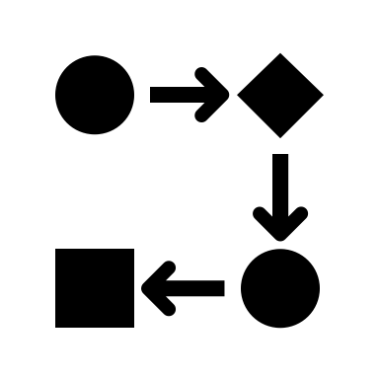
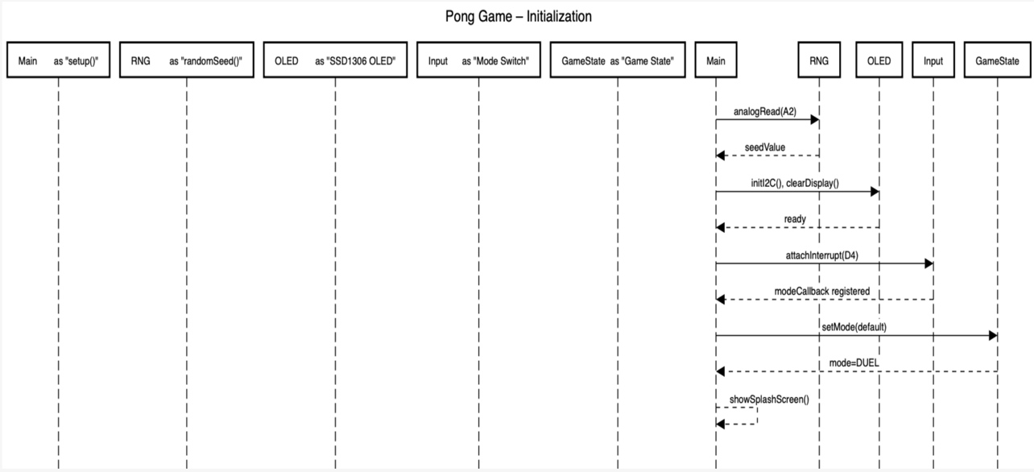
Sequences Diagram

Slide 6
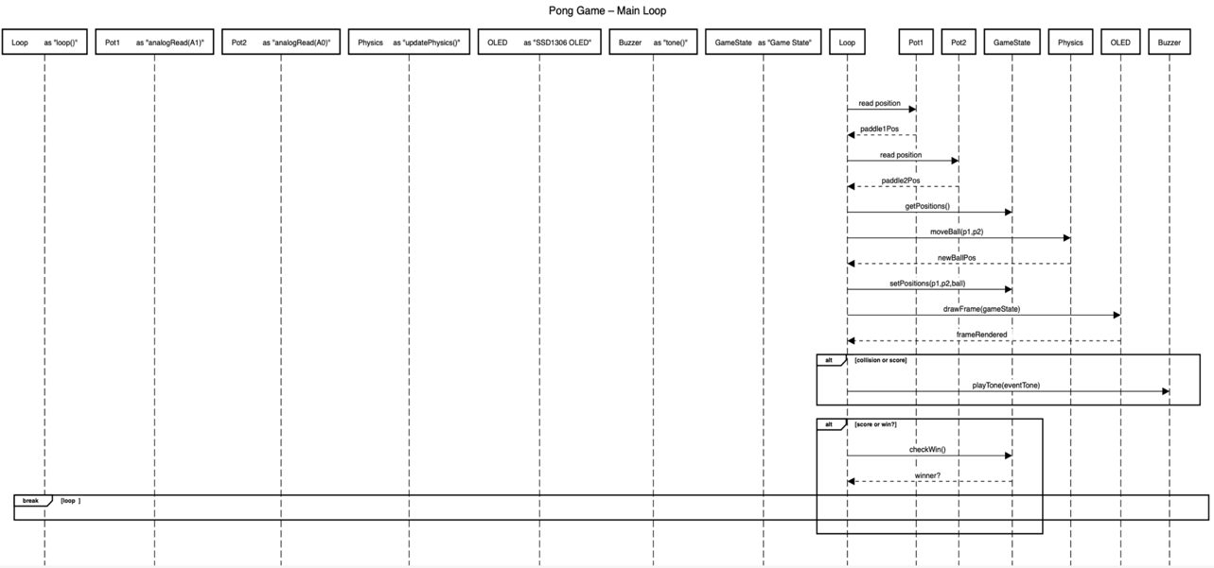

Slide 7
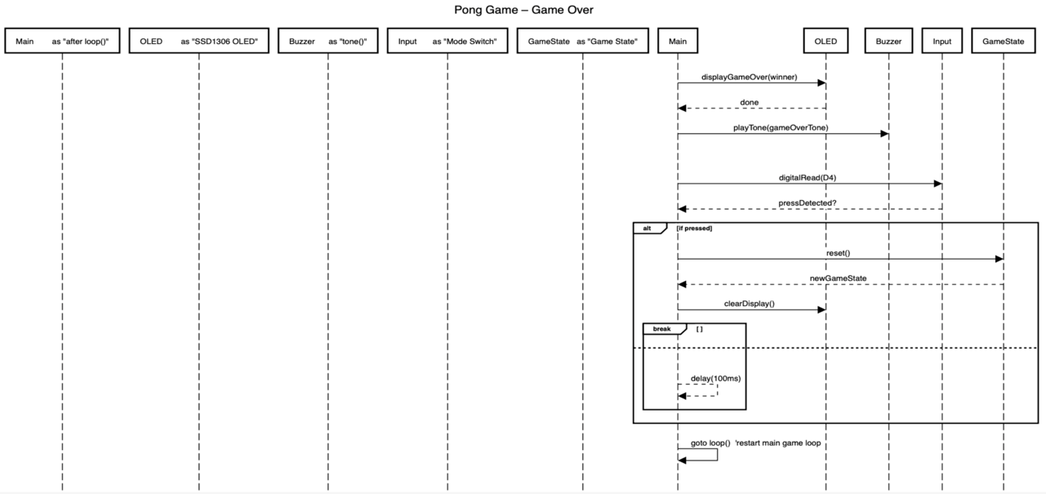

Slide 8
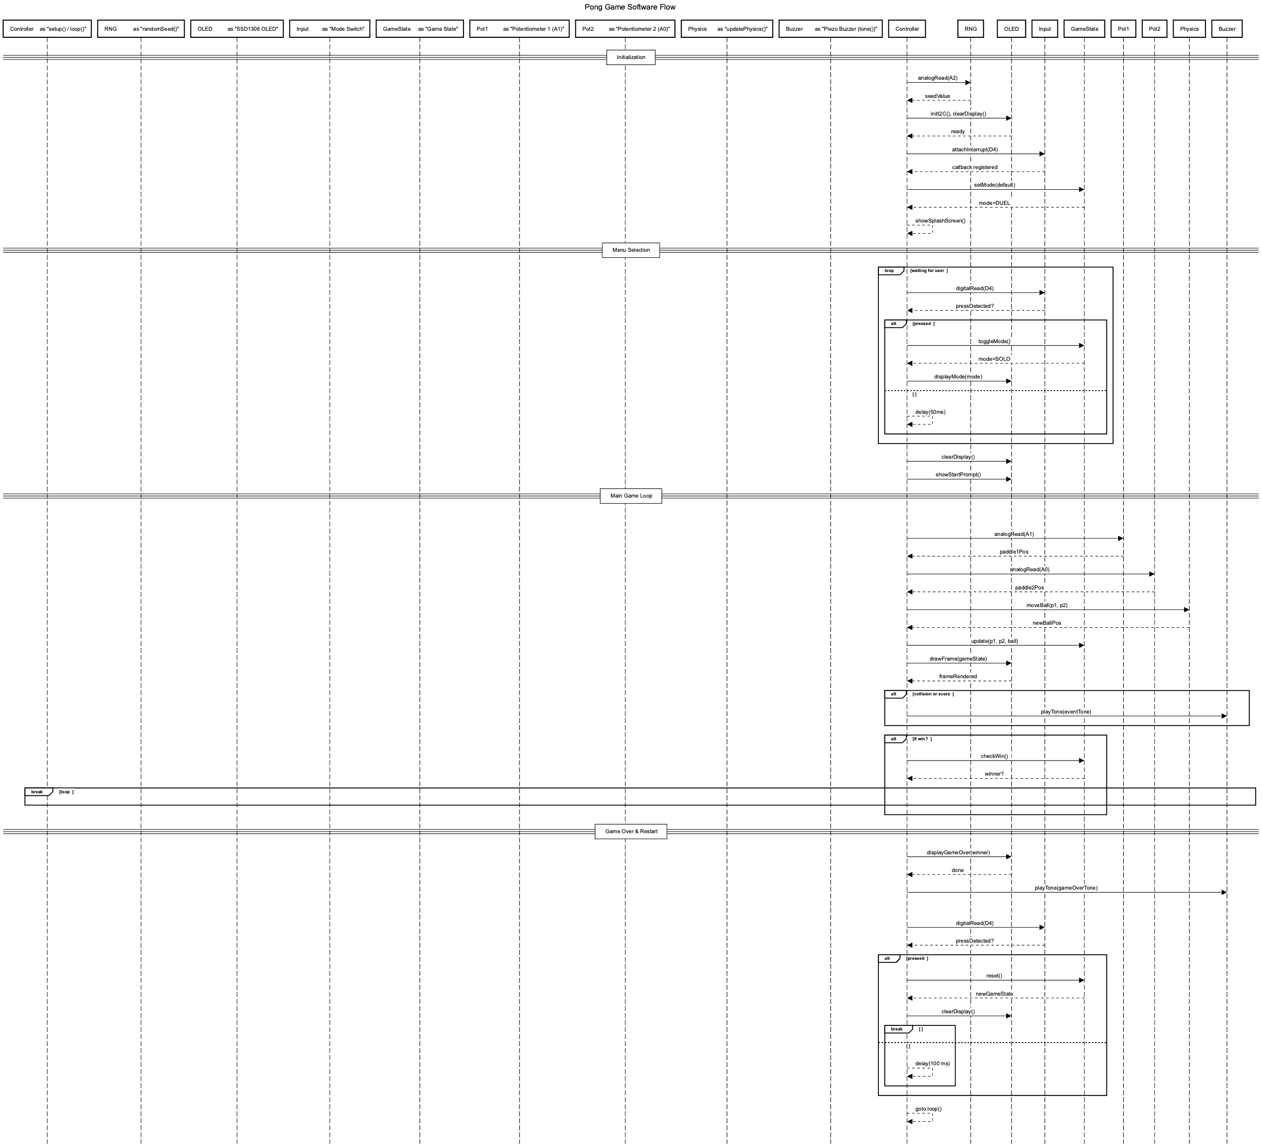

Slide 9

Live Demo
https://wokwi.com/projects/429208251543079937

Slide 10

Conclusions / Future Work
Key takeaways from this project
Learned to map analog inputs (A0/A1) to smooth paddle control.
Gained exp’ I²C communication with an SSD1306 OLED for real-time game rendering.
Organized Arduino code via clear state‐machines (setup(), loop(), game states).
Used UML block & sequence diagrams to document hardware/software flow.
Challenges
Filtering noisy analog readings to avoid jittery paddle movement.
Tuning the frame-rate to prevent display flicker and input lag.
Ideas for Improvement
High-score memory: store top scores in EEPROM for game persistence.
Difficulty levels: user’s choice of diff’ level.
Richer audio: multi-tone melodies and event-based sound effects.
Wireless controllers: swap slide pots for Bluetooth gamepads.
Enhanced UI: add animated start/pause screens and victory animations.

