Slide 1

UC STUDENT TO DO LIST
Mobile application design and development
Macaumbang Abdul ilaah

Slide 2

ITNRODUCTION
This app reminds you on time and your daily works and duties that not must forgotten.
User friendly

Slide 3
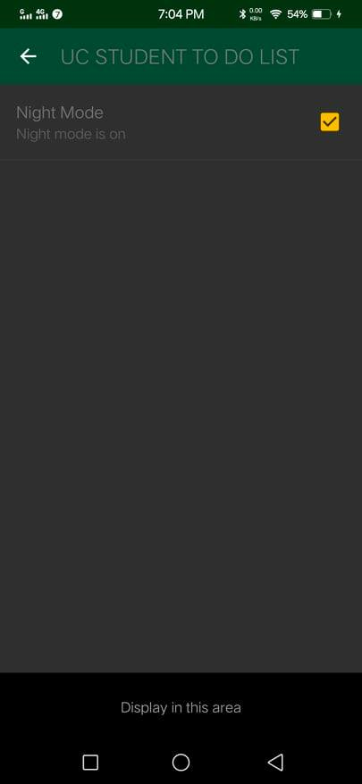
Dark mode
Dark Mode are, it enhances visual ergonomics by reducing eye strain, facilitating screens to adjust according to current light conditions and providing comfort of use at night or in dark

Slide 4
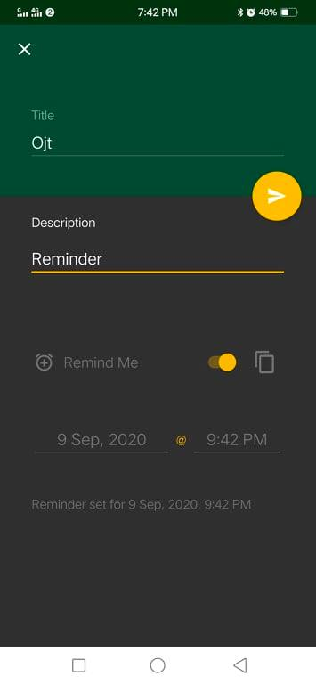
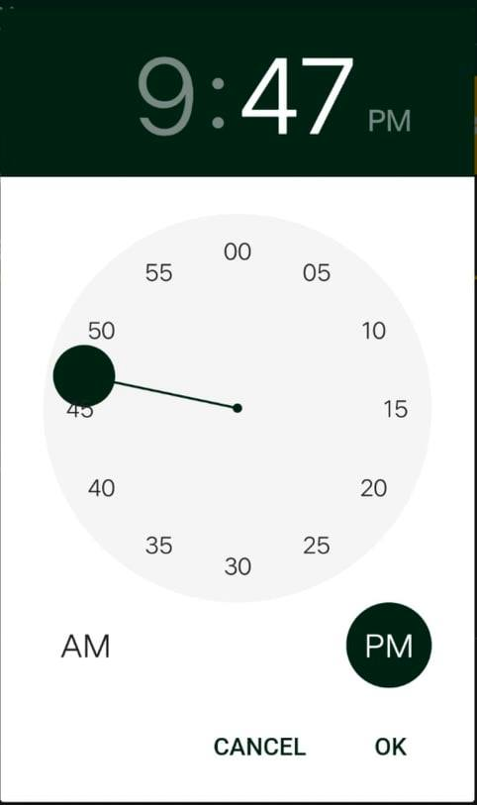
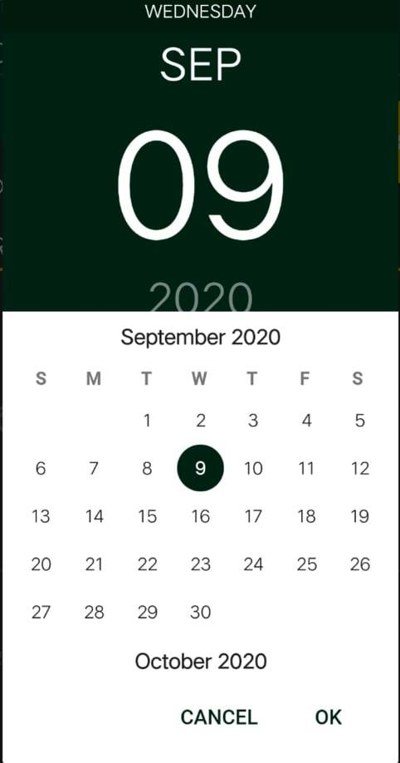
Schedule set date and time
Daily schedule
Managing your daily list.
Reminds you on time.

Slide 5

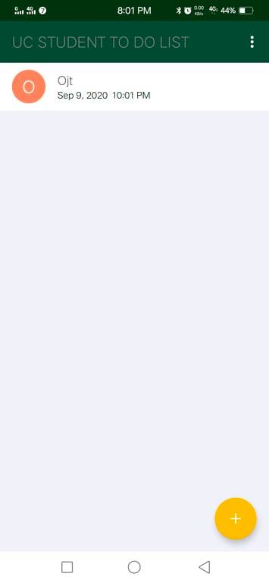
Once you confirmed you already set
And you can add more if you want by clicking button plus.
Swipe left and right for the deletion of the scheduled set

