Slide 1
Ground vehicle
Alerts

Slide 2
Objectives
Develop and construct a set of statistical analysis (algorithms, models, data mining techniques, etc.) tools for identifying required maintenance trend.
Develop and construct a set of prognostics tools for determining remaining useful life of vehicles’ component/subsystem.
Develop a system reliability framework to decrease the frequency of unscheduled maintenance.

Slide 3
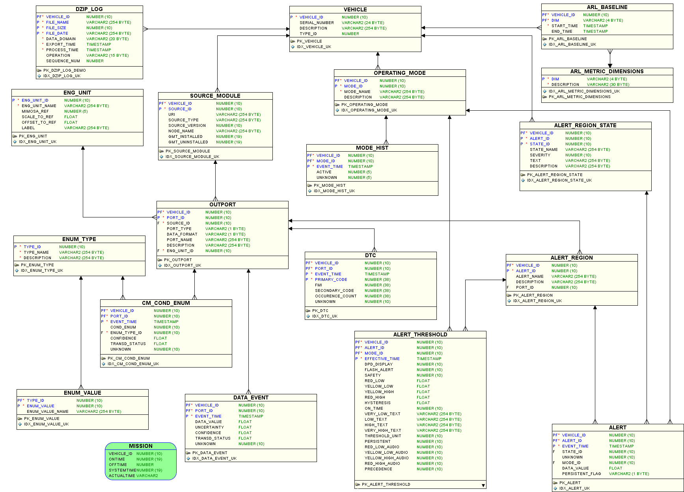
ARL BASELINE: describes different versions of EPLS hardware/software associated with each vehicle
OPERATING MODE: defines the vehicle operating mode
OUTPORT: gives a description of sensors connected with each vehicle, their type and description
ALERTS: explains threshold, state and region associated with each vehicle, operating modes and outports
ENUMERATION TABLES: gives a state level (e.g. very-low, very-high)
DATA EVENTS: provides the time history for each vehicle and sensor

Slide 4
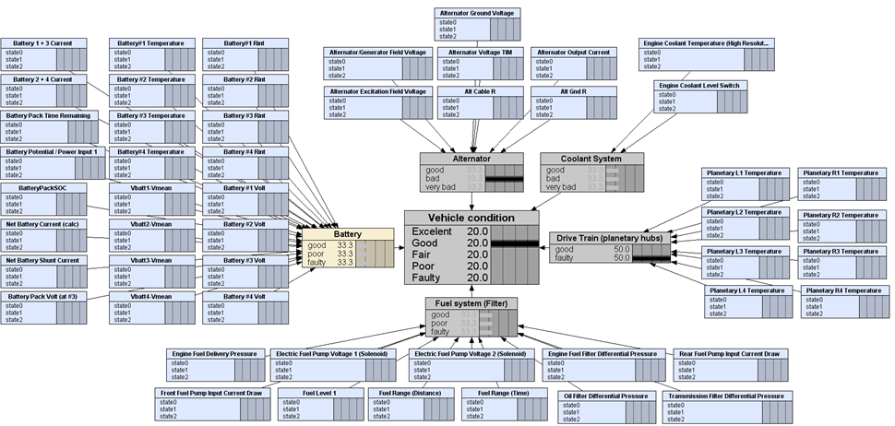
Main subsystems and related sensors

Slide 5
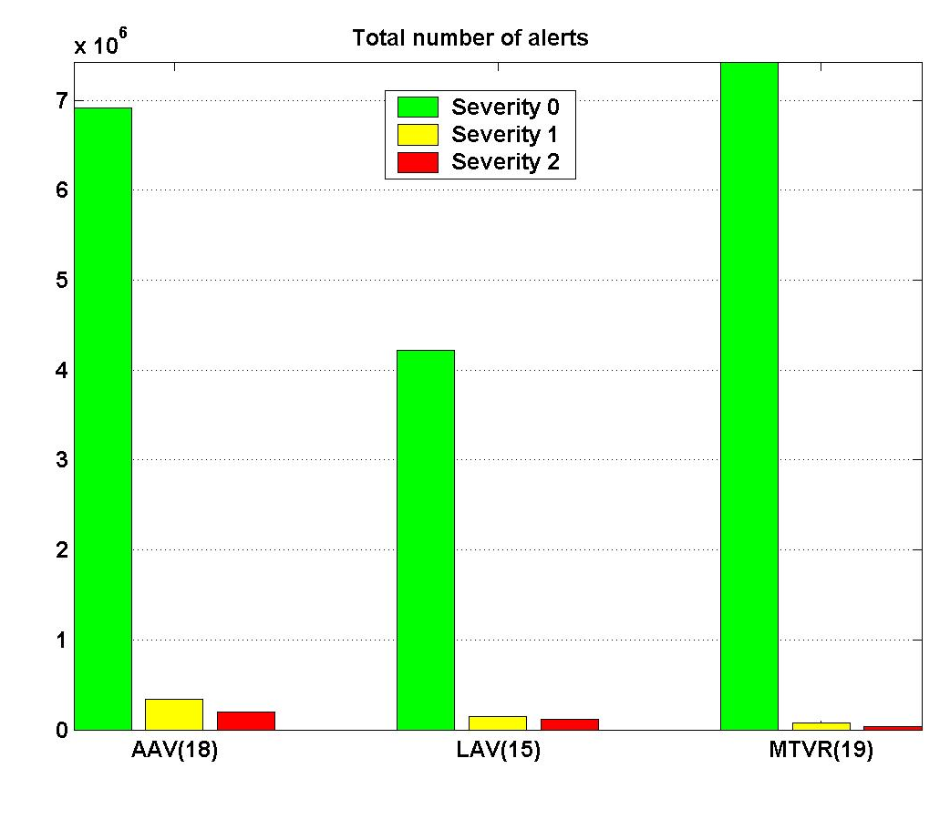
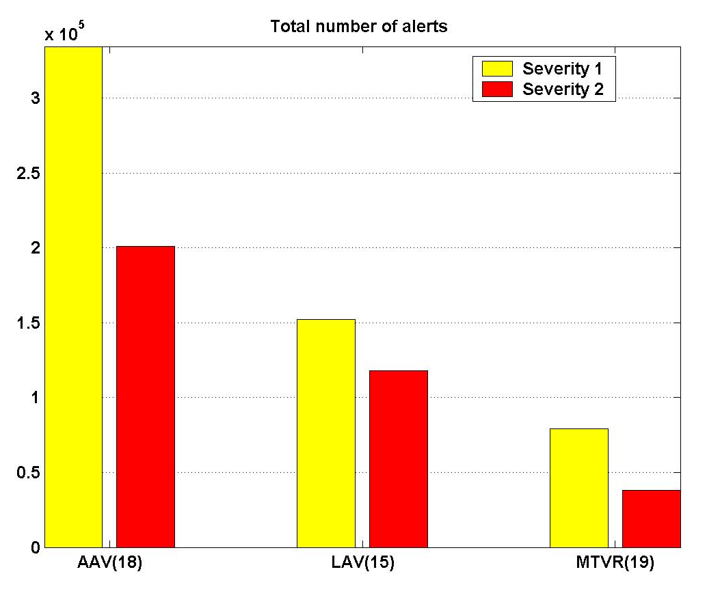
Vehicle type vs. total number of alerts

Slide 6
AAV: Vehicle vs. total number of alerts

Slide 7
AAV: Subsystem vs. total number of alerts

Slide 8
MODES
OPERATING_MODE
MODE_ID | MODE_NAME | DESCRIPTION
0 | 'Standby' | 'Master Switch On and Engine Not Running'
1 | 'Prime' | 'Starter cranking engine, fuel switch off'
2 | 'Start' | 'Vehicle is Starting'
3 | 'IgnitionOn' | 'Ignition Switch Is On'
4 | 'Run' | 'Engine running and Vehicle not Moving'
5 | 'Drive' | 'Vehicle Moving with Engine Running'
6 | 'EngineOn' | 'Engine Running'
7 | 'LowIdle' | 'Vehicle not Moving and Engine RPM Between 500 and 750'
8 | 'HighIdle' | 'Vehicle not Moving and Engine RPM Between 1100 and 1300'
9 | 'Idle' | 'Vehicle Idling (Low or High)'
10 | 'RPM-10' | 'Engine RPM Less than 1000'
11 | 'RPM10to15' | 'Engine RPM [1000 1500['
12 | 'RPM15to23' | 'Engine RPM [1500 2300['
13 | 'RPM+20' | 'Engine RPM Greater than 2000'
14 | 'DriveRPM-10' | 'Vehicle Driving with ERPM less 1000'
15 | 'DriveRPM+20' | 'Vehicle Driving with ERPM greater 2000'
16 | 'AltCharging' | 'Alternator Providing Power to Vehicle'
17 | 'Ialt+5' | 'Alternator Current greater 5A'
18 | 'StandbyDisch' | 'Vehicle in Standby and Battery Discharging'
19 | 'Ibatt+10' | 'Battery Current Greater than 10 amps'
20 | 'BattCharge' | 'Battery Pack is Being Charged'
21 | 'BattDischEngOff' | 'Battery Pack is Discharging with the engine off'
21 | 'BattDisch' | 'Battery Pack is Being Discharged'
22 | 'FrFuelPumpOn' | 'Front Fuel Pump is Powered'
23 | 'RrFuelPumpOn' | 'Rear Fuel Pump is Powered'
24 | 'IdleIalt-30' | 'Vehicle Idle and Alternator Current Less than 30 amps'
25 | 'Batt1Temp+10' | 'Battery #1 Temperature Greater than 10C'
26 | 'Batt1Temp-10' | 'Battery #1 Temperature Less than 10C'
27 | 'Batt2Temp+10' | 'Battery #2 Temperature Greater than 10C'
28 | 'Batt2Temp-10' | 'Battery #2 Temperature Less than 10C'
29 | 'Batt3Temp+10' | 'Battery #3 Temperature Greater than 10C'
30 | 'Batt3Temp-10' | 'Battery #3 Temperature Less than 10C'
31 | 'Batt4Temp+10' | 'Battery #4 Temperature Greater than 10C'
32 | 'Batt4Temp-10' | 'Battery #4 Temperature Less than 10C'
33 | 'AccelRPM15to23' | 'Acceleration positive, ERPM [1500 2300['
34 | 'RPM+20Spd+50' | 'RPM greater 2000, Speed greater 50kph'
34 | 'RPM-20Spd+50' | 'RPM greater 2000, Speed greater 50kph'

Slide 9
Cont. MODES
OPERATING_MODE
MODE_ID | MODE_NAME | DESCRIPTION
35 | 'RPM+14' | 'Engine RPM Greater than 1400'
36 | 'StdbyIbat-5' | 'Vehicle in Standby and Battery Current Less than 5 amps'
37 | 'Speed2to20' | 'Speed Between 2 and 20 km/h'
38 | 'Speed20to30' | 'Speed Between 20 and 30 km/h'
39 | 'Speed30to45' | 'Speed Between 30 and 45 km/h'
40 | 'Speed45to60' | 'Speed Between 45 and 60 km/h'
41 | 'Speed60to80' | 'Speed Between 60 and 80 km/h'
42 | 'Speed80to100' | 'Speed Between 80 and 100 km/h'
43 | 'Speed100to130' | 'Speed Between 100 and 130 km/h'
44 | 'Speed+130' | 'Speed Greater 130 km/h'
45 | 'DriveRPM1500to3500' | 'Vehicle Driving and Engine RPM Between 1500 and 3500'
46 | 'DriveRPM2000tp3500' | 'Vehicle Driving and Engine RPM Between 2000 and 3500'
47 | 'DriveAccel' | 'Vehicle Driving and Acceleration Positive'
48 | 'DriveBrake' | 'Vehicle Driving and Brake Switch On'
49 | 'RPM+15' | 'Engine RPM greater than 1500'
50 | 'RPM+7' | 'Engine RPM greater than 700'
51 | 'Speed-8' | 'Speed less than 8 km/h'
52 | 'Speed+8' | 'Speed greater than 8 km/h'
53 | 'TCLocked' | 'Torque Converter Locked'
54 | 'TrannyMode1' | 'Gear 2 and Transmission Output RPM Greater than 200'
55 | 'TrannyMode2' | 'Gear -1 and Transmission Output RPM Greater than 50'
56 | 'TrannyMode3' | 'Gear 2 and Not shifting, and Speed greater than 7 km/h'
57 | 'TrannyMode4' | 'Gear -1 and Not shifting, and Transmission Input RPM Greater than 50'
58 | 'TrannyMode5' | 'Gear -1 and Transmission Input RPM Greater 100'
59 | 'PumpState' | 'PTO Pump State Active'
60 | 'EngineOnRPM2310to2610' | 'Engine on, Engine RPM [2310 2610]'
61 | 'RPM+16' | 'Engine RPM Greater than 1600'
62 | 'BattPackI-25' | 'Battery Pack Current Less than 25A'
63 | 'Speed0to5' | 'Speed Between 0 and 5 mph'
64 | 'Speed5to15' | 'Speed Between 5 and 15 mph'
65 | 'Speed15to40' | 'Speed Between 15 and 40 mph'
66 | 'Speed40to65' | 'Speed Between 40 and 65 mph'
67 | 'Speed65+' | 'Speed Greater than 65 mph'
68 | 'LowIdleEngOilTemp+60' | 'Low Idle RPM and Eng Oil Temp Greater than 60C'
69 | 'EngineOnRPM-28' | 'Engine on and RPM less than 2800'
70 | 'EngineOnRPM-24' | 'Engine on and RPM less than 2400'
71 | 'EngineOnRPM-20' | 'Engine on and RPM less than 2000'
72 | 'EngOn1Hour' | 'Engine has been on for over 1 hour'
73 | 'RPM+1500for10Sec' | 'Engine RPM greater than 1500 for at least 10 seconds'
74 | 'RPM+1500CoolTemp+160' | 'Engine RPM greater than 1500 and coolant temp greater than 160F'
75 | 'Mode74inLast10sec' | 'Mode 74 occured within the last 10 seconds'
90 | 'VMDConnected' | 'VMD is connected'
91 | 'DAGRConnected' | 'DAGR is connected'
100 | 'TRUE' | 'Mode independent'

Slide 10
AAV: Modes vs. total number of alerts

Slide 13
Maintenance actions criterion:
Daily number of alerts/subsystem
NO Maintenance
action
Maintenance
action
NO Maintenance
action
threshold
0
i
i+1
i+2
…
j
…
k
k+1
k+2
days
Several alerts followed by no alerts for 2 consecutive days
Several alerts followed by more alerts
NOTE:
Threshold = 5
Need to include a 2nd check that next 2 days are “mission-on”

Slide 14
Predict each vehicle’s achieved availability, which is defined as the probability that a system will be available when required for use
Predict the maintenance pattern to decrease in operations/maintenance logistics footprint; enable more advanced predictive maintenance decision making based on analytical reliability models; achieve intelligent maintenance;

Slide 15
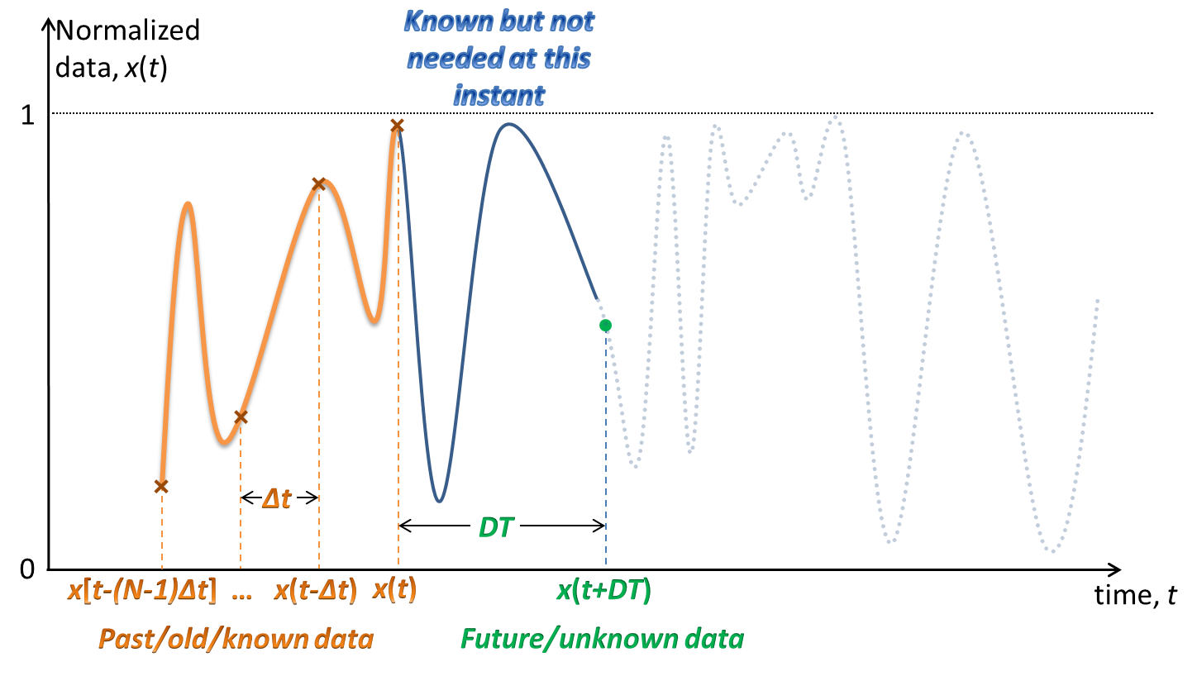
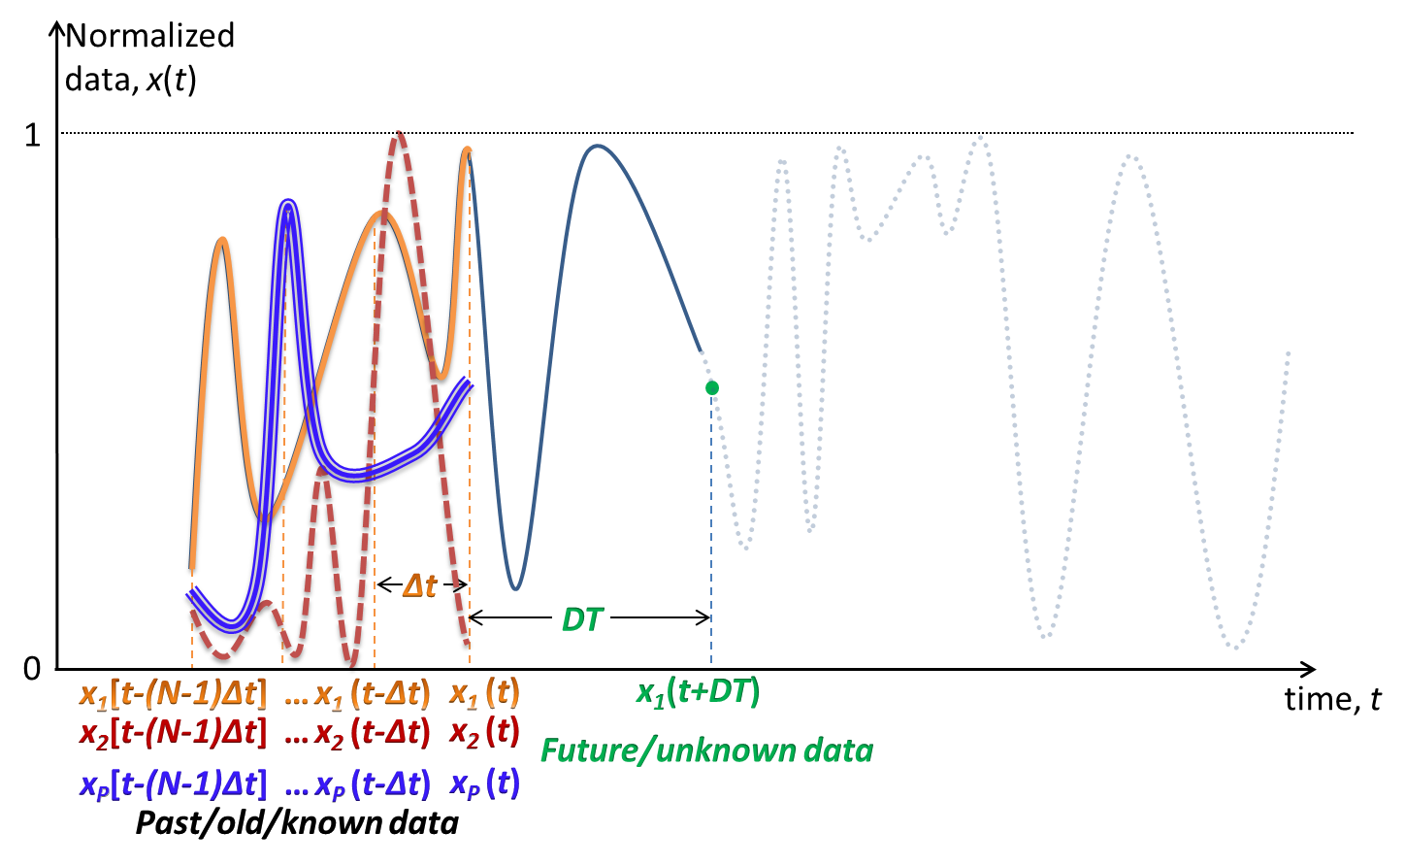
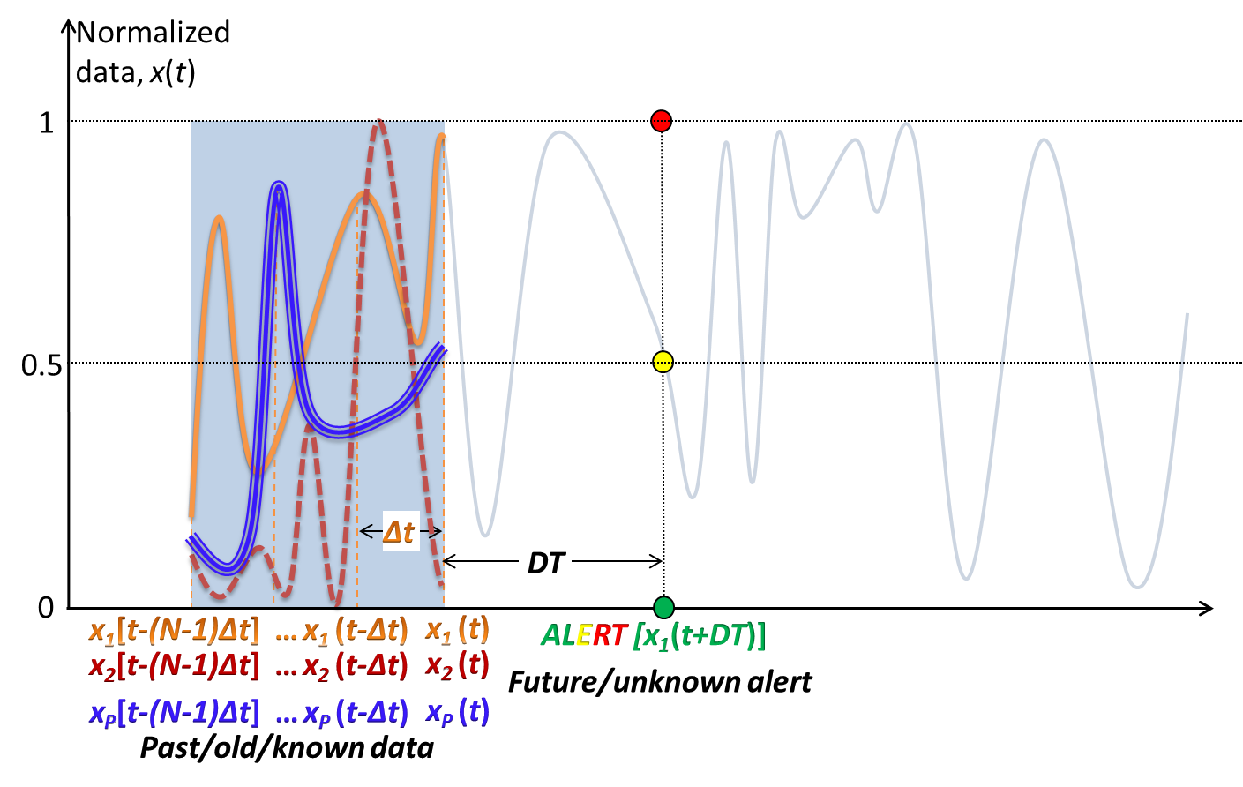
Prediction of the alert pattern
1st model: single port data function, predict future data
2nd model: given data from multiple ports from - different vehicles and - different ports predict future data
3nd model: multiple port data functions, predict future alerts

Slide 16
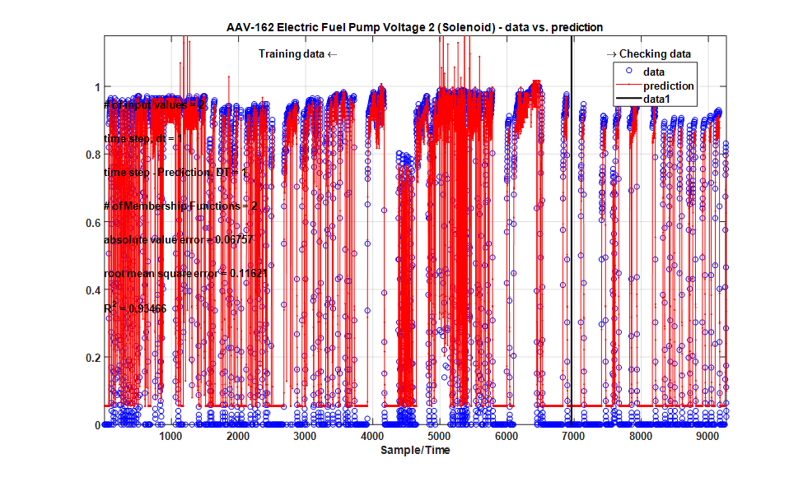
ANFIS – Artificial Neuro-Fuzzy Inference System

Slide 17
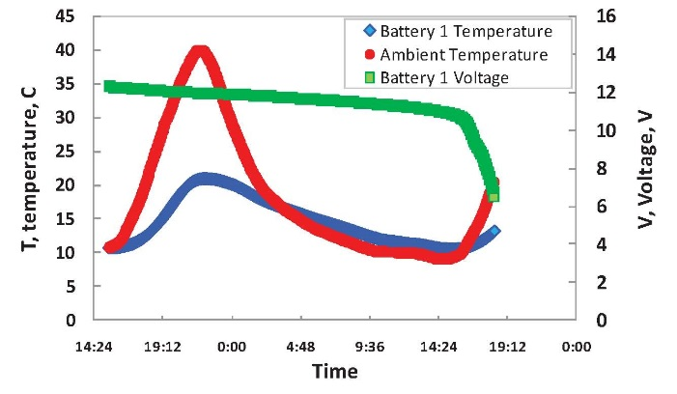
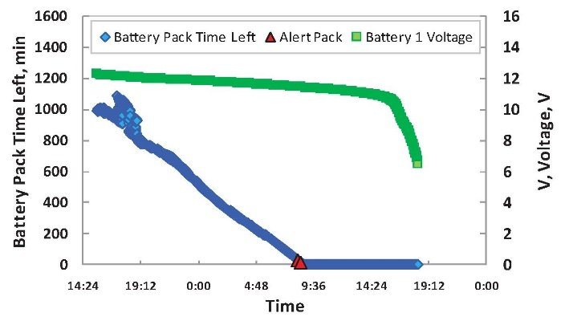
Remaining useful life of each subsystem
Batteries Voltage
Batteries Temperature
Batteries Internal Resistance
Battery Pack time remaining
Battery Pack Volt

Slide 18
Reliability of Vehicle
FUEL SYSTEM (Filter) | PORT_NAME
 | Electric Fuel Pump Voltage 1 (Solenoid)
 | Electric Fuel Pump Voltage 2 (Solenoid)
 | Engine Fuel Delivery Pressure
 | Engine Fuel Filter Differential Pressure
 | Front Fuel Pump Input Current Draw
 | Fuel Level 1
 | Fuel Range (Distance)
 | Fuel Range (Time)
 | Oil Filter Differential Pressure
 | Rear Fuel Pump Input Current Draw
 | Transmission Filter Differential Pressure
 | PORT_NAME | BATTERY
 | Battery #3 Volt
 | Battery #4 Volt
 | Battery 1 + 3 Current
 | Battery 1 Temperature
 | Battery 1 Voltage
 | Battery 2 + 4 Current
 | Battery 2 Temperature
 | Battery 2 Voltage
 | Battery 3 Temperature
 | Battery 4 Temperature
 | Battery Pack Time Remaining
Vehicle
ALTERNATOR | PORT_NAME
 | Alt Cable R
 | Alt Gnd R
 | Alternator Excitation Field Voltage
 | Alternator Ground Voltage
 | Alternator Ground Voltage
 | Alternator Output Current
 | Alternator Output Current
 | PORT_NAME | DRIVE TRAIN
 | Planetary L1 Temperature
 | Planetary L2 Temperature
 | Planetary L3 Temperature
 | Planetary L4 Temperature
 | Planetary R1 Temperature
 | Planetary R2 Temperature
 | Planetary R3 Temperature
COOLANT SYSTEM | PORT_NAME
 | Engine Coolant Level Switch
 | Engine Coolant Level Switch
 | Engine Coolant Temperature (High Resolution)

