Slide 1
Prognostic and health management of ground vehicles

Slide 2
Objectives
Develop and construct a set of statistical analysis (algorithms, models, data mining techniques, etc.) tools for identifying required maintenance trend.
Develop and construct a set of prognostics tools for determining remaining useful life of vehicles’ component/subsystem.
Develop a system reliability framework to decrease the frequency of unscheduled maintenance.

Slide 3
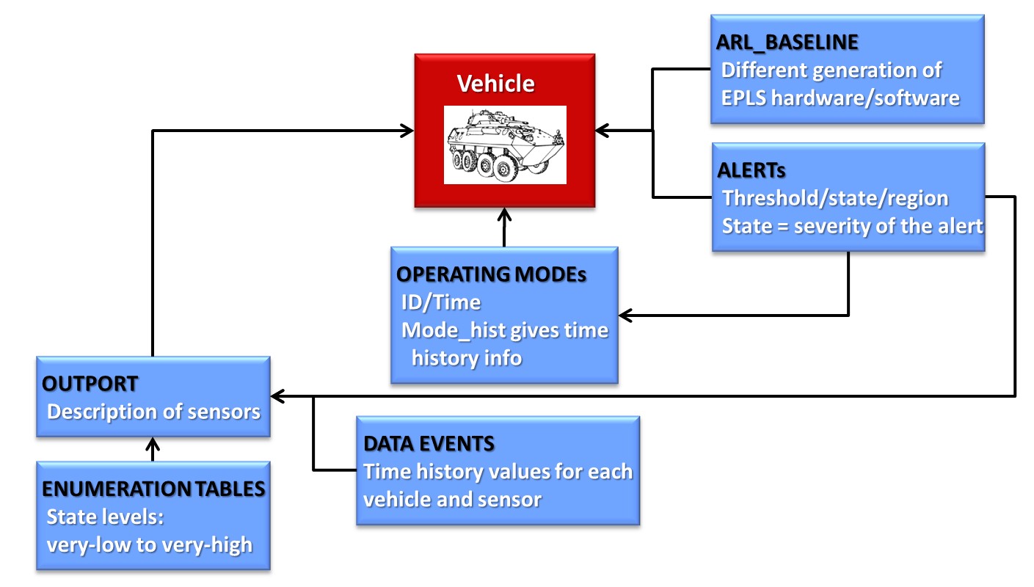
Vehicle
ARL BASELINE: describes different versions of EPLS hardware/software associated with each vehicle
OPERATING MODE: defines the vehicle operating mode
OUTPORT: gives a description of sensors connected with each vehicle, their type and description
ALERTS: explains threshold, state and region associated with each vehicle, operating modes and outports
ENUMERATION TABLES: gives a state level (e.g. very-low, very-high)
DATA EVENTS: provides the time history for each vehicle and sensor

Slide 4
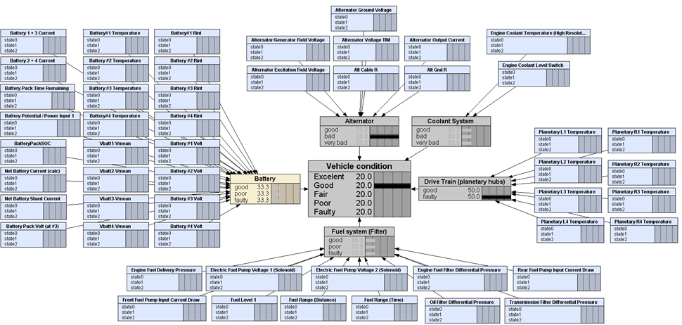
Main subsystems and related sensors

Slide 5
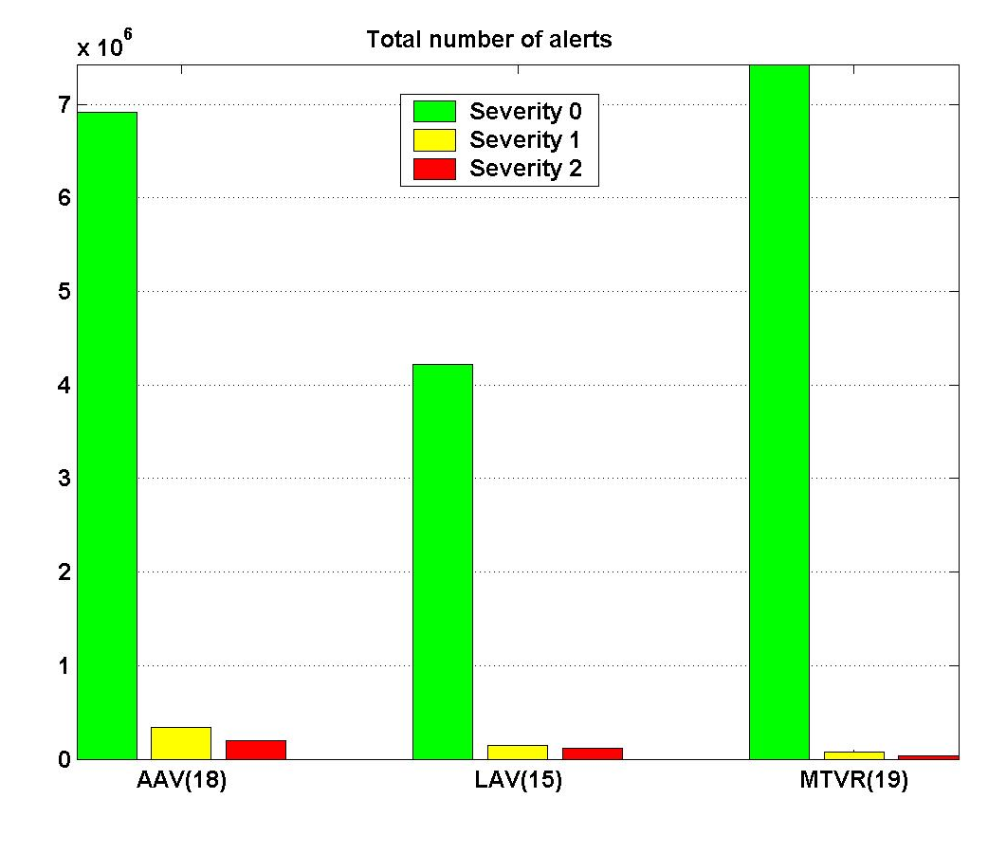
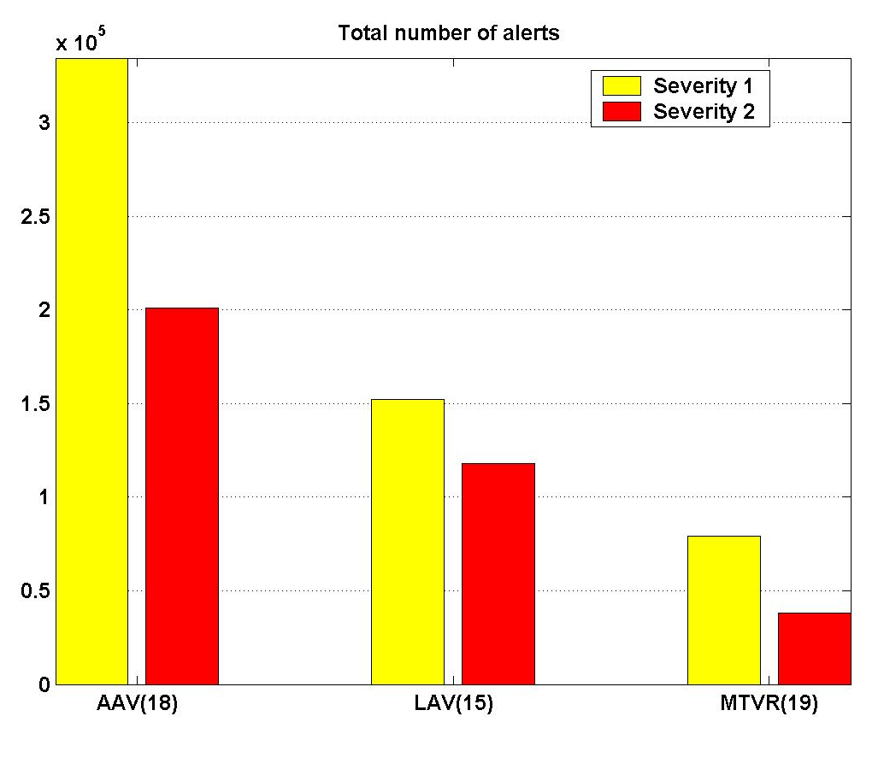
Vehicle type vs. total number of alerts

Slide 6
AAV: Vehicle vs. total number of alerts

Slide 7
AAV: Subsystem vs. total number of alerts

Slide 8
AAV: Modes vs. total number of alerts

Slide 9
Data events and alerts

Slide 11
Maintenance actions criterion:
Daily number of alerts/subsystem
NO Maintenance
action
Maintenance
action
NO Maintenance
action
threshold
0
i
i+1
i+2
…
j
…
k
k+1
k+2
days
Several alerts followed by no alerts for 2 consecutive days
Several alerts followed by more alerts
NOTE:
Threshold = 5
Need to include a 2nd check that next 2 days are “mission-on”

Slide 12
Predict each vehicle’s achieved availability, which is defined as the probability that a system will be available when required for use
Predict the maintenance pattern to decrease in operations/maintenance logistics footprint; enable more advanced predictive maintenance decision making based on analytical reliability models; achieve intelligent maintenance

Slide 13
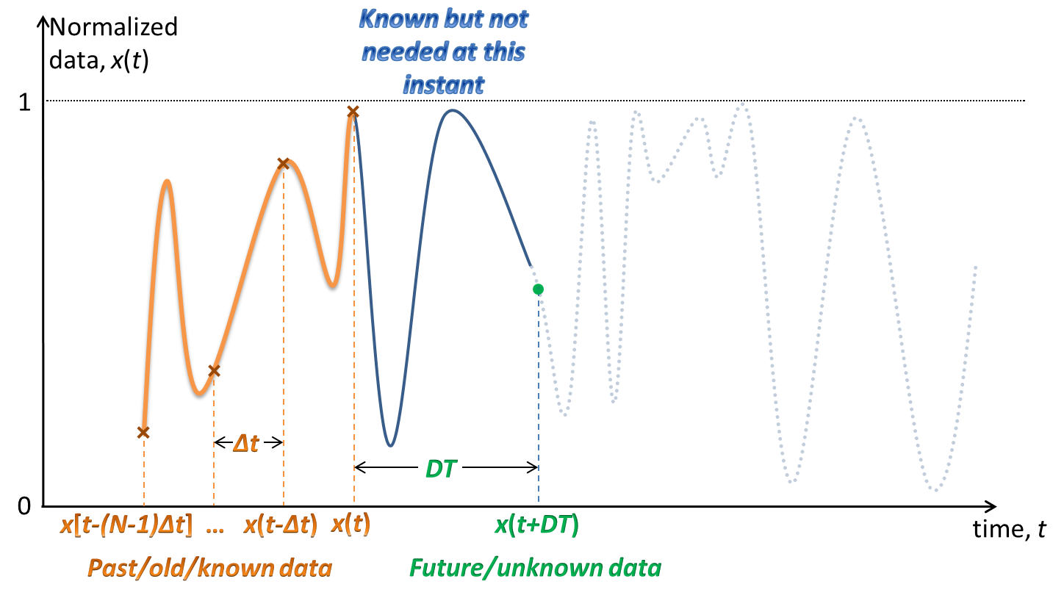
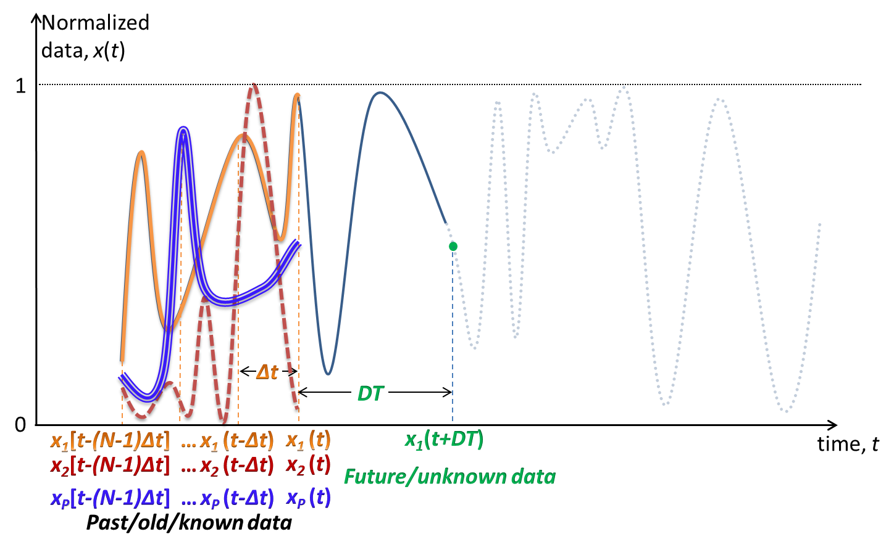
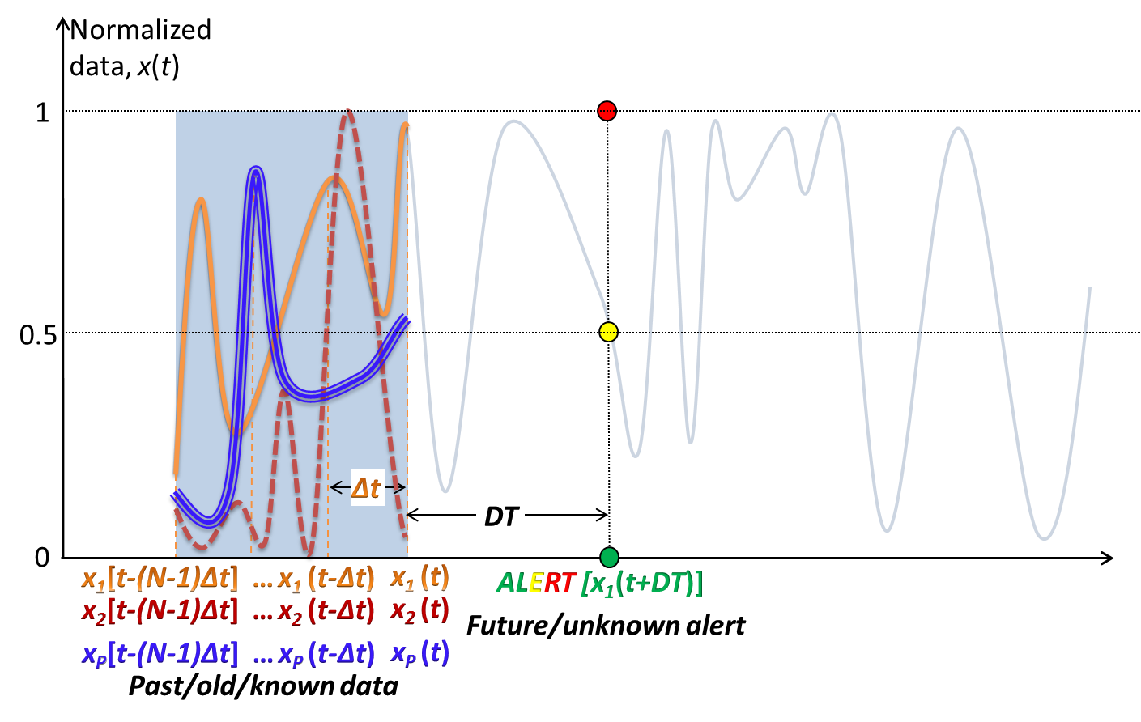
Prediction of the alert pattern
1st model: single port data function, predict future data
2nd model: given data from multiple ports from - different vehicles and - different ports predict future data
3nd model: multiple port data functions, predict future alerts

Slide 14
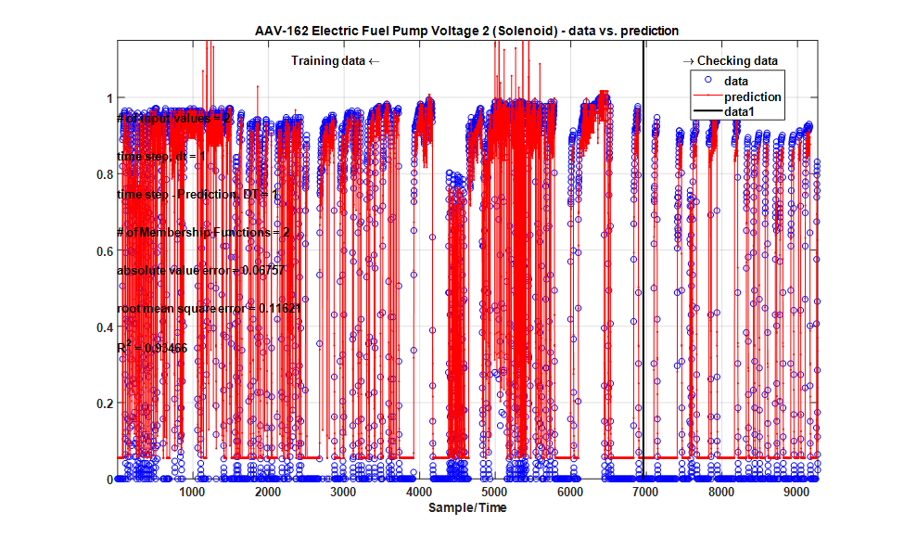
ANFIS – Artificial Neuro-Fuzzy Inference System

Slide 15
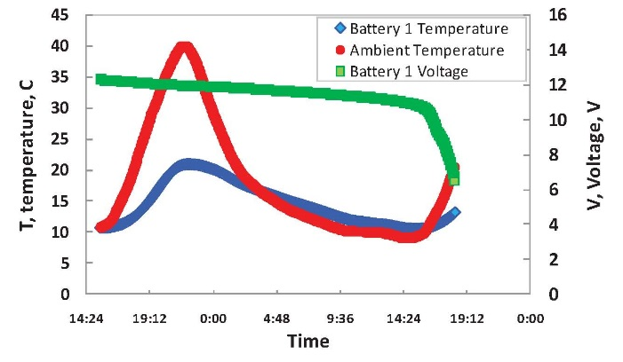
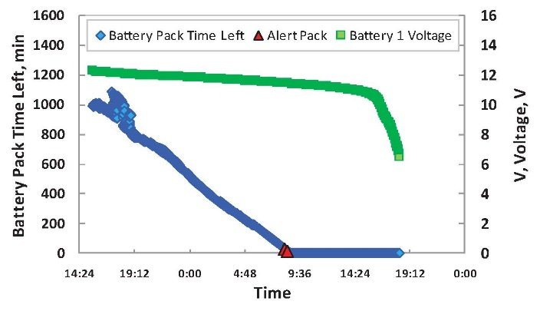
Remaining useful life of each subsystem
Batteries Voltage
Batteries Temperature
Batteries Internal Resistance
Battery Pack time remaining
Battery Pack Volt

Slide 16
Reliability of Vehicle
FUEL SYSTEM (Filter) | PORT_NAME
 | Electric Fuel Pump Voltage 1 (Solenoid)
 | Electric Fuel Pump Voltage 2 (Solenoid)
 | Engine Fuel Delivery Pressure
 | Engine Fuel Filter Differential Pressure
 | Front Fuel Pump Input Current Draw
 | Fuel Level 1
 | Fuel Range (Distance)
 | Fuel Range (Time)
 | Oil Filter Differential Pressure
 | Rear Fuel Pump Input Current Draw
 | Transmission Filter Differential Pressure
 | PORT_NAME | BATTERY
 | Battery #3 Volt
 | Battery #4 Volt
 | Battery 1 + 3 Current
 | Battery 1 Temperature
 | Battery 1 Voltage
 | Battery 2 + 4 Current
 | Battery 2 Temperature
 | Battery 2 Voltage
 | Battery 3 Temperature
 | Battery 4 Temperature
 | Battery Pack Time Remaining
Vehicle
ALTERNATOR | PORT_NAME
 | Alt Cable R
 | Alt Gnd R
 | Alternator Excitation Field Voltage
 | Alternator Ground Voltage
 | Alternator Ground Voltage
 | Alternator Output Current
 | Alternator Output Current
 | PORT_NAME | DRIVE TRAIN
 | Planetary L1 Temperature
 | Planetary L2 Temperature
 | Planetary L3 Temperature
 | Planetary L4 Temperature
 | Planetary R1 Temperature
 | Planetary R2 Temperature
 | Planetary R3 Temperature
COOLANT SYSTEM | PORT_NAME
 | Engine Coolant Level Switch
 | Engine Coolant Level Switch
 | Engine Coolant Temperature (High Resolution)

