Slide 1
IBM University Engagement Project Submission
“Exploring the Power of Agentic AI with IBM Granite and IBM Bob”

Slide 2

Project Tile – Document Q&A RAG Agent for Recipe Generator
Domain of Project –Food Technology & Culinary Automation
Student Name | Recent Passport Photo | Email ID | Mobile number [WhatsApp]
Aimanaz Sarwad |  | aimansarwad@gmail.com | 8431326574
Recommended font style and size:
Font Style: Arial
Font Size (Heading): 28
Font Size (Content): 20

Slide 3
Problem Statement -
Problem Statement : Document Q&A RAG Agent for Recipe Generator
The Challenge
Food enthusiasts and culinary professionals often rely on unstructured recipe documents, cookbooks, blogs, and user-submitted notes. Searching across these scattered resources is time-consuming, and it’s difficult to adapt recipes based on dietary needs, available ingredients, or cultural preferences. The challenge is not just to retrieve recipes but to intelligently query, adapt, and generate personalized cooking instructions.
The Objective
Build a Document Q&A RAG (Retrieval-Augmented Generation) Agent that can act as an intelligent recipe generator. The solution should:
Ingest & Index Recipe Documents: Parse cookbooks, PDFs, blogs, or uploaded recipe notes and store them in a searchable knowledge base.
Enable Conversational Q&A: Allow users to ask natural language questions (e.g., “How can I make a sugar-free version of chocolate cake?”) and receive precise, recipe-aware answers.
Create a Personalized & Agentic Layer: Adapt recipes based on user constraints such as available ingredients, dietary restrictions, cooking time, or cuisine preferences.
Visualize Cooking Guidance: Present results as step-by-step cooking instructions with substitution suggestions, nutritional facts, and even generate a shopping list.

Slide 4
Proposed Solution -
Proposed Solution: Intelligent Recipe Generator & Culinary Companion
The proposed solution is an AI-powered culinary assistant built using Python Flask, Bootstrap 5, and advanced Large Language Models to deliver real-time, personalized cooking guidance and recipe generation. The system addresses challenges in scattered recipe discovery and ingredient adaptation through a robust, user-centric web architecture.
At its core, the application uses dynamic LLM prompting to interpret raw ingredient inputs, dietary restrictions, and time constraints, formulating complete cooking instructions and nutritional estimates on the fly.
The system features core functional modules:
Recipe Generation Agent – Formulates custom, structured recipes based on available pantry items, dietary needs, and preparation time limits.
Culinary Knowledge Agent – Answers real-time cooking and food science queries, offering professional kitchen tips and techniques.
Smart Substitution Engine – Suggests intelligent ingredient alternatives when items are missing, preserving authentic flavor profiles.
Nutritional Estimation Module – Automatically calculates approximate calories and macronutrients for every generated dish.
The solution includes a responsive web interface featuring secure user authentication, interactive chat workflows, a dark mode UI toggle, and a local history tracker for seamless meal planning.

Slide 5
Technology Used
IBM Bob platform -For designing and orchestrating multi-agent workflows visually
IBM Grainte model - for eg – ibm-granite-3-2-8b – For natural language understanding, reasoning, and personalization
IBM Cloud – It provides the infrastructure to build, deploy, and scale the Nutrition Agent efficiently. IBM Cloud enables a reliable, secure, and scalable environment for deploying the Nutrition Agent.
RAG– RAG to fetch real data first, then generate intelligent answers, making the Nutrition Agent more trustworthy and effective.
IBM Watsonx.ai - For model deployment, embeddings, and AI governance
Vector Database (FAISS/Chroma) – For RAG-based nutritional data retrieval

Slide 6
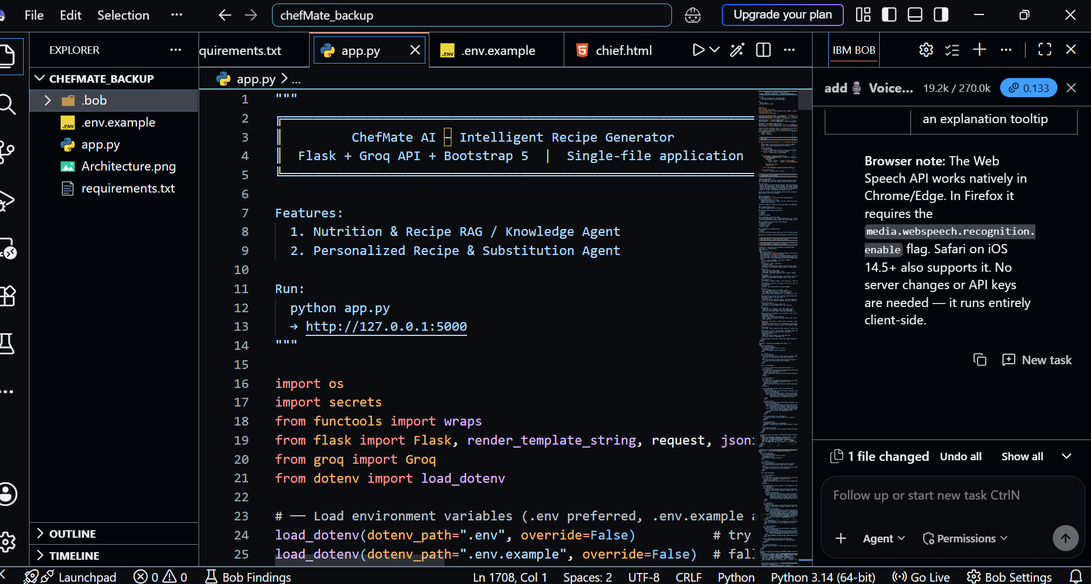
Required Files created using IBM bob -
App.py
.env
Requirements.txt
Chief.html

Slide 7
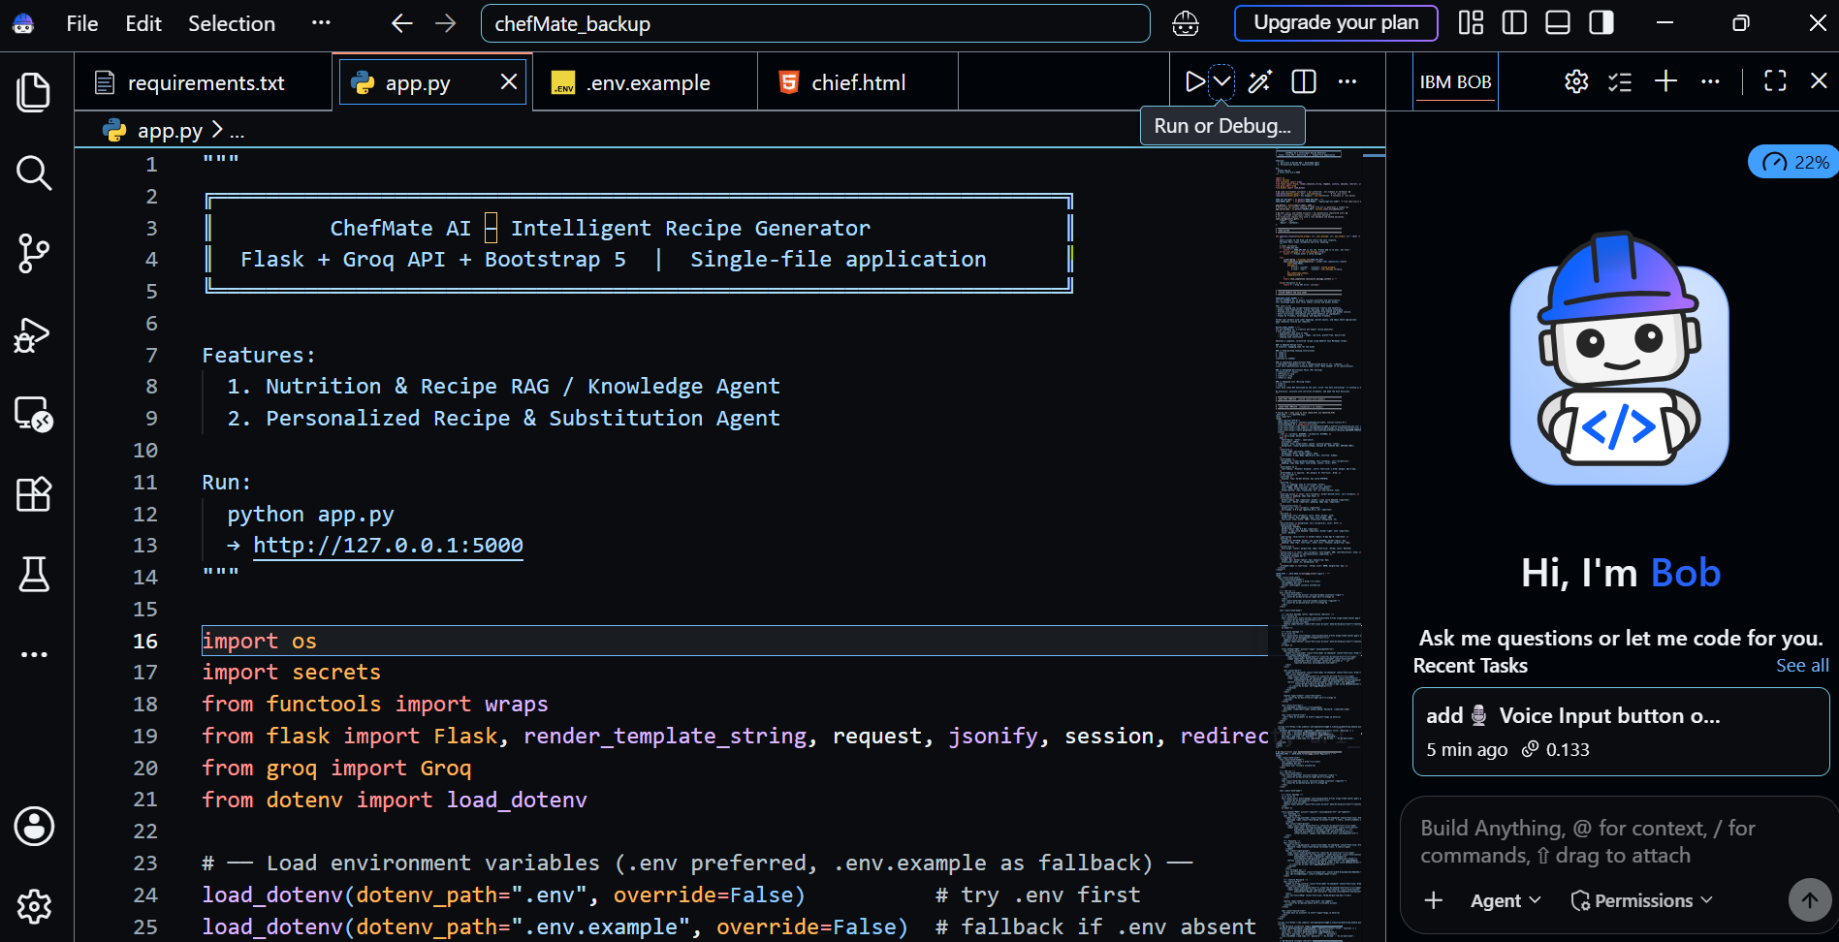
IBM Bob Screenshots:

Slide 8
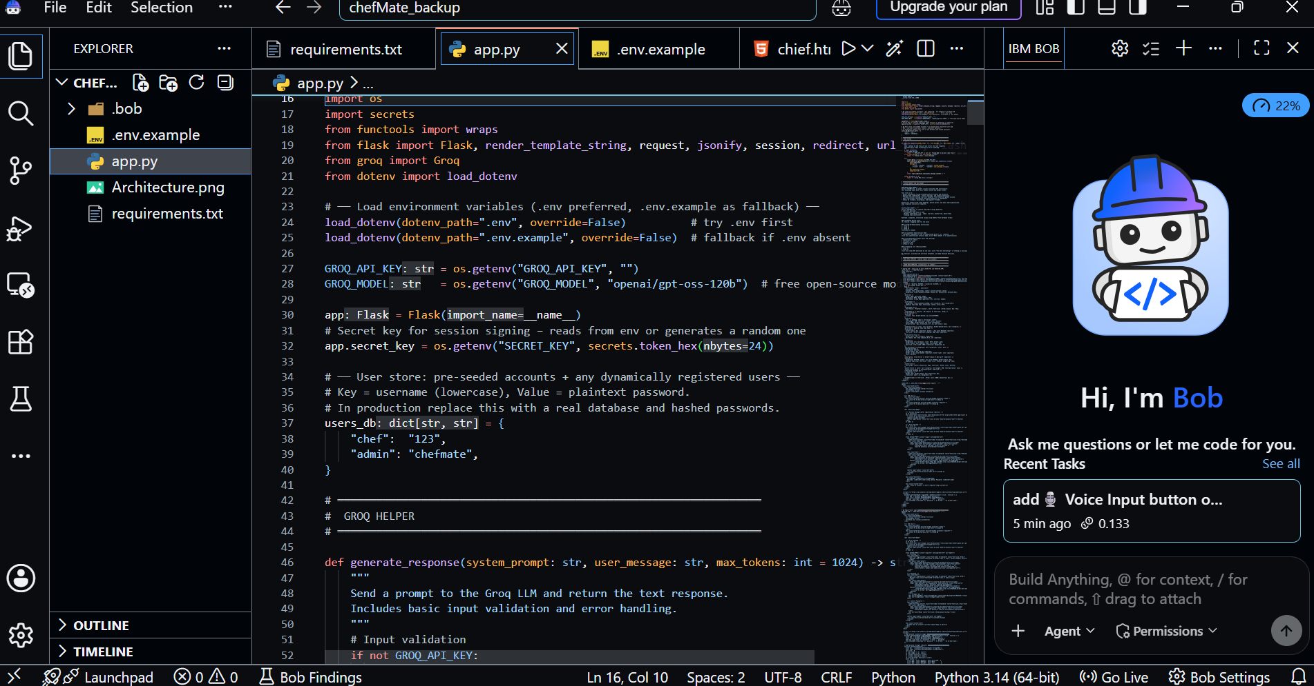

Slide 9
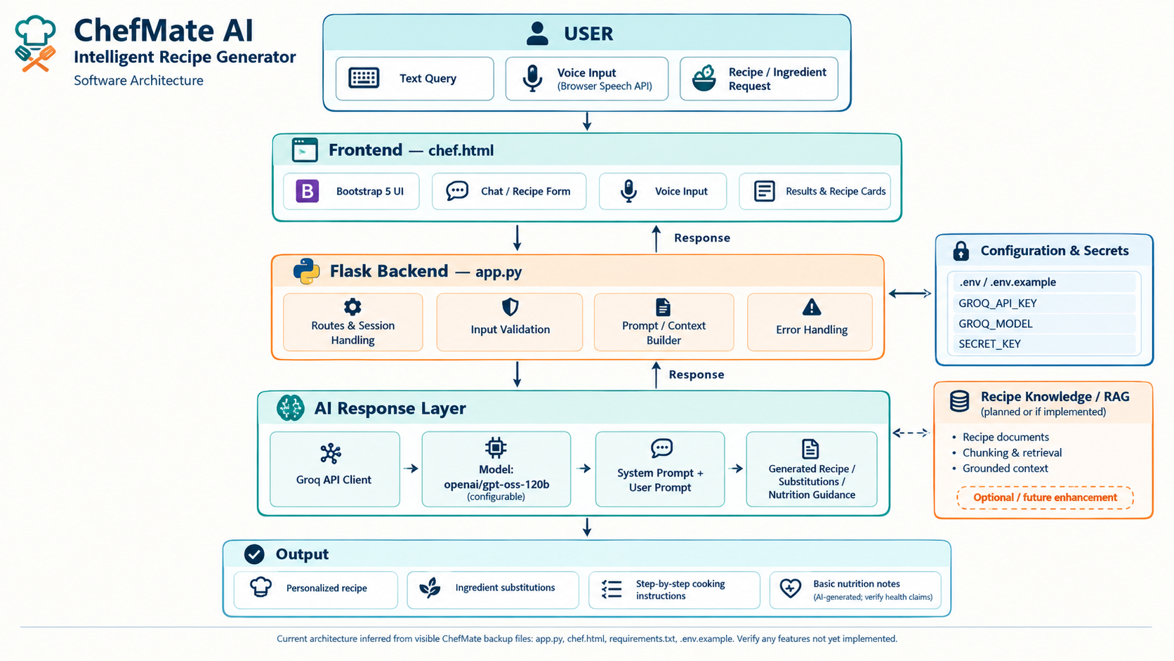
Architecture blueprint for IBM bob:

Slide 10

Role of Agentic AI in the solution
Agentic AI enables ChefMate AI to function as an intelligent, autonomous culinary and nutrition system rather than a simple static chatbot. Using Groq and LLaMA 3.3 models, it coordinates multiple specialized agents to deliver precise recipe generation, pantry management, and nutritional guidance.
Each agent performs a specific role—such as retrieving recipe data via semantic search, analyzing available pantry ingredients, providing dietary tips, and evaluating nutritional breakdowns—while working collaboratively. This multi-agent approach ensures efficient task execution and accurate results.
Agentic AI also brings context awareness, understanding user details like dietary restrictions, available kitchen ingredients, and cooking preferences to generate tailored recommendations. It supports real-time adaptation, continuously updating recipe suggestions and cooking steps based on user inputs or modifications.
Additionally, agents communicate with each other, enabling better decision-making and improved culinary outcomes.
Overall, Agentic AI makes the system proactive, personalized, and goal-driven, acting like a smart digital chef and nutritionist that helps users cook creatively with what is already in their kitchen.

Slide 11
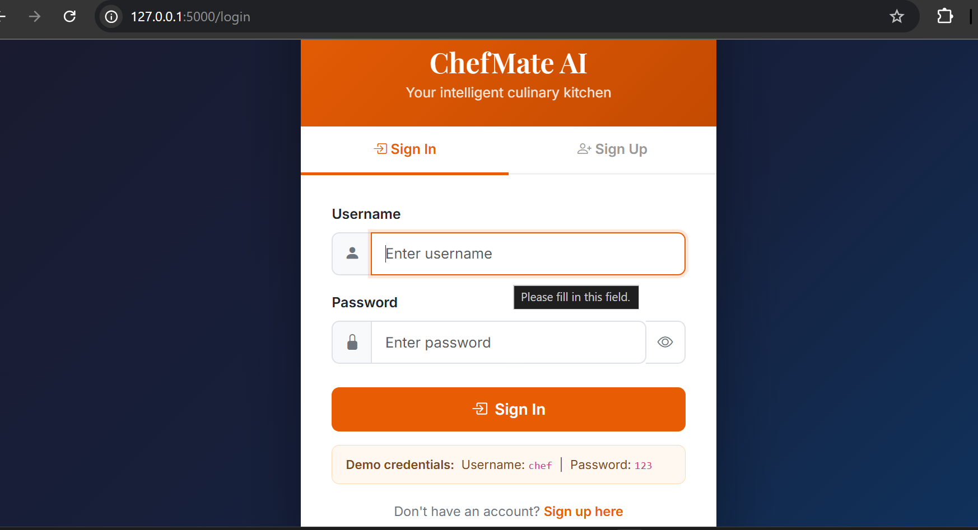
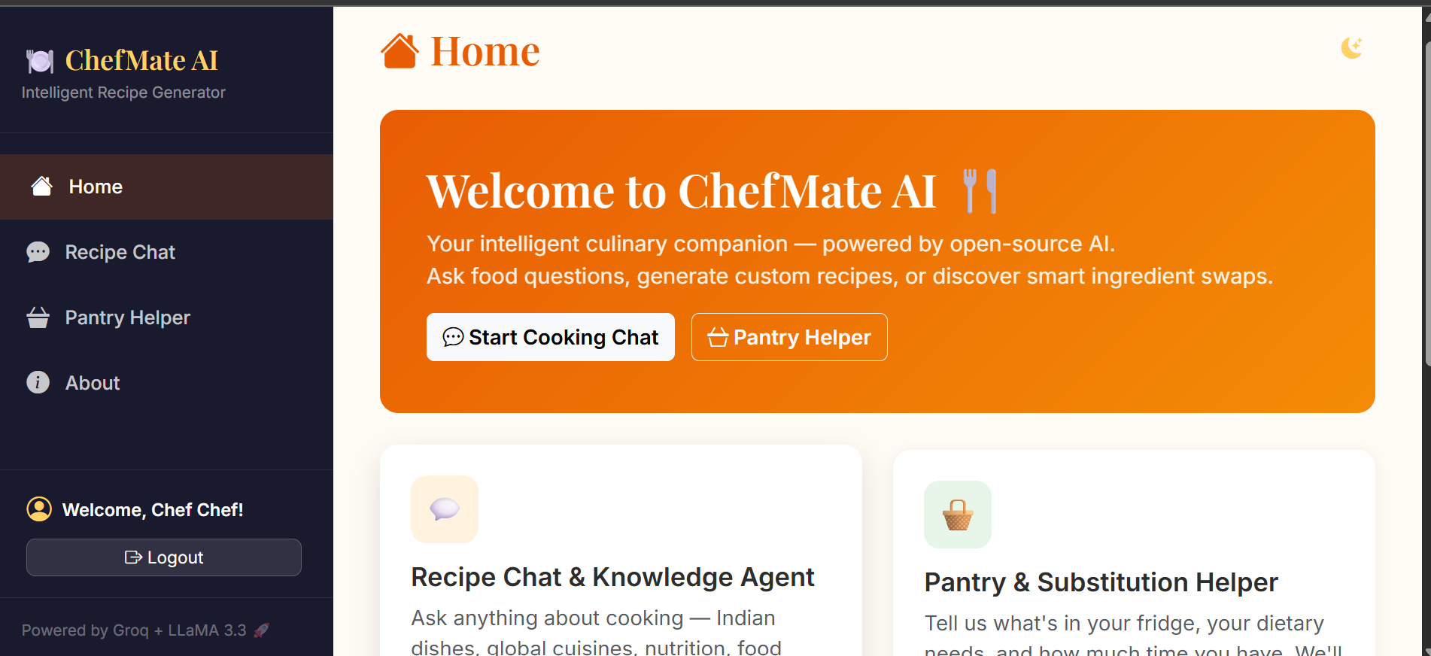
Project Output Screenshot
Please put IBM Bob output screenshots with 2-3 prompts.
You can take 2-3 more slides for each screenshot
·
·
·

Slide 12
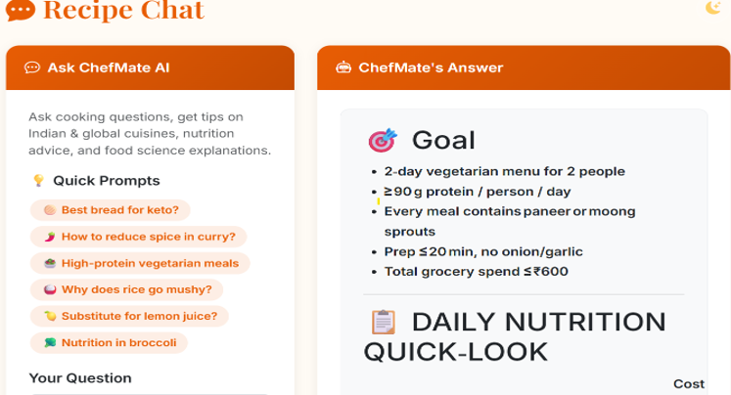
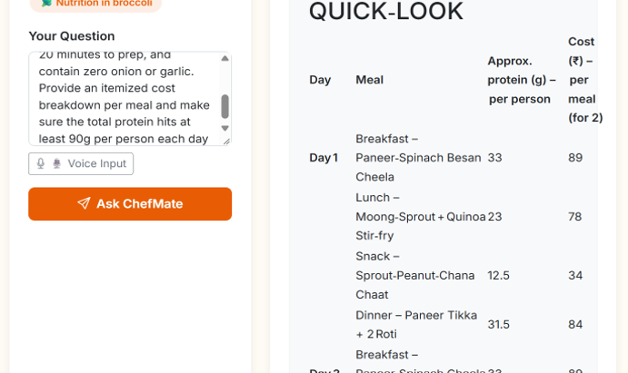
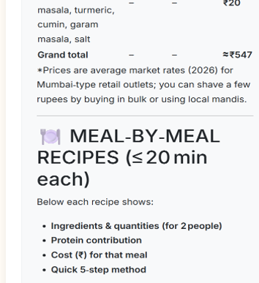
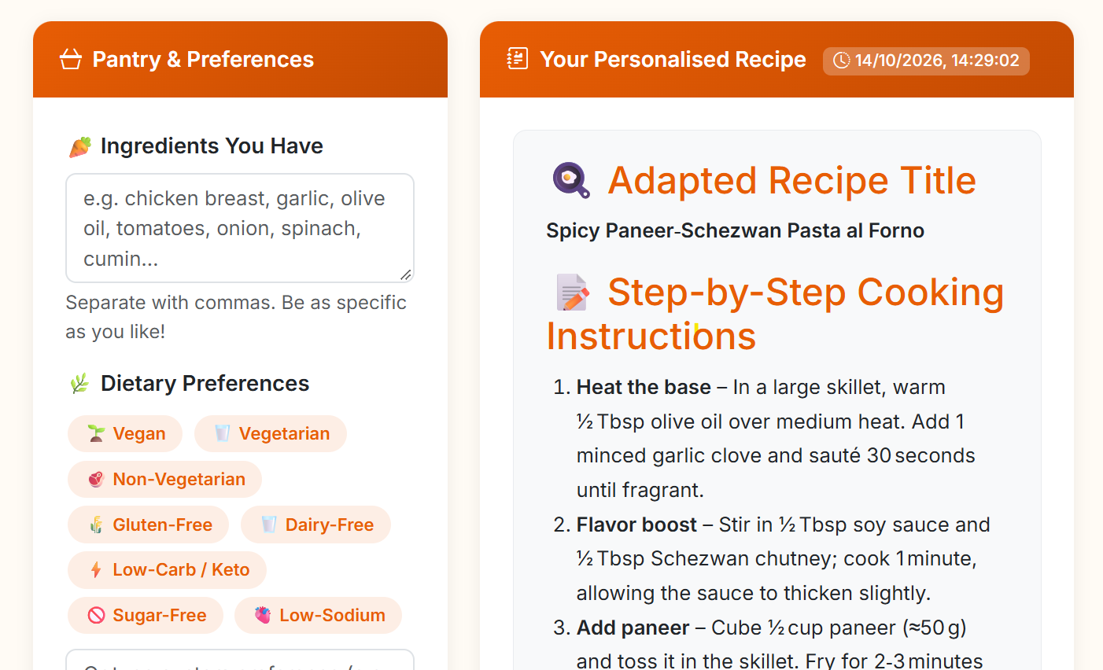
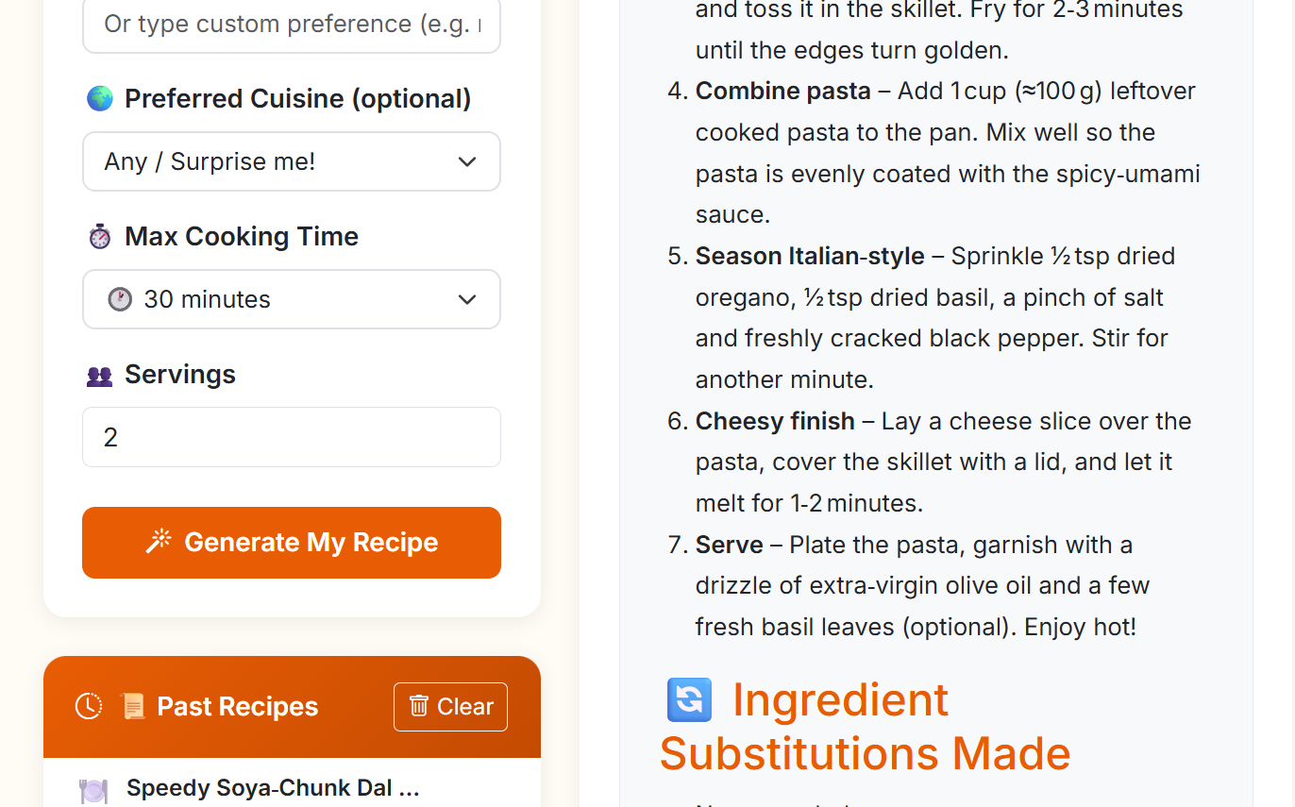
Project Output Screenshot
·
·
·

Slide 13
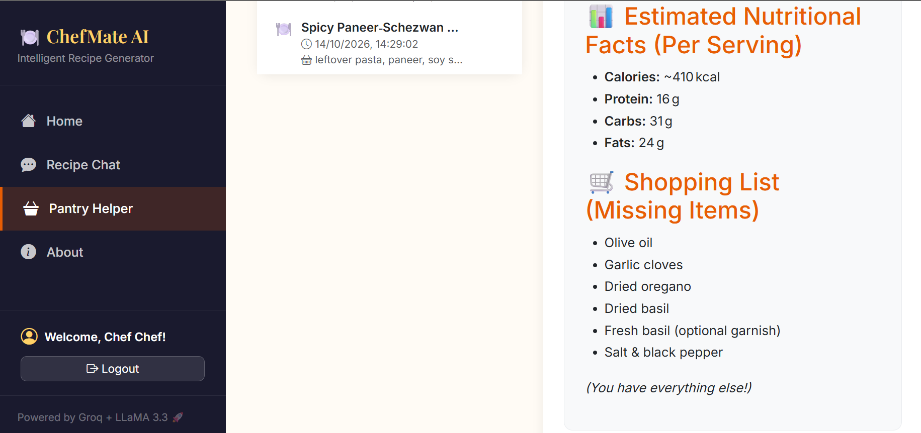
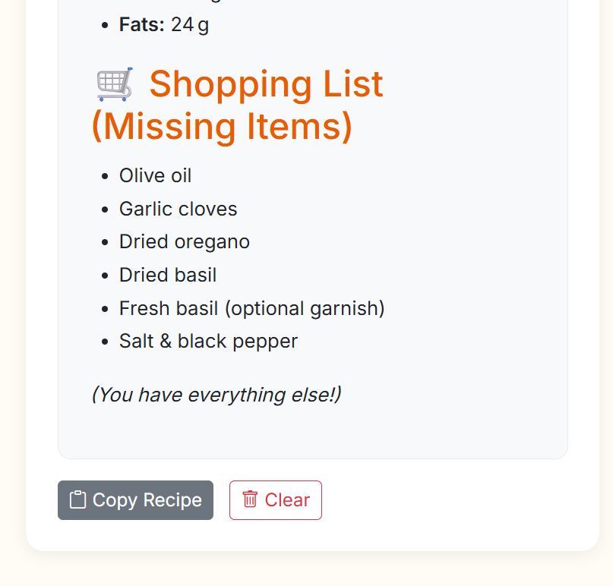
Project Output Screenshot
·
·
·

Slide 14
Novelty and Uniqueness
The proposed ChefMate AI – Pantry Helper stands out by transforming passive ingredient storage into an active, zero-waste culinary engine through real-time pantry auditing, dynamic recipe adaptation, and automated shopping lists.
Intelligent Pantry-to-Plate Matching – Unlike standard recipe search engines, it maps available ingredients instantly to curate custom recipes, eliminating kitchen guesswork and food waste.
Context-Aware Dynamic Adaptation – Automatically adjusts culinary styles, dietary restrictions (vegan, keto, gluten-free, low-sodium), and max cooking times on the fly.
Smart Substitution Engine – Intelligently swaps missing ingredients or leverages leftovers creatively without altering the core flavor profile.
Automated Gap Analysis & Shopping List – Instantly separates what you have from what you need, streamlining grocery runs down to the exact missing item.
Nutritional Transparency – Calculates estimated calorie and macronutrient breakdowns per serving for every custom-generated recipe.
Seamless History & Portability – Tracks past culinary creations with time-stamped logs and single-click copy features for effortless meal planning.
Lightning-Fast LLM Architecture – Powered by Groq and LLaMA 3.3, ensuring instantaneous, low-latency recipe generation.
This makes the solution a smart, resource-aware, and adaptive kitchen companion, rather than just a static recipe repository.

Slide 15
Git Hub Link
https://github.com/aimansarwad-stack/chefmateAI/upload/main
·
·

Slide 16
Future Scope
Wearable & Health-Device Integration – Future scope involves syncing the system with smartwatches and fitness trackers to stream real-time physiological metrics (steps, active calories burned, heart rate, and sleep patterns), enabling the agent to dynamically calibrate dietary plans against actual daily physical output.
AI-Powered Voice Assistant & Multilingual Support – Future enhancements will incorporate a voice-enabled conversational assistant with multi-language support, allowing users to interact naturally in their regional language for broader accessibility and inclusivity across diverse demographics.
·
·
·

Slide 17
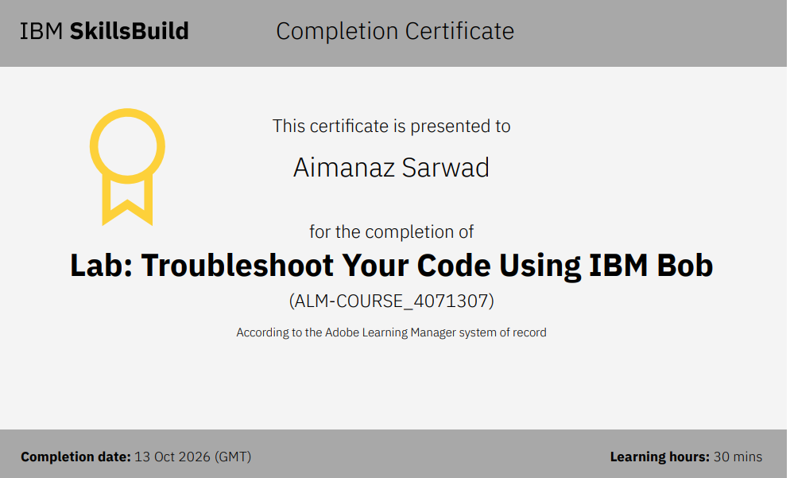
Certificates Earned:​

Slide 18
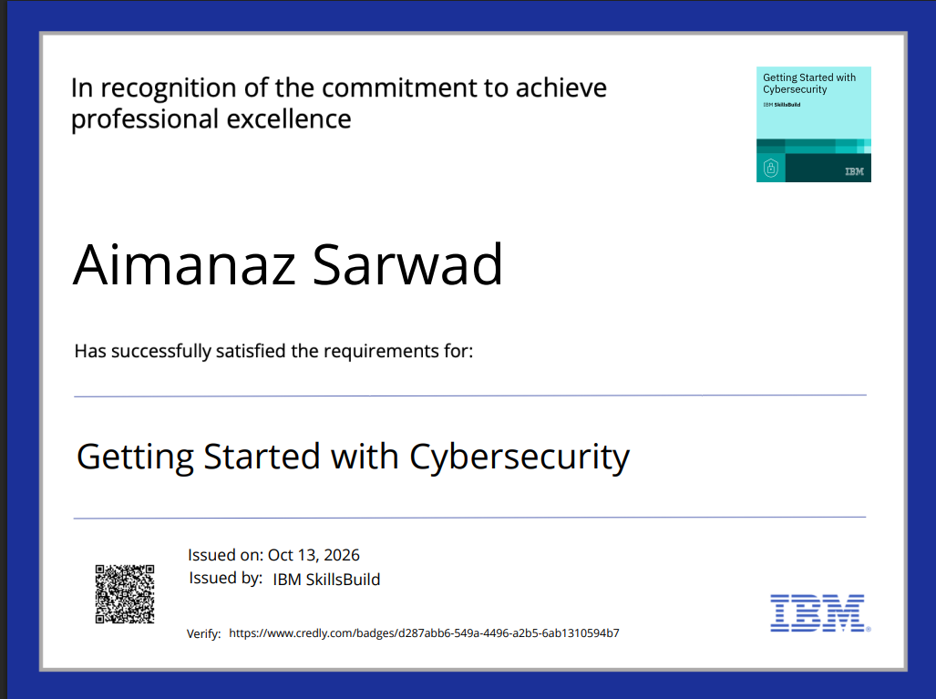
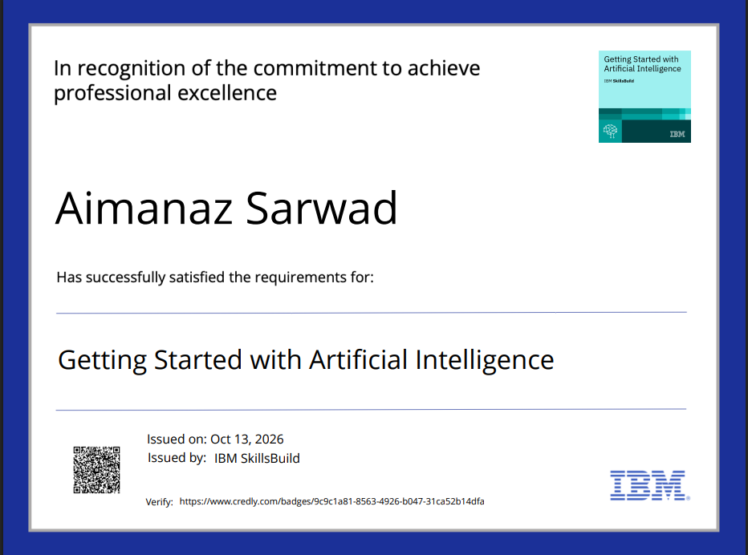
Certificates Earned:

Slide 19


