Slide 1
Music Generation
Dimitris Konstantakopoulos ΜΤΝ2013
Dimitra Manoura ΜΤΝ2015

Slide 2
Dataset
Our Dataset consists of a total of 122 “Blues” songs
We augment our Dataset \
talk about midi and a photo to be happy

Slide 3
Data preprocessing

Slide 4
MODELS USED
φωτογραφίες δύο μοντέλων (λιγα πράγματα για αυτα)

Slide 5
METRICS
loss
pleople

Slide 6
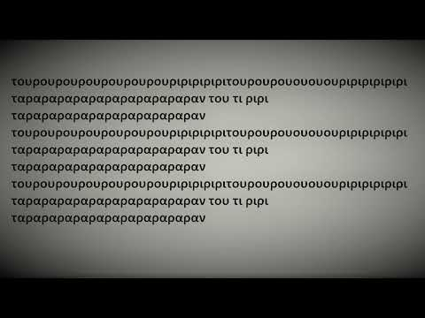
SELECTs
TOUROURI play
SHEET MUSIC

Slide 7
google forms

Slide 8
autoencoder play
lousame edw epeidi auto

Slide 9
Conclusions

Slide 10
Thank youuuuuuuuu

