Slide 1
Music Generation
Dimitris Konstantakopoulos ΜΤΝ2013
Dimitra Manoura ΜΤΝ2015

Slide 2
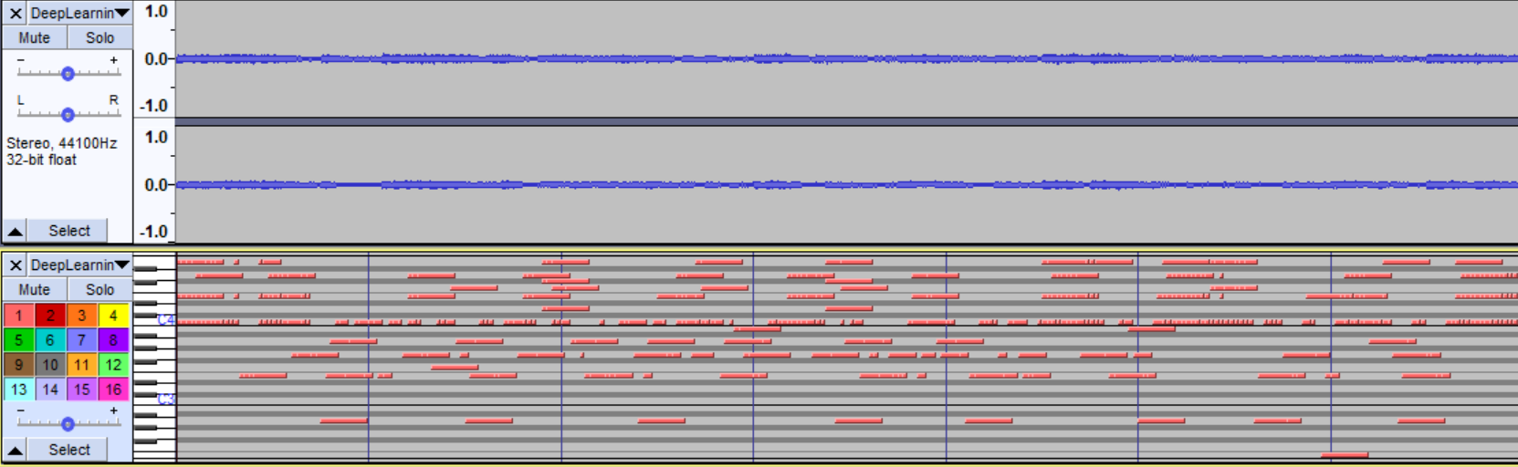
Dataset
Our Dataset consists of a total of 122 “Blues” midi files

Slide 3
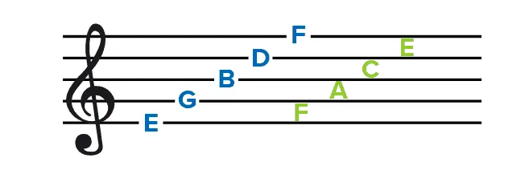
Dataset
We augment our Dataset by transposing each song one semitone up and one down
Midi file to list of letters that represent the notes of each song (“#” for sharp and “-” for flat)
Convert to integers

Slide 4
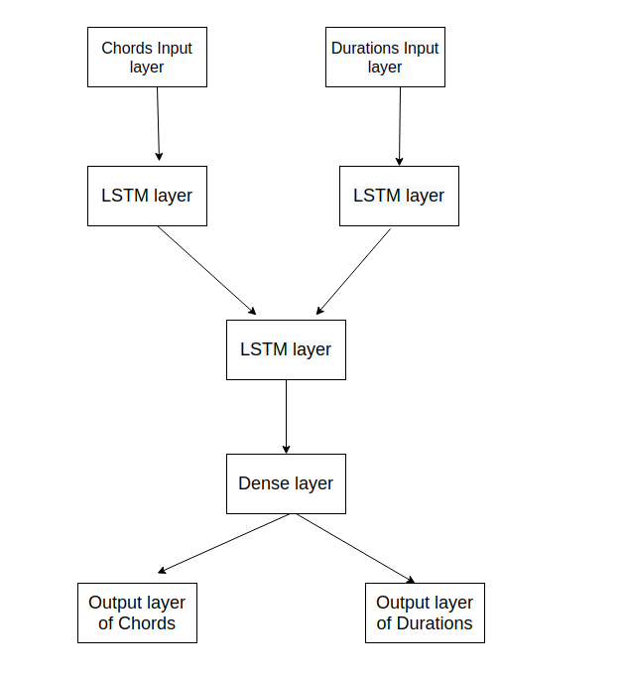
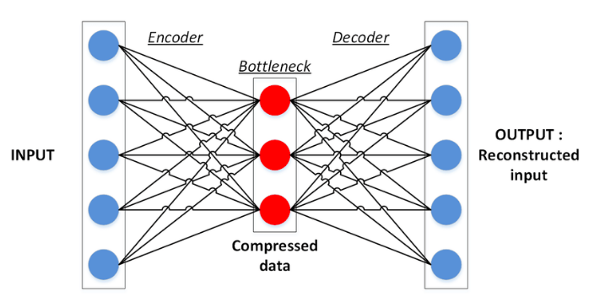
MODELS USED
Autoencoder Two Input-Output LSTM

Slide 5
Metrics used
Loss: We made sure that our loss is not too large, neither too small
Peoples’ opinions: Because at the end of the day, that’s the important part

Slide 6
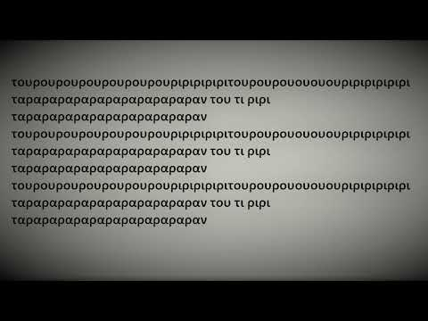
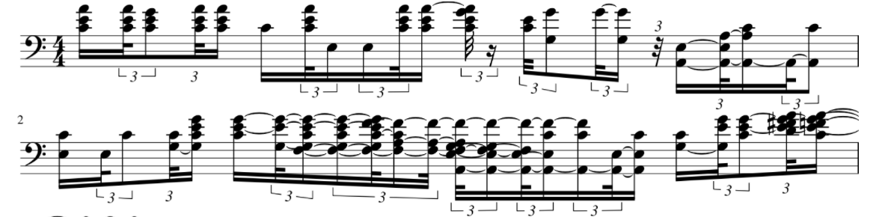
Our select from the LSTM
Notes:
C major

Slide 7
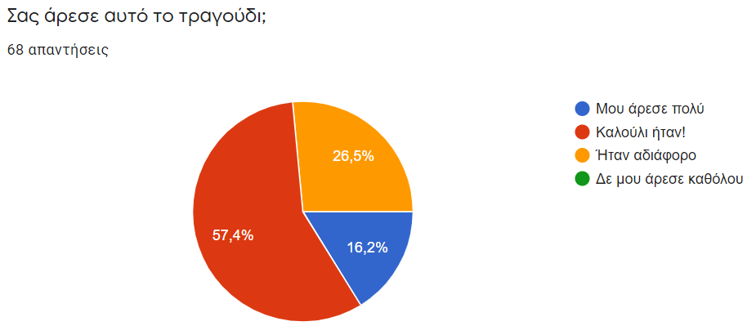
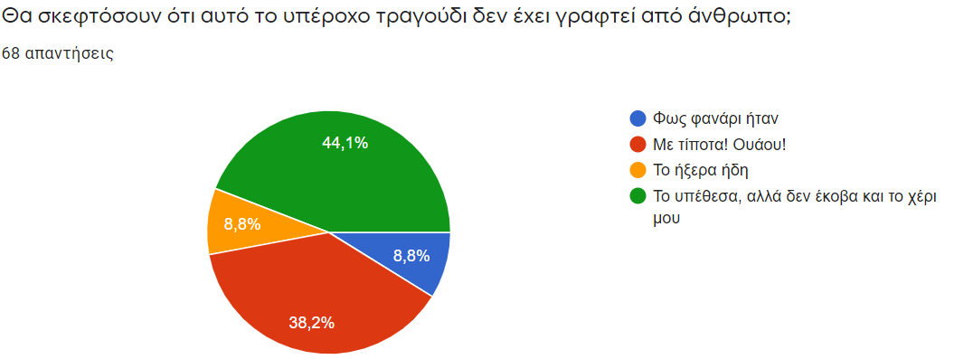
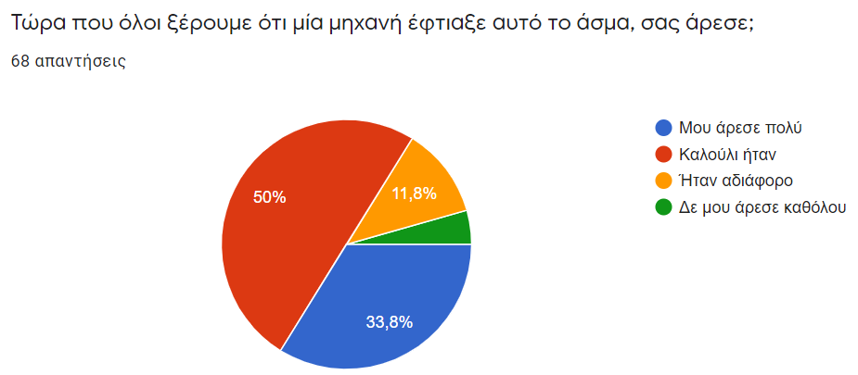
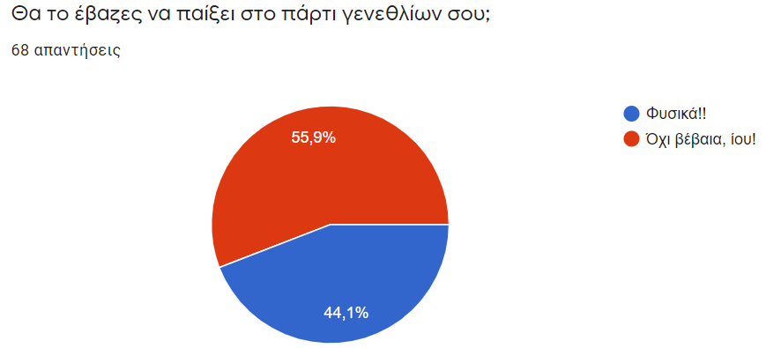
Notes:
73.6 τους άρεσε
83.3 τους άρεσε και μάλιστα στους 33.8 πολύ!!

Slide 8
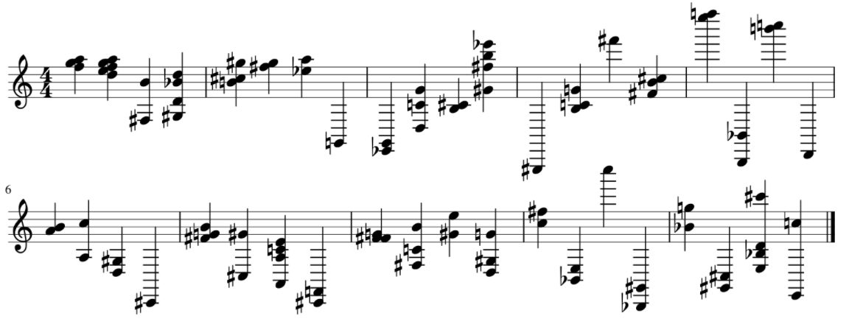

Our select from the Autoencoder
Notes:
G major

Slide 9
Conclusions
Overall the generated songs from our LSTM was satisfying
Our Autoencoder could definitely use some extra work
Future work: Improve Autoencoder and experiment with different models

Slide 10
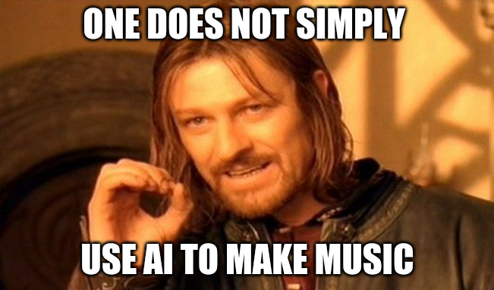
Thank youuuuuuuuu!

