Slide 1

AI/ML at TU Spring ML Workshop 2025
Reinforcement Learning Day 1

Slide 2
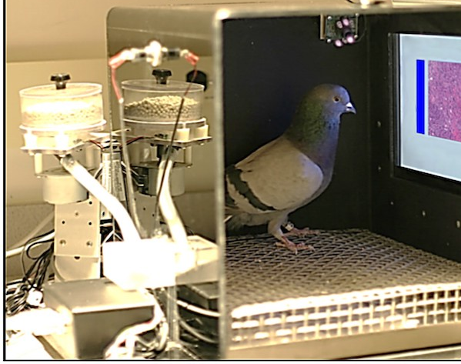
What is Reinforcement Learning Really?

Slide 3
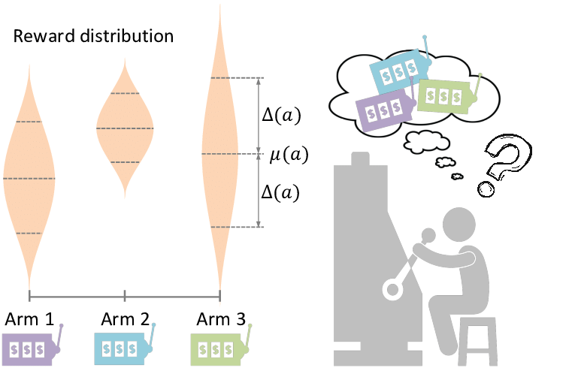
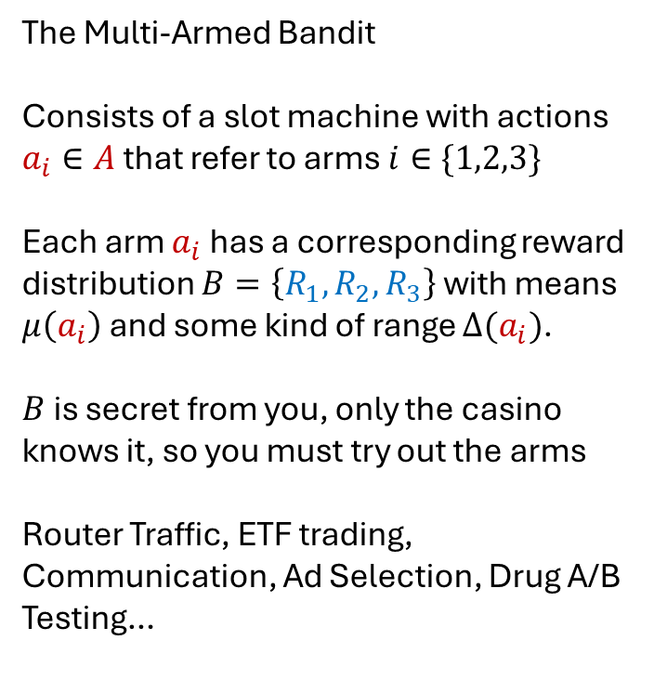
First, a Simpler Problem
The Multi-Armed Bandit
Consists of a slot machine with actions $a_{i}∈A$ that refer to arms $i∈\{1,2,3\}$
Each arm $a_{i}$has a corresponding reward distribution $B=\left\{R_{1},R_{2},R_{3}\right\}$ with means $μ\left(a_{i}\right)$ and some kind of range $Δ(a_{i})$.
$B$ is secret from you, only the casino knows it, so you must try out the arms
Router Traffic, ETF trading, Communication, Ad Selection, Drug A/B Testing…
Gao, Chongming & Lei, Wenqiang & He, Xiangnan & Rijke, Maarten & Chua, Tat-Seng. (2021). Advances and Challenges in Conversational Recommender Systems: A Survey. 10.48550/arXiv.2101.09459.

Slide 4


First, a Simpler Problem
The Multi-Armed Bandit
Consists of a slot machine with actions $a_{i}∈A$ that refer to arms $i∈\{1,2,3\}$
Each arm $a_{i}$has a corresponding reward distribution $B=\left\{R_{1},R_{2},R_{3}\right\}$ with means $μ\left(a_{i}\right)$ and some kind of range $Δ(a_{i})$.
$B$ is secret from you, only the casino knows it, so you must try out the arms
Router Traffic, ETF trading, Communication, Ad Selection, Drug A/B Testing…
$a_{i}∈A$:$a_{i}$is an action from the set of all actions in this problem $A$
$i∈\{1,2,3\}$: $i$ refers to arm 1, 2, or 3
$B=\left\{R_{1},R_{2},R_{3}\right\}$: You do not know the reward distributions $\left\{R_{1},R_{2},R_{3}\right\}$
$μ\left(a_{i}\right)$: unknown mean of reward distribution $R_{i}$
$Δ(a_{i})$: unknown range of reward distribution $R_{i}$
Gao, Chongming & Lei, Wenqiang & He, Xiangnan & Rijke, Maarten & Chua, Tat-Seng. (2021). Advances and Challenges in Conversational Recommender Systems: A Survey. 10.48550/arXiv.2101.09459.

Slide 5
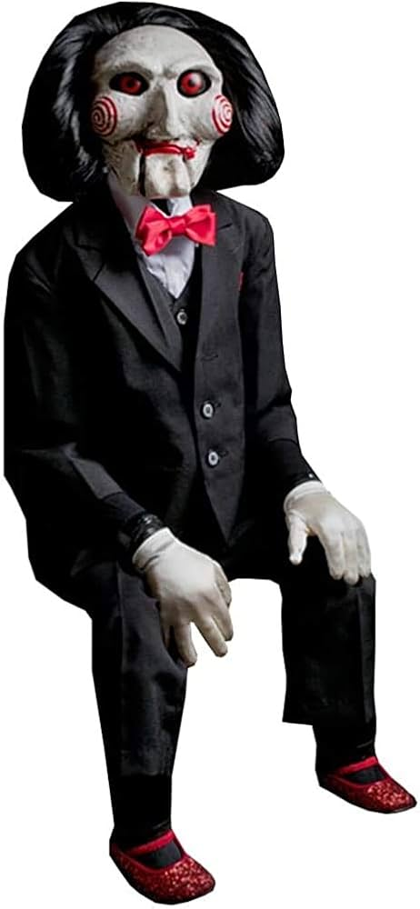
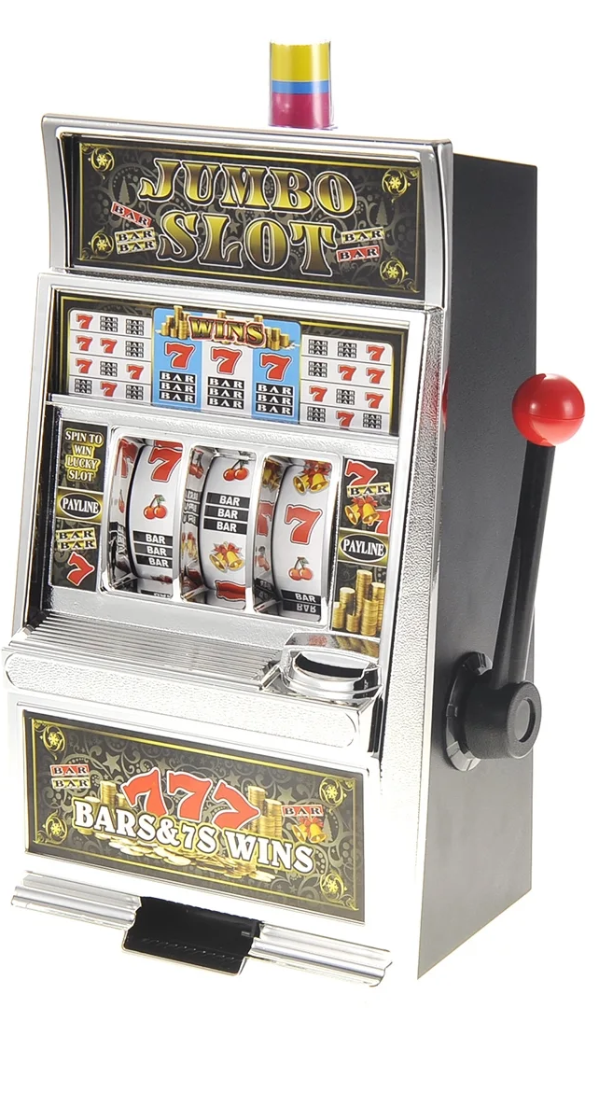
What is The Challenge?
Exploration vs Exploitation (Similar to BV tradeoff)
Red or Green?
Let’s Play a Game

Slide 6
What is The Challenge?
Exploration vs Exploitation (Similar to BV tradeoff)
Let’s Play a Game
10% chance of $100.00
100% chance of $1.00

Slide 7





What if we have information? (Contextual Bandit)
7/10
10/10
5/10
8/10
5/10
1/10

Slide 8
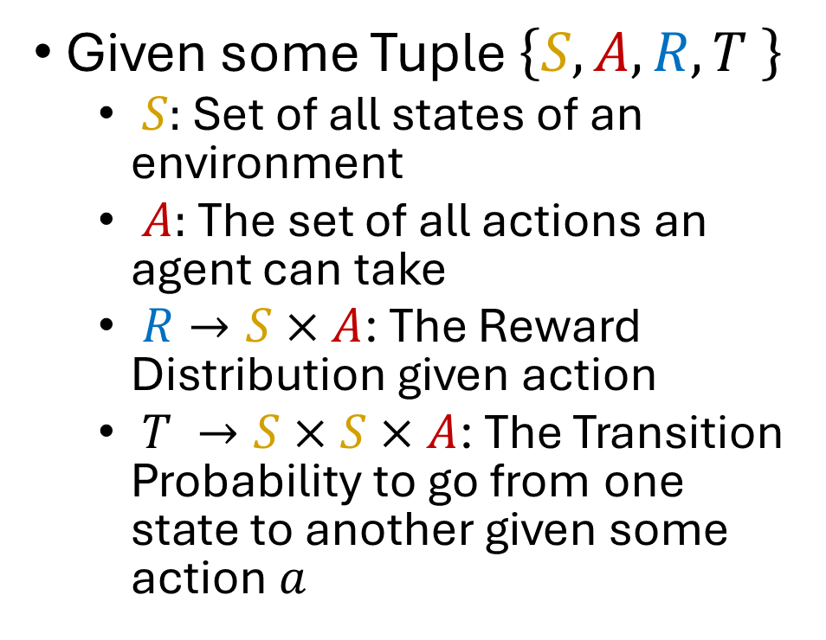
The Markov Decision Process
Given some Tuple $\left\{S,A,R,T \right\}$
$S:$ Set of all states of an environment
$A:$ The set of all actions an agent can take
$R→S×A$: The Reward Distribution given action
$T →S×S×A$: The Transition Probability to go from one state to another given some action $a$
7/10
10/10
Does bringing and umbrella change the weather?

Slide 9
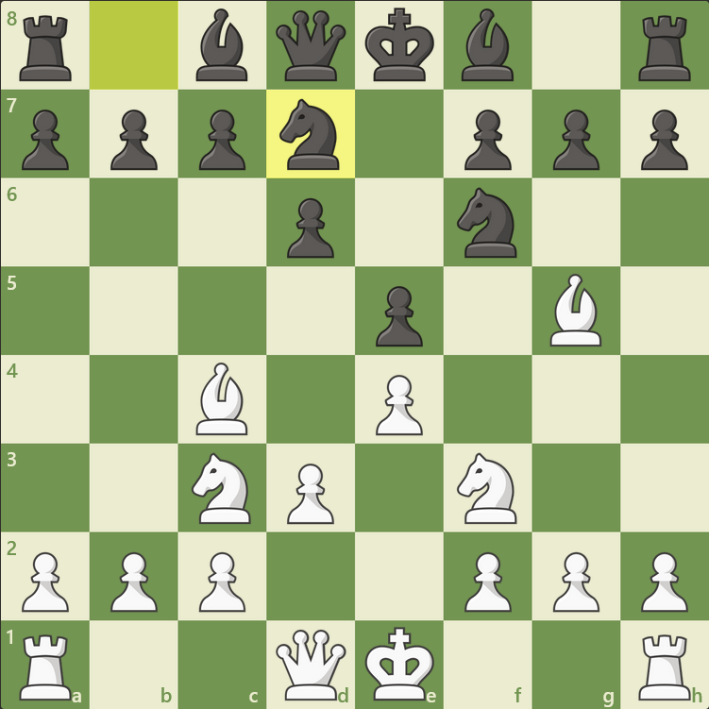
What is MDP Then?
White is to move,
R = Piece Value Captured
P=1, K=3, B=3, R=5, Q=9
What would a contextual bandit do?
What is the best move?

Slide 10
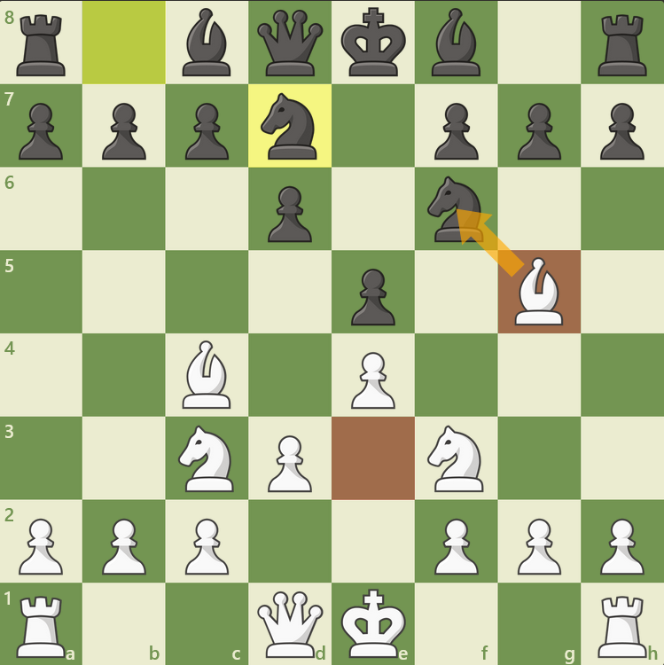
What is RL Then?
White is to move,
R = Piece Value Captured
P=1, K=3, B=3, R=5, Q=9
What would a contextual bandit do?
What is the best move?

Slide 11
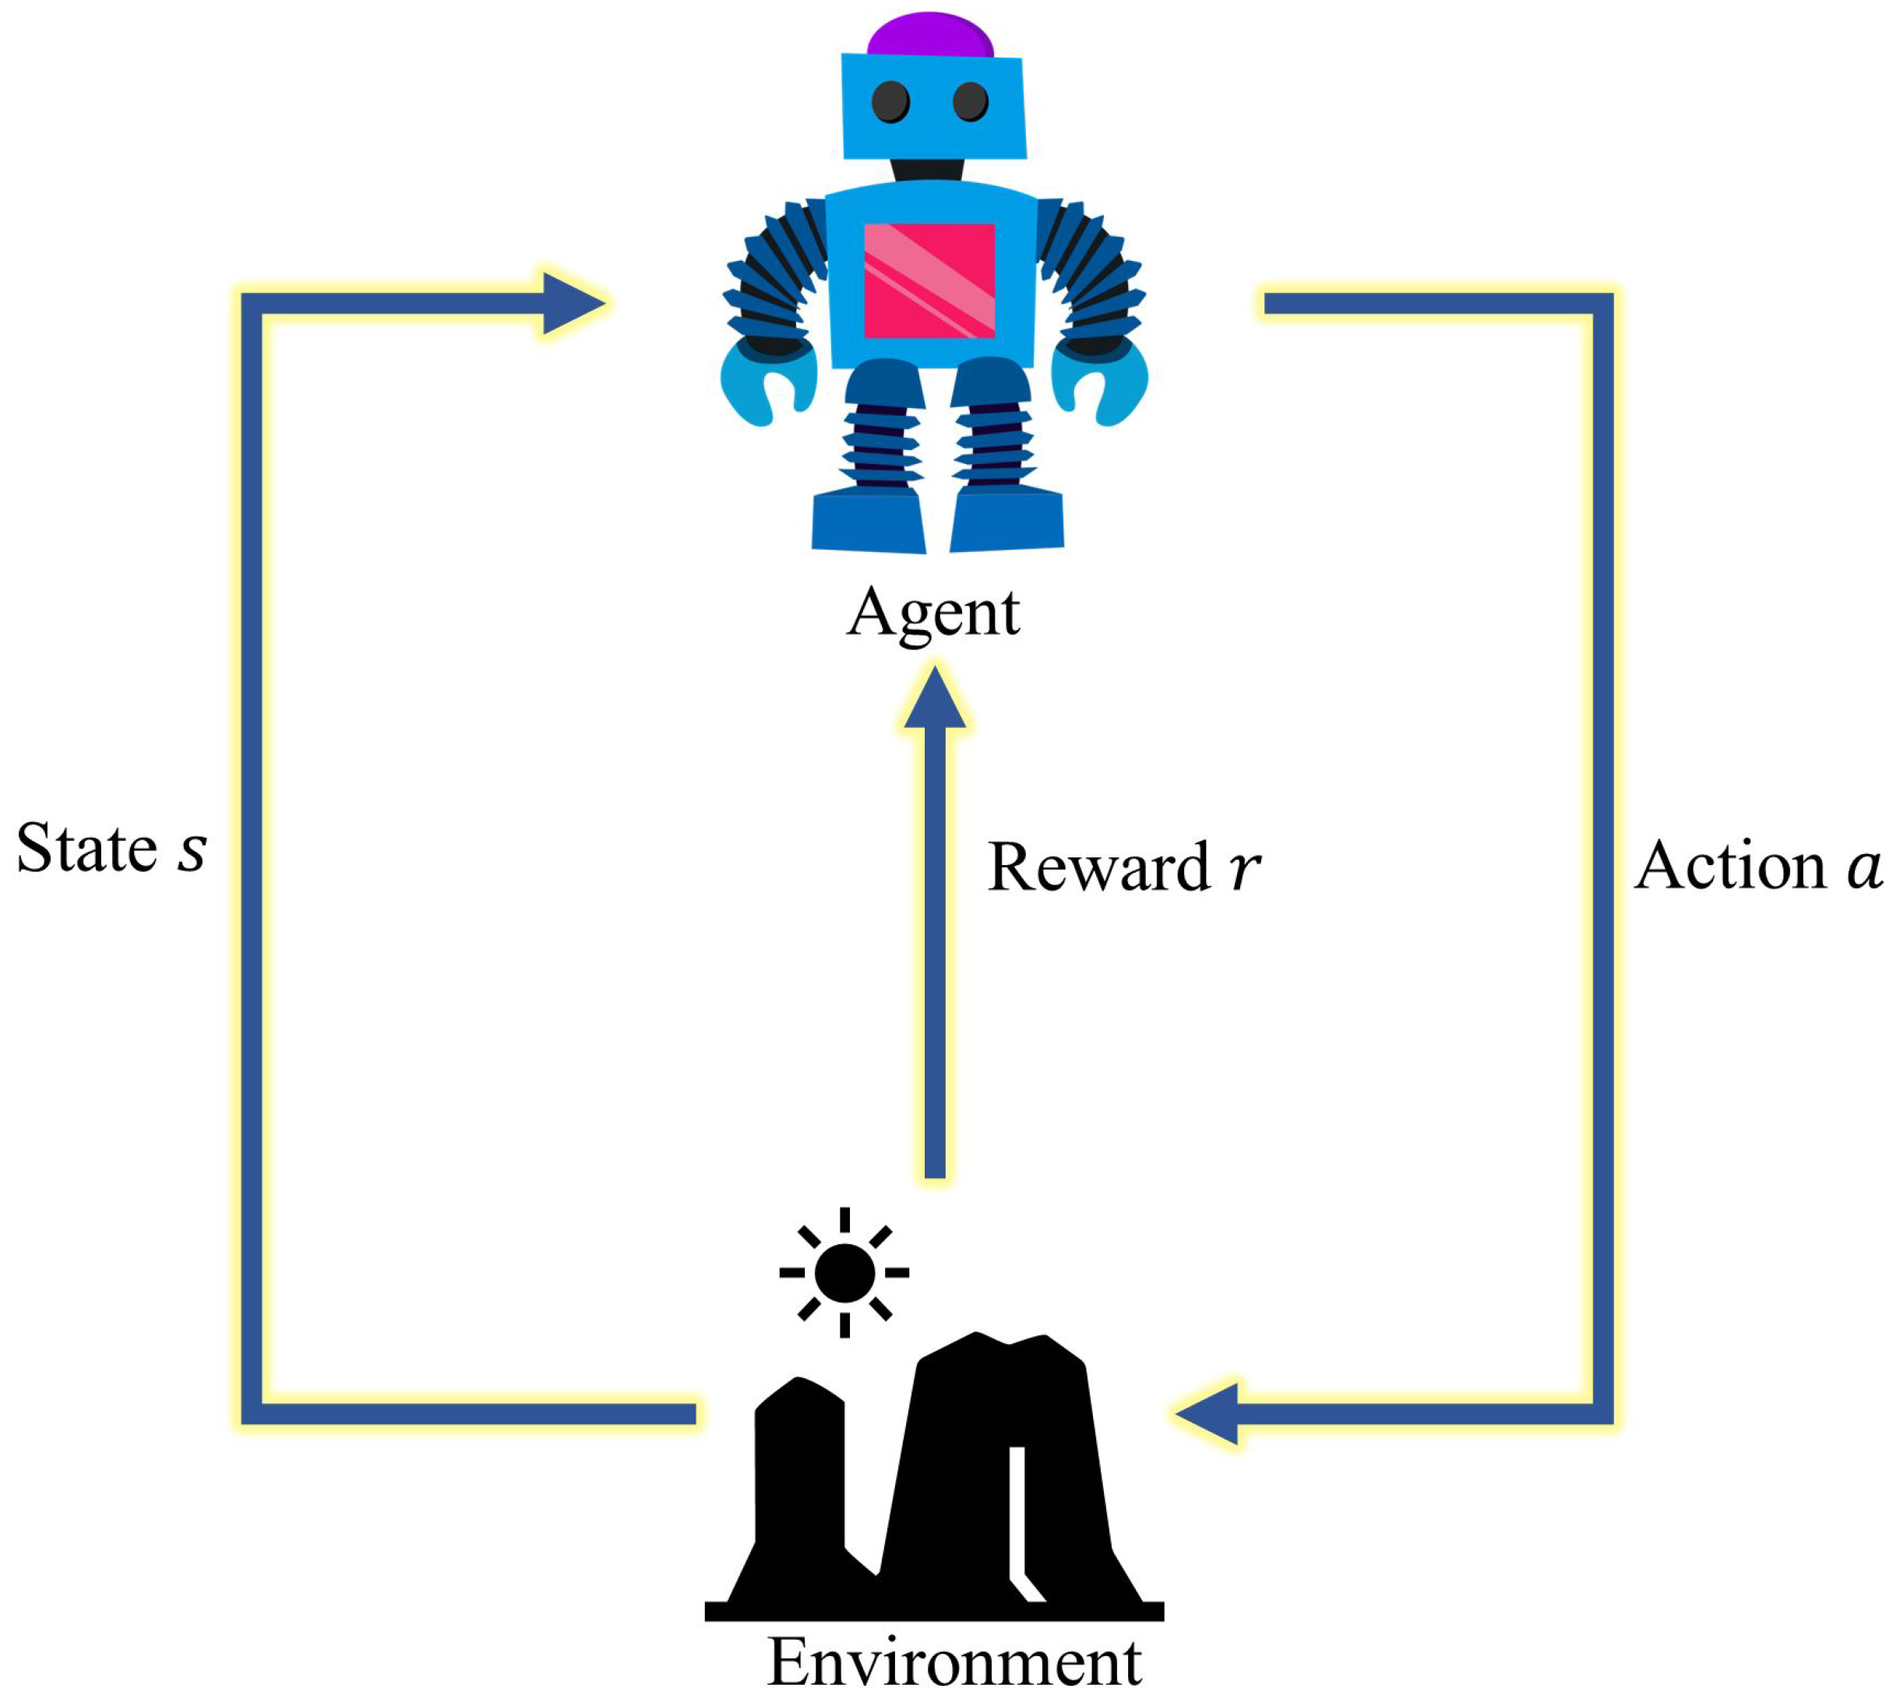
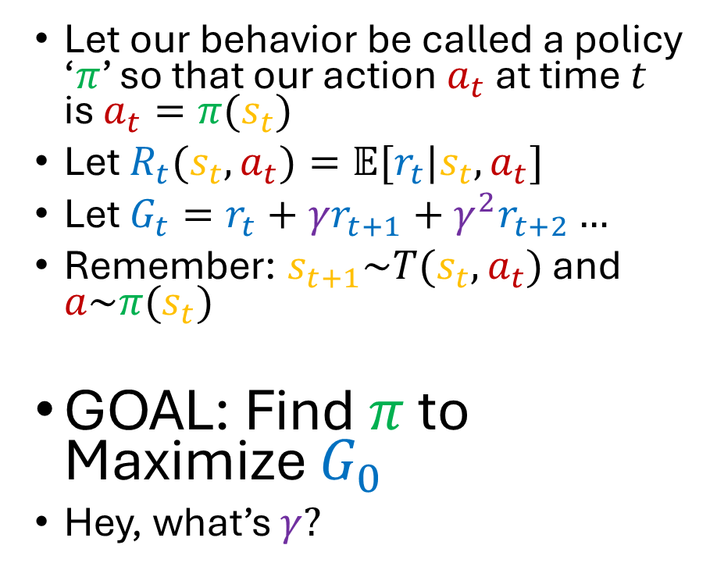
What is The Goal of RL?
Let our behavior be called a policy ‘$π$’ so that our action $a_{t}$ at time $t$ is $a_{t}=π(s_{t})$
Let $R_{t}(s_{t},a_{t})=𝔼[r_{t}|s_{t},a_{t}]$
Let $G_{t}=r_{t}+γr_{t+1}+γ^{2}r_{t+2}…$
Remember: $s_{t+1}\sim T(s_{t},a_{t})$ and $a\sim π(s_{t})$
GOAL: Find $π$ to Maximize $G_{0}$
Hey, what’s $γ?$

Slide 12
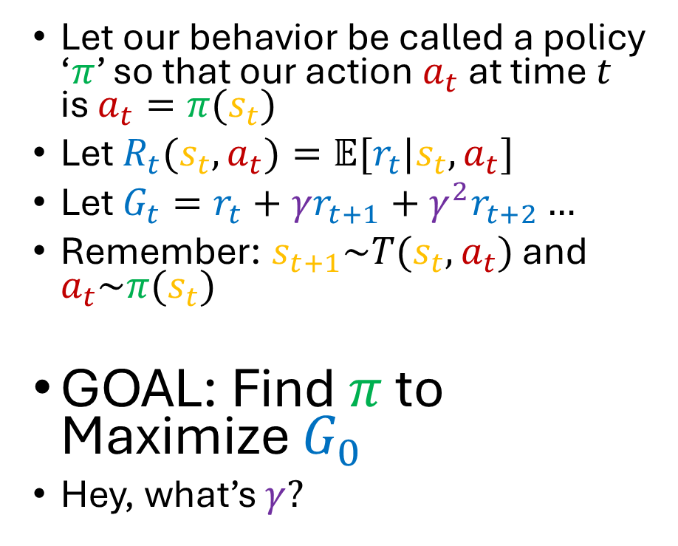
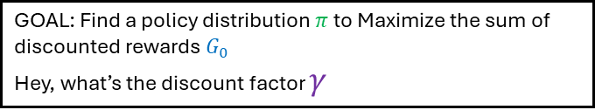

What is The Goal of RL?
Let our behavior be called a policy ‘$π$’ so that our action $a_{t}$ at time $t$ is $a_{t}=π(s_{t})$
Let $R_{t}(s_{t},a_{t})=𝔼[r_{t}|s_{t},a_{t}]$
Let $G_{t}=r_{t}+γr_{t+1}+γ^{2}r_{t+2}…$
Remember: $s_{t+1}\sim T(s_{t},a_{t})$ and $a_{t}\sim π(s_{t})$
GOAL: Find $π$ to Maximize $G_{0}$
Hey, what’s $γ?$
$a_{t}=π(s_{t})$: The action taken by an agent following the policy function $π$ at state $s_{t}$ is action $a_{t}$
$R_{t}(s_{t},a_{t})=𝔼[r_{t}|s_{t},a_{t}]$: The average expected reward $r_{t}$ given the action $a_{t}$is taken at state $s_{t}$is the definition of the expected reward function $R_{t}\left(s_{t},a_{t}\right)$
$G_{t}=r_{t}+γr_{t+1}+γ^{2}r_{t+2}…$: The discounted rewards $G_{t}$at time $t$ is defined as the sum of all future rewards $r_{t}$, $r_{t+1}$, $r_{t+2}$,…, except that rewards received in the future are discounted by a factor of $γ$ for each step in the future, ensuring that future rewards are weighted slightly less than current rewards, all else equal.
$s_{t+1}\sim T(s_{t},a_{t})$: The next state $s_{t+1}$ is determined from the transition distribution $T$, the current state $s_{t}$, and the action taken by the agent $a_{t}$.
$a_{t}\sim π(s_{t})$: The actions $a$are determined from the agent’s policy distribution $π$ at the current state $s_{t}$
GOAL: Find a policy distribution $π$ to Maximize the sum of discounted rewards $G_{0}$
Hey, what’s the discount factor $γ$

Slide 13
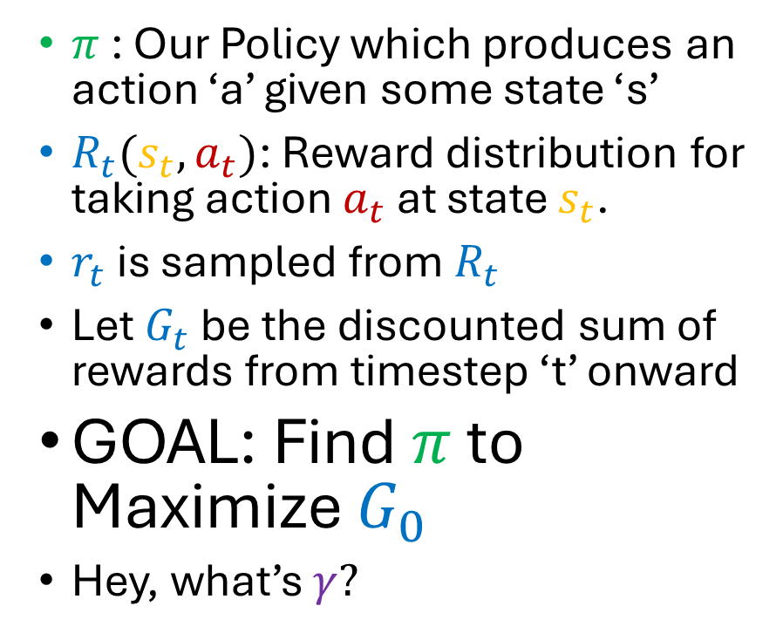
What is The Goal of RL?
$π$: Our Policy which produces an action ‘a’ given some state ‘s’
$R_{t}(s_{t},a_{t})$: Reward distribution for taking action $a_{t}$ at state $s_{t}$.
$r_{t}$ is sampled from $R_{t}$
Let $G_{t}$ be the discounted sum of rewards from timestep ‘t’ onward
GOAL: Find $π$ to Maximize $G_{0}$
Hey, what’s $γ?$

Slide 14
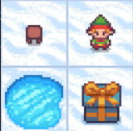

Example Time: Frozen Lake
Elf starts top left
$A=\left\{0:up, 1:down,2:left, 3:right\right\}$
Elf moves in desired direction 1/3 or left 1/3 right 1/3
$S=[0:top left, 1:top right,$ $2:bottom left, 3:bottom right]$
r$\left(s, a\right)=1 if s==3, else 0$
If $s==2$, the game ends
0
1
2
3

Slide 15

Example Time: Frozen Lake
Elf starts top left
$A=\left\{0:up, 1:down,2:left, 3:right\right\}$
Elf moves in desired direction 1/3 or left 1/3 right 1/3
$S=[0:top left, 1:top right,$ $2:bottom left, 3:bottom right]$
r$\left(s, a\right)=1 if s==3, else 0$
If $s==2$, the game ends
0
1
$A$:Complete set of acceptable actions for this game. Can choose up, down, left, or right.
The elf slips on the ice, so if it chooses to go right, it may end up going up or down instead, but will never go in the opposite direction of its choice (in this example, left)
$S$: Complete set of accessible states for this game. Includes top left, top right, bottom left, and bottom right.
r$\left(s, a\right)=1 if s==3, else 0$: Reward function for this game. Reward is 1 if state is bottom right, is 0 in every other case.
2
3

Slide 16

Example Time: Frozen Lake
What is the value of each state given a random player rolling a 4 sided die?
$π_{rand}=[\frac{1}{4},\frac{1}{4},\frac{1}{4},\frac{1}{4}]$ for all states
What is the value of each action at a given state?
$$V_{π}(s_{t})=𝔼[G_{t}|π,s_{t}]$$
$$Q_{π}(s_{t},a_{t})=𝔼[G_{t}|π,s_{t},a_{t}]$$
Let’s look at calculating these together for Frozen Lake
0
1
2
3

Slide 17


Example Time: Frozen Lake
What is the value of each state given a random player rolling a 4 sided die?
$π_{rand}=[\frac{1}{4},\frac{1}{4},\frac{1}{4},\frac{1}{4}]$ for all states
What is the value of each action at a given state?
$$V_{π}(s_{t})=𝔼[G_{t}|π,s_{t}]$$
$$Q_{π}(s_{t},a_{t})=𝔼[G_{t}|π,s_{t},a_{t}]$$
Let’s look at calculating these together for Frozen Lake
0
1
$π_{rand}=[\frac{1}{4},\frac{1}{4},\frac{1}{4},\frac{1}{4}]$ for all states: The policy chooses with equal likelihood to go up, right, down, or left, regardless of where the agent is.
$V_{π}(s_{t})=𝔼[G_{t}|π,s_{t}]$: The value function $V_{π}\left(s_{t}\right)$ for the policy $π$ at state $s_{t}$ is the expected discounted sum of current and future rewards $G_{t}$ for an agent at the state $s_{t}$ following policy $π$.
$Q_{π}(s_{t},a_{t})=𝔼[G_{t}|π,s_{t},a_{t}]$: The action valuation function $Q_{π}(s_{t},a_{t})$ at state $s_{t}$ for taking action $a_{t}$ is the expected discounted sum of current and future rewards $G_{t}$ for an agent at the state $s_{t}$ taking action $a_{t}$ and afterwards for all future actions following policy $π$.
2
3

Slide 18
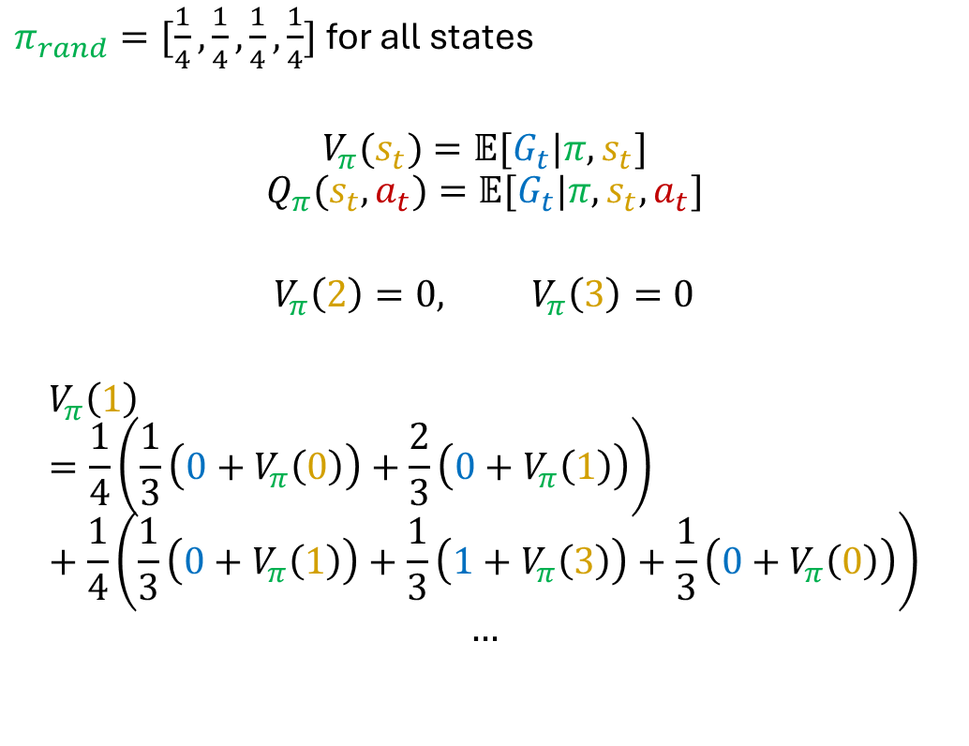




Example Time: Frozen Lake
$π_{rand}=[\frac{1}{4},\frac{1}{4},\frac{1}{4},\frac{1}{4}]$ for all states
$$V_{π}(s_{t})=𝔼[G_{t}|π,s_{t}]$$
$$Q_{π}(s_{t},a_{t})=𝔼[G_{t}|π,s_{t},a_{t}]$$
$$V_{π}\left(2\right)=0, V_{π}\left(3\right)=0$$
$$V_{π}\left(1\right)=\frac{1}{4}\left(\frac{1}{3}\left(0+V_{π}\left(0\right)\right)+\frac{2}{3}\left(0+V_{π}\left(1\right)\right)\right)+\frac{1}{4}\left(\frac{1}{3}\left(0+V_{π}\left(1\right)\right)+\frac{1}{3}\left(1+V_{π}\left(3\right)\right)+\frac{1}{3}\left(0+V_{π}\left(0\right)\right)\right)$$
$$…$$
$$0→??$$
$$1→??$$
$$3→0$$
$$2→0$$

Slide 19
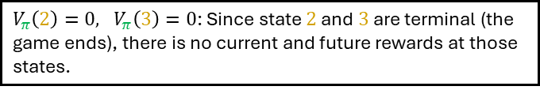





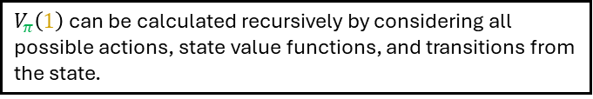
Example Time: Frozen Lake
$π_{rand}=[\frac{1}{4},\frac{1}{4},\frac{1}{4},\frac{1}{4}]$ for all states
$$V_{π}(s_{t})=𝔼[G_{t}|π,s_{t}]$$
$$Q_{π}(s_{t},a_{t})=𝔼[G_{t}|π,s_{t},a_{t}]$$
$$V_{π}\left(2\right)=0, V_{π}\left(3\right)=0$$
$$V_{π}\left(1\right)=\frac{1}{4}\left(\frac{1}{3}\left(0+V_{π}\left(0\right)\right)+\frac{2}{3}\left(0+V_{π}\left(1\right)\right)\right)+\frac{1}{4}\left(\frac{1}{3}\left(0+V_{π}\left(1\right)\right)+\frac{1}{3}\left(1+V_{π}\left(3\right)\right)+\frac{1}{3}\left(0+V_{π}\left(0\right)\right)\right)$$
$$…$$
$$0→??$$
$$1→??$$
$V_{π}\left(2\right)=0, V_{π}\left(3\right)=0$: Since state $2$and $3$are terminal (the game ends), there is no current and future rewards at those states.
$$3→0$$
$V_{π}\left(1\right)$ can be calculated recursively by considering all possible actions, state value functions, and transitions from the state.
$$2→0$$

Slide 20


Example Time: Frozen Lake (Gotta be another way)
$π_{rand}=[\frac{1}{4},\frac{1}{4},\frac{1}{4},\frac{1}{4}]$ for all states
$$V_{π}(s_{t})=𝔼[G_{t}|π,s_{t}]$$
$$Q_{π}(s_{t},a_{t})=𝔼[G_{t}|π,s_{t},a_{t}]$$
$$V_{π}\left(2\right)=0, V_{π}\left(3\right)=0, γ=1.0$$
$$V_{π}\left(1\right)=\frac{1}{4}\left(\frac{1}{3}\left(0+V_{π}\left(0\right)\right)+\frac{2}{3}\left(0+V_{π}\left(1\right)\right)\right)+\frac{1}{4}\left(\frac{1}{3}\left(0+V_{π}\left(1\right)\right)+\frac{1}{3}\left(1+V_{π}\left(3\right)\right)+\frac{1}{3}\left(0+V_{π}\left(0\right)\right)\right)$$
$$…$$
$$0→??$$
$$1→??$$
$$3→1$$
$$2→0$$

Slide 21

Back to Gambling!! Monte-Carlo
$π_{rand}=[\frac{1}{4},\frac{1}{4},\frac{1}{4},\frac{1}{4}]$ for all states
$$V_{π}(s_{t})=𝔼[G_{t}|π,s_{t}]$$
$$Q_{π}(s_{t},a_{t})=𝔼[G_{t}|π,s_{t},a_{t}]$$
How about we play 1,000 episodes of frozen lake and just see what the reward was from each state?
$$G_{t}=r_{t}+γr_{t+1}+γ^{2}r_{t+2}…$$
Say we observe: $\{0:right,1:up,0:right,1:down,3:up\}$
With rewards: $\{0:0, 1:0, 0:0, 1:1, 3:0\}$
We are left with returns: $\{0:γ^{3}1, 1:γ^{2}1, 0:γ1, 1:1, 3:0\}$
What can we do with that?
$$0→??$$
$$1→??$$
$$3→1$$
$$2→0$$

Slide 22



Back to Gambling!! Monte-Carlo
$π_{rand}=[\frac{1}{4},\frac{1}{4},\frac{1}{4},\frac{1}{4}]$ for all states
$$V_{π}(s_{t})=𝔼[G_{t}|π,s_{t}]$$
$$Q_{π}(s_{t},a_{t})=𝔼[G_{t}|π,s_{t},a_{t}]$$
How about we play 1,000 episodes of frozen lake and just see what the reward was from each state?
$$G_{t}=r_{t}+γr_{t+1}+γ^{2}r_{t+2}…$$
Say we observe: $\{0:right,1:up,0:right,1:down,3:up\}$
With rewards: $\{0:0, 1:0, 0:0, 1:1, 3:0\}$
We are left with returns: $\{0:γ^{3}1, 1:γ^{2}1, 0:γ1, 1:1, 3:0\}$
What can we do with that?
$$0→??$$
$$1→??$$
$\{0:right,1:up,0:right,1:down,3:up\}$: Sequence of states $0$,1,0,1,3 are a result of the sequence of actions $right$, $up$, $right$, $down$
$\{0:0, 1:0, 0:0, 1:1, 3:0\}$: The rewards that were received were $0,0,0,1,0$ (since the state 3 was reached after the action $down$
$\{0:γ^{3}1, 1:γ^{2}1, 0:γ1, 1:1, 3:0\}$: Each timestep looks at the future rewards received to define its discounted sum of rewards $G_{t}$. These are $γ^{3}1$, $γ^{2}1$, $γ1$, $1$, $0$
$$3→1$$
$$2→0$$

Slide 23
Back to Gambling!! Monte-Carlo
Lets run it 10k times

