Slide 1
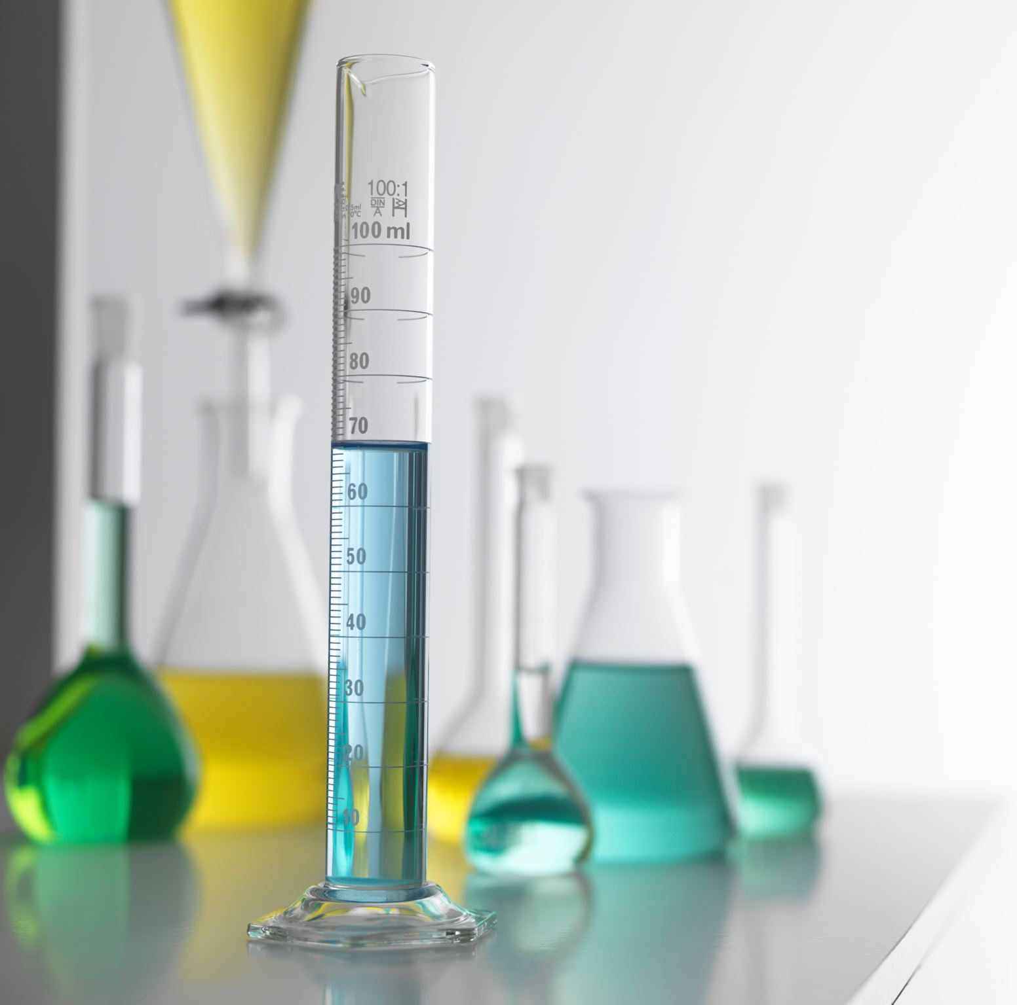
AI/ML at TU Spring ML Workshop 2025
Reinforcement Learning Day 2

Slide 2
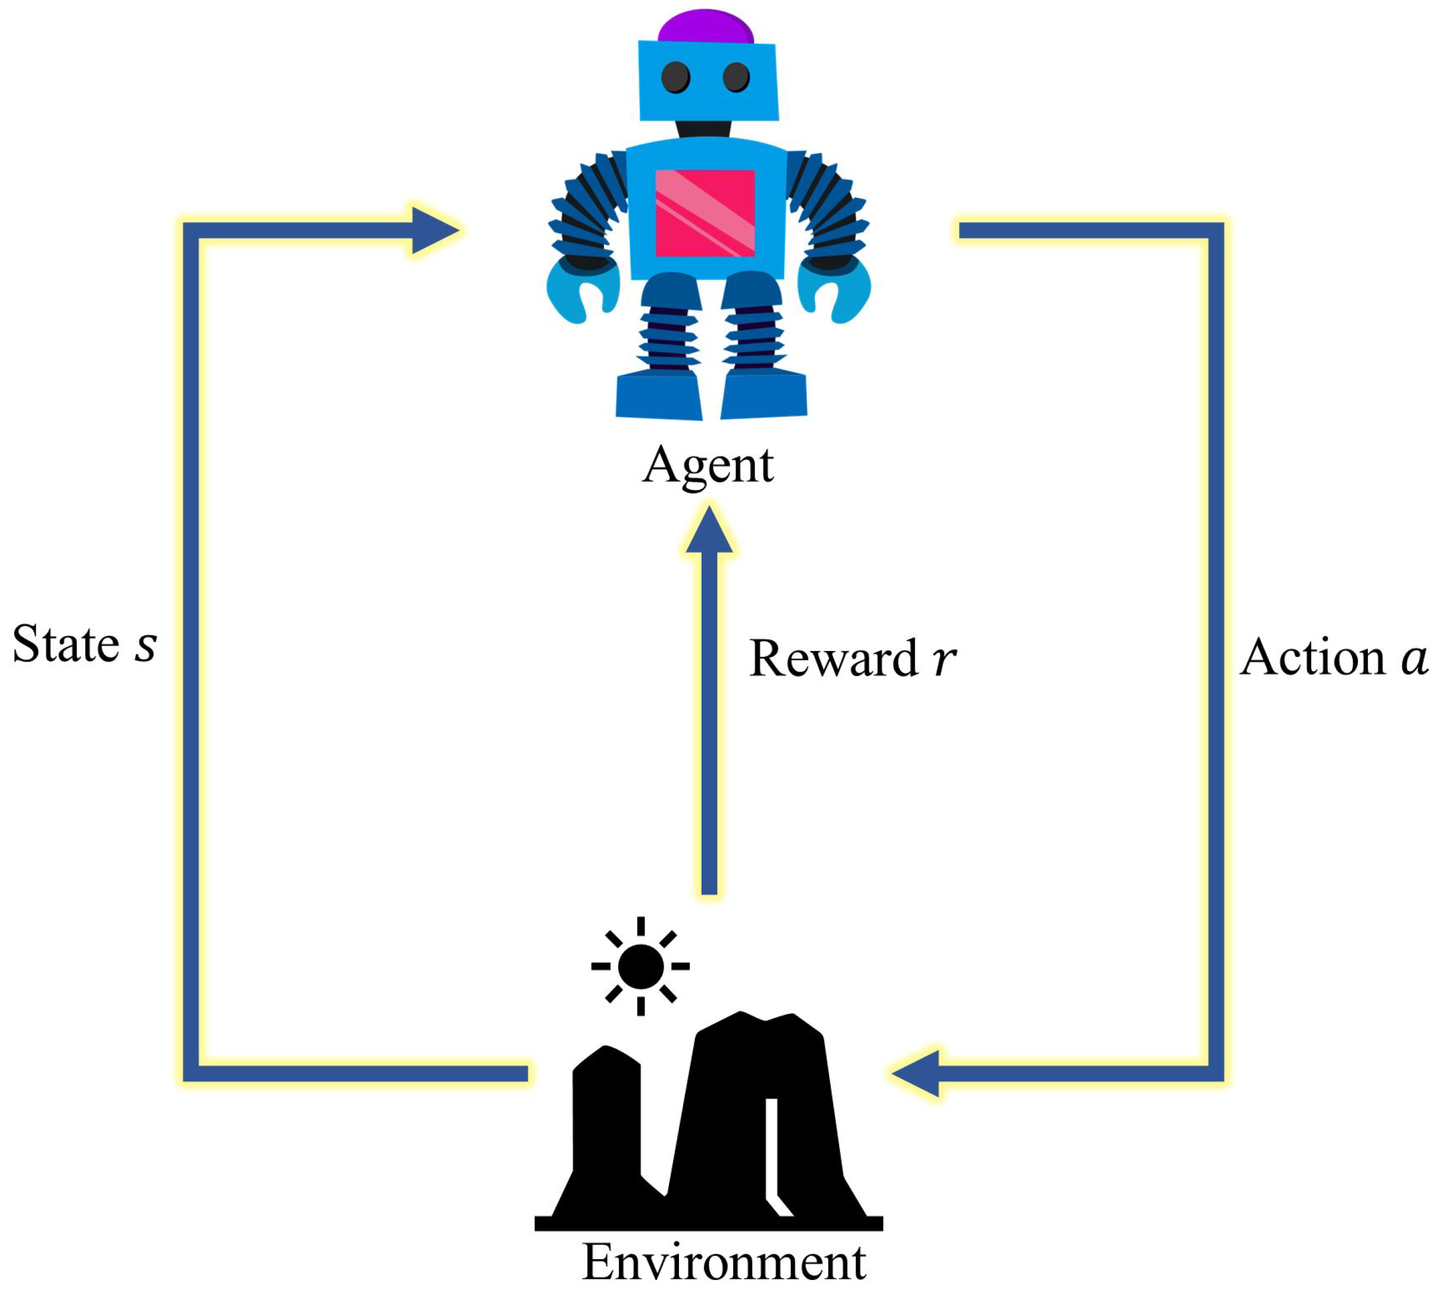

What is our goal in RL?
We Are an Agent in some environment where we observe the current state $s$, receive a reward $r$, and take some action $a$
We care more about rewards now than rewards later because we are unsure about the future.
The amount we discount future rewards is $γ$ where $0>γ≥1$

Slide 3

What is our goal in RL?
The Total discounted reward we get from the environment from time $t$ till the “game ends”
$G_{t}^{γ}=r_{t}+γr_{t+1}+γ^{2}r_{t+2}+…+γ^{t_{end}−t }r_{{ t}_{end }}$
We observe $G_{t}^{γ}$ when we play the game. We want to maximize the expected value of $G_{t}^{γ}$.
The rewards we get are based on the states we reach and the actions we take at those states.

Slide 4
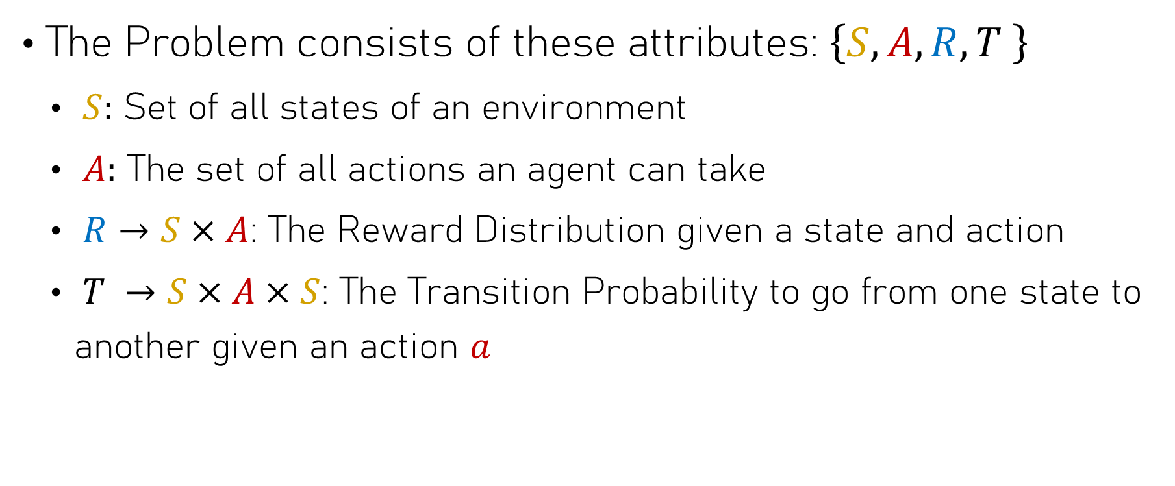
How Does Our Environment Work?:
The Problem consists of these attributes: $\left\{S,A,R,T \right\}$
$S:$ Set of all states of an environment
$A:$ The set of all actions an agent can take
$R→S×A$: The Reward Distribution given a state and action
$T →S×A×S$: The Transition Probability to go from one state to another given an action $a$

Slide 5
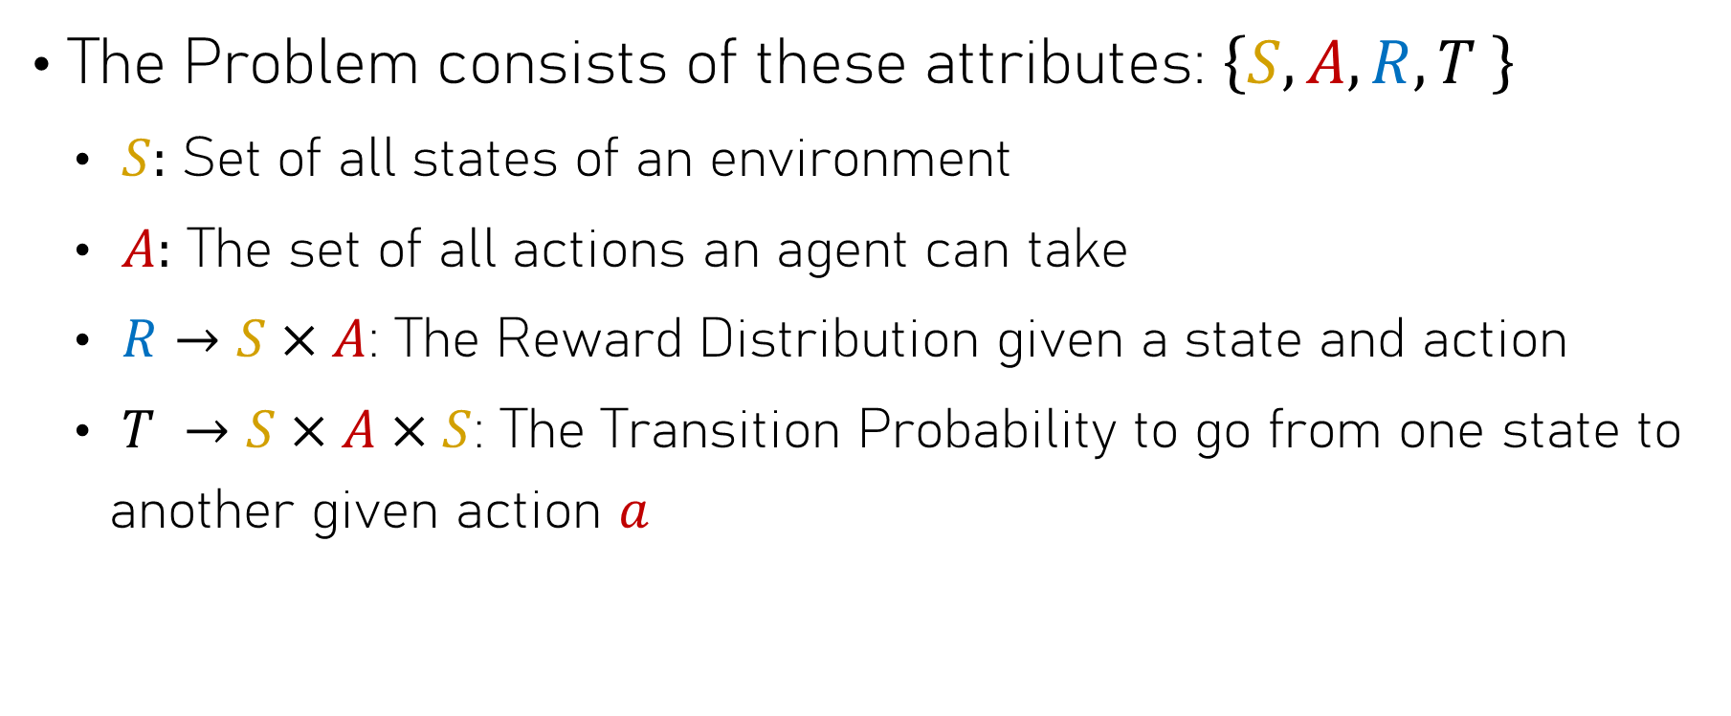
What can we control?
The Problem consists of these attributes: $\left\{S,A,R,T \right\}$
$S:$ Set of all states of an environment
$A:$ The set of all actions an agent can take
$R→S×A$: The Reward Distribution given a state and action
$T →S×A×S$: The Transition Probability to go from one state to another given action $a$

Slide 6



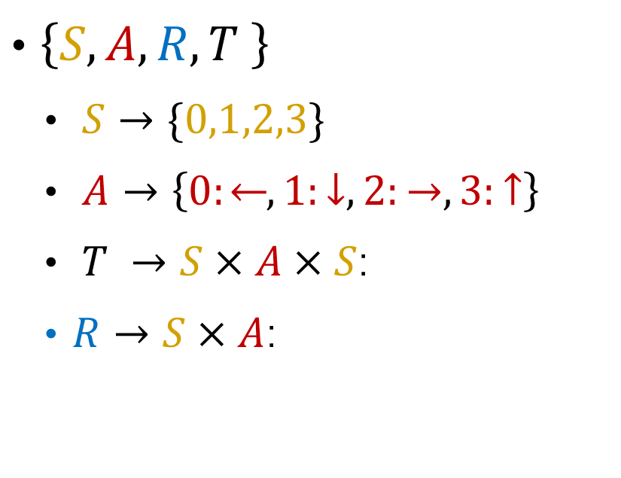





Back to Our Example: Frozen Lake
$$r=0$$
$\left\{S,A,R,T \right\}$
$S→\{0,1,2,3\}$
$A→\left\{0:⃪, 1:↓, 2:→, 3:↑\right\}$
$T →S×A×S$:
$R→S×A$:
0
1
$$→$$
$$↓$$
$$→$$
$$r=1$$
$$r=0$$
2
3
$$→$$

Slide 7
Back to Our Example: Frozen Lake
$$r=0$$
$\left\{S,A,R,T \right\}$
$S→\{0,1,2,3\}$
$A→\left\{0:⃪, 1:↓, 2:→, 3:↑\right\}$
$T →S×A×S$:
$R→S×A$:
0
1
$$→$$
$$↓$$
$$→$$
$$r=1$$
$$r=0$$
2
3
$$→$$

Slide 8
Back to Our Example: Frozen Lake
$$r=0$$
$\left\{S,A,R,T \right\}$
$S→\{0,1,2,3\}$
$A→\left\{0:⃪, 1:↓, 2:→, 3:↑\right\}$
$T →S×A×S$:
$R→S×A$:
0
1
$$→$$
$$↓$$
$$→$$
$$r=1$$
$$r=0$$
2
3
$$→$$

Slide 9
Back to Our Example: Frozen Lake
$$r=0$$
$\left\{S,A,R,T \right\}$
$S→\{0,1,2,3\}$
$A→\left\{0:⃪, 1:↓, 2:→, 3:↑\right\}$
$T →S×A×S$:
$R→S×A$:
0
1
$$→$$
$$↓$$
$$→$$
$$r=1$$
$$r=0$$
2
3
$$→$$

Slide 10
Back to Our Example: Frozen Lake
$$r=0$$
$\left\{S,A,R,T \right\}$
$S→\{0,1,2,3\}$
$A→\left\{0:⃪, 1:↓, 2:→, 3:↑\right\}$
$T →S×A×S$:
$R→S×A$:
0
1
$$→$$
$$↓$$
$$→$$
$$r=1$$
$$r=0$$
2
3
$$→$$

Slide 11
Back to Our Example: Frozen Lake
$$r=0$$
$\left\{S,A,R,T \right\}$
$S→\{0,1,2,3\}$
$A→\left\{0:⃪, 1:↓, 2:→, 3:↑\right\}$
$T →S×A×S$:
$R→S×A$:
0
1
$$→$$
$$↓$$
$$→$$
$$r=1$$
$$r=0$$
2
3
$$→$$

Slide 12

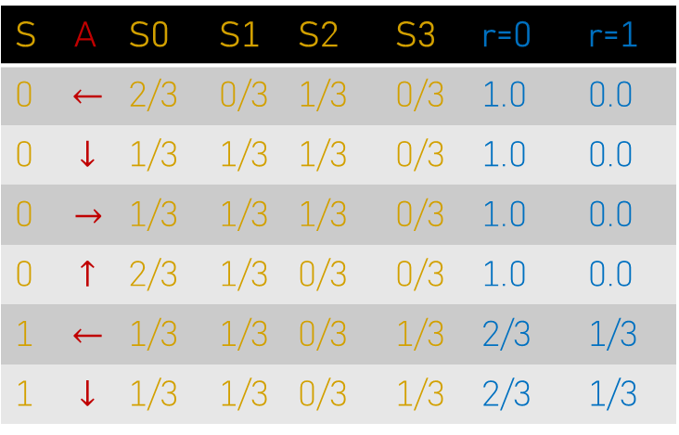

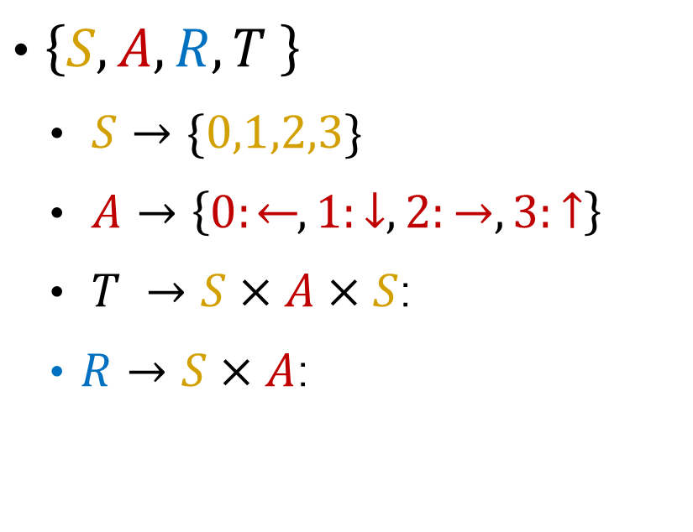


Back to Our Example: Frozen Lake
$$T R$$
$\left\{S,A,R,T \right\}$
$S→\{0,1,2,3\}$
$A→\left\{0:⃪, 1:↓, 2:→, 3:↑\right\}$
$T →S×A×S$:
$R→S×A$:
S | A | S0 | S1 | S2 | S3 | r=0 | r=1
0 | $$⃪$$ | 2/3 | 0/3 | 1/3 | 0/3 | 1.0 | 0.0
0 | $$↓$$ | 1/3 | 1/3 | 1/3 | 0/3 | 1.0 | 0.0
0 | $$→$$ | 1/3 | 1/3 | 1/3 | 0/3 | 1.0 | 0.0
0 | $$↑$$ | 2/3 | 1/3 | 0/3 | 0/3 | 1.0 | 0.0
1 | $$⃪$$ | 1/3 | 1/3 | 0/3 | 1/3 | 2/3 | 1/3
1 | $$↓$$ | 1/3 | 1/3 | 0/3 | 1/3 | 2/3 | 1/3
0
1
$$→$$
$$↓$$
$$→$$
2
3
...
$$→$$

Slide 13


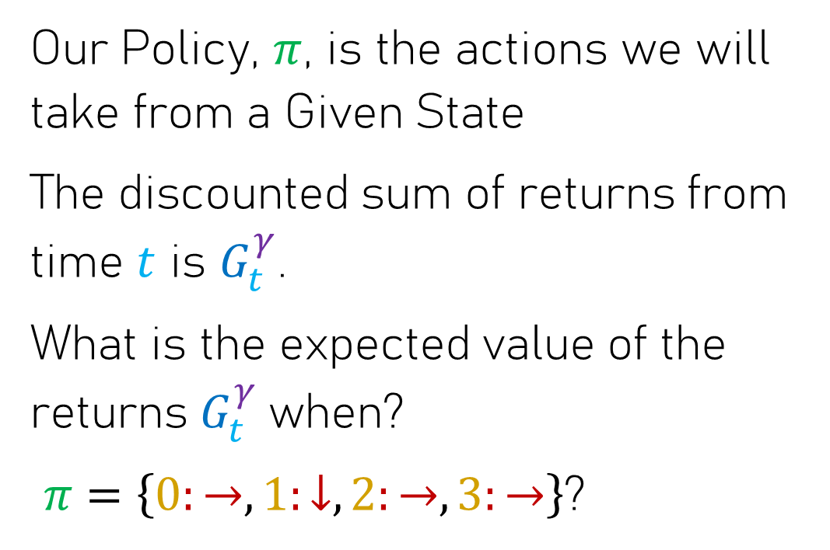


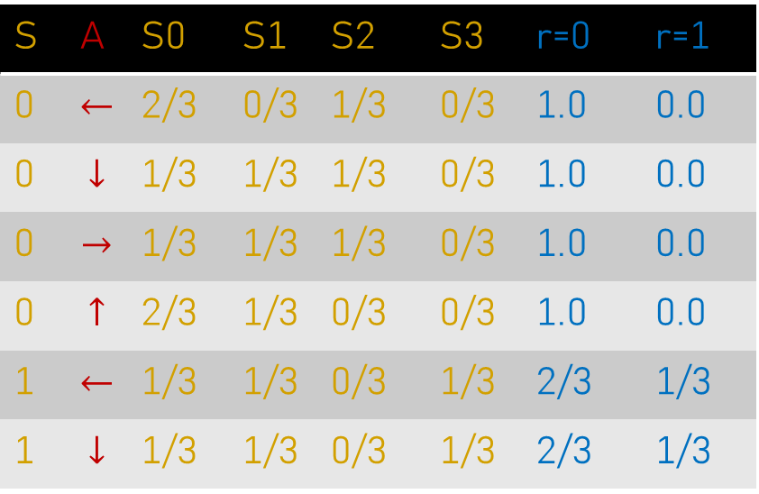
Back to Our Example: Frozen Lake
0
1
$$→$$
$$↓$$
$$→$$
2
3
$$→$$
Our Policy, $π$, is the actions we will take from a Given State
The discounted sum of returns from time $t$ is $G_{t}^{γ}$.
What is the expected value of the returns $G_{t}^{γ}$when?
$π=\left\{0:→, 1:↓, 2:→, 3:→\right\}$?
S | A | S0 | S1 | S2 | S3 | r=0 | r=1
0 | $$⃪$$ | 2/3 | 0/3 | 1/3 | 0/3 | 1.0 | 0.0
0 | $$↓$$ | 1/3 | 1/3 | 1/3 | 0/3 | 1.0 | 0.0
0 | $$→$$ | 1/3 | 1/3 | 1/3 | 0/3 | 1.0 | 0.0
0 | $$↑$$ | 2/3 | 1/3 | 0/3 | 0/3 | 1.0 | 0.0
1 | $$⃪$$ | 1/3 | 1/3 | 0/3 | 1/3 | 2/3 | 1/3
1 | $$↓$$ | 1/3 | 1/3 | 0/3 | 1/3 | 2/3 | 1/3

Slide 14


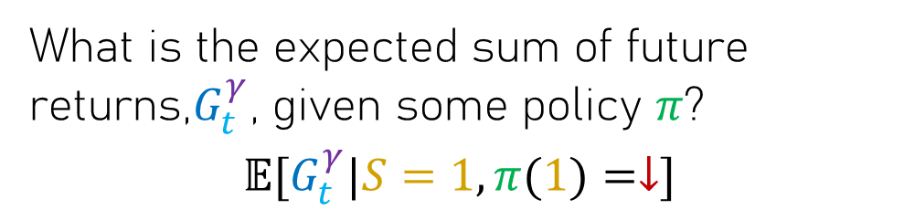


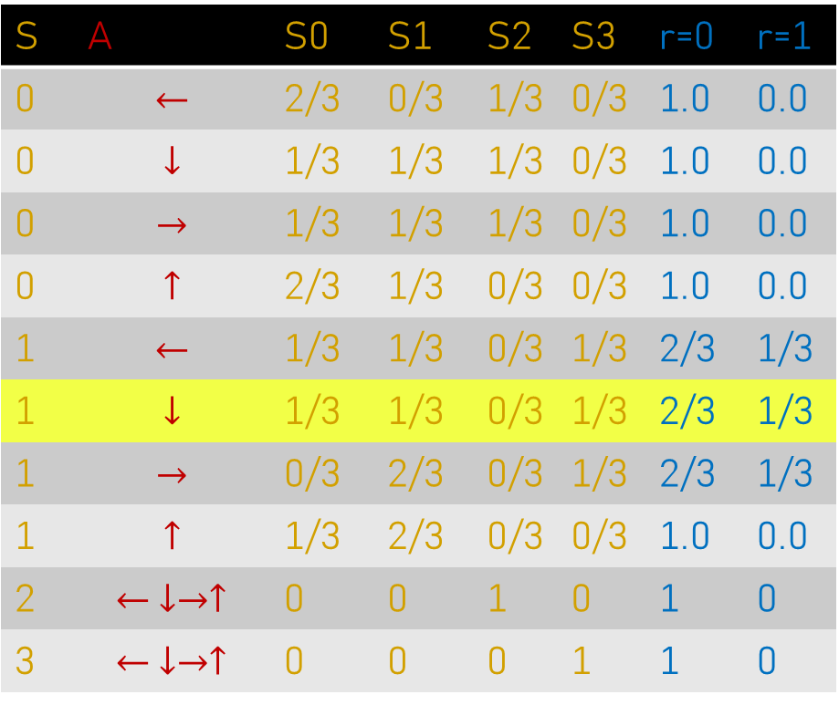
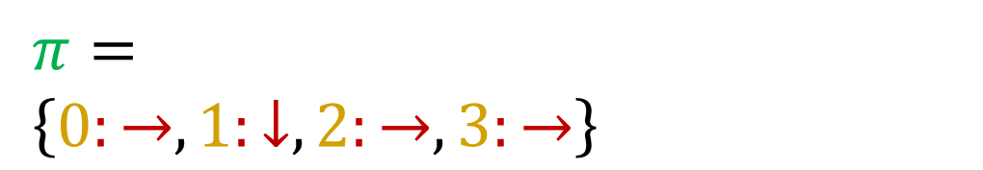
Back to Our Example: Frozen Lake
What is the expected sum of future returns,$G_{t}^{γ}$, given some policy $π$?
$$𝔼[G_{t}^{γ}|S=1,π(1)=↓]$$
S | A | S0 | S1 | S2 | S3 | r=0 | r=1
0 | $$⃪$$ | 2/3 | 0/3 | 1/3 | 0/3 | 1.0 | 0.0
0 | $$↓$$ | 1/3 | 1/3 | 1/3 | 0/3 | 1.0 | 0.0
0 | $$→$$ | 1/3 | 1/3 | 1/3 | 0/3 | 1.0 | 0.0
0 | $$↑$$ | 2/3 | 1/3 | 0/3 | 0/3 | 1.0 | 0.0
1 | $$⃪$$ | 1/3 | 1/3 | 0/3 | 1/3 | 2/3 | 1/3
1 | $$↓$$ | 1/3 | 1/3 | 0/3 | 1/3 | 2/3 | 1/3
1 | $$→$$ | 0/3 | 2/3 | 0/3 | 1/3 | 2/3 | 1/3
1 | $$↑$$ | 1/3 | 2/3 | 0/3 | 0/3 | 1.0 | 0.0
2 | $$⃪↓→↑$$ | 0 | 0 | 1 | 0 | 1 | 0
3 | $$⃪↓→↑$$ | 0 | 0 | 0 | 1 | 1 | 0
$π=$
$\left\{0:→, 1:↓, 2:→, 3:→\right\}$
0
1
$$→$$
$$↓$$
$$→$$
2
3
$$→$$

Slide 15
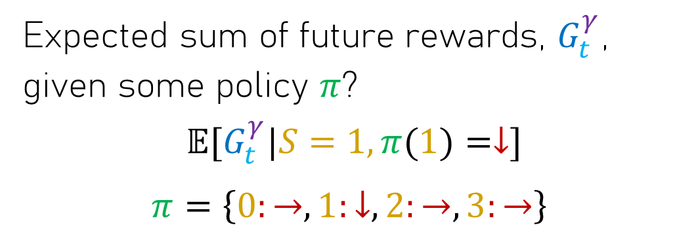
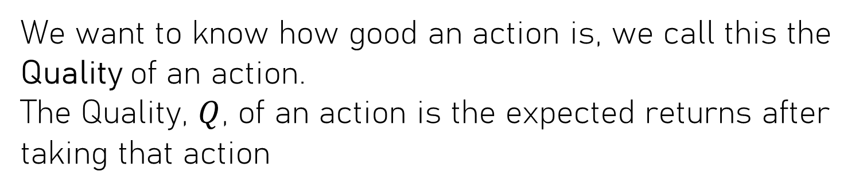
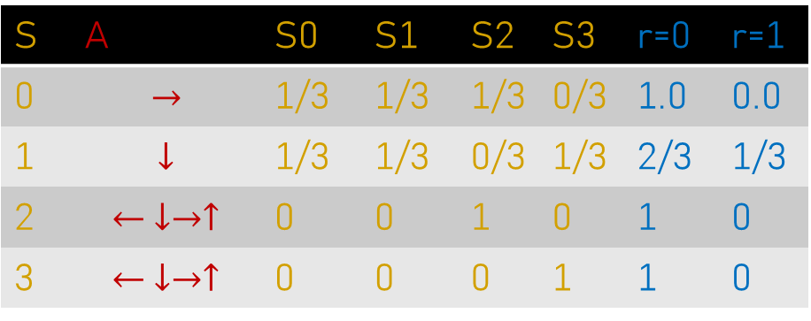

Back to Our Example: Frozen Lake
Expected sum of future rewards, $G_{t}^{γ}$, given some policy $π$?
$$𝔼[G_{t}^{γ}|S=1,π(1)=↓]$$
$π=\left\{0:→, 1:↓, 2:→, 3:→\right\}$
S | A | S0 | S1 | S2 | S3 | r=0 | r=1
0 | $$→$$ | 1/3 | 1/3 | 1/3 | 0/3 | 1.0 | 0.0
1 | $$↓$$ | 1/3 | 1/3 | 0/3 | 1/3 | 2/3 | 1/3
2 | $$⃪↓→↑$$ | 0 | 0 | 1 | 0 | 1 | 0
3 | $$⃪↓→↑$$ | 0 | 0 | 0 | 1 | 1 | 0
0
1
We want to know how good an action is, we call this the Quality of an action.
The Quality, $Q$, of an action is the expected returns after taking that action
$$→$$
$$↓$$
$$→$$
2
3
$$→$$
$$Q_{π}(s_{t},a_{t})=𝔼[G_{t}^{γ}|π,s_{t},a_{t}]$$

Slide 16
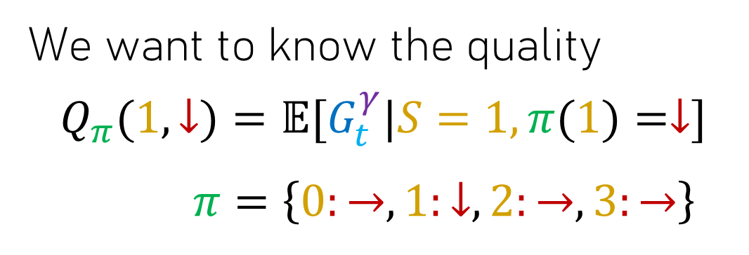
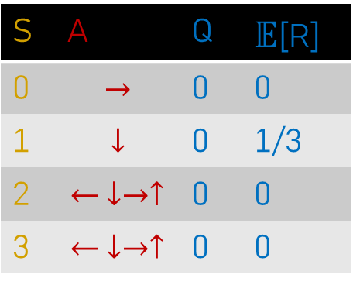
Back to Our Example: Frozen Lake
We want to know the quality
$$Q_{π}(1,↓)=𝔼[G_{t}^{γ}|S=1,π(1)=↓]$$
$π=\left\{0:→, 1:↓, 2:→, 3:→\right\}$
S | A | S0 | S1 | S2 | S3 | r=0 | r=1
0 | $$→$$ | 1/3 | 1/3 | 1/3 | 0/3 | 1.0 | 0.0
1 | $$↓$$ | 1/3 | 1/3 | 0/3 | 1/3 | 2/3 | 1/3
2 | $$⃪↓→↑$$ | 0 | 0 | 1 | 0 | 1 | 0
3 | $$⃪↓→↑$$ | 0 | 0 | 0 | 1 | 1 | 0
0
1
We can save the quality estimates in a table ->
S | A | Q | $𝔼$[R]
0 | $$→$$ | 0 | 0
1 | $$↓$$ | 0 | 1/3
2 | $$⃪↓→↑$$ | 0 | 0
3 | $$⃪↓→↑$$ | 0 | 0
$$→$$
$$↓$$
$$→$$
2
3
$$→$$

Slide 17
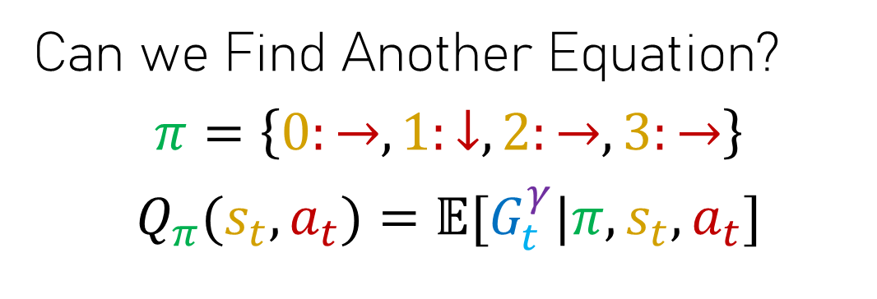
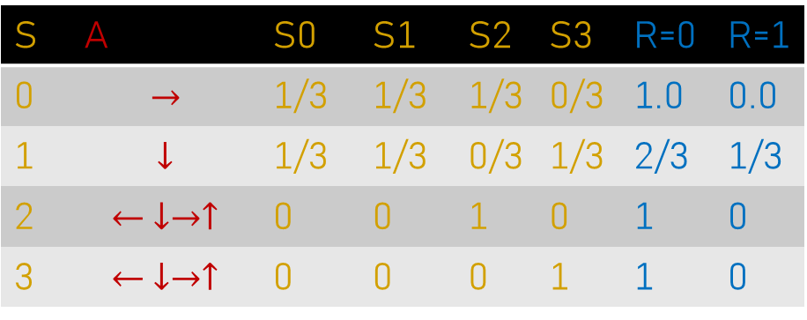
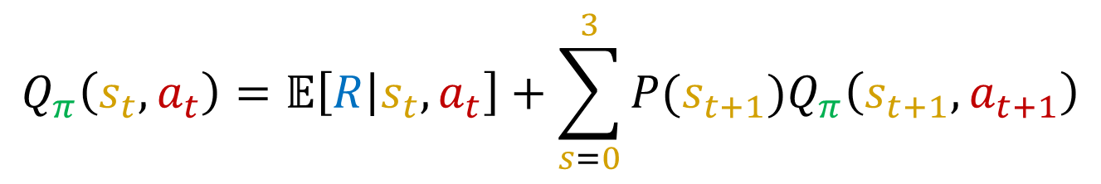
Back to Our Example: Frozen Lake
Can we Find Another Equation?
$$π=\left\{0:→, 1:↓, 2:→, 3:→\right\}$$
$$Q_{π}(s_{t},a_{t})=𝔼[G_{t}^{γ}|π,s_{t},a_{t}]$$
S | A | S0 | S1 | S2 | S3 | R=0 | R=1
0 | $$→$$ | 1/3 | 1/3 | 1/3 | 0/3 | 1.0 | 0.0
1 | $$↓$$ | 1/3 | 1/3 | 0/3 | 1/3 | 2/3 | 1/3
2 | $$⃪↓→↑$$ | 0 | 0 | 1 | 0 | 1 | 0
3 | $$⃪↓→↑$$ | 0 | 0 | 0 | 1 | 1 | 0
0
1
Quality of our action right now is the reward we receive now plus the Quality of the states we end up in times the probability that we end up in them
$$→$$
$$↓$$
$$→$$
2
3
$$Q_{π}\left(s_{t},a_{t}\right)=𝔼\left[R | s_{t},a_{t}\right]+\sum_{s=0}^{3}{P(s_{t+1})Q_{π}\left(s_{t+1},a_{t+1}\right)}$$
$$→$$

Slide 18

Back to Our Example: Frozen Lake
Can we Find Another Equation?
$$π=\left\{0:→, 1:↓, 2:→, 3:→\right\}$$
$$Q_{π}(s_{t},a_{t})=𝔼[G_{t}^{γ}|π,s_{t},a_{t}]$$
S | A | S0 | S1 | S2 | S3 | R=0 | R=1
0 | $$→$$ | 1/3 | 1/3 | 1/3 | 0/3 | 1.0 | 0.0
1 | $$↓$$ | 1/3 | 1/3 | 0/3 | 1/3 | 2/3 | 1/3
2 | $$⃪↓→↑$$ | 0 | 0 | 1 | 0 | 1 | 0
3 | $$⃪↓→↑$$ | 0 | 0 | 0 | 1 | 1 | 0
0
1
Quality right now
Immediate Reward
Probability of ending up in next states
$$→$$
$$↓$$
Quality of the next states
$$→$$
2
3
$$Q_{π}\left(s_{t},a_{t}\right)=𝔼\left[R | s_{t},a_{t}\right]+\sum_{s=0}^{3}{P(s_{t+1})Q_{π}\left(s_{t+1},a_{t+1}\right)}$$
$$→$$

Slide 19

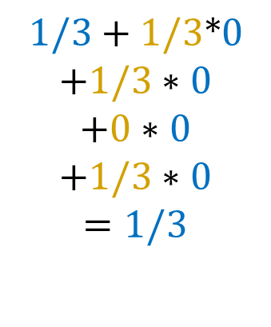

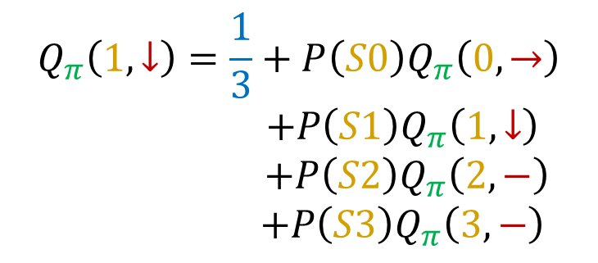

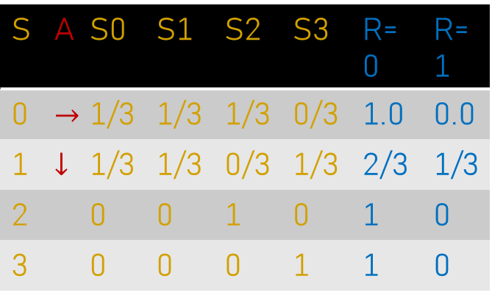

Back to Our Example: Frozen Lake
Lets work through an example:
$$π=\left\{0:→, 1:↓, 2:→, 3:→\right\}$$
S | A | S0 | S1 | S2 | S3 | R=0 | R=1
0 | $$→$$ | 1/3 | 1/3 | 1/3 | 0/3 | 1.0 | 0.0
1 | $$↓$$ | 1/3 | 1/3 | 0/3 | 1/3 | 2/3 | 1/3
2 |  | 0 | 0 | 1 | 0 | 1 | 0
3 |  | 0 | 0 | 0 | 1 | 1 | 0
$$Q_{π}\left(s_{t},a_{t}\right)=𝔼\left[R | s_{t},a_{t}\right]+\sum_{s=0}^{3}{P(s_{t+1})Q_{π}\left(s_{t+1},a_{t+1}\right)}$$
0
1
$$Q_{π}\left(1,↓\right)=\frac{1}{3}+P\left(S0\right)Q_{π}\left(0,→\right)$$
$$+P\left(S1\right)Q_{π}\left(1,↓\right)$$
$$+P\left(S2\right)Q_{π}\left(2,−\right)$$
$$+P\left(S3\right)Q_{π}\left(3,−\right)$$
S | A | Q | E[R]
0 | $$→$$ | 0 | 0
1 | $$↓$$ | 0 | 1/3
2 | $$⃪↓→↑$$ | 0 | 0
3 | $$⃪↓→↑$$ | 0 | 0
$$1/3+1/3*0$$
$$+1/3∗0$$
$$+0∗0$$
$$+1/3∗0$$
$$=1/3$$
$$→$$
$$↓$$
$$→$$
$$=$$
2
3
$$→$$

Slide 20
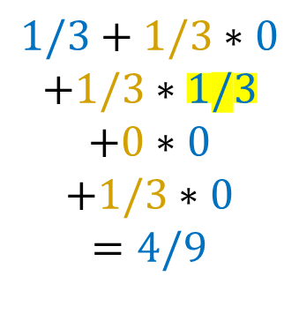

Back to Our Example: Frozen Lake
Lets work through an example:
$$π=\left\{0:→, 1:↓, 2:→, 3:→\right\}$$
S | A | S0 | S1 | S2 | S3 | R=0 | R=1
0 | $$→$$ | 1/3 | 1/3 | 1/3 | 0/3 | 1.0 | 0.0
1 | $$↓$$ | 1/3 | 1/3 | 0/3 | 1/3 | 2/3 | 1/3
2 |  | 0 | 0 | 1 | 0 | 1 | 0
3 |  | 0 | 0 | 0 | 1 | 1 | 0
$$Q_{π}\left(s_{t},a_{t}\right)=𝔼\left[R | s_{t},a_{t}\right]+\sum_{s=0}^{3}{P(s_{t+1})Q_{π}\left(s_{t+1},a_{t+1}\right)}$$
0
1
$$Q_{π}\left(1,↓\right)=\frac{1}{3}+P\left(S0\right)Q_{π}\left(0,→\right)$$
$$+P\left(S1\right)Q_{π}\left(1,↓\right)$$
$$+P\left(S2\right)Q_{π}\left(2,−\right)$$
$$+P\left(S3\right)Q_{π}\left(3,−\right)$$
S | A | Q | E[R]
0 | $$→$$ | 0 | 0
1 | $$↓$$ | 1/3 | 1/3
2 | $$−$$ | 0 | 0
3 | $$−$$ | 0 | 0
$$1/3+1/3∗0$$
$$+1/3∗1/3$$
$$+0∗0$$
$$+1/3∗0$$
$$=4/9$$
$$→$$
$$↓$$
$$→$$
$$=$$
2
3
$$→$$

Slide 21
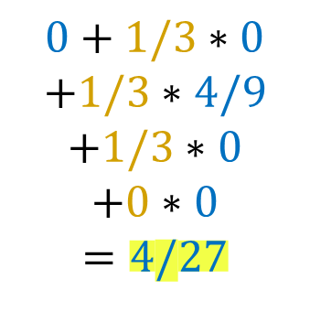
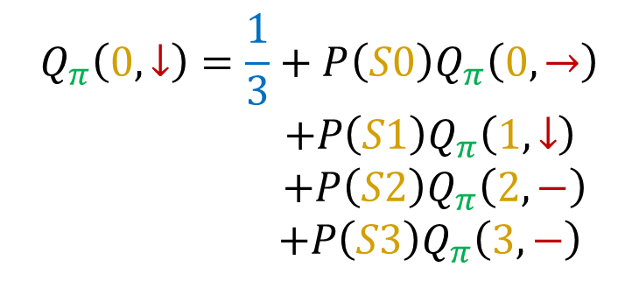

Back to Our Example: Frozen Lake
Lets work through an example:
$$π=\left\{0:→, 1:↓, 2:→, 3:→\right\}$$
S | A | S0 | S1 | S2 | S3 | R=0 | R=1
0 | $$→$$ | 1/3 | 1/3 | 1/3 | 0/3 | 1.0 | 0.0
1 | $$↓$$ | 1/3 | 1/3 | 0/3 | 1/3 | 2/3 | 1/3
2 |  | 0 | 0 | 1 | 0 | 1 | 0
3 |  | 0 | 0 | 0 | 1 | 1 | 0
$$Q_{π}\left(s_{t},a_{t}\right)=𝔼\left[R | s_{t},a_{t}\right]+\sum_{s=0}^{3}{P(s_{t+1})Q_{π}\left(s_{t+1},a_{t+1}\right)}$$
0
1
$$Q_{π}\left(0,↓\right)=\frac{1}{3}+P\left(S0\right)Q_{π}\left(0,→\right)$$
$$+P\left(S1\right)Q_{π}\left(1,↓\right)$$
$$+P\left(S2\right)Q_{π}\left(2,−\right)$$
$$+P\left(S3\right)Q_{π}\left(3,−\right)$$
S | A | Q | E[R]
0 | $$→$$ | 0 | 0
1 | $$↓$$ | 4/9 | 1/3
2 | $$−$$ | 0 | 0
3 | $$−$$ | 0 | 0
$$0+1/3∗0$$
$$+1/3∗4/9$$
$$+1/3∗0$$
$$+0∗0$$
$$=4/27$$
$$→$$
$$↓$$
$$→$$
$$=$$
2
3
$$→$$

Slide 22

Back to Our Example: Frozen Lake
Lets work through an example:
$$π=\left\{0:→, 1:↓, 2:→, 3:→\right\}$$
S | A | S0 | S1 | S2 | S3 | R=0 | R=1
0 | $$→$$ | 1/3 | 1/3 | 1/3 | 0/3 | 1.0 | 0.0
1 | $$↓$$ | 1/3 | 1/3 | 0/3 | 1/3 | 2/3 | 1/3
2 |  | 0 | 0 | 1 | 0 | 1 | 0
3 |  | 0 | 0 | 0 | 1 | 1 | 0
$$Q_{π}\left(s_{t},a_{t}\right)=𝔼\left[R | s_{t},a_{t}\right]+\sum_{s=0}^{3}{P(s_{t+1})Q_{π}\left(s_{t+1},a_{t+1}\right)}$$
0
1
$$Q_{π}\left(0,↓\right)=\frac{1}{3}+P\left(S0\right)Q_{π}\left(0,→\right)$$
$$+P\left(S1\right)Q_{π}\left(1,↓\right)$$
$$+P\left(S2\right)Q_{π}\left(2,−\right)$$
$$+P\left(S3\right)Q_{π}\left(3,−\right)$$
S | A | Q | E[R]
0 | $$→$$ | 4/27 | 0
1 | $$↓$$ | 4/9 | 1/3
2 | $$−$$ | 0 | 0
3 | $$−$$ | 0 | 0
$$0+1/3∗0$$
$$+1/3∗4/9$$
$$+1/3∗0$$
$$+0∗0$$
$$=4/27$$
$$→$$
$$↓$$
$$→$$
$$=$$
2
3
$$→$$

Slide 23
Lets look at the code!

Slide 24
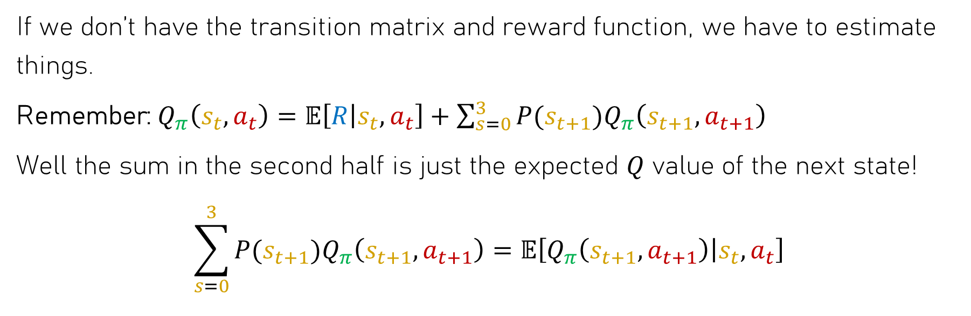
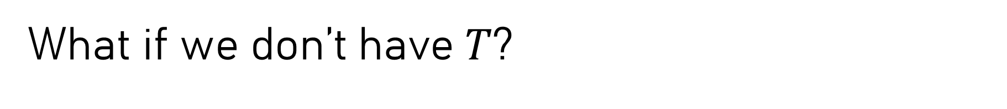
What if we don’t have $T$?
If we don’t have the transition matrix and reward function, we have to estimate things.
Remember: $Q_{π}\left(s_{t},a_{t}\right)=𝔼\left[R | s_{t},a_{t}\right]+\sum_{s=0}^{3}{P(s_{t+1})Q_{π}\left(s_{t+1},a_{t+1}\right)}$
Well the sum in the second half is just the expected $Q$ value of the next state!
$$\sum_{s=0}^{3}{P(s_{t+1})Q_{π}\left(s_{t+1},a_{t+1}\right)}=𝔼\left[Q_{π}\left(s_{t+1},a_{t+1}\right) | s_{t},a_{t}\right]$$

Slide 25
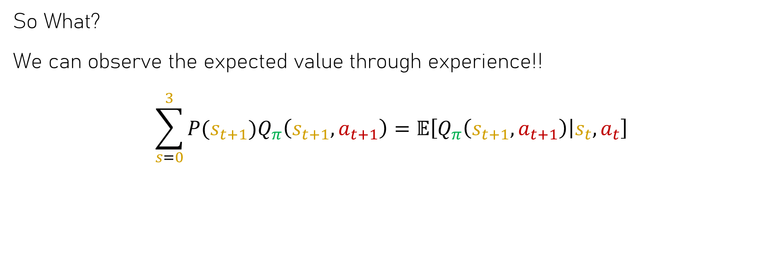
What if we don’t have $T$?
So What?
We can observe the expected value through experience!!
$$\sum_{s=0}^{3}{P(s_{t+1})Q_{π}\left(s_{t+1},a_{t+1}\right)}=𝔼\left[Q_{π}\left(s_{t+1},a_{t+1}\right) | s_{t},a_{t}\right]$$

Slide 26
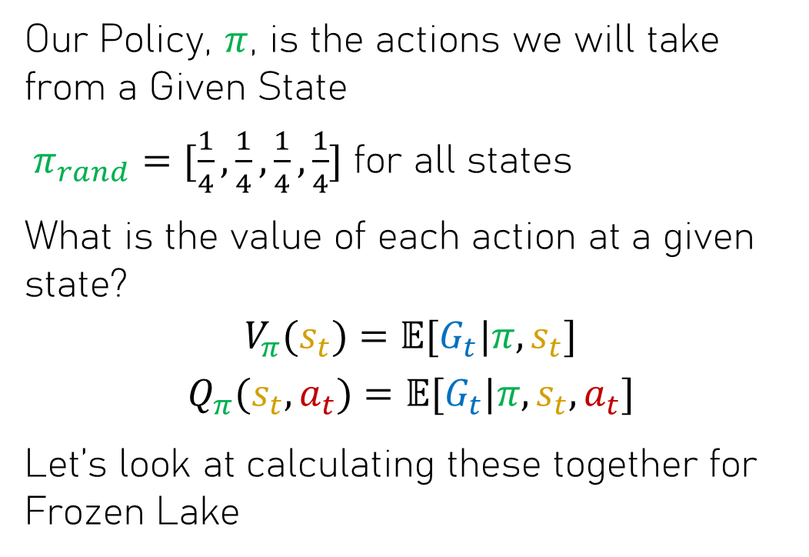
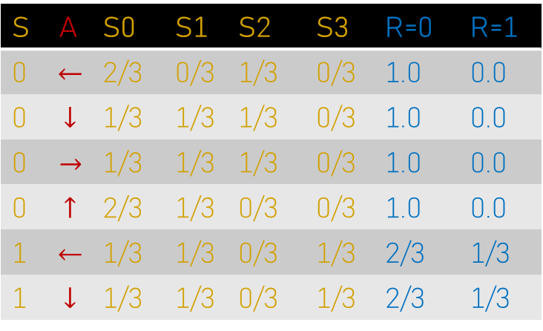
Back to Our Example: Frozen Lake
0
1
2
3
Our Policy, $π$, is the actions we will take from a Given State
$π_{rand}=[\frac{1}{4},\frac{1}{4},\frac{1}{4},\frac{1}{4}]$ for all states
What is the value of each action at a given state?
$$V_{π}(s_{t})=𝔼[G_{t}|π,s_{t}]$$
$$Q_{π}(s_{t},a_{t})=𝔼[G_{t}|π,s_{t},a_{t}]$$
Let’s look at calculating these together for Frozen Lake
S | A | S0 | S1 | S2 | S3 | R=0 | R=1
0 | $$⃪$$ | 2/3 | 0/3 | 1/3 | 0/3 | 1.0 | 0.0
0 | $$↓$$ | 1/3 | 1/3 | 1/3 | 0/3 | 1.0 | 0.0
0 | $$→$$ | 1/3 | 1/3 | 1/3 | 0/3 | 1.0 | 0.0
0 | $$↑$$ | 2/3 | 1/3 | 0/3 | 0/3 | 1.0 | 0.0
1 | $$⃪$$ | 1/3 | 1/3 | 0/3 | 1/3 | 2/3 | 1/3
1 | $$↓$$ | 1/3 | 1/3 | 0/3 | 1/3 | 2/3 | 1/3

