Slide 1
CAPSTONE PROJECT
Automation of Ticket Assignment (NLP)
Group 10 A (Batch May 19)
Anuj Kumar Agrawal
Brijesh Kumar
Girish Kumar
Seema Malhotra
Raman Rangasamy

Slide 2
Agenda
Current ITSP Process (IT Service Organization)
  Current IT Setup and Support Process
  Key Business Values
  Problem Areas
  Proposal for Improvement
Exploratory Data Analysis
Text Pre-Processing
  Text Cleaning
  Feature Extraction
  Topic Modeling
  Model Building (Various ML Algorithm and Deep Learning )
  Model Evaluation and Fine Tuning
Evaluate Business Objectives
Model Deployment
Conclusion
  Further Improvements

Slide 3




Current IT Support Process Setup
IT / Functional Expert Groups/ Vendors
IT Support Process :
End users (composed of IT Users/ Business Users and Vendor and Supplier (if they have access to IT Support Portal) create IT incidents / tickets using IT Support Portal
The tickets are automatically assigned to Service Desk.
Service Desk resolves the L1/L2 tickets
If Service Desk is unable to solve the tickets (L3 tickets), they assign the L3 tickets to Functional and IT Experts.
Functional / IT Experts resolves the L3 tickets. If required, external vendor’s help is taken for L3 tickets resolution
L3 tickets/ priority tickets can be directly assigned to Functional experts in case of urgency via phone calls/ e-mails etc.
L3 Tickets
L3 Tickets
L3 Tickets
Service Desk
(L1/L2 tickets)
Support Tickets
IT Service Portal
End Users/ Business User/Vendor/Supplier

Slide 4
Current IT Support Process : Keys Business Values
IT / Functional Expert Groups/ Vendors
Volumes being Handled :
~ 54% of L1/L2 tickets are handled and resolved by Service Desk
~56% of L3 tickets are handled and resolved by Functional/ IT Experts/ Vendors (as per requirements)
Time Spent:
15 min is being spent for SOP review for each incident
Minimum ~25-30% of incidents needs to be reviewed for SOPs before ticket assignment
Minimum of ~1 FTE effort needed “only “for incident assignment to L3 teams.
Others:
Around ~25% of Incidents are wrongly assigned to functional teams
L3 Tickets
L3 Tickets
L3 Tickets
Service Desk
(L1/L2 tickets)
Support Tickets
IT Service Portal
End Users/ Business User/Vendor/Supplier

Slide 5

Current IT Support Process: Problem Areas
Volumes being Handled :
~ 54% of L1/L2 tickets are handled and resolved by Service Desk
~56% of L3 tickets are handled and resolved by Functional/ IT Experts/ Vendors (as per requirements)
Time Spent:
15 min is being spent for SOP review for each incident
Minimum ~25-30% of incidents needs to be reviewed for SOPs before ticket assignment
Minimum of ~1 FTE effort needed “only “for incident assignment to L3 teams.
Others:
Around ~25% of Incidents are wrongly assigned to functional teams
Delay in ticket resolution impacting the business
Additional FTEs required for L1/L2 support and correct assignment of tickets
User dissatisfaction
Under-utilization of resources because of non-value added activities

Slide 6
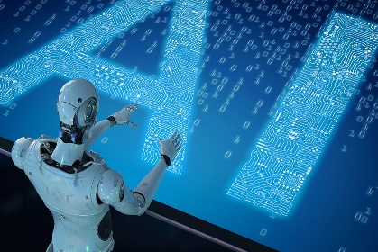

Objective : Proposed IT Support Process Setup
IT / Functional Expert Groups/ Vendors
Proposal :
To automate the ticket the process of ticket analysis and assignment to the right functional / IT expert groups
(using Machine Learning / AI tool)
Objective:
To reduce the ticket assignment time
To reduce ticket resolution time
To reduce wrong assignment of tickets
To optimize the resources
e.g. Service Desk can utilize the time for ticket resolution instead of going through SOP and ticket assignment
ML/AI can work 24X7 through out the year (without worrying about corona ☺)
L3 Tickets
Automatic Routing of tickets to the right functional group
AIops
L3 Tickets
L3 Tickets
Support Tickets
IT Service Portal
End Users/ Business User/Vendor/Supplier

Slide 7
EDA, Preprocessing and Topic Modelling

Slide 8
High Level Process Flow
Keras LSTM
We Will see
???
LDA
ML Algorithms
Linear Regression
Decision Tree
Random Forest
AdaBoost
GradientBoost
Multinomial Naïve Bayes
Support Vector
Data Exploration
Text Cleaning
Text Pre-processing
4 Groups
74 Groups
Different combination of groups (orig. 74 groups)
Accuracy ranges between
45 – 65 %
Data Distribution
Data Types
Features/ Attributes
NULL Values
Covert to Lower Case
Remove Punctuation Remove Digits
Remove E-mail IDs, URL
Remove Stop Words
…
Tokenization
Dictionary Creation
Feature Extraction
Corpus Preparation
…

Slide 9
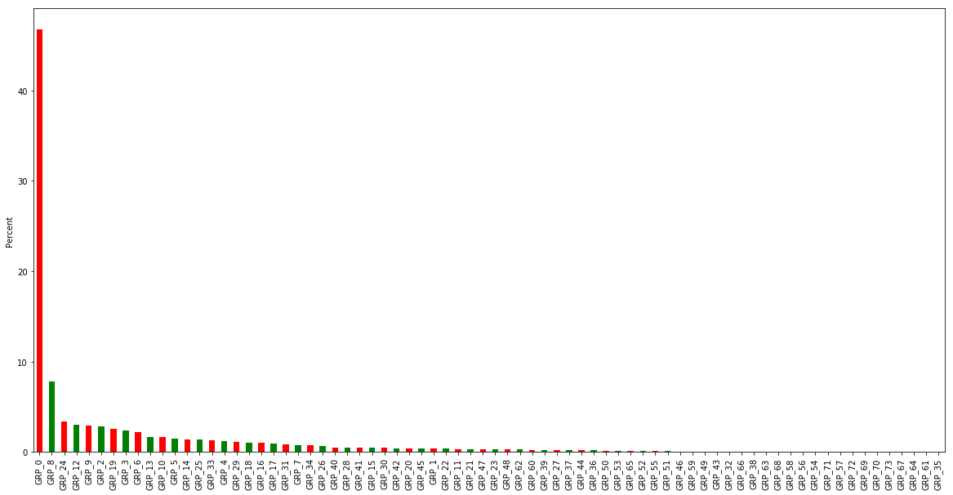
Exploratory Data Analysis
74 assignment groups
8500 observations (8 observations with NULL values
Many of the groups have very few observations (single digits)
Top 5-10 groups prominent. They seem to cover almost 90% of the observations
Dataset is highly unbalanced.
The observations and not uniformally distributed among assignment groups
The model cannot learn reasonably well across various groups
We will require other techniques for labelling and assignment of the group

Slide 10
Data Set Preparation and Topic Modelling
Data Cleaning :
Remove e-mail addresses
Remove punctuation marks, special characters
Remove digits, new line characters, spaces
Etc..
Data Preprocessing:
Tokenization
Removal of stop words
Lemmatization
Preparing dictionary of the words
Text vectorization (Bag of words , TF-IDF)
Prepare corpus
Topic Modelling:
Build model for topic modelling (LDA model)
Parameter tuning for distinct clusters of topics

Slide 11
Data Set Preparation and Topic Modelling
For grammatical reasons, documents use different forms of a word, such as organize, organizes, and organizing. Additionally, there are families of derivationally related words with similar meanings, such as democracy, democratic, and democratization. In many situations, it seems as if it would be useful for a search for one of these words to return documents that contain another word in the set.
FEATURE EXTRACTION
Need of feature extraction techniques The main problem in working with language processing is that machine learning algorithms cannot work on the raw text directly. So, we need some feature extraction techniques to convert text into a matrix(or vector) of features. Some of the most popular methods of feature extraction are :
Bag-of-Words
TF-IDF
Word2vec
Glove
Bag of Words: Bag-of-Words is one of the most fundamental methods to transform tokens into a set of features. The BoW model is used in document classification, where each word is used as a feature for training the classifier. We'll also use Bag-of-words for feature extraction and for LDA. We'll also use TF-IDF to validate the LDA of Bag-of-words

Slide 12
Data Set Preparation and Topic Modelling
As we have seen previously that with 74 groups , we could not really justify a model which can be used to AUTOMATICALLY assign the tickets to a group with accuracy better than the current ITSP process. Manual trial and error of regrouping didn't help either.
Topic modeling is a machine learning technique that automatically analyzes text data to determine cluster words for a set of documents. This is known as ‘unsupervised’ machine learning because it doesn’t require a predefined list of tags or training data that’s been previously classified by humans.
Topic modeling involves counting words and grouping similar word patterns to infer topics within unstructured data. Instead of spending hours going through heaps of text feedback, in an attempt to deduce which texts are talking about our topics of interest, we could analyze them with a topic modeling algorithm.
Topic modeling algorithms churn out collections of expressions and words that it thinks are related, leaving US to figure out what these relations means
By detecting patterns such as word frequency and distance between words, a topic model clusters feedback that is similar, and words and expressions that appear most often. With this information, you can quickly deduce what each set of texts are talking about.
So for our project, we'll assume that whatever text data we have is NOT LABELLED and we'll use topic modelling to create the labels for us (WHICH CAN BE TREATED AS NEW ASSIGNMENT GROUP
We'll use Latent Dirichlet Allocation (LDA) modelling technique classify text in a document (data sets).
It will build a topic per document model and words per topic model, modeled as Dirichlet distributions

Slide 13
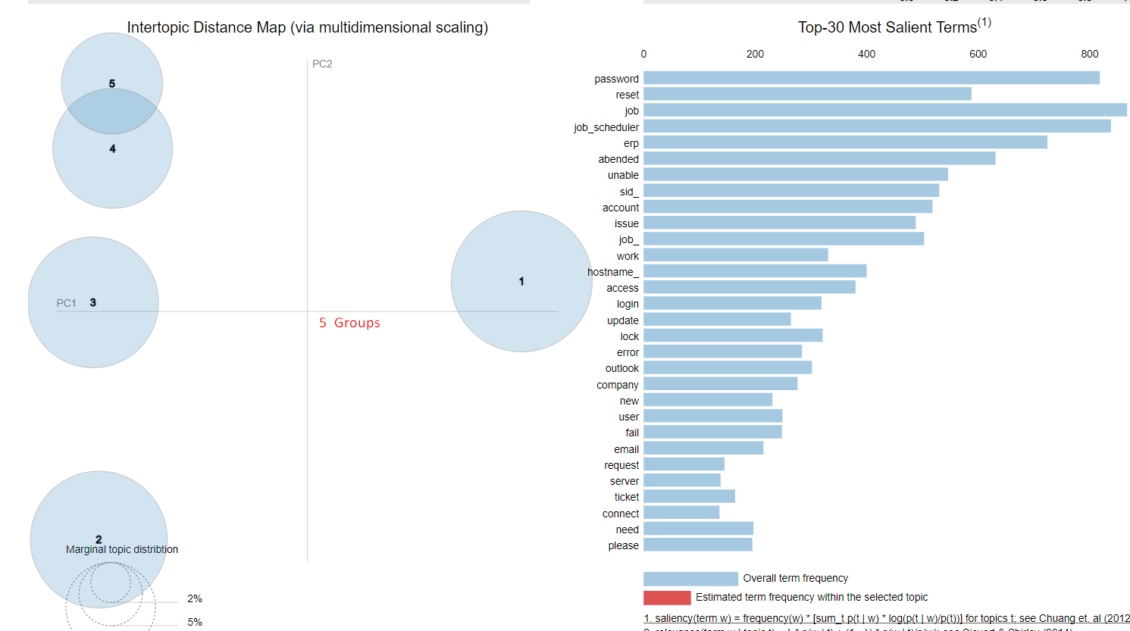
Topic Model : 5 Topics 1#6

Slide 14
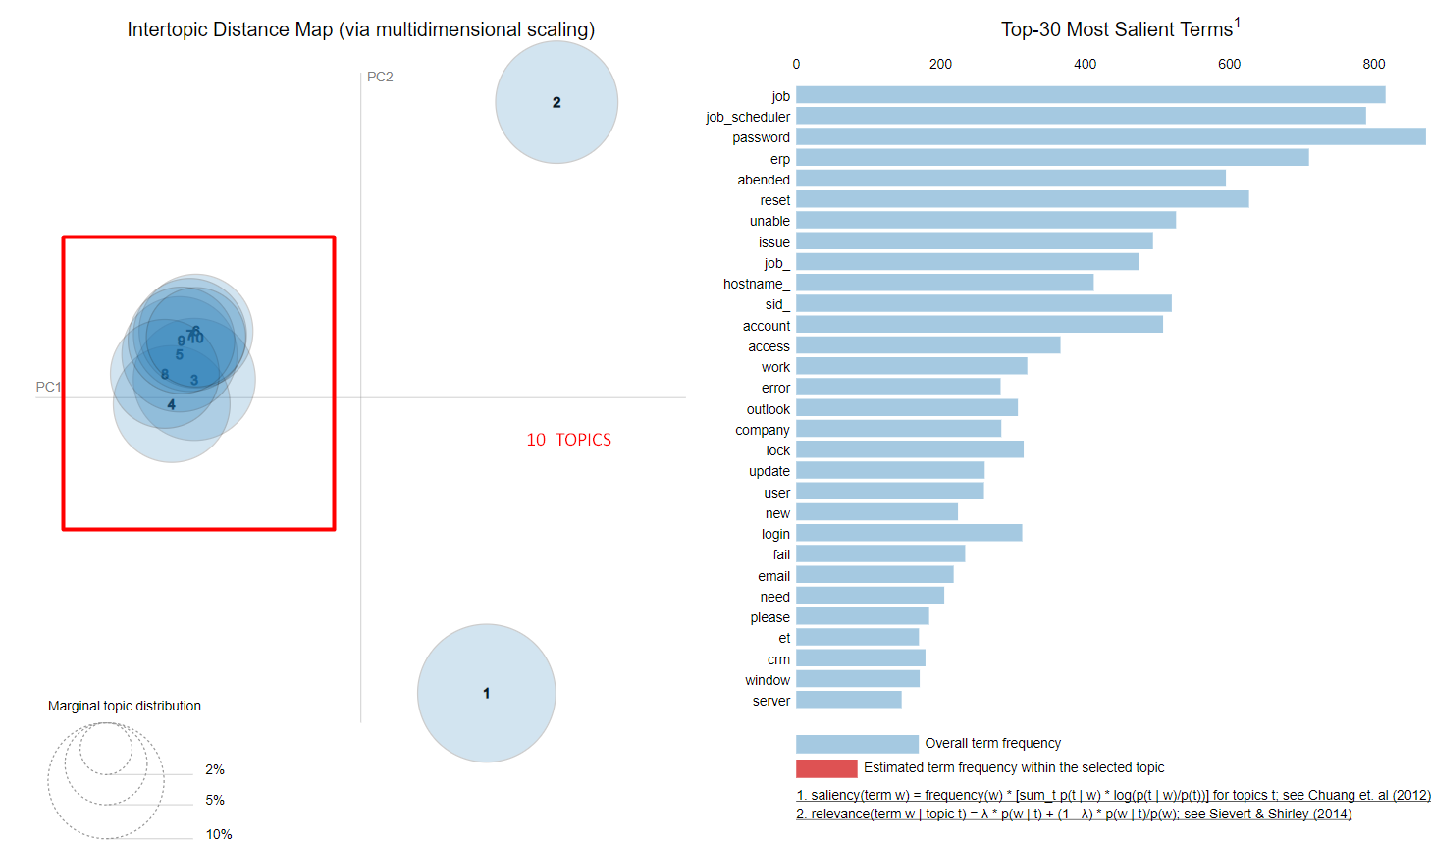
Topic Model : 10 Topics 2#6

Slide 15
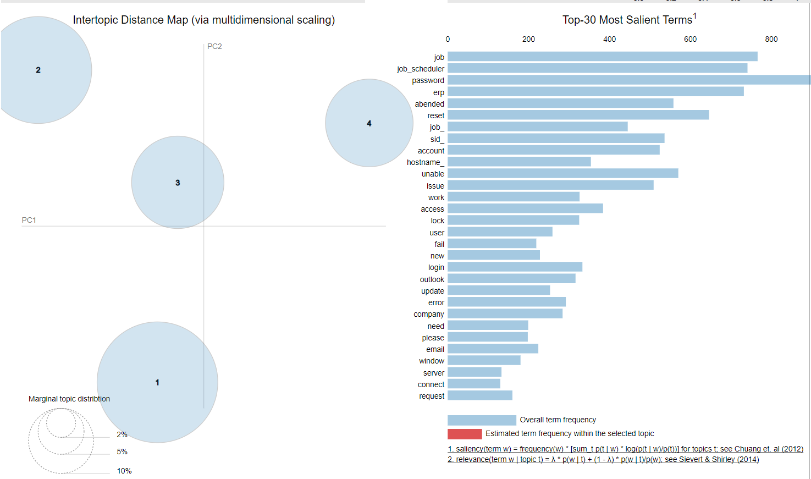
Topic Model : 4 Topics (Bag-of-words) 3#6

Slide 16
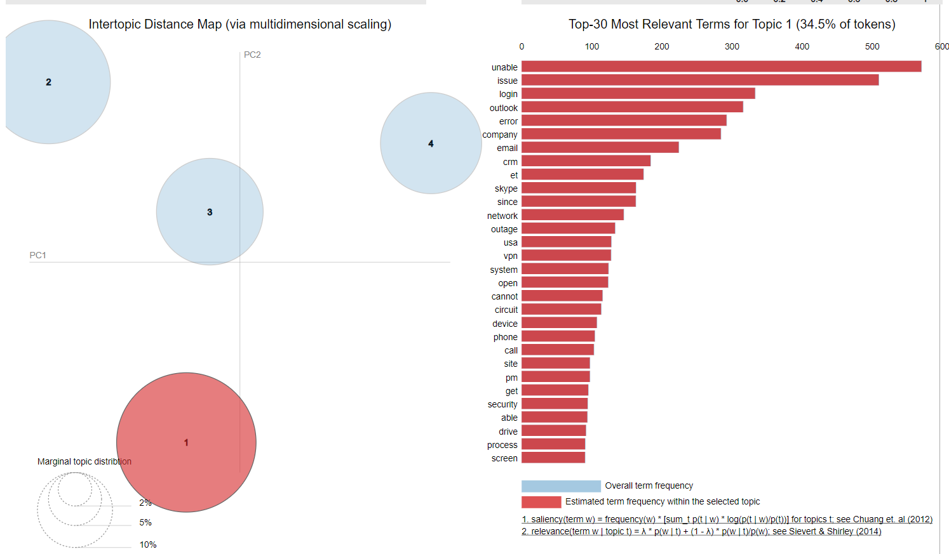
Topic Model : 4 Topics (Bag-of-words) 4#6

Slide 17
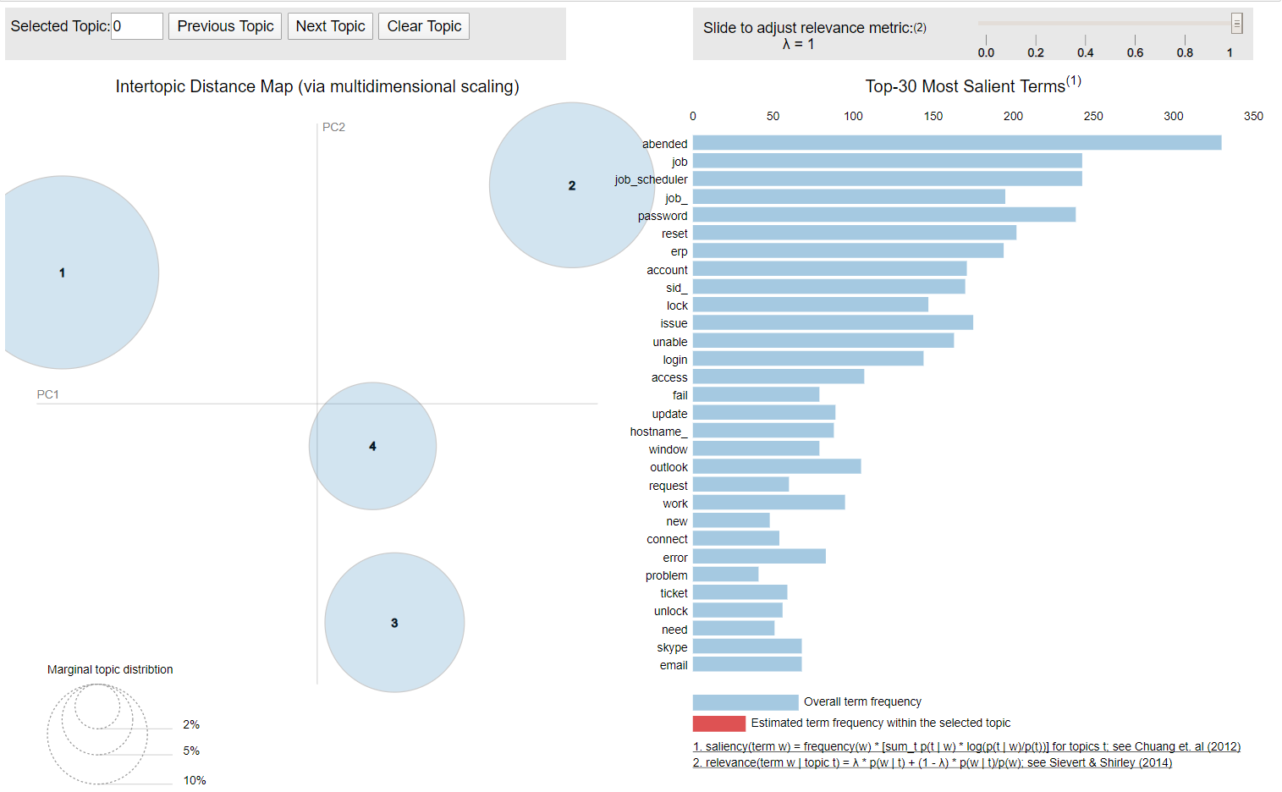
Topic Model : 4 Topics (TF-IDF) 5#6

Slide 18
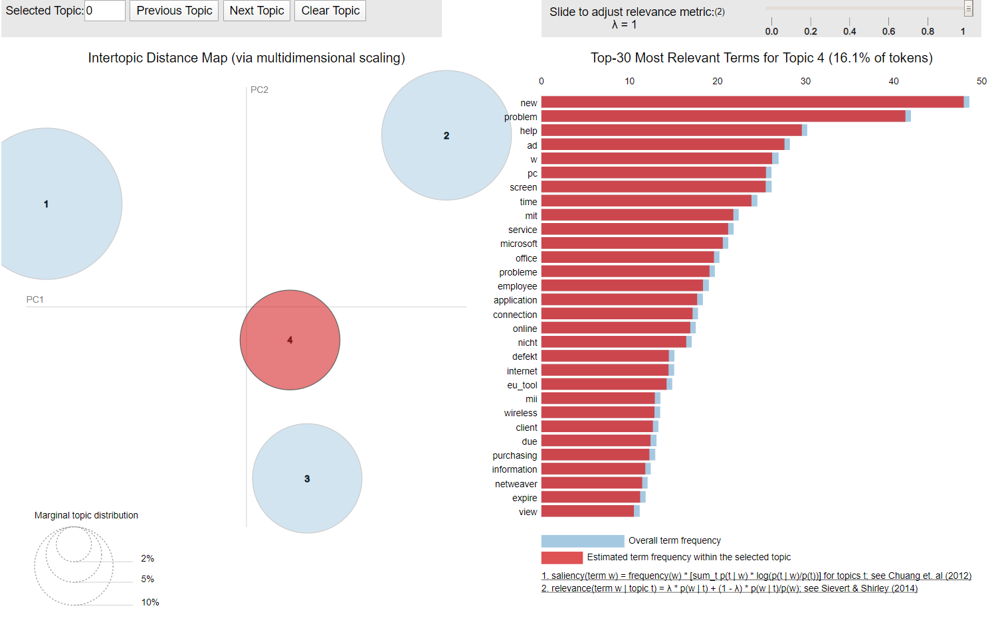
Topic Model : 4 Topics (TF-IDF) 6#6

Slide 19
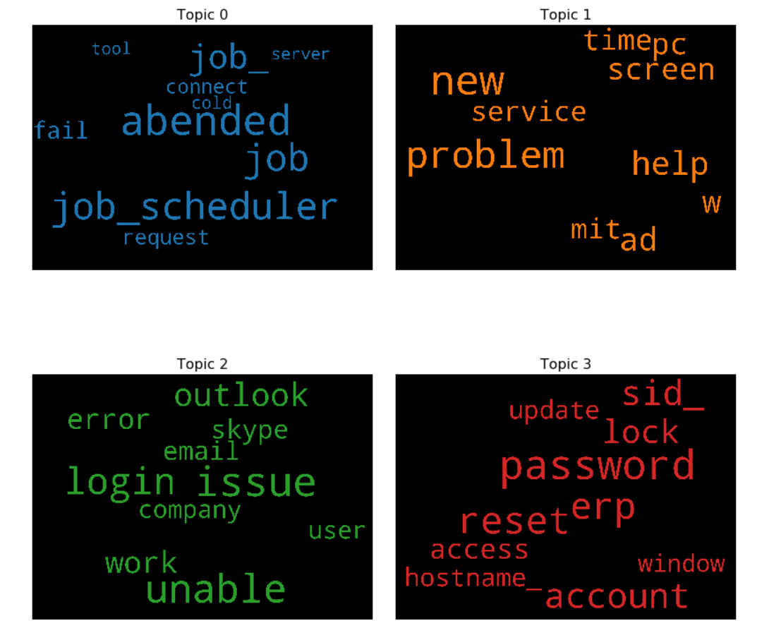
Word Cloud – LDA (Bag-of-words)
Topic 0: seems to be related to problems about background jobs, status, issues etc.
Topic 1 :seems to be related to general problems about user pcs (e.g. setup, services etc.)
Topic 2 :seems to be related to problems about communication problems (e.g. outlook, email, skype etc.)
Topic 3 :seem to be related to the problems arising out of applications (erp, crm password reset locked etc.)

Slide 20
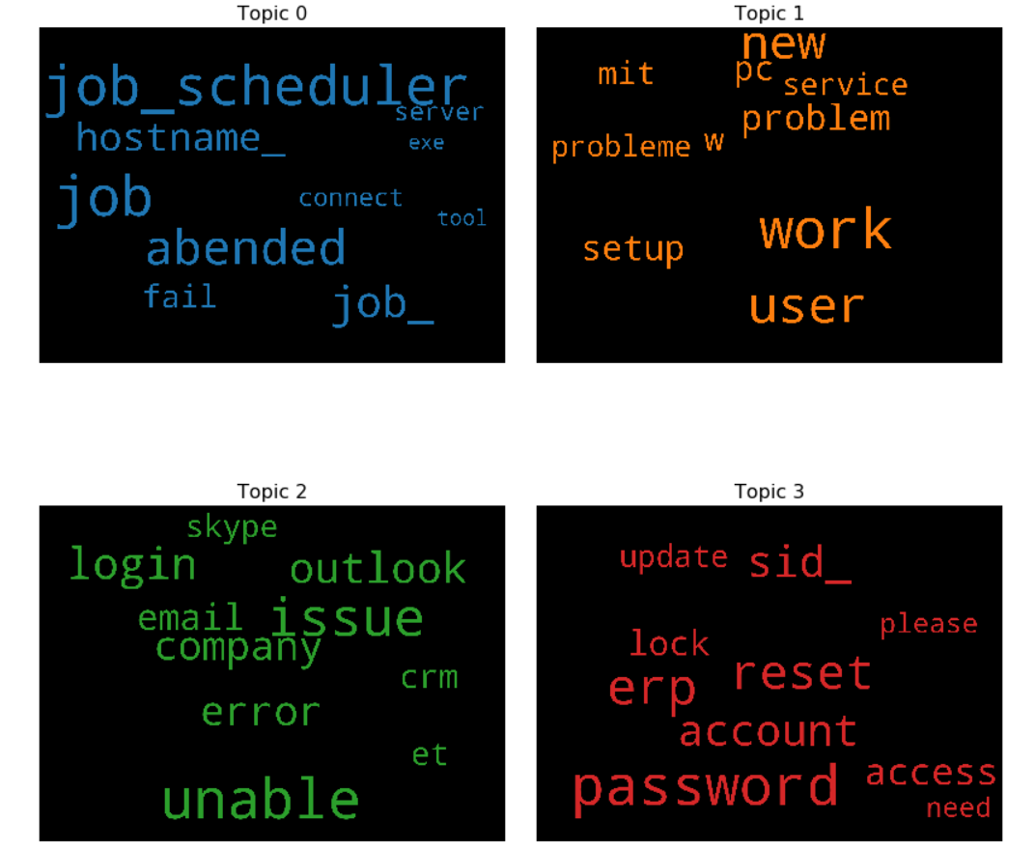
Word Cloud – LDA (Bag-of-words)
Topic 0: seems to be related to problems about background jobs, status, issues etc.
Topic 1 :seems to be related to general problems about user pcs (e.g. setup, services etc.)
Topic 2 :seems to be related to problems about communication problems (e.g. outlook, email, skype etc.)
Topic 3 :seem to be related to the problems arising out of applications (erp, crm password reset locked etc.)

Slide 21
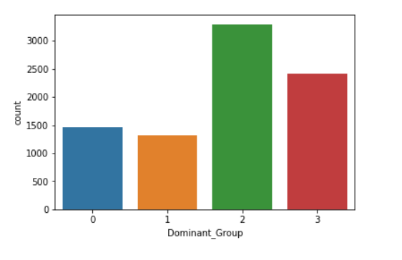
Word Cloud – LDA (Bag-of-words)
3291
3291
2493
1464
1324
Summary " Here we can see the distribution of documents based on the new assignment groups. Still unbalanced but still much better as compared to the original one . Also the document counts per groups have decent number of observations based on which we can train the model and get some meaningful model

Slide 22
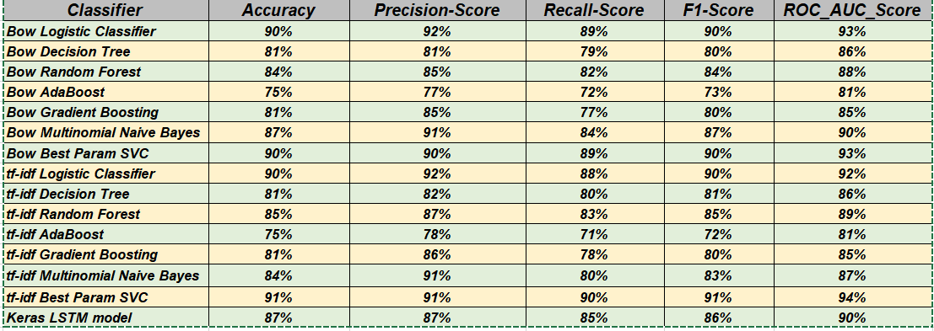
Model Evaluation Matrix: A Comparison

Slide 23
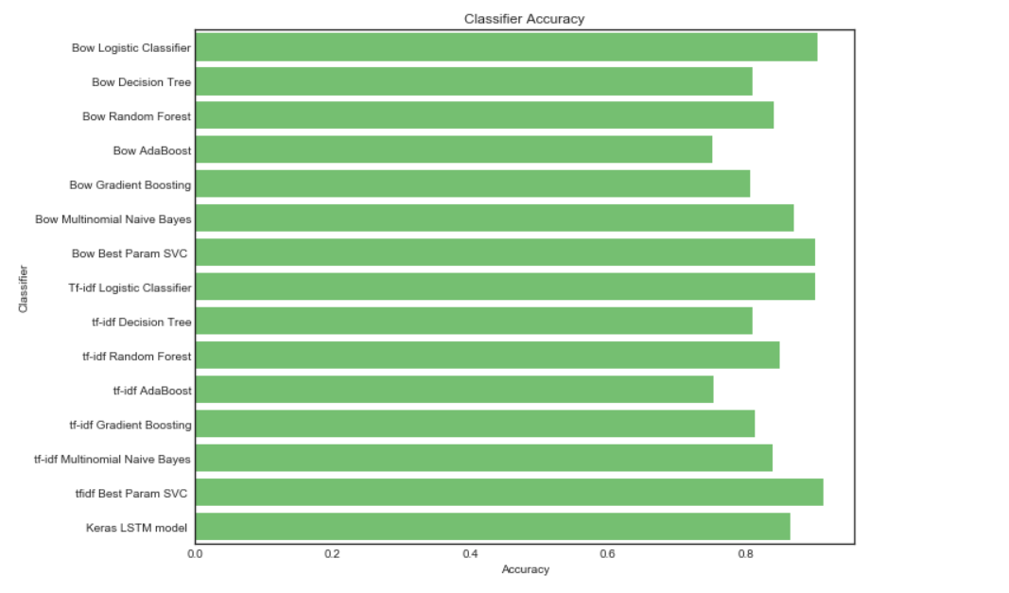
Comparison : Accuracy Score

Slide 24
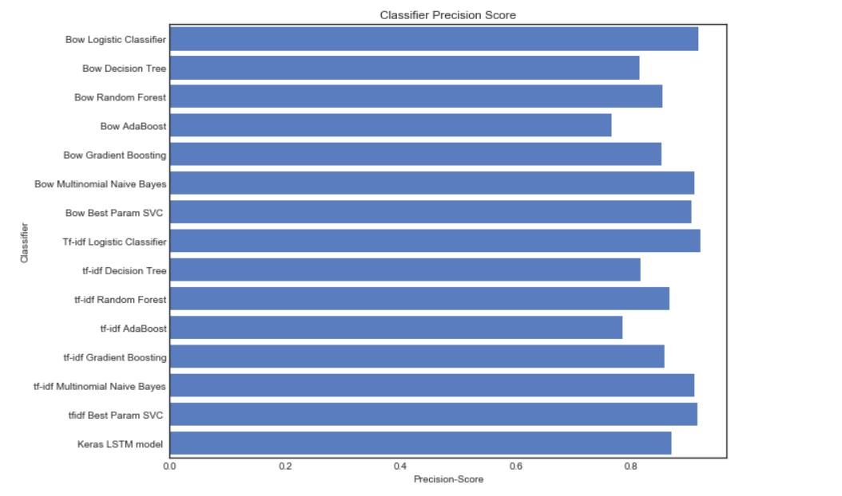
Comparison : Precision Score

Slide 25
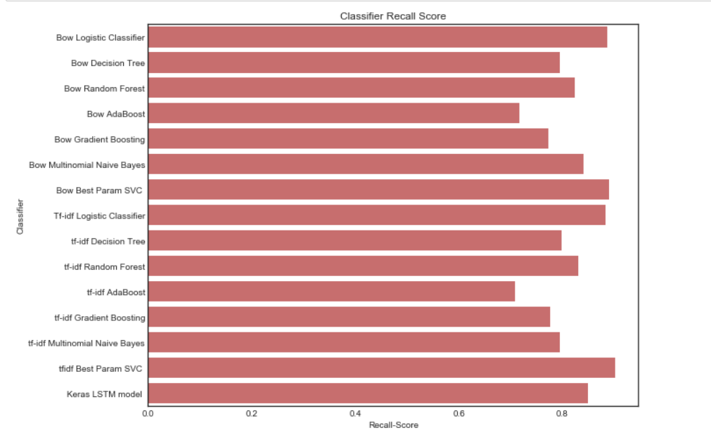
Comparison : Recall Score

Slide 26
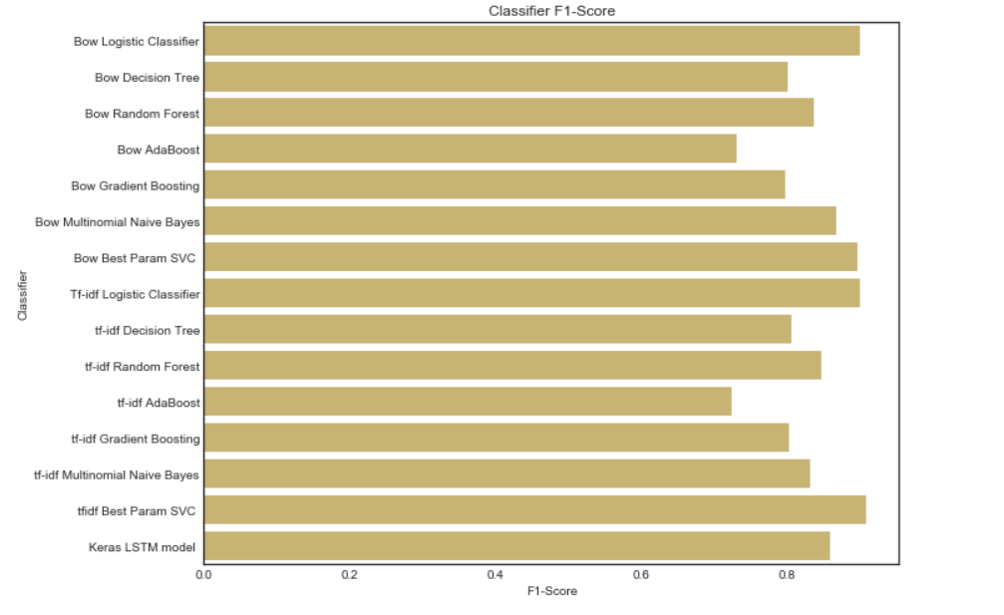
Comparison : F1-Score

Slide 27
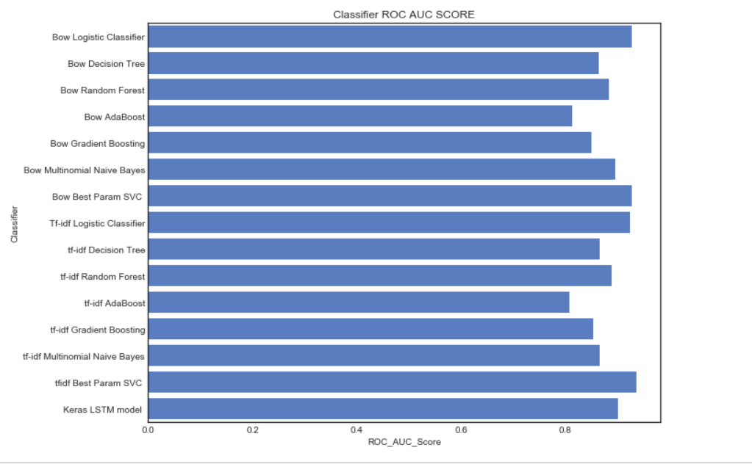
Comparison : ROC AUC Score

Slide 28
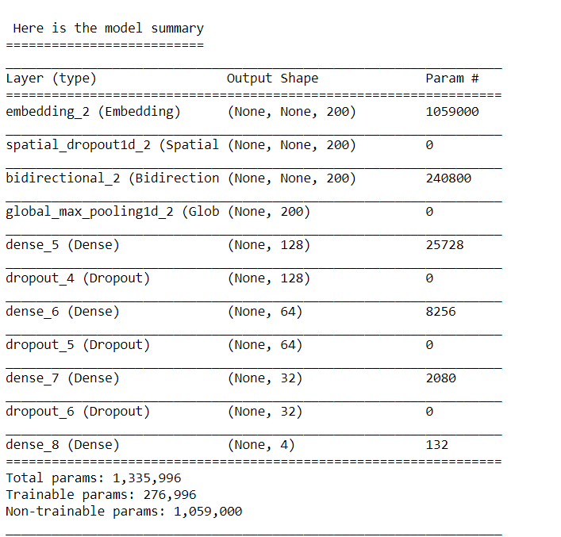
Keras LSTM Deep Learning Model

Slide 29
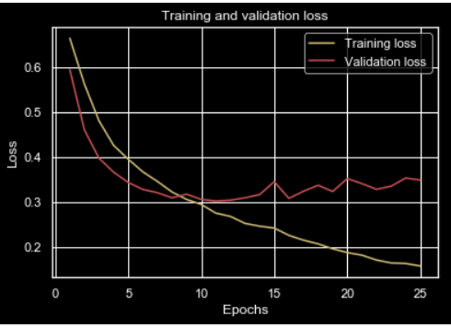
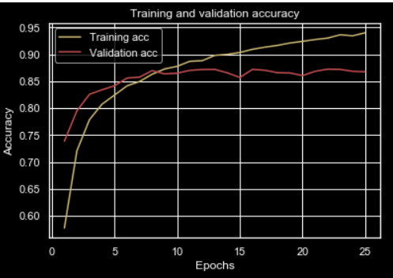
Epocs, Loss and Accuracy

Slide 30
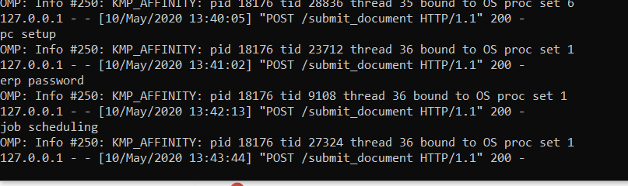
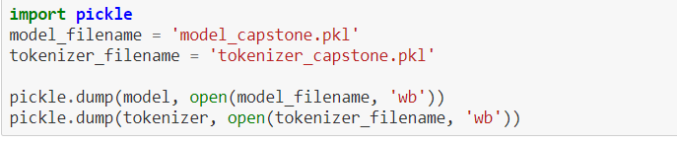
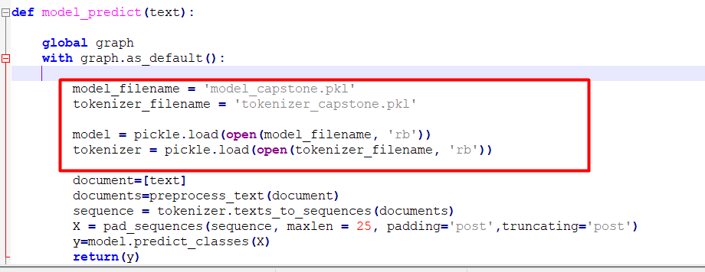
Model Deployment (using Flask)

Slide 31
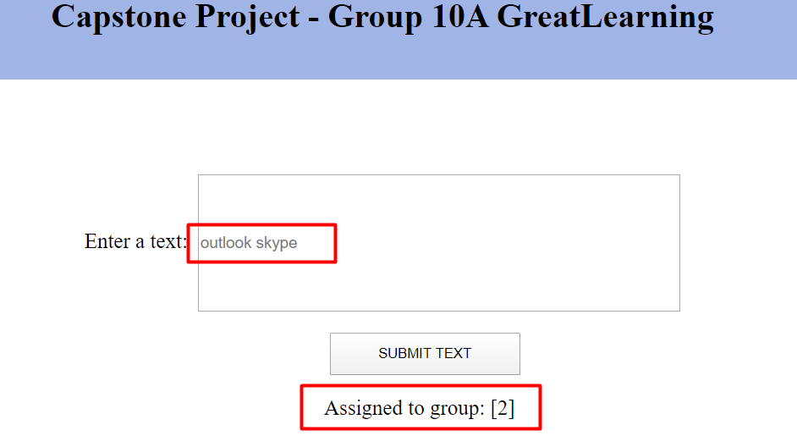
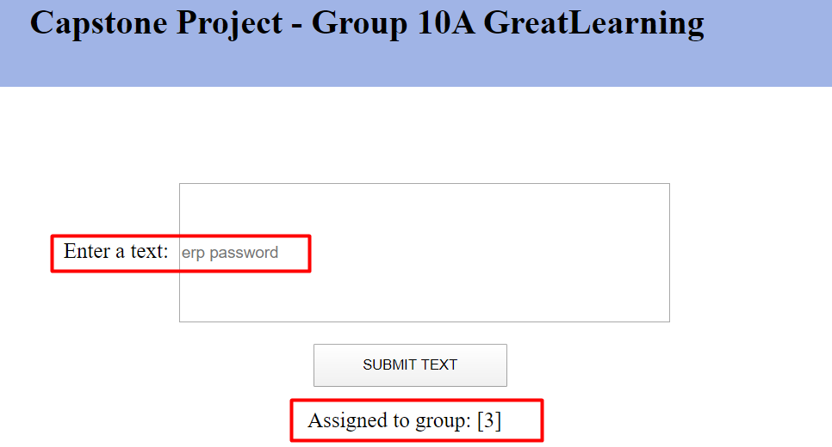
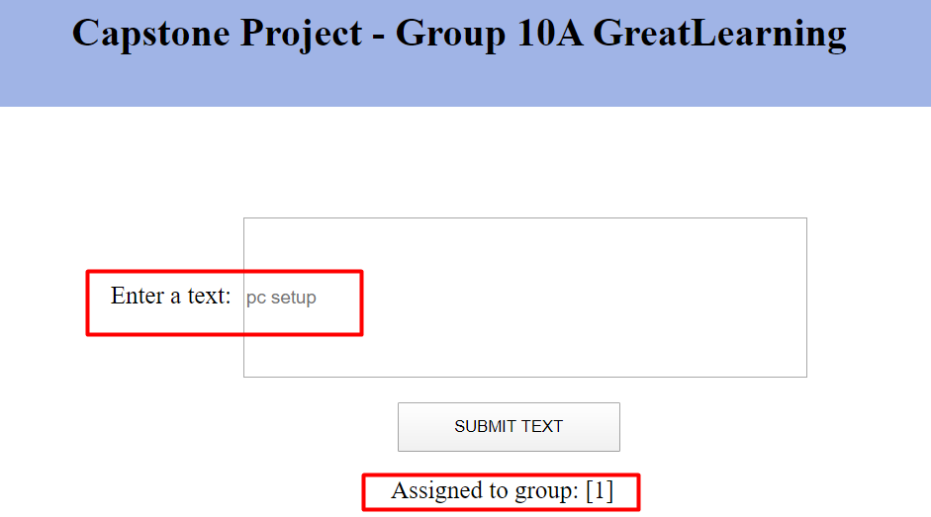
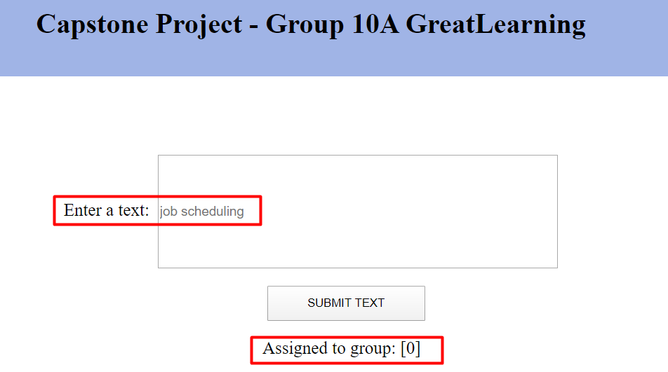
Model Deployment Output

Slide 32
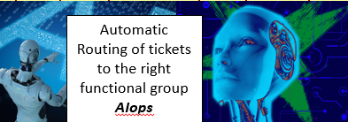
Conclusion:Proposed solution with Business Benefits
Volumes being Handled :
~ 54% of L1/L2 tickets are handled and resolved by Service Desk
~56% of L3 tickets are handled and resolved by Functional/ IT Experts/ Vendors (as per requirements)
Time Spent:
15 min is being spent for SOP review for each incident
Minimum ~25-30% of incidents needs to be reviewed for SOPs before ticket assignment
Minimum of ~1 FTE effort needed “only “for incident assignment to L3 teams.
Others:
Around ~25% of Incidents are wrongly assigned to functional teams
Volumes being Handled :
~ 54% of L1/L2 tickets are handled and resolved by Service Desk
~56% of L3 tickets are handled and resolved by Functional/ IT Experts/ Vendors (as per requirements)
Time Spent:
15 min is being spent for SOP review for each incident
Minimum ~25-30% of incidents needs to be reviewed for SOPs before ticket assignment
Minimum of ~1 FTE effort needed “only “for incident assignment to L3 teams.
Others:
Around ~10 % of Incidents are wrongly assigned to functional teams

Slide 33
Improvements : What Else ?
More data sets from each group can help better learning
Balanced Data Sets
We could have used foreign dictionaries for better understanding of words
Use of FastText for word embeddings
    This helps capture the meaning of shorter words and allows the embeddings to understand suffixes and prefixes.
    fastText works well with rare words. So even if a word wasn’t seen during training, it can be broken down into n-grams to get its embeddings.
  Word2vec and GloVe both fail to provide any vector representation for words that are not in the model dictionary. This is a huge advantage of this method.
Use of advanced layers (Attention Layers)
    Final state of the encoder RNN/ LSTM ultimately decides the decoding process, or at least heavily influences it, while the previous states do not have any influence over the decoding process. Next observation is that the final encoder state
  Attention Mechanism does – it allows the decoder to pay attention to different parts of the source sequence at different decoding steps.

