Slide 1

Seminar: Deep Learning for Inverse Problems in Medical Imaging (IN2107)
Dr. Lina Felsner | Dr. Sevgi Gökçe Kafalı | Hannah Eichhorn
Cosmin Bercea | Prof. Julia Schnabel
I32 – Chair for Computational Imaging and AI in Medicine - CompAI
Faculty of Informatics and Institute for Advanced Study
I31 - Chair of Artificial Intelligence in Healthcare and Medicine - AIM
School of Computation, Information and Technology

Slide 2
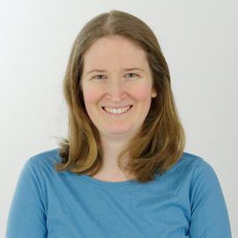
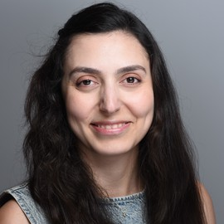

Meet the Team
Lina Felsner
Sevgi Gökçe Kafalı
Hannah Eichhorn

Slide 3
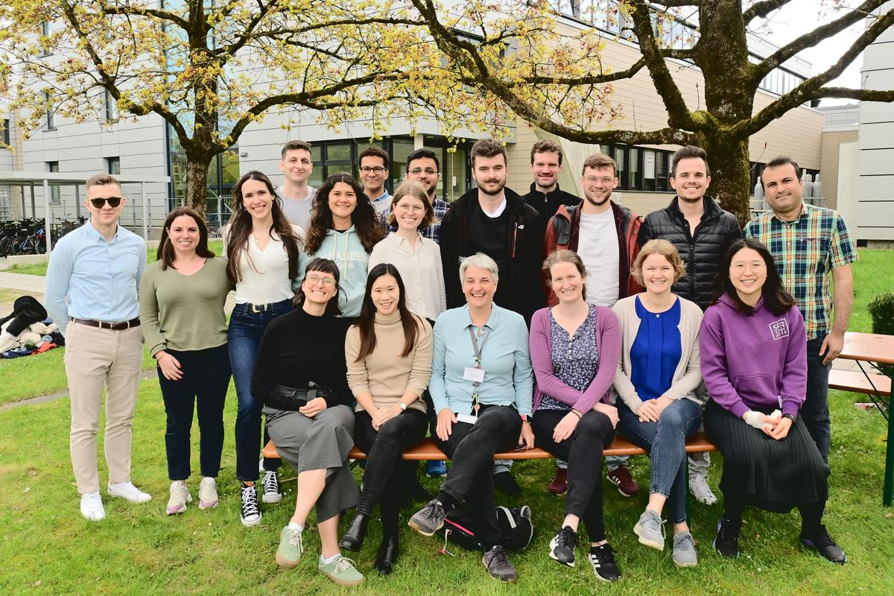

Chair for Computational Imaging and AI in Medicine
Chair of Artificial Intelligence in Healthcare and Medicine

Slide 4
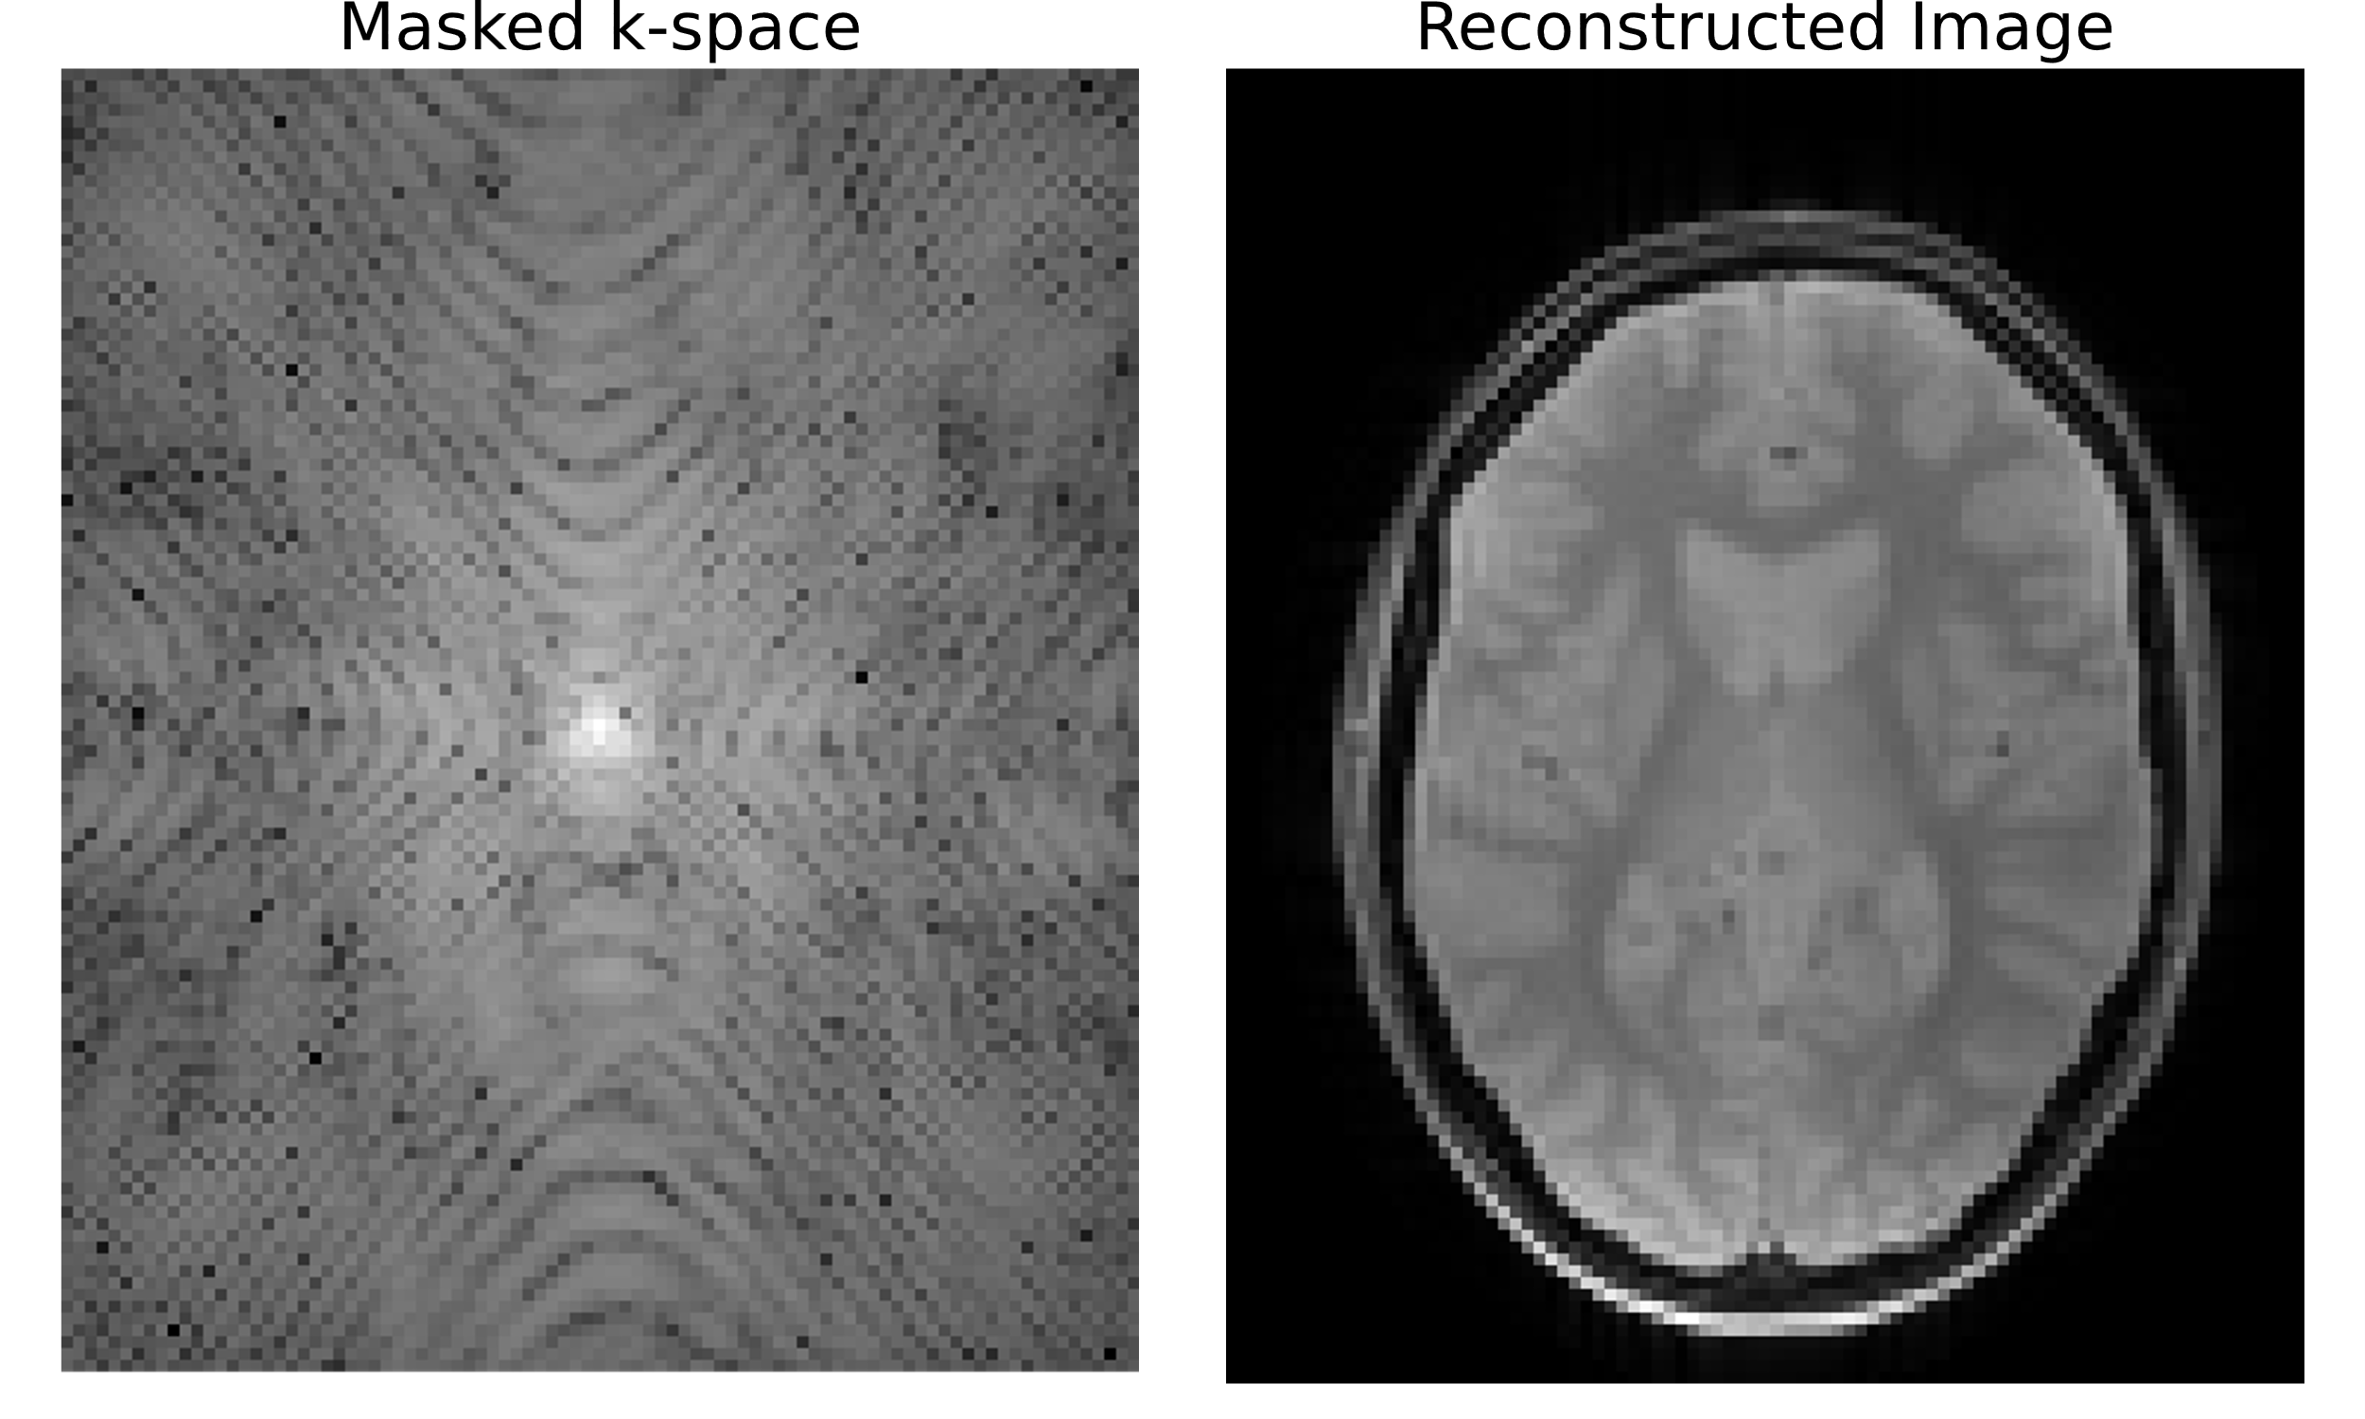

Inverse Problems in Medical Imaging
$$y=Ax+n$$
MRI, CT, PET Reconstruction & Artefact Correction
Recent research directions
Emerging trends & Clinical applications

Slide 5
Course Objectives
Understand ○ What are inverse problems in medical imaging? ○ How can they be solved with deep learning? ○ What are recent research directions?
Learn ○ How to read, analyze and discuss a research paper ○ How to present a complex research topic to a broad audience ○ How to design and present a research poster
Participants need to ○ Present a paper ○ Present a poster in a poster session at the end of the semester ○ Actively participate in the discussions
Evaluation ○ Attendance ○ Presentation and poster ○ Active participation in discussions

Slide 6

Registration
Matching system:
Or
Email to: lina.felsner@tum.de hannah.eichhorn@tum.de s.kafali@tum.de

