Slide 1

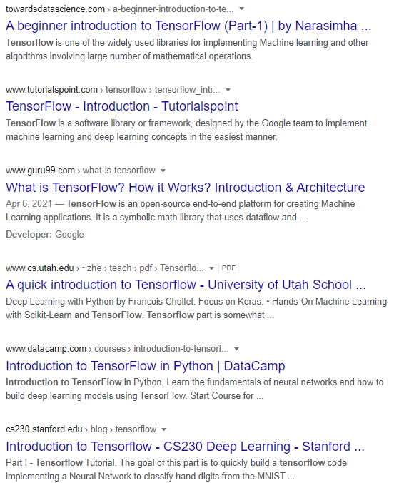
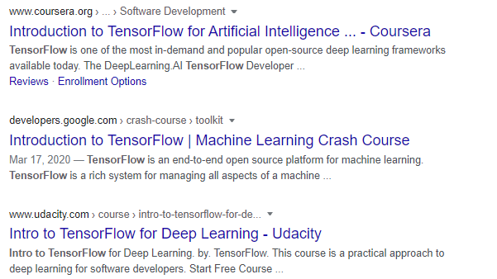

Slide 2


https://www.tensorflow.org/learn

Slide 3

TensorFlow Products

Slide 4
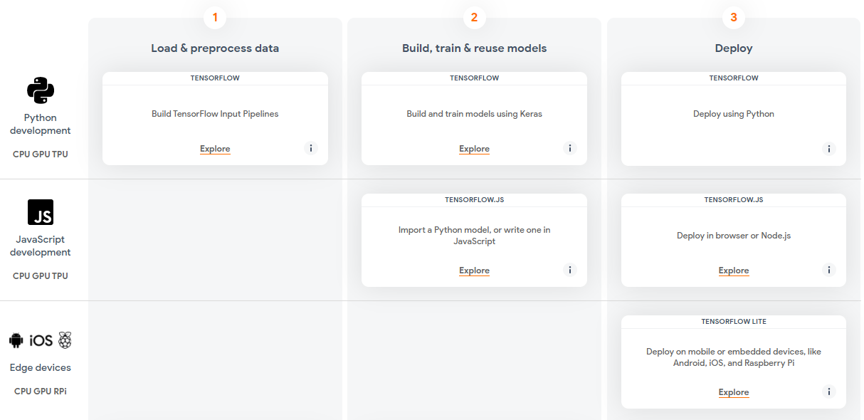
TensorFlow Ecosystem

Slide 5
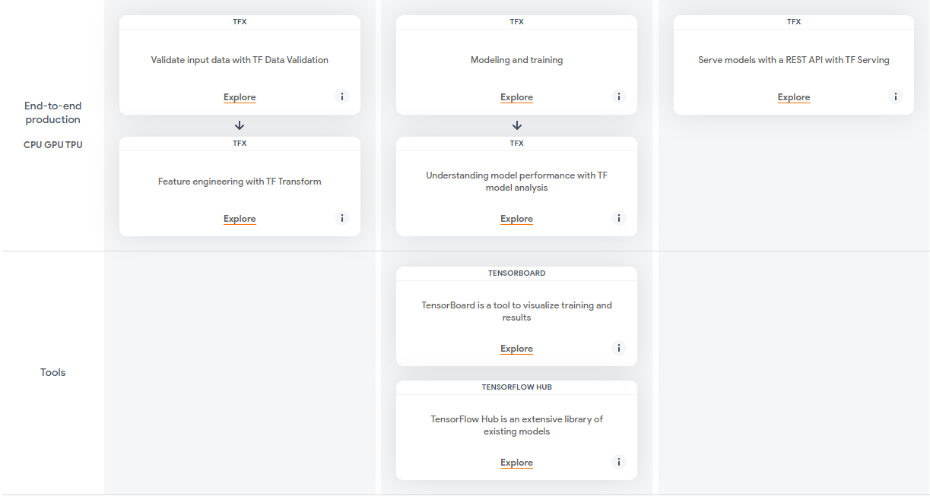

Slide 6
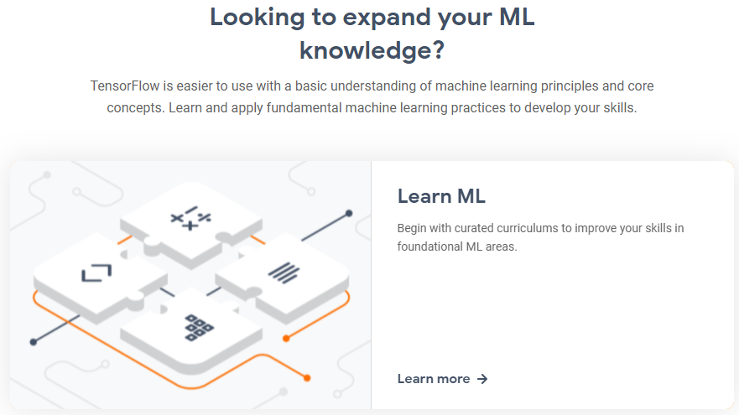

Learning TensorFlow
https://www.tensorflow.org/tutorials

