Slide 1
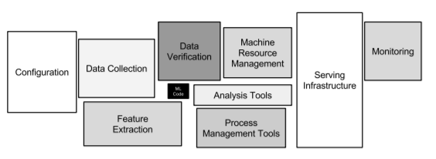
asdf

Slide 2
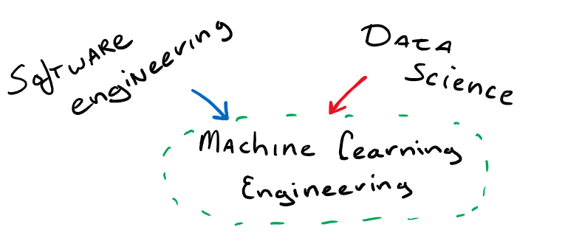
Common ML Engineering Backgrounds

Slide 3
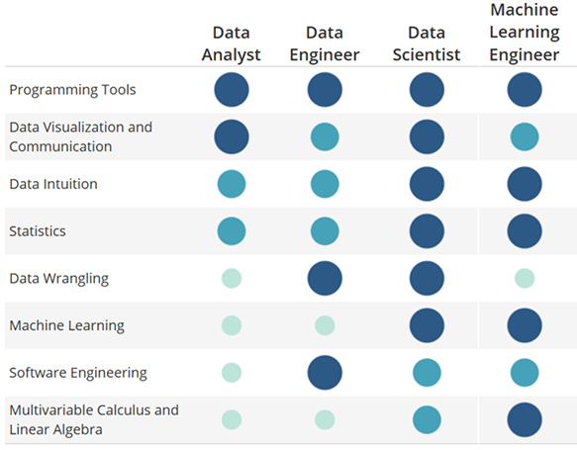
Data Science
Skills
Software engineering
What is Data Science? 8 Skills That Will Get You Hired in Data, 2014-11-07, Udacity
DL Frameworks
ML Frameworks
Scipy packages
Python
최적화
확률/통계
선형대수, 미적분

