Slide 1
네이버 파파고
파파고 (Papago)=앵무새 (에스페란토어)
N2MT (Naver Neural Machine Translation)
베타서비스. 영어only. 200자로 제한

Slide 2
http://blog.uplus.co.kr/2816

Slide 3
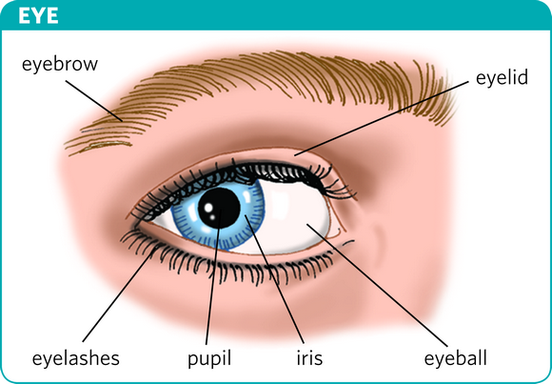
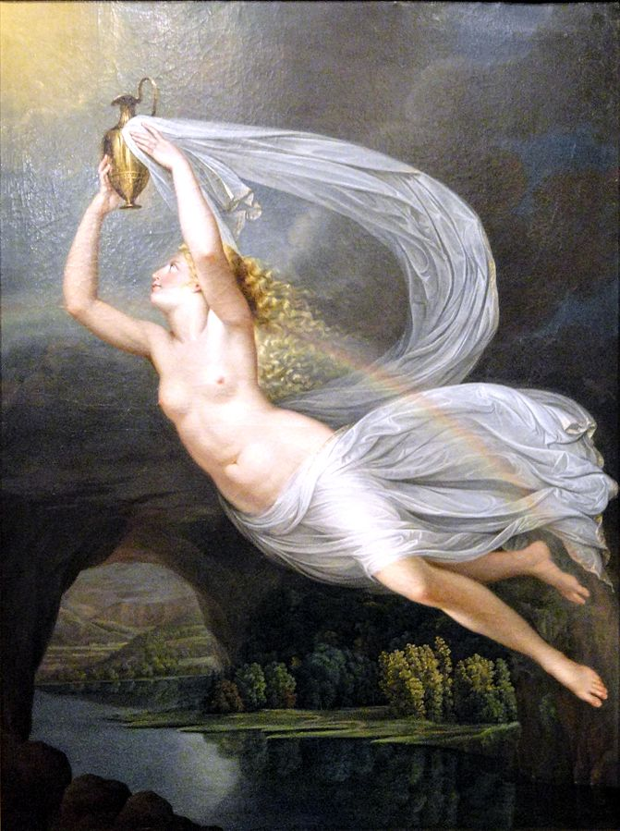
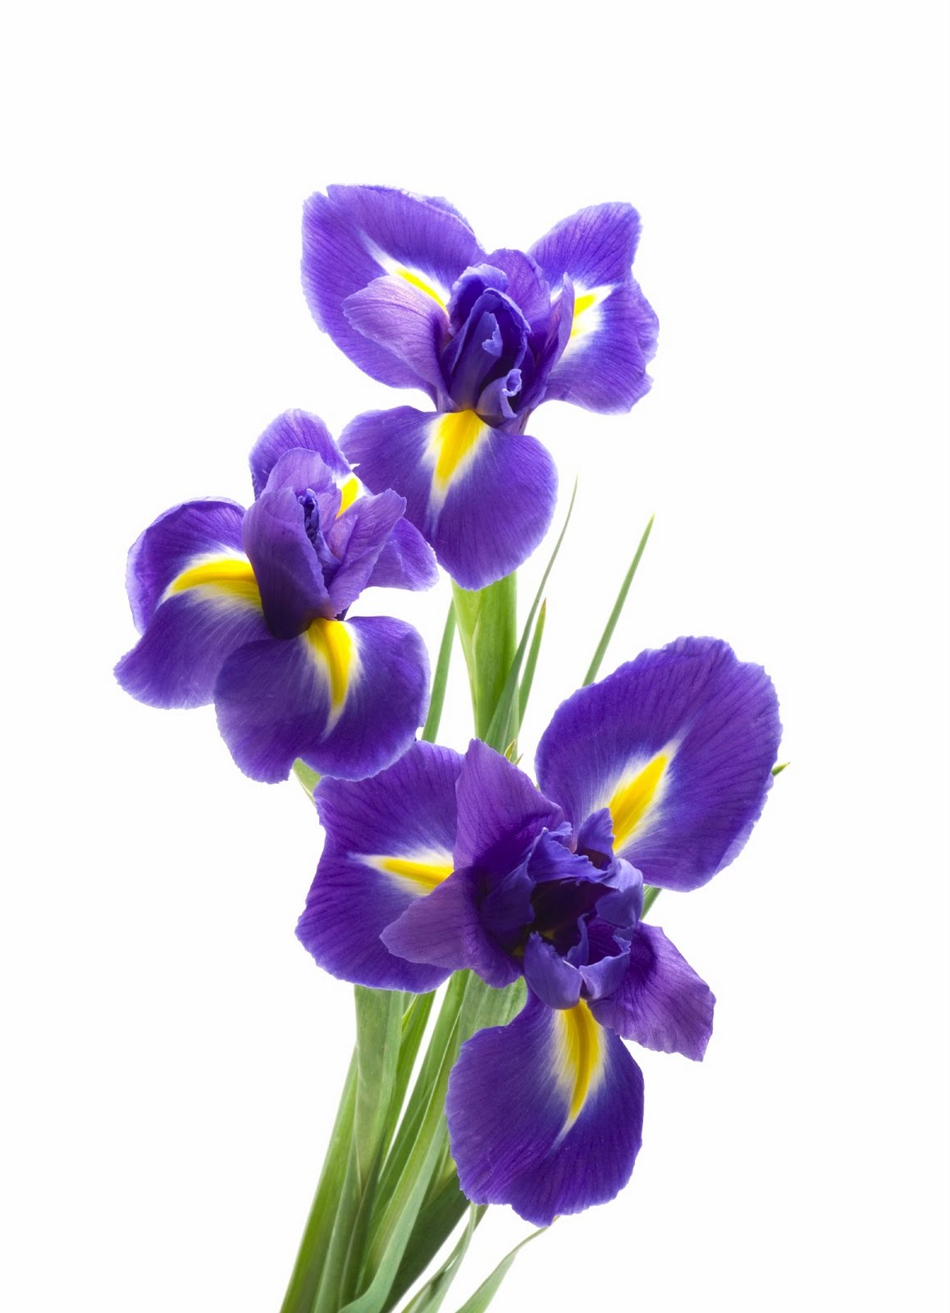
Iris
iris [aɪrɪs]
Noun.
1. (안구의) 홍채
2. 붓꽃
3. 이리스 (그리스 여신)
4. 여자 이름
The personification of the rainbow and messenger of the gods.
This personification of a rainbow was once described as being a link to the heavens and earth.
As a goddess, Iris is associated with communication, messages, the rainbow and new endeavors.
Though Iris was principally associated with communication and messages, she was also believed to aid in the fulfillment of humans' prayers, either by fulfilling them herself or by bringing them to the attention of other deities
[Iris (Mythology) wikipedia]
홍채[1]
이리스 [3]
붓꽃 [2]
[1] https://www.ldoceonline.com/dictionary/iris
[2] http://www.being-here.net/page/8030/fresh-ten-iris-jpg
[3] https://en.wikipedia.org/wiki/Iris_(mythology)

Slide 4
Building parallel corpora
TED
Scripts exist

Slide 5
